Slide 1
Microsoft® Access® 2010 Training
Design the tables
for a new database
Notes:
[Note to trainer: For detailed help in customizing this template, see the very last slide. Also, look for additional lesson text in the notes pane of some slides.]

Slide 2
Course contents
Overview: Plan for good design
Lesson: Includes nine instructional sections
Suggested practice tasks
Test
Quick Reference Card

Slide 3

Overview: Plan for good design
New to Access 2010? Here you’ll begin to learn Access basics, starting with good design, which ensures that your database captures all your data accurately.
This course will focus specifically on designing the tables and relationships for a new database.

Slide 4
Course goals
Plan the table structure of a new database.
Plan the fields — the individual columns in each table.
Plan the primary key fields that enable the relationships among your tables.
Design tables for a web database — a database you publish to a Microsoft® SharePoint® site.

Slide 5
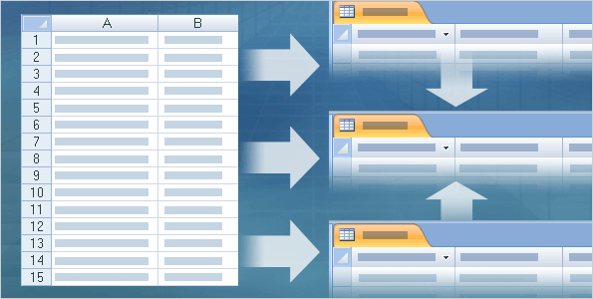
Start with a plan
For this course, pretend you manage your company’s asset data — computers, desks, and other equipment. You’ve been using a spreadsheet to enter and manage that data, but the file is becoming so big that it’s hard to find and change data, and some of the records are inaccurate.
Moving that data into an Access database can make your job easier, but where do you start?
Save time and effort by making a plan.

Slide 6
Start with a plan
The language around database design can become fairly technical — you’ll hear terms such as “normal forms” — but here are the basics:
First, look at the data you need to capture. How much of that data is repeated? For example, how many times does your spreadsheet list suppliers? You look for that repeated data, and you move it into a table all its own.
Save time and effort by making a plan.
Notes:
You repeat that process until you’ve identified the various types of repeated data and moved each type into its own table.

Slide 7
Start with a plan
As part of that, you make sure each table contains unique data. For example, a table of asset data won’t contain sales information, and a table of payroll data can’t contain medical records.
The process of breaking your data into smaller tables is called normalization.
Save time and effort by making a plan.

Slide 8
Start with a plan
After you normalize your data, you then “remarry” it by linking your tables with relationships. The picture shows this.
The original spreadsheet places the data in one long list, while the database divides it into tables. In turn, the tables are related together in a way that lets you find information and extract meaning from your data.
Save time and effort by making a plan.

Slide 9
Start with a plan
That set of tables and relationships is the backbone of any relational database. Without it, you don’t have a database.
So keep going, and we’ll show you the design process step by step.
Save time and effort by making a plan.

Slide 10
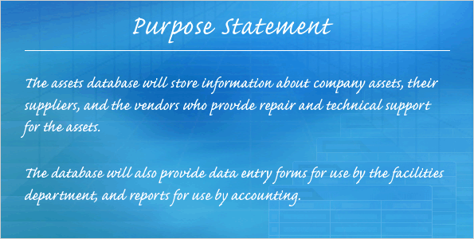
Decide on a purpose
The first step in planning a new database is to write down its purpose. In this case, you need to enter and manage your company’s asset data.
But don’t stop there. Ask yourself who will use the database and how they’ll use it, and make sure your purpose statement addresses all of those different needs and uses.
Who, what, when, where, why, and how.
Notes:
For example, the technician who fixes a defective machine has different information needs than the accountant who tracks costs.

Slide 11
Decide on a purpose
Keep your purpose statement handy and refer to it as you design your tables.
And don’t try to make the statement perfect; you can always change it, and you probably will.
Who, what, when, where, why, and how.

Slide 12

List the data you want to store
A good database design helps prevent you from duplicating data. It also helps ensure your data is complete, and most importantly, that it’s accurate.
All the data that’s fit to keep.

Slide 13
List the data you want to store
To reach those goals, start by listing the data you want to capture. You can start with your existing data — in this case, your spreadsheet. Or, if you use paper ledgers or forms, gather examples of those.
And don’t hesitate to ask your coworkers what they need.
All the data that’s fit to keep.

Slide 14
List the data you want to store
Another way to identify the information you need to store is to create a flowchart of the tasks associated with your data.
For example, who will enter the data, and how? What kinds of forms will they need?
All the data that’s fit to keep.

Slide 15
List the data you want to store
And while you’re at it, think about the reports or mailings you want to produce from the database.
For example, do you want to know when desks and chairs need to be replaced? Who needs that information? Looking at the data you need to enter and consume can help you decide which data to store.
All the data that’s fit to keep.

Slide 16
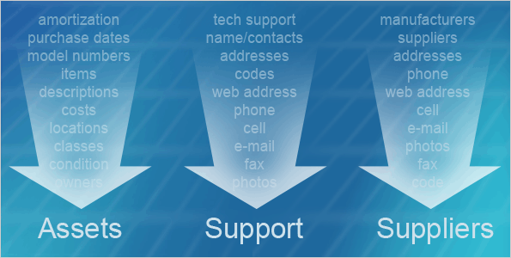
Group your data by subject
As you list the data you want to capture, you’ll see it naturally falls into one or more subject matter categories or groups. For example, your information may group itself like this:
Asset data, such as models, purchase dates, and costs.
Sets of unique information.

Slide 17
Group your data by subject
Supplier data — those who provide the computers, desks, and other equipment. This category will probably include company names, addresses, phone numbers, and contact names.
Support data — those who repair and maintain the equipment. This will look like supplier data because it also includes companies and contact names.
Sets of unique information.

Slide 18
Group your data by subject
Grouping is important because each group can correspond to a table, such as Assets, Support, and Suppliers. Your groups may not result in a complete list of tables, but they’re a good starting point.
And don’t be afraid to redraft them. Just make sure each group contains unique data — only the asset information in one group, only the supplier data in another, and so on.
Sets of unique information.

Slide 19
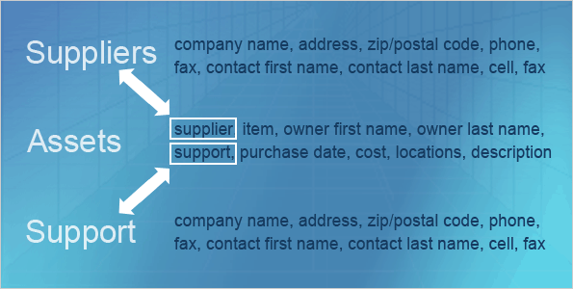
From groups, fields
The next step in your design is to list the fields for each table. In an Access table, columns are called fields and individual records are called rows. As a rule, each field in a table is related to the other fields.
For example, in a table of business contact data, you’d typically have fields for first name, last name, company, phone numbers, and more.
You’re starting on the gritty details.

Slide 20
From groups, fields
Each field must be related to the others, and each field must only apply to business contacts. That set of related fields is called a relation, and that’s where we get the term relational database.
You plan your fields by deciding the specific information each of your groups should capture. Again, you can refer to your existing data — the spreadsheet, a ledger, or even your card file.
You’re starting on the gritty details.
Notes:
You can also open an existing database, such as one of the Access database templates, and see which fields it uses.

Slide 21
From groups, fields
For your asset database, you’ll probably want to list each item and information about each item, such as purchase dates and costs. As part of this, try to reduce each field to its smallest logical component.
In a good design, a field represents a single piece of data, and the name of the field clearly identifies that data.
You’re starting on the gritty details.
Notes:
For example, your tables should have separate fields for first and last names because that makes it easier to find and sort your information.
Also, ask yourself if you need to record international data. If you do, you’ll need fields for Country, plus Region instead of State, and Postal Code instead of Zip Code.

Slide 22
From groups, fields
As you work, you may find yourself wanting to use data from one table in another. For example, the picture shows that the Assets group includes fields for suppliers and support.
That’s natural — you’re seeing how you need to relate your tables, and we’ll discuss those relationships in just a bit. For now, include all the fields you think each table should have.
You’re starting on the gritty details.
Notes:
Note: If a field name contains more than one word, don’t separate each word with spaces. They can make it harder to create other components, such as Visual Basic for Applications code and a type of formula called an expression. If you need to use multiple words in a field name, eliminate spaces and capitalize the first letter of each word, or separate the words with an underscore.

Slide 23
From groups, fields
Finally, in case you’re wondering, you don’t plan rows. Those come naturally as you enter data in your fields.
You’re starting on the gritty details.

Slide 24

Plan data types
After you list the fields in each table, you need to decide on a data type for each field. A data type is a property that controls what you can and can’t enter into a field.
For example, if you want to store textual data such as names and addresses, you set your fields to the Text data type. If you want to store dates and times, you set the field to the Date/Time data type.
Each field receives a data type.

Slide 25
Plan data types
Data types are a standard for all relational databases, and they help ensure accurate data entry. For example, you can’t enter a name in a field set to contain dates and times.
What’s more, data types also help you control the size of your database, because they control the sizes of your fields. You won’t waste space putting a small amount of text in a large field.
Each field receives a data type.

Slide 26
Plan data types
Access makes it easy to set data types. For now, as you list your fields, note the data type for each.
Each field receives a data type.
Notes:
You’ll find a complete list of data types in the Quick Reference Card that’s linked to at the end of this course.

Slide 27
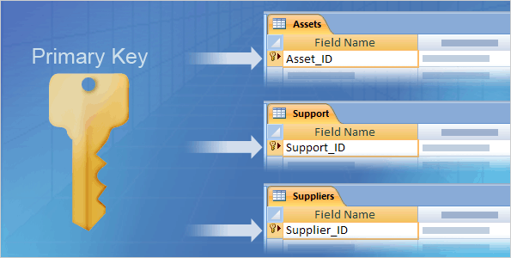
Plan your primary keys
The next step in your plan is to add a primary key field to each of your tables. A primary key is a field, or a combination of fields, with a value that makes each record — each row in a table — unique.
For example, the phone company keeps track of all those John Smiths by identifying them with a unique primary key value.
A critical field for all tables.

Slide 28
Plan your primary keys
In addition to identifying each record in your database, you also use primary keys in the relationships among your tables.
In fact, primary keys are so important, we have a rule for them: Every table in your database must have a primary key. Without primary keys, you can’t create relationships and extract meaningful information from your data.
A critical field for all tables.
Notes:
Without primary keys, you also stand a good chance of duplicating records, and your data will be much harder to use.

Slide 29
Plan your primary keys
Access provides several ways to create primary keys.
Since you’re just starting out, the simplest way is to plan an “ID” field, such as “AssetID” or “SupplierID”, for each of your tables, and then set that field to the Autonumber data type.
A critical field for all tables.

Slide 30
Plan your primary keys
Access will then increment the value in that field by one whenever you add a new record.
Also, if you’re planning to publish your database to SharePoint, you need to use Autonumber fields as the primary keys for all your tables.
A critical field for all tables.

Slide 31
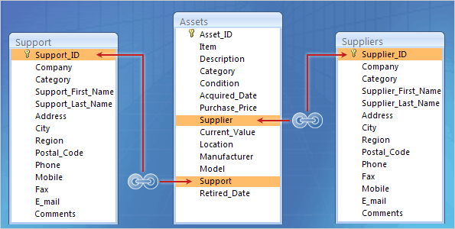
Plan your foreign keys
We mentioned earlier in this course that after you break your data into tables, you marry it back together with links called relationships. Table relationships can become complex, and go beyond the scope of this course.
For now, you need to plan them, and you do that by deciding where to put foreign keys.
The key to relationships: sharing your keys.

Slide 32
Plan your foreign keys
A foreign key is simply a primary key that you use in another table.
The picture shows this: You can see how the primary keys in the Suppliers and Support tables have become fields in the Assets table. Those duplicate fields in the Assets table are foreign keys.
The key to relationships: sharing your keys.

Slide 33
Plan your foreign keys
At this point, you may be thinking, “Hang on, sharing fields like that duplicates some data!” Don’t worry, this kind of duplication is okay.
Primary key values are small, and you can’t extract information from your database unless you use them in relationships. So, as a step in your design, indicate your foreign key fields.
The key to relationships: sharing your keys.
Notes:
For example, the relationships in the picture allow you to answer questions such as, “Who supplied the monitors that we bought two years ago?”
In the Quick Reference Card that’s linked to at the end of the course, there are pointers to more information about database design and relationships.

Slide 34
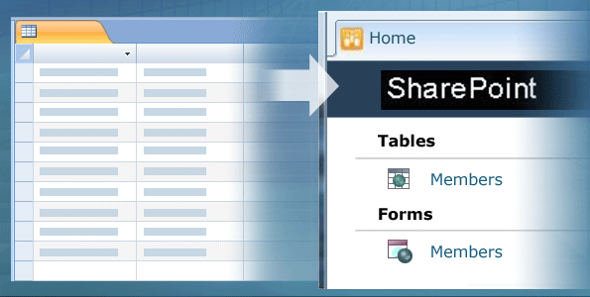
Design tables for SharePoint
As a final step in the design process, decide whether you’ll publish your database to SharePoint. If you will, then your tables can’t use some of the features that Access provides.
For example, you can only use Datasheet view to create tables, not the table designer.
Web databases take some planning.

Slide 35
Design tables for SharePoint
In addition, the only types of relationships you can create are called Lookup Fields. That’s a type of relationship that allows you to select the values that reside in one table from a list in another table.
Web databases take some planning.

Slide 36
Design tables for SharePoint
Access imposes those limits because the publishing process converts your database to Dynamic HTML and ECMAScript, so you need to avoid creating any database components — Access calls them objects — that can’t be converted into those languages.
So, as a final step in your plan, note whether you’ll publish the database. It’s a small detail, but it’s critical.
Web databases take some planning.
Notes:
The Quick Reference Card that’s linked to at the end of the course has pointers to information about creating databases for use with SharePoint.

Slide 37
Suggestions for practice
Start your plan.
Explore the Assets database template.
Explore ways to avoid redundant data without creating tables.
Online practice (requires Access 2010)
Notes:
[Note to trainer: With Access 2010 installed on your computer, you can click the link in the slide to go to an online practice. In the practice, you can work through each of these tasks in Access 2010, with instructions to guide you. Important: If you don’t have Access 2010, you won’t be able to access the practice instructions.]

Slide 38
Test question 1
What is the function of a primary key? (Pick one answer.)
To uniquely identify each record in a table.
To encrypt and decrypt your database.
To help ensure you enter data in the correct table.

Slide 39
Test question 1
What is the function of a primary key?
Answer:
To uniquely identify each record in a table.
Primary keys do all that, and all your tables must have a primary key field.

Slide 40
Test question 2
A good database design helps ensure that your data is: (Pick one answer.)
Always backed up.
Complete and accurate.
Duplicated so it’s easier to find.

Slide 41
Test question 2
A good database design helps ensure that your data is:
Answer:
Complete and accurate.
Completeness and accuracy are essential for making sound decisions.

Slide 42
Test question 3
You should always place all your data in separate tables. (Pick one answer.)
True.
False.

Slide 43
Test question 3
You should always place all your data in separate tables.
Answer:
False.
If you only need to store and track a few items, you can use a lookup field that contains a value list.

Slide 44
Test question 4
How many tables should a well-designed database contain? (Pick one answer.)
As many as necessary to capture all your data without redundancy.
One.
Two.

Slide 45
Test question 4
How many tables should a well-designed database contain?
Answer:
As many as necessary to capture all your data without redundancy.
That can be one table, or it can be dozens.

Slide 46
Test question 5
You establish a relationship between Table A and Table B by: (Pick one answer.)
Merging Table A with Table B.
Linking Table A with Table B.
Adding the primary key from Table A to Table B (or vice-versa).

Slide 47
Test question 5
You establish a relationship between Table A and Table B by:
Answer:
Adding the primary key from Table A to Table B (or vice-versa).
When you add a primary key field to another table and create a relationship, that new field becomes a foreign key.

Slide 48
Quick Reference Card
For a summary of the tasks covered in this course, view the Quick Reference Card.

Slide 49
Using this template
See the notes pane or view the full notes page (View tab, Notes Page) for detailed help on this template.
Notes:
Using This Template
This Microsoft PowerPoint® template has training content about designing database tables and relationships in a Microsoft Access® 2010 database. Its content is adapted from the Office.com Training course called “Design the tables for a new database.”
Slide layouts: Each slide has a custom layout. To apply the custom layout to a new slide, right-click the slide thumbnail, point to Layout, and click the layout from the Layout gallery. To alter the layouts, open master view and alter the specific master layout in that view. You can find the layout’s title by pointing to its thumbnail.
Animations: Custom animation effects are applied throughout the presentation. These include Float In (Up or Down option), Fade, and Zoom. To alter animation effects, click the Animations tab, and use the Add Animation gallery and Timing options. Effect Options gives you choices about the effect; click Animation Pane on the Animations tab to work with multiple animations.
Transitions: One transition, Doors, is used to emphasize sections of the slide show. It’s applied on the Course Contents slide, Lesson slide, and the first test slide.
Hyperlinks to online course: The template contains links to the online version of this training course. The links take you to the hands-on practice session for each lesson and to the Quick Reference Card that is published for this course. Please take note: You must have Access 2010 installed to view the hands-on practice sessions. If you don’t have Access 2010, you won’t be able to access the practice instructions.
Headers and footers: The template contains a footer that has the course title. To add footers such as the date or slide numbers, click the Insert tab, and click Header & Footer.

