Slide 1
Save Money with OCS 2007 R2 Conferencing “a session with free stuff”
Paul Dolley
UC Solution Specialist
Microsoft
UNC310

Slide 2
Agenda
Audio Conferencing
P2P Video
Multimedia conferencing
3rd Party VC Integration
Deployment and server configuration
Q&A

Slide 3
Conferencing for the Masses
Office Communications Server 2007 R2
R2 Conferencing
Audio Conferencing | Video Conferencing | Web Conferencing
dial-out conferencing | CIF video | Single console across server and service
Scheduled voIP calls | VGA video | Rich media support
ACP integration | HD video | RoundTable
Reservationless calls | Interoperability with Polycom and TANDBERG | RDP Desktop sharing
Scheduled mixed (PSTN-voIP) calls |  | Multi-platform support
Dynamic bandwidth allocation
Active speaker detection

Slide 4
Where Do We Play?
PBX Functionality
Audio Conferencing Provider (ACP) Functionality
Office Communications Server 2007
N-way conferencing
  “Conference” button on the desktop phone
Bridge functionality
  Similar to that provided
  by ACPs
Reservation-less bridges
  Dial-in number provided along with conference ID
Operator assisted calls
  High profile assisted
  conferencing events
Scheduled unattended
  Ports are reserved for the conference
new R2 feature

Slide 5
What Do We Do?
Feature Sets | Office Communications Server 2007 R2 | Typical Audio Conferencing Provider | Typical On-premises solution
Paticipant Passcode
Leader Passcode | (Corporate User PIN)
Music on Hold
Multiple access numbers with Toll free support
One access number supports multiple languages
Entry/Exit Announcement | (Tone only)
Scheduled Meeting
Reservation-less Meeting
Mute/Un-mute Notification
Usage reporting
DTMF in-meeting control | OC roster control
Recorded name | OC roster / caller ID
User Identity |  | User roles only | User roles only
Note: Table stakes features only

Slide 6
Microsoft’s Strategy
Hit the core scenario
  Replicate engrained ACP experience
  No PC required
Differentiate with Unified Communications
Clear cost savings

Slide 7
Reservationless Comparison
Music on Hold
Typical
ACP
Dial-in
Participant pass code
Conference
Leader pass code
Pass code
Music on Hold
Music on Hold
OCS 2007
R2
Dial-in
Conference ID
Conference
Authenticated user

Slide 8
Differentiate With UC + Audio Conf
Ease of use
  Outlook based scheduling experience
  Non-UC participants can still join with CWA
  Simple roster control: drag and drop participants
Secure
  AD authentication
  Additional security options
Multi-modality
  Seamless escalation to video and desktop sharing
  Automatic handoff between PC and phone
  CWA dial out experience
…more coming!

Slide 9
demo

Slide 10
Office Communications Server 2007 R2
Conferencing for the masses
Audio Conferencing | Video Conferencing | Web Conferencing
dial-out conferencing | CIF video | Single console across server and service
Scheduled voIP calls | VGA video | Rich media support
ACP integration | HD video | RoundTable
Reservationless calls | Interoperability with Polycom and TANDBERG | RDP Desktop sharing
Scheduled mixed (PSTN-voIP) calls |  | Multi-platform support
Dynamic bandwidth allocation
Active speaker detection

Slide 11

Video Conferencing Markets
Market segment | Subcategory
Endpoints | Telepresence
 | Room
 | Desktop
Infrastructure | MCUs, gateways, etc.
Services | Installation, maintenance
OCS 2007 R2 targets desktop video conferencing
  Designed around the
  way teams naturally communicate
  Unlike traditional video conferencing, you communicate with users, not rooms or IP addresses
  Only requires PC and webcam – so all information workers
  in an organization
  can benefit
  Works securely over the public Internet without requiring VPN
Partner integration
(Polycom & TANDBERG)
Office Communications Server

Slide 12
Higher Definition Video Conferencing
In R2, collaborating users can easily use off-the-shelf webcams to participate in immersive video communications
Key Features
Support for VGA and HD for peer to peer video on capable PCs
Interop with Polycom and Tandberg room videoconferencing endpoints
Resolution can be configured by both users and IT pros
Dynamic selection of resolution based on network and processing power

Slide 13
Bandwidth Management
Control bandwidth at pool-level
  MaxVideoResolutionAllowedtoReceive
    CIF – 352 x 288
    VGA – 680 x 480 (Default)
    HD720p – 1280 x 720
Bandwidth & Processor requirements
    CIF – 250 Kbps
    VGA –600 Kbps, dual-core processor
    HD720p - 1.5 Mbps, quad-core processor
    Panoramic Video - 700 Kbps, 2.0 GHz processor

Slide 14
demo

Slide 15
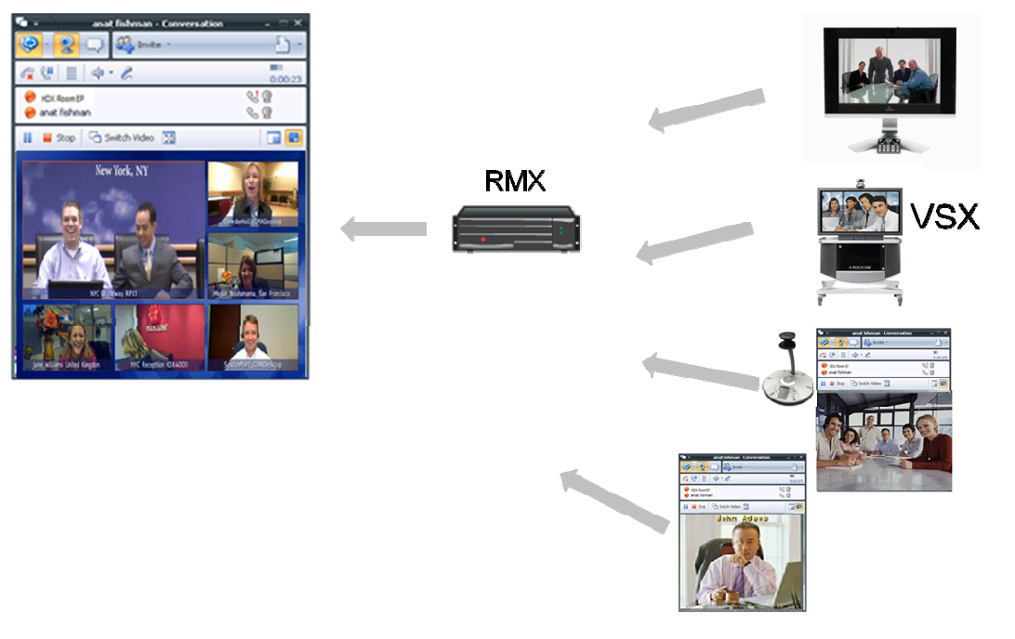
Polycom & OCS Integration Points

Slide 16
Deployment and Server Configuration

Slide 17


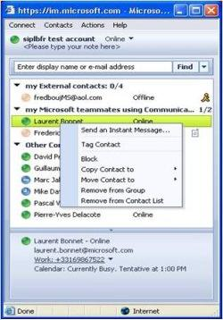

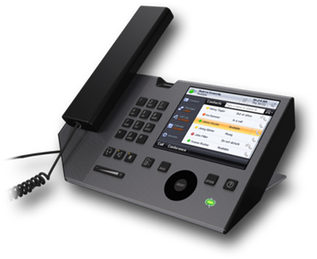



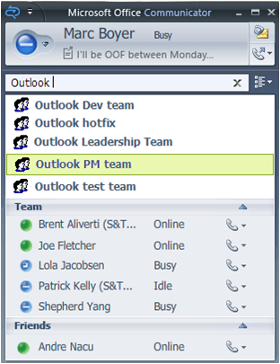

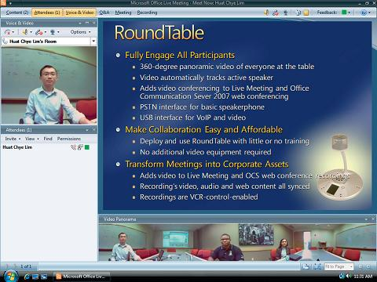
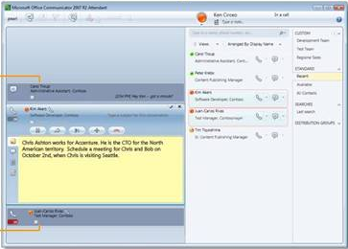















OCS 2007 R2 Roles
Information Worker (UC endpoints)
Management
Remote
Users
Reverse Proxy
Communicator
Phone Edition
Meeting Console
Communicator
Attendant
Console
MOM
MMC
WMI
Access Edge
Active
Directory
Federated
Company
Front End
Back End
ABS,DL,Content
Web Edge
Archiving
Monitoring
Registrar, Proxy, Presence
Response Group
SQL Database
Group Chat
A/V Edge
Mediation
Server
A/V
MCU
Web Conf
MCU
App Share
MCU
Exchange
2007 SP1
CWA
Server
SIP Trunk
PSTN and
Mobile Phones
TDM
PBX
PSTN
GW
SIP/Media
Translation
Audio, Video
Slide/Meeting
Content
Desktop
Sharing
Email, Unified
Messaging
Communicator
Web Access
IP PBX

Slide 18
Core Conferencing Roles
Information Worker (UC endpoints)
Communicator
Phone Edition
Meeting Console
Communicator
Active
Directory
Front End
Back End
Unified Communications Application Server (UCAS):
Conferencing Attendant (CA), Conferencing Announcement Service (CAS),
Personal Virtual Assistant (PVA)
SQL Database
Mediation
Server
A/V
MCU
Web Conf
MCU
CWA
Server
SIP Trunk
PSTN and
Mobile Phones
TDM
PBX
PSTN
GW
SIP/Media
Translation
Audio, Video
Slide/Meeting
Content
Communicator
Web Access
IP PBX

Slide 19
Audio Conferencing Deployment Requirements
Standard OCS infrastructure – Front End Servers, AV Conferencing Server, Mediation Server, etc.
UCAS with CA and CAS applications
  Installed and activated by default on each OCS pool
CWA server
OCS 2007 R2 clients for the best in-meeting experience
  OCS 2007 clients work as well
Additional DID numbers and PSTN trunk capacity for access numbers

Slide 20
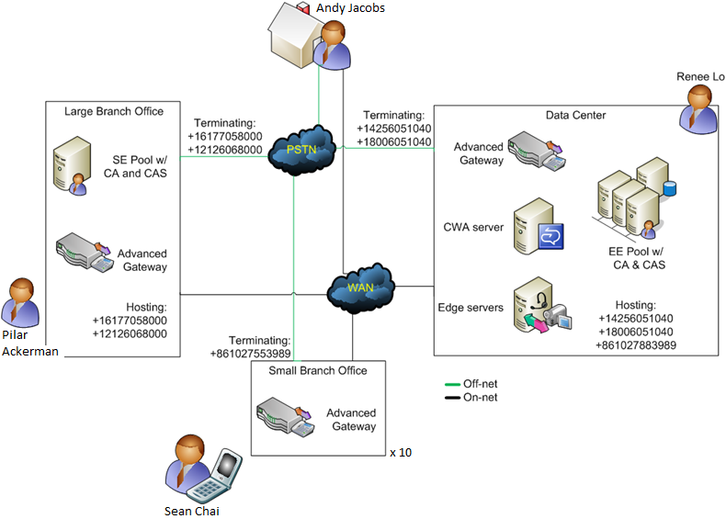
Bringing it Together: Deployment

Slide 21
Bringing it Together: Conference Call

Slide 22
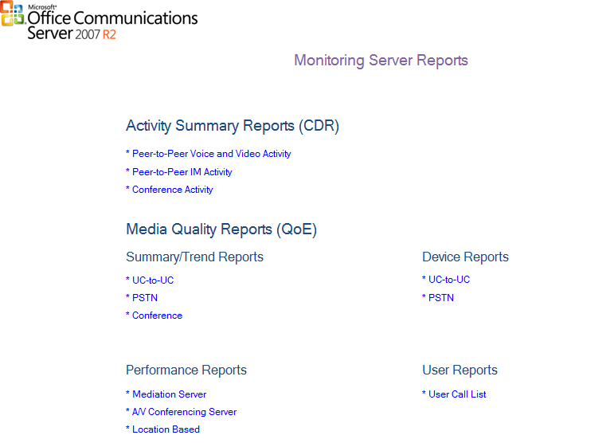
Monitoring Server Reports
Reports can be
filtered by:
  Dates (Admins can choose the range)
  Granularity (Hourly, daily, weekly, monthly)
  Participant Count/ Conference Count/ Minutes

Slide 23
Reporting and CDR
Main data points captured for conferences
  Conference URI
  Conference start time
  Conference end time
  User join time
  User leave time
  User join time to conferencing servers (A/V, Data, IM etc)
  User leave time from conferencing servers
  Join via PSTN (For A/V Conferences only)

Slide 24
Capacity and Scalability
Component | Supported Performance
Conferencing Attendant | 450 simultaneous calls (based on a computer with 8 processor cores running at 2.33Ghz, and 4GB of memory)
Collocated Access Edge & Web Conferencing Edge Server | Access Edge Server: 5,000 client connections
 | Web Conferencing Edge Server: 1,500 client connections
Collocated Access Edge, Web Conferencing Edge and A/V Edge Servers (Consolidated Edge Topology) | Access Edge Server: 5,000 client connections
 | Web Conferencing Edge Server: 1,000 client connections
 | A/V Edge Server 500 concurrent audio/video sessions

Slide 25
Savings for your Business….
Assuming
  100 employees spend 60 minutes/week on conference calls
  @ 64 cents NZ/minute
Savings
  $184k+ /year on ACP cost savings alone!!!!!

Slide 26
question & answer

Slide 27

© 2009 Microsoft Corporation. All rights reserved. Microsoft, Windows, Windows Vista and other product names are or may be registered trademarks and/or trademarks in the U.S. and/or other countries.
The information herein is for informational purposes only and represents the current view of Microsoft Corporation as of the date of this presentation. Because Microsoft must respond to changing market conditions, it should not be interpreted to be a commitment on the part of Microsoft, and Microsoft cannot guarantee the accuracy of any information provided after the date of this presentation. MICROSOFT MAKES NO WARRANTIES, EXPRESS, IMPLIED OR STATUTORY, AS TO THE INFORMATION IN THIS PRESENTATION.

