Slide 2
Reinventing Remote Access with DirectAccess
Gavin Carius
Architect
Microsoft Services
SVR311

Slide 3
Session Objectives And Takeaways
Session Objective(s)
  Present DirectAccess
  Explain core DirectAccess technologies
  Review connectivity options
Key Takeaways
  VPNs connect the user to the network, DirectAccess extends the network to the user
  Three core technologies: IPv6, IPsec, and NRPT
  Smartcards are supported but not required

Slide 4







Network Access Infrastructure Optimization Model
Is IT a Cost Center or a Strategic Asset?
Cost Center
More Efficient Cost Center
Business Enabler
Strategic Asset
No password policies
Perimeter Firewalls only
Antivirus not required or installed by default
No Remote Access policies
IPv4-only network
Strong password policy
Host-based firewalls
Security suite installed on clients
Remote Access available
IPv6 planning and testing in progress
Strong password policy
Basic IPsec policies
Health policies enforced
Remote user experience is similar to local
IPv6 blockers removed, addressing plan complete
Strong Authentication
Network transactions are authenticated; may be encrypted
Policy-based network access with auto-remediation
Remote users are an extension of the network
IPv6 is fully deployed

Slide 5



Trustworthy Networking Vision
Internet
Remote Client
Enterprise Network
Identity: Strong authentication required for all users
Authorization: Machine health is validated or remediated before allowing network access
Local Client
Datacenter Servers
Protection: All network transactions are authenticated and encrypted
Policies are based on identity, not on location

Slide 6


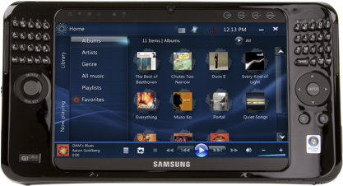
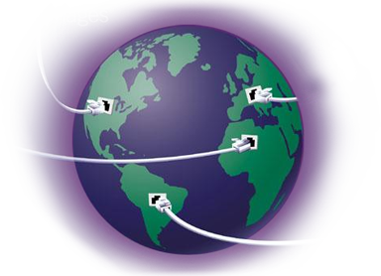
Evolving IT Needs
Mobile Workforce
Increasingly Porous Perimeter
Mobile Data
Globalisation

Slide 7

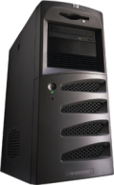
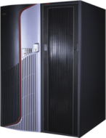






DirectAccess
Securely extending network services and resources to remote users

Slide 8

DirectAccess is more than Remote Access
Always On
Manage Out
Access Policies
Protected Transactions
Improved productivity
Not user initiated
Simplified connectivity
"Light up" remote clients
Decreases patch miss rates
Applies GPOs to remote machines
Pre-logon health checks and remediation
Replaces modal "connect-time" health checks
Full NAP integration
Supports authenticated transactions
Supports encrypted transactions
Authentication and encryption mitigate many attacks
VPNs connect the user to the network
DirectAccess extends the network to the user
Notes:
9/15/2009 2:54 PM
©2004 Microsoft Corporation. All rights reserved.
This presentation is for informational purposes only. Microsoft makes no warranties, express or implied, in this summary.
8

Slide 9
DirectAccess: Technical Foundations
Name Resolution:
DNS and NRPT
Data Protection: IPsec
  Connectivity: IPv6

Slide 10



Connectivity: IPv6
IPv6 Options
DirectAccess requires IPv6
If native IPv6 isn't available, remote clients use IPv6 Transition Technologies
The corporate network can deploy native IPv6, transition technologies, or NAT-PT
DirectAccess works best if the Corporate Network has native IPv6 deployed
Internet
Intranet
NAT-PT
Native IPv6
IPv6 Translation Technologies
IPv4

Slide 11

Data Protection: IPsec
IPsec tightly integrates with IPv6, allowing rules engine to determine when and how traffic should be protected
IPsec
Authentication
Encryption
End to edge
End to end
End to edge
End to end

Slide 12



Name Resolution: DNS and the NRPT
DirectAccess Connection
Internet Connection
Remote DirectAccess clients utilise smart routing by default
The Name Resolution Policy Table allows this to happen efficiently and securely
Sends name queries to internal DNS servers based on pre-configured DNS namespace

Slide 13
Technical Detail

Slide 14

External Connectivity
Native IPv6 support
Public IPv4 addresses will use 6to4 to tunnel IPv6 inside IP Protocol 41
Private IPv4 addresses will use Teredo to tunnel IPv6 inside IPv4 UDP (UDP 3544)
If client cannot connect to DirectAccess Server, IP-HTTPS will connect over port 443
IP Address Assigned by ISP:
IPv6 Address Used to connect:
Private IPv4
6to4
Native IPv6
Teredo
Public IPv4
Native IPv6
DirectAccess Client
Native IPv6
6to4
IP-HTTPS
Teredo

Slide 15
Internal IPv6
IPv6 Options
Native
  - Servers can run any OS that fully supports IPv6
  - Requires IPv6 infrastructure
  - Best choice over time
ISATAP
  - IPv6 inside IPv4
  - Servers must be Windows Server 2008 or R2
  - No router upgrades
NAT-PT
  - Translates IPv6 to IPv4
  - Works with any OS
  - UAG has this built in
DirectAccess works best if the Corporate Network has native IPv6 deployed
Internet
Intranet
NAT-PT
Native IPv6
IPv6 Translation Technologies
IPv4

Slide 16



External IPsec
DirectAccess Client
Internet
DirectAccess Server
IP-HTTPS
Encrypted IPsec+ESP
Encrypted IPsec+ESP
IPsec Gateway
IPsec Hardware Offload Supported

Slide 17

Internal IPsec
Enterprise Network
DirectAccess Server
Line of Business Applications
No IPsec
IPsec Integrity Only (Auth)
IPsec Integrity + Encryption

Slide 18
IPsec Tunnel Detail
DirectAccess Client
DirectAccess Server
Tunnel 1: Infrastructure Tunnel
Auth: Machine Certificate
End: AD/DNS/Management
Tunnel 2: Application Tunnel
Auth: Machine Certificate + (User Kerb or Cert)
End: Any

Slide 19
NRPT
NRPT
.ad.contoso.com | 2001:db8:b90a:c7d8::178 2001:db8:b90a:c7d8::183
.lab.contoso.com | 2001:db8:b90a:c7a8::202
sql01.acme.com.au | 2001:db8:b90a:c7e4::801
Client side only
Requires a leading dot
Static table that defines which DNS servers the client will use for the listed names
Configurable via GPO at Computer Configuration |Policies|Windows Settings|Name Resolution Policy
Can be viewed with NETSH name show policy

Slide 20
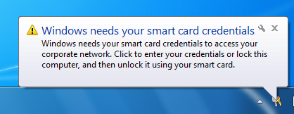
Two Factor Authentication (TFA)
Not required; fully supported
Edge based enforcement: a smarter way to enforce TFA
User is assigned a well-known SID when they log on with a smartcard
  S-1-5-65-1
User may logon to laptop without TFA
When user accesses corporate resources,
IPsec authorization policy checks for this SID
If SID is not present…

Slide 21
Requirements for DirectAccess
Knowledge
  Should have a basic working knowledge or IPsec and TCP/IP
  Should be interested in learning about and deploying new technologies, such as IPv6
DirectAccess Clients
  Windows 7 Enterprise or Ultimate SKU
  Domain-joined machines
DirectAccess Server
  Windows Server 2008 R2, domain-joined machines
  Located at edge

Slide 22
Requirements for DirectAccess
DNS Servers supporting DirectAccess clients must be Windows Server 2008 SP2 or later
Application Server
  End to end IPv6 or Ipsec requires Windows Server 2008 or later
  Earlier server versions require NAT-PT
PKI for certificates
No dependency on Active Directory version/mode

Slide 23
UAG and DirectAccess – Better Together
Forefront Unified Access Gateway (UAG) extends the benefits of Windows DirectAccess across your infrastructure, enhancing scalability and simplifying deployments and ongoing management.
Anywhere Access
Extend Windows DirectAccess to legacy applications and resources running on existing infrastructure.
Integrated Security
Simplified Management
Enhance scale and ongoing administration through built-in array management and integrated load balancing
Support down-level and non Windows clients through integrated SSL VPN capabilities and other connectivity options.
Consolidate access gateways for centralized control and auditing.
Minimize configuration errors and simplify deployment using built-in wizards and tools.
Protect the DirectAccess gateway with a hardened edge solution.
Limit exposure associated with connecting unmanaged, down-level and non-Windows clients through granular application access controls and policies.

Slide 24








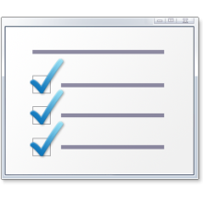






UAG and DirectAccess – Better Together
UAG and DirectAccess better together:
Extends access to line of business servers with IPv4 support
Access for down level and non Windows clients
Enhances scalability and management
Simplifies deployment and administration
Hardened Edge Solution
Access for down level and non Windows clients
Enhances scalability and management
Simplifies deployment and administration
{
Hardened Edge Solution
Windows Server 2008 R2
Managed
Windows 7
Windows Server 2008 R2
Always On
IPv6
Windows Server 2008 R2
IPv6
SSL-VPN
{
Windows Vista/ Windows XP
Windows Server 2003
Windows Server 2008 R2
DirectAccess Server
Legacy Application Server
Unmanaged
Non-Windows
IPv6
or
IPv4
+
Non Windows Server
PDA
SSL-VPN
IPv4

Slide 25

Building “End to End Trust”
Identity + Authentication
Authorisation Policies
  (Optional) Two factor Authentication
  Domain Controller authenticated logon
  Cached credentials are only used if machine is offline
  Define access, encryption, or authentication policies on a per server or application basis
  These rich policy constructs are far beyond traditional VPN
Access Control
Audit
  Identity-aware firewall (Auth-firewall)
  IPsec (At the network layer)
  File Share permissions
  NTFS Permissions
  End-to-end authentication allows remote client connections to be logged by each server

Slide 26
question & answer

Slide 27




Resources
www.microsoft.com/teched
  Sessions On-Demand & Community
www.microsoft.com/learning
Microsoft Certification & Training Resources
http://microsoft.com/technet
  Resources for IT Professionals
http://microsoft.com/msdn
  Resources for Developers

Slide 29

© 2009 Microsoft Corporation. All rights reserved. Microsoft, Windows, Windows Vista and other product names are or may be registered trademarks and/or trademarks in the U.S. and/or other countries.
The information herein is for informational purposes only and represents the current view of Microsoft Corporation as of the date of this presentation. Because Microsoft must respond to changing market conditions, it should not be interpreted to be a commitment on the part of Microsoft, and Microsoft cannot guarantee the accuracy of any information provided after the date of this presentation. MICROSOFT MAKES NO WARRANTIES, EXPRESS, IMPLIED OR STATUTORY, AS TO THE INFORMATION IN THIS PRESENTATION.

