Slide 1
Windows Connect Now
Yatharth Gupta
Program Manager
<yatharth.gupta@microsoft.com>

Slide 2

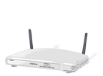
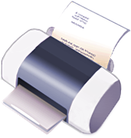
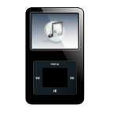

What is Windows Connect Now ?
A Solution to provision Wi-Fi profiles to Devices

Slide 3
Why Now ?
Source: JupiterResearch Home Networking Model, 12/06 (US only)

Slide 4
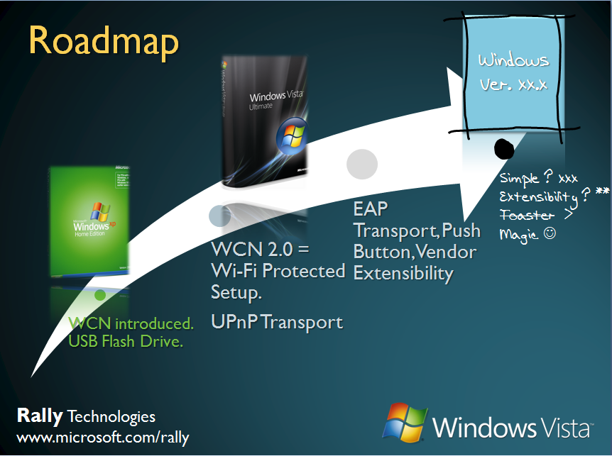
Roadmap
Windows
Ver. xx.x
WCN introduced. USB Flash Drive.
WCN 2.0 = Wi-Fi Protected Setup.
UPnP Transport
EAP Transport, Push Button, Vendor Extensibility
Simple ? xxx
Extensibility ? **
Toaster >
Magic ☺

Slide 5
WCN in Windows Vista
Windows Connect Now
=
Wi-Fi Protected Setup

Slide 6








Wi-Fi Protected Setup
– Windows Connect Now 1.0*
– SecureEZSetup*
– OBC (One Button Configuration)*
These solutions do not interoperate!
  Smart Wireless Solutions
– Network in a Box*
  Auto Link*
– A.O.S.S. (AirStation One-Touch Secure System)*
– AutoSecure*
  – Quick SETUP buttons*

Slide 7









Wi-Fi Protected Setup
Simple Configuration Working Group
  Formed 8/2004
  Initial focus is Home WLAN Setup (WPA-Personal)
  Strong WFA interest and participation (9 companies submitted 6 proposals)

Slide 8
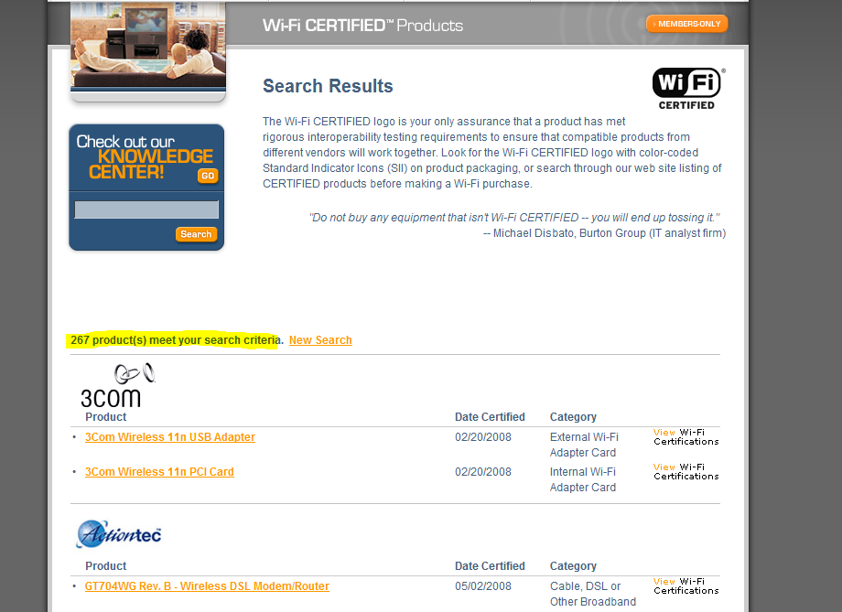
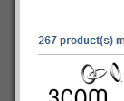
Wi-Fi Protected Setup

Slide 9
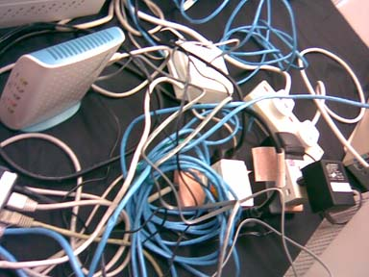

Windows Connect Now
Before
After

Slide 10
Setting up a Wireless Router
Traditional | Wi-Fi Protected Setup
Un-Box device and Power it up. | Un-Box device and Power it up.
Insert CD & start Setup Application | Connect to AP using Windows
Connect cable to the AP | Enter PIN – Proceed through Setup
Run through the Wizard | Connected
Disconnect cable
Connect to AP using Windows
Connected

Slide 11
Connecting to a Wireless Router
Traditional | Wi-Fi Protected Setup
User attempts to Connect to the Network | User attempt to Connect to the Network
Find Passphrase | Push Button on AP or Enter PIN
Connect using a Cable to the AP & find passphrase | Connected
Disconnect cable
Attempt to Connect, Enter Passphrase
Connected

Slide 12
Setting up a Wireless Device
Traditional | Wi-Fi Protected Setup
Un-Box device and Power Up | Un-Box device and Power Up
Insert CD & Start Application | Locate Device & Connect
Connect cable (USB, Ethernet) | Enter PIN & Proceed
Enter Network Information including Wi-Fi Profile or SSID, Security Settings | Device Connected
Disconnect cable
Device Connected

Slide 13
Demo

Slide 14
Protocol Overview
Discovery
Mutual Authentication
“Enrollee”
Transfer of Wireless Profile
“Registrar”

Slide 15
Windows Implementation
M1
“Registrar”
“Enrollee”
M2D
Device appears in Network Explorer
M1
M2
User enters PIN, Wizard flow, Device Configured
M3 – M8

Slide 16
Architecture
Client
Discovery
Provisioning & Control
Function Discovery API
Category
Manager
Query Manager
WCN
Service
Registry Provider
PnP Provider
SSDP Provider
WSD Provider
WCN Provider
Registry
Registry
Setup DI
API
SSDP
WSD
WCN

Slide 17
Extensibility
Discovery of the Device using Function Discovery
Setting up the Device using NetSh

Slide 18
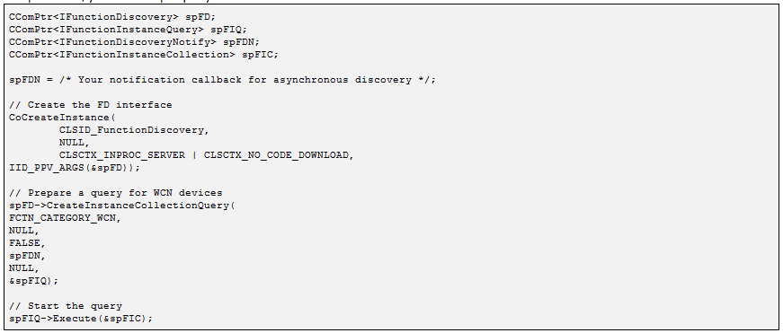
WCN Function Discovery Sample
Initialize → Setup Query → Add Constraints → Execute

Slide 19
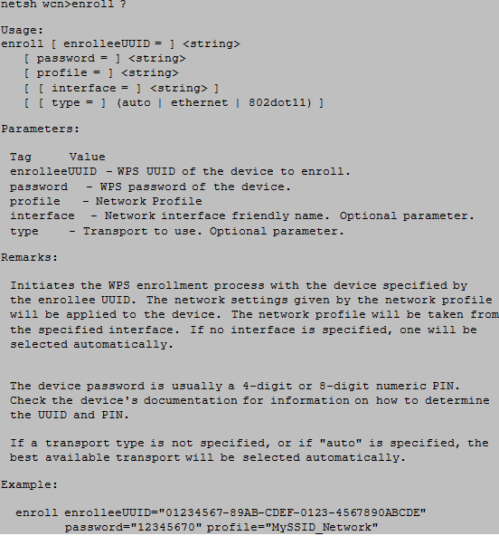
NetSh Sample
Simple NetSh Interface
>NetSh Wlan WCN
Enroll – Setup a Device

Slide 20
Windows Vista Feature Pack for Wireless
New Functionality – EAP Transport, Push Button Configuration, Extensibility
Wave 1 RTM – 5/2/2008 (5 Languages)
Distribution Vehicles
  Wave 1 – OEM Redist
  Wave II – OEM & IHV Redist

Slide 21
Windows Logo Program Update
Windows Logo Program updated with tests for new functionality. WLK 1.2
6 New tests added
  PIN Based Registrar
  Missing Attributes
  Optional Attributes
  Proxy
  Push Button
  Registrar Discovery

Slide 22
Call to Action
Support WCN in your wireless APs and Devices to ensure ease of Setup
Get Specs and Updates from rally website
Use Logo Program to ensure premium experience
Work with MS to ensure Interop
Enable end to end opportunities and scenarios for the consumers

Slide 23
Available Resources
White Papers
  http://www.microsoft.com/Rally
Intel SDK from Wi-Fi Alliance
PlugFests
Summits
WinHec

Slide 24
Questions

