Slide 1
What makes a great device in 2009
Kevin Larkin
Senior Program Manager
KevinLa@Microsoft.com

Slide 2
Agenda
PlaysForSure and Windows Logo Program
Proposed new device classes
What makes a GREAT Device in 2009
  DMC
  DMR
  DMS
Call to Action

Slide 3
PlaysForSure
PlaysForSure helped define a class of Digital Media Players to work with Windows Media Player
PlaysForSure placed additional UI requirements and burdens on our partners
Brand confusion
Multiple test harnesses and submissions

Slide 4
Moving to the Windows Logo Program
Windows Logo Program has a lot of momentum
Great Partner Incentive Programs such as the CNET Feed
Microsoft Begins Embracing the DLNA Digital Living Network Alliance Specification
Improved support infrastructure

Slide 5
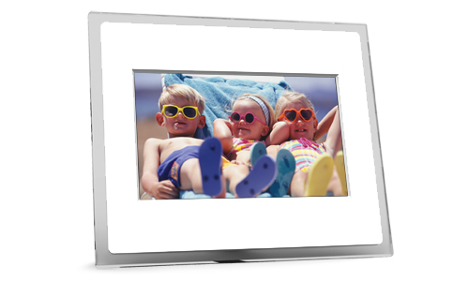
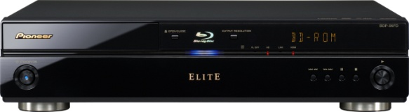

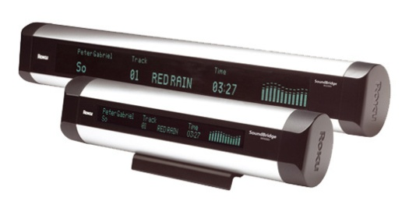
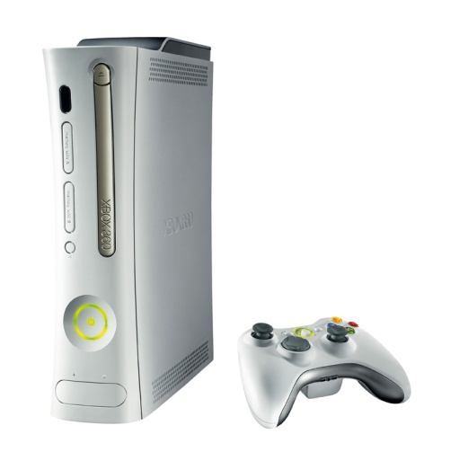
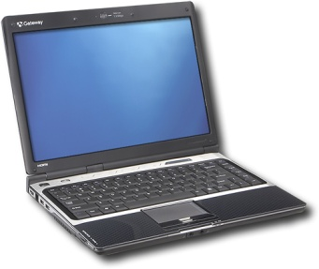
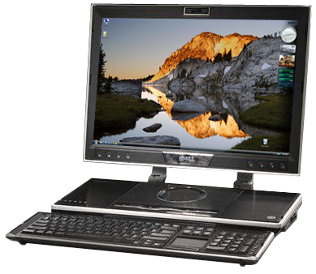
Current Devices and Ecosystem

Slide 6
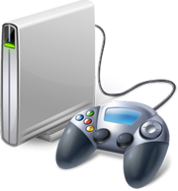
Digital Living Network Alliance
“2-box model”
DMS
Digital Media Server
DMP
Digital Media Player
1 Browse
2 Request
3 Stream

Slide 7
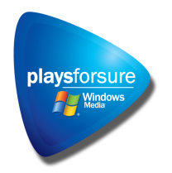

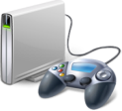
NMD 2008 Platform
Reduce PFS General Device Requirements
Promote Certified for Windows logo and marketing program
Publish 2009 requirements and add 3 new NMD Device Classes (DMC, DMS, DMR)
Take Rally feedback and incorporate it into 2009 logo requirements
Platform and Certification Marks
and/or
PlaysForSure v2.2
PFS Functional Requirements
PFS General Device Function Tests
Windows Media
Microsoft proprietary technologies
WMDRM
Digital Media Player
PFS Device Classes

Slide 8

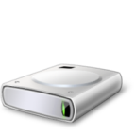

NMD 2009 Platform
PlaysForSure removed from Windows Logo Program
No more Digital Media Player certification
2009 requirements are live and integrated into the Device Test manager (part of WLK)
Platform and Certification Marks
2009 Requirements for Windows
NMD Functional Requirements
NMD General Device Function Tests
Device Specific / Rally
Microsoft proprietary technologies
Windows Media
WMDRM
Digital Media Receiver
Digital Media Server
Digital Media Controller
DLNA Device Profiles

Slide 9

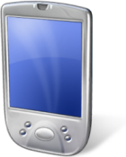
Propose device classes
DMR
DMS
DMC
WMDRM-ND (Cardea)
Windows Media Codecs
LLTD
WiFi supports 802.11a&g with N
DLNA 1.5 compliant
MSFT extensions
WiFi supports WCN 2.0
Windows Media Codecs
LLTD
WiFi supports 802.11a&g with N
DLNA 1.5 compliant
MSFT extensions
WiFi supports WCN 2.0
DLNA 1.5 compliant
MSFT extensions

Slide 10
Digital Living Network Alliance
“3-box model”
DMC
Digital Media Controller
Control
Control
DMS
Digital Media Server
DMR
Digital Media Renderer
Stream

Slide 11
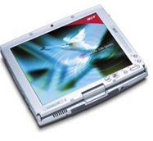

Digital Media Controller (DMC)
Digital Media Controllers are the corner stone for enabling the 3-box model. Digital media controllers discover media on digital media servers and play it on digital media renderers.
Examples:
Cell phones, PDAs, software solutions

Slide 12
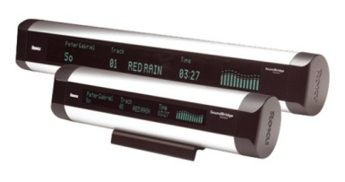
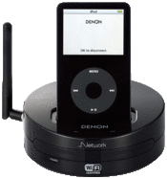
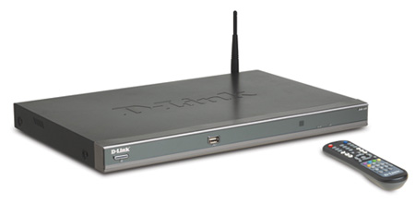
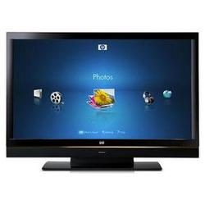

Digital Media Renderer (DMR)
Digital Media Renderers play content received from a digital media controller.
They are often also digital media players.
Examples:
MP3 Players, Stereos, Televisions, EPFs, Windows

Slide 13
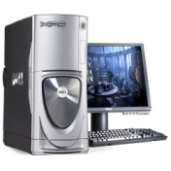
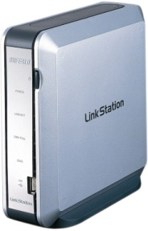
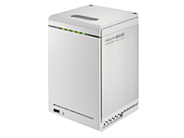
Digital Media Servers (DMS)
Digital Media Servers store the users content and share it with other network attached devices.
Examples:
NAS, PCs, software solutions, and even mobile devices

Slide 14


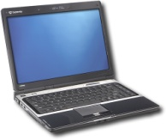


Great Devices in 2009 (all)
Common Recommendations to all Devices
  All devices should be DLNA 1.5 certified
  Guarantees a baseline
  experience

Slide 15

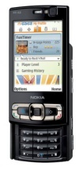
Great Devices in 2009 (all)
Common Recommendations to all devices
  All devices should support WoL either by sending or responding to Magic Packets as specified.
  DMC should wake sleeping devices in 20 seconds
  DMRs and DMSs should wake in 20 seconds
Z z z
Z z z
Magic Packet Sent
DMC tells DMS to Stream to DMR
Alive Message Sent

Slide 16
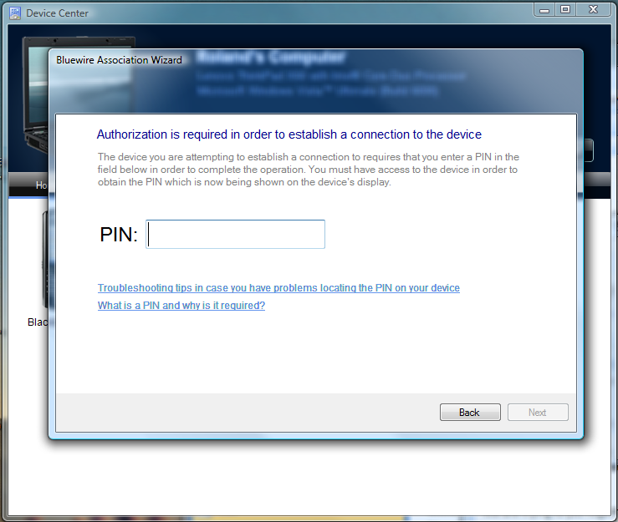
Great Devices in 2009 (all)
Common Recommendations to all devices
  All devices should support Rally Technologies
  Windows Connect Now support
  Link Layer Topology Discovery (LLTD)
  QoS support
123456789

Slide 17

Great Devices in 2009
Common Recommendations for DMS and DMR
  All devices should support Windows Media Formats
  DLNA provides baseline support of MPEG2 Video and LPCM audio
.WMA & .WMV
.WMA & .WMV

Slide 18
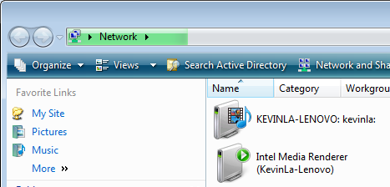
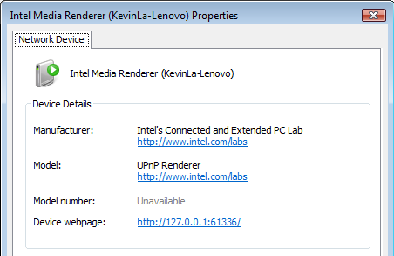
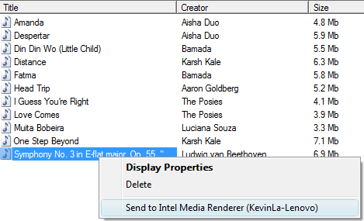
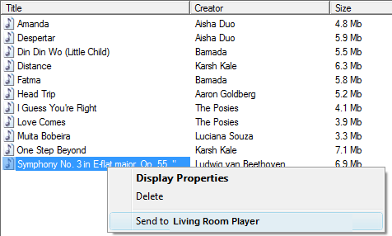
Great Devices in 2009
Common Recommendations to all DMS and DMR
  All devices should support the user renaming the device to a friendly name
  One common location to rename your device through windows

Slide 19

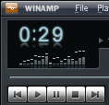



Great Devices in 2009
Common Recommendations to all DMS and DMR
  Basic transport support
    DLNA requires Play and Stop
    Minimalist recommendation is to support Pause and Seek
    Play speed control & trick modes

Slide 20
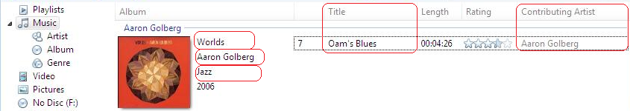
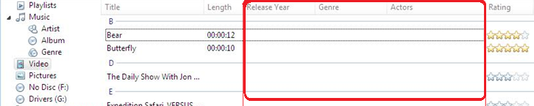
Great Devices in 2009
Common Recommendations to all DMS and DMR
  All devices should support common metadata
  DMRs should provide base level of support

Slide 21
Great Devices in 2009
Additional DMR Specific Recommendations
  DMRs should play the right RES element
{
<res DIVX>
<res WMV >
<res WMV Small >
<res MPEG2 >
WMA
WMV
MPEG2
LPCM

Slide 22




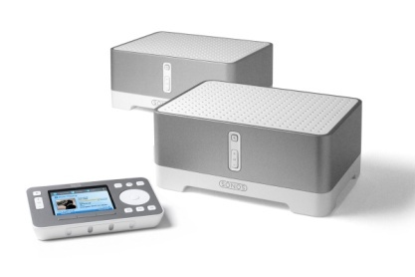

Great Devices in 2009
Additional DMR Specific Recommendations
  DMRs should support WMDRM-ND

Slide 23
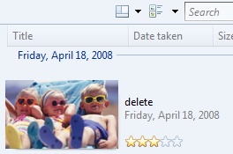
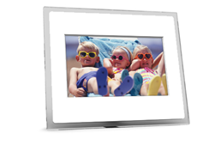


Great Devices in 2009
Additional DMR Specific Recommendations
  Digital Media Renderer support for Metadata Update Object

Slide 24
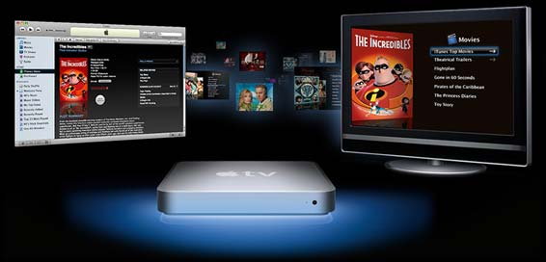
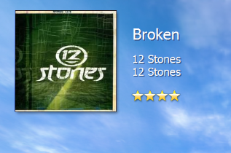
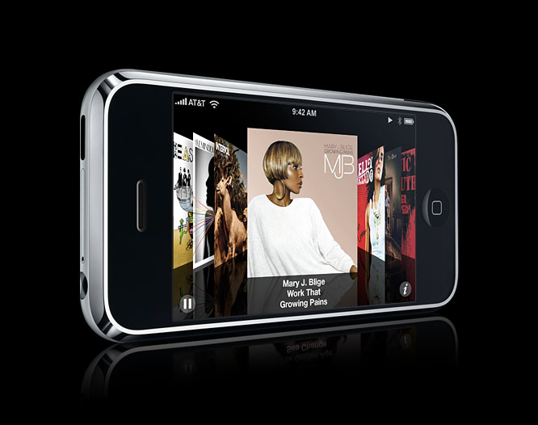
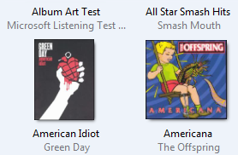
Great Devices in 2009
Additional DMR Specific Recommendations
  Rendering of Album Art
  Rendering of Thumbnails

Slide 25
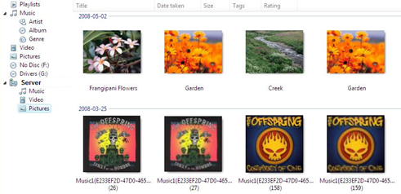
Great Devices in 2009
Additional DMS Specific Recommendations
  DMS does not display album art images as photos

Slide 26
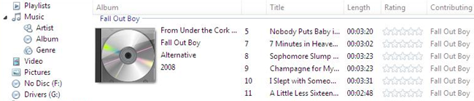
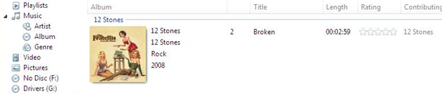
Great Devices in 2009
Additional DMS Specific Recommendations
  Provide album art when available.

Slide 27
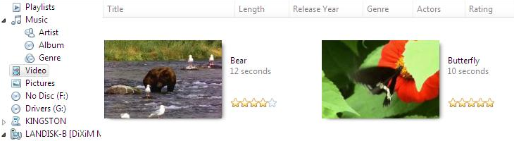
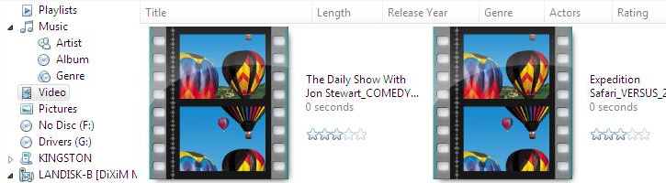
Great Devices in 2009
Additional DMS Specific Recommendations
  Provide video thumbnails when available.

Slide 28
Great Devices in 2009
Recommendations may become Requirements
  Please offer your feedback
Potential other requirements would include basic robustness
Requirements should translate to great user experience
Requirements should leave room for differentiation

Slide 29
Call to Action
Give final feedback on logo recommendations to NMDInfo@Microsoft.com
Work with Microsoft to deliver premium network media devices that are “Certified for Windows”
  Digital Media Servers
  Digital Media Renderers
  Digital Media Controllers

Slide 30

© 2006 Microsoft Corporation. All rights reserved. Microsoft, Windows, Windows Vista and other product names are or may be registered trademarks and/or trademarks in the U.S. and/or other countries.
The information herein is for informational purposes only and represents the current view of Microsoft Corporation as of the date of this presentation. Because Microsoft must respond to changing market conditions, it should not be interpreted to be a commitment on the part of Microsoft, and Microsoft cannot guarantee the accuracy of any information provided after the date of this presentation.
MICROSOFT MAKES NO WARRANTIES, EXPRESS, IMPLIED OR STATUTORY, AS TO THE INFORMATION IN THIS PRESENTATION.

