Slide 1
Microsoft Dynamics CRM 4.0
Introduction to Microsoft Dynamics CRM 4.0
[NAME]
[TITLE]
[YOUR COMPANY]
Notes:
The purpose of this presentation is to provide everyone with an overview of both what Microsoft CRM is as well as what is new in CRM 4.0. Not all audience members will be fully familiar with what Microsoft CRM is and what it can do “out of the box”. This and the other presentations attempts to provide a general education about the existing functionality as it contrasts that with what is new in CRM 4.0.
Attendees that are not familiar with Microsoft CRM 1.x or 3.0 should be encouraged to review the many overviews and tutorials available online.
Attendees that are familiar with Microsoft CRM 3.0 should be asked to be patient as we cover content that they are already familiar with.

Slide 2
Caveats & Disclaimer
Dates and capabilities are subject to change
Screen shots are prototypes only
Disclaimer
This presentation contains preliminary information that may be changed substantially prior to final commercial release of the software described herein.
The information contained in this presentation represents the current view of Microsoft Corporation on the issues discussed as of the date of the presentation. Because Microsoft must respond to changing market conditions, it should not be interpreted to be a commitment on the part of Microsoft, and Microsoft cannot guarantee the accuracy of any information presented after the date of the presentation.
This presentation is for informational purposes only. MICROSOFT MAKES NO WARRANTIES, EXPRESS, IMPLIED OR STATUTORY, AS TO THE INFORMATION IN THIS PRESENTATION.
Microsoft may have patents, patent applications, trademarks, copyrights, or other intellectual property rights covering subject matter in this presentation. Except as expressly provided in any written license agreement from Microsoft, the furnishing of this information does not give you any license to these patents, trademarks, copyrights, or other intellectual property.
© 2008 Microsoft Corporation. All rights reserved.

Slide 3
Agenda
What is Microsoft CRM
The CRM Clients
Setup
The evolution of CRM Extensibility
What’s new in CRM 4.0
  Online, Hosted, On Premise
  Multi-Language / Multi-Region
  More
What are we going to build in the labs?
Basic Customizations Features
Notes:
Audience is probably a 70/30 split of those that are familiar with CRM and those that are not.
Take a poll of the audience to gauge who is familiar with CRM 3.0 and pace this deck accordingly.

Slide 4
What is Microsoft CRM?
“Microsoft CRM redefines customer relationship management with a fast, flexible, and affordable solution for driving consistent and measurable improvements in all of your customer business processes using tools and technology like Microsoft Office and Outlook that you already know and use.”
  Works the way you do
  Works the way your business does
  Works the way your IT staff wants it to
  CRM 4.0 – The power of choice
Notes:
The key messaging around CRM 4.0 is that it improves upon the existing goals (evolutionary), enables on-premise, hosted and online (revolutionary).
CRM 4.0 also makes major strides in making CRM a true “Business Development Platform”. CRM’s flexibility, SDK and intuitive database schemas make it an ideal platform for solving business problems.
Why build your own data layer for each app?
Why build your own presentation layer for each app?

Slide 5
The CRM Clients
Available Anywhere

Slide 6
CRM Clients
Web Client
  “Zero Foot Print”
  Used for all administrative functions
  Only requires Microsoft Internet Explorer 6.0 SP1+
  Requires minimal hardware (64MBs RAM)
  Works with IE7
  Limited Office integration
  Fastest
  Support for CRM Online
Outlook Laptop Client
  Large installation (up to 200MBs)
  Requires Microsoft Office 2003+, SQL Express, IE6SP1+, .NET Framework v2.0
  Requires better hardware (700 RAM min.)
  Extensive Office integration
  Major improvements from CRM 3.0
  Can go offline
  Support for CRM Online
Outlook Desktop Client
  Medium installation (up to 50MBs)
  Requires Microsoft Office 2003+, IE6SP1+, .NET Framework v2.0
  Requires good hardware (512MBs RAM min.)
  Extensive Office integration
  Major Improvements from CRM 3.0
  Online only
  Support for CRM Online
Notes:
Note: Office 2000 / XP Support has been dropped
Generally speaking, you can expect that more modern environments will be supported.
Legacy Office / OS support has been removed
A lot of work is being made to improve the performance of CRM, although the minimum hardware requirements will probably not drop
Q&A: No FireFox support, IE6 SP1+ only

Slide 7
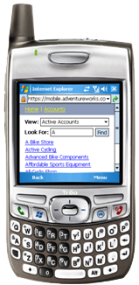
CRM Clients – Mobile Device
Windows Mobile Client
  Offline enabled
  Works with most Windows Mobile 2003+ Devices
  Uses the .NET Compact Framework
  Not able to support Form JScript events
Mobile Express Client
  Online only
  Works with any device with a HTML 4.0 compliant browser:
    Pocket PC
    BlackBerry
    Palm
    Many cell phones
  Open source,
  available and
  supported via CRM Sandbox
  OTB: Does not support Form JScript events
Notes:
From CRM 3.0.

Slide 8
The Evolution CRM
CRM v1.x and CRM 3.0

Slide 9
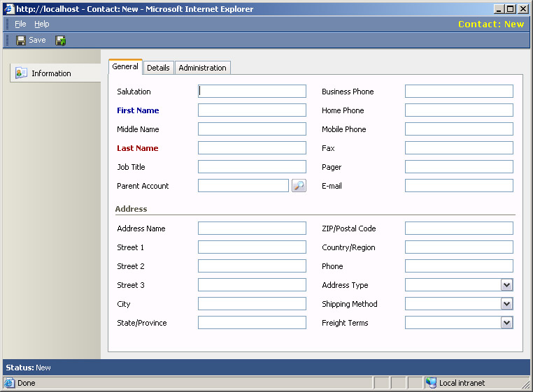
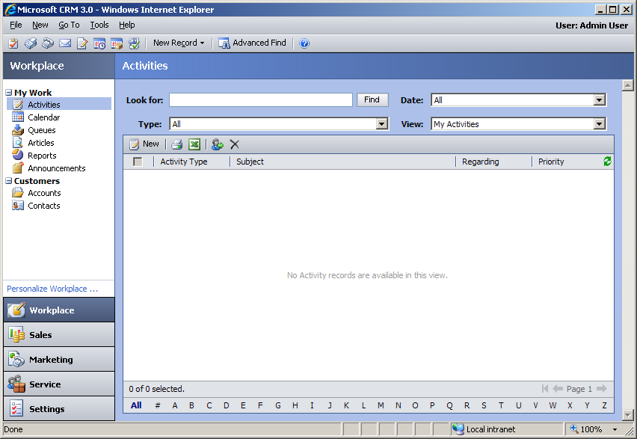
The Evolution of Microsoft CRM
CRM v1.0 (“Get it out”)
  Initial version
  Core features + SFA + CS
CRM v1.2 (“Refresh it”)
  Minor improvements
  Internationalization push
CRM v3.0 (“Getting it right”)
  Lots of new core features
  Focus on extensibility (Add Entity)
  Focus on user experience
  Service Management
  Marketing Automation
Notes:
The “history of CRM” in a single slide.
CRM v1.0 – Focused on core “CRM Scenarios”. Customer Service and Sales Force Automation.
CRM v1.2 – Was a generally minor update, a lot of work was done here for improved support of other languages and regions
CRM v3.0 – New UI, major updates to the Outlook client, added Marketing Automation, this was the version where CRM really took off in the market place.

Slide 10
What’s New
The Evolution Continues…

Slide 11
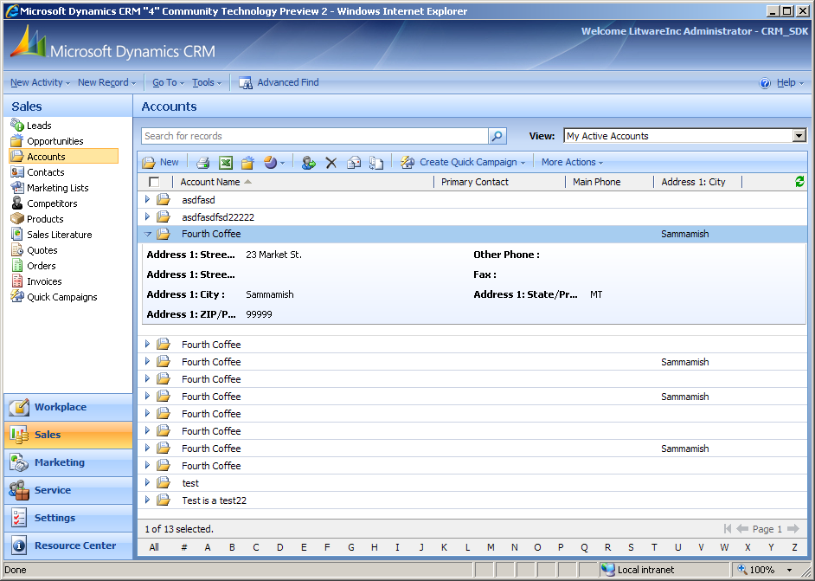
The Evolution Continues – 4.0
The Power of Choice
Duplicate Detection
The CRM 4.0 Multi-Plex
  Multi-Tenancy
  Multi-Lingual
  Multi-Currency
Expanded Relationships
Unified Event and Extensibility Model
  Workflow Changes
  Plug-ins (Previously known as “Callouts”)
Offline SDK
Notes:
The Power of Choice
Offering On-Premise, Partner Hosted, and CRM Online. You now have choices on how to deploy and how you will use CRM.
There have been investments in
With CRM “Online” CRM is re-architected on a multi-tenanted architecture, offering Software as a Service at Microsoft MSN Hosting for Online
There have been big investments on internationalization around Multi-Lingual User Interface, and Multi-Currency.
Many:Many relationships across standard and custom objects and are now available.
Multiple relationships between entities
Create new relationships between system entities
With 4.0, CRM is moving to a common workflow engine share with other Microsoft products and solutions called Windows Workflow Foundation (shipped with .NET 3.0 framework). Office 2007 and SharePoint also ship with this workflow engine. Opens opportunities for tighter integration between products
New Callout architecture now called Plug-ins. Plug-ins can be registered before or after built-in platform functionality (synchronously or asynchronously). Entity images come in the form of dynamic entity. Registration accomplished through SDK APIs and a sample tool
Offline capabilities, can still use CRM while disconnected through the new Offline SDK. You will see an example of this in the Hands on Labs, where we build a custom Timesheet entity, fill in the hours and can submit the Timesheet for the week while disconnected from the network and CRM in Outlook.

Slide 12
Dynamics CRM: The Power of Choice
Dynamics CRM
On-Premise
Online
Partner Hosted
Choose where:
  Outlook, browser, mobile
Choose how:
  Software or service
Choose when:
  Own it or rent it
Change your mind
any time
Shared code-based across versions, written with internet facing deployments in mind.
Notes:
Q&A – The shared code-base between versions enables all flavors of CRM to benefits from advances made in each version. Ex: Online requires faster and lighter-weight HTML for internet performance, the on-premise version benefits from this and WAN performance is improved.
See previous slide for talking points
Change your mind any time – It is planned that all customizations will be interchangeable from installation type to installation type. Some obvious exceptions include Workflows / Plug-ins (Callouts) that require code to execute; as the online version will not support running code on the server
However, all non-code workflows and schema customizations (forms, views, attributes, entities, relationships) as well as system settings etc, should be able to be simply exported from one and imported into another.

Slide 13

CRM Online vs. On-Premise
Microsoft Dynamics
CRM Online
Microsoft Dynamics
CRM On-Premise
Basic Customization
Create, rename, extend entities
Create, rename, extend entities
Client SDK: UI Extensions
IFRAME, ISV.Config & SiteMap
IFRAME, ISV.Config & SiteMap
Client SDK: Jscript Support
Onload, Onsave & Onchange
Onload, Onsave & Onchange
Authentication Support
Passport / Live ID
Active Directory
SDK: Web Services
CrmService, MetadataService
CrmDiscovery
CrmService, MetadataService
CrmDiscovery
SDK: .NET Plug-ins
Pre and Post – Sync and Async
SDK: Offline SDK
Enterprise Edition Only (No Plug-ins)
Full SDK and Plug-in Support
Workflow: Declarative
Web-based Designer Only
Web-based Designer
Workflow: .NET / Custom Activities
Full support
Reports: Custom Reports
Report Wizard Only
Report Wizard & Custom RDL
Import / Export Customizations
Schema, Workflows, Settings & More
Schema, Workflows, Settings & More

Slide 14
Partner Hosted vs. On-Premise
Microsoft Dynamics
CRM Partner Hosted
Microsoft Dynamics
CRM On-Premise
Basic Customization
Create, rename, extend entities
Create, rename, extend entities
Client SDK: UI Extensions
IFRAME, ISV.Config & SiteMap
IFRAME, ISV.Config & SiteMap
Client SDK: Jscript Support
Onload, Onsave & Onchange
Onload, Onsave & Onchange
Authentication Support
Active Directory / Form based
Active Directory
SDK: Web Services
CrmService, MetadataService
CrmDiscovery
CrmService, MetadataService
CrmDiscovery
SDK: .NET Plug-ins
Dependent on partner capabilities
Pre and Post – Sync and Async
SDK: Offline SDK
Dependent on partner capabilities
Full SDK and Plug-in Support
Workflow: Declarative
Web-based Designer
Web-based Designer
Workflow: .NET / Custom Activities
Dependent on partner capabilities
Full support
Reports: Custom Reports
Dependent on partner capabilities
Report Wizard & Custom RDL
Import / Export Customizations
Schema, Workflows, Settings & More
Schema, Workflows, Settings & More

Slide 15
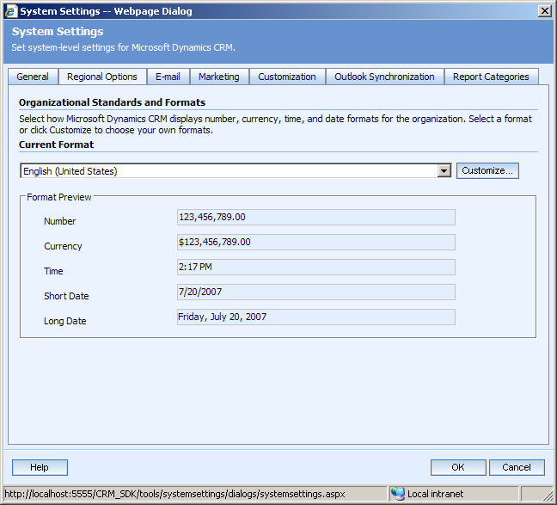
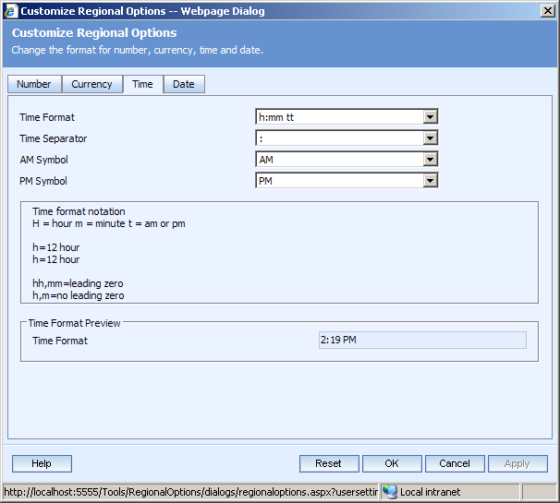
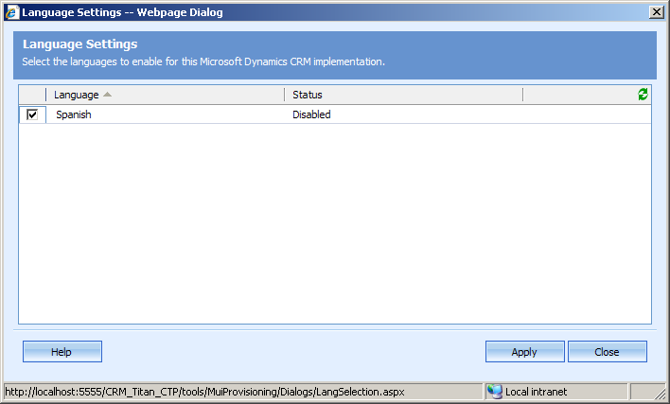
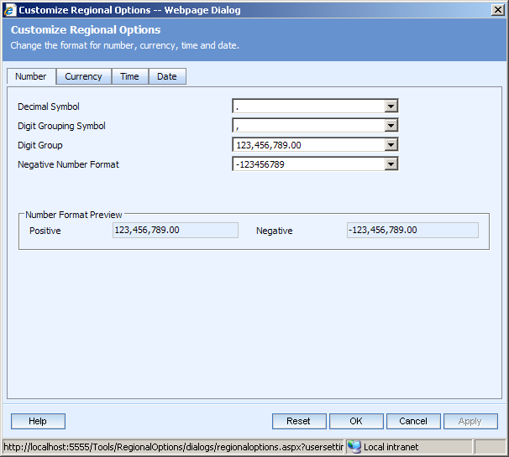
Multi-Language / Multi-Region Support
Multi-Language User Interface
Multi-Currency sales transactions
Regional and language based customization
IME Support
Notes:
Customizations are compatible across languages. You can make your customizations on a German version of CRM 4.0 and import them into an English version. If no English strings are provided in the customizations, labels (etc) will “default” to German.
User’s select their interface language via their personal user settings

Slide 16
Multi-Lingual Overview
Multiple Languages supported for a single CRM Organization.
Each Organization has a base language which is determined during install.
Additional MUI Packs can then be installed on the server and enabled per Organization.
If a localized string is not available, it will fall back to the installation language.
Help will be available in each language as part of the MUI pack
Notes:
Programmability
The metadata web service is multi-lingual aware. This provides ISVs with a mechanism to determine the multi-lingual string values used by CRM.
The regular CRM web service does have some Multi-Lingual support
Q&A: It is by design that each user can elect their language and that is not “automatically detected” by the computer they are logging in from.

Slide 17
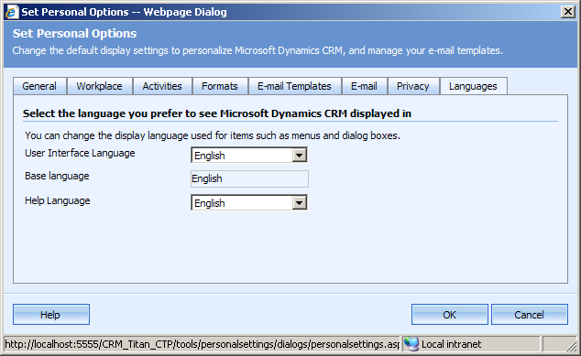
Multi-Lingual Overview
Reports and Templates will be assigned a language.
Customization is always performed in the Base Language. Modification of Translation strings will be performed with a separate translation editor.
Upgrade from CRM 3.0 to 4.0 is only supported within the same language.
Each user may select the
language that their UI and
Help pages are rendered in.
Notes:
Q&A: Upgrade must be done within their base language. So if you have Dutch CRM 3.0 install and want to upgrade to CRM 4.0 you will need the Dutch CRM 4.0.

Slide 18
Multi-Currency: Overview
Addition of new Currency entity
  Stores a single exchange rate between a Currency and the Base Currency.
  Currency entity will be a normal organization owned entity (Ex: It will be programmable).
All CrmMoney attributes will be multi-currency enabled
  Including ‘out of the box fields’ and custom attributes.
  Addition of three columns to an entity per money field: Currency, Conversion Rate and Base Currency.
  Upgrade will ‘convert’ (Ex: Add new fields) automatically.
  Each record instance stores its own “copy” of the transaction currency as well as the conversation rate to the base currency.
Notes:
Conversion from the Transactional Currency (ie. The number which users type in the form) to the Base Currency takes place at the point of update using the Conversion Rate found on the Currency Entity.
The Transactional Amount, Base Amount, Transactional Currency ID and Conversion rate are all stored on the entity record. If the base system conversation rate is updated it does NOT affect any existing “copies”. A workflow or set of plug-ins would have to be written to enable this business logic.
Note: Currency settings is per record and not per field.
Q&A: How does this work internaly?
Internally, the currency conversions are handled via a system-level plug-in.

Slide 19
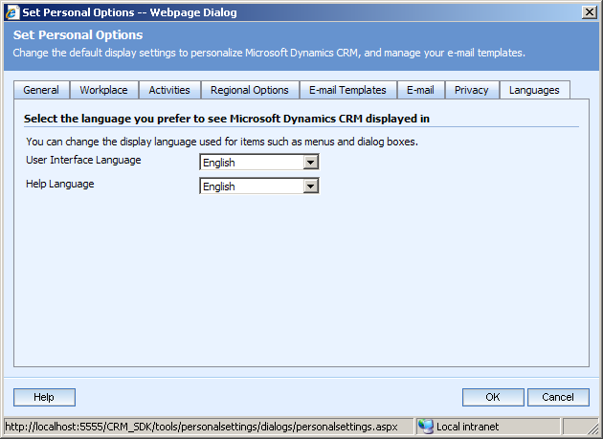
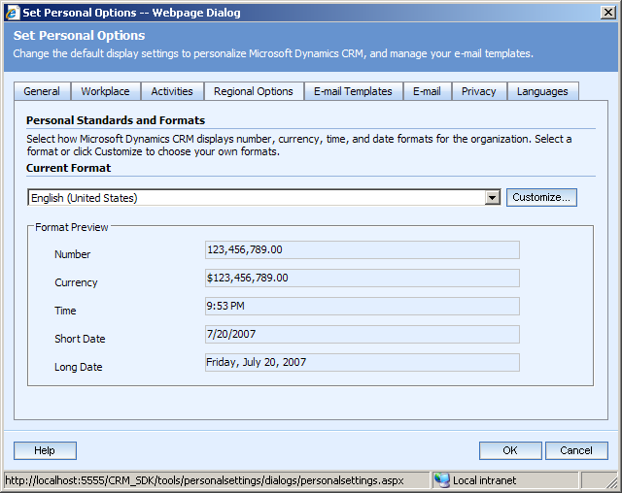
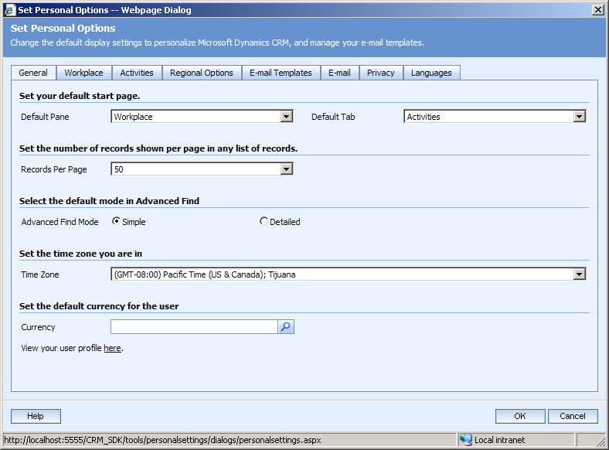
Multi-Plex User Options
Each user configures their desired organization, language, default currency, time zone and region settings (number / date formats) via Personal Options.
These settings will “roam” with them.
Notes:
Note: The Outlook client only supports a single Organization at time. Changing organizations requires a re-run of the client configuration tool.

Slide 20



















Scale up and out easily
Deployment Choice
Enhanced Architecture
Internet-scale performance
Enhanced
application &
platform
customization
Data lifecycle management
Organization-wide
Centralized CRM system
Example: ACME, Inc
Work Teams
Small collaboration groups
Example: ACME Account Team
Corporate Divisions
By geography and product line
Example: ACME European Operations
Work Departments
Line of business functions
Example: ACME Customer Service

Slide 21
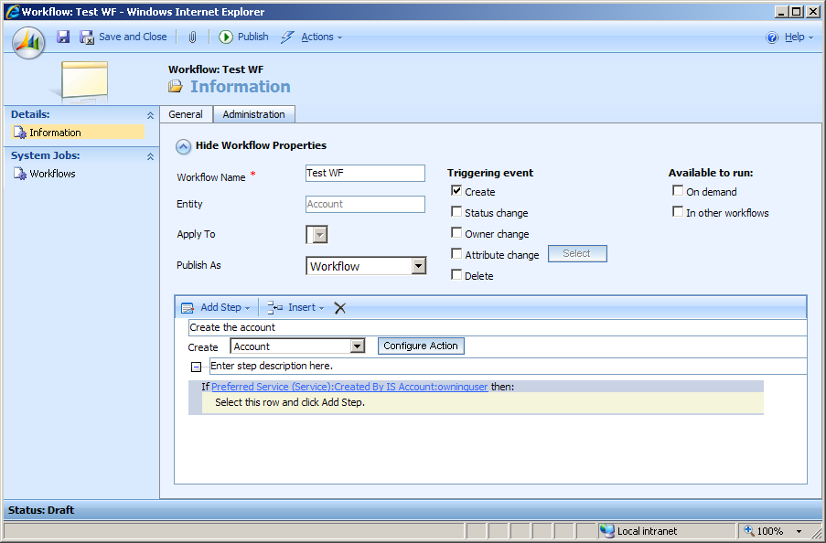
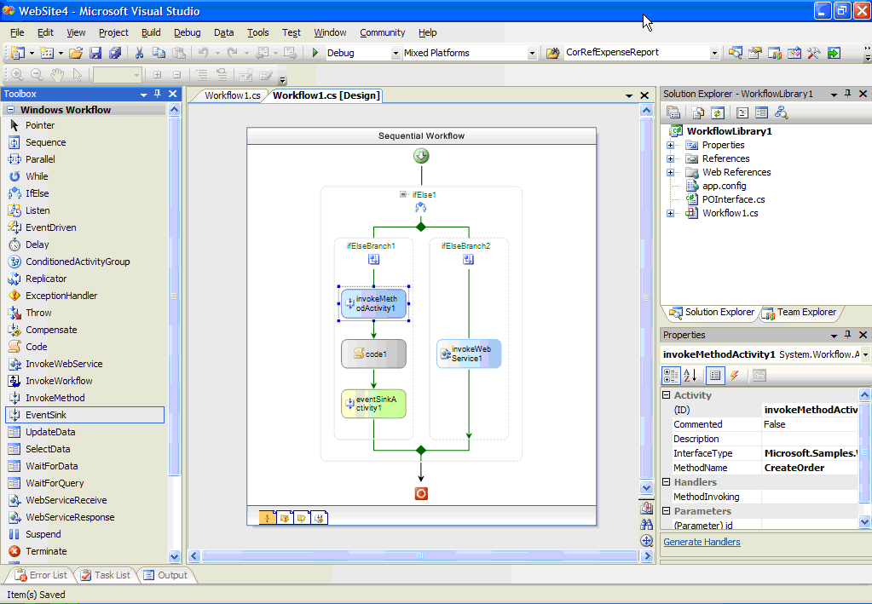
Built on the Microsoft Office Experience
UI updates bring enhanced end-user experience
Revolutionary Workflow
Enriched Reporting and Dashboards
Outlook, Excel and Word integration
Notes:
Microsoft CRM is designed to be familiar to users of Microsoft Office applications. This increases productivity and easy of use.

Slide 22
Workflow Changes
Windows Workflow Foundation(WF) integration with CRM platform
Shared event model
Targeting multiple personas from sales manager (web-based designer) to expert developer (custom activities)
Tight integration with other Microsoft products
Notes:
CRM Workflows are based on the Windows Workflow Foundation. The .NET 3.0 Framework is required to use the WF.
Why Windows Workflow Foundation
Generic workflow engine and services platform
Big Microsoft investment area
Highly adopted inside and outside of Microsoft
Great developer tools and productivity
Explicit and visible application logic
Modular development
Safe declarative execution in shared and CRM Online environments
Unified eventing across all the synchronous and asynchronous operations (callouts/plug-ins, workflow, bulk operations, bulk mail,etc)
Workflows can be built by a broad range of users from sales managers to expert developers, Workflows allow quick development of custom business logic with a consistent experience across other technologies and advanced scenarios with Visual Studio.

Slide 23


Rich Business Modeling
Enhanced application & platform customization
Many:Many relationships across standard and custom objects
Multiple relationships between entities
Create new relationships between system entities
Data modeling maps more closely to business realities
Powerful system workflow
New web-based workflow experience
Native Windows Workflow Foundation orchestration and monitoring
Scalable, reliable workflow service
Robust process automation across end-user applications
Regional and locale-based customization
Data object and form-based translation settings
Ability to import and export system-based translations per language
Personalized system settings across your global operations

Slide 24
Robust Developer Experience
Enhanced Event and Plug-in Infrastructure
Unified event pipeline
Streamlined plug-in registration and deployment
Offline system SDK
Leverage development investments across solutions
Deep Visual Studio Integration
Support for Windows Workflow Foundation
Enhanced programmatic management for metadata
Visual Studio Add-in for deployment of plug-ins
Improved developer productivity
Enhanced Smart Client Support
Full SDK available while offline
Option to automatically deploy registered assemblies
Deliver symmetric experience

Slide 25
Callout Changes, now Plug-ins
Callout – Shorthand for ‘Business Logic Extension’; a v3 extensibility feature whereby 3rd party code can be integrated synchronously within the platform
Plug-in – Mechanism for defining business logic; used to implement built in behavior as well as offer 3rd parties the ability to add their own functionality, synchronously or asynchronously
Notes:
Plug-ins can be registered before or after built-in platform functionality (synchronously or asynchronously.)
Plug-ins are stored in the database to enable automatic deployment across a cluster
Entity images come in the form of dynamic entity (in 3.0, this came in as Xml)
Registration accomplished through SDK APIs (there is also a Plug-in Registration Tool) you can use to register the plug-ins, this the method used in the Hands on Labs.
Supported plug-in events
Create / Retrieve / RetrieveMultiple / Update / Delete / SetState
Assign / Route
Merge
DeliverIncoming / DeliverPromote / Send

Slide 26
Offline API
Web service APIs in offline mode
Access to CRM data and major operations while CRM Outlook client is offline
Offline programmability for plug-ins and custom CRM code
Offline changes are automatically synced back when going online
The offline endpoint is 100% compatible with the online endpoint, although only a sub-set of classes will be available.
Notes:
The Offline capabilities of CRM 4.0 allow users to experience much of the same functionality of CRM connected or disconnected from the network. The Offline API allows users to perform the same actions they would do connected to the network as when they are disconnected. When the Outlook client is taken back online all changes are synchronized between the client and CRM server.

Slide 27
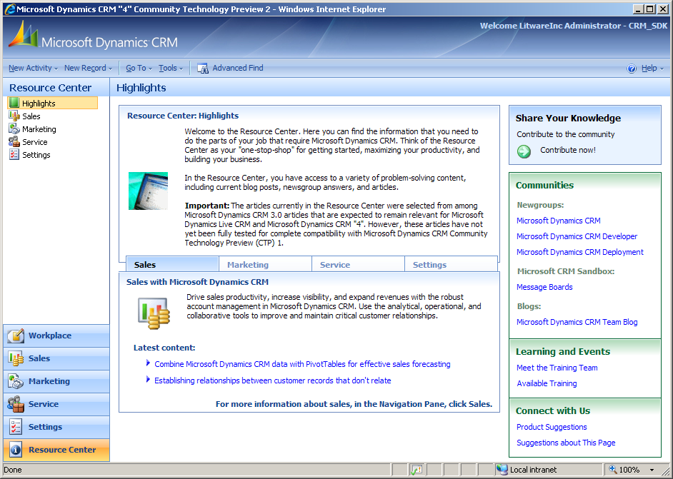
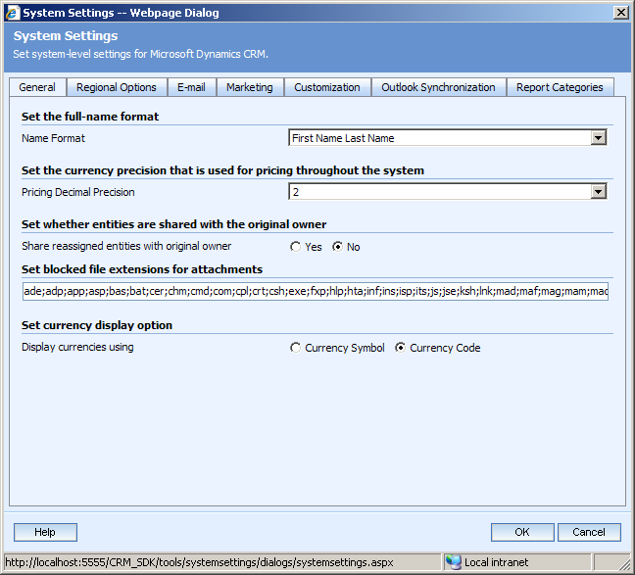
Application
Resource Center
Online help and
solution center.
  Continuously updating
  Language specific
  Can be disabled via SiteMap
Updated User Interface
More system settings moved to the application
New auto-complete support on Lookups
Notes:
New Interface – There will be a new Office 2007 / SharePoint 2007 like interface
IME - IME Support is required for East Asian languages. It lets you enter East Asian languages directly into the UI. Whenever a field that requires these characters is selected by a user and the field has IME enabled, the user is presented with an interface to enter the extended characters.
More Info: http://www.microsoft.com/windows/ie/ie6/downloads/recommended/ime/default.mspx

Slide 28
Setup
Getting CRM installed

Slide 29
Basic Features
Scriptable via command-line arguments and a installation XML file
Supports both repairing an installation and uninstalling it
Uninstalling CRM does not remove the databases
Prerequisite checks
Includes the Environment Diagnostic Wizard (EDW)
  Tests the environment and user input for the most common problems that might occur during setup
  New feature in CRM 3.0 and greatly reduced setup issues and support calls

Slide 30
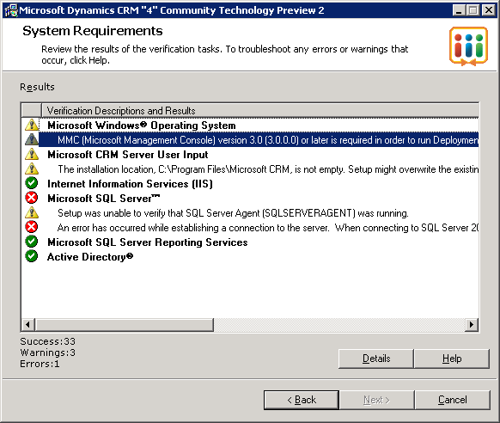
Environment Diagnostic Wizard
Improved in CRM 4.0
Updated to test for more scenarios and technologies

Slide 31













Server Support
Windows Server
SQL Server
Exchange
Platform and Tools
Notes:
Note: SQL Server 2008 “Katmai” support may not be available until after RTM and Update Rollup #1 for CRM is released

Slide 32









Client Support
Windows Client
Office
Web Client
Platform and Database
Notes:
Bandwidth requirement (128 Kbps DSL line)
Drop Office 2000 and XP
No MSDE 2000

Slide 33
64-Bit Support
Server
  32-Bit and 64-Bit Support for both Database and Application Servers
Client
  Supported under 64-Bit Vista using WOW64

Slide 34
Server Setup
Installing the server

Slide 35
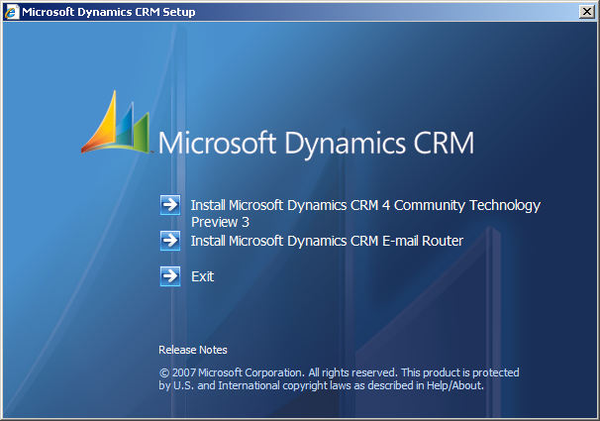
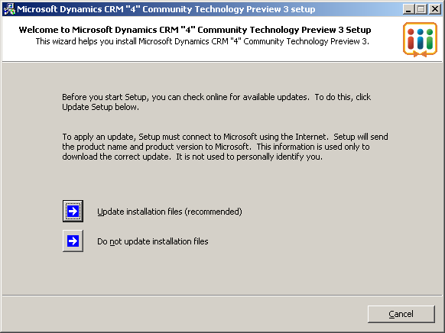
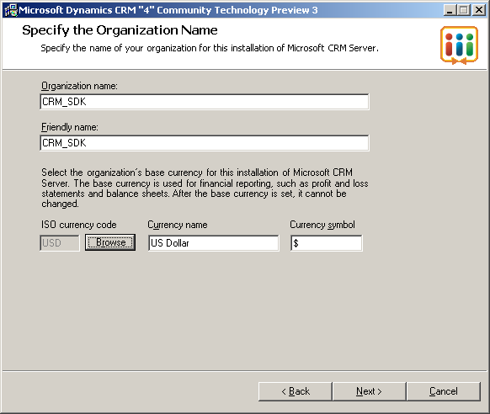
What’s New – Server Setup
Pre-installation Hot fix Support
  Setup can now update itself prior to running
  This prevents the need for re-releases and allows for slip-streaming of roll ups.
Default organization currency configuration
Simplified licensing
  Single key license
  Pre-keyed media available
Notes:
Single Key Mechanism:
There is no need to enter several, cumulative license keys.
Pre-PID:
For volume-licensed SKUs, the distribution media will be pre-PID-ed with right license key.
Server setup will pickup this key automatically.
Simpler UI and license agreement selection.

Slide 36
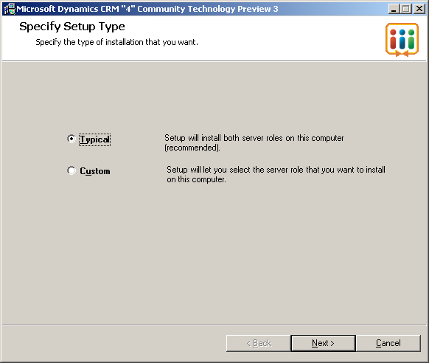
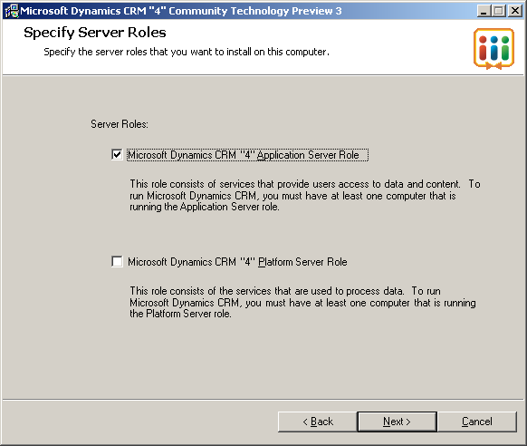
What’s New – Server Setup
Server Role Support
  Application Only
  Platform Only
“Typical” installs both
platform and application
on the same server
Setup can now be run off of network shares.
Notes:
In CRM 3.0 there we several none issues that could prevent Server Setup from being run from a network shares. This is now fixed.
The new server “role” feature allows for a wide range of possible and scalable installations. Dedicated servers can be configured to just run the CRM Platform, while others handle the application.

Slide 37
Scaling CRM Deployments
Server Roles and more…

Slide 38
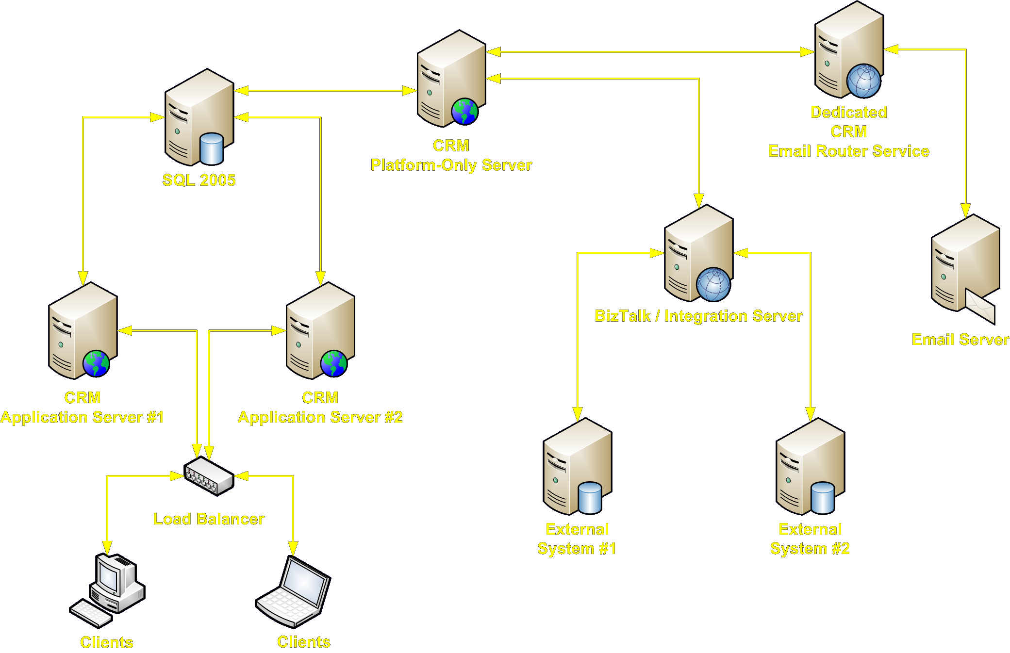
Server Roles
Enable a range of scalable configurations

Slide 39
Server Roles
Server Roles provide:
  Scaling
  Reliability
  Performance
Role-based and Service-based deployments
The CRM Asynchronous Service can be spread across any number of servers and as such asynchronous plug-ins and workflows can easily scaled horizontally.
Notes:
Takeaway: Server Roles provide greater scalability, reliability and performance.
For larger CRM deployments, server concerns can now be separated across different machines.
Modeled loosely on Exchange Server Roles.
Clustering of machines is supported. (Performance + Reliability)
Role-based clustering can be done via the UI.
Service-based clustering can be done via the configuration file.
You need at least one of each to have a complete, fully-functional CRM deployment!
Want to separate CRM server concerns across machines? Now you can!
Clustering of roles is also supported

Slide 40

Server Roles
Application Server
Platform Server
Web Application Service
Help Content Service
SDK Service
Asynchronous Service
Discovery Service
Deployment Service
Notes:
Via the setup UI, you can pick “Application” or “Platform” Roles. Via the Setup Config XML file, you can be vary granular and for example, have a dedicated “Help Content Server”.

Slide 41
Client Setup
Installing the Outlook Client

Slide 42
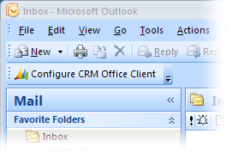
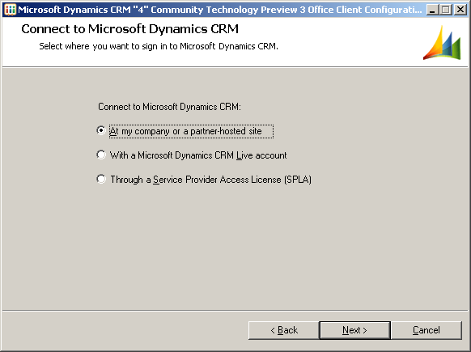
What’s New – Client Setup
Installation is significantly faster as the installation and configuration are now two separate steps
Once the client is installed on the machine, different users can “configure” their copy.
Users can re-configure
their client at any point
in the future
Support for on-premise,
online and SPLA hosted

Slide 43
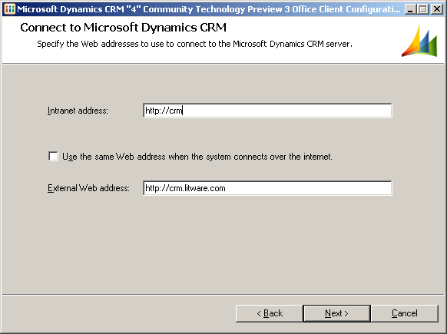
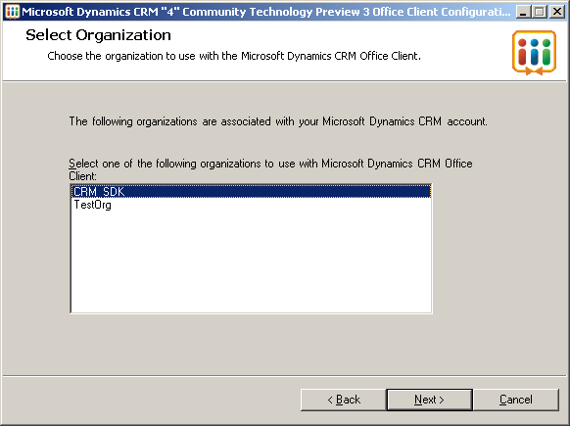
What’s New – Outlook Client Setup
New “internal” and
“external” connection
URLs
Multi-org aware (connect
to one)
Check for updates
Configuring the client is now separate from setup and is used to “connect” the user’s client to a CRM installation and organization.

Slide 44
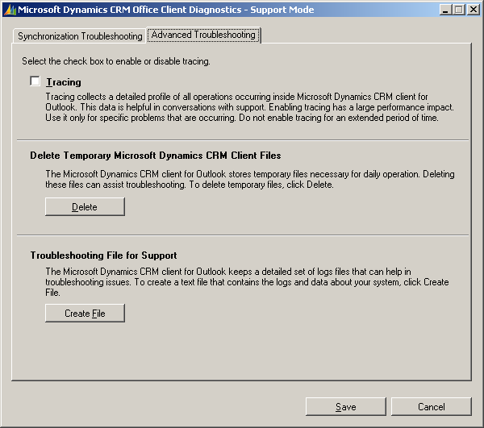
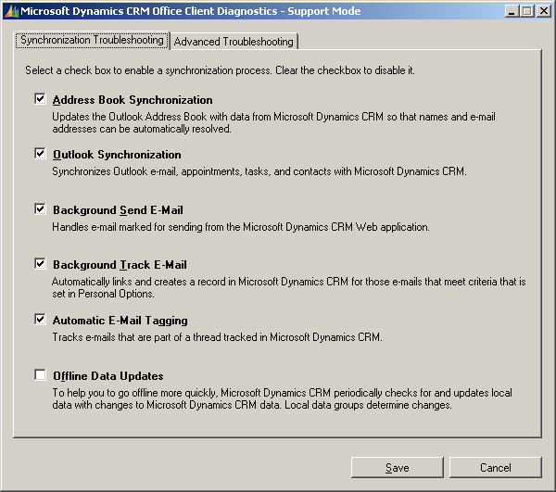
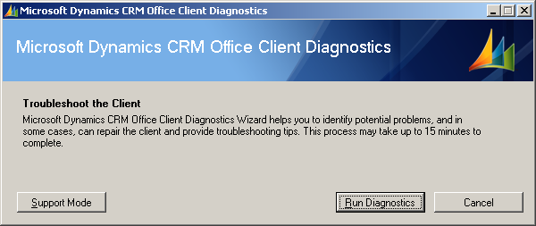
Client Setup
New “Client Diagnostic Wizard” that can be used to find and fix common issues
Also useful when calling support, allows easy enabling of tracing plus the creation of “Troubleshooting File” that can be used by Microsoft support.

Slide 45
Client Setup
The Outlook client also now supports an “automatic update”, which can deploy rollups and hot fixes automatically.
This can be disabled if required via the following registry key:
HKLM\Software\Microsoft\MSCRMClient\AutoUpdateDisabled DWORD 1 (to disable)

Slide 46
Basic Customizations
Customizing CRM…

Slide 47
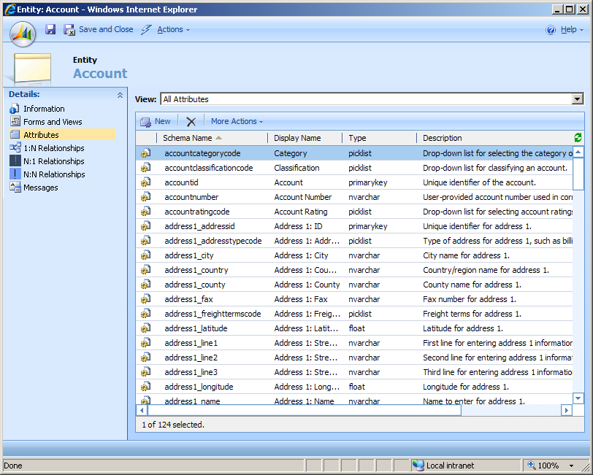
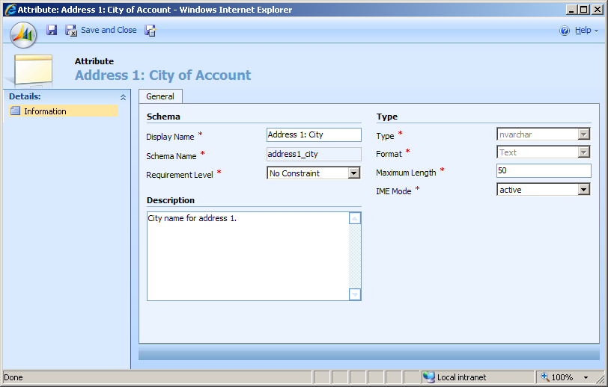
Customizations – Schema Changes
All “customizable” and “custom” entities support schema customizations
You can add, remove and manage your own attributes
Supported Types:
NVarChar, Picklist, Bit,
Integer, Float, Money,
NText, Datetime, Lookup
via relationships)
Schema changes
happen right-away,
there is no need to
“Publish”.
Notes:
Q&A: There are no plans to add “versioning” to customizations
Q&A: The schema is changing from CRM 3.0 to CRM 4.0, so you will not be able to simply import 3.0 customizations into 4.0. Upgrade however will upgrade all supported customizations.
Q&A: Picklists should not have more than 1000 attributes. With CRM 4.0, it is expected that users will use Lookups more than Picklists. Lookups now have an “auto-complete” feature, which makes them a lot easier to use than CRM 3.0. In addition, using roles you can lock-down the ability to create Lookup related entities if needed.
General CRM Knowledge Review
There are only a handful of entities that are not customizable. Think system-level entities like Workflow Process and License
You can add your own entities, but cannot add new Activity types
Changes to the schema happen right-away, end users won’t see the changes (except for delete) until you make the changes visible via the Form or a View
Generally speaking, changes can be made while the system is in use, although it is a good idea to get users off the system
Note, the schema name of an attribute cannot be changed
Under the covers:
All custom attributes are stored in the EntityNameExtensionBase table.
All system attributes are stored in the EntityNameBase table
Remind the audience that since CRM is 100% metadata-driven, the underlying schema is not important, it always appears as one entity via the SDK, UI and Filtered Views
The Filtered Views are automatically updated by the system

Slide 48
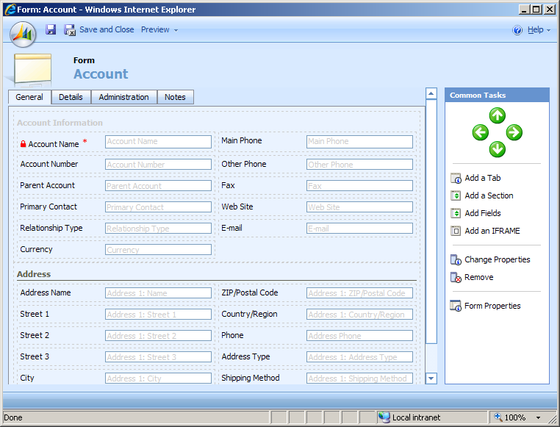
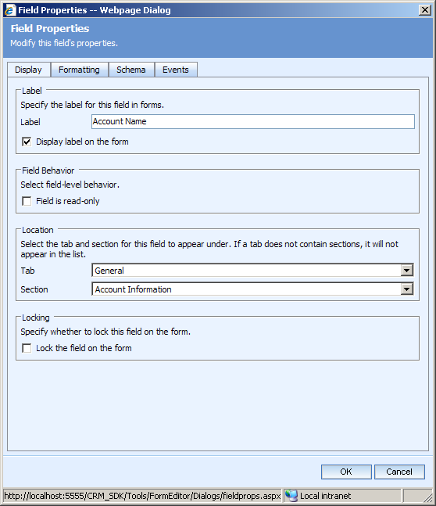
Customizations – Form Design
All Form customizations are done
via the Form Editor
Add / Remove / Modify:
  Tabs
  Sections
  Available Fields
  Client-Side Events
Change the Form Layout
Enable / Disable the Form
Assistant (New in CRM 4.0)
Changes are not seen by users
until they are “Published”
Notes:
General CRM Knowledge Review
Explain the different form types and how all forms are derived from one layout (Create, Update, Read-Only, Disabled, Bulk Edit and Quick Create)
Quick Create only shows “Required” and “Recommended” fields
Form changes need to be published, this means you can make changes while the system is “live”, test them using the “Preview” feature and only publish them when ready
Editing of the Previews is done very much the same as the Forms

Slide 49
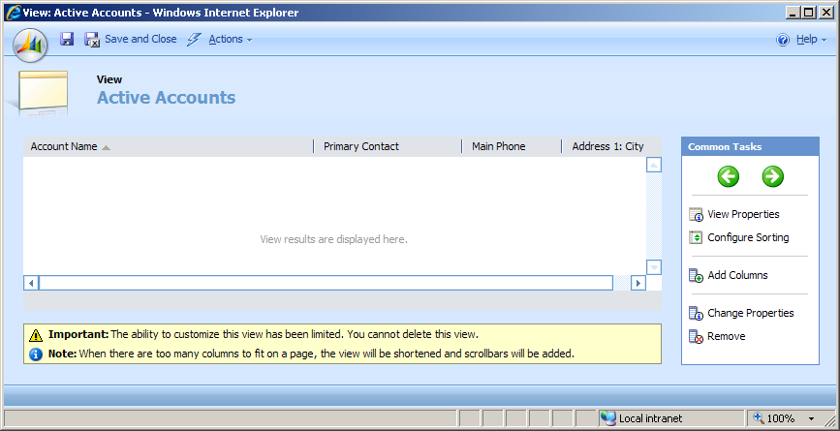
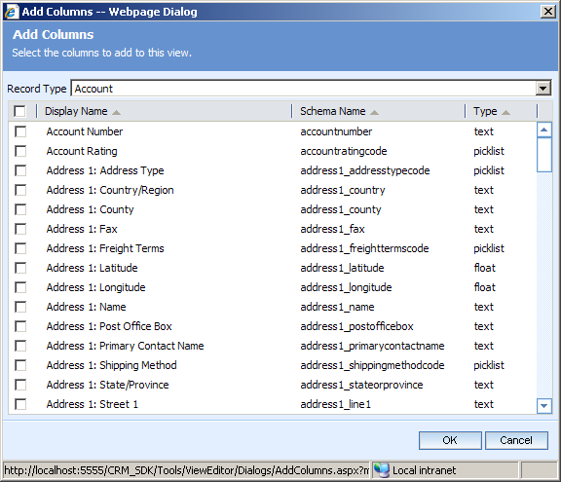
Customizations – View Design
A View represents the layout and query behind a grid.
System Views, are designed by administers or ship with Microsoft CRM
User Views are designed
by and shared amongst users
The View Editor enables:
  Adding / removing columns
  Defining the query
  Define Sort Order
  Defined column widths
Changes to System Views are
only visible after they are “Published”
Grids can now display data from more than one entity (TAP3)
Notes:
General CRM Knowledge Review
User’s can define and share their own views via Advanced Find

Slide 50
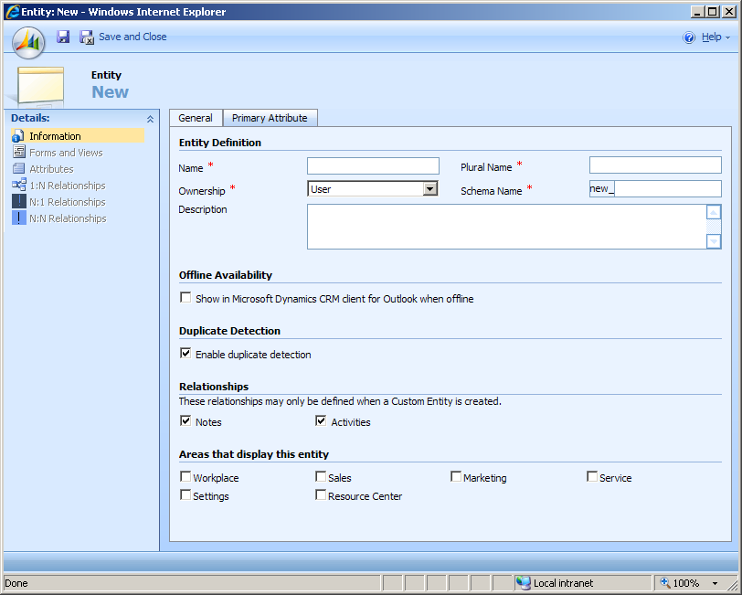
Customizations – Add Entity
Enables endless business scenarios
A custom entity could represent anything.
Example: Project, Marketing Event, Work Item, Bug, etc.
You define:
  Entity Name
  Offline availability
  Permissions
  Duplicate Detection
  Ownership (User vs. Org)
  Note / Activity support
  Schema
  Icons
Notes:
Q&A: CRM 4.0 will have published “supported” limits on the number of entities you can create. This number is expected to be measured in the hundreds.
You cannot add new Activity types
Suggested workaround: Rename a rarely used Activity Type, like “Fax” or “Letter”
When you add an entity, by default all Roles have NO access
The schema name of an entity cannot be changed
The “Areas that display this entity” – Automatically generates SiteMap XML – This can be changed later

Slide 51
Customizations – Delete Entity
Results in:
  Loss of all data stored in instances
  Deletion of all relationships
  Deletion of all Activities and Notes
Entity cannot be deleted if another entity references it
  When the entity is the primary entity in a relationship, the related entity may have a lookup field to store a link to the custom entity
  The lookup field must be removed from the published related entity form before you can delete the custom entity
Notes:
Note – There is no “undo”

Slide 52
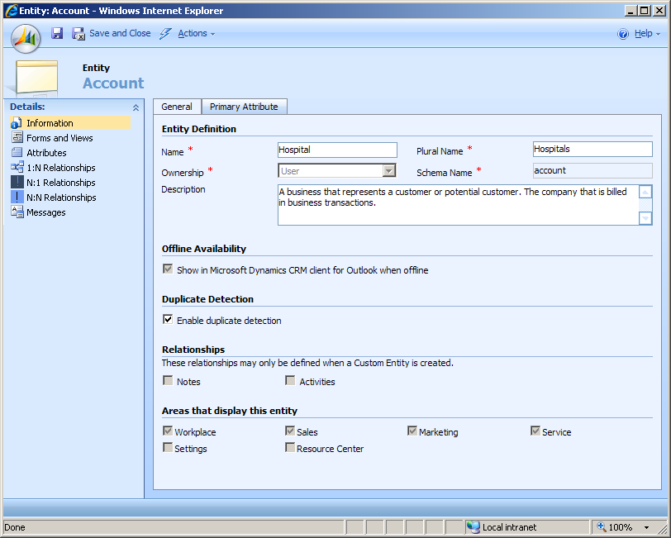
Customization – Rename Entity
Entities and easily be renamed
You define both the singular and plural names
Entity names must be unique
within the system
Renaming is done via
the Web Client
Example:
A healthcare provider
may want to rename
“Account” to “Hospital”
and “Contact” to “Patient”
Notes:
The unique name requirement sometimes becomes a problem. Customers often want to rename Accounts to “Business” or “Organization” both of which are reserved because they are used by the system.
When you rename an entity, you also have to be mindful of renaming the entity’s resources (also done via the Web Client). The resources are strings that are displayed to the user on dialogs or error messages. The reason the rename doesn’t automatically fix these is that the grammar does not always directly translate within the context of the sentence presented to the user.
Resource customizations are exportable and importable
Customizers will also need to update the Help table of contents (TOC) and documents. This is a simply XML / HTML editing processes and is documented in the SDK.

Slide 53
Demo
Basic Customizations

Slide 54
Customization Portability
Design, develop and test customizations in one environment and easily export and them import them into another.
Export / Import between Online, Hosted and On Premise
API support to enable programmatic customizations. Useful for plug-in setups.
The following customizations are exportable:
  Entity customizations (Custom and system)
  Email, KB and Contract Templates
  Relationship Roles
  Roles (New)
  Entity relationships and behavior
  Schema changes
  Entity renames
  Workflows (New)
  System Settings (New)
Notes:
Customizations are intended to exported and imported between versions (online, on-premise, hosted)
All customizations are exported to an XML file – “customizations.xml”
Q&A: There have been no changes to the granularity of import/export. It is still on a per entity basis.
Q&A: Plugins, Reports and Duplicate Detection features will not be importable or exportable

Slide 55
Demo
Import / Export of Customizations

Slide 56
What are we going to build in the labs?
Professional Service department for Trey Research
Manage company’s projects and time keeping
Labs will build out a complete CRM Solution
  Multiple Organization Support
  Custom Workflows
  Plug-Ins
  Reporting
  Offline SDK
  Business Intelligence using a cube
  Metadata API’s
  Office and SharePoint 2007 Integration

Slide 57
Lab - Overview
In this lab you will:
  Create Project, Work Item and Timesheet Entities
  Define attributes of these entities
  Test your work
Finished Early? Already done this lab?
  Try the new auto-complete on lookup fields. Create a few Accounts, on your 2nd account create and use the auto-complete lookup to set the Parent Account to the 1st account you created.
  Try creating additional entities and have fun exploring the other areas of CRM 4.0.

Slide 58

© 2008 Microsoft Corporation. All rights reserved.
This presentation is for informational purposes only. Microsoft makes no warranties, express or implied, in this summary.

