Slide 1
Windows Application Compatibility
Microsoft Technology Center
© 2007 Microsoft Corporation. All rights reserved. Microsoft, Windows, Windows Vista and other product names are or may be registered trademarks and/or trademarks in the U.S. and/or other countries.
The information herein is for informational purposes only and represents the current view of Microsoft Corporation as of the date of this presentation. Because Microsoft must respond to changing market conditions, it should not be interpreted to be a commitment on the part of Microsoft, and Microsoft cannot guarantee the accuracy of any information provided after the date of this presentation.
MICROSOFT MAKES NO WARRANTIES, EXPRESS, IMPLIED OR STATUTORY, AS TO THE INFORMATION IN THIS PRESENTATION.

Slide 2
Topics
Common Windows™ Operating System Application Compatibility Issues
  User Account Control (UAC)
    Mandatory Integrity Control, Internet Explorer: Protected Mode
  Installation
  Service Isolation
  Miscellaneous
    User Interface, Networking
Specific Windows™ Server 2008 Compatibility Issues
  IIS, RODC, Windows Core
Logo Certification and “Works with”

Slide 3
Why User Account Control?
At risk from malware when running as administrator.
Misplaced Administrator checks in Windows XP that needed to get fixed.
Enterprises realize significant TCO reductions when running with managed systems.

Slide 4
Windows UAC Overview
All users run as Standard User by default
  Filtered token created during logon
    Only specially marked applications get the unfiltered token
Explicit consent required for elevation
  Predictable shell elevation paths
High application compatibility
  Data redirection
    Enabling legacy applications to run as standard user
  Installer Detection

Slide 5









UAC Architecture
Standard User Rights
Administrative Rights
Admin logon
Abby
Admin Token
“Standard User” Token

Slide 6

UAC Architecture
Standard User Rights
Administrative Rights
Standard User Mode
Standard User Privilege
Change Time Zone
Run IT Approved Applications
Install Fonts
Install Printers
Run MSN Messenger
Etc.
Abby
User Process

Slide 7

UAC Architecture
Standard User Rights
Administrative Rights
Admin Privileges
Standard User Privilege
Admin Privilege
Change Time
Change Time Zone
Run IT Approved Applications
Install Fonts
Install Printers
Run MSN Messenger
Etc.
Admin Process
Admin Privilege
Configure IIS
Admin Process
Abby
Install Application
Admin Privilege
User Process
Admin Process

Slide 8
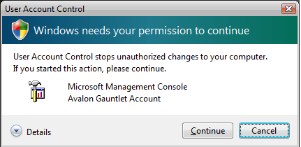
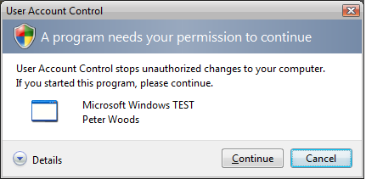
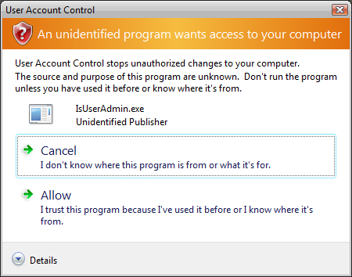
Consent User Interface
Notes:
1/31/2008 12:25 PM
8
©2005 Microsoft Corporation. All rights reserved.
This presentation is for informational purposes only. Microsoft makes no warranties, express or implied, in this summary.

Slide 9
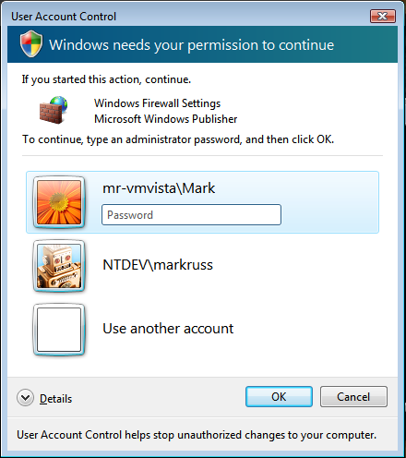
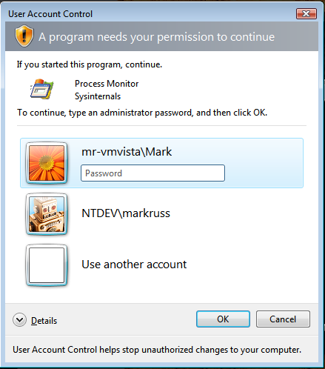
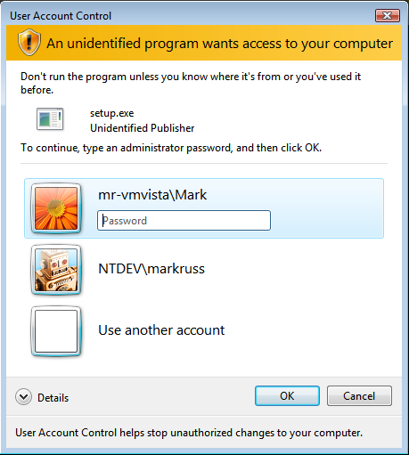
UAC: Elevation Prompt Dialogs

Slide 10

UX Goals: Simple & Predictable
1st Choice: Make application run as Standard User only
2nd Choice: Clearly identify Administrative tasks
  Ensure Standard users can be fully productive
  Identify tasks that need elevation with a “shield”

Slide 11
UX: The Shield
Attached to controls which, if clicked, will require elevation as the next step
Has only one state (i.e. no hover, disabled etc.)
Does not remember elevated state
  Not an unlock operation
Send the BCM_SETSHIELD message to a button control, using SendMessage
  Button.FlatStyle has to be set to System

Slide 12
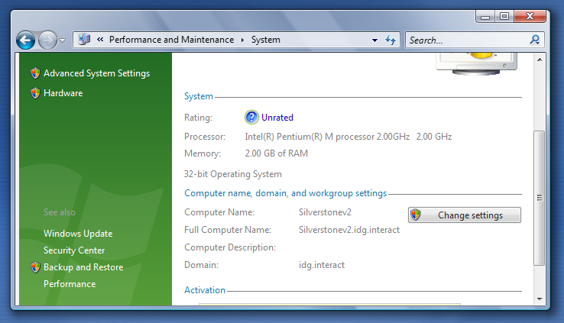

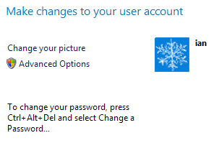
Security Shield UI Examples

Slide 13
UAC Mitigations For Legacy Apps
Non Windows Vista / Windows Server 2008-aware applications (legacy) will get:
Installer Detection
Data Redirection

Slide 14
Installer Detection
Without this, almost all custom (non-MSI) legacy installations would fail
Heuristics: look for Setup, Install, Update, etc.
Looks in binary name and resources
Auto adds shield icon when detected
Elevated when launched

Slide 15
Data Redirection
Legacy apps write to admin locations
  HKLM\Software;
  %SystemDrive%\Program Files
  %WinDir%\System32
Redirected to:
  %LocalAppData%\VirtualStore\
  HKCU\Software\Classes\VirtualStore
Redirection removes need for elevation
  Writes to HKLM go to HKCU redirected store
  Writes to system directories redirected to per-user store
  Copy-on-write
This is a crutch for legacy applications.

Slide 16

Windows Vista / Windows Server 2008-Aware Your Application
Makes use of manifest file or section
Manifest is already used for SxS configuration
Two choices:
  External: MyAdminApp.exe.manifest next to binary
  Internal: link in with MT.exe or thru VS
Priority
  Windows Vista / Windows Server 2008: internal overrides external
  Pre –Windows Vista / Windows Server 2008: external overrides internal manifest
Add a <trustInfo> section to your manifest to make it Windows Vista-aware
Notes:
16

Slide 17

Sample Manifest
<?xml version="1.0" encoding="UTF-8" standalone="yes"?>
<assembly xmlns="urn:schemas-microsoft-com:asm.v1" manifestVersion="1.0">
<assemblyIdentity version="1.0.0.0" processorArchitecture="X86“
name="MyAdminApp" type="win32"/>
<!-- Identify the application security requirements. -->
<trustInfo xmlns="urn:schemas-microsoft-com:asm.v3">
<security>
<requestedPrivileges>
<requestedExecutionLevel level="requireAdministrator"/>
</requestedPrivileges>
</security>
</trustInfo>
</assembly>
Notes:
17

Slide 18
RequestedExecutionLevel
RequestedExecutionLevels
  Level = asInvoker
    Launch with the same token as the parent process
  Level = highestAvailable
    Launch with the highest token this user possesses
  Level = requireAdministrator
    Highest token of the User provided User is a member of Administrators group
Windows XP SP2 Blue Screen Issue…
  http://support.microsoft.com/Default.aspx?kbid=921337
Notes:
18

Slide 19
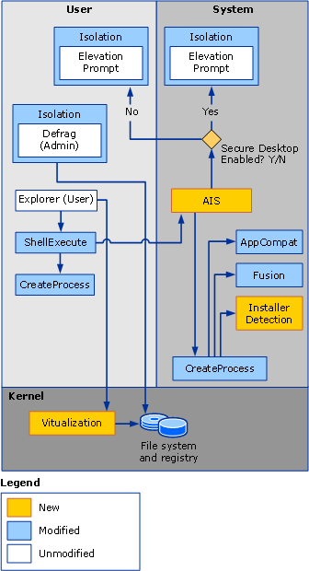
UAC Architecture
Elevating User Launch Path (Reference)
  ShellExecute() calls CreateProcess().
  CreateProcess() calls AppCompat, Fusion, and Installer Detection to assess requestedExecutionLevel
  CreateProcess() returns a Win32 error code ERROR_ELEVATION_REQUIRED.
  Receiving it, ShellExecute() calls (AIS)
  AIS re-evaluates the requested execution level and Group Policy
  If elevation required, service launches the elevation prompt
  After consent or valid credentials, AIS retrieves appropriate access token, if necessary.
  AIS re-issues a CreateProcessAsUser() call, supplying the token and specifying the caller’s interactive desktop.
Key Points:
  Elevation happens per process
  One process = one elevation level
  Immutable for life of process
  Process creation API choice important

Slide 20
Mandatory Integrity Control (MIC)
Traditional NT security model revolves around process token
Windows Vista / Windows Server 2008 enhances this with MIC:
  Each process gets a MIC level
  All resources get a MIC level (medium is default)
There are four commonly-used pre-defined levels
  0: Low
  1: Medium
  2: High
  3: System
Notes:
MIC: One purpose of MIC is to help protect elevated/system processes. Another is to prevent untrusted applications from writing to more-trusted locations or interfering with more-trusted applications. Most users should not have elevated/admin apps running on their desktops, but most WILL be running Protected Mode IE.

Slide 21
MIC: Process Isolation
Administrative and Standard User applications share the same desktop
  Primary threats
    Cross-process Window messages (Shatter Attack)
    DLL injection and create remote thread
  Process Isolation mechanisms
    Integrity level for processes
    User Interface privilege isolation
  “Lower” cannot interfere with “Higher”

Slide 22
MIC and Resources
www.sysinternals.com tool “accesschck –i” shows access levels on files and other resources
Services, registry, COM components all get MIC level
Potected Mode Internet Explorer (PMIE) currently only application that has a MIC level of Low
Internet Explorer resources that PMIE needs to WRITE to need to have a MIC level of Low as well.
Resources medium by default in Windows Vista / Windows Server 2008
Generally “write-up” is blocked for files; “read-up” still allowed.
Read-up blocked if resource is a process

Slide 23
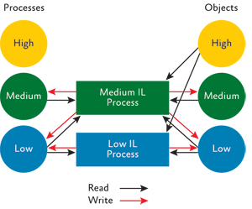
MIC and Securable Objects

Slide 24
Internet Explorer Protected Mode
Internet Explorer runs with low permissions (low MIC)
Internet Explorer cannot even modify user files, registry keys
File/registry writes are redirected, visible from Internet Explorer only. Different than UAC virtualization
Windows Messaging blocked to non-low IL
Issues
  Controls that share data with external processes fail
  New prompts requesting user permission interaction may impact some apps
Mitigations
  Add the site to the trusted sites list (turns off protected mode)
Surprising twists
  Creating an OOP COM component from IE fails

Slide 25
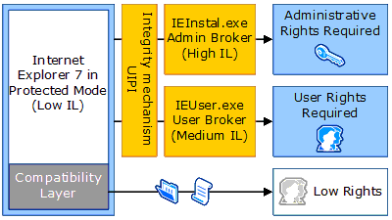
Internet Explorer – Protected Mode
  Resource:
  Understanding and Working in Protected Mode Internet Explorer…
Notes:
1/31/2008 12:25 PM
25
© 2005 Microsoft Corporation. All rights reserved.
This presentation is for informational purposes only. Microsoft makes no warranties, express or implied, in this summary.

Slide 26
Separation of Admin Code
Cannot elevate a running process
Three Design Patterns
  Creation of an Administrator COM object to perform elevated task.
    COM Elevation Moniker
  Side by Side Processes
    Shared memory
    RPC
  Service Broker Model (no consent dialog)
    RPC, named pipes, etc

Slide 27
UAC Impact Summary
Fails on Windows Server 2003 as Standard User?
  Mitigated by Redirection
  Simple app with Admin dependencies: split up.
  Admin app on Windows Server 2003: Needs to be manifested
  Web apps need special attention due to Protected Mode Internet Explorer
Use:
  Standard User Analyzer
  ProcMon
  ProcExp

Slide 28
UAC FAQ
If I mark my app as “admin”, can I skip the elevation consent dialog?
No
Can you modify the privilege of a running application?
No
Will UAC elevate whenever a privileged API is used?
No, the entire process is either elevated or not
How about command line tools?
Guidance is to mark them asInvoker
How long does the elevated process last? Can it time out?
Until the process ends – it does not time out
Can I enable which users will use UAC?
Currently this is a per machine setting
Does UAC apply to all processes and services?
It applies to any interactive login (services and scheduled tasks non-interactive)
What areas of the Registry and File system get redirected? HKLM\Software, %SystemRoot%, %ProgramFiles%, %ProgramData%
Won’t Redirection de-motivate developers to fix their code?
Yes, it is a short term mitigation (not in 64bit)
What happens when installer detection fails?
The app runs as non-admin
Will UAC be going down-level?
No

Slide 29
UAC Resources
General Security Information http://msdn.microsoft.com/windowsvista/security/
Getting Started with UAC: http://www.microsoft.com/technet/windowsvista/evaluate/feat/uaprot.mspx
UAC Developer Guidelines: http://msdn2.microsoft.com/en-us/library/aa480150.aspx http://msdn.microsoft.com/library/?url=/library/en-us/UxGuide/UXGuide/Home.asp?frame=true
UAC Question on Update: http://forums.microsoft.com/msdn/showpost.aspx?postid=111453&siteid=1
Windows Vista Developer Story Series http://msdn2.microsoft.com/en-us/library/bb188741.aspx
Windows Security Blog http://blogs.msdn.com/windowsvistasecurity/
Notes:
1/31/2008 12:25 PM
29
© 2006 Microsoft Corporation. All rights reserved. Microsoft, Windows, Windows Vista and other product names are or may be registered trademarks and/or trademarks in the U.S. and/or other countries.
The information herein is for informational purposes only and represents the current view of Microsoft Corporation as of the date of this presentation. Because Microsoft must respond to changing market conditions, it should not be interpreted to be a commitment on the part of Microsoft, and Microsoft cannot guarantee the accuracy of any information provided after the date of this presentation.
MICROSOFT MAKES NO WARRANTIES, EXPRESS, IMPLIED OR STATUTORY, AS TO THE INFORMATION IN THIS PRESENTATION.

Slide 30
Topics
Common Windows Application Compatibility Issues
  User Account Control (UAC)
    Mandatory Integrity Control, Internet Explorer– Protected Mode
  Installation
  Service Isolation
  Miscellaneous
    User Interface, Networking
Specific Windows Server 2008 Compatibility Issues
  IIS, RODC, Core
Logo Certification and “Works with”

Slide 31
Installation and Updating
Installer Detection
User initiates
install
System identifies application as installer?
App proceeds as SU
No mitigation
Follow manifest
Yes
Manifest
RunLevel?
No
No
Yes
Prompt for elevation
Install Launches
Preferences Entered

Slide 32
Installation and Updating
MSI has a service which controls its own elevation for setups
Elevation prompt after the user enters installation preferences not on launch
  Better overall experience
  Allows for per-user installation scenarios
  Greater security as the user has more information about the installation pre-elevation
MSI is a requirement for Windows Vista / Windows Server 2008 Logo Certification
Integrates with other platform technologies (e.g. Restart Manager)
MSI allows for updates without requiring elevation for signed patches
  MsiPatchCertificate table in original MSI

Slide 33
MSI and UAC Interoperation
Basic Windows Installer Architecture
Client – run by user, thus user rights
Server – Local System, impersonating user
Transaction – power behind rollback

Slide 34
Installation and Updating
Some applications incorporate update functionality into their main application – for example, by spawning a process to handle application updates.
Issue:
  Running as Standard User may not have privilege
  Apps disable updates when running as Standard User
Mitigations:
  Use patching technology with MSI
  Some other service based approach / architecture
  Updaters can be a separate process launched with appropriate elevation – see next slide

Slide 35
Installation and Updating
Application Initiated Updates
App initiates
Update as SU
Manifest AsAdministrator / Installer Detected / app specific elevation shim?
Process creation API?
ShellExecute()
Yes
Elevation - Correct
App runs as SU – probable failure
No
Yes
CreateProcess()
No
Using elevation API flags?
Manifest AsAdministrator / Installer Detected / app specific elevation shim?
No
App runs as SU – probable failure
Fails with Elevation Required
Yes

Slide 36
Installation Best Practices
Use MSI for Install and Update
  Alternate to MSI – call Update.exe marked as admin to do the update
Self Updating Code – DON’T DO IT
  This is our LARGEST App Compat problem Home consumer user applications
Keep in mind:
  Do not assume the user is an administrator
  Run Custom Actions in right context
    msidbCustomActionTypeNoImpersonate – deferred execution only

Slide 37
Topics
Common Windows Compatibility Issues
  User Account Control (UAC)
    Mandatory Integrity Control, Internet Explorer – Protected Mode
  Installation
  Service Isolation
  Miscellaneous
    User Interface, Networking
Specific Windows Server 2008 Compatibility Issues
  IIS, RODC, Core
Logo Certification and “Works with”

Slide 38
Services and Security
Attractions for mal-ware
  May be configured to auto start on boot
    Potential to run from boot without using well known auto-start methods
  Often run in highly privileged contexts
  As mentioned, runs outside of UAC and enables app to potentially take control of UAC behavior (e.g. MSI)
Services can run in their own process or shared hosted process

Slide 39
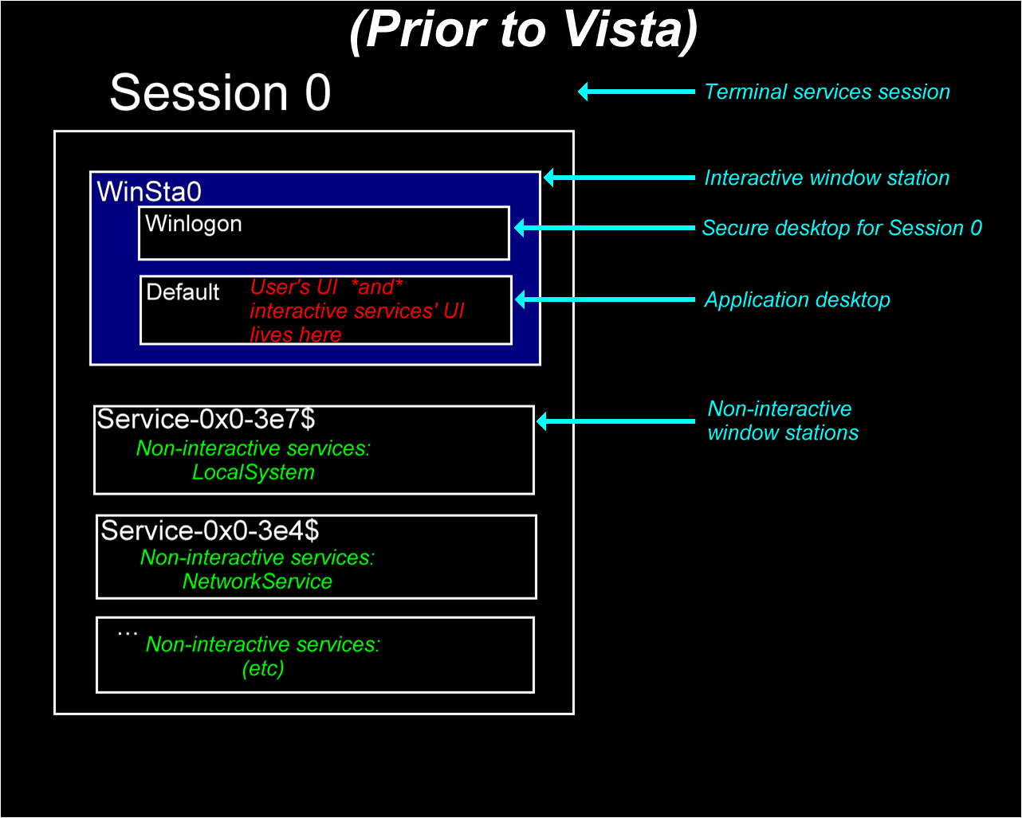

Slide 40
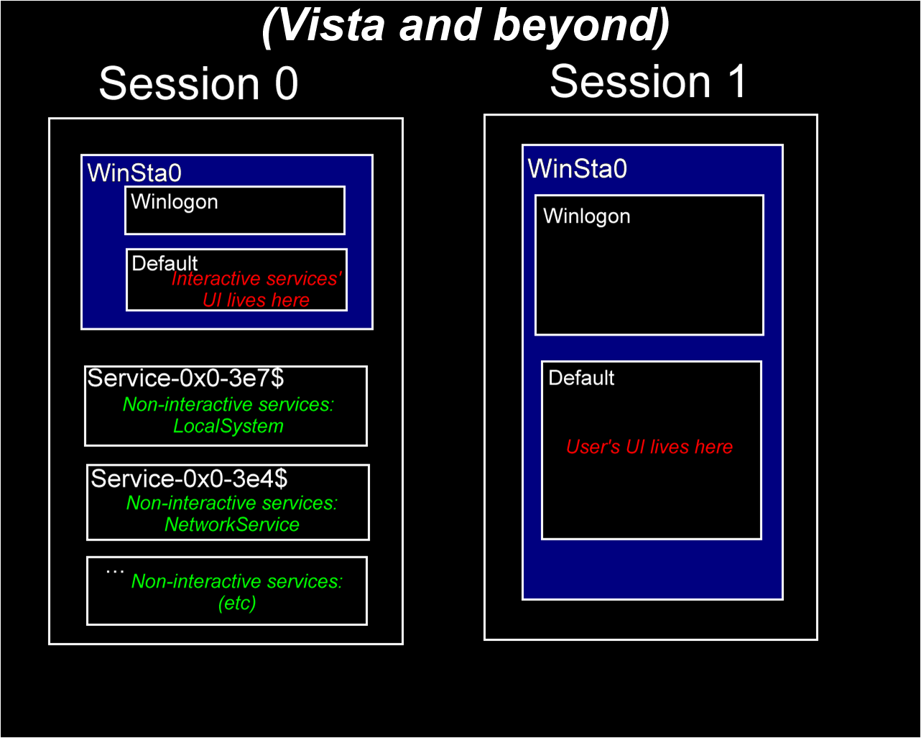

Slide 41
Service Isolation
Services run in a dedicated session isolated from user login
Services will not be able to directly interact with user desktop and applications
Issues
  Services with user interaction may hang as User Interface will not be visible, so…
  Mitigation: Notification sent to current user when there is UI in session 0 (temporary)
Guidance
  If must send UI, use WTSSendMessage()
  For more complex, use CreateProcessAsUser() and spawn UI from there
    SetTokenInformation if in a different session than the one that called LogonUser
Notes:
Guidance –
Be aware that there are hard to find security issues with running as a different then logged on user
Can be hard to identify the users session (e.g. getting the console ID)
May want to have an auto start process in each session (e.g. tray process) that identifies the communicating session
Communicate using IPC mechanisms, but keep security in mind (e.g. ACLing objects correctly)
1/31/2008 12:25 PM
41
© 2005 Microsoft Corporation. All rights reserved.
This presentation is for informational purposes only. Microsoft makes no warranties, express or implied, in this summary.

Slide 42
Service Hardening
Services need to run least privileged
Services are now capable of having their own SID
This can be used to lock down the resources that the Service has access to
Good
  Move to a lesser privileged account (Local Service, Network Service)
  Refactor services into two parts where necessary.
  Privilege stripping on a per-service basis.
Better
  Grant Service Sid access via ACLs on service specific resources.
Best
  Use Service-SID, ACLs and “write-restricted token” to isolate services.
  Supply network firewall rules.

Slide 43

Windows Server 2008 Services
Performance Enhancements
Service start up
  Windows XP / Windows Server 2003 - Auto and Demand start
    Auto start reasons:
      Required due to other boot services dependencies on service
      Need service to run outside user context
    Many auto start services causes boot time congestion
  Windows Server 2008 / Windows Vista, third - Delayed Auto-Start
    Auto start but after boot
    No specific time guarantee. Calling clients must handle this.
    Set with flag in ChangeServiceConfig2()
Notes:
Note: autostart services in Windows XP and Windows Server 2003 also had no time guarantee – many services may still not be up and running when an interactive user logs on.

Slide 44
Windows Server 2008 Services
Performance Enhancements
Notification of service status change
  Windows XP / Windows Server 2003 required query of state through QueryServiceStatusEx() or other API
  Windows Vista / Windows Server 2008 NotifyServiceStatusChange() Allows for callback notification of service status changes
    Local or remote clients
Shutdown
  Windows XP / Windows Server 2003 – notification (random order from SCM) then 20 sec to shutdown
  Windows Vista / Windows Server 2008 pre-shutdown notification for services with more cleanup
    3 min by default but configurable by service
  Registration of shutdown dependencies for order

Slide 45
Topics
Common Windows Compatibility Issues
  User Account Control (UAC)
    Mandatory Integrity Control, IE – Protected Mode
  Installation
  Service Isolation
  Miscellaneous
    User Interface, Networking
Specific Windows Server 2008 Compatibility Issues
  IIS, RODC, Core
Logo Certification and “Works with”

Slide 46
Windows Resource Protection
Protects the system: files, folders, registry keys
Only Trusted Installer Service can update protected resources – now accomplished using normal system security (ADC, DACL)
Issues
  Replacing System binaries
  Writing to system registry keys
  Writing to certain directories
Maintains a cache of only critical restart files
Installers can use APIs to determine if protected
  SfcIsFileProtected - also in WFP
  SfcIsKeyProtected – new to WRP, checks registry keys
Mitigation – will return success instead of Access Denied for well known installers
Cached files are in %Windir%\winsxs\Backup

Slide 47
Global Memory Mapped File Creation
Creating Memory Mapped File objects in global or session namespace (e.g. global\mmfile) is a privileged operation
  will fail as Standard User
Creating any global namespace object requires the SeCreateGlobalPrivilege

Slide 48
Version Checking
App checks for specific Operating System versions
  Dependency verification
  Product marketing restrictions
Symptoms vary by application
  Silently fails to install or launch
  Display “unsupported OS” message
Mitigations
  Application should accept current AND future OS versions (AppVerifier check)
  Use GetVersionEx

Slide 49
New Folder Locations
“My Documents” folder structure has changed
  The user data is now stored in:
  ‘\users\%username%\’ folder structure
  Pictures, Music, Documents, Desktop, and Favorites are all new folders directly under this structure
  The “My “ prefix was dropped from Documents, Music, etc.
  “All Users” became “Public” and “\ProgramData”
My Documents still exist as directory junction
Use the SHGetKnownFolderPath APIs
Notes:
The My Documents location and structure has changed in Windows Vista / Windows Server 2008 to provide a better user experience. The user data is now stored in \users\%username%\ folder structure. Pictures, Music, Documents, Desktop, and Favorites are all new folders directly under this structure

Slide 50
Application Data Best Practices
Where to put your data:
Place per-user configuration data into %LOCALAPPDATA% (Roaming into %APPDATA%)
Place Per-Machine (Shared) configuration data into %ALLUSERSPROFILE% (e.g. c:\ProgramData)
Per-Machine (Shared) user documents into %PUBLIC%
Per user documents go to %USERPROFILE%

Slide 51
User Interface: Aero
Applies most to client – available in Server as add on through the Desktop Experience Pack
New Feature: Desktop Composition (Disabled by default)
Desktop Window Manager (dwm.exe)
Top level windows are no longer painted directly to the screen
Issues:
    Black areas around tool tips, pop-up menus, balloons, etc.
    Flashes of black
    Aero disabled for an application
    Improved far east fonts can change layout slightly
    Width of chars is changed and variable
Guidance for GDI programmers with DWM…
  http://msdn.microsoft.com/library/default.asp?url=/library/en-us/shellcc/platform/shell/programmersguide/dwm/dwm_bestpractices_ovw.asp
Notes:
1/31/2008 12:25 PM
51
© 2006 Microsoft Corporation. All rights reserved. Microsoft, Windows, Windows Vista and other product names are or may be registered trademarks and/or trademarks in the U.S. and/or other countries.
The information herein is for informational purposes only and represents the current view of Microsoft Corporation as of the date of this presentation. Because Microsoft must respond to changing market conditions, it should not be interpreted to be a commitment on the part of Microsoft, and Microsoft cannot guarantee the accuracy of any information provided after the date of this presentation.
MICROSOFT MAKES NO WARRANTIES, EXPRESS, IMPLIED OR STATUTORY, AS TO THE INFORMATION IN THIS PRESENTATION.
1/31/2008 12:25 PM
51
© 2005 Microsoft Corporation. All rights reserved.
This presentation is for informational purposes only. Microsoft makes no warranties, express or implied, in this summary.

Slide 52
User Interface: High DPI
High dpi monitors cause problems (e.g. small icons)
Windows Server 2008 will auto-scale to match for non-dpi aware apps
Application can disable this by calling SetProcessDPIAware()
  Manifest way to do this is under investigation
Issues…
  Partially hidden or clipped text
  Text is too big
  Graphic drawn at the wrong size or in the wrong place
For detailed testing suggestions see
  http://msdn2.microsoft.com/en-us/library/ms969894.aspx

Slide 53
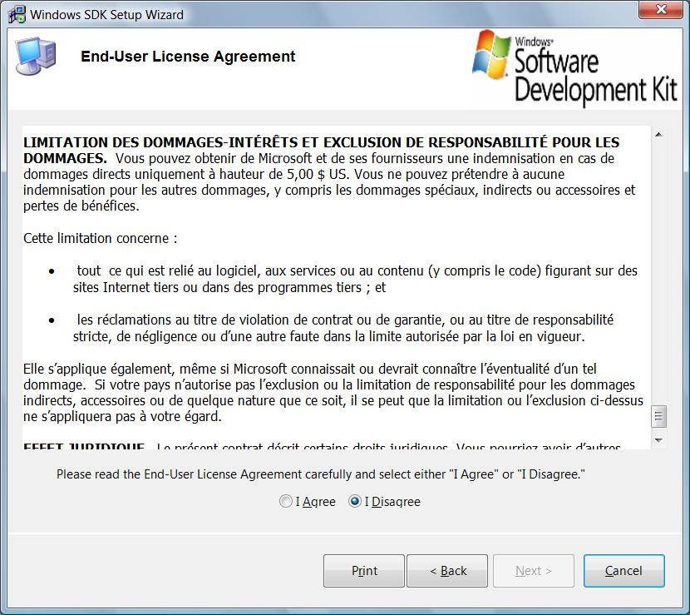
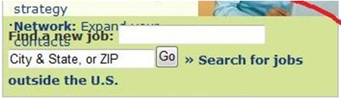
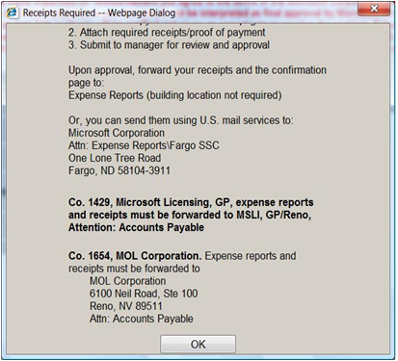
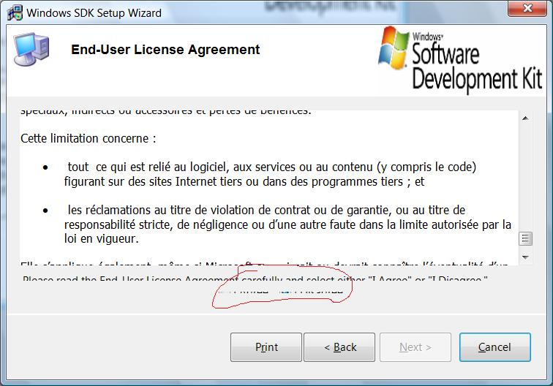
User Interface: High DPI

Slide 54
User Interface Testing Guidance
Make sure to test…
Aero Glass including Flip3D (Window key + TAB)
New Themes
Thumbnail representations
Far east fonts – screen and printer
Multi-monitor support
Drag and drop support
High DPI support

Slide 55
Networking
TCP/IP stack completely re-written from Windows XP / Windows Server 2003
The following elements are no longer supported
  Firewall-hook driver functions / filter-hook driver functions
  R-Series of tools – only available through services for Unix
  IPX Protocol
The firewall hook APIs have been replaced with a fully documented way of filtering – Windows Filtering Platform (WFP)
  Internal system calls and hooks removed
  Network scanning, firewall, anti-virus apps that used internal system calls, data structures fail
  http://msdn2.microsoft.com/en-us/library/aa364931.aspx
Notes:
1/31/2008 12:25 PM
55
© 2005 Microsoft Corporation. All rights reserved.
This presentation is for informational purposes only. Microsoft makes no warranties, express or implied, in this summary.

Slide 56
Networking: TCP/IP stack
Compound TCP introduced
TCP receive window auto-tuning introduced
IP v4 and v6 share a single stack
IP v6 addresses will be present and on by default
IPv6 Porting document…
  http://msdn2.microsoft.com/en-us/library/ms738649.aspx
Checkv4.exe utility flags porting issues in source
Compiler flag – IPv6Strict
Functions and structures have been introduced to support IPv4 and IPv6 addresses
Use version agnostic APIs
Notes:
Compound TCP
Goal: prevent flooding of network by restricting data sent out
Old way, increase segments sent based on acknowledgements
Problem: could take lots of time to reach maximum throughput on high bandwidth (lots of potential segments), high latency (longer time to receive ack) networks (e.g. high bandwidth WAN)
Solution Compound TCP (CTCP)
More aggressive about size increase
Works hand in hand with Receive auto tuning below
monitoring delay variations and losses.
substantial performance gains for large bandwidth-delay product connections.
CTCP is enabled by default in computers running beta versions of Windows
Server 2008 and disabled by default in computers running Windows Vista.
You can enable CTCP with the netsh interface tcp set global
congestionprovider=ctcp command.
You can disable CTCP with the netsh
Interface tcp set global congestionprovider=none command.
Receive window auto-tuning
Goal: maximize throughput by looking at bandwidth delay product (bandwidth * round trip time – rtt) and app retrieve time
Old way: Can be dynamically set, but for all TCP connections and does not vary with network conditions – registry key also
New way: measures above continually and adjusts with changing conditions
Note Some Internet gateway devices and firewalls block packet flows because they do not correctly interpret the scaling factor used in TCP connections. Because of this, Internet Explorer in Windows Vista uses an initial scaling factor of 2. Other applications use a default initial scaling factor of 8. Microsoft is investigating changing the initial scaling factor for Internet Explorer-based connections to 8 in a future update of Windows Vista. Microsoft is working with the manufacturers of these devices so that they can be updated for compliance with TCP window scaling.

Slide 57
x64 Windows Vista / Windows Server 2008
  64-bit drivers required
    Digitally signed kernel mode drivers required
  No upgrade path
  16-bit subsystem removed
    Watch out for 16-bit installers or older dependencies
  WOW64 offers highly performing 32-bit compatibility
  64-bit and 32-bit code cannot co-exist in the same process
    Watch for necessary interactions with 64-bit code – e.g. monitoring apps, etc.
Notes:
1/31/2008 12:25 PM
© 2005 Microsoft Corporation. All rights reserved.
This presentation is for informational purposes only. Microsoft makes no warranties, express or implied, in this summary.
57

Slide 58
Mitigations
Recap…
  File / Registry Redirection
    IE 7 protected mode
    User Access Control
    WOW64
  Access denied = success
    WRP – for installers
  Auto setup elevation
  High DPI awareness

Slide 59
Winlogon and GINA
Winlogon credential extension re-architected
  New Credential Provider API simplifies authentication
  Support for custom GINA removed
Issues
  Apps supporting custom login and authentication fail
    Biometric devices
    Custom VPN solution for Windows XP
    Smart Card readers
Mitigation
  Update application to support new Winlogon architecture
  Built in smart card authentication
Well documented in SDK

Slide 60
Removed Components
Front Page Server Extensions (for now)
Post Office Protocol (POP3) server
Services for Macintosh
Kernel mode printer drivers (moved to user mode)
WinHelp. Download available for end-users (HTML Help/CHM files are supported)
VB5/VC5
Notes:
1/31/2008 12:25 PM
© 2005 Microsoft Corporation. All rights reserved.
This presentation is for informational purposes only. Microsoft makes no warranties, express or implied, in this summary.
60

Slide 61
Resources
Great portal for Application Compatibility
  http://www.devreadiness.org
    Start with the Application Compatibility Cookbook
AppCompat blogs
  http://blogs.msdn.com/VistaCompatTeam
  http://blogs.msdn.com/cjacks
Other blogs:
  http://blogs.msdn.com/UAC
  http://blogs.msdn.com/IE
  http://blogs.msdn.com/rflaming
Notes:
1/31/2008 12:25 PM
© 2005 Microsoft Corporation. All rights reserved.
This presentation is for informational purposes only. Microsoft makes no warranties, express or implied, in this summary.
61

Slide 62
Topics
Common Windows Compatibility Issues
  User Account Control (UAC)
    Mandatory Integrity Control, Internet Explorer – Protected Mode
  Installation
  Service Isolation
  Miscellaneous
    User Interface, Networking
Specific Windows Server 2008 Compatibility Issues
  IIS, RODC, Core
Logo Certification and “Works with”

Slide 63
Windows Server 2008 Compatibility
Server Roles
IIS
Failover Clustering
Active Directory Changes
Server Core
Windows Firewall

Slide 64
Server Roles
Windows Server 2008 is componentized
  Roles are highly granular
  No roles activated by default
  Roles from prior versions “not exactly” the same
  Scripts/installers/applications may break because of uninstalled features now in a new or changed role

Slide 65
Server Roles
Active Directory
  Certificate Services
  Domain Services
  Federation services
  Lightweight Directory Services (old ADAM)
  Rights Management Services
Application Server (COM+, MSMQ, etc.)
DHCP
DNS
Fax
File
Network Policy and Access (VPN, Radius)
Print
Terminal
UDDI
Web (IIS)
Windows Deployment
Sharepoint

Slide 66
Server Manager
Combination of
  Windows Server 2003 Manage Your Server
  Windows Server 2003 Configure Your Server
  Add/Remove Windows Components
Eliminates Security Configuration Wizard (secure by default)
Use Servermanagercmd to install roles from commandline

Slide 67
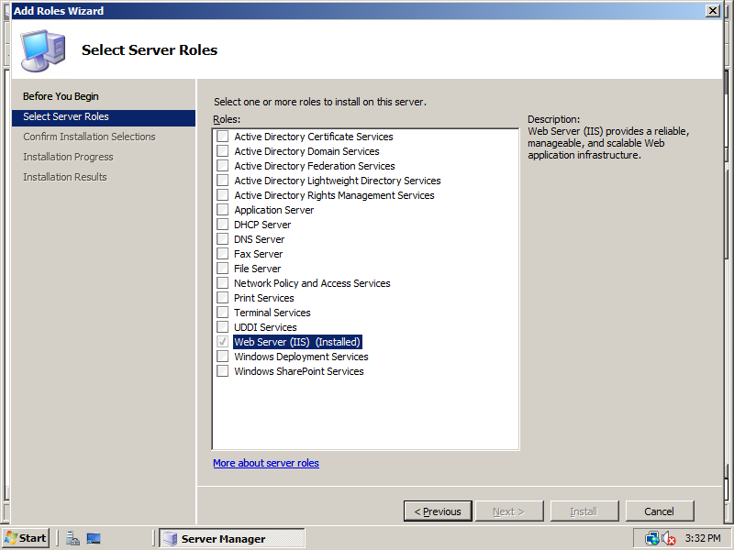
Notes:
Roles and Features are highly componentized compared to previous version of Server O/S.

Slide 68
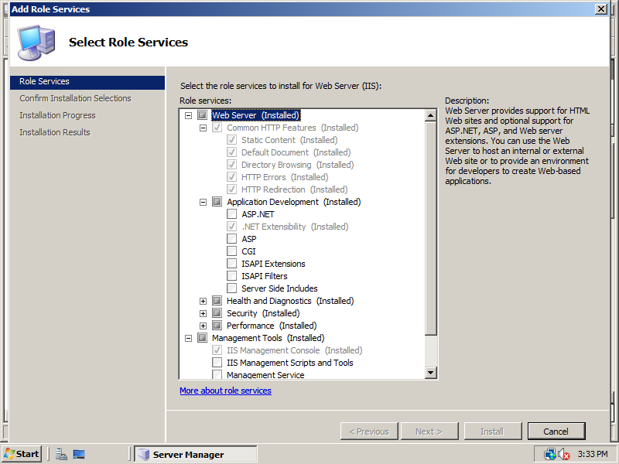

Slide 69
Component Features
Auxiliary, Supporting functions to Roles. Eg:
Failover Clustering
Desktop Experience Pack
  Desktop applications are not installed by default
  DirectX/Media files missing
RPC over HTTP Proxy
.NET Framework 3.0
Remote Assistance

Slide 70
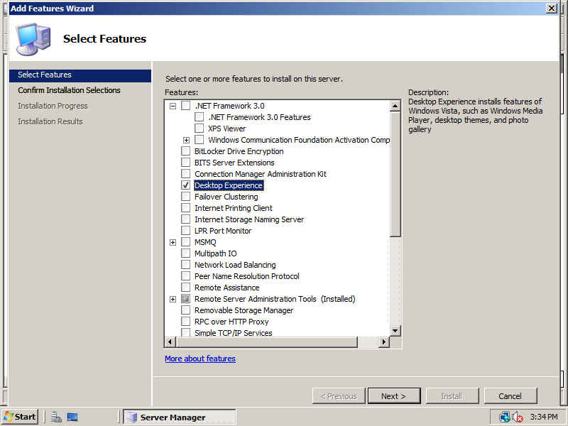

Slide 71
Windows Server 2008 Compatibility
Server Roles
IIS
Failover Clustering
Active Directory Changes
Server Core
Windows Firewall

Slide 72
What Is New in IIS7
New ASP.NET Integrated model
Powerful command line administration using appcmd.exe
Automatic application pool isolation
  New site gets new application pool with same name
  Own apppool.config
  Unique SID for the AppPool to ACL apppool.config
Delegated Remote administration support over HTTP/SSL
Built in FastCGI support for PHP
Shared centralized configuration
Built in FTP (comp IIS6 FTP) and optional download FTP

Slide 73
What Is Gone in IIS7
No support for Front Page Server Extensions.
WebDav is removed by default, it will be available as an optional component
IIS5 Isolation Mode
ASP.NET 1.0
Currently (beta 3), no support for .NET framework in WS08 core.
Convlog

Slide 74
What Is Gone In IIS7
IIS 5.0 Isolation Mode | ASP content rotator and nextlink
Metabase account recreation (checker code) | Server-side image maps
Sub-authentication (password synchronization and old digest authentication) | Internet Data Connector (HTTPODBC.DLL)
Built-in Passport support | Url Authorization ISAPI
Convlog.exe | Content Rating UI
Clustering UI support | Password change code
IISRESET –reboot option | IIS*.VBS command-line tools in %windir%\system32
IIS Shell Extension | WebDAV
NNTP | FPSE

Slide 75
Classic and Integrated Mode
Two modes of deployment - classic mode and Integrated Mode
Classic mode uses IIS6 pipeline (ISAPI extension aspnet_isapi.dll)
Integrated mode integrates ASP.NET runtime extensibility model with IIS core.
  Share a single config file for IIS and ASP.NET
  Reduces the need to configure two places for ASP.NET applications

Slide 76
Integrated Mode
ASP.NET extensibility model (HTTP handlers and filters) run within IIS7 server runtime
Extensibility in IIS can be implemented in
  ASP.NET extensibility API. No need to write C++ ISAPI extensions and filters
  New IIS7 native server extensibility APIs (C++)
  ISAPI is still fully supported
ASP.NET features like forms authentication and output caching now work with all types of applications (CGI, ASP, static content)

Slide 77
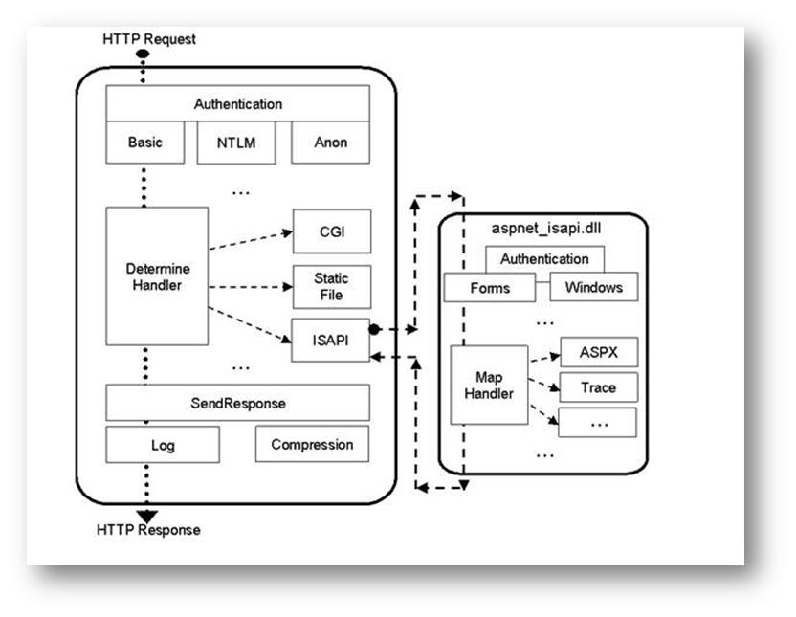
Classic Mode

Slide 78
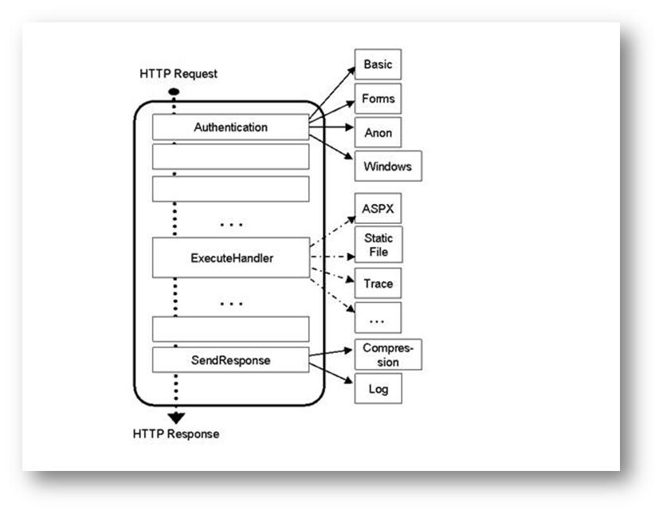
Integrated Mode

Slide 79
IIS7 .NET Extensibility
Future of ASP.NET Development
Configuration
  ISAPI vs. Integrated mode per app-pool
  Unified <modules>, <handlers> configuration
System.web replaced by System.webserver
ISAPI Mode (ASP.NET)
Integrated Mode (ASP.NET + IIS)
system.web/customErrors
system.webServer/httpErrors
system.web/httpHandlers
system.webServer/handlers
system.webServer/modules

Slide 80
IIS7 Core Server Modules
When do I need C++?
Almost never...
  Managed and native APIs have similar fidelity
  Exceptions in some scenarios that require a native module:
    Handling non-request events, e.g. file or config change, cache cleanup
    Cross-appdomain scenarios
    Stringent performance scenarios

Slide 81
ASP.NET Migration Issues
.NET 1.0 not supported in Windows Server 2008. Need to migrate to at least .NET framework 1.1
Configuration errors in Integrated mode
  HTTP Modules loaded by applications are defined in web.config under <system.web>/<httpModules>. Need to move it under <system.webServer>/<modules>
  HTTP Handlers have to be moved from <system.web>/<httpHandlers> to <system.webServer>/<handlers>

Slide 82
ASP.NET Migration Issues
Identity impersonation ( <identity impersonate=“true”>) is not available in Integrated mode before AuthenticateRequest.
In integrated mode BeginRequest occurs before AuthenticateRequest. If client identity is required in BeginRequest handler switch to classic ASP.NET mode or move code to PostAuthenticateRequest handler.
No built-in passport authentication support

Slide 83
Automatic Configuration Migration
IIS7 APPCMD.EXE utility provides automatic migration of configuration file
IIS7 shows configuration errors of migrated applications along with command to migrate
APPCMD to migrate
  <%windir%>\system32\inetsrv\APPCMD.EXE migrate config <Application Virtual Path>
After migrating application will work in both classic mode and integrated mode

Slide 84
ASP.NET Modes and Application Pools
Application pool can be configured to run in classic or integrated ASP.NET mode
ASP.NET setup ships with an app pool named "Classic .NET AppPool" that runs in the classic ASP.NET mode.
Any new app pool will run in Integrated mode
App pool ASP.NET mode can be changed using IIS7 admin tool, APPCMD.EXE or by editing app pool configuration

Slide 85
Metabase Changes
IIS Metabase replaced by XML configuration.
Metabase compatibility feature is available for backward compatibility at API level
By default, IIS7 does not install metabase compatibility feature.
FTP, SMTP and NNTP configuration is still persisted in metabase.
Metabase compatibility feature is at API level (file itself does not exist)
  metabase ACLs are not supported

Slide 86
Metabase Changes
Configuration auditing added in Windows 2003 sp1 is not supported by IIS7
Only legacy properties are returned by metabase compatibility feature
API calls related to backup configuration files will be ignored as it relies on new configuration system properties
IIS6 doesn’t require unique names for sites, but for metabase compatibility, names have to be unique per site as required in IIS7.

Slide 87
Admin Feature Changes
Convlog is not supported anymore. Convert log files to NCSA log file format
Content rating UI not supported, but content rating response header can be inserted using WMI or Appcmd.exe or by editing the XML configuration file manually.
IISRESET does not support machine restarts
IIS*.vbs tools not supported. Use AppCmd.exe

Slide 88
Other Feature Changes
Internet Data Connector to connect to ODBC sources not supported. Use Asp.net
SSINC EXEC CMD to run command-line not supported. Use ASP.NET/ASP to run command-line paths from web pages

Slide 89
IIS Resources
What’s New In IIS7? http://blogs.iis.net/bills/archive/2007/04/25/what-s-new-in-iis7-beta-3.aspx
New FTP
http://www.iis.net/articles/view.aspx/IIS7/Managing-IIS7/Using-FTP-Server-in-IIS7/What-s-New-for-Microsoft-and-FTP-
Migrating ASP.Net appliations http://www.iis.net/articles/view.aspx/IIS7/Hosting-Web-Applications/ASP-NET/ASP-NET-Integration-with-IIS7
Deprecated Components http://www.iis.net/articles/view.aspx/IIS7/Deploy-an-IIS7-Server/Installing-IIS7/Compatibility-and-Feature-Requirements-for-Windows?Page=2

Slide 90
Windows Server 2008 Compatibility
Server Roles
IIS
Failover Clustering
Active Directory Changes
Server Core
Windows Firewall

Slide 91
Failover Cluster
Cluster Service Account (CSA) has been removed (now runs as Local System)
Cluster Automation Server (MSClus) COM interface deprecated (although still supported)
Removed APIs:
  BackupClusterDatabase()
  RestoreClusterDatabase().
  Use the new Cluster VSS Writer
No backward compatibility
  Windows Server 2008 node and Windows Server 2003 node can not be in the same cluster at the same time
  No rolling upgrades

Slide 92
Windows Server 2008: A Clean Slate
Compatibility
  Some hardware may not be upgradeable
  Can not assume solutions that previously
  worked with clustering will continue to work in Windows Server 2008 Clustering
Supportability
  There will be no grandfathering of support for
  currently qualified solutions listed on the
  Windows Server Catalog
    Solutions proven to work with Windows Server 2003 Clustering means nothing in the context of Windows Server Clustering compatibility

Slide 93
Specific Windows Server 2008 Issues
Server Roles
IIS
Failover Clustering
Active Directory Changes
Server Core
Windows Firewall

Slide 94
Read Only Domain Controller
Secure by default - no principal (account) passwords replicated to or stored in a Read Only Domain Controller (RODC)
Selectively enable password caching
Unidirectional replication for AD and SYSVOL
  Read Only Partial Attribute Set to prevent replication of sensitive information
  Requires manual configuration
Enables delegation of DC administration

Slide 95
RODC Compat Issues
Central Issue:
  App is unaware of RODC and treats it as writable
  By default, write operations are referred by the RODC to a writable DC
Notes:
There is currently no way to find these referrals outside of noticing longer delays in application performance.

Slide 96
RODC Issues
Application requiring that it runs on DC may use API which does not distinguish RODCs
Write oriented apps may not distinguish RODCs when querying for a DC
  Ask for writable DC (GetDcName pass DS_WRITABLE_REQUIRED flag)
Referral from RODC may fail (e.g. app is not setup to “chase referrals”, communication failure, etc.)
  Avoid write operations to RODC as above
App may do a referred write, then attempt to read
  Fails due to latency in replication of written data to RODC

Slide 97
RODC Compat Issues
Questions to ask…
  Does your application require that it runs on a domain controller?
  Does your application write to the directory?
  Does your application explicitly disable LDAP referrals by using the LDAP option?
  If not, do you know if your application works when it gets a referral?
  Can your application write LDAP data and then soon thereafter attempt to read it again?
  When your application calls LDAP_open/init, does it allow LDAP to choose the host name on its behalf (rather than passing a host name explicitly)?
  If you use Active Directory Service Interfaces (ADSI), does your application specify the domain name in ADsPath? Or does it use a serverless path?

Slide 98
RODC Detection
Wrong
  GetVersionEx( OSVERSIONINFOEX )
    No specific flag in wProductType
  Registry
Right
  DsRoleGetPrimaryDomainInformation
  New flag: DSROLE_PRIMARY_DS_READONLY

Slide 99
RODC Resources
For a detailed description of all scenarios including referenced APIs, flags, etc. See Appendix C of the following document…
  http://technet2.microsoft.com/windowsserver2008/en/library/ea8d253e-0646-490c-93d3-b78c5e1d9db71033.mspx?mfr=true

Slide 100
Windows Server 2008 Compatibility
Server Roles
IIS
Failover Clustering
Active Directory Changes
Server Core
Windows Firewall

Slide 101
Server Core
Minimal installation option for
Windows Server 2008
Available for Standard, Enterprise, and Datacenter
Available for x86 and x64
Notes:
All the common controls and other user interface elements are available but things that rely on Explorer in some way like the File Open and Save dialogs aren’t present and other common dialogs don’t function properly.

Slide 102
Server Core
Subset of server roles:
  DHCP, File, AD, AD LDS, Media Services, DNS, IIS 7 (minus ASP.Net)
The following optional features:
  WINS, Failover Clustering, Subsystem for UNIX-based applications, Backup, Multipath IO, Removable Storage Management, Bitlocker Drive Encryption, SNMP, Telnet Client
Command Line interface, no Shell
Lost your prompt? (SHFT-CTRL-ESC gives taskmgr for you to relaunch cmd.exe)

Slide 103
Limitations On Server Core
Only native code.
No managed code. This means:
  No Powershell
  No ASP.Net
Limited MSI support (unattended mode only).

Slide 104
No Application Support
Server Core is not an application platform
  Applications might work; not supported
Server Core does support management tools, utilities, and agents
Remote Management tools should not require changes
  Remediation: Need to use one of the protocols supported in Server core, such as RPC
DLLs included with Server Core
  http://msdn2.microsoft.com/en-us/library/ms723876.aspx

Slide 105
Developing For Server Core
Issues:
  Agents cannot have shell dependencies; minimal GUI
  Agents cannot use managed code
Test your agents on Server Core
MSDN has a list of APIs supported in Server Core (see resources)
GetProductInfo (new in Windows Vista / Windows Server 2008) will tell you that you’re running on Server Core

Slide 106
Server Core Resources
Blog: http://blogs.technet.com/server_core/default.aspx
Search: Server Core Installation Option
Server Core on MSDN:
http://msdn2.microsoft.com/en-us/library/ms723891.aspx

Slide 107
Windows Server 2008 Compatibility
Server Roles
IIS
Failover Clustering
Active Directory Changes
Server Core
Windows Firewall

Slide 108
Windows Firewall On By Default
Symptoms:
  Applications may break after installation
    Dependent TCP/IP ports will not be open by default
  Security audit event is logged to signal that an application was blocked
  No user prompting to unblock application (unlike Windows Vista)

Slide 109
Windows Firewall on by Default
Mitigations:
  For legacy application installers, the ports need to be explicitly opened by an administrator
  Add a netsh script
Administrators can leverage:
  The ‘netsh advfirewall’ context to work with firewall rules from scripts
  Security Configuration Wizard templates to configure their Servers only
Remediation
  Use INetFwPolicy2 Firewall APIs to integrate installer guidance available at http://msdn2.microsoft.com/en-us/library/bb736286.aspx.

Slide 110
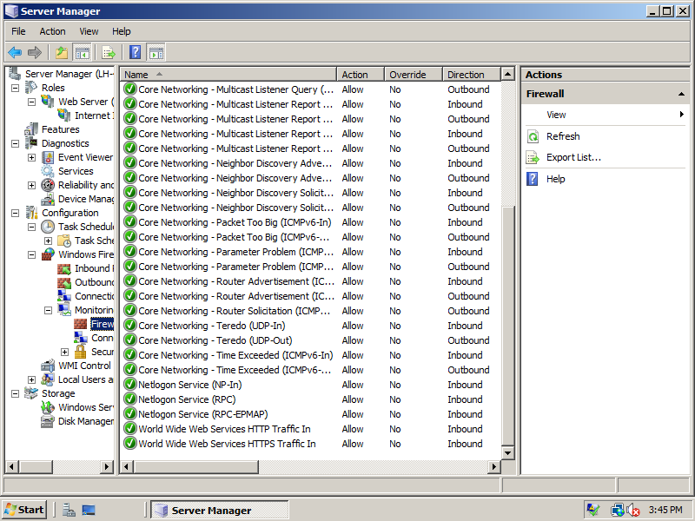

Slide 111
Windows Firewall on by Default
Integration with the firewall is required for logo certification, integration != disabling the Firewall
Windows components and server roles create firewall rules as they are installed.

Slide 112
Tools
System tools
  MSConfig
  New System Information
SysInternals
  Process Explorer
  Process Monitor
Debugging Tools
  Standard User Analyzer
  Application Verifier
  Debugging Tools for Windows

Slide 113
System Tools Demos
MSConfig
System Information
Event Viewer

Slide 114
Process Explorer
http://www.microsoft.com/technet/sysinternals/Processesandthreadsutilities.mspx
Other useful features
  Identify hosted services
  Show loaded modules
  Show handles in use
  Search for modules / handles
Demo

Slide 115
Process Monitor
New Windows Vista / Windows Server 2008 compatible version combining RegMon and FileMon applications
New functionality – snapshoting
Demo

Slide 116
Standard User Analyzer
Available in Application Compatibility Toolkit (ACT)
Tool built using AppVerifier APIs
Friendly version of LuaPriv tests
Demo

Slide 117
Application Verifier
Overview
  Application Verifier is a runtime verification tool for unmanaged code that assists in finding subtle programming errors that can be difficult to identify with normal application testing
Usage
  Graphic User Interface (GUI)
  Command line User Interface (CUI)
  Scriptable COM Interfaces

Slide 118
What Can Be Done In GUI?
Enable/Disable specific check for an application.
Adjust property setting for each check.
Configure Verifier Stop.
Check the log after running.
Demo

Slide 119
Command Line User Interface
You can do everything in the Command Line User Interface as you can in the User Interface
Examples:
  appverif -enable handles locks -for foo.exe bar.exe
  appverif -enable heaps handles -for foo.exe -with heaps.full=false
  appverif -disable * -for foo.exe bar.exe
  appverif -export log -for foo.exe -with to=c:\sample.xml
  appverif /verify notepad.exe /faults 5 1000 kernel32.dll advapi32.dll

Slide 120
COM Interfaces
Scriptable
Support all the functions supported by appverif.exe
You could build your own User Interface

Slide 121
Debugging
Debugger Extensions
  Windbg commands specific to AppVerifier
Verifier Tests
  LUAPriv
  Basic
    Exceptions
    Handles
    Heaps
    Locks
    Memory
    TLS
  Low Resource Simulation

Slide 122
Resources
Product Guide http://www.microsoft.com/windowsserver/longhorn/prodguide.mspx
Application Compatibility Cookbook
  http://msdn2.microsoft.com/en-us/library/bb757005.aspx
DevReadiness.org
  http://devreadiness.org/
Logo Programs
  http://www.innovateonwindowsserver.com
Notes:
1/31/2008 12:25 PM
122

Slide 123

© 2007 Microsoft Corporation. All rights reserved. Microsoft, Windows, Windows Vista and other product names are or may be registered trademarks and/or trademarks in the U.S. and/or other countries.
The information herein is for informational purposes only and represents the current view of Microsoft Corporation as of the date of this presentation. Because Microsoft must respond to changing market conditions, it should not be interpreted to be a commitment on the part of Microsoft, and Microsoft cannot guarantee the accuracy of any information provided after the date of this presentation.
MICROSOFT MAKES NO WARRANTIES, EXPRESS, IMPLIED OR STATUTORY, AS TO THE INFORMATION IN THIS PRESENTATION.

