Slide 1

Introduction to Data Mining
Rafal Lukawiecki
Strategic Consultant, Project Botticelli Ltd
rafal@projectbotticelli.co.uk

Slide 2

Objectives
Overview Data Mining
Introduce typical applications and scenarios
Explain some DM concepts
Review wider product platform
This seminar is partly based on “Data Mining” book by ZhaoHui Tang and Jamie MacLennan, and also on Jamie’s presentations. Thank you to Jamie and to Donald Farmer for helping me in preparing this session. Thank you to Roni Karassik for a slide. Thank you to Mike Tsalidis, Olga Londer, and Marin Bezic for all the support. Thank you to Maciej Pilecki for assistance with demos.
The information herein is for informational purposes only and represents the opinions and views of Project Botticelli and/or Rafal Lukawiecki. The material presented is not certain and may vary based on several factors. Microsoft makes no warranties, express, implied or statutory, as to the information in this presentation.
© 2007 Project Botticelli Ltd & Microsoft Corp. Some slides contain quotations from copyrighted materials by other authors, as individually attributed. All rights reserved. Microsoft, Windows, Windows Vista and other product names are or may be registered trademarks and/or trademarks in the U.S. and/or other countries. The information herein is for informational purposes only and represents the current view of Project Botticelli Ltd as of the date of this presentation. Because Project Botticelli & Microsoft must respond to changing market conditions, it should not be interpreted to be a commitment on the part of Microsoft, and Microsoft and Project Botticelli cannot guarantee the accuracy of any information provided after the date of this presentation. Project Botticelli makes no warranties, express, implied or statutory, as to the information in this presentation. E&OE.

Slide 3
Before We Dive In...
To help me select the most suitable examples and demonstrations I would like to ask you about your background
Who do you identify yourself with:
  IT Professional,
  Database Professional,
  Software/System Developer?

Slide 4
The Essence of Data Mining as Part of Business Intelligence

Slide 5



Business Intelligence
Improving Business Insight
“A broad category of applications and technologies for gathering, storing, analyzing, sharing and providing access to data to help enterprise users make better business decisions.”
– Gartner

Slide 6
Relationships
And Acronyms...
Data Mining (DM)
Knowledge Discovery in Databases (KDD)
Business Intelligence (BI)

Slide 7
Data Mining
Technologies for analysis of data and discovery of (very) hidden patterns
Fairly young (<20 years old) but clever algorithms developed through database research
Uses a combination of statistics, probability analysis and database technologies

Slide 8

What does Data Mining Do?
Explores Your Data
Finds Patterns
Performs Predictions

Slide 9
DM and BI
BI is geared at an end user, such as a business owner, knowledge worker etc.
DM is an IT technology generally geared towards a more advanced user – today
By the way: who is qualified to use DM today?

Slide 10
DM Past and Present
Traditional approaches from Microsoft’s competitors are for DM experts: “White-coat PhD statisticians”
  DM tools also fairly expensive
Microsoft’s “full” approach is designed for those with some database skills
  Tools similar to T-SQL and Management Studio
  DM built into Microsoft SQL Server 2005 and 2008 at no extra cost
DM “easy” is geared at any Excel-aware user

Slide 11
DM Enables Predictive Analysis
Predictive Analysis
Role of Software
Data mining
Proactive
Interactive
OLAP
Ad-hoc reporting
Canned reporting
Passive
Business Insight
Presentation
Exploration
Discovery

Slide 12
Application and Scenarios

Slide 13
Value of Predictive Analysis
Typical Applications
Predictive Analysis
Seek Profitable Customers
Understand Customer Needs
Anticipate Customer Churn
Predict Sales & Inventory
Build Effective Marketing Campaigns
Detect and Prevent Fraud
Correct Data During ETL

Slide 14


Data Mining Process
CRISP-DM
“Doing Data Mining”
Business Understanding
Data Understanding
Data
Data Preparation
“Putting Data Mining to Work”
Deployment
Modeling
Evaluation
www.crisp-dm.org

Slide 15
Customer Profitability
Typically, you will:
  Segment or classify customers in a relevant way
    Clustering
  Find a relationship between profit and customer characteristics
    Decision Tree
  Understand customer preferences
    Association Rules
  Study customer behaviour
    Sequence Clustering
  and
  Predict profitability of potential new customers

Slide 16
Predict Sales and Inventory
You may:
  Structure the sales or inventory data as a time series
    Perhaps from a Data Warehouse
  Forecast future sales and needs
    Time Series or Decision Trees with Regression

Slide 17
Build Effective Marketing Campaigns
You would:
  Segment your existing customers
    Clustering and Decision Trees
  Study what makes them respond to your campaigns
    Decision Tree, Naive Bayes, Clustering, Neural Network
  Experiment with a campaign by focusing it
    Lift Charts
  Run the campaign
    Predict recipients
  Review your strategy as you get response
    Update your models

Slide 18
Detect and Prevent Fraud
You could:
  Build a risk model for existing customers or transactions
    Decision Trees, Clustering, Neural Networks, and often Logistic Regression
  Assess risk of a new transaction
    Predict risk and its probability using the model
Or
  Model transaction sequences
    Sequence Clustering
  Find unusual ones (outliers)
    Mine the mining model – neural networks, trees, clustering
  Assess new events as they happen
    Predicting by means of the metamodel

Slide 19
New Opportunity:
Intelligent Applications
Examples of Intelligent Applications:
  Input Validation, based on previously accepted data, not on fixed rules
  Business Process Validation – early detection of failure
  Adaptive User Interface based on past behaviour
Also known as Predictive Programming
Learn more by downloading “Build More Intelligent Applications using Data Mining” from www.microsoft.com/technetspotlight

Slide 20
Data Mining Products

Slide 21
Microsoft DM Competitors
All trademarks respectfully implicitly acknowledged
SAS, largest market share of DM, specialised product for traditional experts
SPSS (Clementine), strength in statistical analysis
IBM (Intelligent Miner) tied to DB2, interoperates with Microsoft through PMML
Oracle (10g), supports Java APIs
Angoss (KnowledgeSTUDIO), result visualisation, works with SQL Server
KXEN, supports OLAP and Excel,
CRM space: Unica, ThinkAnalytics, Portrait, Epiphany, Fair Isaac

Slide 22




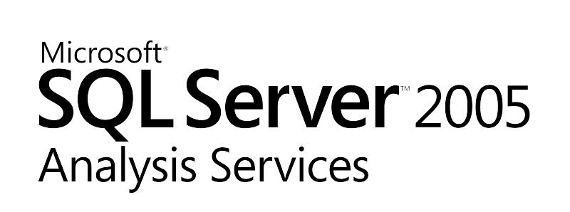

SQL Server
We Need More Than Just Database Engine
Integrate
Analyze
Report
Data acquisition and integration from multiple sources
Data transformation and synthesis using Data Mining
Knowledge and pattern detection through Data Mining
Data enrichment with logic rules and hierarchical views
Data presentation and distribution
Publishing of Data Mining results

Slide 23
DM Technologies in SQL Server 2005
Strong, patented algorithms from Microsoft Research labs
Interoperability
  PMML (Predictive Model Markup Language) for SAS, SPSS, IBM and Oracle
Multiple tools:
  Business Intelligence Development Studio (BIDS)
  Data Mining Extensions for Excel (and more)
  DMX and OLE DB for Data Mining
  XML for Analysis (XMLA)

Slide 24
What is New in SQL Server 2008?
Data Mining Enhancements
Enhanced Mining Structures
  Easier to prepare and test your models
  Models allow for cross-validation
  Filtering
Algorithm Updates
  Improved Time Series algorithm combining best of ARIMA and ARTXP
  “What-If” analysis
Microsoft Data Mining Framework
  Supplements CRISP-DM

Slide 25
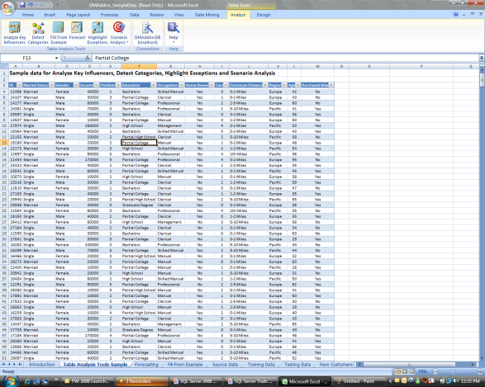

DM Add-Ins for Microsoft Office 2007
Define Data
Identify Task
Get Results

Slide 26
Demo
Using Data Mining Add-in Table Tools for Microsoft Excel 2007
Notes:
26

Slide 27




Server Mining Architecture
BIDS
Excel
Visio
SSMS
Excel/Visio/SSRS/Your App
OLE DB/ADOMD/XMLA/AMO
App
Data
Deploy
Analysis Services
Server
Mining Model
Data
Source
Data Mining Algorithm

Slide 28
Conclusions

Slide 29


ABS-CBN Interactive (ABSi)
Subsidiary of the largest integrated media and entertainment company in the Philippines
Wireless Services Firm Doubles Response Rates with SQL Server 2005 Data Mining
Challenge
Selling custom ring tones and other downloadable content for mobile phone users requires staying in tune with the market.
Solution
ABSi deployed Microsoft® SQL Server™ 2005 to use its data mining feature to determine product recommendations.
Benefit
More accurate and personalized service recommendations to customers
Searching transactional data for hints on what to offer users in cross-selling value-added mobile services took days and didn’t provide customer-specific recommendations.
Doubling response rates from marketing campaigns
Ad hoc reporting in minutes, not days
Eight times faster data mining process
Faster data mining prediction
“Our management is very impressed that we could double our response rate through our SQL Server 2005 data mining … managers of other services ask us to provide the same magic for them—which is what we will do with the full project rollout”
- Grace Cunanan, Technical Specialist, ABS-CBN Interactive

Slide 30

Clalit Health Services
Data Mining Helps Clalit Preserve Health and Save Lives
Provides health care for 3.7 million insured members, representing about 60 percent of Israel’s population
Challenge
Identify which members would most benefit from proactive intervention to prevent health deterioration
Solution
Use sociodemographic and medical records to generate a predictive score, identifying elder members with highest risk for health deterioration
Benefit
A chance to preserve life and enhance life quality
Once identified, physicians can try to involve these patients in proactive treatment plans to prevent health deterioration
Reduced health care costs
Tightly integrated solution
“Providing physicians with a list of patients that the data mining model predicts are at risk of health deterioration over the next year, gives them the opportunity to intervene, and prevent what has been predicted.”
- Mazal Tuchler, Data Warehouse Manager , Clalit Health Services

Slide 31





More Data Mining Customers
.8 TB SS2005 DW for Ring-Tone Marketing Uses Relational, OLAP and Data Mining
3 TB end-to-end BI decision support system Oracle competitive win
End-to end DW on SQL Server, including OLAP Extensive use of Data Mining Decision Trees
1.2 TB, 20 billion records Large Brazilian Grocery Chain
.8 TB DW at main TV network in Italy Increased viewership by understanding trends
.5 TB DW at US Cable company End to end BI, Analysis and Reporting

Slide 32
Summary
Data Mining is a powerful technology still undiscovered by many IT and database professionals
Turns data into intelligence
SQL Server 2005 and 2008 Analysis Services have been created with you in mind
Let’s mine for valuable gems of knowledge in our databases!

Slide 33

© 2008 Microsoft Corporation & Project Botticelli Ltd. All rights reserved.
The information herein is for informational purposes only and represents the opinions and views of Project Botticelli and/or Rafal Lukawiecki. The material presented is not certain and may vary based on several factors. Microsoft makes no warranties, express, implied or statutory, as to the information in this presentation.
© 2007 Project Botticelli Ltd & Microsoft Corp. Some slides contain quotations from copyrighted materials by other authors, as individually attributed. All rights reserved. Microsoft, Windows, Windows Vista and other product names are or may be registered trademarks and/or trademarks in the U.S. and/or other countries. The information herein is for informational purposes only and represents the current view of Project Botticelli Ltd as of the date of this presentation. Because Project Botticelli & Microsoft must respond to changing market conditions, it should not be interpreted to be a commitment on the part of Microsoft, and Microsoft and Project Botticelli cannot guarantee the accuracy of any information provided after the date of this presentation. Project Botticelli makes no warranties, express, implied or statutory, as to the information in this presentation. E&OE.

