Slide 1

Windows Vista for the Developer
Pre-requisites for this presentation:
1) Must want to have fun.
2) Must know how to applaud
3) Must cut down the tallest tree in
the forest with a herring.
Level: Intermediate
Sam Gazitt
Product Manager
blogs.msdn.com/samgaz

Slide 2


How can Windows Vista help an agent?

Slide 3


The biggest release of Windows ever!
User Account Control
Aero
WS-Management
Restart Manager
Sync Center
Windows Sidebar
Monad
Network Access Protection
Windows Feedback Services
Ad-hoc Meeting Networks
Windows Presentation Foundation
Ink Analysis
Secure Startup
Reading Pane
Protected Mode IE
Presentation Settings
Windows Imaging Format
Parental Controls
High Resolution/High DPI
Cancelable I/O
Windows Communication Foundation
Registry/File System Virtualization
MMC 3.0
Network Location Awareness
Stacks
Single binary
People Near Me
Quick Search
IPv6
Shell Property System
Power Management
Windows Service Hardening
Crypto Next Generation
Live Icons
Glass
SuperFetch
Peer Name Resolution Protocol
Preview Pane
Windows Vista Display Driver Model
Split Tokens
Winlogon Rearchitecture
Transactional Registry
Taskbar Thumbnails
Windows Resource Protection
Search Folders
User Mode Driver Framework
Memory Diagnostics
Desktop Window Manager
Startup Repair Toolkit
Function Discovery API
Windows Filtering Platform
Windows Workflow Foundation
Windows Installer 4.0
Flip3D
Credential Providers
Open Package Specification
Windows Defender
RSS Platform
Mandatory Integrity Control
CardSpace
Segoe UI Font
New Open/Save Dialogs
Wizard Framework
Eventing and Instrumentation
XAML
Windows Sideshow
Transactional File System
XML Paper Specification
Resource Exhaustion Diagnostics
New Explorers
Windows Disk Diagnostics
Clear | Confident | Connected

Slide 4















Clear
Connected
Confident
Aero
People Near Me
Security
Sidebar
Search
Cryptography
DirectX 10
RSS Support
Smart Cards
Rich Preview
IIS7
UAC

Slide 5


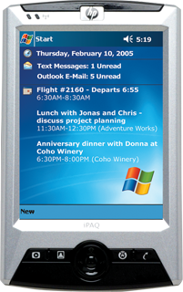



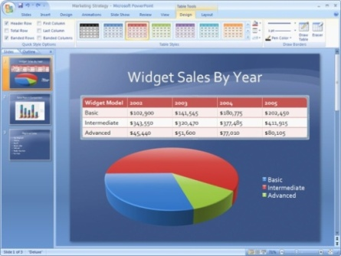

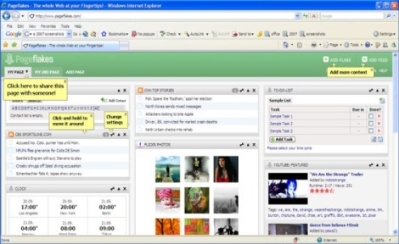







Your users demand a great experience
Clear
Aero
Sidebar
DirectX 10
Rich Preview

Slide 6

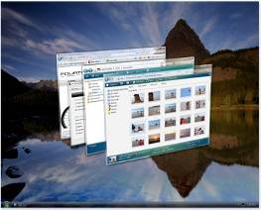
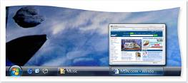

Windows Vista Aero
Visual quality and reliability
  Applications are no longer responsible for desktop updates
  Fewer CPU resources spent on application repaints: Programs appear more responsive
Style
  Focus on appearing professional,
  streamlined and efficient
  Immersive Windows Flip 3D for switching
Developer Value
  Higher capability, more compelling
  user interfaces that fully utilize all
  system resources
Aero – Vista Bridge – Search – Sidebar– WPF – Designer – UX

Slide 7

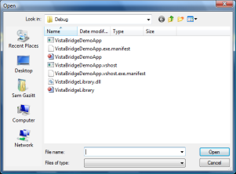
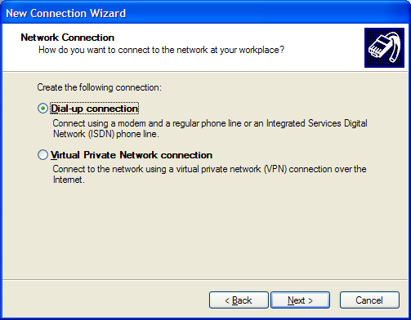
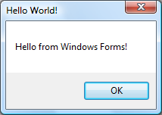
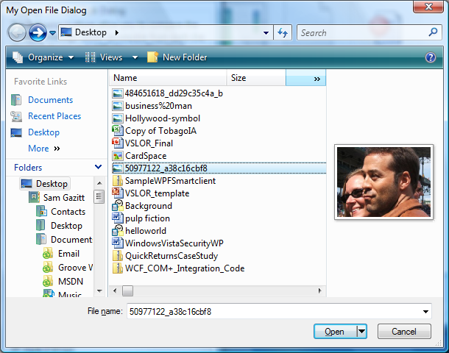
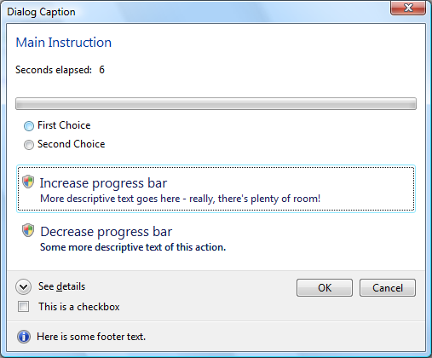
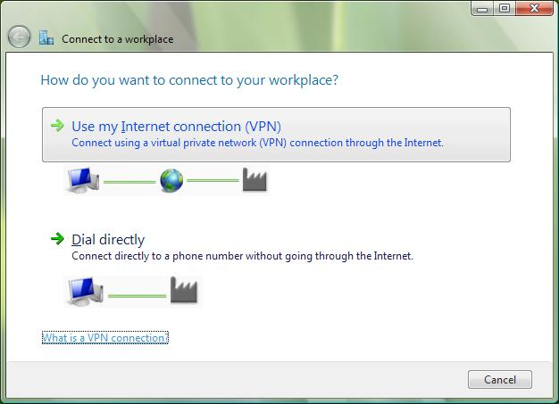
Use the Vista Bridge!
Aero – Vista Bridge – Search – Sidebar– WPF –Designer – UX

Slide 8
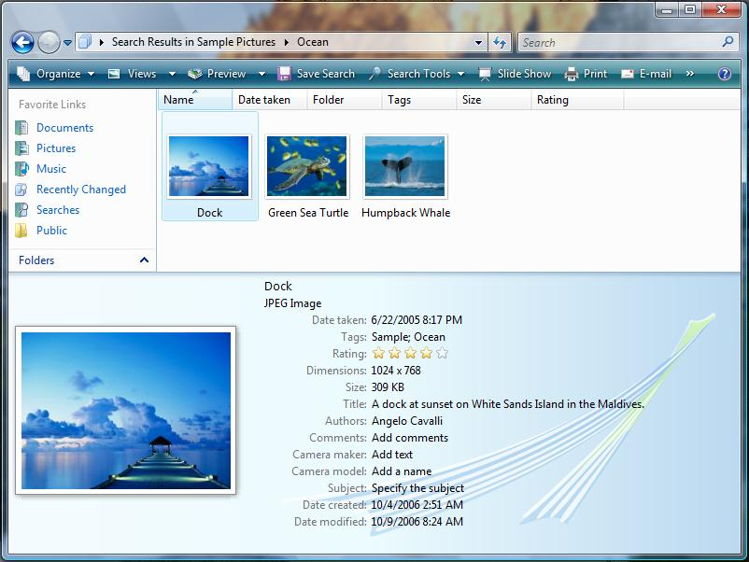
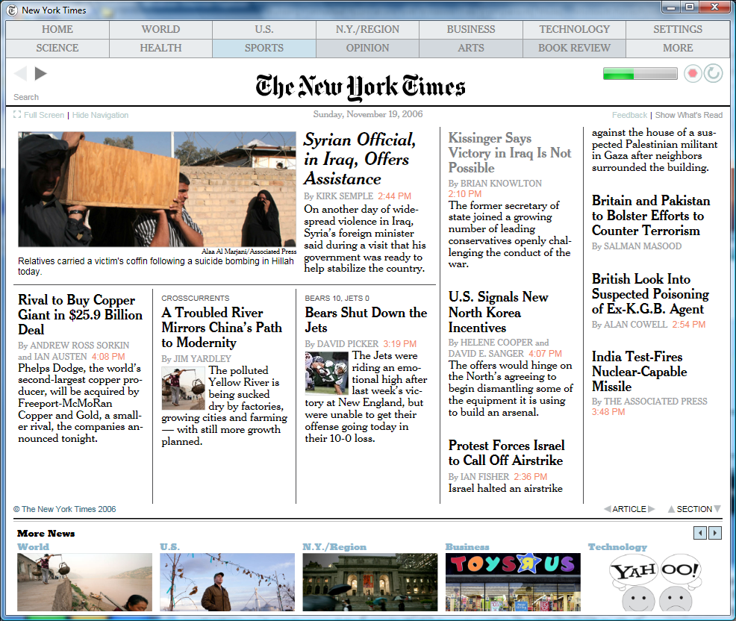
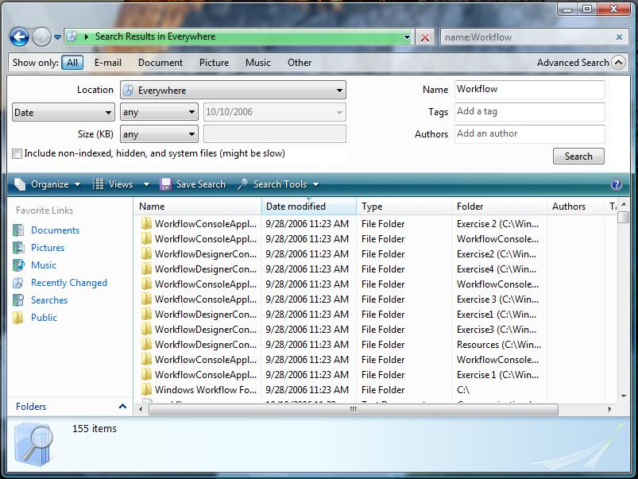
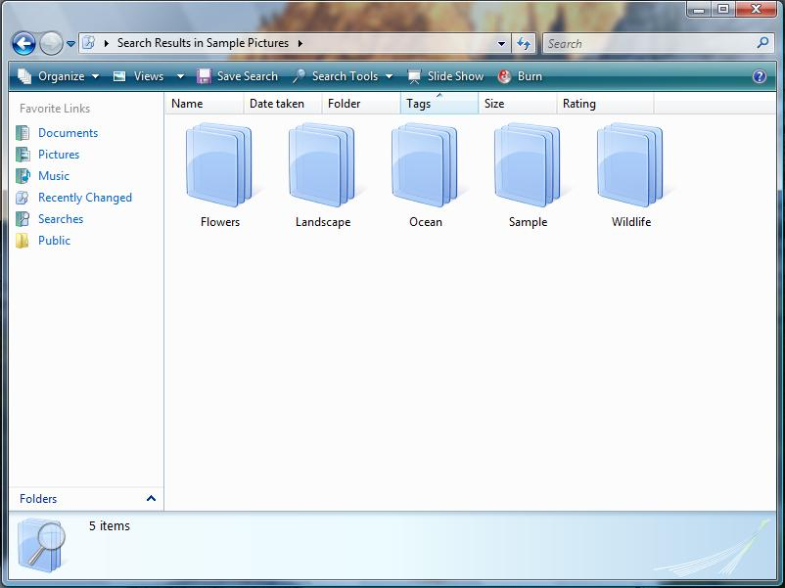
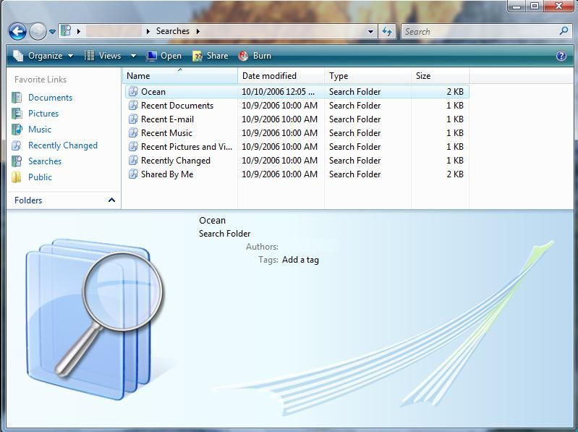
Data at your fingertips
End User View
  Filtering
  Stacking
  Search Folders
  Preview Pane
Can be integrated
into applications
Aero – Vista Bridge – Search – Sidebar– WPF – Designer – UX

Slide 9
Integrate Search into your applications
Built-in client indexing platform and property system
Search is fully integrated throughout Windows Vista
  Start Menu, Control Panel, Explorer Windows
Applications can build on top of this platform
  Outlook 2007 and OneNote 2007
Query APIs
    OLE DB Provider for Windows Search
    ISearchQueryHelper
Aero – Vista Bridge – Search – Sidebar– WPF – Designer – UX

Slide 10
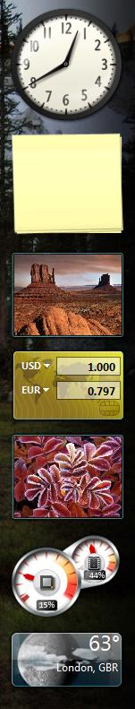
Windows Vista Sidebar Gadgets
Desktop Productivity Enhancement
  Hosts mini-applications for Desktop and Web
  Optimized for work and
  home scenarios
Non-intrusive user-experience
  “Less is More” Model
  Native support for std
  and widescreen displays
Aero – Vista Bridge – Search – Sidebar– WPF – Designer – UX

Slide 11

Windows Presentation Foundation and Windows Vista Sidebar
Show your clients the love!
Aero – Vista Bridge – Search – Sidebar– WPF – Designer – UX

Slide 12


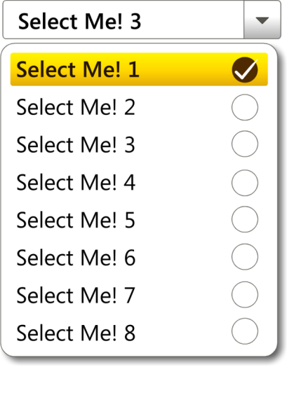
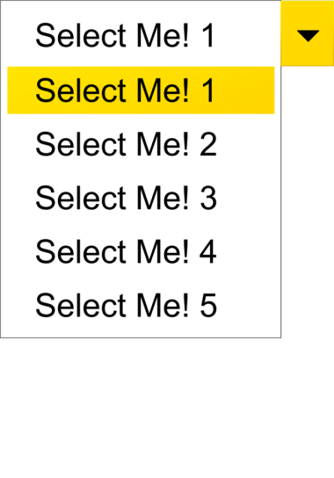







Designer-Developer Productivity
  With XAML designers & developers can streamline their collaboration
Designers design
Developers add business logic
Aero – Vista Bridge – Search – Sidebar– WPF – Designer – UX
Notes:
12

Slide 13
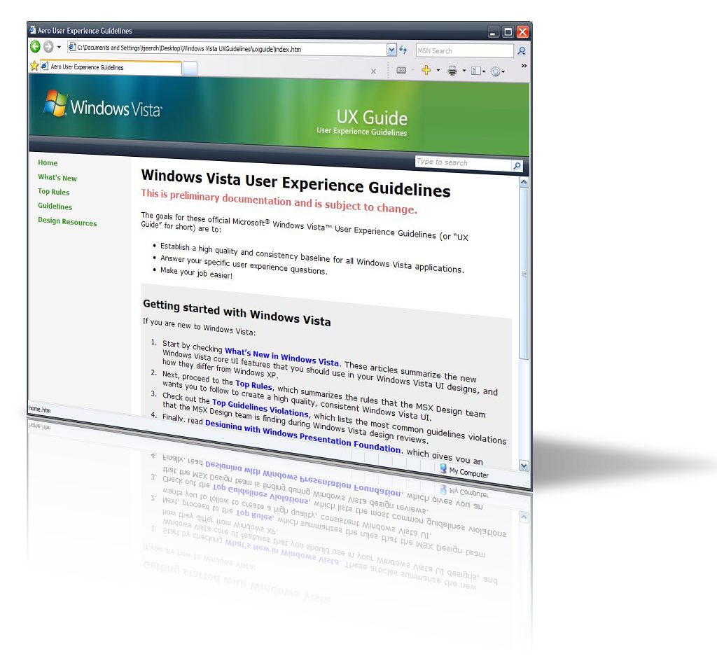
Windows Vista User Experience Guidelines
http://msdn.microsoft.com/windowsvista/uxguide
Aero – Vista Bridge – Search – Sidebar– WPF – Designer – UX

Slide 14
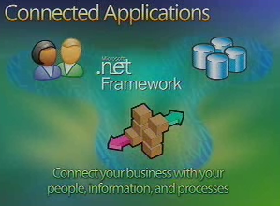
Connected
People Near Me
Search
RSS Support
IIS7

Slide 15




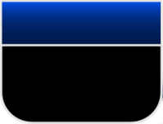

Unified Programming Model
ASMX
.NET Remoting
Interop
with other
platforms
Extensibility
Location transparency
Attribute-
Based
Programming
Message-
Oriented
Programming
WS-*
Protocol
Support
Enterprise Services
System.Messaging
WSE
WCF – WF – P2P – RSS – IIS7

Slide 16




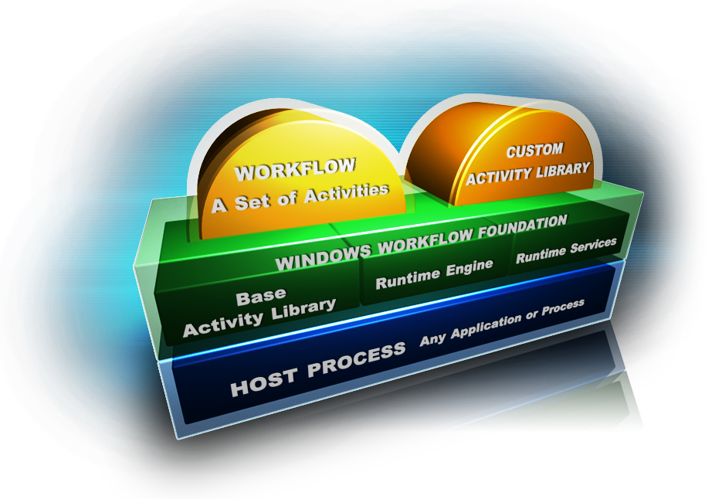


Windows Workflow Foundation
Long Running and Stateful Process Implementation
Flexible Control
Flow
Transparent Declarative Model Driven Software
Windows Workflow Foundation is the programming model, engine and tools for quickly building workflow-enabled applications on Windows.
WCF – WF – P2P – RSS – IIS7

Slide 17


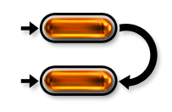
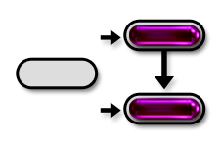


Flexible Control Flow
Sequential Workflow
State Machine Workflow
Rules-driven Activities
Event
State1
Rule1
Step1
Step1
Sequential structure
Prescribes processing order
Data
Event
State2
Rule2
Step2
Step2
External events drive processing order
Rules + data state drive processing order
Prescriptive, formal
Automation scenarios
Flowchart metaphor
Reactive, event-driven
Skip/re-work,
exception handling
Graph metaphor
Data-driven
Simple Conditions,
complex Policies
Constrained
Activity Group
WCF – WF – P2P – RSS – IIS7

Slide 18
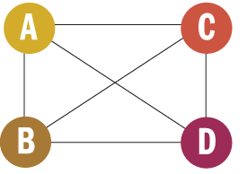
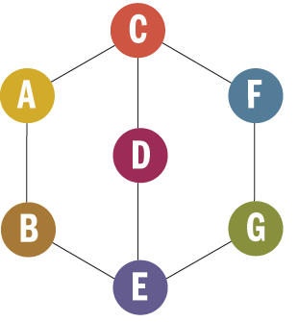
What is Peer-to-Peer(P2P)?
Directly communicating PCs
One-to-one, one-to-many, many-to-many
  Telephony and video
  Chat
  Co-editing
  Gaming
  Data access and replication
http://msdn.microsoft.com/msdnmag/issues/06/10/PeerToPeer/default.aspx
WCF – WF – P2P – RSS – IIS7

Slide 19
Why P2P?
Reduce reliance
on servers
Eliminate bottlenecks,
improve scalability
Lower deployment costs
and complexity
Faster data transmission
Support ad-hoc and
disconnected networks
Better resilience – no single
point of failure
Powerful social
interactions
Direct client
connections
Direct Client
Connections
P2P systems
Versatile
Connections
WCF – WF – P2P – RSS – IIS7

Slide 20
P2P Communication
Build your client network

Slide 21
RSS
Windows Vista with Internet Explorer 7.0 provides a new platform for working with RSS
  Windows RSS Platform is exposed via a COM library
The new API provides access to the Common Feed List (CFL)—a collection of RSS feeds that a user has subscribed too
Microsoft applications such as IE7 and Outlook 2007 support the CFL out-of-the-box
WCF – WF – P2P – RSS – IIS7

Slide 22
IIS7 Ships in Windows Vista!
Full featured Web server in Client OS
  Same version of IIS7 in Windows Server “Longhorn”
  Design, test, configure, deploy Web applications from IIS7 on desktop/laptop
Unlimited Sites, Unlimited Connections
  10 Simultaneous Requests
Full Backwards Compatibility
  Get started quickly!
WCF – WF – P2P – RSS – IIS7

Slide 23
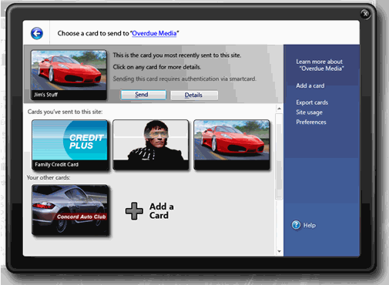
Confident
Security
Cryptography
Smart Cards
UAC

Slide 24




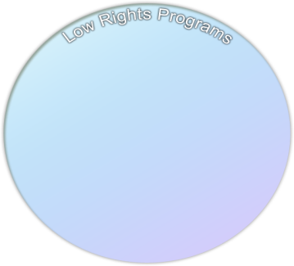



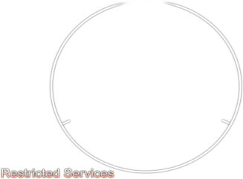




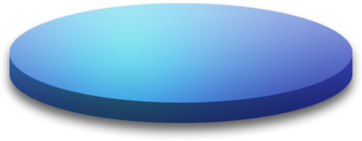

The most secure version of Windows built to date!
Engineering
for Security
Windows Service Hardening
Kernel Security
Improved Security Development Lifecycle (SDL) process
Threat modeling and code reviews
Common Criteria (CC) Certification
Runs services with reduced privileges
Services have profiles for allowed file system, registry, and network activities that are enforced by the firewall and ACLs
Make it harder for rootkits to elude detection
x64 Driver Signing
  Kernel-mode drivers must be signed
Kernel Patch Protection
  Kernel hooks by applications disabled
Secure Platform – UAC – CardSpace – Application Compatibility – VS’05

Slide 25



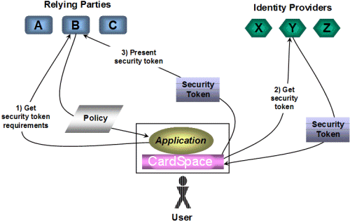


Enable Secure Access
User Account Control
Windows CardSpace
Easier to run as standard user
Parental controls
Greater protection
for administrators
Hardware-enabled
data protection
Provides full
volume encryption
Laptop and server scenarios
Replaces usernames and passwords with strong tokens
Provides consistent user experience
Protects users from Phishing
Supports two-factor authentication
Secure Platform – UAC – CardSpace – Application Compatibility – VS’05

Slide 26
Windows CardSpace
Keep other agents out of your contact list
Secure Platform – UAC – CardSpace – Application Compatibility – VS’05

Slide 27

Ensuring Compatibility
If your app runs correctly as a Standard User:
No action needed ☺
If your app doesn’t run as a Standard User:
Remove any operations that require elevated privileges
Set machine-wide settings during installation
If your app targets administrators:
Include a manifest and specify requestedExecutionLevel
If only certain operations require elevated privileges:
Factor into separate processes
Identify administrative operations with a “shield” icon
Secure Platform – UAC – CardSpace – Application Compatibility – VS’05

Slide 28
Visual Studio 2005 on Windows Vista
Install Visual Studio 2005 Service Pack 1
  http://msdn2.microsoft.com/en-us/vstudio/bb265237.aspx
  Run as administrator!
Install Visual Studio 2005 Service Pack 1 Update for Windows Vista
  http://go.microsoft.com/?linkid=6366078
  Run as administrator!
Windows Vista Developer Center Downloads
  http://msdn2.microsoft.com/en-us/windowsvista/aa904955.aspx
  Windows SDK
  WF / WCF / WPF Extensions
Secure Platform – UAC – CardSpace – Application Compatibility – VS’05

Slide 29



Best tool set for Office 2007 & Windows Vista
Expanded Role- based &
Team offerings
Complete AJAX and SOA platform support
Improved Language & Data integration

Slide 30


code name ‘Orcas’
Best tool set for Office 2007 & Windows Vista
  WCF, WF, and WPF Designers
  Office 2007 support including ClickOnce & VSTO
  Integrates designer & developer workflow
Expanded Role-based & Team offerings
  Database developer tools
  Expanded enterprise load testing
  Improved test management
Complete AJAX support
  Expressive and standards compliant
  Better designer and developer collaboration
  Delivers a secure, scalable platform
Improved Language & Data integration
  Simple and powerful data access with LINQ
  Develop application concepts with models built using ADO.NET entities
  Create workflow based applications with integrated workflow tools

Slide 31
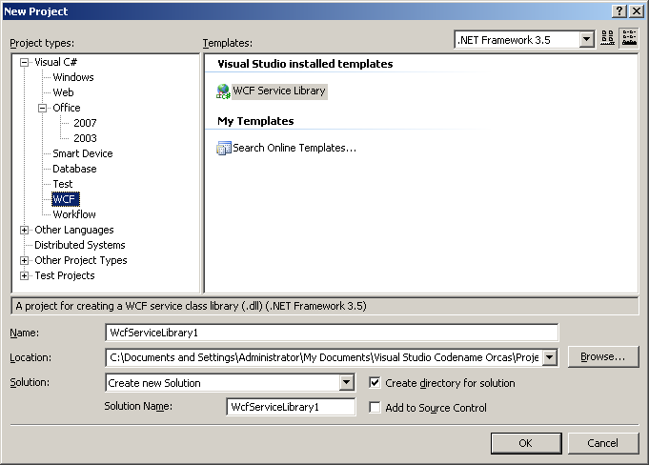
New Project Templates

Slide 32
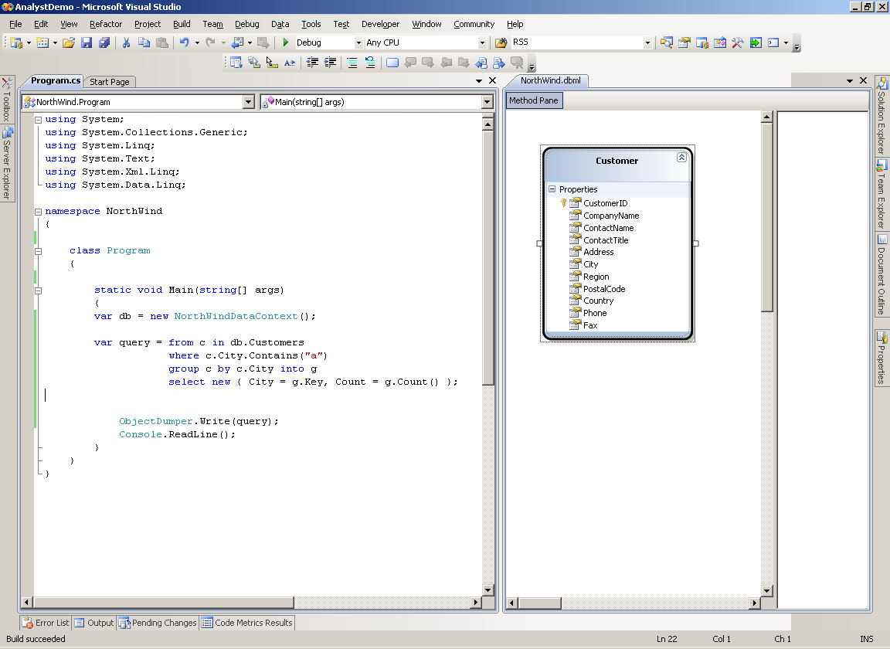
LINQ Design Surface

Slide 33
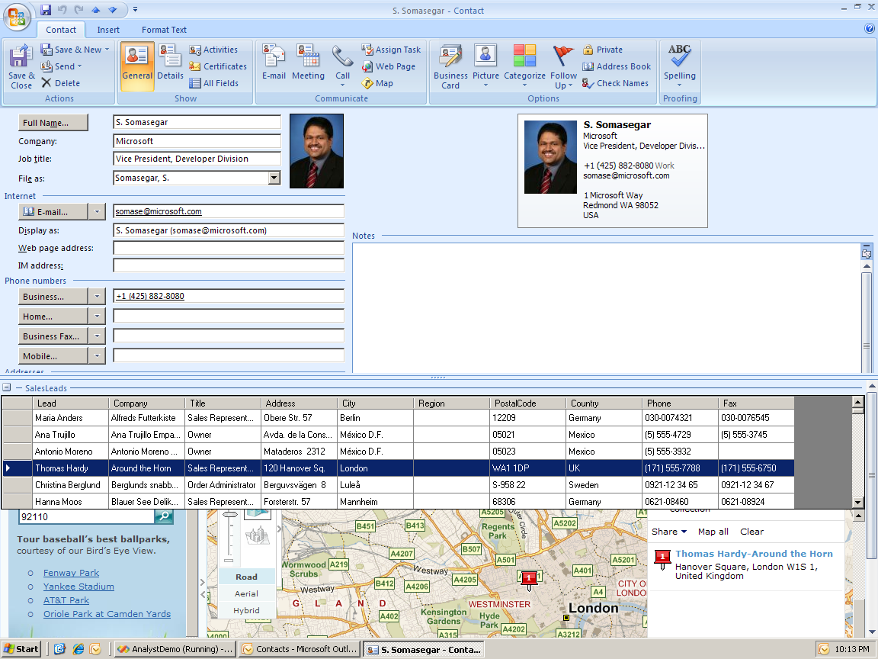
Outlook Add-ins in Action

Slide 34
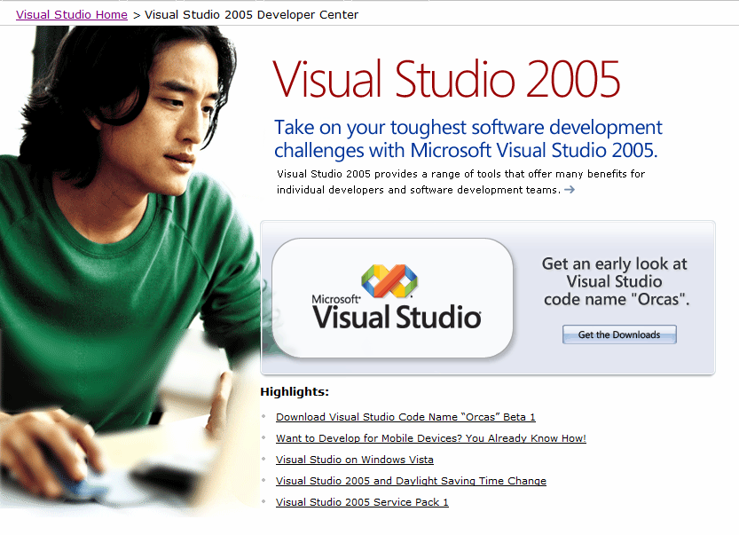
code name ‘Orcas’
http://msdn2.microsoft.com/en-us/vstudio/aa700831.aspx

Slide 35

Summary:
-Clear
-Connected
-Confident

Slide 36

© 2007 Microsoft Corporation. All rights reserved.
This presentation is for informational purposes only. Microsoft makes no warranties, express or implied, in this summary.

