Slide 2
Plug and Play Key Concepts
Jim Cavalaris
Lead Software Design Engineer
George Roussos
Senior Program Manager
Device Foundation Platform Team,
Device & Storage Technologies Group

Slide 3
Agenda
Prepared Content
  Device Installation Fundamentals
  Device and Driver Installation Scenarios
  Hardware-First Installation Sequence
    Search
    Select
    Stage
    Install
  Software-First Installation
  OEM Preload (OS Offline)
  Extending Device Installation
Audience Q&A

Slide 4
Fundamentals
  Device Instance
    A unique instance of a model of device detected by the system or other components
    Software and settings are configured for each device instance detected by the system
  Device ID
    A fundamental characteristic describing the model of a device
  Driver Package
    .INF File and all the files it copies
    Describes software and default settings for applicable devices
    Defines applicability to devices using Device IDs
    Driver Packages may apply to multiple models of devices
    Devices may be supported by multiple Driver Packages

Slide 5
Fundamentals
  Driver Store
    Local store containing software and settings supported by the system
  Driver Selection
    Process of selecting the “best” software and settings to configure for a device
  Device Installation
    Process of configuring a device with selected software and settings

Slide 6
Device IDs
Identifies the model of hardware
  Format defined by bus driver
  Treated as opaque strings – are not parsed!
Discovered before drivers selected
Used to select matching drivers
Reported by drivers as two separate lists
  Hardware IDs
    Usually includes manufacturer and model information
  Compatible IDs
    Usually includes “generic” IDs
      Without specific manufacturer or model information
    Compatible IDs considered for match only after Hardware IDs
Each list is ordered from most to least specific
Hardware IDs:
USB\Vid_vvvv&Pid_pppp&Rev_rrrr
USB\Vid_vvvv&Pid_pppp
Compatible IDs:
USB\Class_cc&SubClass_ss&Prot_pp
USB\Class_cc&SubClass_ss
USB\Class_cc

Slide 7
Driver Packages
Consists of the INF file and any associated files
  Simple text file (INF file), required
  Driver files (.sys, .dll files), optional
  Digital signature (.cat), best practice
Describes supported devices
  Hardware IDs, Compatible IDs
  A package’s IDs are the “applicability rules”
Specifies associated files
  Where to find them relative to INF
  Where to copy them on system
Defines settings
  Instance-specific default registry settings
Driver Package
INF
ID1, ID2, ID3,…
File 1
File 2
File 3
File 4

Slide 8
Driver Store
Driver Store
INF 1
File 1
File 2
Local copy of complete driver packages
  All files required for all devices supported by the INF are always present
  Drivers are available to the System to automatically install new devices without user intervention (“hardware-initiated”)
A driver package must be “staged” to the Driver Store before the driver can be used to install any devices
  “Driver staging“ and “Device installation” are logically separate operations
File 3
File 4
INF 2
File 1
File 2
File 3
File 4
INF 3
File 1
File 2
File 3
File 4
. . .

Slide 9
Device and Driver Installation Scenarios
Most developers consider installation with an interactive user present.
How many of you have thought about device installs in the following contexts?
  OS installation
  OS SKU upgrade (e.g., Home Basic to Ultimate)
  OS Service Pack install
  Settings transfer from old PC to new PC (same or different OS versions)
  Home Server machine recovery—boot client off CD & restore system from image on Home Server
  Hardware first install before user logs in
  OEM factory floor preloads where no user is logged in
  IT department mass deployment with no interactive user
  IT department remotely pushing a driver update to a machine where the user doesn’t have administrator credentials
  Windows Update, Auto Update
  Headless server, Terminal Server, etc.

Slide 10
Device and Driver Installation Scenarios
Encourage you as developers to concentrate on the general case of device installation and avoid special-casing specific install scenarios.
Attend “The Driver Store: Creating Deployable Driver Packages” presentation about authoring installs to work in these scenarios.

Slide 11
Hardware-First Installation Sequence
A Hardware-First Installation is triggered when a user attaches a device to a system.
Go through a sequence that illustrates what PnP does in Windows Vista from the point at which a user attaches a USB mouse up to when a user can use that device.
Four phases of Hardware-First Installation Sequence:
Search
Select
Stage
Install

Slide 12
Search
The Search phase defines where PnP searches for drivers that match a device, and in what sequence.
Search
Select
Stage
Install

Slide 13
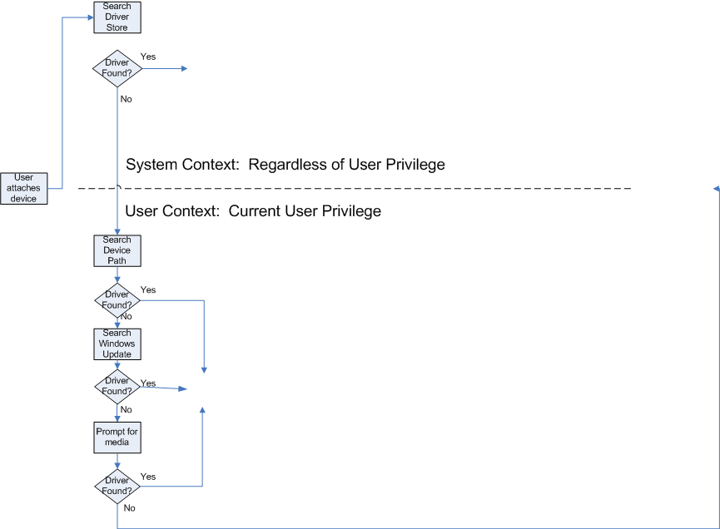
Search
Select
Found New Hardware Wizard
Select
Driver Not Found

Slide 14
Select
The Select phase is where Ranking occurs.
Ranking is the method PnP uses to determine the best driver match from more than one available device driver install package for a device.
Rank Factors – in a progressive tie-breaker fashion:
  Signature for driver package
  Feature score (primarily matters for Display choosing XP or Vista driver model)
  Rank of matching Device ID (Hardware ID or Compatible ID)
  DriverVer Date field
  DriverVer Version field
Given two packages, if both are equivalently signed, next PnP compares the feature score, then Hardware ID, and so forth to determine which is the best driver match
For details, see How Setup Selects Drivers (Windows Vista)
http://msdn2.microsoft.com/en-us/library/aa477022.aspx
Select
Search
Stage
Install

Slide 15
Driver Selection
Find common IDs between device and driver packages
  Exact ID match required
Best match determined by “driver ranking” algorithm
  Position of matching ID in
  Device’s ID lists
  Position of matching ID in
  INF’s ID list
  Digital signature “score”
  Date, Version used for tiebreaker only!
If selected driver is not present in the Driver Store, it must first be “staged”
INF
ID1, ID2, ID3,…
best match
File 1
File 2
File 3
File 4
Hardware IDs:
USB\Vid_vvvv&Pid_pppp&Rev_rrrr
USB\Vid_vvvv&Pid_pppp
Compatible IDs:
USB\Class_cc&SubClass_ss&Prot_pp
USB\Class_cc&SubClass_ss
USB\Class_cc
INF
ID1, ID2, ID3,…
File 1
File 2
other match
File 3
File 4
no match!!
INF
ID1, ID2, ID3,…
File 1
File 2
File 3
File 4

Slide 16
Stage
The Stage phase is where driver packages are imported into the Driver Store (if not already staged) before installation.
Digital Signature evaluation occurs during the Stage phase.
De-couple staging from installation of drivers. Two distinct operations in Windows Vista and onwards.
Different permissions required to stage vs. install drivers, which enables more Standard User device installation scenarios.
Stage
Search
Select
Install

Slide 17
Driver Staging
Driver Disk
May be Original Media, Windows Update, DevicePath, Local Directory or Network Share, etc.
INF
File 1
File 2
File 3
File 4
Allows flexible access rights requirements for user-initiated store importation
Digital signature validation and unsigned driver consent prompt performed only once
System actions
Drivers can be “staged” independently of device installation
Driver Store
INF
File 1
File 2
File 3
File 4

Slide 18
Install
The Install phase configures the device; it loads and starts executing the driver.
Installation is performed in a non-interactive system context regardless of permission of any currently logged in user.
Loads the driver into memory and instantiates against a specific device instance.
A Finish-Install Action or Co-installer may be launched at the end of the Install phase.
Install
Search
Select
Stage

Slide 19

Device Installation
User privilege not required to directly manipulate files or settings
Allows flexible access rights requirements for user-initiated device installation
System actions
No additional signature or file prompts for installation of devices using staged drivers
Driver Store
Target Destination
INF
File 1
File 2
File 3
File 4
File 3
File 4

Slide 20
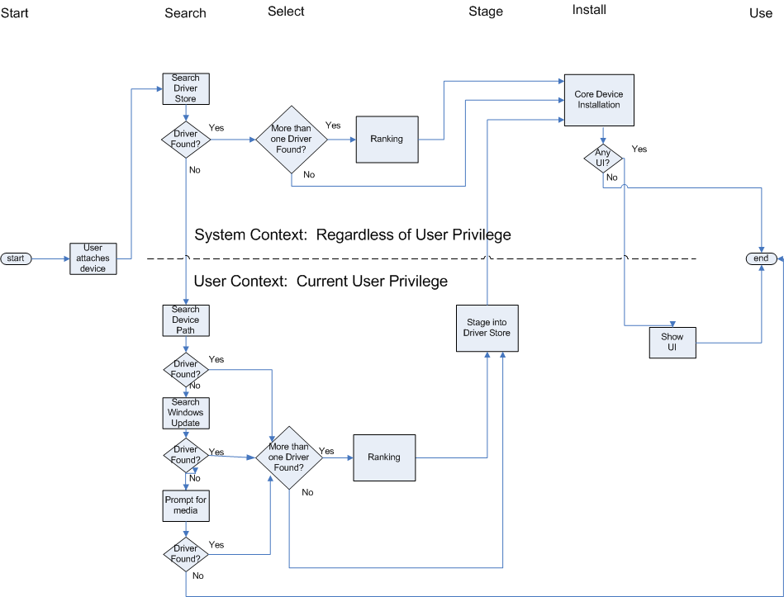
Hardware-First Install Sequence
Search
Select
Stage
Install

Slide 21
Hardware-First Installation
Driver Disk
INF
File 1
File 2
File 3
File 4
Software or user selection of “unstaged” driver
System actions
Driver Store
Target Destination
INF
File 1
File 2
File 1
File 2
Re-select “staged” driver
File 3
File 4

Slide 22
Software-First Installation
A Software-First install is a Hardware-First Install preceded by running a Setup.exe application.
The Software-First Install sequence of events is:
An interactive user with Administrative credentials launches Setup.exe application.
Setup.exe stages the driver install package by calling an API like SetupCopyOEMInf, DiInstallDriver, or DIFx DriverPackagePreinstall.
Setup.exe *may or may not* force the selection of the driver install package using the “force” flag.
Setup.exe triggers driver package install by calling UpdateDriverForPlugAndPlayDevices, DiInstallDevice, or DIFx DriverPackageInstall.
Setup.exe can perform other actions—such as installing applications—before or after installing the device.
Stage
Select
Install

Slide 23
Software-First Installation
Driver Disk
INF
File 1
File 2
File 3
File 4
System actions
System selection of “staged” driver
Driver Store
Target Destination
INF
File 1
File 2
File 3
File 4
File 3
File 4

Slide 24
OEM Preload (OS Offline)
During an OEM Preload, staging occurs under a different “Host” OS like WinPE.
  There is no means for user input during staging beyond specifying file name.
Key Definitions
  Offline Windows image (OS Offline)
    A Windows image that is not currently running, either an image in a .wim file or a Windows installation on a separate partition.
  Online Windows installation (OS Online)
    A Windows installation currently running on the computer

Slide 25
OEM Preload (OS Offline)
The OEM Preload (OS Offline) Install Sequence of events is:
Host OS OS install on Target machine
During OS install on Target machine there is no means for user input during search, select, install.
Stage
Search
Select
Install

Slide 26
Extending Device Installation
How do I install applications related to a device as part of a Hardware-first Installation?
  Co-installer
  Finish-install action
Each approach has pros and cons. We encourage interested parties to attend the following sessions:
    The Driver Store: Creating Deployable Driver Packages
    Extending Device Installation by Using Co-Installers

Slide 27
Key Takeaways
Consider the vast number of different installation scenarios when authoring your driver packages.
  Assume that someone is going to use your driver package in other installation scenarios than you originally intended.
  Don’t hard-code for one installation scenario.
    Software-first, non-Administrator users, OS installation,
    Offline staging
  Recognize that the different phases of PnP installation occur in different sequences depending upon the installation scenario.
OS Offline is a new context introduced in Windows Vista that matters to OEMs and IT departments.
  Get the Windows Automated Install Kit (WAIK) and stage packages to offline images

Slide 28
Resources
Related Sessions
    Creating Deployable Driver Packages Mon. 1:30-2:30
    Extending Device Installation by Using Co-installers Mon. 4-5 and Wed. 1:30-2:30
Windows Automated Installation Kit (WAIK)
  Nearly identical to OPK
  Go to Microsoft.com, search for “Windows Automated Installation Kit” or “WAIK” and download from there
WDK documentation on MSDN
  How Setup Selects Drivers (Windows Vista)
  http://msdn2.microsoft.com/en-us/library/aa477022.aspx

