Slide 1
Serverová vlna pokračuje...
Ján Paulech
Server & Tools Business Group Lead
Microsoft Slovakia

Slide 2
Agenda – Ready to Sell
Windows Server 2008 - Virtualization
SQL Server 2008
DevTools
BizTalk
Small Business Server / Essentials Business Server 2008
System Center – management
Security
MS Learning, Technet
CAL Suites
…

Slide 3





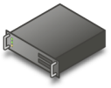




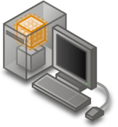



Microsoft Virtualization
A comprehensive set of virtualization products, from the data center to the desktop.
Assets – both virtual and physical – are managed from a single platform.
User State
Virtualization
Folder Redirection
Offline files
Server Virtualization
Presentation Virtualization
Desktop Virtualization
Application Virtualization
Notes:
…“Microsoft provides a full virtualization solution stack”…
Use the slide to present the breadth of Microsoft’s virtualization proposition
Focus the audience on Desktop Virtualization. I would recommend ignoring Presentation Virtualization at this point.

Slide 4






Virtualization Road Map
Now
2008
RTM
RTM
Microsoft Hyper-V
Server 2008
VMM 2007/
VMM 2008 Beta
Oct 2008 RTM
MDOP w/
SoftGrid 4.2
MDOP w/ MAV4.5
Updated w/ Server 2008 guest support

Slide 5


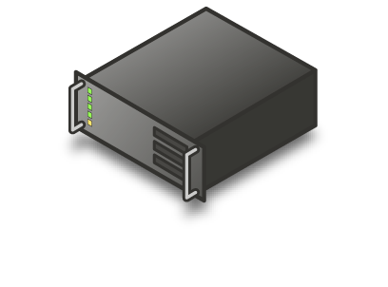











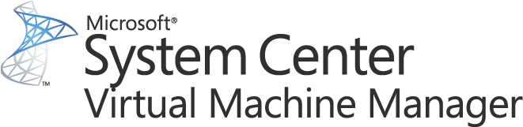


Virtualization
Server consolidation
Challenge
  Real Estate Costs
  Management overhead
  Lower server Utilization
  Power and Cooling Costs
  Impact on Environment
Solution
  Consolidated and Green Datacenter with Management
SQL
.NET
.NET
IIS
.NET
File & Print
Oracle
Hyper-V
VMM
Hyper-V
Hyper-V

Slide 6
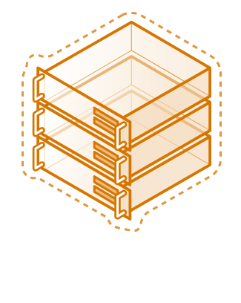
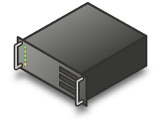
Virtualization
Server consolidation
Challenge
  Interoperability
  Virtualization Cost
  Management Complexity
Solution
  Consolidated and Green
  Datacenter with Management
  Coexistence with VMware
SQL
.NET
.NET
IIS
.NET
File & Print
Oracle
VM Ware
Hyper-V
VMM
Hyper-V
Hyper-V

Slide 7

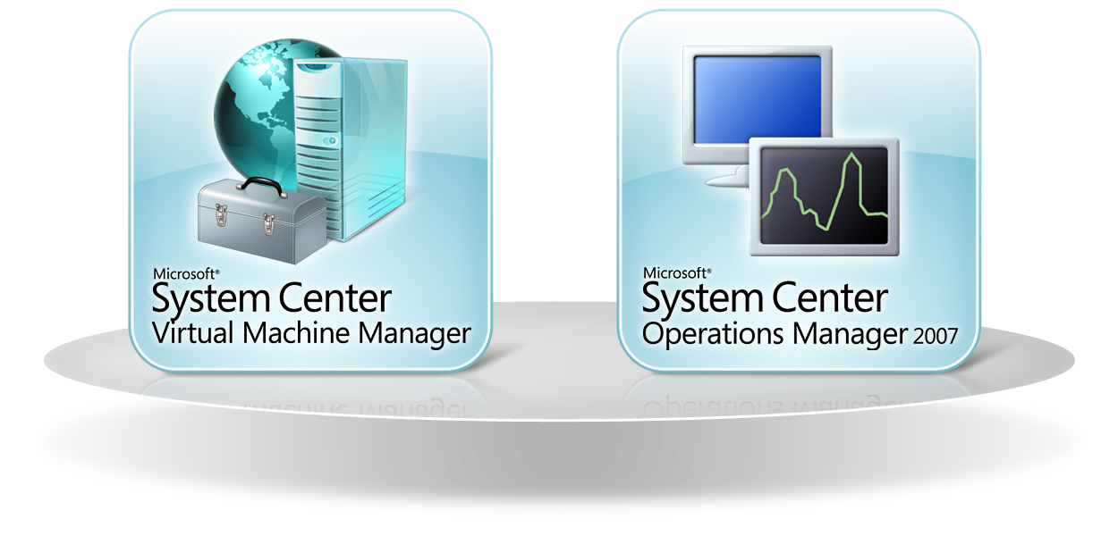

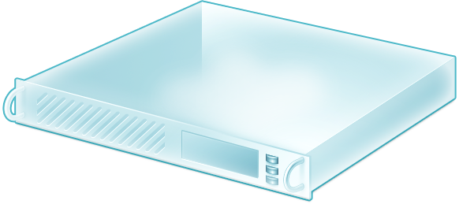


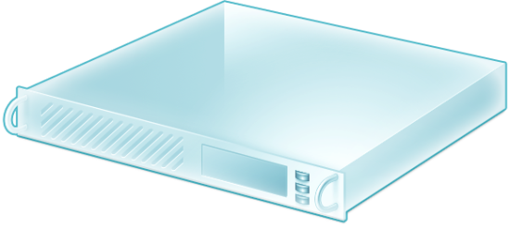
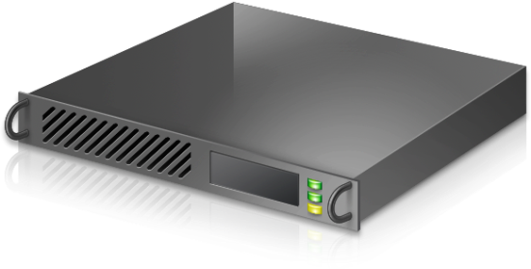


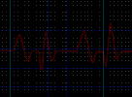
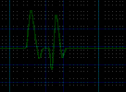
Virtual Machine Manager + Operations Manager
Performance And Resource Optimization (PRO)

Slide 8
3 MS produkty pre virtualizáciu serverov ???

Slide 9
Microsoft Virtual Server 2005
Microsoft Hyper-V Server
Hyper-V, feature of Windows Server 2008
Instances of WS from separate WS Licenses
Instances of WS as part of WS license or separate licenses
Windows
Windows
Virtual Server
Windows
Windows
Windows (parent partition)
Windows
Windows
Windows Server
Parent Partition
Hardware
Windows hypervisor
Windows hypervisor
Hardware
Hardware
Hosted Virtualization product
Can be managed by SCVMM
Scenarios
Virtualization on 32-bit systems
Virtualization on systems with no support for IVT/AMD-V
Hypervisor-based
Windows hypervisor and other components, kernel, drivers
Can be managed by SCVMM
Scenarios
Basic virtualization
Consolidation of Linux only workloads
Hypervisor-based
Role in Server Core or full installation of Win Server 2008
Can be managed by SCVMM
Scenarios
Rich and robust virtualization

Slide 10

Scenario |  | Microsoft Hyper-V Server | Windows Server 2008
Processor Architecture | 32 bit | Use Virtual Server 2005 R2 SP1
 | 64 bit
Server Consolidation | Basic
 | Robust
Development & Test
Business Continuity
Dynamic Datacenter
Scalability |  | (32GB) | (Upto 1TB memory depending on WS edition)
Virtualization Rights |  |  | Std Edition (1 physical: 1 virtual) Enterprise Edition (1 physical: 4 virtual instances) Datacenter Edition (1 physical: unlimited virtual instances)
 |  | Basic and Simplified Virtualization | Rich and Robust Virtualization
Key Competitive Products |  | VMware ESX Server 3i Citrix XenServer Express Edition | VMware VI Citrix XenServer Standard & Enterprise Editions

Slide 11
Odporúčaná virtualizačná platforma ???
Windows Server 2008 with Hyper-V

Slide 12
Windows Server 2008 Standard Edition
1 fyzické a 1 virtuálne OSE
Spúšťanie aplikácií vo fyzickom OSE
Spúšťanie aplikácií vo virtuálnom OSE
Aplikačný softvér
Aplikačný softvér
Aplikačný softvér
Aplikačný softvér
Windows Server
Windows Server
Windows Server
Hypervisor
Hypervisor
Serverový hardvér
Serverový hardvér
Oddelenie SW od HW !!!

Slide 13
Windows Server 2008 Enterprise Edition
1 fyzické a 4 virtuálne OSE
Spúšťanie aplikácií vo fyzickom OSE
Spustenie všetkých 4 virtuálnych prostredí OSE
Aplikačný softvér
Aplikačný softvér
Aplikačný softvér
Aplikačný softvér
Aplikačný softvér
Aplikačný softvér
Aplikačný softvér
Aplikačný softvér
Aplikačný softvér
Aplikačný softvér
Aplikačný softvér
Aplikačný softvér
Aplikačný softvér
Aplikačný softvér
Aplikačný softvér
Aplikačný softvér
Windows Server
Windows Server
Windows Server
Windows Server
Windows Server
Windows Server
Windows Server
Windows Server
Windows Server
Hypervisor
Hypervisor
Serverový hardvér
Serverový hardvér
Iba správa

Slide 14
Windows Server 2008 Datacenter / Itanium
1 fyzické + neobmedzený počet virtuálnych OSE
Aplikačný softvér
Aplikačný softvér
Aplikačný softvér
Aplikačný softvér
Aplikačný softvér
Aplikačný softvér
Aplikačný softvér
Aplikačný softvér
∞
Aplikačný softvér
Aplikačný softvér
…
Windows Server
Windows Server
Windows Server
Windows Server
Windows Server
Hypervisor
Serverový hardvér

Slide 15
Odporúčaná virtualizačná platforma ???
Windows Server 2008 with Hyper-V
Datacenter Edition

Slide 16
Virtualizácia – MS SK FY09
Prípadové štúdie, referencie – MS podpora
Partnerské podujatia – MS co-sponsoring
Školenia pre partnerov (semináre, HOLy, certif.)

Slide 17
Agenda – Ready to Sell
Windows Server 2008 -Virtualization
SQL Server 2008
DevTools
BizTalk
SBS / EBS 2008
System Center – management
Security

Slide 18















Your Data Any Place, Any Time
Enterprise Data Platform
Services
Reporting
Integration
Analysis
Synch
Entity Data Model
Beyond Relational
FILE
Query
RDBMS
OLAP
Search
XML
Dynamic Development
Mobile and
Desktop
Cloud
Storage
Datacenter
Pervasive Insight

Slide 19
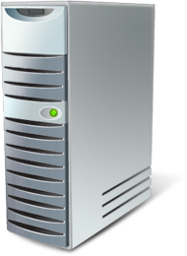
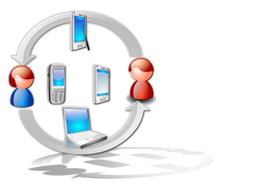







Trusted
Productive
Intelligent
Protect your information
Ensure business continuity
Predictable response
Manage by policies
Simplify app development
Store any information
Integrate data
Deliver relevant information
Drive actionable insights
Notes:
SQL Server 2008 was released in August and is available to all customers!
SQL Server 2008 enables you to manage this data explosion with a trusted, productive and intelligent data platform.
SQL Server provides a trusted platform by providing the highest levels of security, reliability and scalability for your mission critical applications
SQL Server provides a productive platform by reducing the cost of managing your data with enterprise wide policies, bring applications faster to market with integrated development environment of Visual Studio and .NET Framework, consistent programming experience from device to the data center and the ability to manage wide variety of information with extended support for Documents, XML and Spatial information
SQL Server provides an intelligent data platform that delivers insights and information to all users within your organization with enterprise reporting and comprehensive analytics while delivering the information directly through Microsoft Office.

Slide 20
SQL Server 2008 - Key Business Opportunities
Upgrade Existing
Microsoft SQL Server
Migrate from
Other Database
Sell to
New Customer
High Impact Service Opportunities
with Microsoft SQL Server 2008
Enterprise Application Development and Integration
Business Intelligence
Data Warehousing
Server Consolidation & Optimization
Compliance
Mobile and Web Application
Notes:
This slide introduces the Partner “High Impact Service Opportunities” (Blue bars) that span across the different buying cycles.
The three buying cycles are:
Upgrade existing SQL Servers (2005, 2000, 7.0 etc)
Migrate from competitive Database (Oracle, IBM DB 2, etc)
Identify a new customers that would benefit from SQL Server 2008
We will go into specific details on each of these High Impact Service Opportunities later in the presentation.

Slide 21
Top Executive Priorities
Source: Gartner EXP (January 2008)
Top 10 Business Priorities
1 | Business process improvement
2 | Attracting and retaining new customers
3 | Creating new products and services (innovation)
4 | Expanding into new markets or geographies
5 | Reducing enterprise costs
6 | Improving enterprise workforce effectiveness
7 | Expanding current customer relationships
8 | Increasing the use of information and analytics
9 | Targeting customers and markets more effectively
10 | Acquiring new companies and capabilities (mergers and acquisitions)
Top 10 Technology Priorities
1 | Business Intelligence Applications
2 | Enterprise Applications (ERP, CRM and others)
3 | Servers and Storage Technologies
4 | Legacy Modernization, Upgrade or Enhancement
5 | Technical Infrastructure
6 | Security Technologies
7 | Networking, Voice and Data
8 | Collaboration Technologies
9 | Document Management
10 | Service-Oriented Architecture (SOA) and Service-Oriented Business Applications (SOBA)

Slide 22




Microsoft Integrated BI Offering
DELIVERY
COLLABORATION
CONTENT MANAGEMENT
SEARCH
SharePoint Server
Reports
Dashboards
Excel
Workbooks
Analytic
Views
Scorecards
Plans
END USER TOOLS & PERFORMANCE MANAGEMENT APPS
Excel
PerformancePoint Server
BI PLATFORM
SQL Server
Reporting Services
SQL Server
Analysis Services
SQL Server DBMS
SQL Server Integration Services

Slide 23











Comparative Pricing
$329k
$348–464k
Multi-core
OLAP: $ 20k
Mining: $20k
BI Bundle: $20k
OLAP: $35k
Warehouse: $75k
Cube Views: $9.5k
Business Intelligence
Data Guard: $116k
Recovery Expert: $10k
Tuning Pack: $3k
Diagnostic Pack: $3k
Partitioning: $10k
High Availability
Performance
Expert: $10k
Manageability
Base Software
$25k
$40k
$25k
*Estimated retail pricing as of November, 2005 (SQL Server 2005)

Slide 24
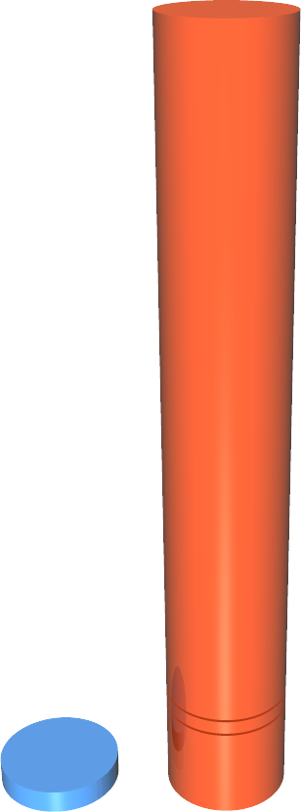

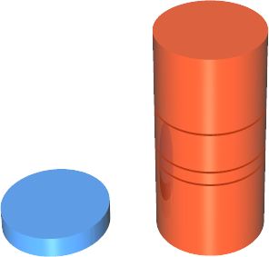
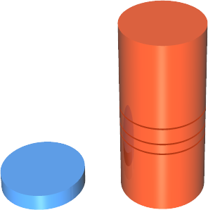


$1,398K
14x
Compare prices in scenarios
BIEE Suite Plus
$1,364K
DATA WAREHOUSING Scenario
OLTP
Scenario
BUSINESS INTELLIGENCE Scenario
$528K 10x
$494K 10x
BI: OLAP & DM
$184K
Remote Mirroring
$264K
Partitioning
Compression
$92K
Security
$46K
$100K
$50K
Manageability
$28K
$50K
Manageability
$28K
Manageability
$28K
Performance Point
$50K
SQL Server 2008
$50K
Oracle 11g
$190K
SQL Server 2008
$50K
Oracle 11g
$190K
SQL Server 2008
$50K
Oracle 11g
$190K
Note: 1. the price comparison is based on a server with 2 proc, 4 core ; see slide notes for details; based on public prices
2. Comparison is between SQL Server 2008 Enterprise Edition and Oracle 11g Enterprise Edition
Notes:
“When you take a look at it, good things happen to good people. One of the greatest gifts we've been given in years is Oracle just recently decided to raise the price 15 to 20 percent across the board on all their products. And my favorite quote here is from the CIO in India, Oracle can afford to hike prices like this, because people can't change their database environment overnight. The CIOs I know, if you're going to raise prices across the board 15 to 20 percent, most of the great CIOs in the world will say, watch me.
The thing that I would tell you here, with the tough economic, and challenging economic environments that all of us have, when you raise prices, and put it on your Web site, across the board 15 to 20 percent, you're either extremely bold and confident, or something else. And I'll let you figure out what the something else is. But, when you look at the delta that we have with SQL, it is unbelievable. Just take a look at this, these are list prices, no Oracle discount, but these are their list prices. And when you look at this from a data warehousing standpoint, almost $500,000 to $50,000, business intelligence, $528,000 to $50,000, online transaction processing $1.3 million to $50,000.
Now, I don't know about you but I love to compete with great products at a cheaper price. It makes up for a lot of opportunities. So the big challenge, our go do, which is want I talked to our field about, our go do, ours, yours and mine, is let's go win some Oracle databases. Let's save customers money. Can we do that. We're going to do that, and we're going to have a lot of fun doing it.”
As this builds - This shows you a comparison between SQL 2008 EE vs. Oracle 11g EE across 3 different scenarios – Data Warehousing, BI & Online Transaction Processing, running in a 2 proc, quad core server.
Data came directly from Oracle’s public price list
Pricing for SQL Server 2008 EE: $25K / proc (or $50K for 2 proc)
Important take away here – SQL server includes a huge amount of value for customers in the box
We give customers the flexibility and choice for the workloads they need to run at one price point
Not only do we lead in price – we win in benchmarks & security
This is a prime time for use to Win Share from Oracle
Prices are taken from Oracle public price lists: http://www.oracle.com/corporate/pricing/technology-price-list.pdf
SQL Server 2008 EE: $25K / proc (or $50K for 2 proc)
PPS Server pricing: $20K per server plus $30K for unlimited external connector http://www.microsoft.com/business/performancepoint/howtobuy/default.aspx
PPS system requirement: http://www.microsoft.com/business/performancepoint/productinfo/systemrequirements.aspx
DATA WAREHOUSING SCENARIO:
Oracle database 11g EE: $47.5K / per every 2 cores = $190K for 2 procs with 4 core
Manageability: two packs: diagnostics and tuning packs. $3.5K / proc (per 2 cores), so $14K per pack, total $28K
Partitioning option: $11.5K / proc(2 cores) = $46K
Compression option: $11.5K / proc(2 cores) = $46K
OLAP option: $23K/proc, total $92K
Data mining option: $23K/proc, total $92K
TOTAL: $494K
BUSINESS INTELLIGENCE SCENARIO:
Oracle database 11g EE: $47.5K / per every 2 cores = $190K for 2 procs with 4 core
Manageability: two packs: diagnostics and tuning packs. $3.5K / proc (per 2 cores), so $14K per pack, total $28K
BI EE Suite Plus: $295K/proc (2 cores), or $1,180K
TOTAL: $1,398K
OLTP SCENARIO
Oracle database 11g EE: $47.5K / per every 2 cores = $190K for 2 procs with 4 core
Manageability: two packs: diagnostics and tuning packs. $3.5K / proc (per 2 cores), so $14K per pack, total $28K
Advanced Security: $11.5K/proc (2 cores), total $46K
subtotal: $264K
HA: it is calculated as 2x the base cost, as mirroring requires additional license, so 2x $264K
It is even MORE if you add RAC to this scenario, as each RAC/proc (2 cores) is $23K, so it would add $92K for this single server
TOTAL: $528K

Slide 25
Even with an 80% discount,
Oracle still more expensive
BUSINESS INTELLIGENCE Scenario
DATA WAREHOUSING Scenario
OLTP
Scenario
$317K
3x
BIEE Suite Plus
$273K
$106K
2x
$99K
2x
Remote Mirroring
$53K
$100K
BI: OLAP & DM
$37K
$50K
Partitioning
Compression
$18K
$50K
Security
$9K
Performance Point
$50K
Manageability
$6K
Manageability
$6K
Manageability
$6K
SQL Server 2008
$50K
SQL Server 2008
$50K
SQL Server 2008
$50K
Oracle 11g
$38K
Oracle 11g
$38K
Oracle 11g
$38K
Note: 1. the price comparison is based on a server with 2 proc, 4 core ; see slide notes for details; based on public prices
2. Comparison is between SQL Server 2008 Enterprise Edition and Oracle 11g Enterprise Edition
Notes:
Let’s talk about Oracle “discounts”. Many customers do not pay full price for Oracle software. Oracle pricing structure is set up for negotiation and the better the customer negotiates, the lower the price will be. For example, some companies helped Oracle by writing some software and in return, they do not pay for Oracle licenses. Amazon, is a good example, where they helped Oracle develop what is now called Oracle Enterprise Manager Grid Control.
So let’s say that you are a great negotiator (and are not in a position to help Oracle write software like Amazon did). And let’s say that you are able to negotiate a massive 80% discount for your Oracle license! Even with that extreme discount, SQL Server full price is still a better value than Oracle. In fact, at that discount, Oracle still costs ~300% more than SQL Server.
Prices are taken from Oracle public price lists: http://www.oracle.com/corporate/pricing/technology-price-list.pdf
SQL Server 2008 EE: $25K / proc (or $50K for 2 proc)
PPS Server pricing: $20K per server plus $30K for unlimited external connector http://www.microsoft.com/business/performancepoint/howtobuy/default.aspx
PPS system requirement: http://www.microsoft.com/business/performancepoint/productinfo/systemrequirements.aspx
DATA WAREHOUSING SCENARIO:
Oracle database 11g EE: $47.5K / per every 2 cores = $190K for 2 procs with 4 core
Manageability: two packs: diagnostics and tuning packs. $3.5K / proc (per 2 cores), so $14K per pack, total $28K
Partitioning option: $11.5K / proc(2 cores) = $46K
Compression option: $11.5K / proc(2 cores) = $46K
OLAP option: $23K/proc, total $92K
Data mining option: $23K/proc, total $92K
TOTAL: $494K
80% Discount = $99K
3 Year Support (22% L) = $99K + $108K per year X 3 years = $423K
BUSINESS INTELLIGENCE SCENARIO:
Oracle database 11g EE: $47.5K / per every 2 cores = $190K for 2 procs with 4 core
Manageability: two packs: diagnostics and tuning packs. $3.5K / proc (per 2 cores), so $14K per pack, total $28K
BI EE Suite Plus: $295K/proc (2 cores), or $1,180K
TOTAL: $1,398K
80% Discount = $317K
3 Year Support (22% L) = $317K + $348K per year X 3 years = $1,361K
OLTP SCENARIO
Oracle database 11g EE: $47.5K / per every 2 cores = $190K for 2 procs with 4 core
Manageability: two packs: diagnostics and tuning packs. $3.5K / proc (per 2 cores), so $14K per pack, total $28K
Advanced Security: $11.5K/proc (2 cores), total $46K
subtotal: $264K
HA: it is calculated as 2x the base cost, as mirroring requires additional license, so 2x $264K
It is even MORE if you add RAC to this scenario, as each RAC/proc (2 cores) is $23K, so it would add $92K for this single server
TOTAL: $528K
80% Discount = $106K
3 Year Support (22% L) = $106K + $116K per year X 3 years = $454K

Slide 26
3 years of support
$1,361K
8x
Year 3
$348K
DATA WAREHOUSING Scenario
OLTP
Scenario
BUSINESS INTELLIGENCE Scenario
Year 2
$348K
$454K
5x
$423K
5x
Year 3
$116K
Year 1
$348K
Year 3
$108K
Year 2
$108K
Year 2
$116K
$175K
$88K
Year 1
$108K
$88K
Year 1
$116K
Performance Point
$50K + $37.5K SA
SQL Server 2008
$50K + $37.5K SA
80% discount
$99K
SQL Server 2008
$50K + $37.5K SA
80% discount
$106K
SQL Server 2008
$50K + $37.5K SA
80% discount
$317K
Note: 1. the price comparison is based on a server with 2 proc, 4 core ; see slide notes for details; based on public prices
2. Comparison is between SQL Server 2008 Enterprise Edition and Oracle 11g Enterprise Edition
Notes:
How about support? Oracle almost always requires customers to purchase support (22% of License) and they rarely discount the support. This slide is based on feedback from our Microsoft field from TR6.
Prices are taken from Oracle public price lists: http://www.oracle.com/corporate/pricing/technology-price-list.pdf
SQL Server 2008 EE: $25K / proc (or $50K for 2 proc)
3 year support (25%L) = $50K + $12.5K per year X 3 years = $88K
For SQL + PPS, 3 year support (25% L) = $100K + $25K per year X 3 years = $175K
DATA WAREHOUSING SCENARIO:
Oracle database 11g EE: $47.5K / per every 2 cores = $190K for 2 procs with 4 core
Manageability: two packs: diagnostics and tuning packs. $3.5K / proc (per 2 cores), so $14K per pack, total $28K
Partitioning option: $11.5K / proc(2 cores) = $46K
Compression option: $11.5K / proc(2 cores) = $46K
OLAP option: $23K/proc, total $92K
Data mining option: $23K/proc, total $92K
TOTAL L: $494K
22% L: $108K
80% Discount = $99K
3 Year Support (22% L) = $99K + $108K per year X 3 years = $423K
BUSINESS INTELLIGENCE SCENARIO:
Oracle database 11g EE: $47.5K / per every 2 cores = $190K for 2 procs with 4 core
Manageability: two packs: diagnostics and tuning packs. $3.5K / proc (per 2 cores), so $14K per pack, total $28K
BI EE Suite Plus: $295K/proc (2 cores), or $1,180K
TOTAL L: $1,398K
22% L: $348K
80% Discount = $317K
3 Year Support (22% L) = $317K + $348K per year X 3 years = $1,361K
OLTP SCENARIO
Oracle database 11g EE: $47.5K / per every 2 cores = $190K for 2 procs with 4 core
Manageability: two packs: diagnostics and tuning packs. $3.5K / proc (per 2 cores), so $14K per pack, total $28K
Advanced Security: $11.5K/proc (2 cores), total $46K
subtotal: $264K
HA: it is calculated as 2x the base cost, as mirroring requires additional license, so 2x $264K
It is even MORE if you add RAC to this scenario, as each RAC/proc (2 cores) is $23K, so it would add $92K for this single server
TOTAL L: $528K
22% L : $116K
80% Discount = $106K
3 Year Support (22% L) = $106K + $116K per year X 3 years = $454K

Slide 27
Oracle: Unbreakable?
# of CVE – Software Flaws
Two-thirds of Oracle DBAs don’t apply security patches
January 14, 2008 Computerweek
http://www.computerworld.com/action/article.do?command=viewArticleBasic&articleId=9057226
http://www.sentrigo.com/press_releases-newsid-39.htm
Source: NIST National Vulnerability Database
Notes: Update as of 07/16/2008.
Vulnerabilities are included for SQL Server 2000 , SQL Server 2005 . Oracle (8i, 9i, 9iR2, 10g, 10gR2,11g)
Query for Oracle was run with vendor name: ‘Oracle’ , and product name: ‘any’ (all database product name variations were queried) .
Query for Microsoft was run with vendor name: ‘Microsoft ‘ ; product name: ‘Microsoft SQL Server’; version name: ’Any’
We are counting NIST CVE – Software Flaws (Each CVE might include more than one Oracle vulnerabilities)

Slide 28
Ďalšia známa výhoda proti Oracle ?
Jediný vývojový nástroj
Visual Studio 2008

Slide 29
Microsoft Has A Single Development Tool
Dev Area | Oracle | Microsoft
Database | SQL Developer SQL*Plus | Visual Studio 2008
ETL | Oracle Warehouse Builder Oracle Data Integrator
OLAP | Oracle Warehouse Builder Hyperion ESSBase
Reporting | Oracle Publisher Oracle Reports Oracle Discoverer Financial Reporting Interactive Reporting SQR Production Reporting

Slide 30
Agenda – Ready to Sell
Windows Server 2008 - Virtualization
SQL Server 2008
DevTools
BizTalk
SBS / EBS 2008
System Center – management
Security

Slide 31

New Application Platform Support
New Hyper-V Virtualization Support
Improved Failover Clustering
New Web Services Registry
New Line of Business Adapters
Enhanced Host Systems Integration
Enhanced Business Activity Monitoring
Enhanced Enterprise Service Bus (ESB) Guidance
Business to Business Integration
Enhanced Support for EDI and AS2 Protocols
Updated SWIFT Support
New Mobile RFID Platform and device management
New Application Lifecycle Management (ALM) support
Enhanced Developer Productivity

Slide 32
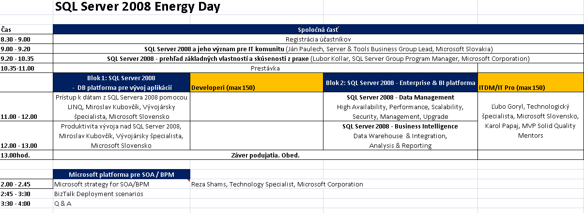
SQL Server 2008 Energy Day
14.oct 2008 Aupark
Registrácia cez www.microsoft.com/slovakia

Slide 33
Agenda – Ready to Sell
Windows Server 2008 - Virtualization
SQL Server 2008
DevTools
BizTalk
SBS / EBS 2008
System Center – management
Security

Slide 34


Windows Small Business Server 2008
Standard
Premium
    Windows Server 2008 Standard
    Windows SharePoint Services 3.0
    Microsoft Exchange Server 2007 Standard Edition
    Microsoft Forefront Security for Exchange Server
    Windows Server Update Services 3.0
    Windows Live OneCare for Server
    Integration with Office Live Small Business
    Standard plus a second server running...
      Windows Server 2008 Standard
      Microsoft SQL Server 2008 Standard
      WS Terminal Services
1 product,
1 price, 1 CAL
5 Step Setup takes 30 minutes
Hosted security and marketing services
Supports
75 users or devices

Slide 35
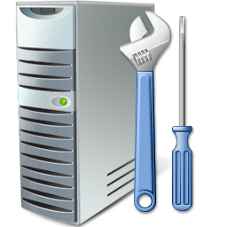
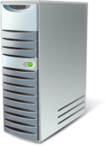





Windows Essential Business Server 2008
Standard
Premium
    Management Server
Windows Server 2008
  Networking
  Active Directory
  File and Print
Windows SharePoint Services 3.0 compatible
Microsoft System Center Essentials 2007
    Messaging Server
    Windows Server 2008 Standard technologies
    Microsoft Exchange Server 2007 Standard Edition
    Microsoft Forefront Security for
    Exchange Server
    Security Server
    Windows Server 2008 Standard technologies
    Microsoft Exchange Server 2007 Standard Edition
    Forefront Threat
    Management Gateway, Medium Business Edition
    Standard, Plus…
    Database Server
    Windows Server 2008 Standard
    Microsoft SQL Server 2008
    Standard
1 product,
1 price, 1 CAL
Integrated setup and Migration
300+ pages of best practices built in
Unified, extensible Console
Supports
300 users or devices

Slide 36
Windows SBS 2008 Pricing
Edition | Server software, including 5 CALs* | Additional CALs* | Discount (compared to standalone)
Windows SBS 2008 Standard | USD 1089 | USD 77 | 35%
Windows SBS 2008 Premium | USD 1899 | USD 189 | 45%
  Affordable solution for SB customers with 35-45% discount compared to standalone
  Partners can earn higher license margins for initial deployment
  Customers can affordably scale with reduced CAL cost, single CALs, flexible CAL
*Estimated Retail Price in USD
Notes:
Key Message: SBS 2008 bundle is a bargain.
Instructor: Point to Discounts in column four (4) and comment on the simplicity.
Timing: 4 mins.
Slide Transition Note: Now let’s dig deeper into EBS2008 pricing.
We revisit the pricing and I want to highlight the great value of SBS 2008. Look at the implicit and effective discount associated with SBS 2008 versus purchasing the individual standalone components.
Additional facts are:
Affordable solution for SB customers with 35-45% discount compared to standalone
Partners can earn higher license margins for initial deployment
Customers can affordably scale with reduced CAL cost, single CALs, flexible CAL option
Slide Transition Note: Now let’s dig deeper into EBS2008 pricing.

Slide 37
Windows EBS 2008 Pricing
Edition | Server software, including 5 CALs* | Additional CALs* | Discount (compared to standalone)
Windows EBS Standard | USD 5472 | USD 81 | ~30%
Windows EBS Premium | USD 7163 | USD 195 | ~30%
  Easier to install, migrate and use products and technologies they already buy
  Make advanced technologies consumable and usable by IT Generalist
  Simplify licensing – one product, one price, one CAL
  Pricing that is more attractive, compared to buying separately
*Estimated retail price in USD
Notes:
Key Message: Observe EBS 2008 implicit discounts.
Instructor: Focus on the Discount column and other benefits
Timing: 2 min.
Slide Transition Note: More pricing analysis where we compare product generations– let’s take a look!
This slide states it simply. EBS is approximately 30% cheaper than the standalone products.
Questions?
Slide Transition Note: More pricing analysis where we compare product generations– let’s take a look!

Slide 38
SBS / EBS 2008
SBS/EBS licencovanie - obed
SBS Roundtable - 14:30
Partnerské školenia v MS
SBS / EBS distributor roadshow
25.9.2008 | SWS - Small Business Server 2008 | Žilina | 9,00 – 15,00
15.10.2008 | Asbis - Small Business Server 2008 | Bratislava | 9,00 – 15,00
27.10.2008 | edSystem - Small Business Server 2008 | Bratislava | 9,00 – 15,00
30.10.2008 | SWS - Small Business Server 2008 | Košice | 9,00 – 15,00
11.11.2008 | SWS - Small Business Server 2008 | Bratislava | 9,00 – 15,00
12.11.2008 | Asbis - Small Business Server 2008 | Košice | 9,00 – 15,00

Slide 39
Agenda – Ready to Sell
Windows Server 2008 - Virtualization
SQL Server 2008
DevTools
BizTalk
SBS / EBS 2008
System Center – management
Security

Slide 40
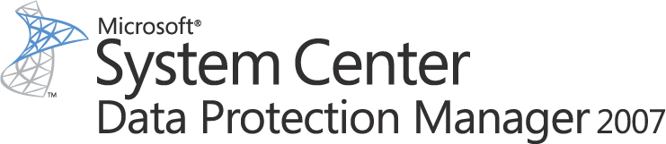
















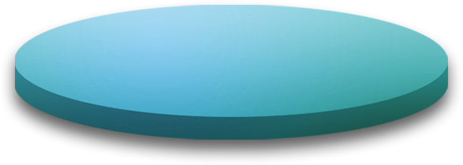




Disk-based
Recovery
Online Snapshots
(up to 512)
Active Directory®
System State
Up to Every 15 minutes
DPM 2007
With Integrated Disk & Tape
Tape-based
Archive
Offline Tape
Windows XP
Windows Vista
Windows Server 2003
Windows Server 2008
file shares and directories
DPM 2007
  Continuous Data Protection for Windows Application and File Servers
  Rapid and Reliable Recovery from disk instead of tape
  Advanced Technology for enterprises of all sizes

Slide 41

Disaster Recovery Staging
P2V – Physical to Virtual weekly … VMM
Svr1
Data Protection every 15 minutes … DPM
System State daily … DPM
SVR1
data
  Hyper-V
  VMM 2008
  DPM 2007 SP1
P2V – Physical to Virtual weekly … VMM
Svr2
Data Protection every 15 minutes … DPM
System State daily … DPM
SVR2
data
P2V – Physical to Virtual weekly … VMM
Svr3
Data Protection every 15 minutes … DPM
System State daily … DPM
SVR3 data

Slide 42
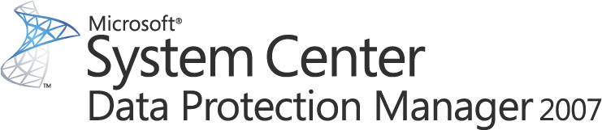
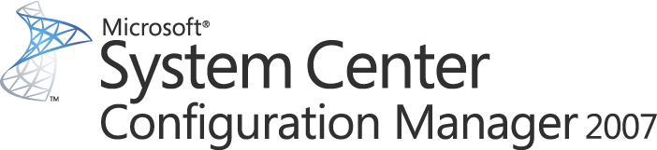
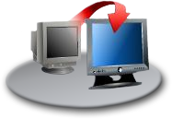
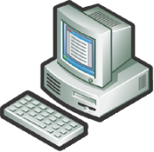








Managing The Server Lifecycle
Backup
Hardware Provisioning
Live host level virtual machine backup
In guest consistency
Rapid recovery
Patch management and deployment
OS and application configuration management
Software upgrades
Server Management
Suite Enterprise
Disaster Recovery
Virtual Workload Provisioning
End to end service management
Server and application health monitoring & management
Performance reporting and analysis
Virtual machine management
Server consolidation and resource utilization optimization
Conversions: P2V and V2V
OS / Software Deploy, Patching and State Mgmt
Performance and Health Monitoring
Notes:
Key points
The SMSE provide an entire suite of applications for the physical and virtual world.
When it comes to the management of the server lifecycle, we must look at all the tasks required for both physical and virtual systems. First, we have System Center Configuration Manager 2007, which provides patch management and deployment, OS and Application configuration, and system compliance to both physical and virtual servers. In a purely virtualization role, System Center Virtual Machine Manager 2008 bring Centralized virtual machine management, allowing for simple server consolidation and better resource utilization and optimization. VMM 2008 can even convert existing physical machines into virtual machines dynamically, easing the consolidation of servers. With System Center Operations Manager 2007, we have end-to-end monitoring of servers and desktops. With that, we get server and application workloads health monitoring and management. Finally, with System Center Data Protection Manager 2007, you get live host level virtual machine backup along with the backup of the actual data and workloads within the Virtual Machines themselves.
All four of these System Center products are available in the Server Management Suite Enterprise, or SMSE, a single solution for virtualization management. With the SMSE, you get the tools for complete server management, from physical to virtual.
42

Slide 43
Management - summary
Attach DPM to every SQL Server
Attach DPM to every Exchange Server
Sell VMM to Microsoft / VMWare virtualization
Upsell to SMSE
System Center – partnerské školenia a HOLy
System Center – customer seminar 20.nov
- SCOM, SCCM, SCVMM, SCDPM

Slide 44
Agenda – Ready to Sell
Windows Server 2008 - Virtualization
SQL Server 2008
DevTools
BizTalk
SBS / EBS 2008
System Center – management
Security

Slide 45
Security
Attach Forefront for Sharepoint to every Sharepoint Server
Attach Forefront for Exchange to every MS Exchange Server
Attach Forefront Client to Vista
H1 – partnerské školenia na ForeFront, ISA2006
H2 – Stirling - next gen version of FFT

Slide 46
Agenda – Ready to Sell
Windows Server 2008
  Virtualization
SQL Server 2008
DevTools
BizTalk
SBS / EBS 2008
System Center – management
Security
…

Slide 47

© 2008 Microsoft Corporation. All rights reserved.
This presentation is for informational purposes only. Microsoft makes no warranties, express or implied, in this summary.
Notes:
47

