Slide 1
Visión y Estrategia de Microsoft en Seguridad y Gestión de TI
Juan Tonda
Director de División
Server & Tools
jtonda@microsoft.com

Slide 2
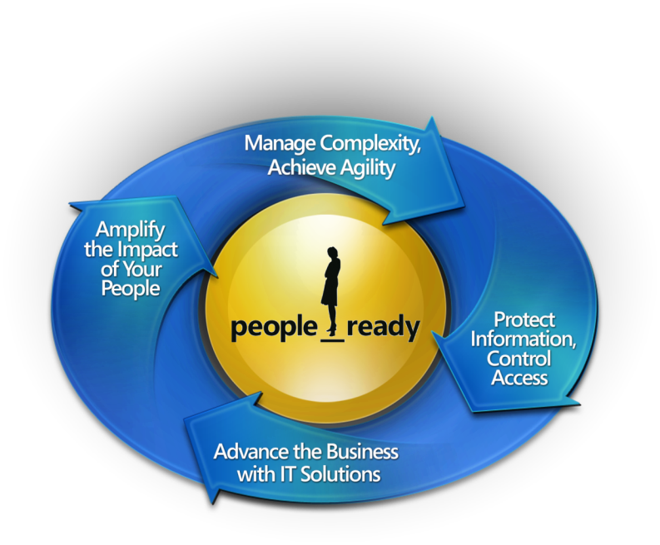
Las Personas son la Clave del Éxito
El Compromiso de Microsoft con TI
Ayudar a los Profesionales de TI y Desarrolladores durante el Clclo de Vida de TI
Notes:
2

Slide 3
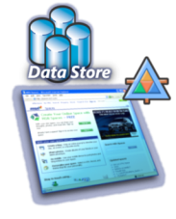
Infraestructura Dinámica de TI
Basada en Modelos
Orientada a Servicios
Experiencia de Usuario
Virtualizada
Segura e Interoperable

Slide 4
Optimizar la Infraestructura
Tecnologia
Procesos
Personas
Basico
Estándar
Racionalizado
Dinámico
Notes:
The IT infrastructure should be an organization’s greatest strategic asset and business enabler. Unlocking that potential requires alignment between IT and the business, a mature infrastructure, and a balance between people, processes, and technology. To help companies advance from costly and inefficient IT environments, Microsoft offers guidance in the form of the Core Infrastructure Optimization (IO) Model. This model outlines steps companies can take to analyze where they are today and to plan for and create an IT environment that is secure, well-managed, and efficient. In the most mature state, IT is incorporated into business strategy and used as a valuable asset in the growth and success of the company.
Security and management are integral parts of the core infrastructure of every business.

Slide 5
IT Dinámico
Optimización de Infraestructura
Core Infrastructure
Application Platform
Business Productivity
Identity & Access
User Experience
Search
Security
Business Intelligence
Business Intelligence
Networking
SOA & BPM
Unified Comms
Management
Data Management
Collaboration
Virtualization
Development
Ent. Content Mgmt.
Dynamic Infrastructure
Dynamic Applications
Dynamic Business

Slide 6
Security Day
Gestionar la Complejidad, Lograr Agilidad
Amplificar el impacto de las personas
You’re In Control!
Proteger Información, Controlar Acceso
Avanzar el Negocio con Soluciones IT
Notes:
We’ve articulated a vision of infrastructure for the People-Ready Business — an end-to-end portfolio of IT products, technologies, services and resources designed to empower IT professionals across the IT life cycle. These promises align our efforts to meet customer needs.
Two of the promises—Manage Complexity, Achieve Agility; and Protect Information, Control Access–are really two sides of the same issue: helping customers maintain control of their infrastructure.
Background Information: Definitions of Promises
Promise: Advance the Business with IT Solutions
According to Gartner, the top four concerns of CIOs revolve around ensuring that the IT organization is doing the right things for its customers. Are we investing (and optimizing )in the right areas? Are we capturing the right requirements? Do our development projects reflect the business needs?
Promise: Manage Complexity, Achieve Agility
Next in CIO concerns come issues of improving capacity and responsiveness. To deliver more of the value that the business expects, we need to get more out of our investments. We need to be able to consolidate existing services, improve quality and throughput in application development, reduce costs in operations, and improve predictability and agility end to end. The pace of business change will continue to accelerate and the demands on our services will continue to grow.
Promise: Protect Information, Control Access
All companies need to worry about protecting information and controlling access. Threats are more dangerous than ever – more advanced, more frequent, and profit motivated – while the workforce becomes more mobile and the boundary between internal and external resources blurs. Organizations need to find the right balance between managing network security while providing the business with the flexibility in accessing information.
Promise: Amplify the Impact of Your People
MS is all about being people-ready, that is amplifying the impact of your most important asset, your people. For the CIO, that means a direct line of sight to the satisfaction of the stakeholders and customers and transparency across the IT org in the satisfaction of business needs, appropriate process improvement and process compliance.

Slide 7
Integrando la Seguridad y la Gestión de TI
Seguridad
Gestión
Actuar Rápidamente Frente a las Amenazas
Mantener Disponibilidad y Eficiencia
Retos Comunes
Mantener la Productividad de Usuarios Locales y Remotos
Gestionar la Complejidad y las Políticas
Obtener Más valor de la Infraestructura Existente
Productivo
Simplificado
Integrado
Notes:
5/31/2007 4:41 PM
© 2007 Microsoft Corporation. All rights reserved. Microsoft, Windows, Windows Vista and other product names are or may be registered trademarks and/or trademarks in the U.S. and/or other countries.
The information herein is for informational purposes only and represents the current view of Microsoft Corporation as of the date of this presentation. Because Microsoft must respond to changing market conditions, it should not be interpreted to be a commitment on the part of Microsoft, and Microsoft cannot guarantee the accuracy of any information provided after the date of this presentation. MICROSOFT MAKES NO WARRANTIES, EXPRESS, IMPLIED OR STATUTORY, AS TO THE INFORMATION IN THIS PRESENTATION.
7

Slide 8
Seguridad + Gestión TI
Seguridad Cliente
Gestión de puestos y dispositivos
Seguridad Servidor
Gestión de Servicios
Seguridad Perímetral
Gestión Integrada: Virtual y Física
Seguridad en Acceso
Notes:
To address these challenges faced in IT security and IT management, Microsoft has launched the Forefront and System Center product lines.
Forefront is Microsoft’s comprehensive line of business security solutions that help customers protect information and control access to their environment. Forefront security solutions integrate with existing IT infrastructure and simplify deployment and management to help IT managers protect their environment and maintain control. Forefront includes solutions for protecting the client operating system, application servers, and the network edge, as well as for providing secure remote access to network resources.
System Center is Microsoft’s family of IT management solutions that helps IT managers proactively plan, deploy, manage, and optimize their physical and virtual IT environment. System Center solutions capture and aggregate knowledge about policies, processes, and best practices so that IT staff can reduce costs, improve application availability, and enhance service delivery. System Center includes solutions for service and systems monitoring; change & configuration management; backup & recovery; virtual machine management; and other management areas. [Note to speaker: For details on individual Forefront and System Center products, refer to the datasheets available on www.microsoft.com/forefront and www.microsoft.com/systemcenter.]

Slide 9
¿Cómo está el panorama en materia de seguridad?

Slide 10
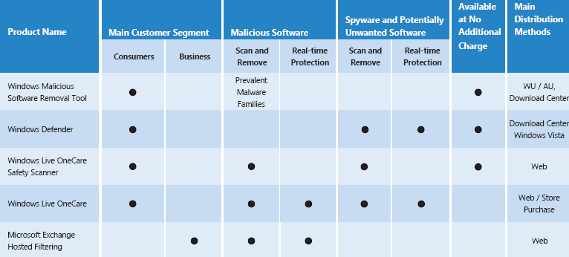
Security Intelligence Report - 2006
Exhaustivo informe de tendencias en las amenazas y software “no deseado” en el año 2006
Fuentes de datos:
5,5 Billones de ejecuciones
310 millones de PCs

Slide 11
Security Intelligence Report - 2006
Vulnerabilidades del Software
Aumento del 41% en el 2006 respecto al año anterior
Diciembre y Martes: Mes y día con mas “anuncios” resp.
Aumento de las vulnerabilidades “dificiles de explotar” respecto al año anterior. Mayor madurez en el sector.
Aplicaciones más vulnerables que Sistemas Operativos. Necesaria mayor atención sector seguridad en ellas.

Slide 12
Security Intelligence Report - 2006
Software Malicioso
Troyanos de puerta trasera y bots los mas activos
Aumento de los Downloaders y Mass mailers
3700 software malicioso dirigido a WMF, independientemente de la existencia del update (MS06-001)
7,5 veces mas probable estar infectado sin Service Packs que con SP2
Microsoft Software Removal Tool (MSRT) aumenta su uso del 32% al 70% en H206

Slide 13
Security Intelligence Report - 2006
Software No deseado. Windows Defender
El Adware supone la categoría mas perseverante aumentando un 59,6% respecto a H106. 16,7Millones de detecciones.
Aumento del 277% y 135% en Software de control remoto y monitorización respectivamente
Las Top 25 amenazas son responsables del 56% de las detecciones de Windows Defender
En total, detectados mas de 38 Millones de Software No deseado entre Julio y Diciembre 2006.

Slide 14
Security Intelligence Report - 2006
Fuentes de datos adicionales:
Common Vulnerabilities and Exposures Web site (http://cve.mitre.org)
National Vulnerability Database (NVD) Web site (http://nvd.nist.gov/)
Security Web sites.
http://www.securityfocus.com
http://www.securityfocus.com/archive/1 (Bugtraq mailing list)
http://www.secunia.com
http://www.securitytracker.com
Vendor Web sites and support sites.
https://rhn.redhat.com/errata
http://support.novell.com/linux/psdb
http://sunsolve.sun.com
http://www.microsoft.com/technet/security/current.aspx
http://www.ubuntu.com/usn

Slide 15
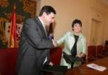
Elaboración manual técnico de adaptación al reglamento con tecnología Microsoft.
Participación en eventos
Evangelización de la Agencia a Microsoft EMEA sobre reglamento LOPD
Nueva versión con Informática 64 (Mayo 2007)
Agencia de Protección de Datos
Dirección General de la Policia
Certificados Cualificados en Internet Explorer. ETSI 101456 (además de Webtrust)
Incorporación de root de Policia en IE via Windows Update
Extensa e Intensa “evangelización” sobre su uso
Bateria de pruebas sobre el CSP desarrollado por la FNMT
Centro Nacional de Inteligencia
Compartición de código Fuente de sistemas Windows (y otros) con CNI. GSP
Formación en Redmond (central de Microsoft) de personal del CCN
Formación intensiva de acceso al código fuente
Creación conjunta de plantillas de seguridad.
Promoción conjunta certificaciones Common Criteria
Desarrollo sistemas de seguridad Multinivel
Formación a Brigada Investigación tecnológica (BIT) de Policia Nacional
Marco de Colaboración permanente con Guardia Civil: Unidades de
Delitos Telematicos y Ciberterrorismo.
Mas de 1400 colaboraciones en el último año con Fuerzas de seguridad del estado
Jornadas conjuntas con Guardia Civil: Protección Infraestructuras Críticas
CETS (Child Explotation Tracking System)
Cuerpos y Fuerzas de Seguridad del Estado
Red.es INTECO
Firma del Security Cooperation Program. Centro de emergencia ante Alertas Informaticas. Barra Antiphishing

Slide 16
¡Gracias!
y a mancharnos un poco …

