Slide 1
Predictive Analysis with SQL Server 2008

Slide 2
Agenda
Data Mining enabling Predictive Analysis
The Value of Predictive Analysis
SQL Server 2008 Predictive Analysis
Complete Predictive Analysis
Integrated Predictive Analysis
Extensible Predictive Analysis

Slide 3

Data Mining enabling Predictive Analysis
Role of Software
Predictive Analysis
Proactive
Data Mining
Interactive
OLAP
Ad-Hoc Reporting
Canned Reporting
Passive
Business Insight
Presentation
Exploration
Discovery

Slide 4
The Value of Predictive Analysis
Inform Common Business Decisions with Actionable Insight
Predictive Analysis
Seek Profitable Customers
Understand Customer Needs
Anticipate Customer Churn
Predict Sales & Inventory
Funnel Marketing Campaigns
Estimate Survey Results

Slide 5






SQL Server 2008 Predictive Analysis
Part of SQL Server 2008 Analysis Services
Complete
Pervasive Delivery through Microsoft Office
Enterprise Grade Capabilities
Integrated
In-Flight Mining during Data Integration
Insightful Analysis
Predictive KPIs
Extensible
Predictive Programming
Custom Algorithms and Visualizations
Native Reporting Integration
Comprehensive Development Environment
Rich and Innovative Algorithms

Slide 6
Complete Predictive Analysis
Pervasive Delivery through Microsoft Office
Comprehensive
Collaborative
Intuitive
Empower all users with predictive analysis capabilities
Share insight with clear and prompt publishing capabilities
Enable advanced users with more validation and control
Share analysis through interactive graphical visualizations
Deliver actionable insight with clear graphical visualizations
Reduce the learning-curve with a familiar environment
Enable complex data mining through simple, automated tasks

Slide 7
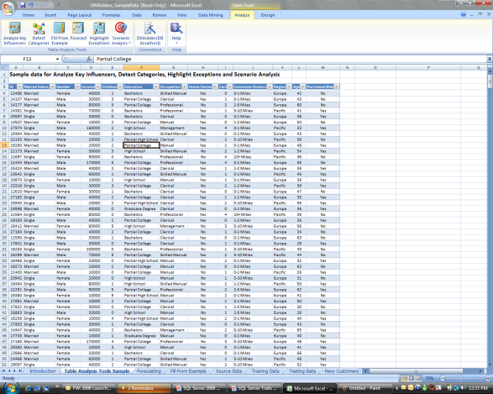


Data Mining Add-Ins for Microsoft Office 2007
DIG for Insight at your Desktop
Define Data
Identify Task
Get Results
“What Microsoft has done is to make data mining available on the desktop to everyone”
- David Norris, Associate Analyst, Bloor Research

Slide 8
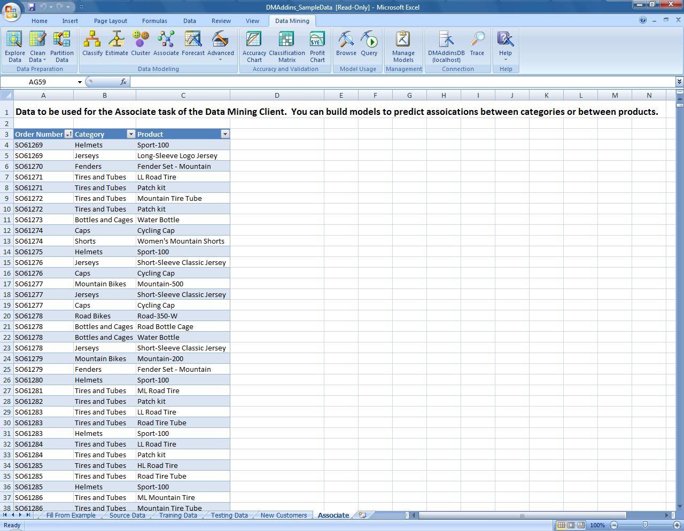
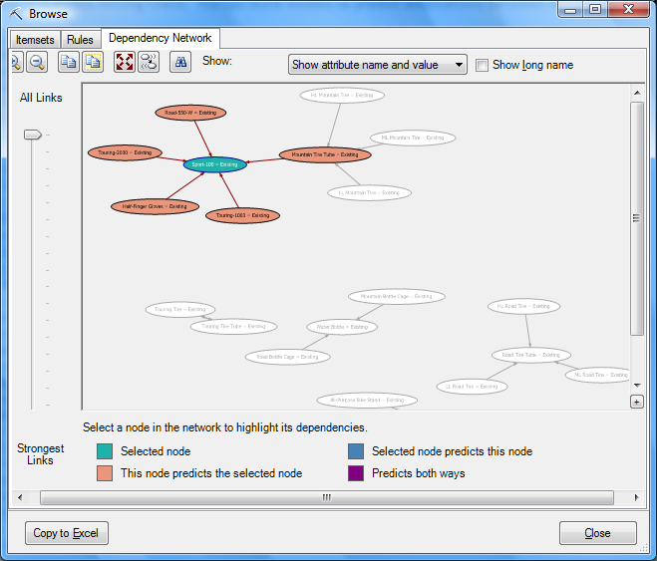
Data Mining Add-In for Microsoft Office 2007
Full Development Lifecycle within Excel
Data Preparation
Explore, clean and set up your data for data mining
Data Modeling
Build patterns and trends from data to make predictions
Accuracy and Validation
Test and validate your model
Model Usage & Management
Browse, modify, and manage existing mining models that are stored on an instance of Analysis Services
Documentation
Trace your actions as Data Mining Extensions (DMX) statements or as Analysis Services Scripting Language (ASSL).

Slide 9
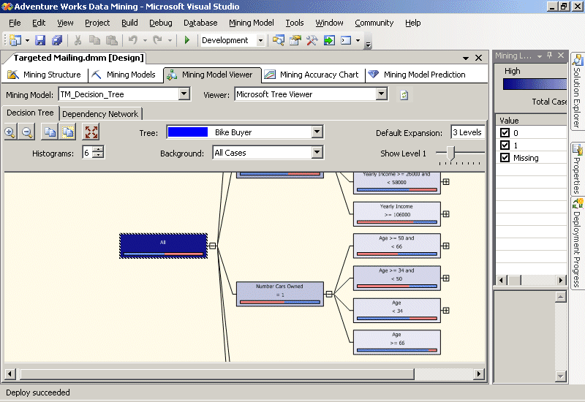
Complete Predictive Analysis
Comprehensive Development Environment
Intuitive Data Mining Wizard
Graphic Data Mining Designer
Visual & Statistical Validation
Cross-validation
Lift charts
Profit charts
Easy and Efficient Access to Source Data
Caching
Filtering
Aliasing

Slide 10









Complete Predictive Analysis
Enterprise Grade Capabilities
Rapid Development
High Availability
Superior Performance and Scalability
Robust Security Features
Enhanced Manageability
Analysis Services

Slide 11
Complete Predictive Analysis
Rich and Innovative Algorithms
Innovative Algorithms from Microsoft Research
Traditional Algorithms such as ARIMA
Broad Range of Choices to Build Optimal Models
Algorithms to solve common business problems
Market Basket Analysis
Churn Analysis
Market Segment Analysis
Forecasting
Data Exploration
Unsupervised Learning
Web Site Analysis
Campaign Analysis
Information Quality
Text Analysis

Slide 12
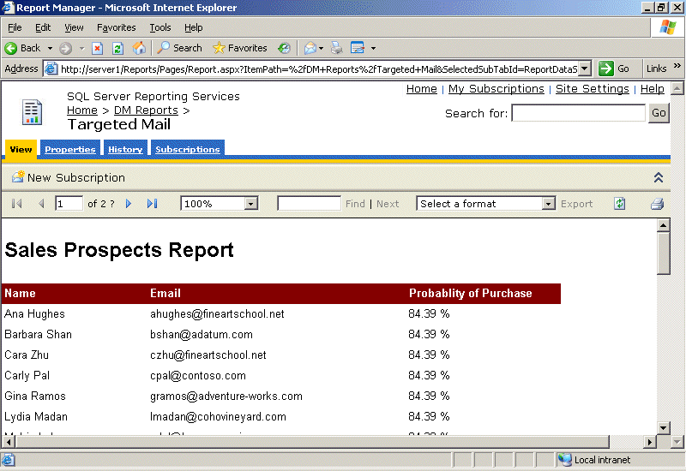
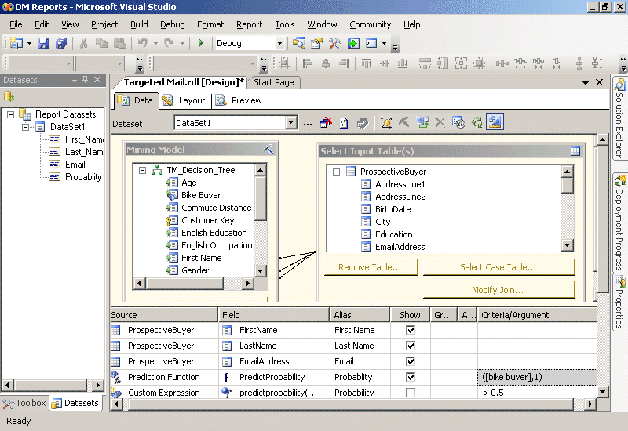
Integrated Predictive Analysis
Native Reporting Integration
Create reports that include prediction
Build reports using data mining queries as your data source
Access visual prediction Query Builder directly within Report Designer
Generate parameter-driven reports based on predictive probability
For example, present high-risk customers
Probability to churn is over 65%

Slide 13
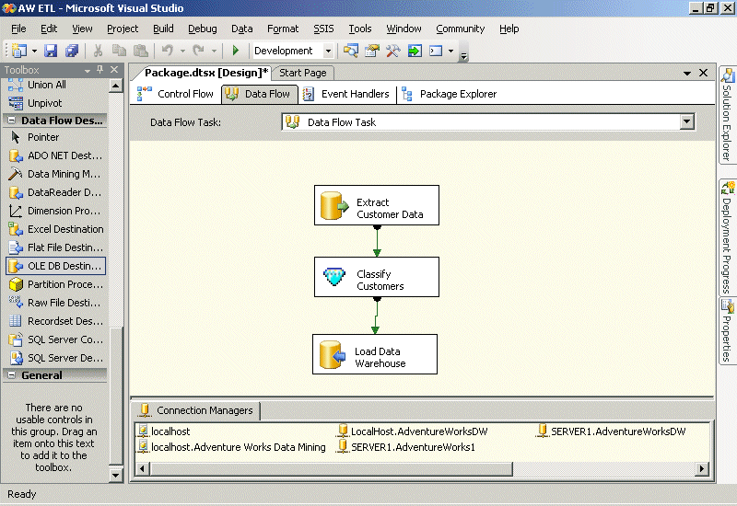
Integrated Predictive Analysis
In-Flight Data Mining During Data Integration
Enhance ETL:
Flag anomalous data
Classify business entities
Identify missing values
Perform text mining
Extend SQL Server Integration Services:
Score rows with Data Mining Query transformations
Train mining models with Data Mining Training destinations

Slide 14
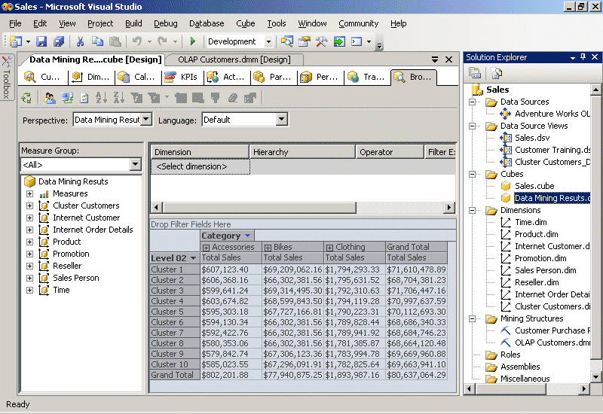
Integrated Predictive Analysis
Insightful Analysis
Use the OLAP cube for data mining
Include data mining results as dimensions in OLAP cubes
Include prediction functions in calculations and KPIs

Slide 15
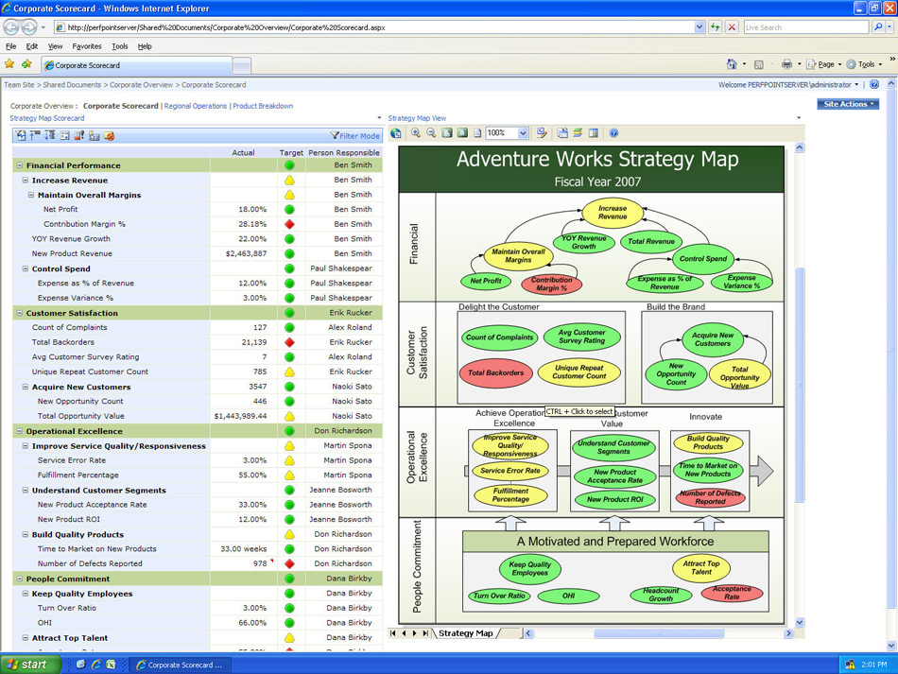
Integrated Predictive Analysis
Predictive KPIs
Combine predictive and retrospective KPIs for more insightful dashboards
Forecast future performance against targets to anticipate potential challenges
Discover and monitor trends in key influencers
Integration with Microsoft Office PerformancePoint Server 2007

Slide 16



Extensible Predictive Analysis
Predictive Programming
Automatic Data Mining
Create a built-in recommendation engine
Update models based on most recent data
Warn for flawed data on-the-fly
Pattern Exploration
Display leading indicators for factors/metrics
Identify profile for churning/high-value customers
Prediction
Recommend relevant products
Anticipate customer risk/churn
Focus promotions on customers with a high expected life-time value
Incorporate predictive analysis into your business applications through comprehensive APIs
?

Slide 17
Extensible Predictive Analysis
Data Mining APIs
XMLA
ADOMD.NET and OLE DB
AMO
Industry standard metadata
Access and query models from clients or stored procedures
Management interfaces
Plug-in Algorithms
Add custom data mining algorithms
Visualizations
Redistributable Viewer - embed standard visualizations in your application
Plug-in Viewer APIs - embed custom visualizations in your application
PMML
Exchange models with other software vendors
Data mining Extensions (DMX)
SQL-like query language
EXTEND
EMBED

Slide 18

ABS-CBN Interactive (ABSi)
Subsidiary of the largest integrated media and entertainment company in the Philippines
Wireless Services Firm Doubles Response Rates with SQL Server 2005 Data Mining
Challenge
Selling custom ring tones and other downloadable content for mobile phone users requires staying in tune with the market.
Solution
ABSi deployed Microsoft® SQL Server™ 2005 to use its data mining feature to determine product recommendations.
Benefit
More accurate and personalized service recommendations to customers
Searching transactional data for hints on what to offer users in cross-selling value-added mobile services took days and didn’t provide customer-specific recommendations.
Doubling response rates from marketing campaigns
Ad hoc reporting in minutes, not days
Eight times faster data mining process
Faster data mining prediction
“Our management is very impressed that we could double our response rate through our SQL Server 2005 data mining … managers of other services ask us to provide the same magic for them—which is what we will do with the full project rollout”
- Grace Cunanan, Technical Specialist, ABS-CBN Interactive

Slide 19






More Data Mining Customers
.8 TB SS2005 DW for Ring-Tone Marketing Uses Relational, OLAP and Data Mining
5 TB DW, serving the 2nd largest global HMO with over 3000 OLAP users. Developed data mining solution to identify members who would most benefit from proactive intervention to prevent health deterioration.
3 TB end-to-end BI decision support system Oracle competitive win
End-to end DW on SQL Server, including OLAP Extensive use of Data Mining Decision Trees
1.2 TB, 20 billion records Large Brazilian Grocery Chain
.88 TB DW at main TV network in Italy Increased viewership by understanding trends
.5 TB DW at US Cable company End to end BI, Analysis and Reporting

Slide 20
Summary
Complete
Pervasive Delivery through Microsoft Office empowers all users with predictive insight
Comprehensive Development Environment delivers an intuitive and rich environment
Enterprise Grade Capabilities provide enhanced server advantages
Rich and Innovative Algorithms support common business problems effectively
Integrated
Native Reporting Integration seamlessly infuses prediction into reports
In-Flight Mining during Data Integration dynamically enhances data quality & relevance
Insightful Analysis enables to slice data by the hidden patterns within
Predictive KPIs extend monitoring with insights to future performance
Extensible
Predictive Programming embeds prediction within the application
Custom Algorithms & Visualizations provide the flexibility to meet uncommon needs

Slide 21

© 2004 Microsoft Corporation. All rights reserved.
This presentation is for informational purposes only. Microsoft makes no warranties, express or implied, in this summary.

Slide 22
What’s New in SQL Server 2008?
Enhanced Mining Structures
Split data into training and testing partitions more effectively
Query against structure data to present complete information beyond the scope of the model
Build models over filtered data
Create incompatible models within the same structure
Use cross-validation to:
Test multiple models simultaneously
Confirm the stability of results given more or less data
Better Time Series Support
Accuracy & Stability
Combine best of both worlds blending ARTXP for optimized near-term predictions and ARIMA for stable long term predictions
Prediction Flexibility
Build a forecasting model on one series and apply the patterns to data from another series.
What If
Anticipate the impact of changes in near-term future values, on long-term forecasts
More Data Mining Add-Ins for Office 2007
New Analysis Tools
Generate interactive forms for scoring new cases with Prediction Calculator
Discover the relationship between items, which are frequently purchased together with Shopping Basket Analysis
New Query and Validation Tools
Choose training and test sets from mining structures
Render richly-formatted cross validation and accuracy reports in Excel
Leverage model documentation for reference and collaboration

Slide 23
Data Mining Algorithms
Algorithm | Description
Decision Trees | Calculates the odds of an outcome based on values in a training set
Association Rules | Helps identify relationships between various elements.
Naïve Bayes | Clearly shows the differences in a particular variable for various data elements
Sequence Clustering | Groups or clusters data based on a sequence of previous events
Time Series | Analyzes and forecasts time-based data combining the power of ARIMA for long-term prediction and the power of ARTXP (developed by Microsoft Research) for short-term prediction. Together optimizing prediction accuracy
Neural Nets | Seeks to uncover non-intuitive relationships in data
Text Mining | Analyzes unstructured text data
Linear Regression | Determines the relationship between columns in order to predict an outcome
Logistic Regression | Determines the relationship between columns in order to evaluate the probability that a column will contain a specific state

Slide 24
Data Mining Architecture
Data Mining Structures
Define the data columns used for analysis
Data Mining Models
Apply data mining algorithms to the data structures to:
Predict values
Identify clusters
Find patterns and associations

Slide 25
Clalit Health Services
Provides health care for 3.7 million insured members, representing about 60 percent of Israel’s population
Data Mining Helps Clalit Preserve Health and Save Lives
Challenge
Identify which members would most benefit from proactive intervention to prevent health deterioration
Solution
Use sociodemographic and medical records to generate a predictive score, identifying elder members with highest risk for health deterioration
Benefit
A chance to preserve life and enhance life quality
Once identified, physicians can try to involve these patients in proactive treatment plans to prevent health deterioration
Reduced health care costs
Tightly integrated solution
“Providing physicians with a list of patients that the data mining model predicts are at risk of health deterioration over the next year, gives them the opportunity to intervene, and prevent what has been predicted.” - Mazal Tuchler, Data Warehouse Manager , Clalit Health Services

