Slide 2
Windows Live Service APIs
Virtual Earth : Global mapping
Live Contacts : 500 million people

Slide 3
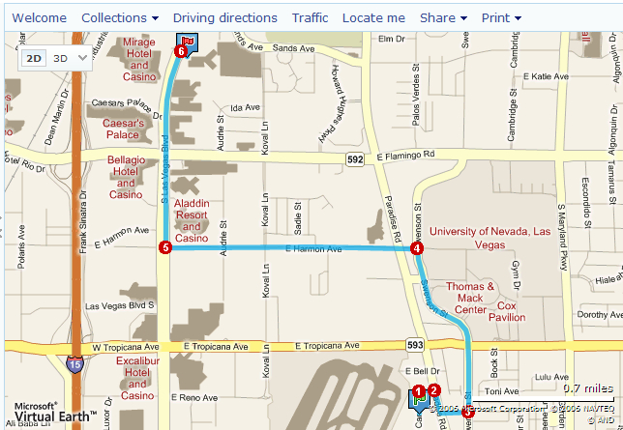
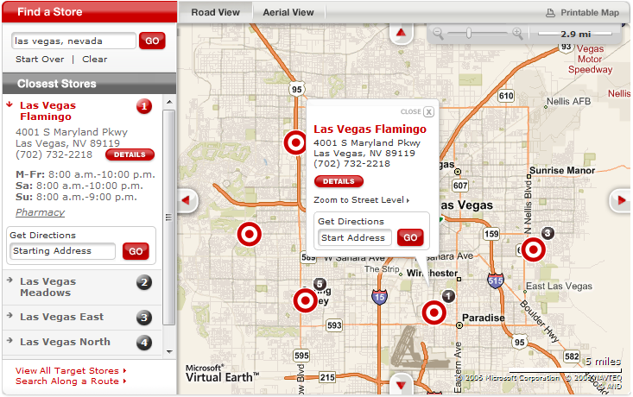
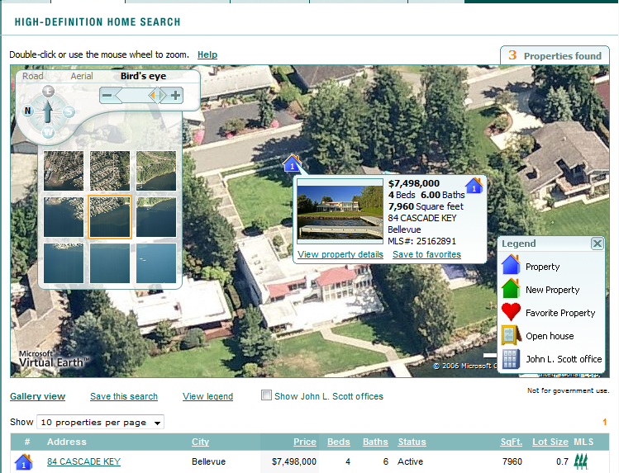
Microsoft Virtual Earth Platform
3rd Party Public
Applications
Redfin, TripHub, Target
Enterprise
Applications
BP HMS
Live Search
Application
Maps.live.com
Microsoft
Applications
Client for Outlook, Mobile
APIs
JavaScript and SOAP services
Platform Services
Search, Geocoding, Directions, Mapping/imagery
Directions
Search
Imagery
Data – Quality Data is Key
Address ranges, POIs, Bird’s Eye, 3D, Geographies
17 petabytes raw map storage

Slide 4
Value of Virtual Earth web services?
Benefits:
  Maintenance and Support
  Developer Control
  Operations & Management
  No data updates
  Minimize Capital Investment
  Flexibility & Scalability
  Ease of use
Notes:
Internet moving worldwide graphic

Slide 5
Virtual Earth: AJAX Interface
Web Browser Support:
Requests made from client; not server
Geocoding
Mapping
Driving Directions
Aerial / Satellite Photography
Line / Polygon Drawing
GeoRSS / Collections Integration
Matching Geographic Coverage
Immersive 3-D Environment

Slide 6

Virtual Earth: SOAP Interface
XML Web Service
Batch geocoding, reverse geocoding
Algorithmic searches
  Proximity Searching (FindNearby)
  Corridor Searching (FindNearRoute)
  Polygonal Searching (FindInPoly)
Static map images (for emailing maps)
Mobile maps (30+ map styles in all)
Preferred routing
Point of interest (Yellow Page) listings
Server-based control over applications

Slide 7
Virtual Earth Tile Architecture

Slide 8

Customer Requirement
Data
  Bird’s eye
  3D
  Streets
  Points of Interest
  Yellow Pages
  Traffic
Functions
  Routing
  Geocoding
  Annotation
  Community
Service
  Service Level Agmt
  Support
  Hosting
Industry
  Real Estate
  Retail
  Travel
  Hospitality
  Transportation
Geography
  North America
  Europe
  Middle East
  Africa
  Japan
  China
Product Category
  Enterprise
  Customer facing
Function
  Data analysis
  Data visualization
  Basic mapping

Slide 9















































Virtual Earth customers include…

Slide 10
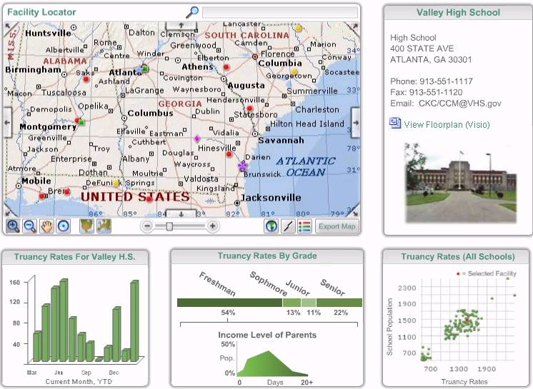
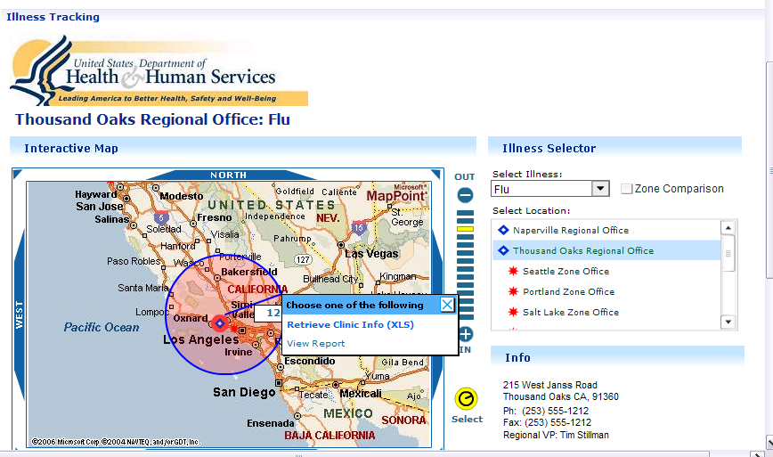
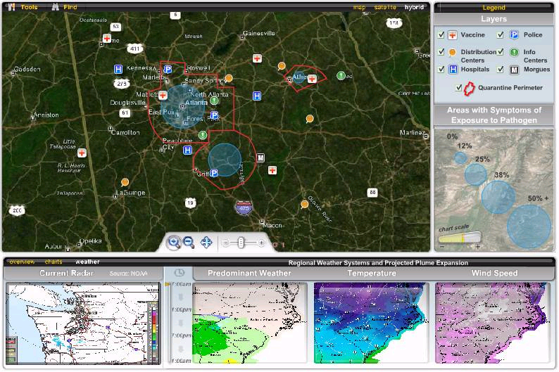
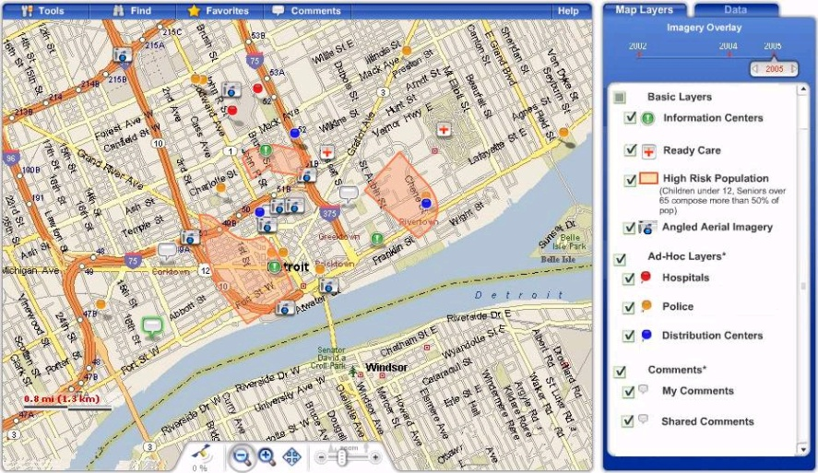
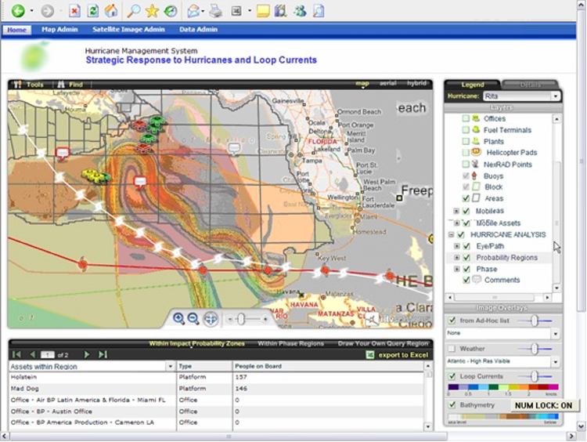
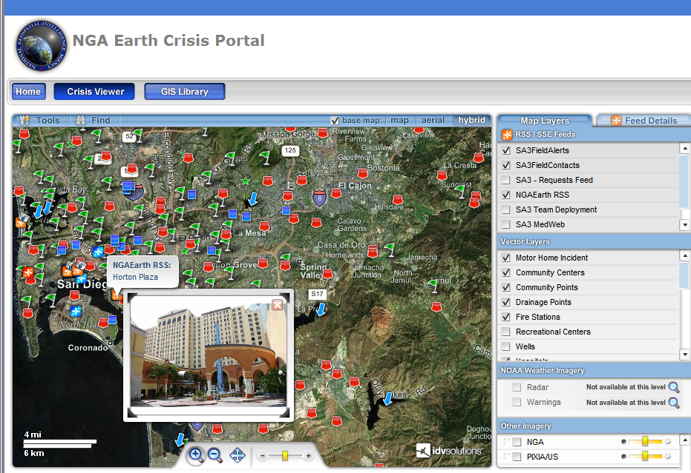
Location Based Solutions
Powered by our Partner Ecosystem
Disaster & Response Management
Health Crisis Portals
Focused Logistics &
Loss Prevention
Supply Chain Management
Business Location Intelligence
Inspection Management
Asset Management
Security Command & Control
Scenario Modeling

Slide 11
Virtual Earth Demonstrations
Harley-Davidson
British Petroleum

Slide 12
Live Contacts

Slide 13


Live Contacts & Messenger
Imagine
New User Registers
Notes:
Here’s a scenario for you:
Imagine you have a Retail Music site and a new customer arrives, sets up an account and creates a music wish list and play list for his friends to see.
Until he tells them though, his friends don’t see it. You don’t know who his friends are, so he has to type their email addresses into your site so that they can be invited to see it.

Slide 14



Live Contacts & Messenger
Without Windows Live Contacts
Invites Friends
Notes:
This is a long and repetitive process so he doesn’t enter many.
He can’t use that list elsewhere. He can’t take this information with them to other sites, so :
He doesn’t enter much information - only the minimum to get the emails out.
You find out almost nothing about his contacts until they respond to the invitation.
Your system sees that some of the friends he just entered, are already customers of yours.
If two of your opted-in users have a connection, you can build additional useful functionality for them.

Slide 15





Live Contacts & Messenger
Without Windows Live Contacts
Some Friends already Registered
Notes:
This encourages them all to spend more time on your site, leaving comments and reviews, and even buying some of those things he wants.
Remember though, your can only really leverage the relationship between two opted-in users of your site.
If they happen to have the same friend, it is important that the friend also opts-in before you reveal that their friend is also on the site, but you cannot reveal common relationships without the express permission of all parties.

Slide 16


Live Contacts & Messenger
Without Windows Live Contacts
Some Friends Accept Invitations and Invite More Friends
Notes:
Eventually, a few of the friends that he invited to your site, join your site, invite more friends, and you can see more connections between them and your existing users.
You still don’t know much about the ones who have not yet joined your site though.
So far, you have relied on shat short list of manually entered email addresses. You don’t know much about the friends they invited, and it’s a relatively slow way to build up a social network.
Now imagine if your customers opted in to provide access to their Live Contacts. Currently this represents an average of 50 contacts per user with more updated and quality information on them from the start.
The friends list that have on your site is larger, the connections are wider across your site, you can pick up relationships you didn’t know about and deduce more about your users from the additional information they share about their location, and interests.
Imagine having all this, with a very simple API. Imagine doing this today.
You can. I will show you how.

Slide 17


Live Contacts & Messenger
With integrated Windows Live Contacts
Notes:
You can now imagine how much more quickly your network of users would grow.
The friends list that have on your site is larger
The number of friends who respond to their invitation is likely to be larger.
The connections are wider across your site
You can pick up relationships you didn’t know about
You can deduce more about your users from the additional information they share about their location, and interests.
Imagine having all this, with a very simple API. Imagine doing this today.

Slide 18


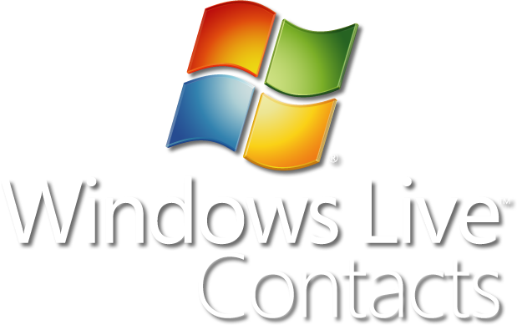

Windows Live Contacts
Shared Contact Store
Messenger
Hotmail
Office Outlook
Mobile
MSN Client
Live Spaces
Xbox Live
More…
500 Million address books
263 Million Messenger Users
280 Million Hotmail Users
30 Billion contact associations
Notes:
This is the largest social network in the world, like the Messenger network….
Network to help benefit your business. Here are the business in side of Microsoft who have taken a bet on our Contacts database.
Let the user bring their social network to you, to help them in the context of you application
With this API we are about to give you access to 500 Million Address Books and 30 Billion Contact Relationships.
This service is built to scale to all of these Microsoft applications today, which use Windows Live Contacts as their single shared Address Book. There are over a 1000 servers storing and backup up the data.
Hotmail and Messenger use the same Address Book. A Messenger contact is just a regular Contact which has a Messenger address too.
Outlook Connector is an add-in to Outlook which enables you to use your Live Contacts in Outlook.
We are about to show you how to gain access to the largest social network in the world.

Slide 19





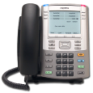

Windows Live Contacts
Possible Scenarios
Buying
Friend Locator
Calendar
Alerts
Reputation
Trust
Collaboration
Borrowing
Bots/Agents
Favorites
Friends of Friends
Music
VoIP
Video
Tagging
Photos
Messenger
Mobile
Party Invitations
Dating
Sharing
Selling
Lending
Recycling
Notifications
Shopping
Targeted Ads
Notes:
(Talk about the high level categories – e.g. eCommerce, Collaboration, Making New Friends, Sharing Media, Keeping in Touch)
I talked about one scenario earlier, but of course there are many other uses for the Live Contacts API, and I’m sure you can think of far more than I’ve listed here today.
Think about the Shopping scenario for instance – customer gets to the shipping address, and simply selects from their existing Live Contacts.
And what about Party Invitations? Much easier to invite all your friends to a party if the list is available right there within the site!
Having the friends list allows your site to establish trust networks, friends of friends, sharing and collaboration scenarios that might take you months to build up if you had to rely on the network invitation effect.

Slide 20

Windows Live Contacts API
What does it look like?
HTTP REST API – Version 1.0 Alpha
  Simple Object URI
  Light on-the-wire
  XML Data Format
HTTP Standard Methods
    POST, GET, PUT, DELETE
  Tools for an Integrated Experience
Notes:
Version 1.0 Simple HTTP (REST) API
Simple URI to point to the Object
e.g. /livecontacts/contacts/contact({id})/firstname
Light on-the-wire (bandwidth) since you only send what you want to update, and you only GET what you need.
HTTP Standard Methods
POST = Insert
PUT = Update/Replace
GET = Retrieve
DELETE = ?
Controls/Contact Picker
Simplified development experience
Built in monetization and WL branding
Windows Live Sign in every time
APIs
More granular control to enable new scenarios
Application/site controls user experience

Slide 21
Windows Live Contacts REST API
Code Sample and Response
Method Call example – GET
/livecontacts/Contacts/Contact(x)/Emails/Email(y)/Address
Response
<Address>some@where.com</Address>
Notes:
You can see here that the URI simply walks down the schema to the specific object you want to address.
In this case the method is GET and the response is the current address stored at that location.
Using the exact same URI we could make a PUT call and update it by providing the new value in the body of the call.
If time allows, DEMO a simple GET call here.
Live version of:
http://pvt-livecontacts.msn-int.com/georgedemo@hotmail-int.com/LiveContacts

Slide 22

Windows Live Contacts REST API
Version 1.0 Schema
Owner
Contacts
  Profiles
    Personal
    Professional
  Emails
  Phones
  Locations
  Tags
Notes:
Owner - First/Last Name, Windows Live ID
Contacts
Profiles
Personal - Names, Birthday, Gender, Spouse
Professional - Job Title, Profession
Emails - Windows Live ID etc.
Phones
Locations - Personal Address, Business Address
Groups/Tags - Hotmail Groups and Tags

Slide 23





Windows Live Contacts REST API
Authentication & Authorization – Security for our Users
User
Opts In
Store
Token
Call Live
Contacts
Live Sign-In
Your Site
REST Call
Notes:
If you don’t have a current Live Services Token for your User, you send them to the Opt-in Page hosted by Windows Live.
Their Live Sign-in and Password are therefore secure and you don’t need to ask for them.
If they grant you access, you store the Token received and make calls to the Live Contacts Service as needed.
If you get a response from Live Contacts that the token is revoked or no longer valid, you can ask the User to opt-in again.
Now, the Terms of Use for this Alpha version of the API and Authentication model limit the number of Opted In users to 100 per domain. We are making this available early especially for you to play with, but you shouldn’t build a business around it until the full release towards the end of this calendar year.
The session “Opening Up Windows Live Data” will be focusing security and privacy, covering in more detail, the authentication and authorization steps you saw here. Please plan on attending that session if you have questions or concerns in this area.

Slide 24
Demonstration
Granting and Revoking Permission for
Live Contacts

Slide 25
Next Steps
Easily add global mapping functions to your site using Virtual Earth
Make it easy for your users to invite their friends into your site NOW using the Live Contacts API
Go to dev.live.com for SDK and other details
See us at TechEd Europe in November

