Slide 2
Windows Live Service APIs
Overview
Business Model
Technology

Slide 3

Services as Platforms: Some Challenges
Will APIs change?
Will the service provider stay in business over the long term?
Can they scale? Geo Scale?
Will the Terms of Use change?
Can you get service-level commitments from platform providers?
12 Ways to Limit an API
http://blog.programmableweb.com/2007/04/02/12-ways-to-limit-an-api/
The vast majority of the over 400 open APIs listed here have imposed some limitations on how much they can be used, certainly in the free use model.
I regret to inform you that SalesCentrix.com Inc. is closing its doors. Friday, April 13, 2007
Geoff Danzig
President & CEO
SalesCentrix.com Inc
As of today, AccountDynamics, the integration solution for Salesforce and QuickBooks, is no longer being sold or supported. The service will remain available to existing AccountDynamics customers until May 31, 2007.
Can Web 2.0 Mashups Survive When Lawyers Show Up? Amazon Sues Alexaholic/Statsaholic
Thu Apr 19 2007 TechDirt
When [Amazon] is going around and pitching itself as being an enabler of web 2.0 infrastructure, it seems like this lawsuit has the potential to be incredibly damaging to Amazon's credibility in the space.
Google Deprecates Their SOAP Search API
Mon Dec 12 2006 O’Reilly Radar
In an odd move Google has quietly deprecated their Search SOAP API, will no longer be issuing keys, and have removed the SDK from their site. They did not even issue a blog post about it.

Slide 4












Windows Live Web Services Evolution
Rich Media
Mashups
Social
Networking
Enterprise
Apps
First Party Applications
3rd Party Applications

Slide 5

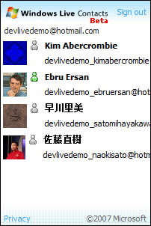
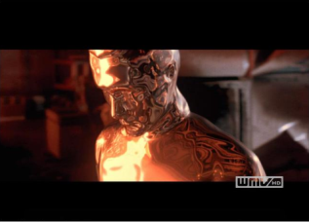
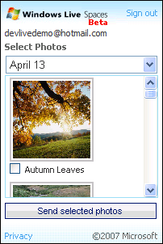
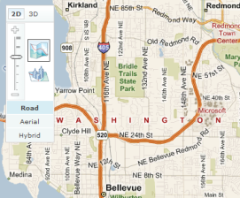
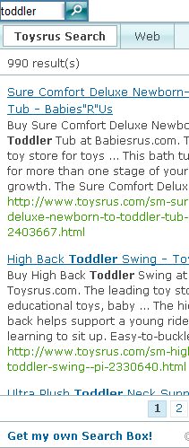
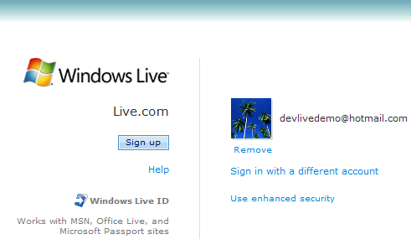
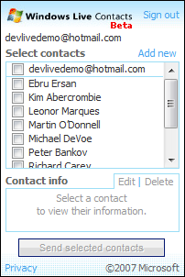
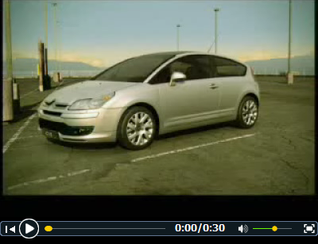
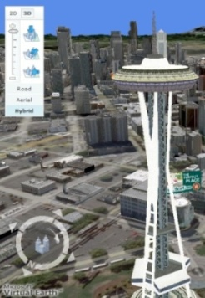






Windows Live Web Services Overview
Add video, photos, contacts, maps and search to your site!
Controls
REST
WebDAV
REST
SOAP
SOAP
HTTP/SOAP
APIs
Spaces
Photo
Live
Contacts
Virtual
Earth
Live
Search
Silverlight Streaming
Authenti-
cation
  Windows Live User
Notes:
5

Slide 6
Easy to Understand Business Model
1M UU’s/month
> 1M UU’s/month
Ad Revenue Sharing
or
Pay $0.25/uu/year
< 1M UU’s/month
Usage = Free
Total size audience (UU’s)
Extended Terms/SLA/Paid support optional - available to all
Same technology for commercial & non-commercial use
Web Sites

Slide 7
What can YOU do?
Information Access Scenarios
Add search scoped to your site
Build a custom search client
Pushpin points of interest on a map
Overlay subways lines & stations on a map

Slide 8
What can YOU do?
Authenticated Access Scenarios
Use the contacts control to
  Send gifts
  Be added to an address book
  Share what you are reading
Use the spaces control to
  Print photos on mug cups

Slide 9
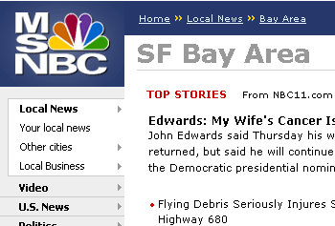
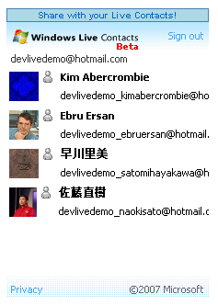
MSNBC
Demo
Social-based Advertising
on your Site

Slide 10
Let's build!! – travel journal
demo
Geospatial Photo Blog

Slide 11
Steps
Create a host DIV for the map
Call new VEMap
Place Map control

Slide 12
Steps
Setup app id
Place authentication iframe
Get unique ID for signed in user
Place Map control
Place Sign in control

Slide 13
Steps
Call FindLocation() to center on location
Call GetCenter() to get Lat and Longitude
Place Map control
Place Sign in control
Write geo coding code

Slide 14
Steps
Open new window
Navigate to http://spaces.live.com/blogit.aspx with blog content
Place Map control
Place Sign in control
Write geo coding code
Write blog posting code

Slide 15
Steps
Create spacescontrol element
Set privacy statement URL
Request fileAccessControlledURL
Place Map control
Place Sign in control
Place Spaces control
Write geo coding code
Write blog posting code

Slide 16
Steps
Create contactscontrol element
Set privacy statement URL
Request name and spacesRssContent
Place Map control
Place Sign in control
Write geo coding code
Write blog posting code
Place Spaces control
Place Contacts control

Slide 17
Steps
Parse RSS feeds
Create pushpins on map
Place Map control
Place Sign in control
Write geo coding code
Write blog posting code
Place Spaces control
Place Contacts control
Write RSS parsing code
Write map pushpin code

Slide 18
Summary
TODAY – Windows Live is present
MASSIVE – data/services waiting for you
EASY – controls make it simple

