Slide 2
Silverlight: Creating and Delivering Amazing Video Experiences on the Web
Steve Marx
Technical Evangelist
Microsoft Corporation
http://smarx.com
See the demo live
http://mixer1004.mixsandbox.com/

Slide 3


Industry Trends in Web Media
Growing Broadband Adoption
Web Video Ad Revenue is Soaring
Video streams viewed per month will rise from
3bn (2006) to 12.4bn (2010)
(Source: Parks & Assoc. 12/2006)
55% of online video consumed will be user-generated (by 2010)
(Source: Screen Digest December 2006)

Slide 4



Opportunities with Video on the Web
Delivering media without going broke
Compelling Web User Experience
User generated content
Monetization with Ads

Slide 5
Compelling Web User Experience

Slide 6



Compelling Web User Experience
Rich and Expressive
Look Great
and feel great
Uninterrupted
Flow
Immediate Response
to user action

Slide 7
Look Great
and feel great

Slide 8

Look Great
and feel great

Slide 9
Look Great
and feel great

Slide 10
Uninterrupted
Flow

Slide 11
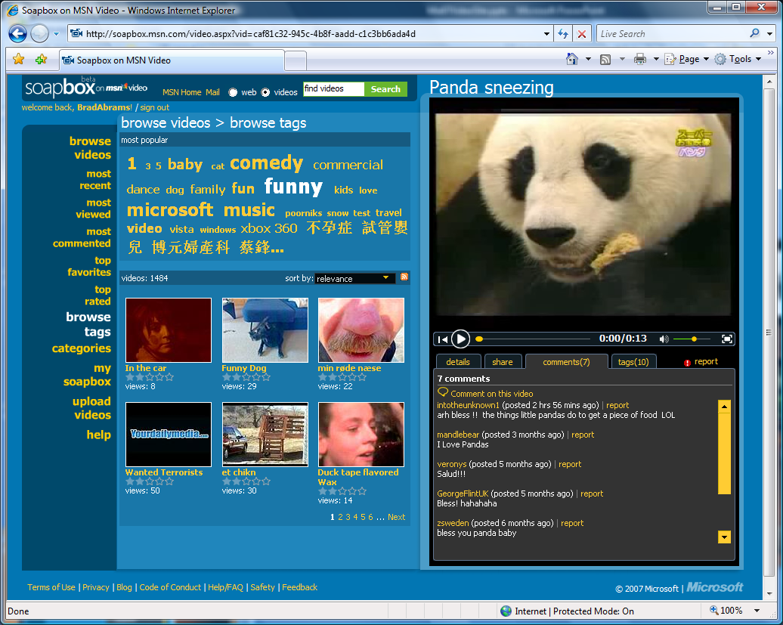
Look Great
and feel great
Uninterrupted
Flow

Slide 12
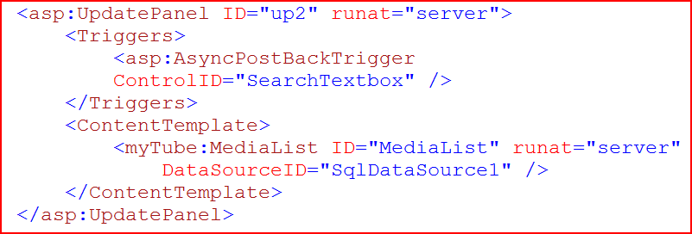

Look Great
and feel great
Uninterrupted
Flow

Slide 13
Uninterrupted
Flow

Slide 14
Immediate Response
to user action

Slide 15
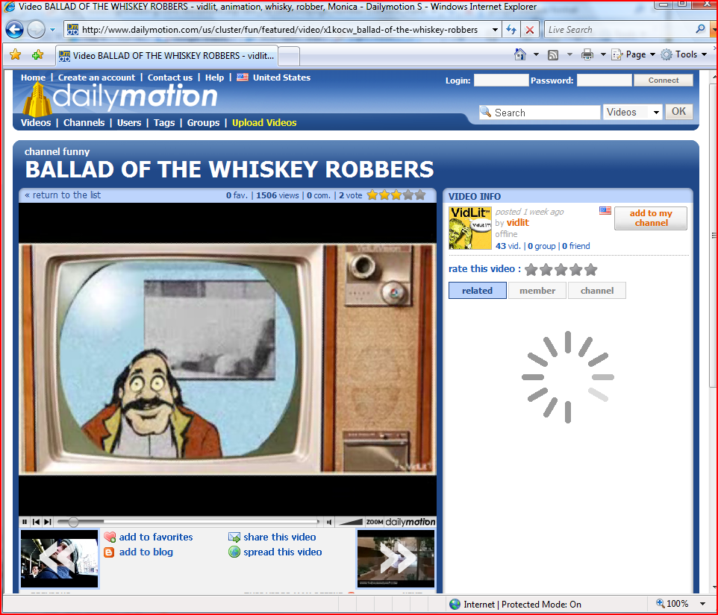
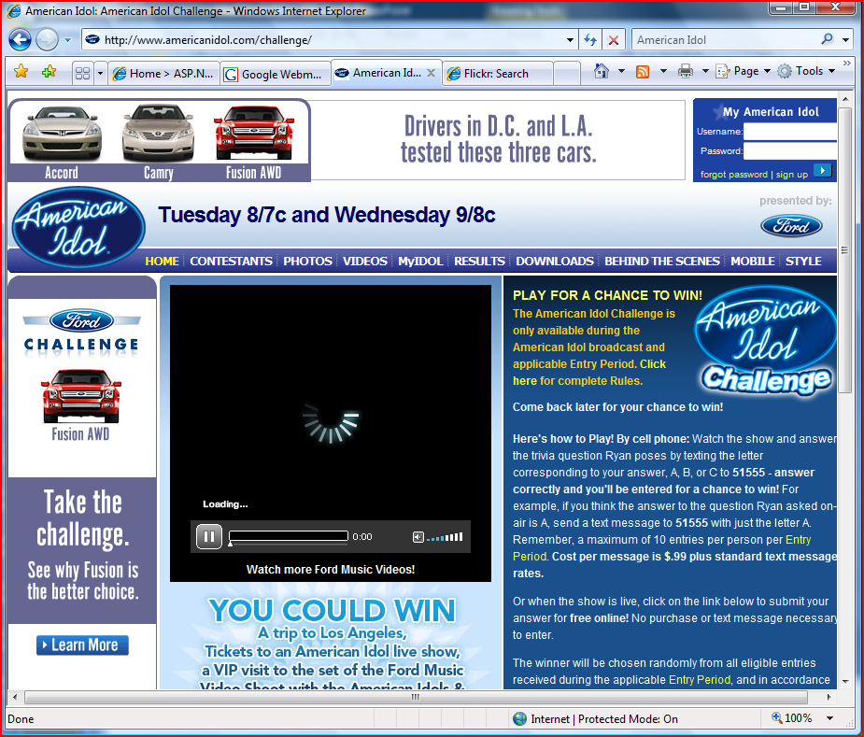
Look Great
and feel great
Uninterrupted
Flow
Immediate Response
to user action

Slide 16
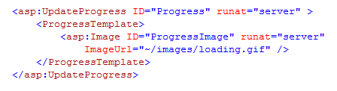
Look Great
and feel great
Uninterrupted
Flow
Immediate Response
to user action

Slide 17
Immediate Response
to user action

Slide 18

Rich and Expressive
Look Great
and feel great
Uninterrupted
Flow
Immediate Response
to user action

Slide 19

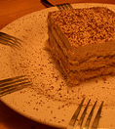

Engaging and easy to use
Preserve
user preferences
enable
Sharing
Suggest
options

Slide 20
Suggest
options

Slide 21
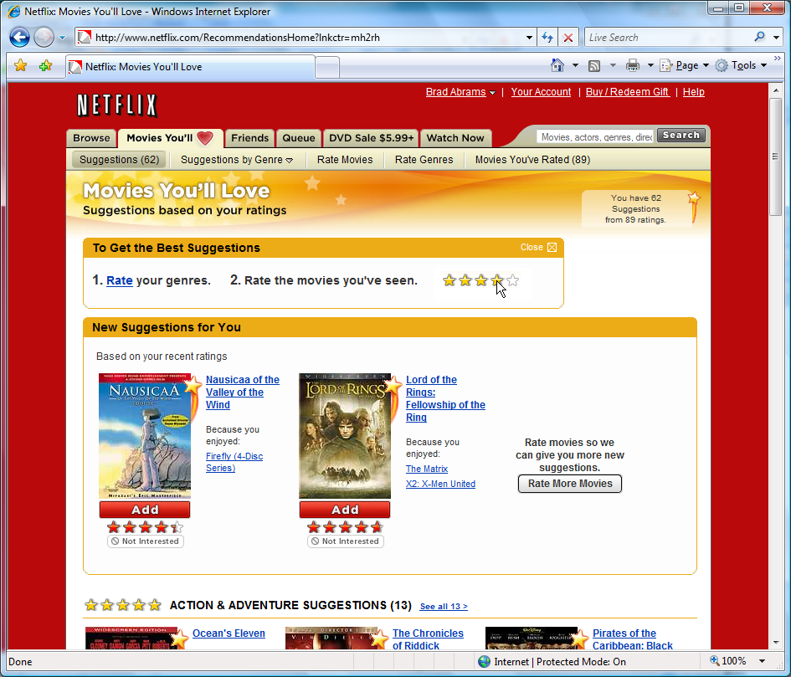
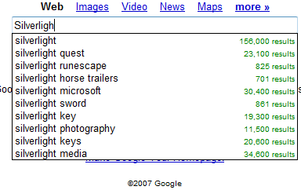
Suggest
options

Slide 22
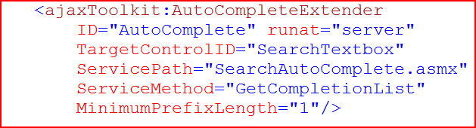
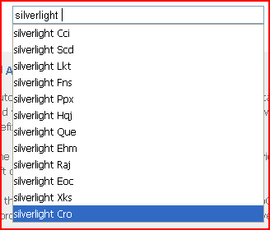
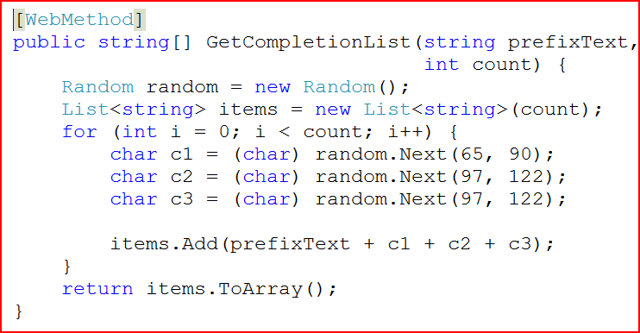
Suggest
options

Slide 23
Suggest
options

Slide 24
Preserve
user preferences

Slide 25
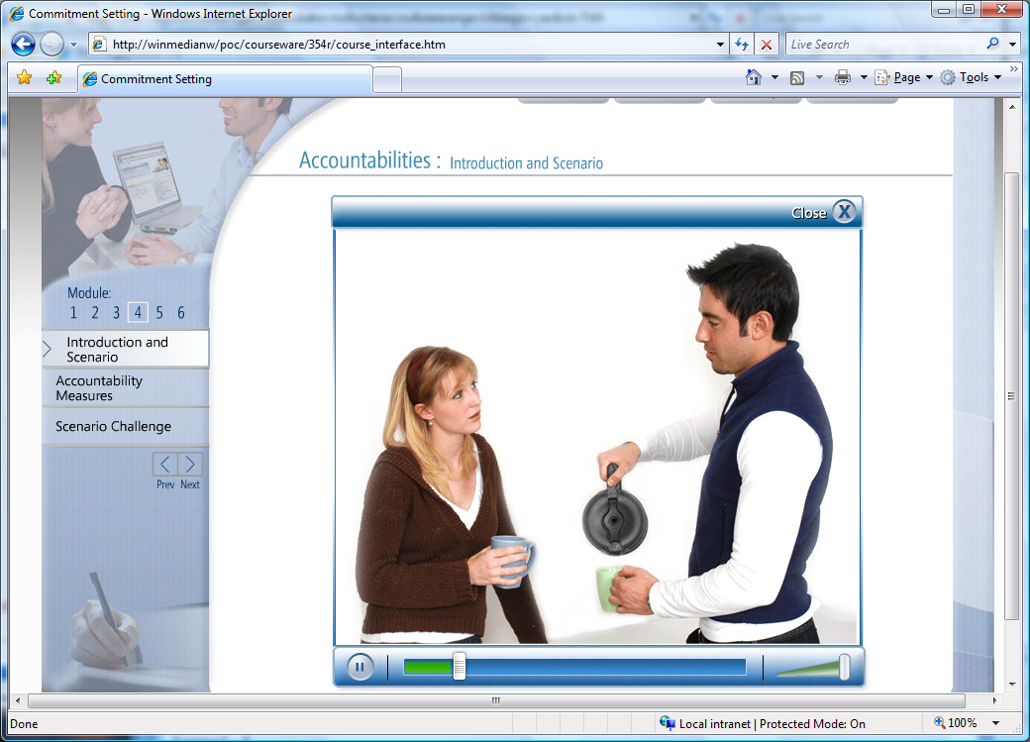
Suggest
options
Preserve
user preferences

Slide 26

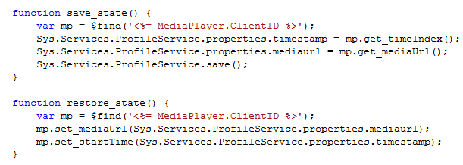
Suggest
options
Futures
Preserve
user preferences

Slide 27
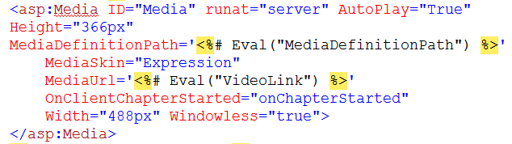
Futures

Slide 28
Preserve
user preferences

Slide 29
enable
Sharing

Slide 30
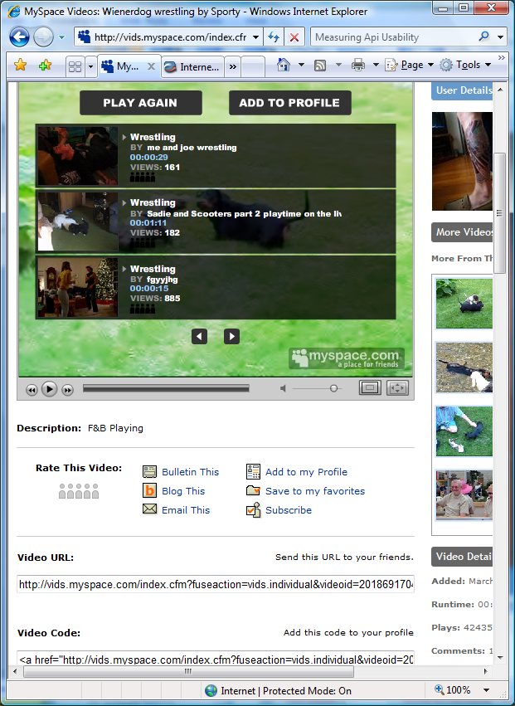
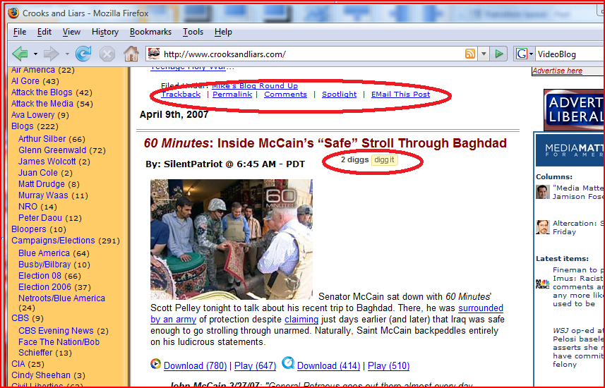
Suggest
options
Preserve
user preferences
enable
Sharing

Slide 31
enable
Sharing

Slide 32
Engaging and easy to use
Suggest
options
Preserve
user preferences
enable
Sharing

Slide 33
Deliver video without going broke

Slide 34
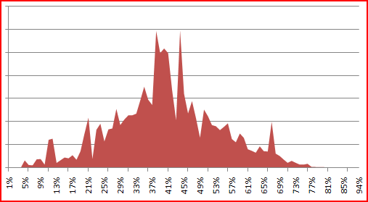
Video Delivery Trends

Slide 35


Delivering Video
Outsource It
and keep it simple
Do It Yourself
if you want
Why use
Silverlight?

Slide 36
Why use
Silverlight?

Slide 37

Why use
Silverlight?

Slide 38
Why use
Silverlight?

Slide 39
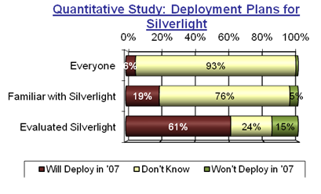
Why use
Silverlight?

Slide 40
Why use
Silverlight?

Slide 41
Do It Yourself
if you want

Slide 42


Why use
Silverlight?
Do It Yourself
if you want

Slide 43

Why use
Silverlight?
Do It Yourself
if you want

Slide 44
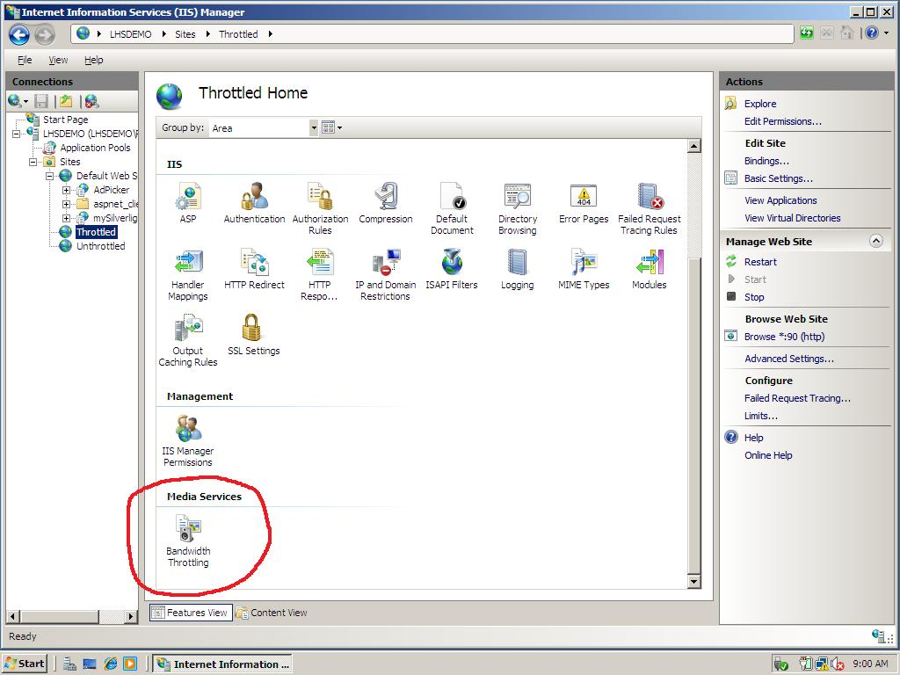
Why use
Silverlight?
Do It Yourself
if you want

Slide 45
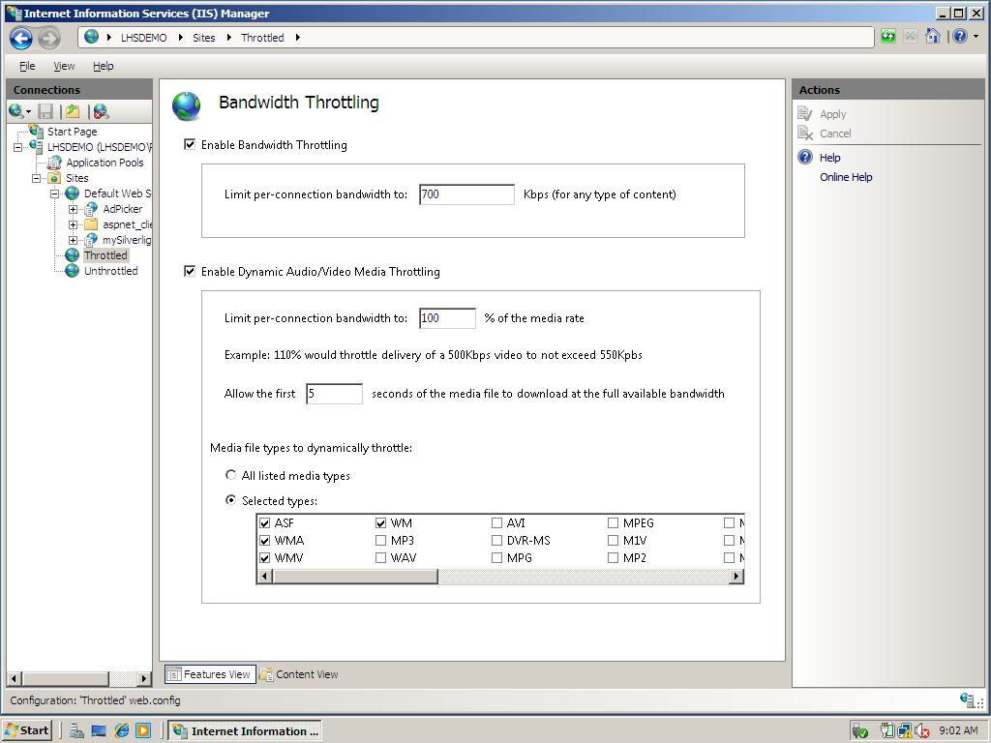
Why use
Silverlight?
Do It Yourself
if you want

Slide 46

Why use
Silverlight?
Services
Do It Yourself
if you want

Slide 47

Why stream?
Live Streaming
Fast Streaming
Logging
Caching and Proxying
Why use
Silverlight?
Do It Yourself
if you want

Slide 48
Why use
Silverlight?
Insert Cache/Proxy Plug-in screenshot and UnHide
Do It Yourself
if you want

Slide 49
Do It Yourself
if you want

Slide 50
Outsource It
and keep it simple

Slide 51
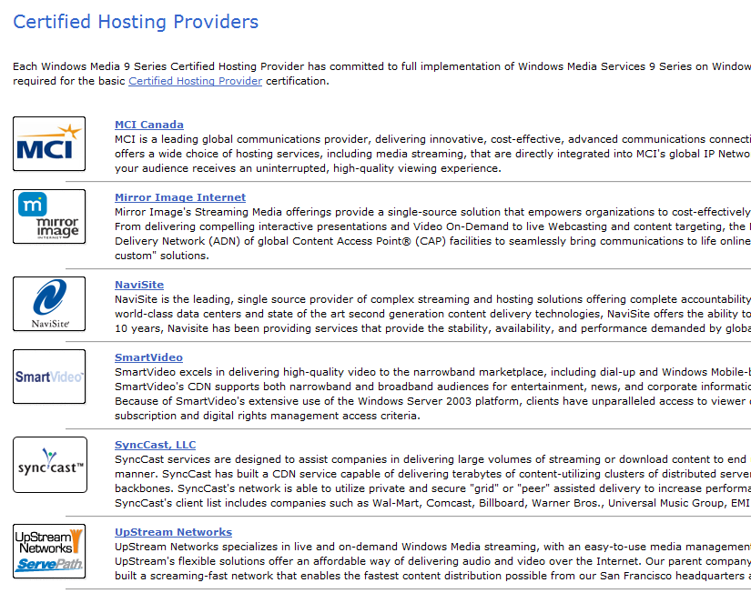
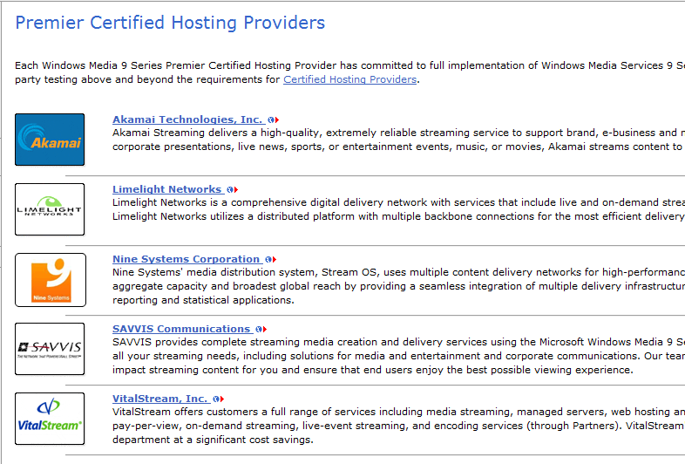
Why use
Silverlight?
Do It Yourself
if you want
Outsource It
and keep it simple

Slide 52
Peer-to-Peer a la Skinkers
Best of p2p and TV, using MS technology
Runs on Silverlight!
No changes to content required
Rolling out with BBC, CNN, etc.
Looking for beta testers and early adopters
Why use
Silverlight?
Do It Yourself
if you want
Outsource It
and keep it simple

Slide 53
Silverlight Streaming by Windows Live
No server maintenance
Cached in edge servers worldwide
4 GB storage
Free!
Why use
Silverlight?
Do It Yourself
if you want
Outsource It
and keep it simple

Slide 54
Outsource It
and keep it simple

Slide 55
Delivering Video
Outsource It
and keep it simple
Do It Yourself
if you want
Why use
Silverlight?

Slide 56

Monetization
via ads

Slide 57


Monetization Principles
Be Found
by users
Let ads
Be Seen

Slide 58

Be Found
by users

Slide 59
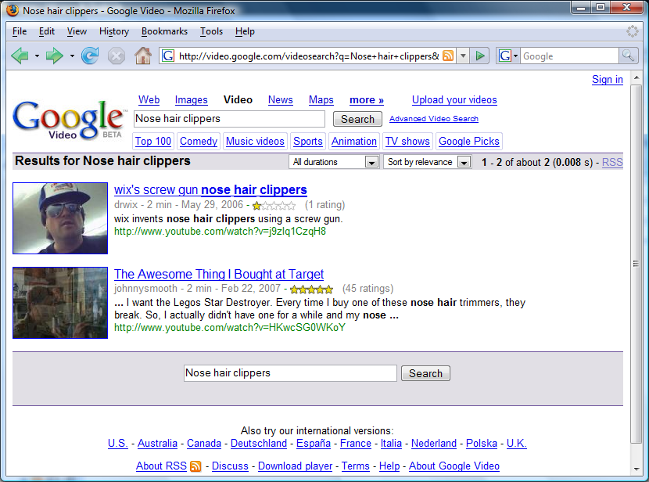



Be Found
by users

Slide 60
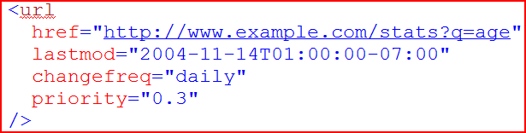

Be Found
by users
Metadata
SiteMap

Slide 61
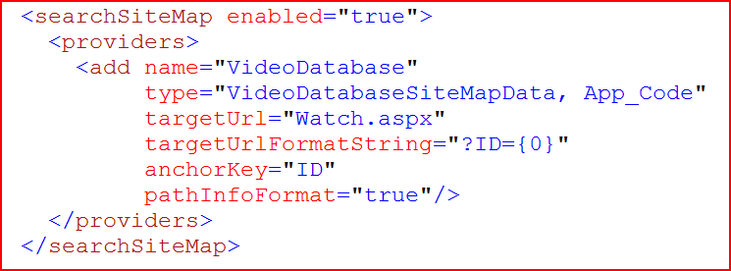
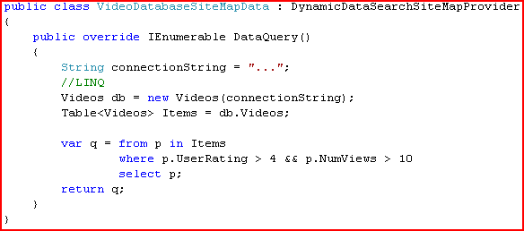
Be Found
by users
Futures

Slide 62
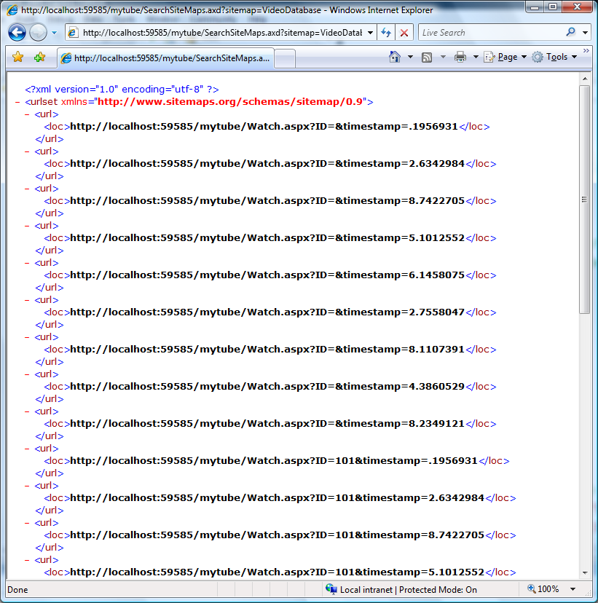
Be Found
by users
Futures

Slide 63
Be Found
by users

Slide 64
Let ads
Be Seen

Slide 65
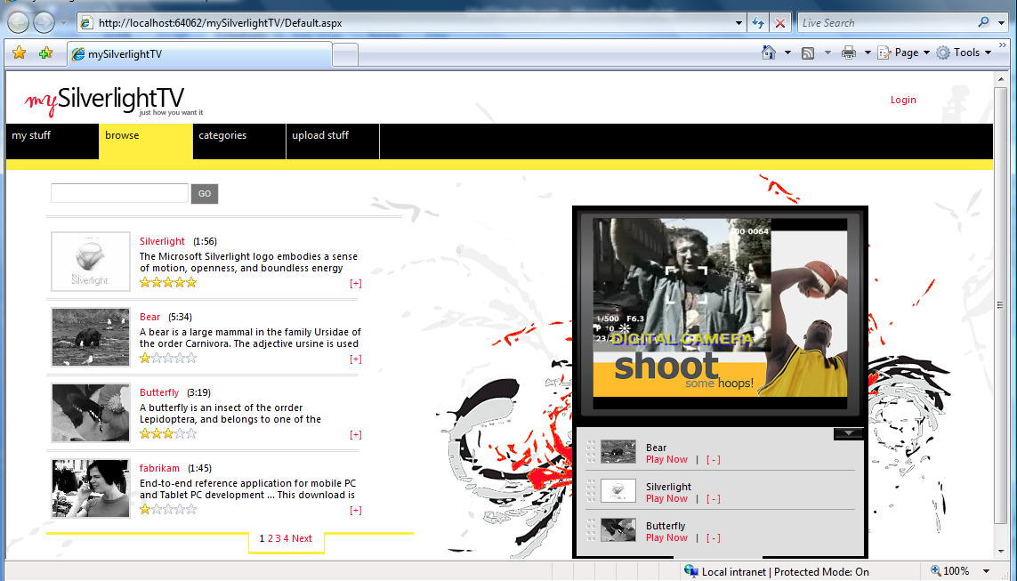
Be Found
by users
Let ads
Be Seen

Slide 66

Be Found
by users
Samples
Let ads
Be Seen

Slide 67
Let ads
Be Seen

Slide 68
Monetization Principles
Be Found
by users
Let ads
Be Seen

Slide 69
For More information
http://asp.net and http://www.microsoft.com/silverlight/
See the demo live http://mixer1004.mixsandbox.com/

Slide 70


Designing Windows Applications with Expression Blend
2-day instructor-led training in over 20 US cities
Tools and Technologies Used
  Expression Blend and Expression Design
  NET Framework 3.0, Windows Presentation Foundation, XAML
  Visual Studio 2005
Target Audience
  User interface designers with advanced experience with Flash or Director. Understanding of Visual Studio 2005 or programming skills is not required.
Prerequisites
  Does not require prior experience using Expression Blend or Windows Presentation Foundation.
  We recommend:
    Building an understanding of .NET Framework 3.0
    Download Expression Blend http://www.microsoft.com/expression
    Get inspired! www.seewindowsvista.com
Learn More:
http://tinyurl.com/3y6jg7

Slide 71
Please fill out your eval
evaluation

Slide 72
For More information @ Mix
  Deep Dive on Silverlight Media Integration (Tuesday 2:15 )
  Design in Motion: Video Production Workflow (Wed 11:30)
  AJAX Patterns with ASP.NET (Mon 4:30)
  High-Speed Development AJAX Control Toolkit (Tues 10:15)
  Designing with Microsoft Expression Web (Mon 1:30)
Hands On Labs: ASP.NET AJAX, Silverlight, "Build a Media Player"
AskTog: http://shrinkster.com/oi8 BradA: http://blogs.msdn.com/brada
http://asp.net and http://www.microsoft.com/silverlight/
See the demo live http://mixer1004.mixsandbox.com/

Slide 73

© 2007 Microsoft Corporation. All rights reserved. Microsoft, Windows, Windows Vista and other product names are or may be registered trademarks and/or trademarks in the U.S. and/or other countries.
The information herein is for informational purposes only and represents the current view of Microsoft Corporation as of the date of this presentation. Because Microsoft must respond to changing market conditions,
it should not be interpreted to be a commitment on the part of Microsoft, and Microsoft cannot guarantee the accuracy of any information provided after the date of this presentation.
MICROSOFT MAKES NO WARRANTIES, EXPRESS, IMPLIED OR STATUTORY, AS TO THE INFORMATION IN THIS PRESENTATION.

