Slide 2
VoIP Topologies and Interoperability
Jamie Stark & Duncan Blake
OCS Technical Product Management
Microsoft Corporation

Slide 3
Session Objectives
Understand the voice deployment scenarios for OCS 2007
Learn how OCS 2007 integrates with SIP/PSTN gateways and PBXs
See how to get started with a simple gateway-only configuration
Understand OCS Integration with any PBX (TDM or IP-based)
Understand Native OCS Integration with an IP-PBX

Slide 4




Today’s Business Environment
What customers are telling us
Employees
Communications tools don’t work together
New infrastructure should support existing work style
IT Decision Makers
Big investments in existing PBX systems
Make decisions that ensure flexibility
IT Professionals
Difficulty managing disparate PBX systems
Moves, adds, and changes should transcend infrastructure

Slide 5


Software-Powered VoIP Architecture
Today
Future
Legacy PBX interoperability
Pilot today to prepare
for the future
Focus on the user experience
OCS & OC replace legacy telephony infrastructure
Integrated user experience across all communication channels
Build Foundation
Single identity with Microsoft Active Directory
Instant Messaging and Presence with OCS 2007
Unified Messaging with Exchange Server 2007
Notes:
10/18/2007 1:31 PM
© 2004 Microsoft Corporation. All rights reserved.
This presentation is for informational purposes only. Microsoft makes no warranties, express or implied, in this summary.
5

Slide 6
Software-Powered VoIP Architecture
Deployment scenarios for today
Scenario | When to Deploy | Infrastructure Required
OCS Co-existence | All the features of the existing PBX, plus all features of OC and OCS | Modern PBX that can natively interoperate with OCS
OCS Standalone | Pilot the future with specific groups: Highly collaborative employees Mobile employees | PSTN Gateway or existing TDM or Hybrid-IP PBX.
Notes:
10/18/2007 1:31 PM
© 2004 Microsoft Corporation. All rights reserved.
This presentation is for informational purposes only. Microsoft makes no warranties, express or implied, in this summary.
6

Slide 7



Software-Powered VoIP Architecture
Deployment scenario: OCS 2007 Co-existence
OCS 2007 Co-existence
Simultaneous ringing
  Interoperability with PBX systems
  Users have both OC and legacy phone
Utilize existing PBX capabilities
  Receptionist and boss-admin needs
  Emergency call requirements
  Analog lines (e.g., fax machines)
  Voicemail
Existing
PBX
Mediation
Server
SIP/PSTN
Gateway
SIP
OCS 2007
Inbound Routing
Outbound Routing
Voicemail Routing
IM, Presence,
Audio, Video, Conferencing, IVR
Notes:
10/18/2007 1:31 PM
© 2004 Microsoft Corporation. All rights reserved.
This presentation is for informational purposes only. Microsoft makes no warranties, express or implied, in this summary.
7

Slide 8
Software-Powered VoIP Architecture
Deployment scenario: OCS 2007 Standalone
OCS 2007 Stand-Alone
Migrate groups to Software-powered VoIP
  Typically information or mobile workers
  All users have IM and presence
Standard PBX migration procedures
  Common PBX network interfaces
  PBX numbering plans
  No PBX upgrade required
Existing
PBX
Mediation
Server
SIP/PSTN
Gateway
SIP
OCS 2007
Inbound Routing
Outbound Routing
Voice Mail Routing
IM, Presence,
Audio, Video, Conferencing, IVR
Notes:
10/18/2007 1:31 PM
© 2004 Microsoft Corporation. All rights reserved.
This presentation is for informational purposes only. Microsoft makes no warranties, express or implied, in this summary.
8

Slide 9
Session Objectives
Understand the voice deployment scenarios for OCS 2007
Learn how OCS 2007 integrates with SIP/PSTN gateways and PBXs
See how to get started with a simple gateway-only configuration
Understand OCS Integration with any PBX (TDM or IP-based)
Understand Native OCS Integration with an IP-PBX

Slide 10












OCS 2007 Voice Components
UC endpoints
Public IM Clouds
QOE MonitoringArchiving
CDR
DMZ
AOL
MSN
Yahoo
Data
Audio/Video
Inbound
Routing
SIP
Outbound
Routing
Remote
Users
Voice Mail
Routing
Active Directory
Front-End Server(s)
(IM, Presence)
Conferencing
Server(s)
Backend
SQL server
Access
Server
Mediation
Server
Exchange
2007 Server UM
Federated
Businesses
SIP-PSTN GW
PRI
Voicemail
PSTN
PBX

Slide 11
Mediation Server
Connects OCS and SIP/PSTN Gateway or IP-PBX
Front-end of the Microsoft OCS voice world
  Intermediate signaling and call flow
  Manage innovative elements of the SIP transaction
  Transcode RTP flows from G.711 to RTAudio and SIREN
  Act as an ICE Client for PSTN-originated calls
Enables OCS to…
  Provide IP telephony
  Interconnect with the legacy PSTN

Slide 12
SIP/PSTN Gateways
Basic Media Gateway
  Standalone appliance
  Supports TDM features
  SIP over TCP
  RFC 3261 compliant SIP
  G.711
  Works with Mediation Server
Hybrid Media Gateway
  Media Gateway appliance
  Collocated with Mediation Server
Vendor | Model | Type | Availability
Aculab | Hybrid for OCS | Hybrid | Fall 2007
Audiocodes | Mediant 2000 | Basic | Today
Audiocodes | Hybrid | Hybrid | Winter 2007
Dialogic | 1000 | Basic | Oct 16th
Dialogic | 2000 | Basic | Oct 16th
Dialogic | 4000 | Hybrid | Oct 16th
Quintum | Tenor DX | Basic | Oct 16th
Quintum | Hybrid | Hybrid | Winter 2007

Slide 13
PBXs: Current Partners and Categories
Many vendors committed to working natively with OCS
TDM-based PBXs
  No UC interoperability
  Use SIP gateway
PBX Vendor | Availability
Alcatel-Lucent | H1, CY2008
Avaya | Q2, CY2008
Cisco | Q3, CY2008
Ericsson | Q2, CY2008
Mitel | Q1, CY2008
NEC | Q2, CY2008
Nortel | Q4, CY2007
Siemens | Q2, CY2008

Slide 14
Session Objectives
Understand the voice deployment scenarios for OCS 2007
Learn how OCS 2007 integrates with SIP/PSTN gateways and PBXs
See how to get started with a simple gateway-only configuration
Understand OCS Integration with any PBX (TDM or IP-based)
Understand Native OCS Integration with an IP-PBX

Slide 15
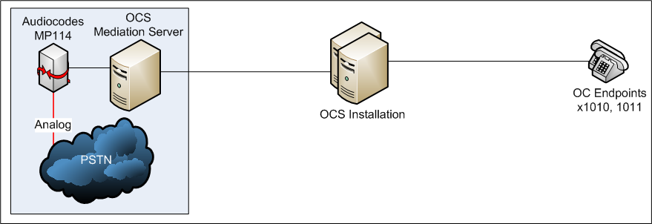
Gateway-Only Configuration

Slide 16
Gateway-Only Configuration Steps
Define location profile for lab environment
Configure
  Media gateway
  Mediation server
Define
  Phone usages
  Voice policies
  Outbound call routes
Call restrictions: Blocking numbers
Use Communicator to dial a PSTN number

Slide 17
Gateway-Only Configuration
demo

Slide 18

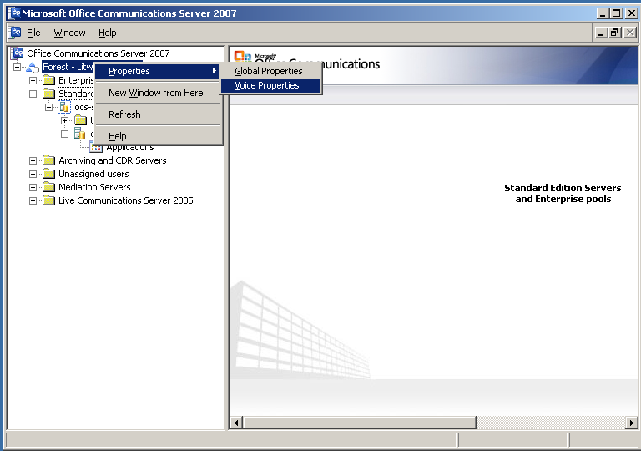
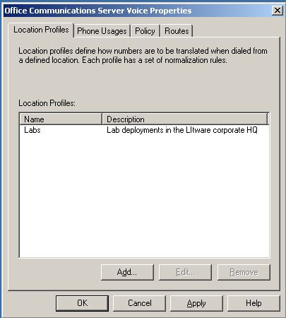
Configure Location Profile
Notes:
If no gateway available, or for reference with Demonstration script.

Slide 19
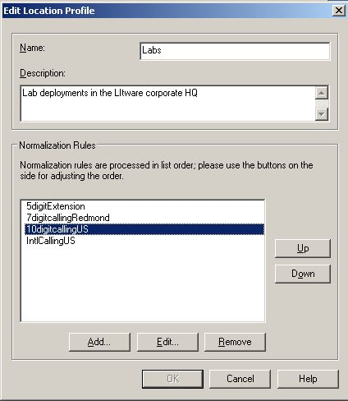
Local Dialing Conditions
Notes:
If no gateway available, or for reference with Demonstration script.

Slide 20
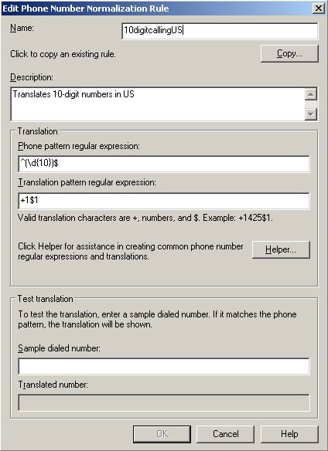
Normalization Rule For Dialing
Notes:
If no gateway available, or for reference with Demonstration script.

Slide 21
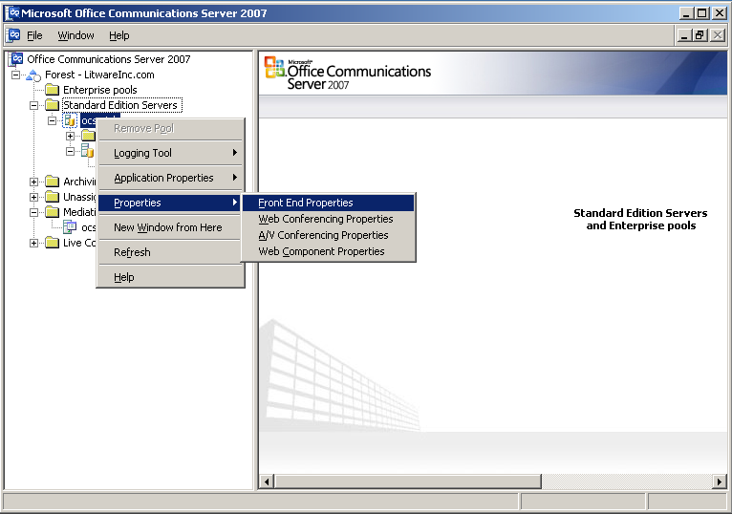
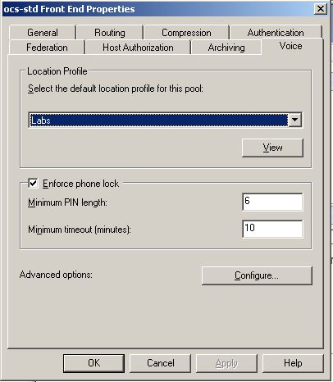
Configuring The Default Location Profile
Notes:
If no gateway available, or for reference with Demonstration script.

Slide 22
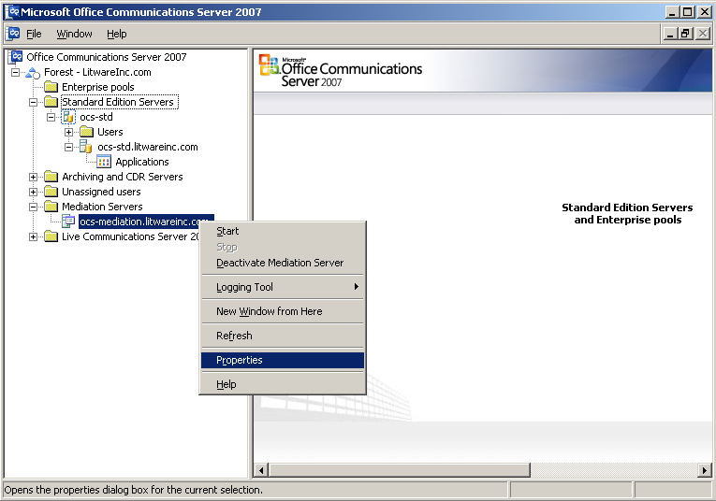
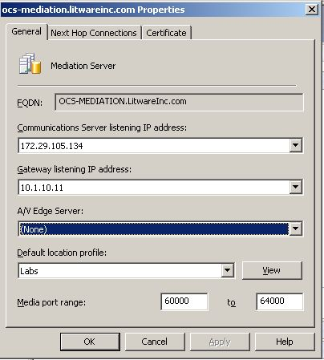
Location Profile For Mediation Server
Notes:
If no gateway available, or for reference with Demonstration script.

Slide 23
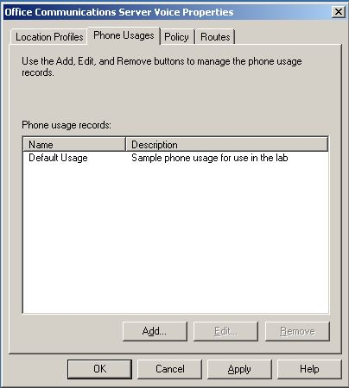
Configure Default Phone Usage
Notes:
If no gateway available, or for reference with Demonstration script.

Slide 24
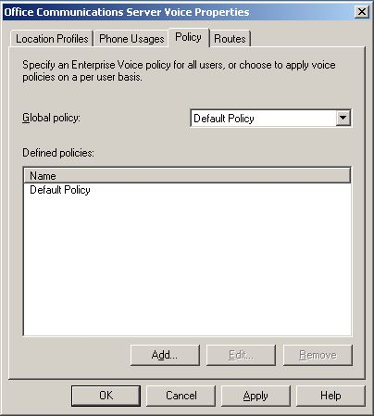
Configure Default Policy
Notes:
If no gateway available, or for reference with Demonstration script.

Slide 25
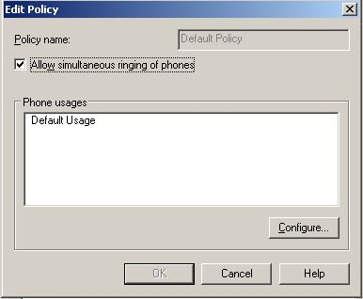
Policy Associated To Phone Usage
Notes:
If no gateway available, or for reference with Demonstration script.

Slide 26
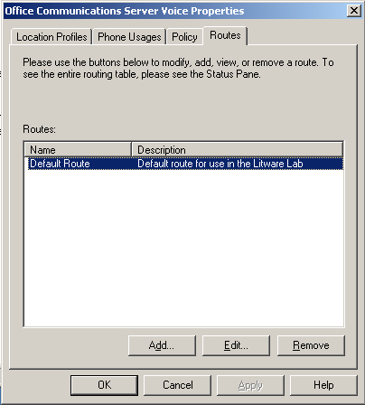
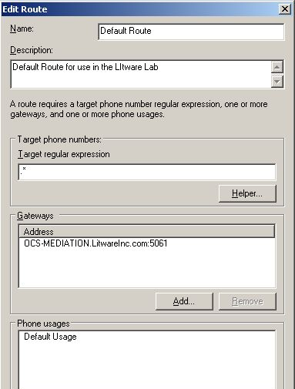
Default Route For Lab – Unrestricted
Notes:
If no gateway available, or for reference with Demonstration script.

Slide 27
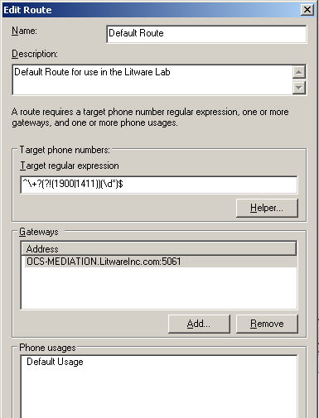
Default Route For Lab – Restricted
Notes:
If no gateway available, or for reference with Demonstration script.

Slide 28
Gateway-Only Configuration

Slide 29
Session Objectives
Understand the voice deployment scenarios for OCS 2007
Learn how OCS 2007 integrates with SIP/PSTN gateways and PBXs
See how to get started with a simple gateway-only configuration
Understand OCS Integration with any PBX (TDM or IP-based)
Understand Native OCS Integration with an IP-PBX

Slide 30
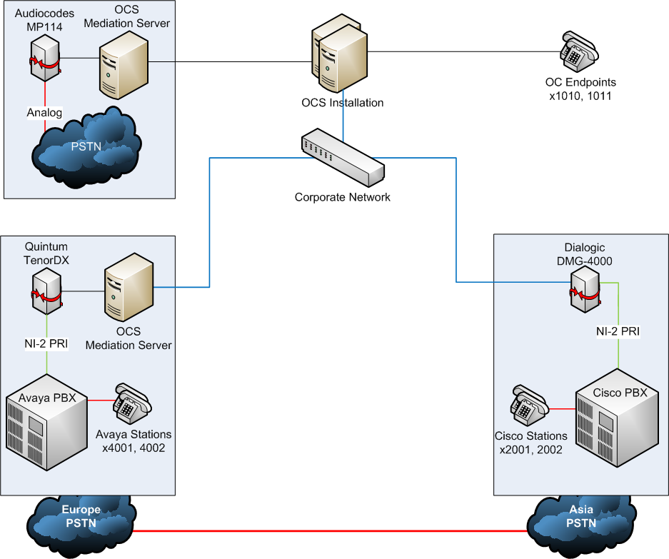
PBX Interoperability (TDM or IP)

Slide 31
PBX Interoperability (TDM or IP)
Define location profile for additional sites
  (examples for London and Hong Kong)
Configuring four-digit dialing across all PBXs
Expand call routes
PSTN toll bypass

Slide 32
PBX Interoperability
(TDM or IP)
demo

Slide 33
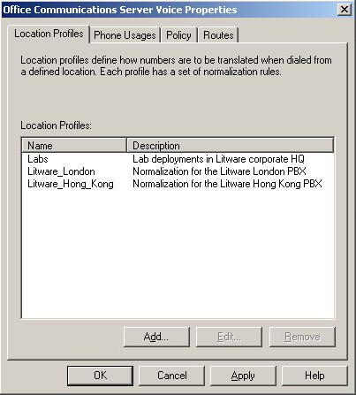
Expanding Location Profiles

Slide 34
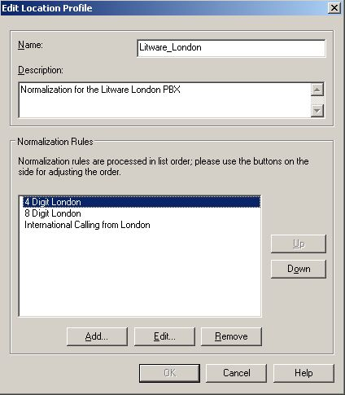
Location Profile For London

Slide 35
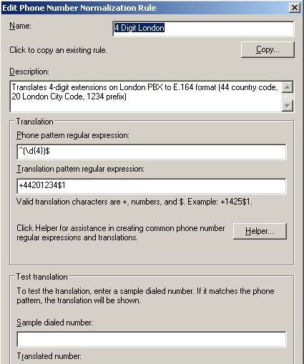
Four-Digit Dialing In The London PBX

Slide 36
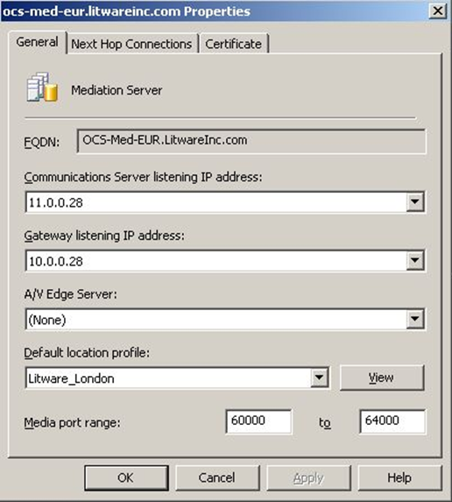
Europe’s Mediation Server

Slide 37

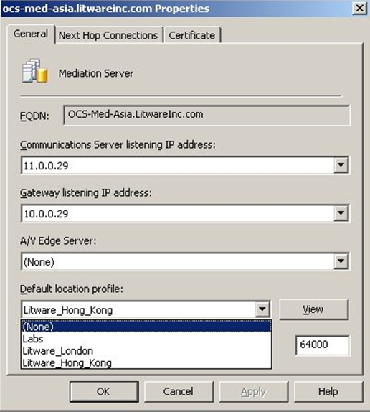
Asia’s Mediation Servers

Slide 38
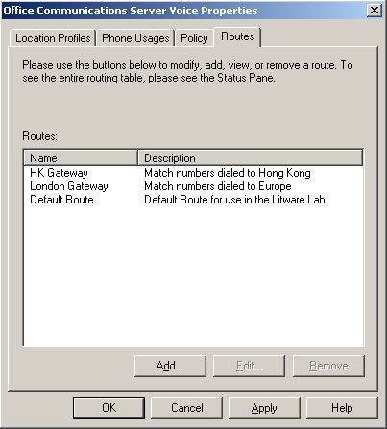
Additional Routes For Mediation Servers

Slide 39
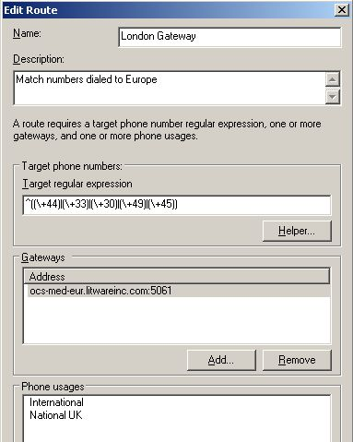
Routes Flexibly Support Site Or Regions
Notes:
+44 = UK
+33 = France
+30 = Greece
+49 = Germany
+45 = Denmark

Slide 40
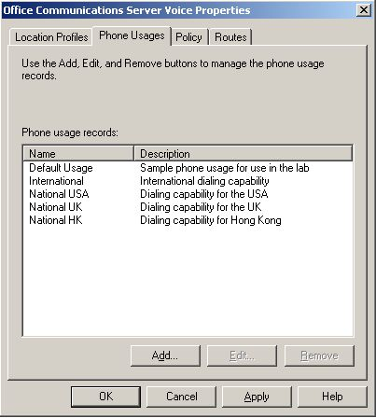
Usage Records For National Dialing

Slide 41
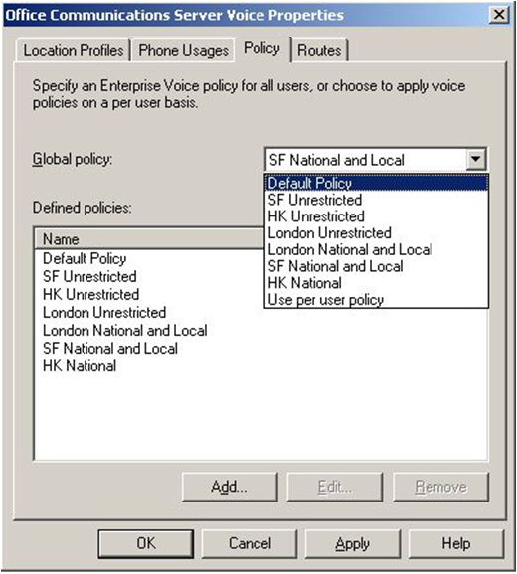
Policies To Restrict User Dialing

Slide 42
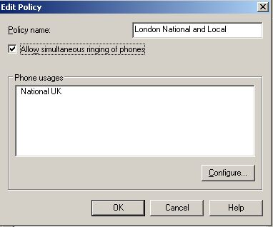
Matching Policy To Phone Usage

Slide 43
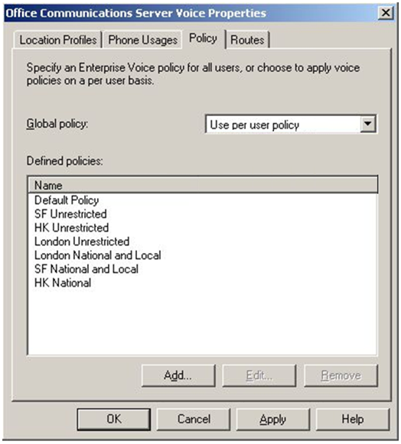
Global Policy Configured Per User

Slide 44
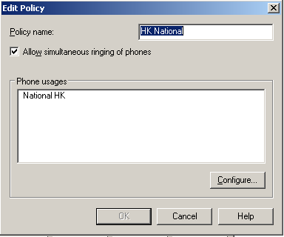
User Policy For Hong Kong

Slide 45
Matching Route To Dialing And Usages
Notes:
+44 = UK
+33 = France
+30 = Greece
+49 = Germany
+45 = Denmark

Slide 46
PBX Interoperability (TDM or IP)

Slide 47
Session Objectives
Understand the voice deployment scenarios for OCS 2007
Learn how OCS 2007 integrates with SIP/PSTN gateways and PBX
See how to get started with a simple gateway-only configuration
Understand OCS Integration with any PBX (TDM or IP-based)
Understand Native OCS Integration with an IP-PBX

Slide 48
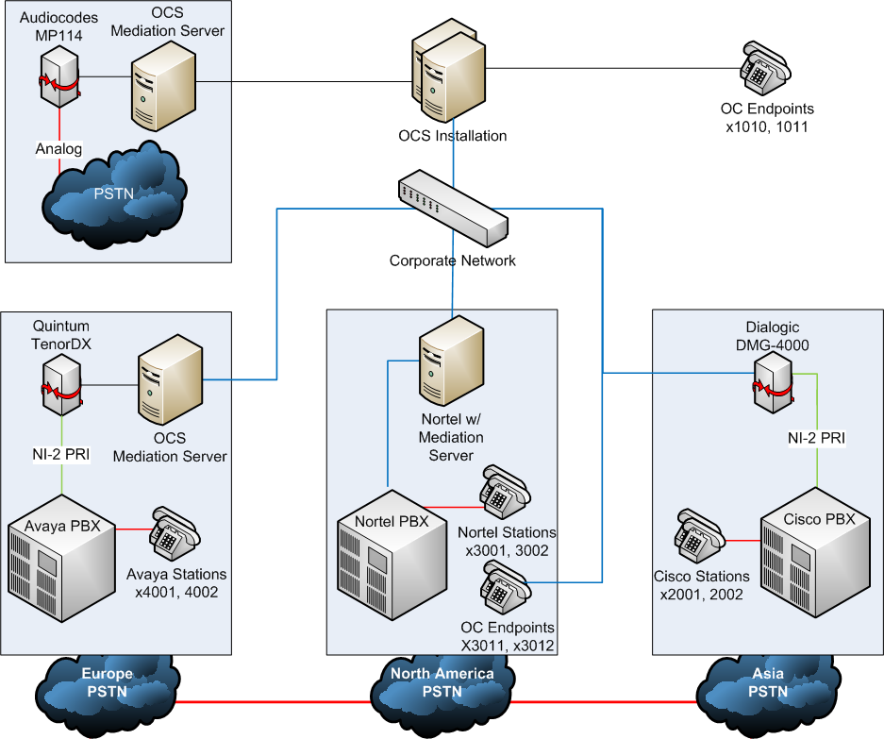
Native IP-PBX Interoperability

Slide 49
Native IP-PBX Interoperability
Define Location Profile for North America PBX
Define Routes and Policies
OCS Co-existence Scenario

Slide 50
Native IP-PBX Interoperability
demo

Slide 51
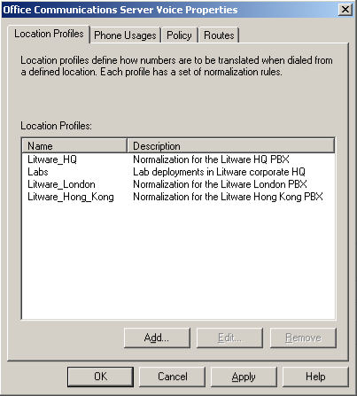
Adding HQ Location Profile

Slide 52
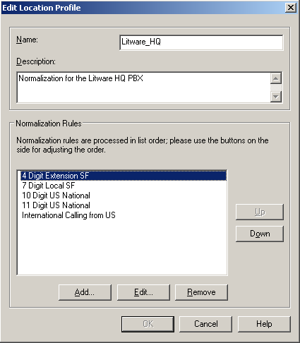
Normalization Rules For HQ

Slide 53
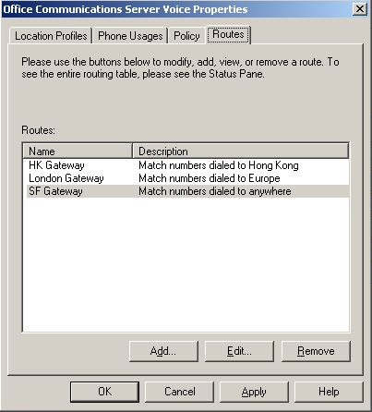
Additional Route For SF Gateway

Slide 54
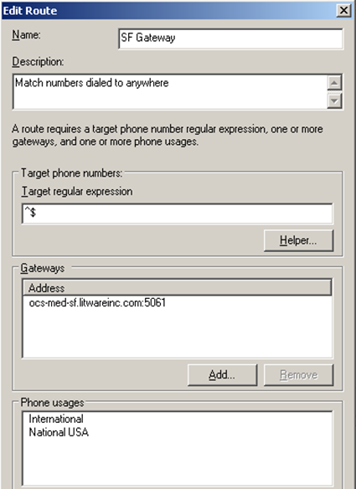
SF Gateway Route Detail

Slide 55
Native IP-PBX Interoperability

Slide 56
Key Takeaways
Understand the voice deployment scenarios for OCS 2007
Learn how OCS 2007 integrates with SIP/PSTN gateways and PBX
See how to get started with a simple gateway-only configuration
Understand OCS Integration with any PBX (TDM or IP-based)
Understand Native OCS Integration with an IP-PBX

Slide 57

© 2007 Microsoft Corporation. All rights reserved. Microsoft, Windows, Windows Vista and other product names are or may be registered trademarks and/or trademarks in the U.S. and/or other countries.
The information herein is for informational purposes only and represents the current view of Microsoft Corporation as of the date of this presentation. Because Microsoft must respond to changing market conditions, it should not be interpreted to be a commitment on the part of Microsoft, and Microsoft cannot guarantee the accuracy of any information provided after the date of this presentation.
This document may contain information related to pre-release software, which may be substantially modified before its first commercial release.
Accordingly, the information may not accurately describe or reflect the software product when first commercially released
MICROSOFT MAKES NO WARRANTIES, EXPRESS, IMPLIED OR STATUTORY, AS TO THE INFORMATION IN THIS PRESENTATION.

