Slide 1

IT管理系列 –
新一代組態管理與部署工具- SCCM 2007導覽
魏早達
亞仕資訊
Notes:
<SLIDETITLE INCLUDE=7>Title Slide</SLIDETITLE>
<KEYWORDS></KEYWORDS>
<KEYMESSAGE></KEYMESSAGE>
<SLIDEBUILDS>0</SLIDEBUILDS>
<SLIDESCRIPT>
Hello and Welcome to this Microsoft TechNet session on {insert session title}. My name is {insert name}
</SLIDESCRIPT>
<SLIDETRANSITION>
<TRANSITION LENGTH=7>Let us start this session by going into more detail on exactly what we will be covering.</TRANSITION>
</SLIDETRANSITION>
<COMMENT></COMMENT>
<ADDITIONALINFORMATION>
<ITEM></ITEM>
</ADDITIONALINFORMATION>

Slide 2
本課程所涵蓋範圍?
SCCM 2007新功能的介紹
SCCM 2007 提升功能的介紹
新功能及提升功能展示
未來SCCM 2007相關Webcast所需知識的基礎
Notes:
<SLIDETITLE INCLUDE=7>What we will Cover</SLIDETITLE>
<KEYWORDS></KEYWORDS>
<KEYMESSAGE></KEYMESSAGE>
<SLIDEBUILDS>0</SLIDEBUILDS>
<SLIDESCRIPT>
[When writing the script for this slide, expand a bit on the list on the slide, do not simply list the slides items here. Think of this as the advert for the session, explain a bit more what will be covered and how.]
</SLIDESCRIPT>
<SLIDETRANSITION>
<TRANSITION LENGTH=7>As with most TechNet sessions, some prior experience of Microsoft technologies or similar technologies is always helpful, the next slide provides a brief overview of what would be helpful, but not essential, for this session.</TRANSITION>
</SLIDETRANSITION>
<COMMENT></COMMENT>
<ADDITIONALINFORMATION>
<ITEM></ITEM>
</ADDITIONALINFORMATION>

Slide 3
預備知識
討論到SCCM 2007所提升功能部份, 需要對 SMS 2003 具備相關知識

Slide 4
議題大綱
SCCM 2007 的藍圖
提升 Configuration Manager Console的功能及操作
SCCM 2007新的Site System Role
提升Operation System Deployment的功能
增進安全性的需求
異動組態管理(Desired Configuration Management)
其他額外的更新

Slide 5
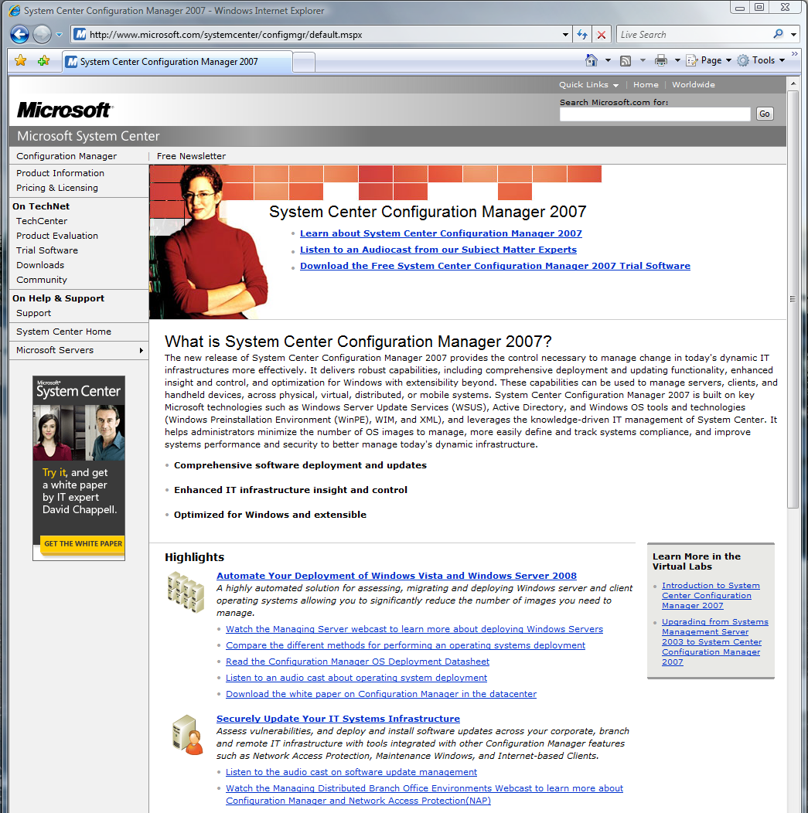
Configuration Manager 2007
Customer momentum
  >300,000 beta seats deployed
  20 Tap and 33 RDP Customers WW
  Over 20,000 downloads of beta 2 and RC
  Over 6,000 RTM evaluations downloaded since August
General availability November ‘07
Configuration Manager Service Pack 1
  Windows Server 2008/ Vista SP1 Support
  Currently testing, dependencies exist
SCCM R2 Plan of Record
  Summer ‘08
  SoftGrid* integration
  Server Provisioning scenarios (including multicast support on WDS)
  Forefront Client security integration (reporting only)
  SQL Reporting service (side by side with SMS Reports
*Microsoft Application Virtualization

Slide 6



From the Datacenter to the Client and Beyond…
Control what workloads to update when: explicit targeting and scheduling for server,
desktop and devices
Learn what you have before deployment or migration
Software Update
Software Distribution
Production Support
Asset Intelligence
HW/SW Inventory
Define
Configuration
standards, maintain
compliancy
Define configurations,
partition model, OS,
drivers and application
suite
Configuration
Management
Client/Server
Design
OS Deployment
Automated delivery of OS and supporting information

Slide 7
議題大綱
SCCM 2007 的藍圖
提升 Configuration Manager Console的功能及操作
SCCM 2007 新的System Role
提升Operation System Deployment的功能
增進安全性需求
異動組態管理(Desired Configuration Management)
其他額外的更新

Slide 8
Configuration Manager Console
Feature | SMS 2003 | ConfigMgr 2007
拖曳功能 | No | Yes
多重選取 | No | Yes
功能視窗 | No | Yes
預覽視窗 | No | Yes
精靈 | 少 | 多
功能首頁 | No | Yes
顯示圖案 | NT 3.51 | 細緻
目錄搜尋 | No | Yes

Slide 9
Home Page
軟體派送狀態
  狀態式顯示advertisement紀錄
  指定軟體派送的連結
  執行Advertisement 回報
Options
  過濾篩選與多重選取
  Bar/Pie 圖表呈現
Actions
  最新、更新過的綜合報告

Slide 10
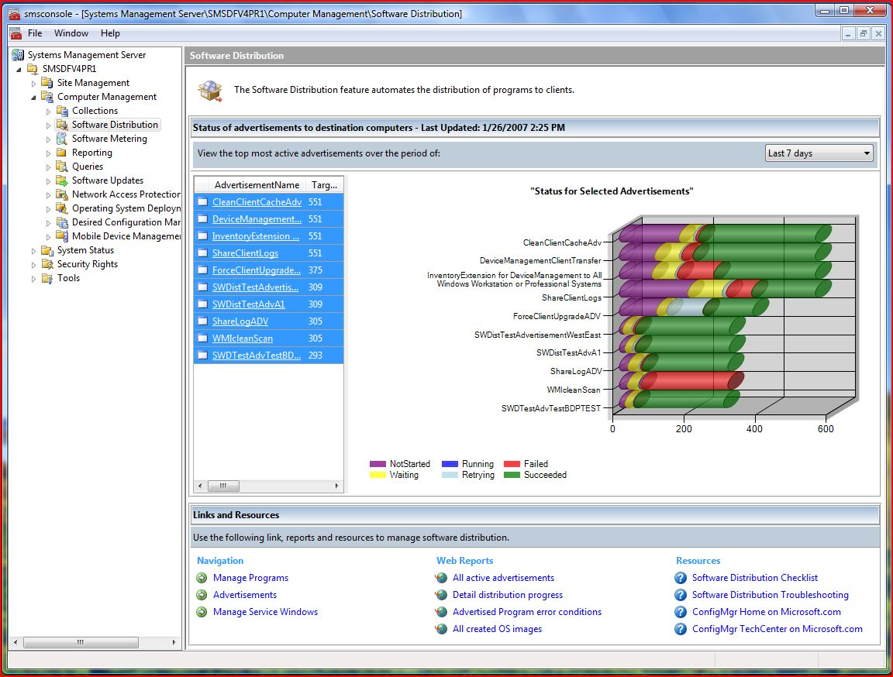

Slide 11

DEMO
Configuration Manager Console
Console Panes
Console Actions
Home Pages

Slide 12
議題大綱
SCCM 2007 的藍圖
提升 Configuration Manager Console的功能及操作
SCCM 2007新的Site System Role
提升Operation System Deployment的功能
增進安全性需求
異動組態管理(Desired Configuration Management)
其他額外的更新

Slide 13
Site System Role
大部份的Site System Role仍然存在
  Site Server (Primary 及 Secondary)
  Site Database Server
  Management Point
  Server locator Point
  Reporting Point
  Distribution Point
移除部份Site System Role Role
  Client access Point
  Sender Component Server

Slide 14
新的 Site System Roles
Operating system deployment
  State migration point
  PXE service point*
  Branch distribution point
Software updates management
  Software update point (WSUS 3.0 server)
  Branch distribution point
*Requires WDS – Windows Deployment Services
**Requires Windows Server 2008

Slide 15
新的 Site System Roles
Network access protection**
  System health validator
Client deployment and distress
  Fallback status point
Software distribution
  Branch distribution point
  Internet Based Client Management
*Requires WDS – Windows Deployment Services
**Requires Windows Server 2008

Slide 16

New Server Roles
SMS 2003 Equivalent Role
New Role
SQL Server
SQL Server
Management Point
Primary Site Server
Server Locator Point
System Health Validator
Reporting Point
Fallback Status Point
Distribution Point
Software Update Point
PXE Service Point
Branch DP
State Migration Point

Slide 17
Supported Client Numbers
Site Role | Maximum # of Client Systems
Hierarchy (Central Site Server) | 200,000
Primary Site Server | 100,000
System Health Validator | 200,000
Management Point | 25,000
Distribution Point (Non OSD) | 4,000
Distribution Point (OSD) | Limited by Network & Disk I/O
State Migration Point | Limited by Network & Disk I/O
Software Update Point (WSUS) | 25,000
Fallback Status Point | 100,000
Branch Distribution Point | Limited by OS License, Network & Disk I/O

Slide 18
DEMO
Configuration Manager 2007 Site System Roles
展示 site system roles及設定
新增新的角色

Slide 19
議題大綱
SCCM 2007 的藍圖
提升 Configuration Manager Console的功能及操作
SCCM 2007新的Site System Role
提升Operation System Deployment的功能
增進安全性需求
異動組態管理(Desired Configuration Management)
其他額外的更新

Slide 20
What’s New in ConfigMgr OSD?
Scenario | SMS 2003 OSD FP | ConfigMgr OSD
End-to-end deployment | Yes | Yes
Fully automated | Yes | Yes
Wipe-and-load upgrade | Yes | Yes
Bare metal deployment w/PXE | Loose integration w/RIS | Built-in integration w/WDS
Side-by-side | BDD scripts | Yes, w/built-in SMP
Fully offline deployment | No | Yes
Integrated Vista upgrade planning | No | Yes
Full server deployment | No | Yes
Security | Good | Much stronger
Flexibility/customizability | Good | Excellent
Vista/LH compatibility | Good | Excellent
Device driver management | No | Yes

Slide 21
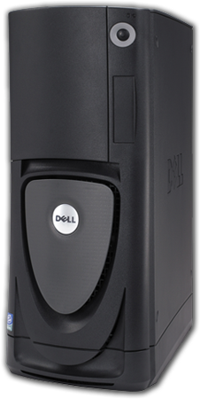
部署情境 (1 of 4)
新機器
  完全全新安裝作業系統在工作站或伺服器
  新的或重新配置的設備
Wipe-and-load
  安裝新版的作業系統在現有的工作站或伺服器
  重新安裝應用程在新的作業系統上
  對工作站而言, 需安全的儲存及回復使用者的狀態及設定在本機或檔案伺服器

Slide 22
部署情境(2 of 4)
Side-by-side
  為現有使用者安裝新版作業系統在新的機器上
  重新安裝應用程式在新的電腦
  需要從舊電腦作狀態的遷移到新的電腦
就地升級
  直接就原機進行作業系統升級
  非全新安裝模式
  就地遷移已安裝的應用程式

Slide 23
部署情境 (3 of 4)
運用媒體進行離線部署
  使用媒體(CD/DVD,
  USB flash drive)部署
  運用在低頻寬的環境
    大的軟體套件置放在媒體中
    無需連線狀態
    每次需從媒體安裝
    沒有狀態回報

Slide 24
部署情境 (4 of 4)
PXE boot
  整合運用 WDS PXE server
  配合使用Configuration
  Manager 公告(advertisements )來控制部署的程序
  使用F12, 來自我啟動
OEM
  OS 已在OEM工廠預先安裝在工作站或伺服器
  在置入企業網路時, 使用Task Sequencer來加入企業的基礎架構及安裝其他軟體

Slide 25
WDS & ConfigMgr Integration
1. Admin advertises task sequence to collection containing
new computer
Site
DB
ConfigMgr Site Server
3. ConfigMgr provider in WDS looks for computer in ConfigMgr database
4. If computer is found, WDS proceeds. If not found, WDS tries next provider
ConfigMgr MP
WDS
Server
5. WDS Server downloads WinPE to new computer
6. ConfigMgr code in WinPE contacts MP to get task sequence
that was advertised
WDS PXE Server hosts multiple providers. ConfigMgr puts its provider first in the list.
2. New computer PXE boots
New Computer

Slide 26
Driver Catalog
ConfigMgr管理設備驅動程式的目錄
“Drivers” node
  Import drivers into this node
  Set properties on drivers
  Assign drivers to Driver Packages
Driver Packages” node
  ConfigMgr packages that are copied to DPs
  Typically group related drivers into one package

Slide 27
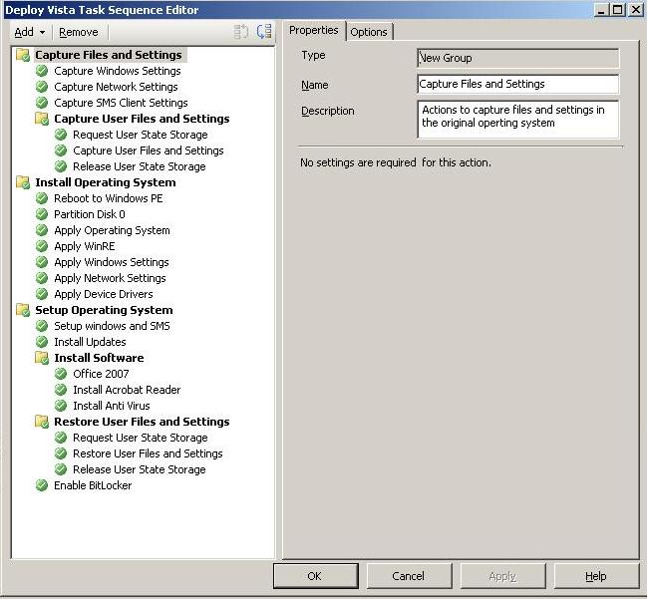
Task Sequence Actions
Two kinds of actions
  ConfigMgr所提供預設的Action
  自行編寫的Action, 可以是一般的命令列執行檔包括 VBscript
不一定要搭配OSD運作
  可以在ConfigMgr中,提供一般性目的的一連串動作

Slide 28

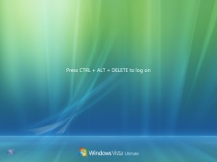


OS Deployment Architecture
Start OS Deployment
Check Deployment Readiness
Save User State & Settings
Save System Settings
Reboot to WinPE
Configure RAID controller
Format & Partition Hard Drive
Deploy OS Image
Add Device Drivers
Reboot to New OS
Install SMS Client
Install Software Updates
Install Applications
Restore User State & Settings
Steps in old OS
Steps in WinPE
Steps in new OS
Bare Metal starts here

Slide 29
DEMO
Operating System Deployment

Slide 30
議題大綱
SCCM 2007 的藍圖
提升 Configuration Manager Console的功能及操作
SCCM 2007新的Site System Role
提升Operation System Deployment的功能
增進安全性需求
異動組態管理(Desired Configuration Management)
其他額外的更新

Slide 31
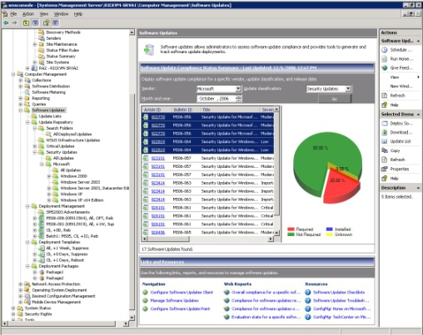



Software Updates Management: How is it Done?
System Center Configuration Manager 2007
WSUS Integration
Universal Scan Agent (WUA)
WSUS Server-based Metadata Catalog
完整的Microsoft Update 和 3rd-party 提供的內容
Policy-based infrastructure
準確的依據遵循狀態佈署
可選擇性的下載
佈署軟體封裝
Administrative Improvements
佈署的範本
更新的清單
EULA management
Client improvements
Maintenance Windows
性能改良
Pre-deadline scheduled installation

Slide 32
Configuring Software Update Management in Configuration Manager 2007
Software Update Point server role
  透過Site Role 精靈新增軟體更新角色
  隨時都可以透過介面或精靈變更軟體更新原件的設定， “Component Configuration -> Software Update Point Component”
Enable and configure the Software Updates
client agent
  可設定排程掃描
  設定更新安裝的方式及佈署前的評估

Slide 33
Configuring Software Update Management in Configuration Manager 2007
Software Update Point server role
  透過Site Role 精靈新增軟體更新角色
  隨時都可以透過介面或精靈變更軟體更新原件的設定， “Component Configuration -> Software Update Point Component”
Enable and configure the Software Updates
client agent
  可設定排程掃描
  設定更新安裝的方式及佈署前的評估

Slide 34
Configuration Manager 2007 SUM Architecture

Slide 35
Configuration of Software Update Points
WSUS 可以支援 NLB的架構
NLB 支援容錯並可支援超過100,000 用戶端電腦
後端資料庫支援 SQL clusters
Clients will always use assigned site SUP
掃描時間設定避免與WSUS同時間
Each WSUS server supports 25,000 clients
Software Update Point (SUP) Role
可搭配現有的WSUS使用
可與Site Server 並存於同一台伺服器
可安裝於Site Server以外的伺服器
Supported configurations
最上層 SUP與Microsoft Update做更新同步
Regional roaming only
SUP = WSUS +Configuration Manager 的元件
Notes:
11/2/2007 12:55 AM
© 2006 Microsoft Corporation. All rights reserved.
This presentation is for informational purposes only. Microsoft makes no warranties, express or implied, in this summary.
35

Slide 36
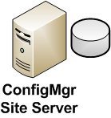

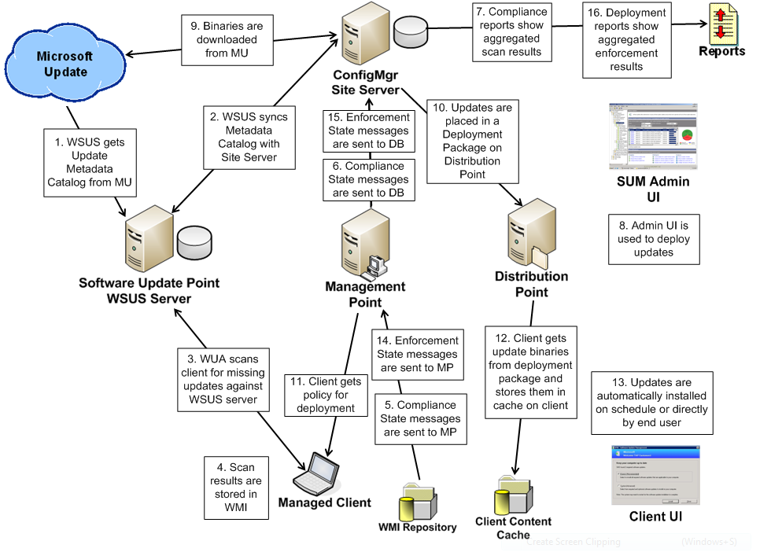

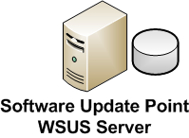
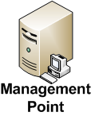

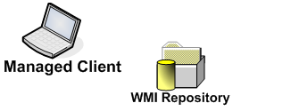

SUM End-to-End

Slide 37













Internet Based Client Management
Manage clients without a VPN
  Road Warriors (Sales force, Consultant)
  Point Of Sale (Restaurant, Retail store, Gas station)
  Employee’s home computers
  Roam in and out intelligently
Converge with standards based technology
  PKI for certificate management
  SSL/TLS for secure HTTP communication
  Firewall for SSL termination
“Deliver a secure and reliable infrastructure to enable IT administrators in an enterprise to manage computers on the internet with the same level of control as computers on the intranet.”

Slide 38
Network Access Protection
Secure your network perimeter
Core feature for Configuration Manager
End point and infrastructure protection through Health Policy Compliance enforcement
Dependencies exist with Windows Server 2008
Policy Validation
Validates the health of client systems as defined by corporate security policy
Quarantine
Restricts access from protected network regions based on client health state.
Network Restriction
Provides access to resources allowing clients to correct security policy compliance deficiencies
Ongoing Compliance
Automatic enforcement of changes to defined corporate security policies ensuring sustained policy compliance

Slide 39
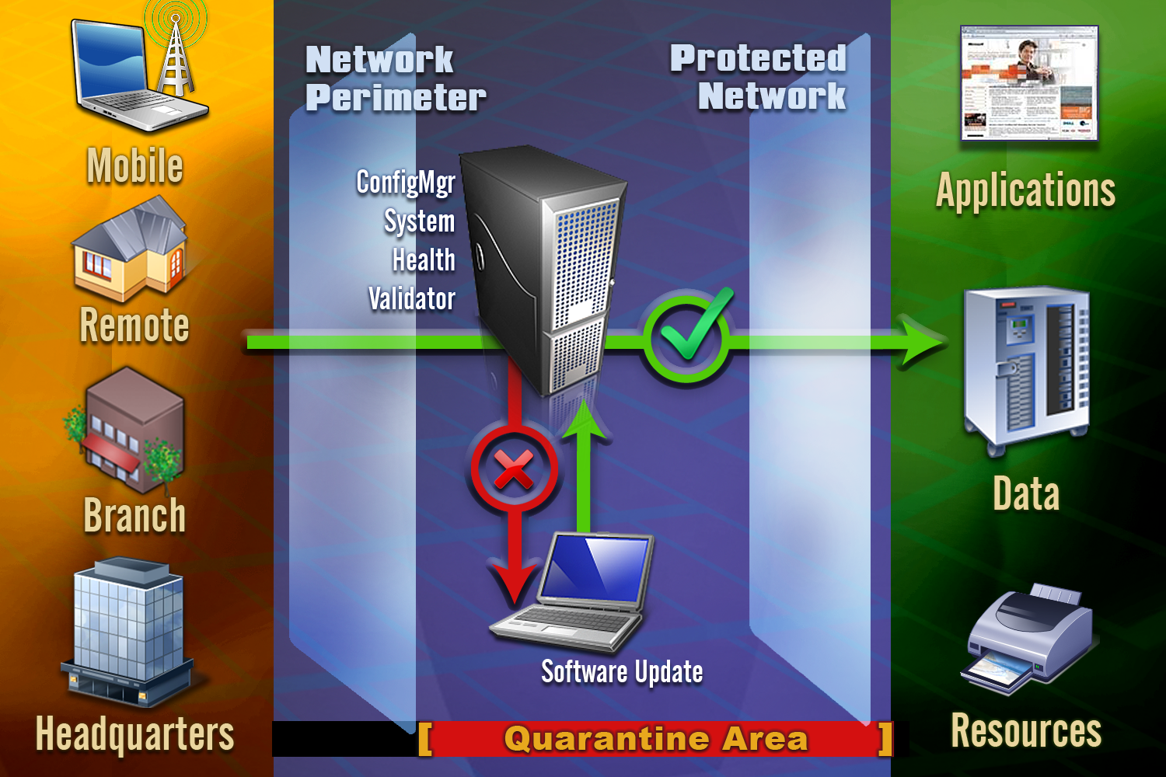

Slide 40
Remote Control: What’s New
Completely rewritten!
Significantly faster performance
Using Vista native “collaboration” technology
  Back-ported to Windows XP and Windows Server 2003
  Underlying protocol: RDP
Same basic functionality as SMS 2003:
  No need for end-user acceptance of new session
NEW! 3 levels of access
  Full control
  View only
  None
Still integrated with Remote Assistance

Slide 41
議題大綱
SCCM 2007 的藍圖
提升 Configuration Manager Console的功能及操作
SCCM 2007新的Site System Role
提升Operation System Deployment的功能
增進安全性需求
異動組態管理(Desired Configuration Management)
其他額外的更新

Slide 42
什麼是 DCM ?
DCM 可以讓管理者作下列事情 :
定義企業組態的標準
報告所管理Windows系統組態規範狀態
結合DCM 組態規範資料與 ConfigMgr 的其他功能來修正用戶端

Slide 43
應用情境
偵測伺服器組態設定 “偏移”
  大約 ½ 的非計劃性的停機時間導因於組態設定的錯誤 !
協助 Helpdesk 進行疑難排解, 並且 “及時解決””
  Helpdesk 對IT而言是最大的 “人員成本”
異動組態規範報告
  針對異動的組態, 定義及報告違反實質組態的政策
預先及事後的變更驗證
  確認系統已經就緒
  驗證計劃性變更的精確及效力

Slide 44
概觀 : DCM名詞及概念
組態項目 Configuration Item (CI)
組態的基本單元, 可以從ConfigMgr 管理的機器偵測、套用及移除
  Application CI
  Operating System CI
  General CI
  Software Updates CI
組態基準線 Configuration Baseline
由不同的CIs組合而成, 根據下列型態 :
  Required
  Optional
  Prohibited
以組態狀態設定collections的條件

Slide 45
Microsoft DCM Knowledge
Microsoft IT “Best Practices”
  Exchange 2003 & 2007
  SQL 2000 & 2005
  Windows Server 2003 AD/DNS/WINS/DHCP
  Sharepoint 2003 & 2007
Product group “Best Practices”
  Configuration Manager server roles
  Vulnerability Assessment
  Operations Manager 2007
  Virtual Machine Manager 2007
  Sharepoint 2007
  SQL 2005

Slide 46
DEMO
異動組態管理
(Desired Configuration Management)
組態項目 (Configuration Items)
組態基準線 (Configuration Baselines

Slide 47
議題大綱
SCCM 2007 的藍圖
提升 Configuration Manager Console的功能及操作
SCCM 2007新的Site System Role
提升Operation System Deployment的功能
增進安全性需求
異動組態管理(Desired Configuration Management)
其他額外的更新

Slide 48
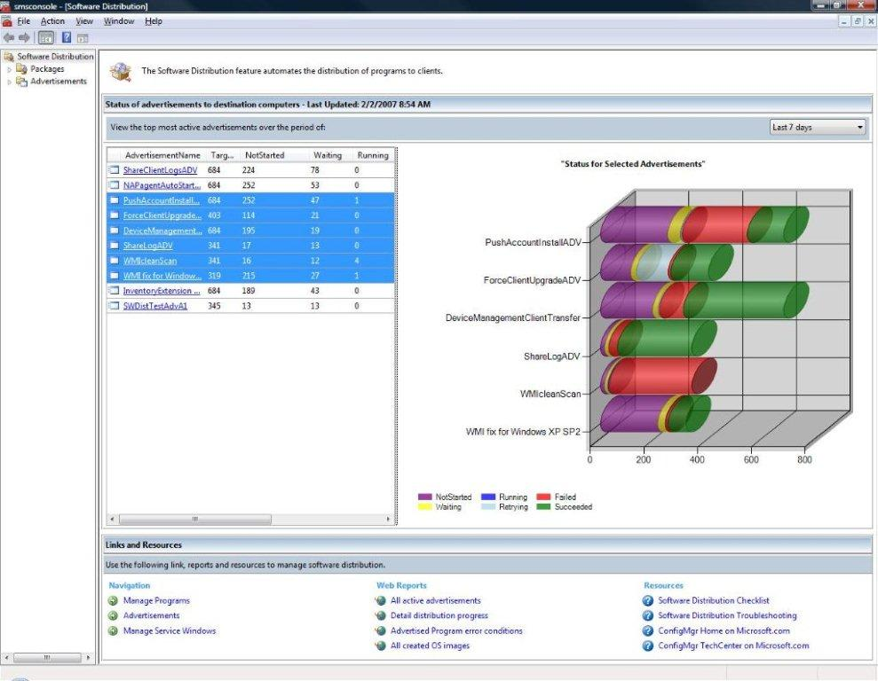
What’s changed in Software Distribution?
New Features
  Copy Package Wizard
  Maintenance Windows
  Branch Support
Improvements
  Improved Package cache control
  Binary delta replication
  Client Branding
  Wake on LAN

Slide 49
DEMO
Maintenance Windows
設定maintenance windows

Slide 50
Device Management - Core Scenarios
Device = CE, PPC, Windows Mobile (SmartPhone)
Basic Management
  Hardware/Software inventory
  File collection
  Software distribution
  Settings management - Password policy management, Security policy management
Support for Smartphone
  Over-the-air management of devices
  Connection Management

Slide 51
Device Management - Core Scenarios
Internet Based Management
  Fallback Status Point
LOB Device Management
  CE on ARM at RTM
Deployment
  Automated client distribution via SMS Advanced Client desktop
  Full integration with SCCM 07
  Over-the-air client upgrade

Slide 52
其他加強功能
Inventory
  Asset Intelligence features added
  Last usage inventory
  Auto-created metering rules
Discovery
  Discover “Extended Active Directory Attributes”
Supports hosting Configuration Manager 2007 Site database on Microsoft SQL Server 2005 Clustered Server
Volume Shadow Copy Service (VSS)-based backup
  Services off-line for minutes
  Snapshot data moved to backup location

Slide 53
課程回顧
System Center Configuration Manager 2007主要是延伸自 SMS 2003既有功能, 並加上 :
  新功能(DCM,NAP,IBCM)
  功能提升(SUM,SWD,DM)
  更容易的安裝方式
  全新管理主控台
可以直接由SMS 2003 SP2 或 SP3進行升級

Slide 54
Resources
Technical Communities, Webcasts, Blogs, Chats & User Groups
http://www.microsoft.com/communities/default.mspx
Microsoft Learning and Certification
http://www.microsoft.com/learning/default.mspx
Microsoft Developer Network (MSDN) & TechNet
http://microsoft.com/msdn
http://microsoft.com/technet
Trial Software and Virtual Labs
http://www.microsoft.com/technet/downloads/trials/default.mspx
System Center Home page
http://www.microsoft.com/systemcenter

Slide 55
在何處取得 TechNet 相關資訊？
訂閱 TechNet 資訊技術人快訊 http://www.microsoft.com/taiwan/technet/flash/
訂閱 TechNet Plus
http://www.microsoft.com/taiwan/technet/
參加 TechNet 的活動
http://www.microsoft.com/taiwan/technet/
下載 TechNet 研討會簡報與錄影檔
http://www.microsoft.com/taiwan/technet/webcast/

Slide 56
Q&A

Slide 57

Notes:
<SLIDETITLE INCLUDE=0>Tag line</SLIDETITLE>
<KEYWORDS></KEYWORDS>
<KEYMESSAGE></KEYMESSAGE>
<SLIDEBUILDS>0</SLIDEBUILDS>
<SLIDESCRIPT></SLIDESCRIPT>
<SLIDETRANSITION>
</SLIDETRANSITION>
<COMMENT></COMMENT>
<ADDITIONALINFORMATION>
<ITEM></ITEM>
</ADDITIONALINFORMATION>

