Slide 1

Welcome
TechNet 技術講座
Notes:
<SLIDETITLE INCLUDE=0>Entry Slide</SLIDETITLE>
<KEYWORDS></KEYWORDS>
<KEYMESSAGE></KEYMESSAGE>
<SLIDEBUILDS>0</SLIDEBUILDS>
<SLIDESCRIPT></SLIDESCRIPT>
<SLIDETRANSITION>
</SLIDETRANSITION>
<COMMENT></COMMENT>
<ADDITIONALINFORMATION>
<ITEM></ITEM>
</ADDITIONALINFORMATION>

Slide 2

Microsoft Office SharePoint Server 2007 與 InfoPath 2007電子表單整合服務應用介紹
黃星峰
技術總監
巧涼地資訊
Notes:
<SLIDETITLE INCLUDE=7>Title Slide</SLIDETITLE>
<KEYWORDS></KEYWORDS>
<KEYMESSAGE></KEYMESSAGE>
<SLIDEBUILDS>0</SLIDEBUILDS>
<SLIDESCRIPT>
Hello and Welcome to this Microsoft TechNet session on {insert session title}. My name is {insert name}
</SLIDESCRIPT>
<SLIDETRANSITION>
<TRANSITION LENGTH=7>Let us start this session by going into more detail on exactly what we will be covering.</TRANSITION>
</SLIDETRANSITION>
<COMMENT></COMMENT>
<ADDITIONALINFORMATION>
<ITEM></ITEM>
</ADDITIONALINFORMATION>

Slide 3
大綱
船務/美國海關InfoPath 運用
InfoPath 表單解決方案
InfoPath Rich Client 架構
InfoPath Browser Form 架構
InfoPath 程式開發
其他應用--人壽保險申請書

Slide 4
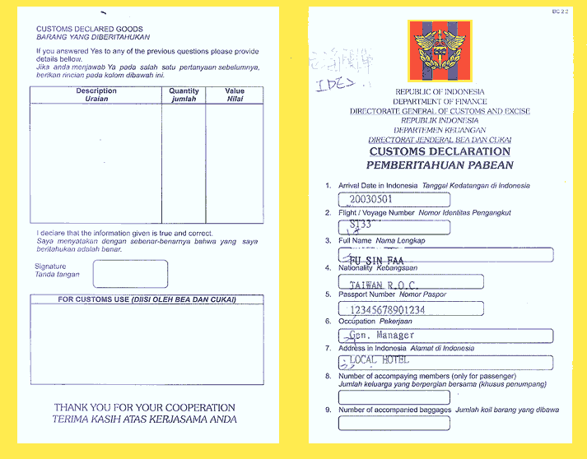
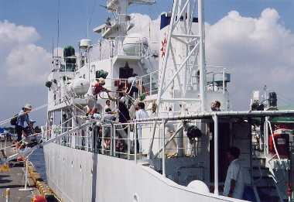

當商船在美國進港時……
申請
回復
Notes:
<SLIDETITLE INCLUDE=7>What we will Cover</SLIDETITLE>
<KEYWORDS></KEYWORDS>
<KEYMESSAGE></KEYMESSAGE>
<SLIDEBUILDS>0</SLIDEBUILDS>
<SLIDESCRIPT>
[When writing the script for this slide, expand a bit on the list on the slide, do not simply list the slides items here. Think of this as the advert for the session, explain a bit more what will be covered and how.]
</SLIDESCRIPT>
<SLIDETRANSITION>
<TRANSITION LENGTH=7>As with most TechNet sessions, some prior experience of Microsoft technologies or similar technologies is always helpful, the next slide provides a brief overview of what would be helpful, but not essential, for this session.</TRANSITION>
</SLIDETRANSITION>
<COMMENT></COMMENT>
<ADDITIONALINFORMATION>
<ITEM></ITEM>
</ADDITIONALINFORMATION>

Slide 5

運行方式
申請
回復
Notes:
<SLIDETITLE INCLUDE=7>What we will Cover</SLIDETITLE>
<KEYWORDS></KEYWORDS>
<KEYMESSAGE></KEYMESSAGE>
<SLIDEBUILDS>0</SLIDEBUILDS>
<SLIDESCRIPT>
[When writing the script for this slide, expand a bit on the list on the slide, do not simply list the slides items here. Think of this as the advert for the session, explain a bit more what will be covered and how.]
</SLIDESCRIPT>
<SLIDETRANSITION>
<TRANSITION LENGTH=7>As with most TechNet sessions, some prior experience of Microsoft technologies or similar technologies is always helpful, the next slide provides a brief overview of what would be helpful, but not essential, for this session.</TRANSITION>
</SLIDETRANSITION>
<COMMENT></COMMENT>
<ADDITIONALINFORMATION>
<ITEM></ITEM>
</ADDITIONALINFORMATION>

Slide 6
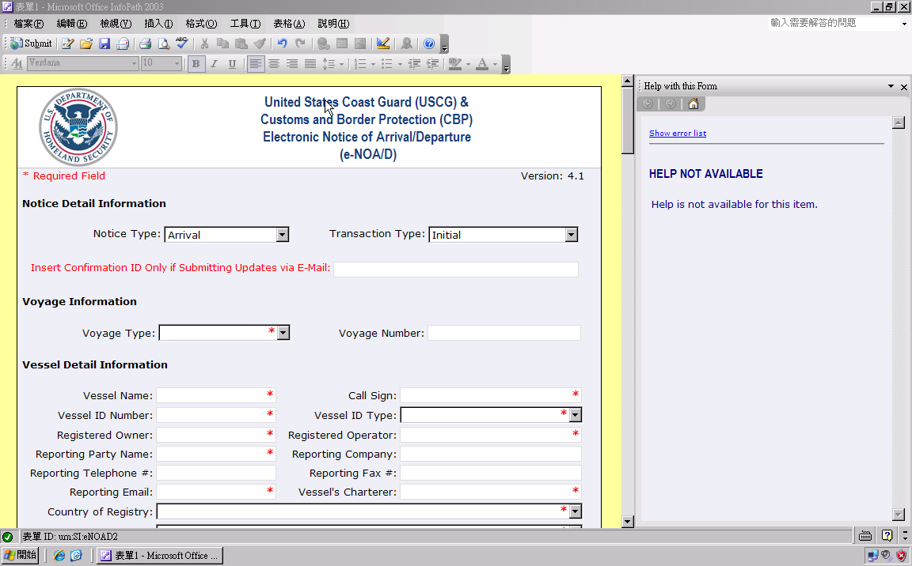
美國海關申請文件—InfoPath 表單

Slide 7
Demo
美國海關表單操作

Slide 8

InfoPath 表單解決方案
擷取商業資料
  動態、XML-based 的表單
  多種資料輸入與驗證控制項
流程自動化
  能夠與多種後端系統與服務做整合
開發解決方案
  提供表單所需 Conditional 和 rule based 的邏輯
  支援指令碼與 Managed Code
封裝檔案小
Notes:
Instructor Notes
Try to figure out if the participants have experience with InfoPath – if not, take your time for this slide
Briefly review the following capabilities and how they support a portals and collaboration offering:
XML data collection
- Conditional formatting
- No coding required
Effective sharing
- Any schema
- XML Web services
Data management
- Dynamic forms
- Text formatting, AutoCorrect
- Offline and e-mail

Slide 9
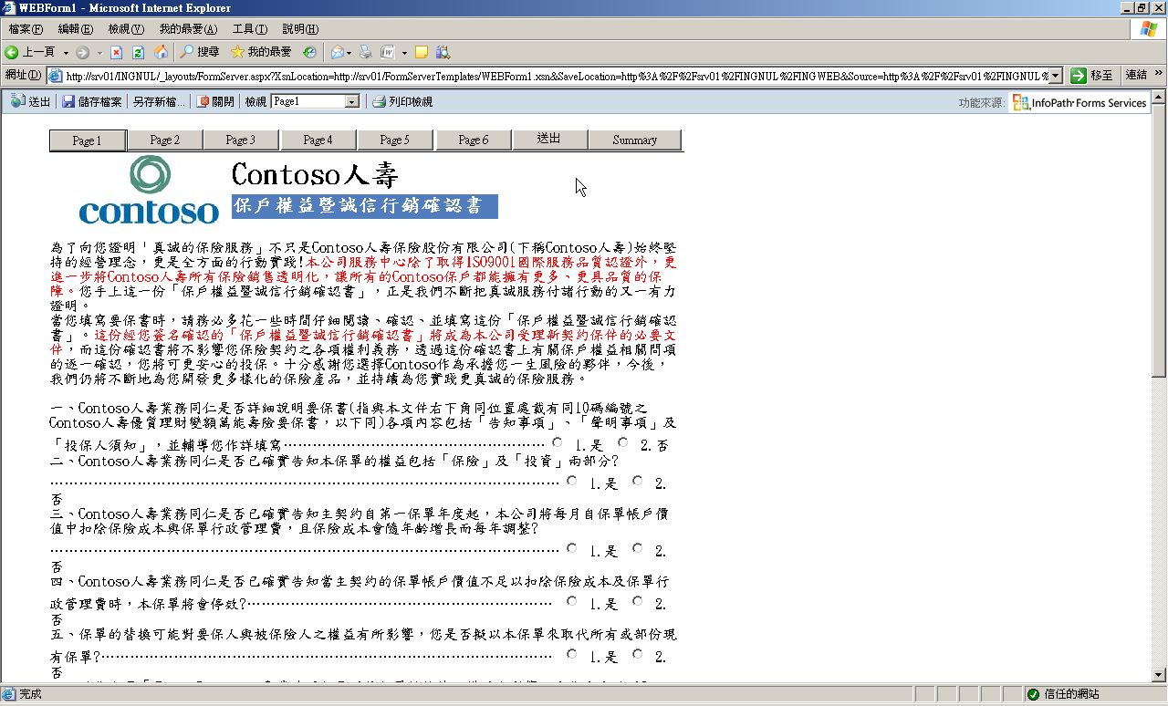
InfoPath 2007運作模式
XML
表單
開啟
InfoPath 2007
表單範本(*.xsn)
*.xsf *.xsd *.xml
*.xsl *.dll *.htm
載入

Slide 10
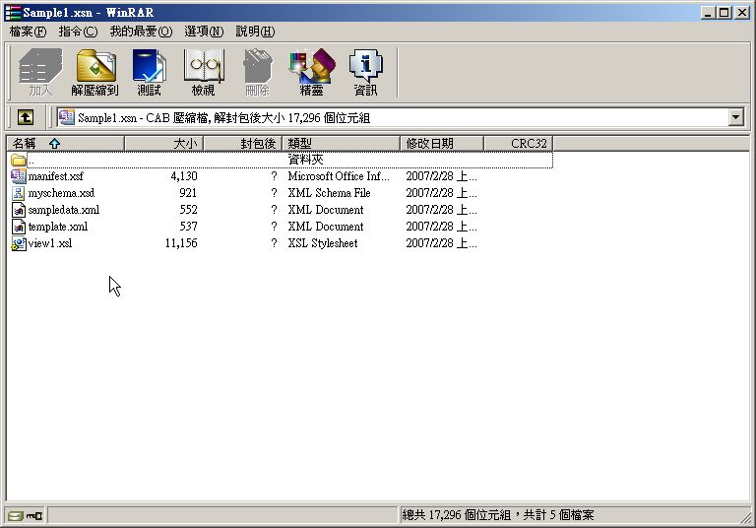
表單範本結構
Manifest (*.xsf)
Data, Resource (*.xml)
Schema (*.xsd)
Views (*.xsl)
Business logic (*.dll)
Custom Task Pane (*.htm)

Slide 11
Browser-Enabled Form

Slide 12
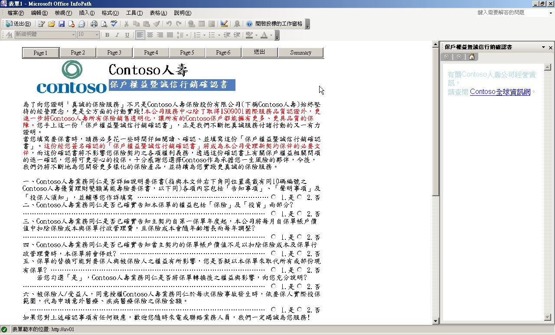
Rich Client Form

Slide 13
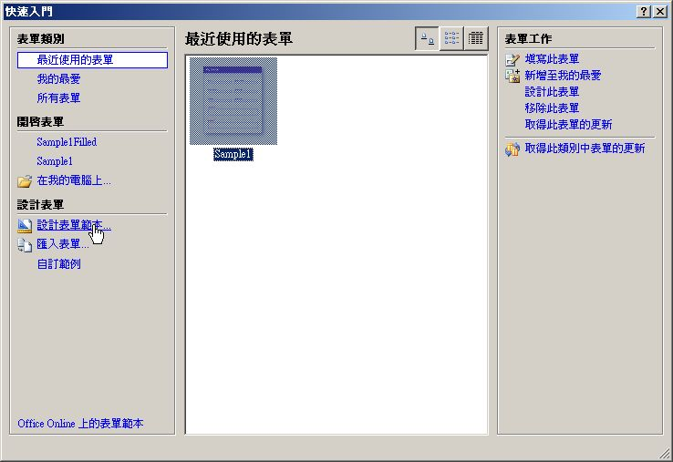
Demo 1:由空白表單開始

Slide 14
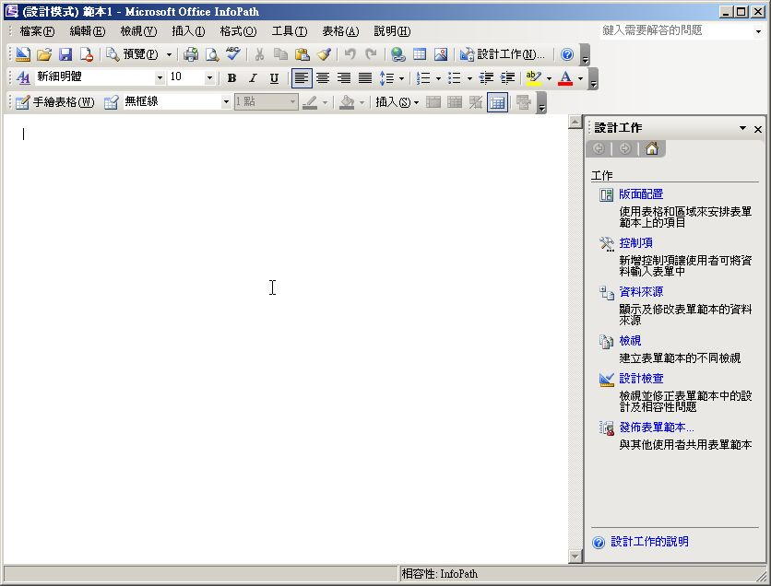
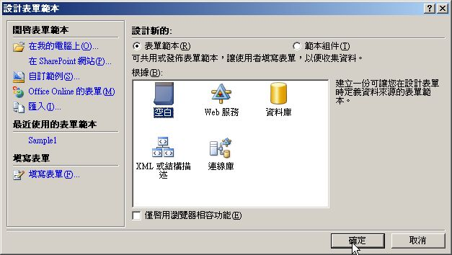
開啟空白表單

Slide 15
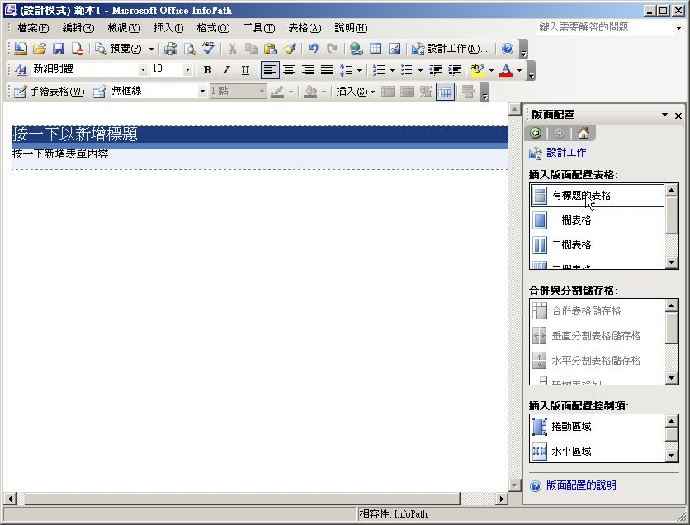
加入標題

Slide 16
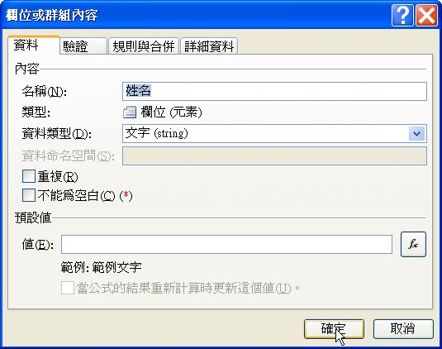
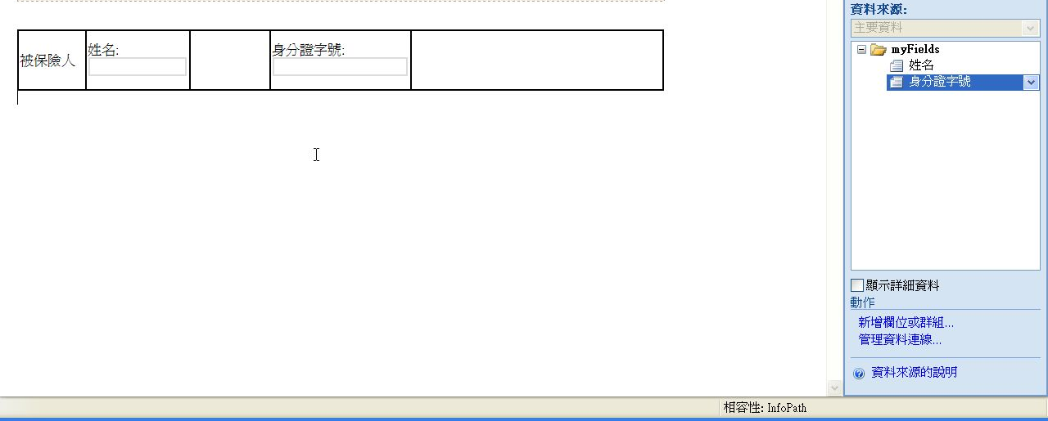
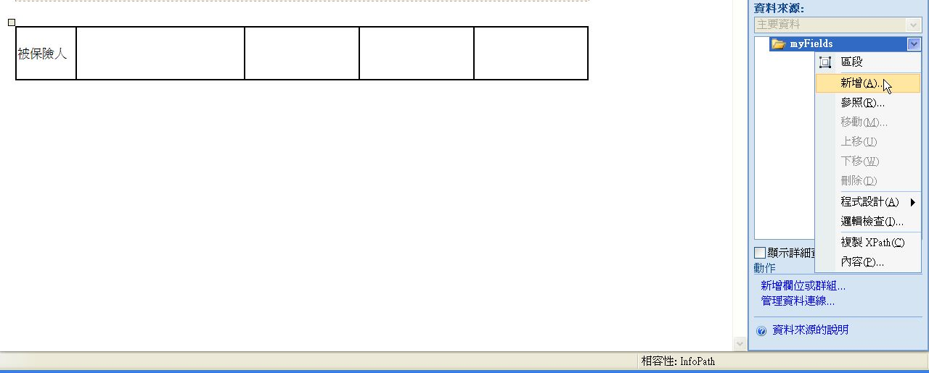
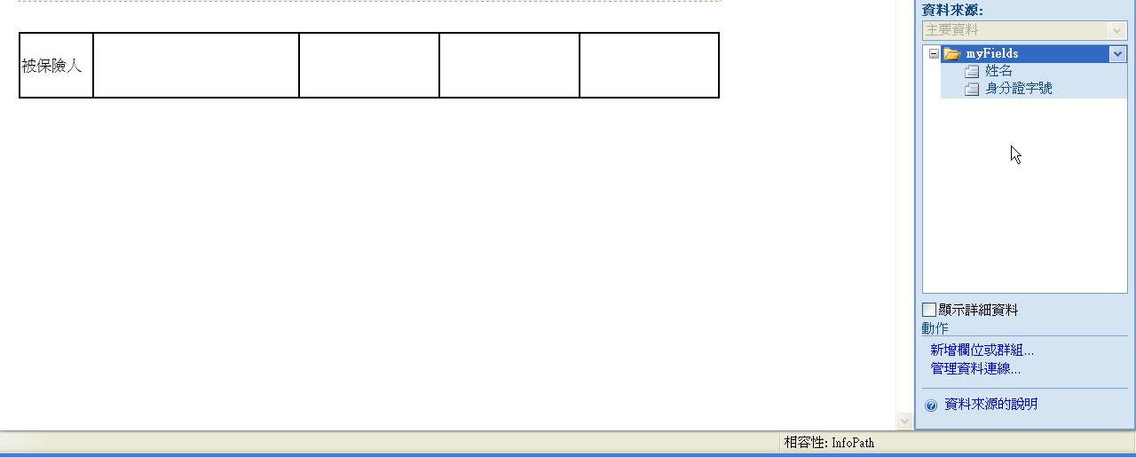
加入資料欄位

Slide 17
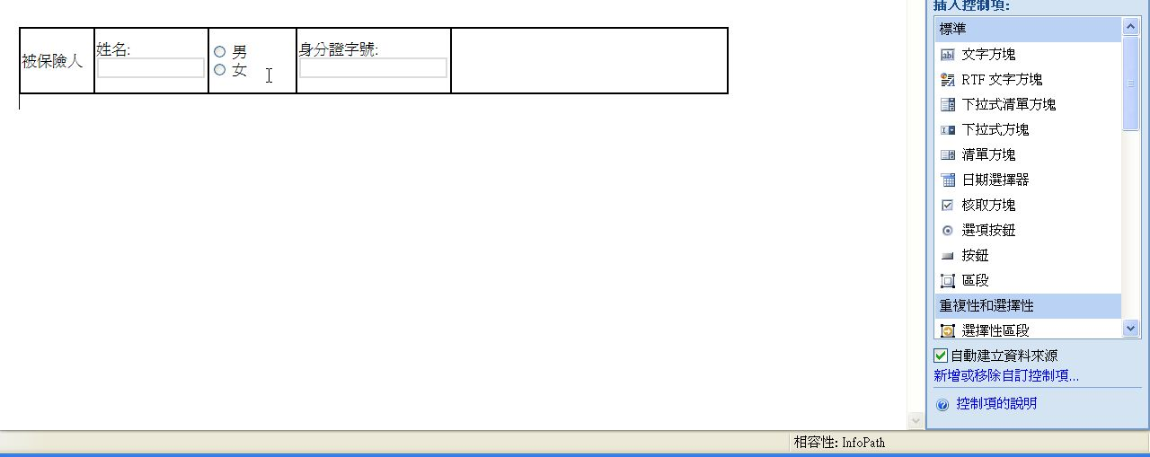
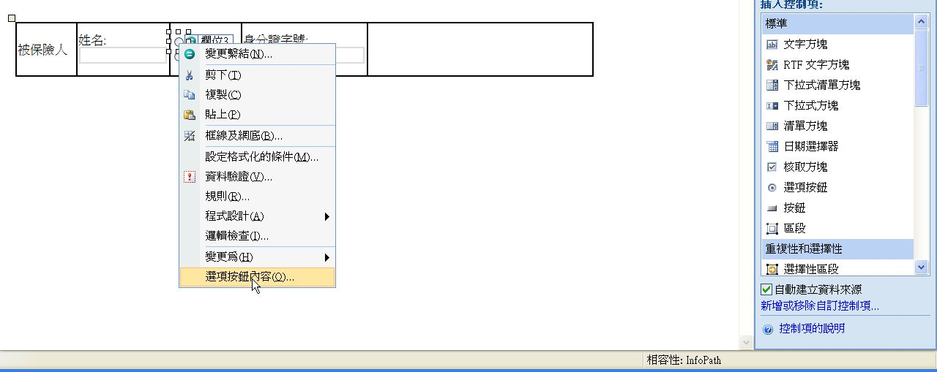
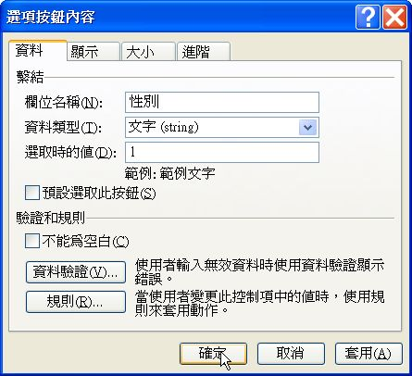
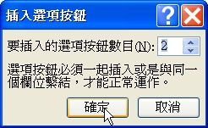
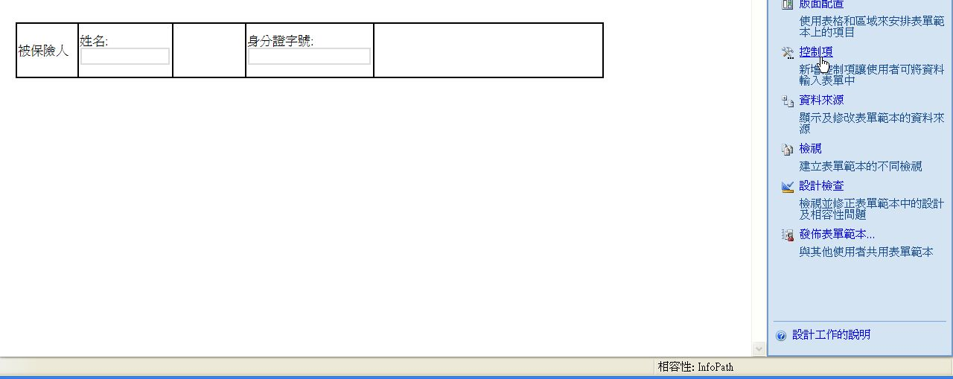

使用控制項

Slide 18
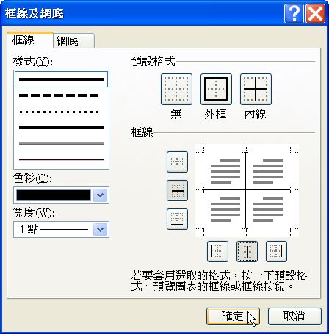
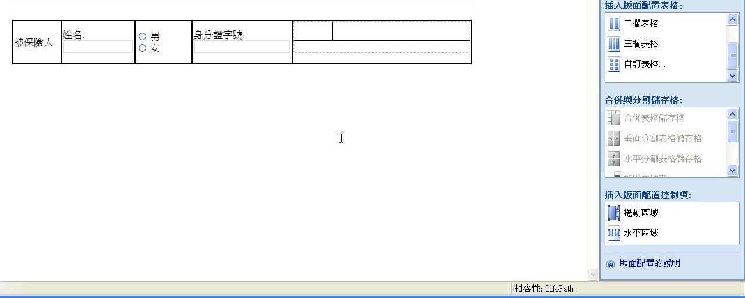
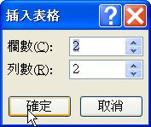
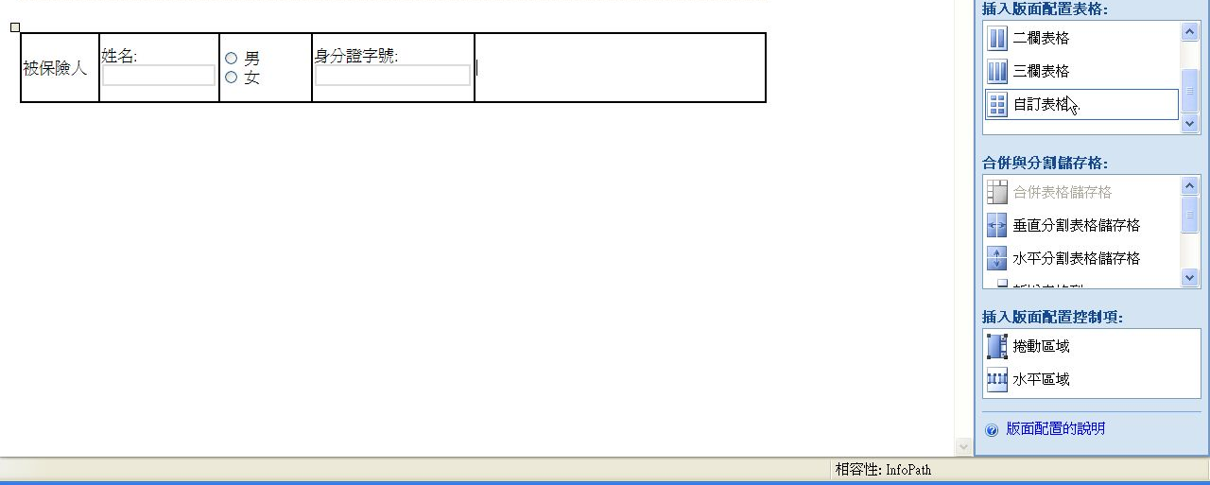
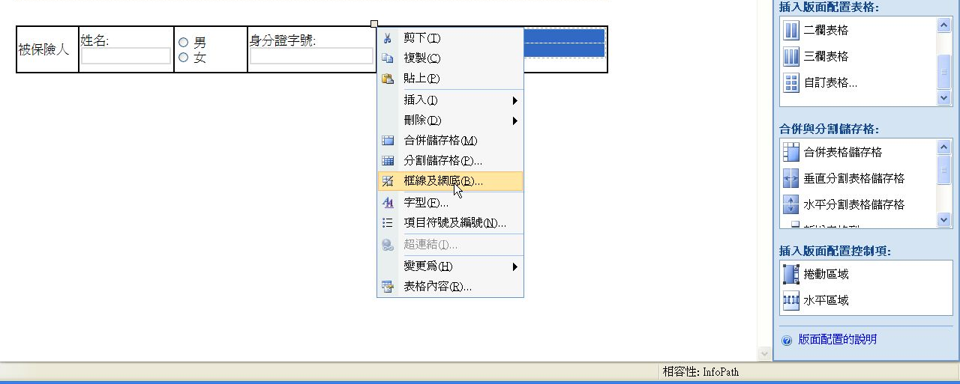
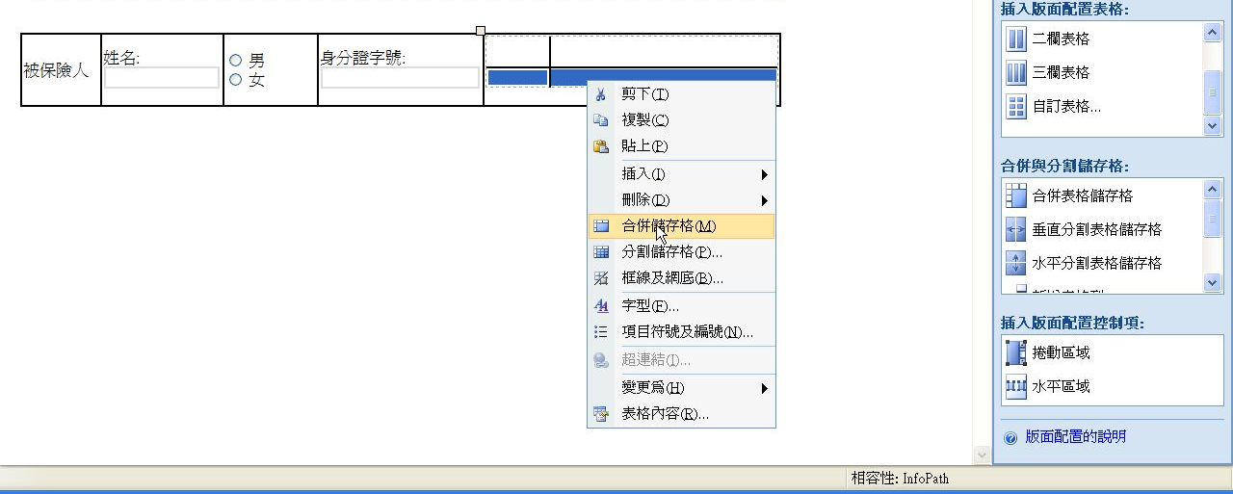
加入表格

Slide 19
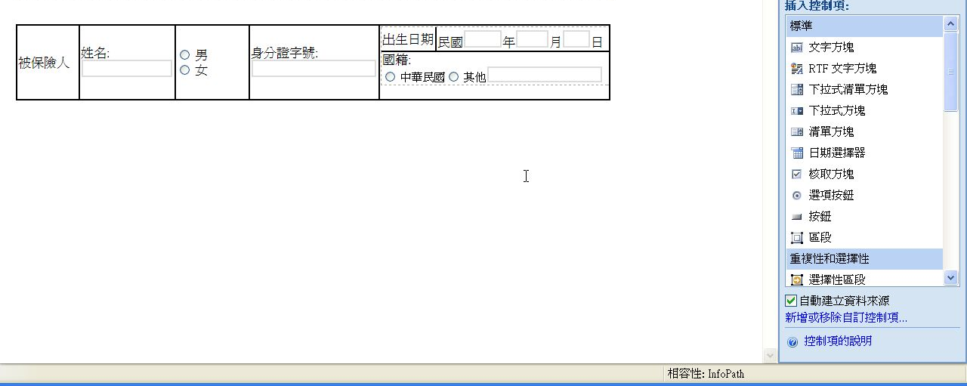
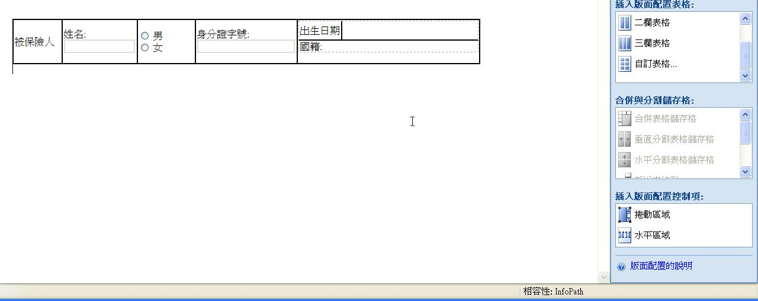
設計表單

Slide 20
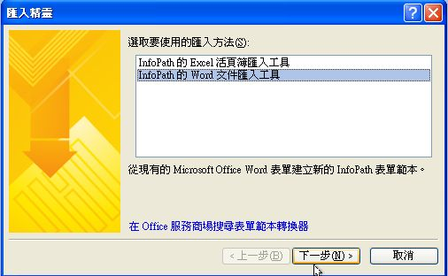
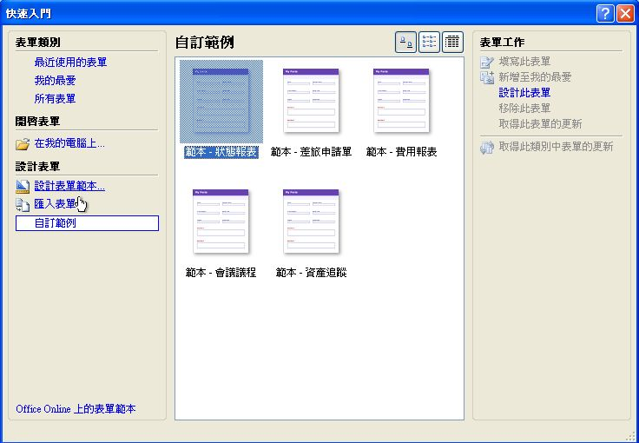
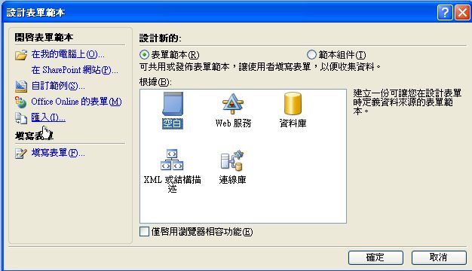
Demo 2:由Word檔匯入

Slide 21
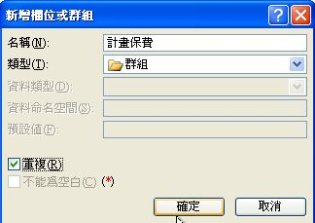
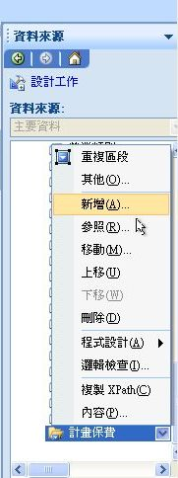
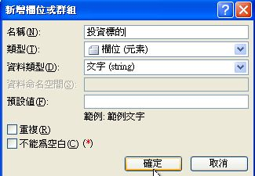
修改表單範本

Slide 22
Demo3:檢視(View)的應用
切割長的表單
提供工作流程各階段的UI

Slide 23
連結資料庫
連結Access

Slide 24















InfoPath 2007 Browser From 架構
Postback event log via XMLHTTP
Server Farm
XSN, XML loaded
Business logic
execution
Browser
Replay event log
Generate
ASPX
Download script
and data array
WSS
XSN
Generate and render HTML (using script)
Return updated
data array
Validation
Execute calculations
Execute rules
Editing actions
(All using script)
Notes:
Instructor Notes
This is new. Explain what happens on the server… an engine that is able to generate ASPX versions of the form
The pages communicate back with the server engine via XMLHTTP (refer to AJAX)

Slide 25
InfoPath 2007程式設計Part1-VSTA
使用Visual Studio Tools for Application (VSTA)
安裝VSTA前，必須已安裝好Microsoft .NET Framework 2.0及Microsoft Core XML Services (MSXML) 6.0
VSTA支援C#與VB .NET兩種.NET程式語言供我們選擇
InfoPath 2007有提供物件模型與多種事件處理常式

Slide 26
事件處理常式
事件處理常式 引發時機
Context Changed 表單中轉移焦點時
Loading 載入表單時
View Switched 切換檢視時
Sign 數位簽章表單時
Submit 送出表單時
Merge 合併表單時
Save 儲存表單時
Version Upgrade 啟更新版本表單時

Slide 27
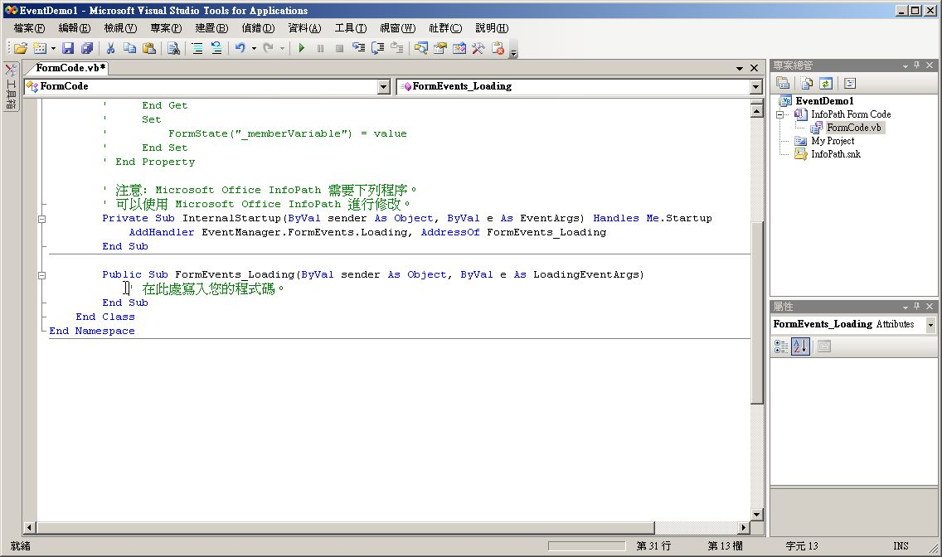
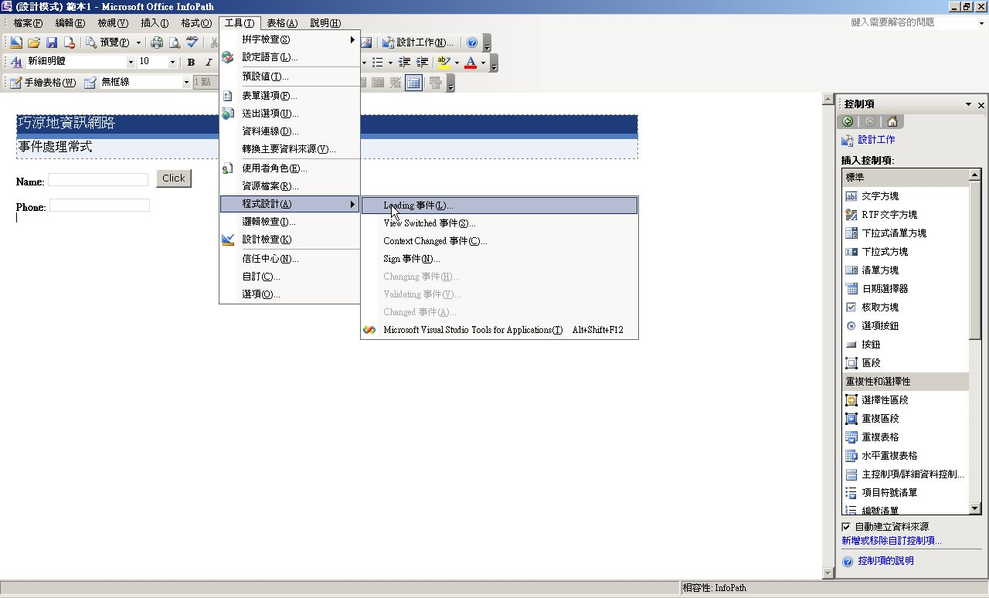
Visual Studio Tools for Application (VSTA)

Slide 28
DEMO
VSTA DEMO

Slide 29
InfoPath 2007程式設計Part2-VSTO
VSTO 2005 SE 是Visual Studio 2005的套件。只要擁有Visual Studio 2005 Professional以上的版本，即可下載並安裝VSTO 2005 SE來設計擴充Office 2007的程式
透過VSTO 2005 SE，我們可以自行設計Office 2007的增益集與工作窗格
下載安裝完成之後各位可以發現Visual Studio 2005中會多出一些專案範本

Slide 30
DEMO
VSTO Demo

Slide 31
InfoPath表單的多種佈署方式
網路位置
電子郵件
SharePoint伺服器(使用或不使用InfoPath Form Service 皆可)
可安裝的表單範本

Slide 32
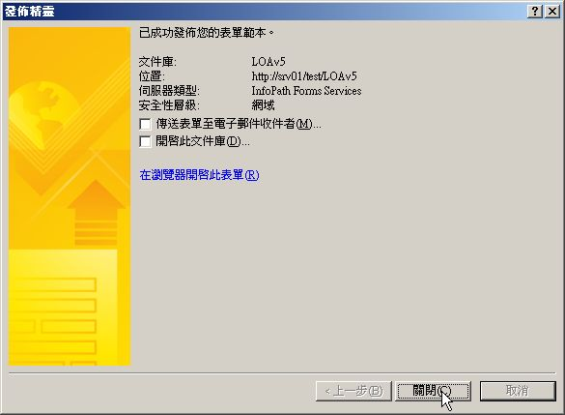
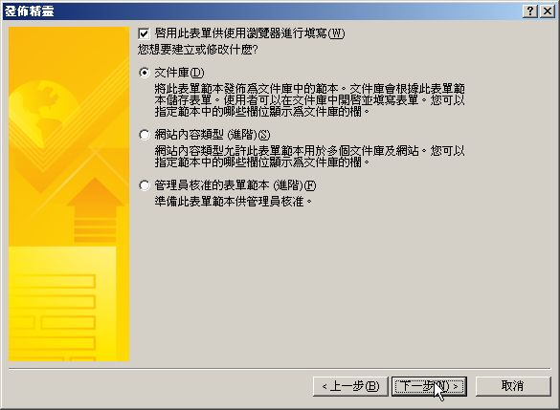
部署表單範本到表單庫

Slide 33
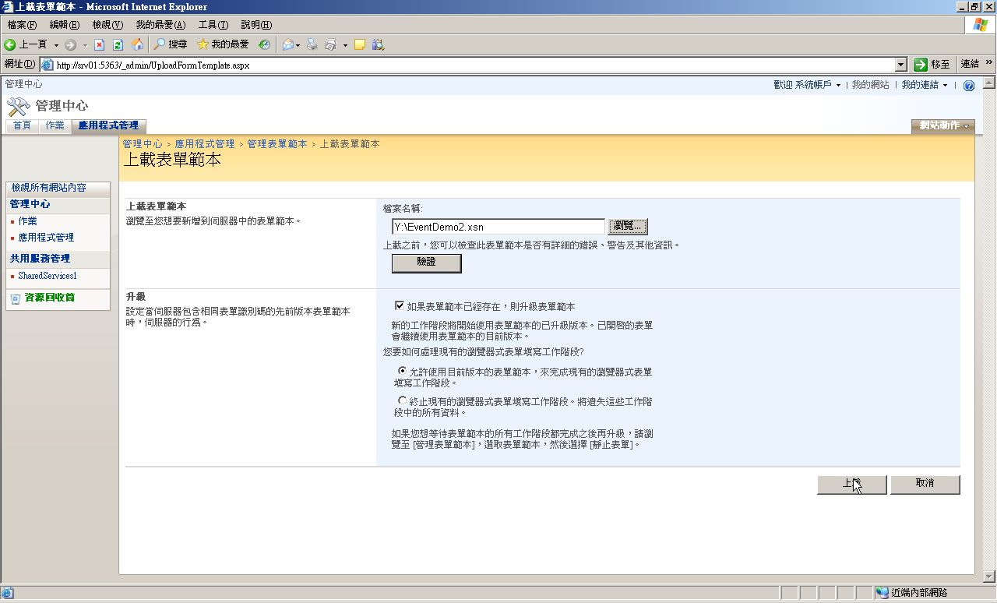
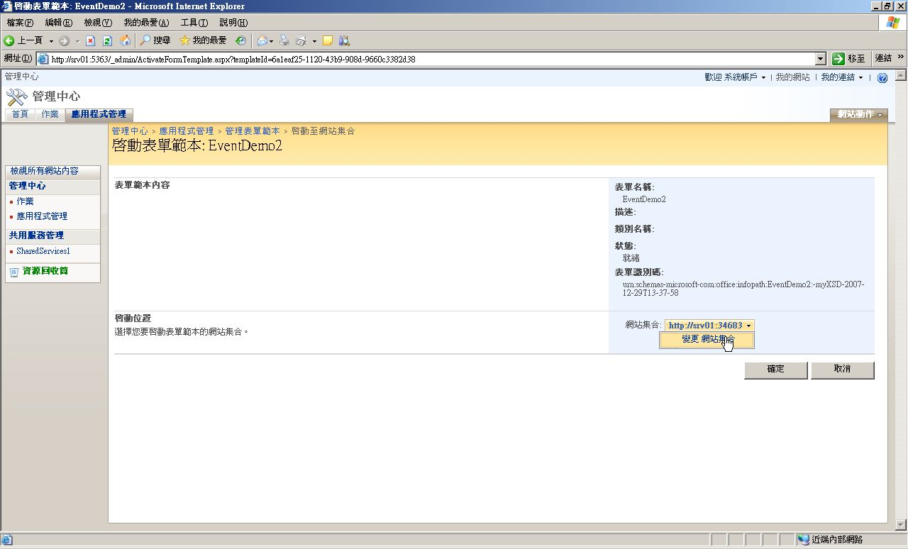
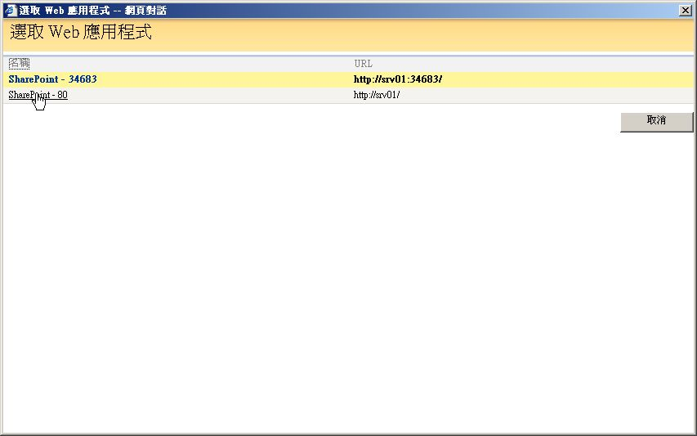
佈署表單範本到SharePoint伺服器管理中心

Slide 34
人壽保險申請書
Demo
Browser Form
Rich Client Form with Contextual Help
Rich Client Form with Custom Task Pane
Embedded Form with OCS Presence Information

Slide 35
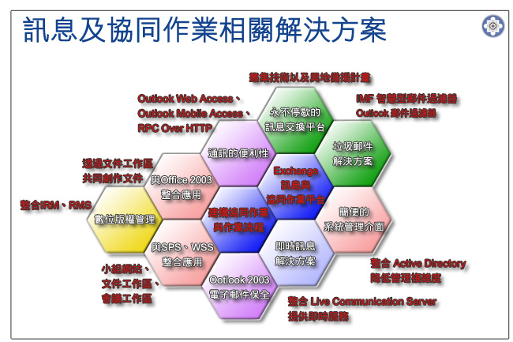

巧涼地資訊
訊息與協同作業平台的專家
協助客戶開創資訊新價值
縮短溝通障礙，創造無遠弗屆的競爭力
結合技術與方法，提供完整解決方案
秉持以客為尊的服務信念

Slide 36
在何處取得 TechNet 相關資訊？
訂閱 TechNet 資訊技術人快訊 http://www.microsoft.com/taiwan/technet/flash/
訂閱 TechNet Plus
http://www.microsoft.com/taiwan/technet/
參加 TechNet 的活動
http://www.microsoft.com/taiwan/technet/
下載 TechNet 研討會簡報與錄影檔
http://www.microsoft.com/taiwan/technet/webcast/

Slide 37

Notes:
<SLIDETITLE INCLUDE=0>Tag line</SLIDETITLE>
<KEYWORDS></KEYWORDS>
<KEYMESSAGE></KEYMESSAGE>
<SLIDEBUILDS>0</SLIDEBUILDS>
<SLIDESCRIPT></SLIDESCRIPT>
<SLIDETRANSITION>
</SLIDETRANSITION>
<COMMENT></COMMENT>
<ADDITIONALINFORMATION>
<ITEM></ITEM>
</ADDITIONALINFORMATION>

