Slide 1
全新資料備援方案
DPM 2007 技術導覽
David Feng 馮立偉
技術服務處 處長
精誠資訊

Slide 2
議程大綱
現今客戶在備份上的痛
DPM 2007 架構及功能改變快速導覽
DPM 2007 如何同步備份資料
DPM 2007 創新備份機制
Demo – DPM 2007 備份/還原/介面/先進備份機制

Slide 3
現今客戶在備份上的痛
只能夜間備份
磁帶實在沒有效率
無法有效備份各式應用AP
集中備份跨 WAN 並不適合
磁碟備份消耗大量空間
跨點資料備份繁瑣且不穩定
客戶需要一家備份軟體能備份各式企業資料

Slide 4


















Snapshots (63)
Active Directory®
Hourly
Clients
File Servers
DPM 2006 Server
Third-Party Tape
DPM 2006
Centralized Backup of Branch Offices
Rapid & Reliable Recovery — from disk instead of tape
End user recovery without IT intervention

Slide 5


Online Snapshots (up to 512)
Disk-based
Recovery
Active Directory®
Every 15 minutes
Windows
Desktops
Windows file servers
DPM 2007 Server
Microsoft® Exchange Server
with Tape Library
Tape-based
Archive
Microsoft® SQL Server™
Microsoft ® Office SharePoint Server
Virtual Server 2005 R2 sp1
Offline tape
including clusters
DPM 2007
Continuous Data Protection for Windows Application and File Servers
Rapid & Reliable Recovery from disk instead of tape
Advanced Technology for enterprises of all sizes

Slide 6





Version 2 – 可保護之平台
System State – Active Directory
Windows 2003 File Services
Longhorn File Services
Linux
Notes
Netware
2000
Oracle
NT4
Exchange 2003
Exchange 2007
Virtual Server 2005 R2
SQL Server 2000
SQL Server 2005
DPM 2007
DPM 2007
SharePoint 2003 & WSS 2.0
SharePoint 2007 & WSS 3.0
XP Desktops
Vista Desktops

Slide 7
版本功能比較
 | DPM 2006 sp1 | DPM v2
Protect File Servers and Shares | YES | YES
Protect Microsoft Exchange Server | YES KB 909644 | YES Native DPM
Protect Microsoft SQL Server | YES KB 910401 | YES Native DPM
Protect Microsoft SharePoint Server | YES KB 915181 | YES Native DPM / beta 2
Protect system state | YES TechNet | YES Native DPM / beta 2
Protect R2 SIS Servers | YES | YES
Protect Windows x64 Editions | YES | YES
Protect clusters | YES | YES
Tape media – in addition to disk | -- | YES
Time between synchronizations | 1 hour | 15 minutes
Number of shadow copies | 64 | up to 512
Not a complete feature list – simply for comparison of DPM 2006 to DPM v2

Slide 8
demonstration
DPM Agent 安裝

Slide 9
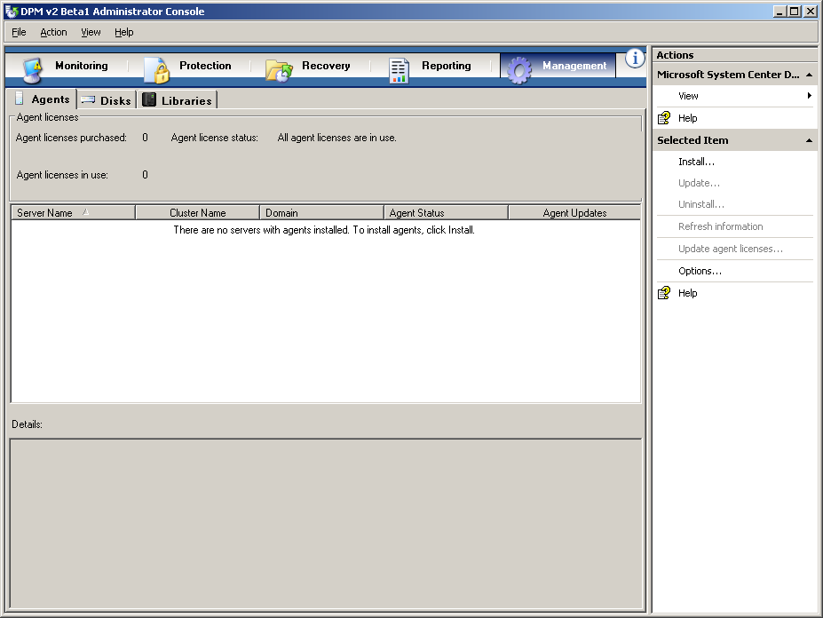

Slide 10
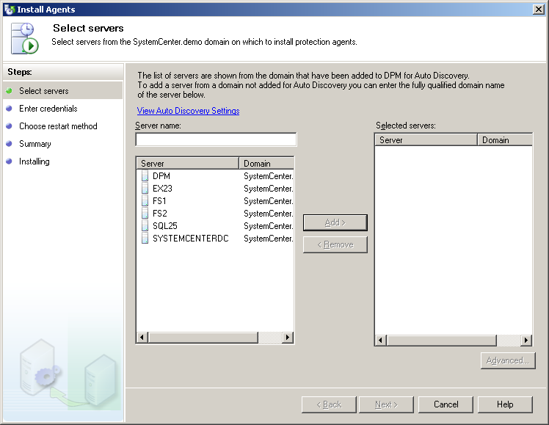


Slide 11
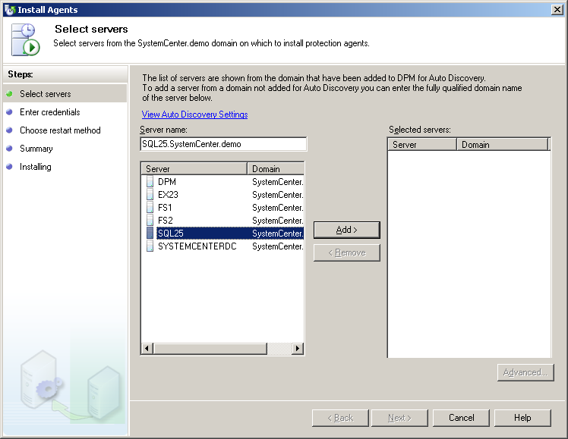

Slide 12
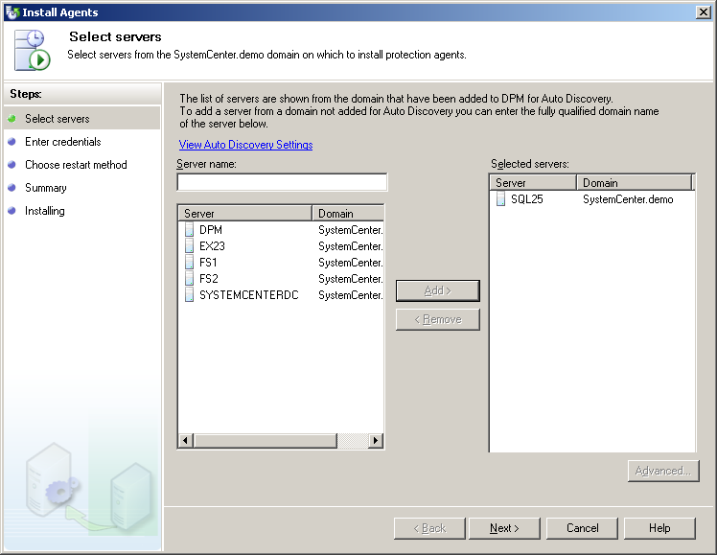

Slide 13
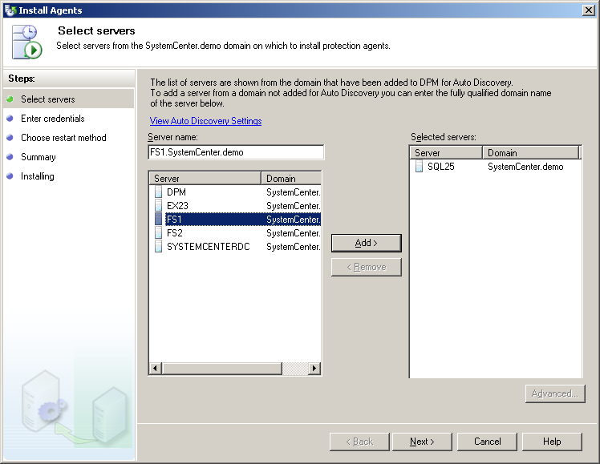

Slide 14


Slide 15
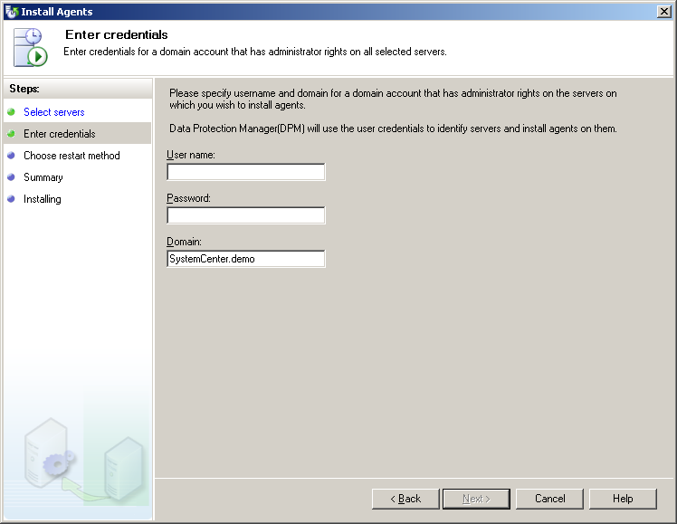

Slide 16
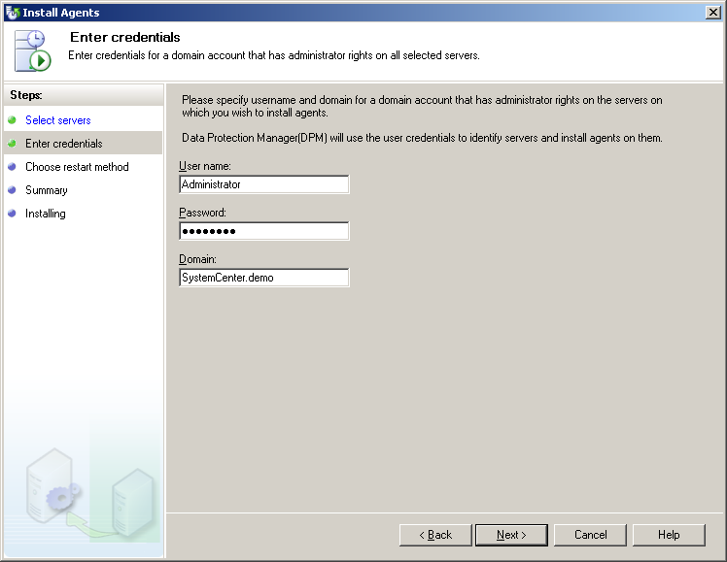

Slide 17
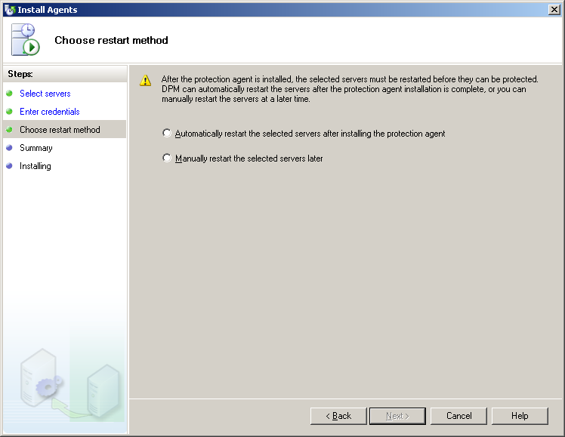

Slide 18
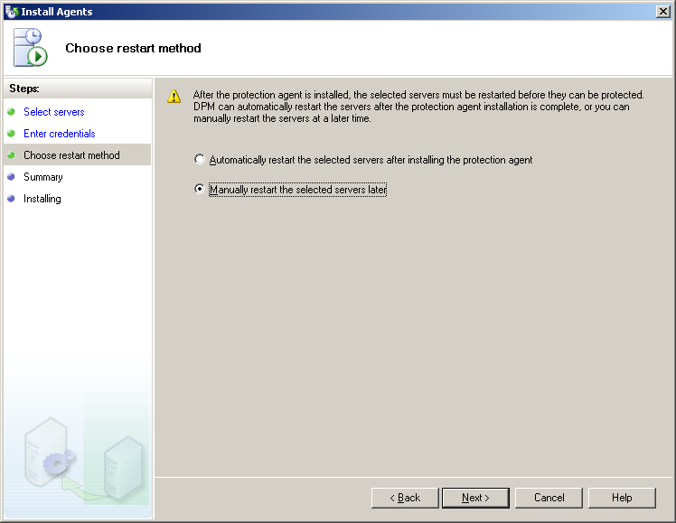

Slide 19
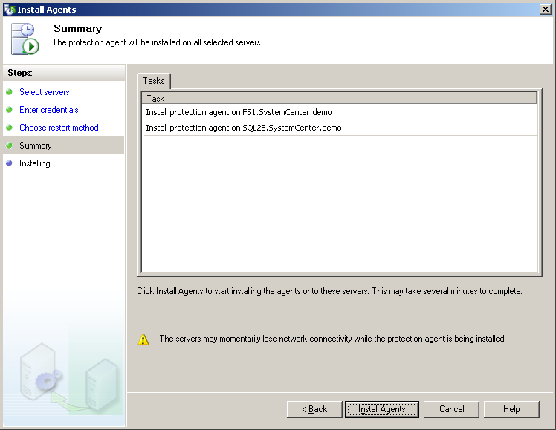

Slide 20
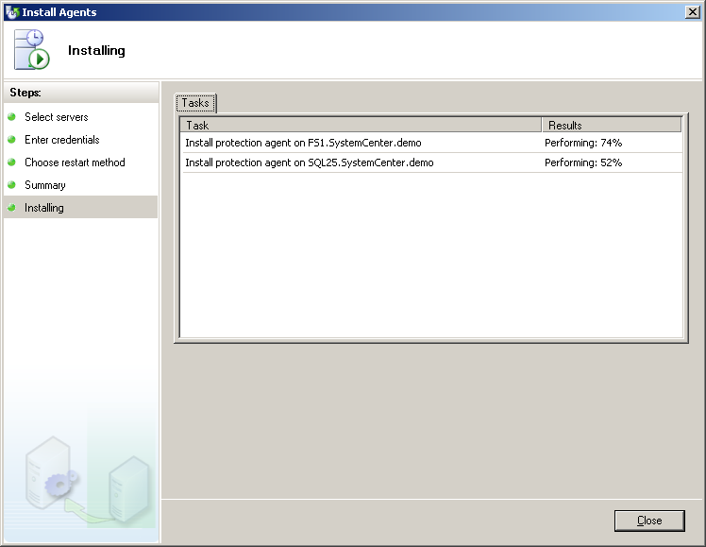

Slide 21
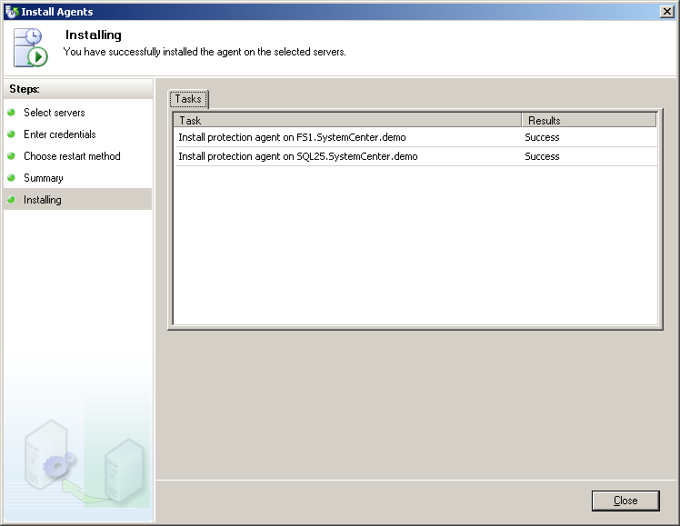

Slide 22
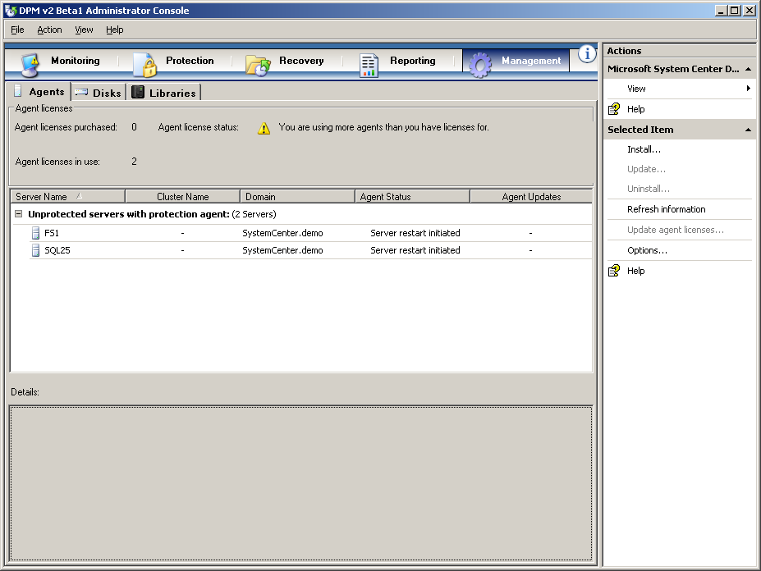

Slide 23
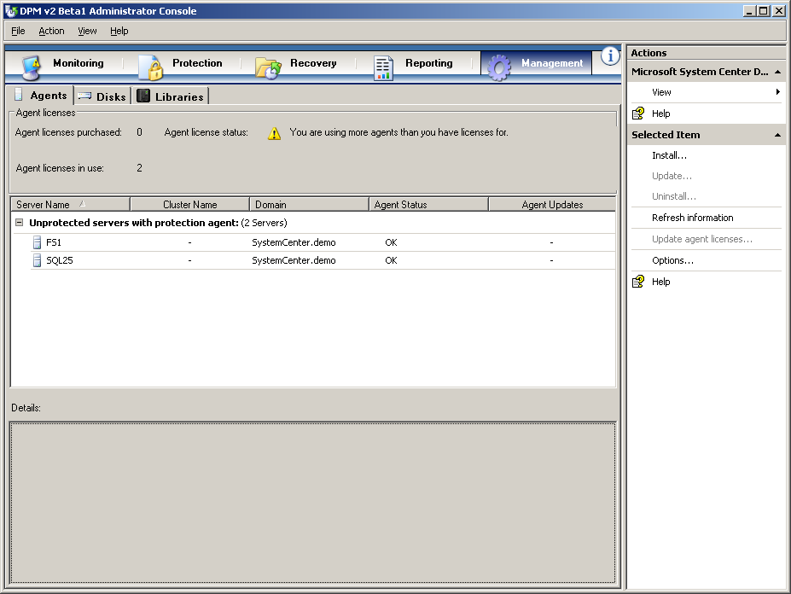

Slide 24
DPM 2007 如何同步備份資料 ?

Slide 25

DPM 尋找組成資料的檔案
E:\
+ Exchange\
+ ExecMail.EDB
ExecMail.STM
L:\
+ \Exchange\
+ ExecMail.LOG
ExecMail.CHK

Slide 26
DPM 確認組成資料的 Blocks
Compose Files
DPM filter creates a volume map, to monitor which
disk blocks contain portions of the files to be protected.
E:\
+ Exchange\
+ ExecMail.EDB
ExecMail.STM
L:\
+ \Exchange\
+ ExecMail.LOG
ExecMail.CHK
DPM Filter – Volume Map

Slide 27
開始同步視窗
Time = 10:00
VOLUME (actual disk blocks)
DPM Filter – Volume Map

Slide 28
Time = 10:02
File Write
VOLUME (actual disk blocks)
 |  | 1 |  |  |  | 2 | 3 |  | 4
DPM Filter – Volume Map
Changed blocks noted

Slide 29
Time = 10:05
File Write
VOLUME (actual disk blocks)
 |  |  |  |  | 7
 |  | 1 |  |  |  | 2 | 3 |  | 4
 | 5
 |  | 6
 |  |  |  | 8 |  |  |  | 9
DPM Filter – Volume Map
Changed blocks noted

Slide 30
Time = 10:08
File Write
VOLUME (actual disk blocks)
11 |  |  |  |  | 7
 |  | 1 |  |  |  | 2 | 3 |  | 4
 |  |  |  | 12
 | 5
 |  | 6
 |  |  |  |  |  |  | 15
 |  |  |  | 8 |  |  |  | 9
10 |  |  |  |  |  | 13 |  |  | 14
DPM Filter – Volume Map
Changed blocks noted

Slide 31
Time = 10:11
File Write
VOLUME (actual disk blocks)
11 |  |  |  |  | 7
 |  | 1 |  |  | 16 | 17 | 18 | 19 | 4
 |  |  |  | 12
 | 5
 |  | 6
 |  |  |  |  |  |  | 15
 |  |  |  | 8 |  |  |  | 9
10 |  |  |  |  |  | 13 |  |  | 14
DPM Filter – Volume Map
Changed blocks noted

Slide 32
Time = 10:15 (every 15 minutes)
DPM Synchronization
VOLUME (actual disk blocks)
11 |  |  |  |  | 7
 |  | 1 |  |  | 16 | 17 | 18 | 19 | 4
 |  |  |  | 12
 | 5
 |  | 6
 |  |  |  |  |  |  | 15
 |  |  |  | 8 |  |  |  | 9
10 |  |  |  |  |  | 13 |  |  | 14
DPM Filter – Volume Map
VSS Snapshot taken on
production volume to
ensure consistent data

Slide 33
Time = 10:15 (every 15 minutes)
DPM Synchronization
VOLUME (actual disk blocks)
11 |  |  |  |  | 7
 |  | 1 |  |  | 16 | 17 | 18 | 19 | 4
 |  |  |  | 12
 | 5
 |  | 6
 |  |  |  |  |  |  | 15
 |  |  |  | 8 |  |  |  | 9
10 |  |  |  |  |  | 13 |  |  | 14
DPM Filter – Volume Map
VSS Snapshot taken on
production volume to
ensure consistent data
Block Order
14
13
10
9
8
15
6
5
12
4
19
18
17
16
1
7
11

Slide 34
Time = 10:15:01
Transmit changed blocks from 10:00-10:15 to DPM server
Data integrity preserved, since volume snapped
VOLUME (actual disk blocks)
1 |  |  |  |  | 2
 |  | 3 |  |  | 4 | 5 | 6 | 7 | 8
 |  |  |  | 9
 | 10
 |  | 11
 |  |  |  |  |  |  | 12
 |  |  |  | 13 |  |  |  | 14
15 |  |  |  |  |  | 16 |  |  | 17
DPM Filter – Volume Map
VSS Snapshot taken on
production volume to
ensure consistent data
2) Cache of changed blocks
is sent to DPM server
Block Order
17
16
15
14
13
12
11
10
9
8
7
6
5
4
3
2
1

Slide 35
Time = 10:15:02
Transmit changed blocks from 10:00-10:15 to DPM server
Data integrity preserved, since volume snapped
And File IO continues
VOLUME (actual disk blocks)
1 |  |  |  |  | 2
 |  | 3 |  |  | 4 | 5 | 6 | 7 | 8
 |  |  |  | 9
 | 10 |  |  |  | 18 | 19 | 20
 |  | 11
 |  |  | 21 |  |  |  | 12
 |  |  |  | 13 |  | 22 |  | 14
15 |  |  |  |  |  | 16 |  |  | 17
DPM Filter – Volume Map
VSS Snapshot taken on
production volume to
ensure consistent data
2) Cache of changed blocks
is sent to DPM server,
while live disk continues

Slide 36
And the process continues…
Time = 10:15:03 +
And File IO continues
VOLUME (actual disk blocks)
 |  |  |  |  | 18 | 19 | 20
 |  |  | 21
 |  |  |  |  |  | 22
DPM Filter – Volume Map
VSS Snapshot taken on
production volume to
ensure consistent data
2) Cache of changed blocks
is sent to DPM server,
while live disk continues

Slide 37
demonstration
DPM 2007 使用者介面

Slide 38
Exchange 回復選項
Storage Group 回復
Database 回復
Public Folder 回復
Mailbox 回復
SG’s 可以被回復到不同位置
DB’s可以被回復到不同位置 (EX 2007)
SG 在被回復後可以被自動裝載

Slide 39




Exchange 2003 & 2007 Cluster
MSCS Exchange Cluster
MSCS Cluster
傳統 cluster 設定, 兩個 servers – 一個 Exchange dataset
自動 Failover 到新的 server 名稱
在 failover 及 failback 情況下保護持續進行, 不需要使用者介入調整
當保護建立時, DPM 自動偵測 cluster 設定及搭配 server 名稱
Exchange
Active-node
Exchange
Passive-node
DPM

Slide 40
Exchange 2007 – LCR
Exchange 2007 LCR
Local Continuous Replication
一台 exchange server 具備 redundant 資料庫複本
資料庫損毀時或磁碟損壞時, Failover 到 redundant 複本
由 Active DB drive 備份資料
Exchange
2007
Active
Backup
DPM

Slide 41
Exchange 2007 – CCR
Exchange 2007 CCR
Cluster Continuous Replication
Redundant exchange servers and redundant databases
Databases logs are replicated
Node Preferred backup (geography)
Role Preferred backup (Active - Passive)
Exch2007
Active
Exch2007
Passive
DPM

Slide 42




SharePoint 2007 & WSS 3.0
System State
IIS “Front End”
“Farm” Config dB
(SQL)
SharePoint VSS Writer
DPM 2007
SQL
SQL
SQL
File
Search
(files)
Content Servers (SQL)

Slide 43
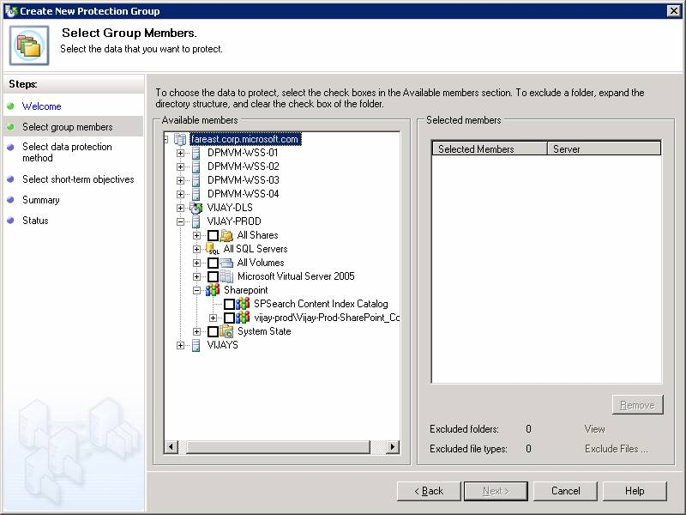
SharePoint 2007 備份選項
Restore the Farm !
Config dB
Content dB
Site & Site Collection
(and the two-stage recycle bin takes care of individual items)

Slide 44
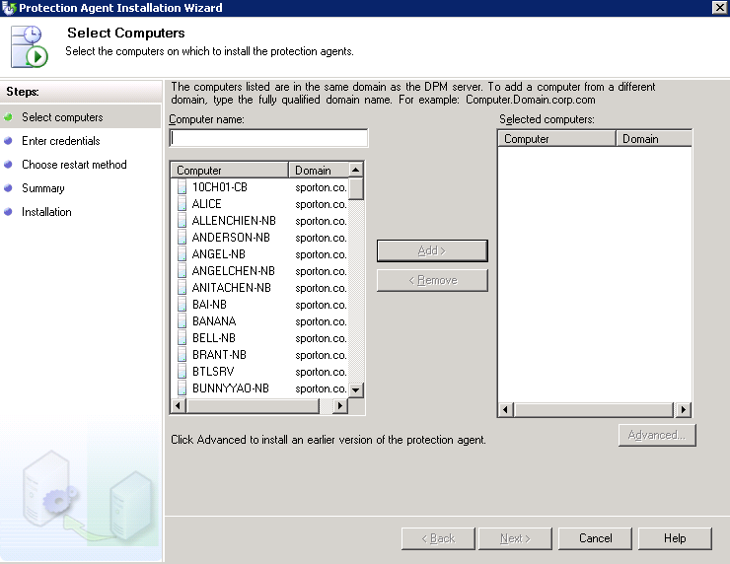
Client Backup

Slide 45
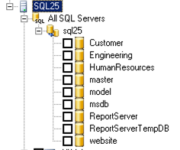
Virtual Servers
Exchange 2003
Exchange 2007
Virtual Server 2005 R2 sp1
VSSVR
Guest OS instances
SQL Server 2005
Linux02
NT4-CustomApp
Win2003-SQL2005

Slide 46
Virtual Server host-based protection
Windows Server
2003
Linux
SQL2005
Virtual Server 2005 R2 with Service Pack 1

Slide 47
Virtual Server host-based protection
Linux
Linux.VMC
Linux_C.VHD
Linux_D.VHD
Virtual Server 2005 R2 with Service Pack 1

Slide 48
Virtual Server host-based protection
Linux
Linux.VMC
VSS Writer
Linux_C.VHD
Linux_D.VHD
Save State
Linux.VSV
2-3 minutes
Virtual Server 2005 R2 with Service Pack 1

Slide 49
Virtual Server host-based protection
Windows Server
2003
SQL2005
Virtual Server 2005 R2 with Service Pack 1

Slide 50
Virtual Server host-based protection
Windows Server
2003
WinSvr.VMC
SQL2005
VSS Writer
VSS writer for SQL 2005
Database consistent
VSS writer for Windows Server
C: & D: volumes
VSS writer for Virtual Server 2005 R2 sp1
WinSvr_C.VHD & WinSvr_D.VHD
Virtual Server 2005 R2 with Service Pack 1

Slide 51
Virtual Server host-based protection
Windows Server
2003
No downtime
Recursive VSS consistency
Only requires updated VM additions from MSVS sp1
SQL2005
Virtual Server 2005 R2 with Service Pack 1

Slide 52
DPM to DPM for DR
All data protected
Sync / 15min
File RPO = 2hrs (12d)
App RP = 512 days
with 15m RP’s
Important Data
Sync / 4 hours
File RPO = daily (63d)
App RP = 512 weeks
with 15m RP’s
dpm2dpm4dr
Notes:
52

Slide 53
DPM to DPM for DR
FS1 \ data (share)
AccountingdB
(SQLdb)
OFFSITE TAPE BACKUP
Mailboxes
(ExchSG)
DPM2007A
FS1_data (share)
SQL25\AccountingdB (sql)
EX23\SG1\Mailboxes (exchange)
FS2_E:\team\ (directory)
DPM2007B
FS1_data (share)
SQL25\AccountingdB (sql)
EX23\SG1\Mailboxes (exchange)
FS2_E:\team\ (directory)
FS2 E:\team
(directory)
dpm2dpm4dr
Notes:
53

Slide 54
DPM to DPM for DR
FS1 \ data (share)
AccountingdB
(SQLdb)
Mailboxes
(ExchSG)
DPM2007B
FS1_data (share)
SQL25\AccountingdB (sql)
EX23\SG1\Mailboxes (exchange)
FS2_E:\team\ (directory)
FS2 E:\team
(directory)
dpm2dpm4dr
Notes:
54

Slide 55
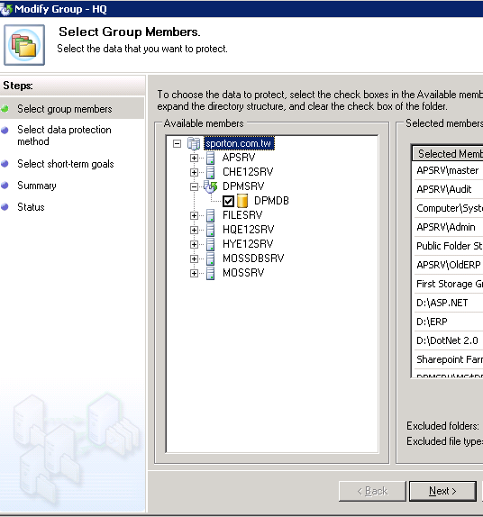
DPM Backup DPM

Slide 56
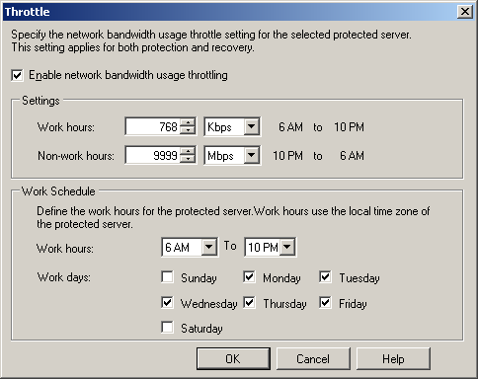
Network Bandwidth Throttling

Slide 57
DPM 管理套件
Centrally monitor the health and status of data protection and critical performance indicators of multiple DPM servers and the servers that they protect.
View the state of all roles on DPM servers and protected servers.
Monitor actionable DPM alerts relating to replica creation, synchronization, and recovery point creation. The DPM Management Pack filters out alerts that do not require an action, such as a synchronization job in progress.
Through Operations Manager alerts, monitor the status of memory, CPU, and disk resources on DPM servers, and be alerted to DPM database failures.
Monitor resource usage and performance trends on DPM servers.
Diagnose and resolve problems on a remote DPM server

Slide 58
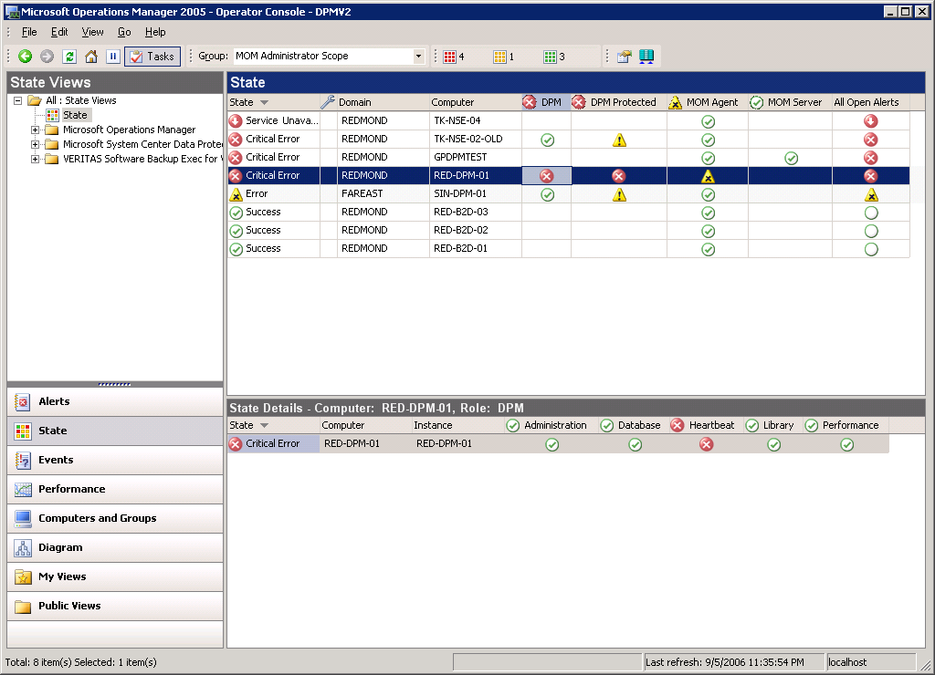

The State View
1
2

Slide 59
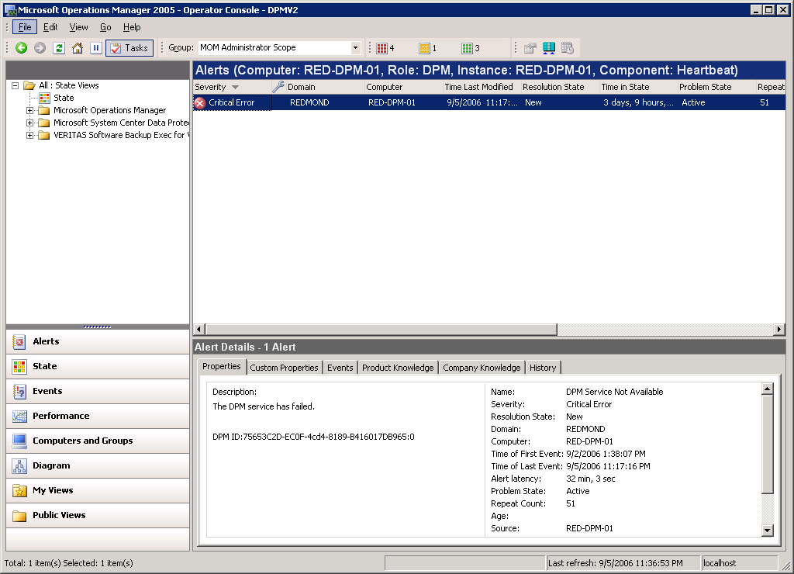
Alerts View

Slide 60
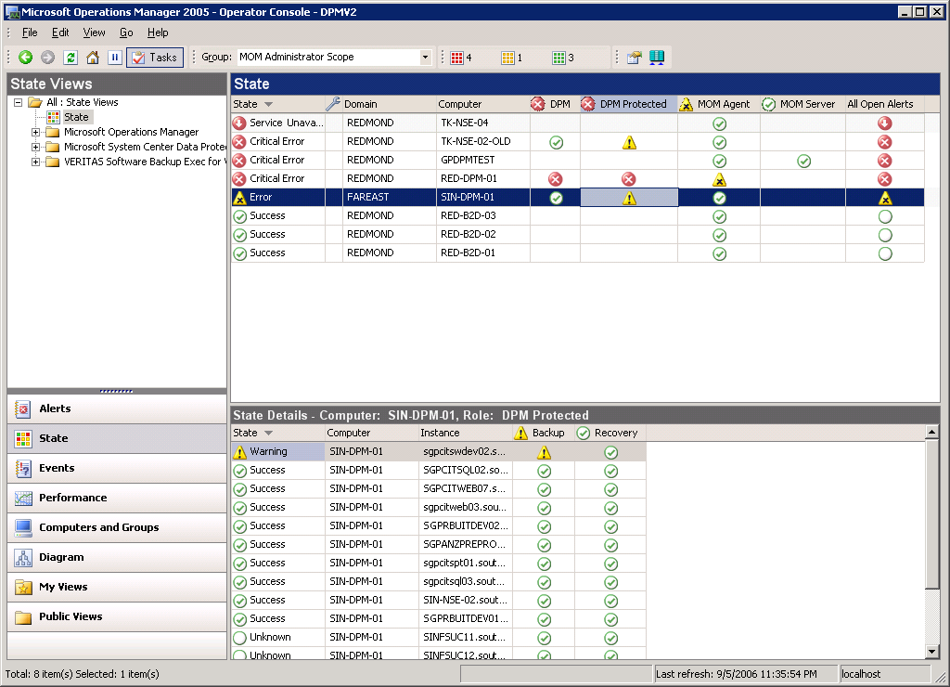
State View of PS
1

Slide 61
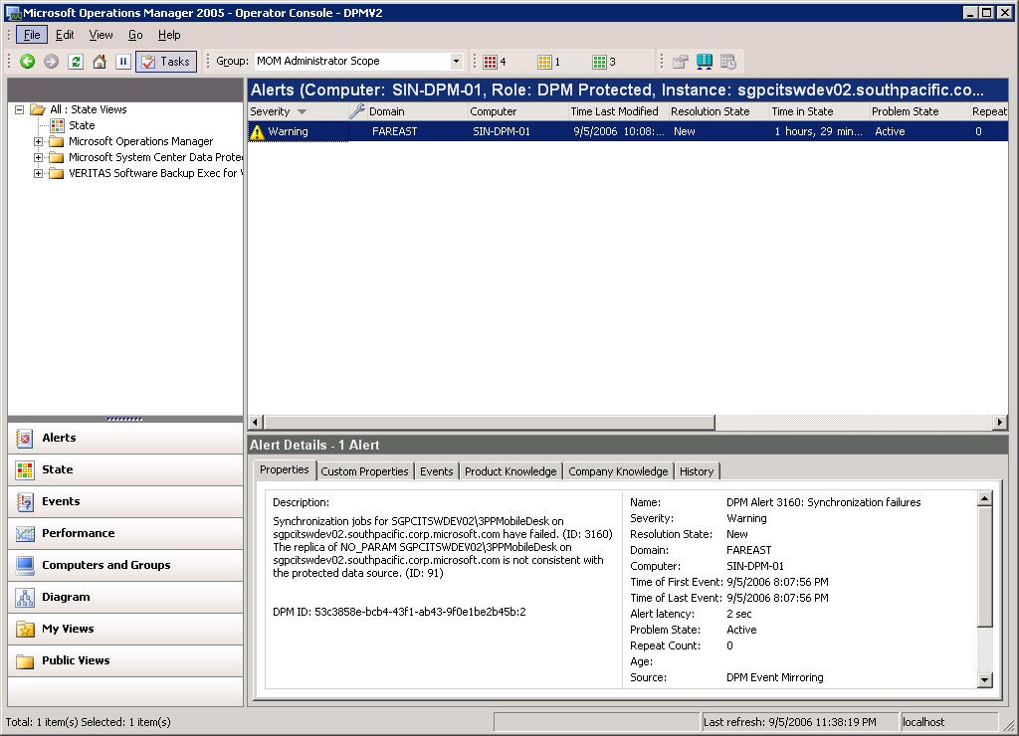
Backup Failure Alert

Slide 62
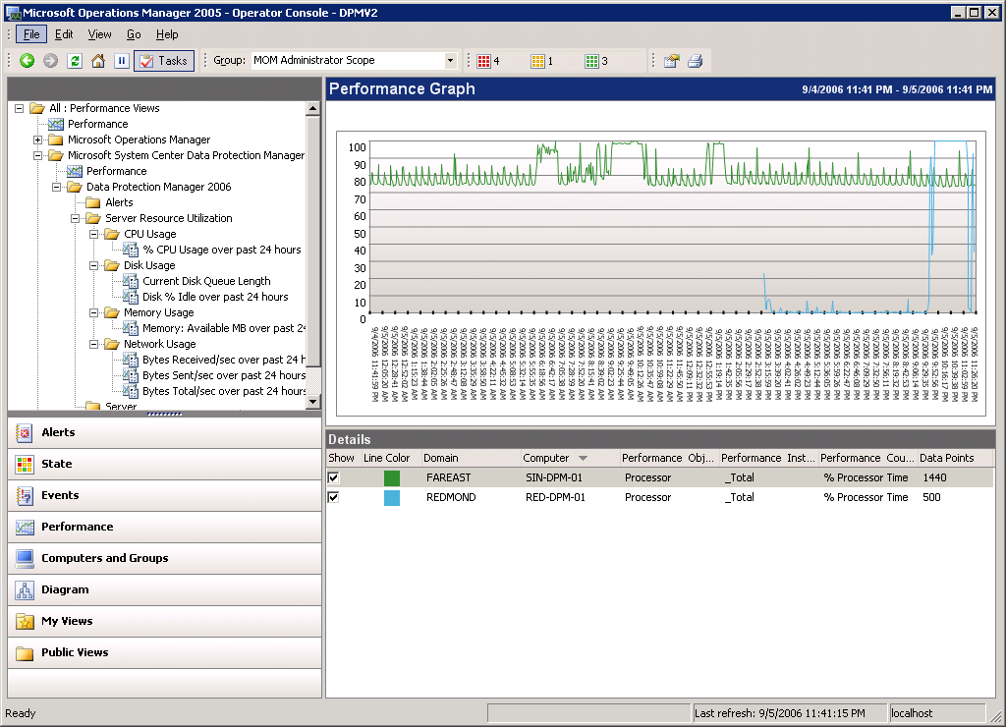
Performance Graphs

Slide 63
DPM Scripting Feature Details
100% of following UI have cmdlets
  Protection
  Recovery
  Disk and library management
CLI-only scenarios
  Configuring backup LAN
  Disconnected protection agent install
  Configuring maintenance and consistency jobs
  Disaster recovery switch protection

Slide 64
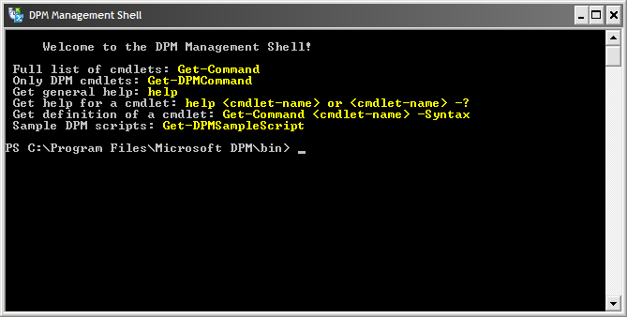
Screenshot

Slide 65
Modify-PG Setting Across All DPM
Scenario
  Admin manages 30 DPM servers
  Needs to change retention range etc. in all PG
Today
  Manually TS into 30 DPM servers
  Open DPM UI
  Run through modify-PG in each
  Close UI and disconnect
Sample skeleton script
$DPM = import-csv DPMserverList.csv
foreach $DPM
  {
  Connect-DPMServer $_
  $PG= Get-PG
  foreach $PG
  {
  Get-ModifiableProtectionGroup $_ | Set-PolicyObjective –shortterm – Retentionrange 10 | Set-ProtectionGroup
  }
  Disconnect-DPMServer
  }

Slide 66
demonstration
備份 / 還原

Slide 67
Bare Metal Restore
DPM System Recovery Tool* is used to:
  Protect servers from
    Hard-disks or other hardware failure (Bare Metal Recovery)
    System becomes unbootable
  Rollback recently applied patches
  Restoring disk layouts (for NTFS) for MBR disks
  Backup/restore system volume & other critical volumes
  * For protecting data use DPM 2007

Slide 68
Active Directory®
Recovery Points
Daily
Clients
Windows 2003 Servers
XP Workstations
DPM SRT Server
DPM System Recovery Tool
Centralized Backup of Disk Layout, System Volume and other Critical volumes by creating recovery points
Protects Window 2003 Servers or XP workstations
Recovery uses customized ISO image that can be burnt to a CD
Uses “Single Instancing” technology – thereby drastically reducing the storage requirements

Slide 69
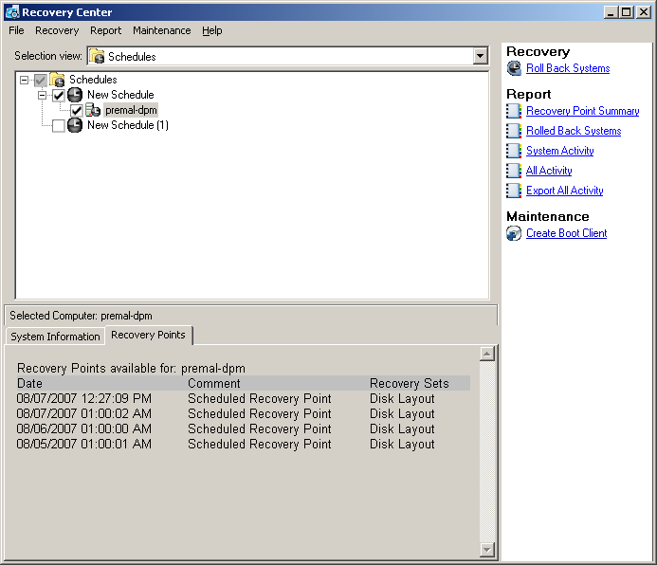
Recovery Center

Slide 70
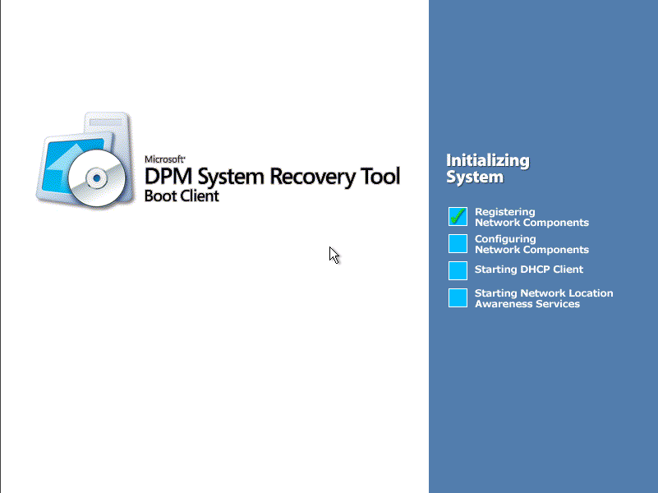
Boot Client – Start up

Slide 71

部署 DPM 2007 十大理由
復原不再失敗
幾乎零資料損失 : Exchange, SQL, and SharePoint Servers
無縫式 disk-to-disk-to-tape 備份
幾分鐘回復資料而非數小時
單一原則允許針對多種資料型態進行保護
降低上線伺服器的 backup window
縮短被保護資料遺失之風險到 15 分鐘
直接從 UI 還原應用程式資料
允許一般使用者自行回復
分點備份不在需要擺放磁帶

Slide 72
Q & A / Discussion

Slide 73


