Slide 1


Slide 2
運用 OCS 2007 建置
符合企業規範及安全性之即時通訊系統
David Feng 馮立偉
精誠資訊 技術服務處 處長

Slide 3
議程目標
就即時通訊, 會議, 語音而言, compliance 及衛生保健意義為何 ?
\Microsoft® Office Communications Server 2007 如何啟用封存機制 ?
Communications Server 2007 如何啟用使用量分析資訊 ?

Slide 4
需先具備 :
Windows Server® infrastructure
Enterprise IT deployments
Microsoft® Office Communication Server 2007
Level 200

Slide 5
議程大綱
Overview of Communications Server 2007
Compliance-Enabling Features in Communications Server 2007
Deploying and Configuring Archiving
Call Detail Records
Hygiene
Questions and Comments

Slide 6
OCS 2007 概觀

Slide 7
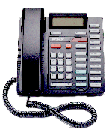
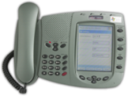
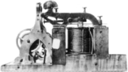
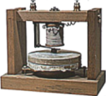
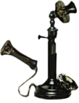
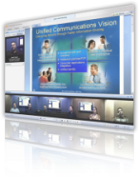


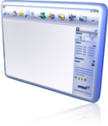


通訊演進歷程
Network-Driven Communications
1837
1876
1984
2007
Software-Driven Communications

Slide 8


Here Is Where We Are Coming From
Previous release: Live Communications Server 2005 Service Pack (SP1)
Enterprise-grade
presence and
real-time communications (RTC) server
Server
Client:
Microsoft® Office Communicator 2007
Scalability, high availability
Federation, public IM
connectivity (with SP1)
Standards-based
Integrates with Microsoft infrastructure
Presence, instant messaging (IM), telephony, audio, P2P video; T.120 multipoint capabilities
Notes:
8

Slide 9



Communications Server 2007 目標
Deliver
on-premise
Web conferencing
Start
delivering on
enterprise voice road map
Data collaboration,
audio, video, IM, others…
Complete built-in solution
Deliver foundational capabilities for voice deployments
Integrated deployment
and management
Build on Live Communications Server 2005
Continued advancements in presence, manageability, etc.
Carry forward existing
investments in HA, PIC,
and federation
Notes:
9

Slide 10












Communications Server 2007 Overview
Additions to Live Communications Server 2005
Web conferencing
Audio/video conferencing
PSTN conferencing
Microsoft® Office Communicator Web Access
AJAX APIs – Presence
SIP signaling stack
PSTN connectivity
(mediation server)
Exchange UM
integration
Inbound routing
Dial plans and
outbound routing
Call statistics
Conferencing
Developer
Guided setup
MMC status
Policy
Meeting statistics
Compliance
Same time migration
Voice
Manageability
Outside
Access
Presence/IM
Rich Presence
Rich access control lists (ACLs)
Federated conferencing
Securing open federation

Slide 11
基本伺服器角色
Role | Scenario | Purpose
Standard Edition | IM/Presence, Conferencing, Voice | All-in-one functionality for simplest deployments
Edge Server | IM/Presence, Conferencing, Voice | Perimeter Network (a.k.a. DMZ) –based relay for external/ anonymous access, federation, media firewall traversal
Archiving Server | IM/Presence, Conferencing, Voice | Compliance archive for IM CDR store for conferences and voice
Communicator Web Access | IM/Presence | Web Access for Communicator IM/ Presence functionality

Slide 12











OCS 2007 架構
Perimeter
Network
(DMZ)
Information Worker (UC endpoints)
Manage-
ment
Remote
Workers
Communicator 2007 Devices
Microsoft®
Operations
Manager /
Microsoft®
Management
Console (MMC)
Access
Edge Server
Communications
Server 2007
Front-End Server(s)
Inbound
Routing
Back-End Server
Archiving
and Call Data
Records
(CDR)
Federated
Businesses
Outbound
Routing
A / V / Web
Conferencing
Edge Server
Registrar, Proxy, and
Presence Server
Voice Mail
Routing
Microsoft®
SQL Server™
Database
Existing
PBX Network
Mediation
Server
Conferencing
Server
Microsoft®
Speech
Server
Microsoft®
Exchange
Server 2007
Active
Directory
PSTN and
Mobile Phones
SIP/PSTN
Gateway
Audio, Video
and Data
Unified
Messaging
SIP
IVR
Notes:
11/28/2007 2:49 PM
© 2004 Microsoft Corporation. All rights reserved.
This presentation is for informational purposes only. Microsoft makes no warranties, express or implied, in this summary.
12

Slide 13




部署示意圖
Active Directory® directory service
External/
Federated/
Anonymous
Users
Perimeter
Network
Archiving server with database
Edge Server
Standard Edition
HTTP Reverse
Proxy

Slide 14
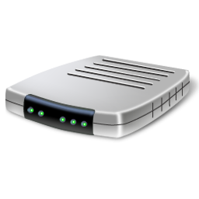
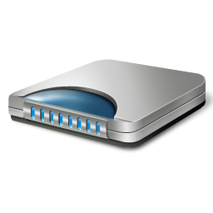

Security For Anywhere Access
Corporate Network
DMZ
Remote User
ISP
Internet
NAT
Notes:
Remote user – from a public internet connection (like a coffee shop)
On the Network Address Translator (NAT) – usually the wireless router in the coffee shop.
ISP – provides gateway to internet for the coffee shop
The external firewall of the corporation is routable via the internet.

Slide 15
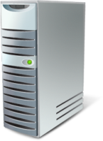
Sign In
Corporate Network
DMZ
Remote User
ISP
Internet
Access Edge Server
Front End Server
NAT
Notes:
Let’s see how authentication works in this scenario:
Office Communicator on Remote User’s laptop initiates a connection (using SIP – session initiation protocol).
SIP message travels via the NAT (wireless router) and through the Gateway provided by the ISP onto the external edge of the corporate firewall.
Office Communications Server 2007 Access Edge Server – sits on the DMZ and accepts the incoming request for Sign-In.
It then forwards request to the Office Communications Server 2007 Front-End Server.
Front-End server authenticates this user for sign-in similar to the process it uses for corporate users. It uses the services from Microsoft Active Directory for authentication and authorization. Active Directory is THE single place for the IT Administrator to manage identities for all users, devices, messaging and communications in the organization.
We did not require a VPN connection from the remote user in this case.

Slide 16

Connection Setup
Corporate Network
DMZ
Remote User
ISP
Internet
Access Edge Server
Front End Server
NAT
Corporate User
Notes:
Once the remote user is signed-on:
User can see his buddy list, search the organization’s directory and view rich presence information about other users – just as though he or she was signed-in from within the corporate network.
Similarly, other users within the corporate network will be able to see the remote user’s presence state. In this example, a corporate user requests a new IM session with the remote user. The SIP messages required for this connection travel a similar path as in the Sign-In above.
Once both users have accepted, an IM session is established.

Slide 17
Media Connection
Corporate Network
DMZ
Remote User
ISP
Internet
Access Edge Server
Front End Server
NAT
A/V Edge Server
Corporate User
Notes:
The media connection flows in a similar path up to the corporate firewall. At this point, the Office Communicator 2007 Audio/Video Edge Server assumes responsibility for taking the media data (audio/video) and switching this into the corporate network.
The Edge server establishes a direct connection with the corporate user and so media flows ‘peer-to-peer’.
The media stack uses the RT Audio codec. A similar media stack is also used for the consumer product (Windows Messenger) where more than 1.5 billion minutes of audio/video are transcoded each month on this media stack.
The codecs dynamically adapt to network conditions and enable a rich media experience (audio/video) even on public internet connections.

Slide 18
Media Connection
Corporate Network
DMZ
Remote User
ISP
Internet
Access Edge Server
Front End Server
NAT
A/V Edge Server
Corporate User
Notes:
Control information –such as SIP Messages for Call setup, Call teardown etc – flow through the Access Edge Server role and the Front-End server role enabling features such as archiving, policy enforcement.
But once a media connection is established, media data flows ‘peer-to-peer’ enabling better performance and scalability.

Slide 19
外部存取
Internet
Corporate Network
DMZ
Signaling
SIP/TLS/443
SIP/MTLS/5061
Signaling
SIP/TLS/443
SIP/MTLS/5061
Access Edge Server
Audio/Video
STUN/TCP/443
SRTP/TCP/(Range)
STUN/UDP/3478
SRTP/UDP/(Range)
Audio/Video
STUN/TCP/443
SRTP/TCP/(Range)
STUN/UDP/3478
SRTP/UDP/(Range)
A/V Edge Server
Notes:
Let us examine what happens in the firewall to enable communications for remote users.
On the DMZ we have 2 server roles – the Access Edge Server which is responsible for authentication, and control information such as call setup, call teardown. The Audio/Video edge server enables media packets to flow across the firewall in both directions.
A similar server role (Conferencing Edge Server) can be deployed for supporting remote users to join Conferences.
All signaling (SIP messages) and media is encrypted with AES 128 bit encryption.
Signaling requires authenticated servers (using TLS – Transport layer security). The signaling between servers is mutually authenticated (MTLS).
Audio/Video media data flows uses the Secure Real-Time Protocol (SRTP).
In summary, we have seen that:
Remote users are enabled to access the rich presence information, click-to-IM, click-to-call and other features such as – multi-party audio and video, conferencing – while outside the corporate network.
This does not require a VPN connection and is secured with encryption, authentication and authorization. All the streams including control information and media are encoded and the Edge Server roles in Office Communications Server 2007 help enable secure communications through the firewall boundary.

Slide 20
OCS 2007 Compliance 機制

Slide 21
什麼是 Compliance?
Systems or departments at corporations that enable users to comply with relevant regulations through capture, retention, and retrieval of electronic communication records. It also entails specification, enforcement, and supervision of policies.

Slide 22
什麼是 Compliance?
Data: Who communicated what with whom and when?
  Capture
  Archival
  Retention
  Retrieval
Policies: Who can communicate how with whom?
  Entitlement of usage
  Enforcement of archival
Across instant messaging, conferencing, and voice calls

Slide 23
Compliance: 即時通訊
All IM conversations are archived in a Microsoft® SQL Server™ database (SQL Server 2005, 2000 SP4)
Communications Server 2007 empowers the admin with:
  The database schema
  Sample queries
  Resource kit tool to view archived conversations

Slide 24
Compliance: 會議
Content (presentations, documents, etc.) is archived in a file share
  The original uploaded content (Microsoft® Office PowerPoint® presentations, documents, etc.) whether or not it was subsequently deleted
  Annotations in the uploaded content
  White board sessions
  Log of questions and answers
  Log of polling activity
  Log of chat activity
  Log of content upload activity
  Log of handouts (native file-formats) upload activity

Slide 25
Compliance: 會議
Communications Server 2007 empowers the admin with:
  XML-based schema of meeting content
  XML-based logs with compliance metadata
  Tools to retain/delete meeting content

Slide 26





Compliance Overview
Archival
Service
Meeting
metadata
IM and
CDR
archive
(SQL)
Helps customers with regulatory compliance for SEC 17-a4,
NASD3010/3110, HIPAA,
Sarbanes-Oxley, etc.
Retention, audit, search for
text messaging, PowerPoint, and Microsoft® Office documents
No requirements yet for application sharing, white-boarding, annotations, audio/video
Allow mandatory enforcement at global or BU level
Associate meeting metadata
with meeting content
Microsoft
Message
Queuing
(MSMQ)
MSMQ
Focus
Third-party
compliance
solution
Data
MCU
Meeting
content
Meeting
content
App-sharing Microsoft
Office documents
whiteboard/poll
File
share
Notes:
26

Slide 27
Compliance 部署規劃

Slide 28
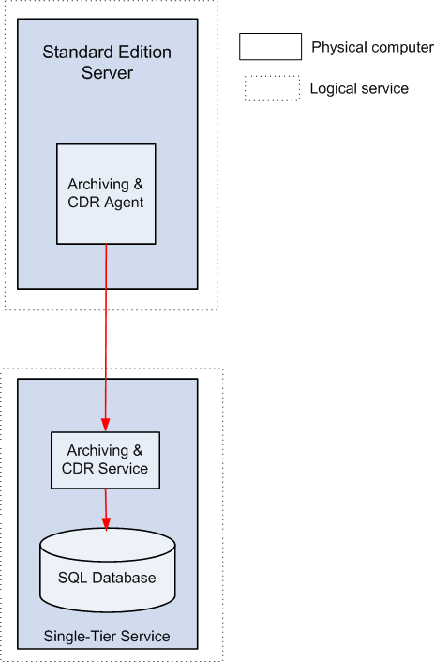
Deploying Archiving-CDR Server
Standard Edition server connected to single-tier archiving and CDR service

Slide 29
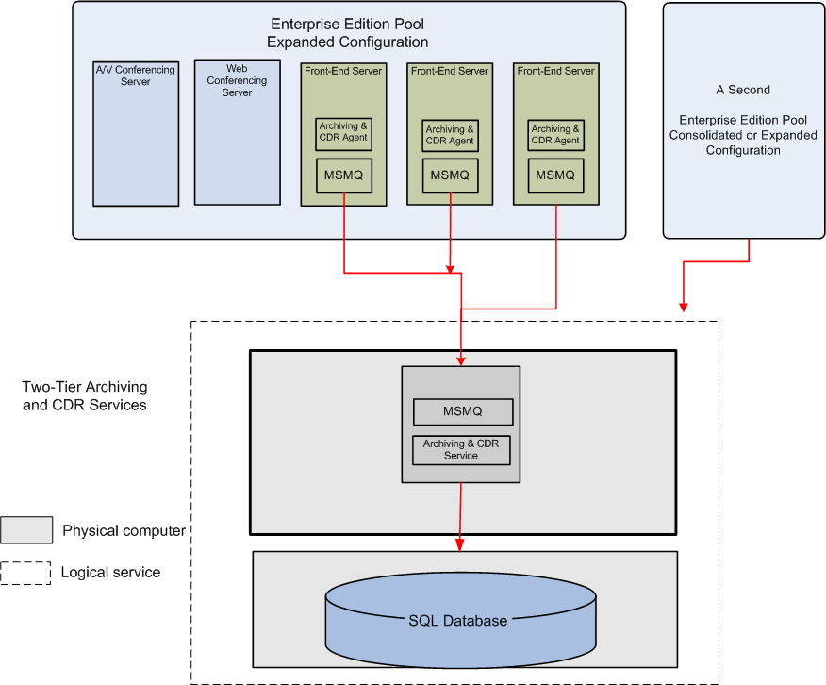
Deploying Archiving-CDR Server
Two Enterprise Edition pools connected to two-tier archiving and CDR service

Slide 30
Deploying Archiving-CDR Server
A single Enterprise Edition pool connected to multiple archiving and CDR service
Enterprise Edition Pool Expanded Configuration
A/V Conferencing
Server
Web
Conferencing
Server
Front-End Server
Front-End Server
Front-End Server
Front-End Server
A/V Conferencing
Server
Web
Conferencing
Server
Archiving and
CDR Agent
Archiving and
CDR Agent
Archiving and
CDR Agent
Archiving and
CDR Agent
MSMQ
MSMQ
MSMQ
MSMQ
MSMQ
MSMQ
Archiving and
CDR Agent
Archiving and
CDR Agent
SQL Database
SQL Database

Slide 31
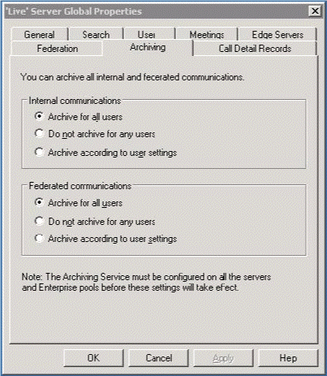
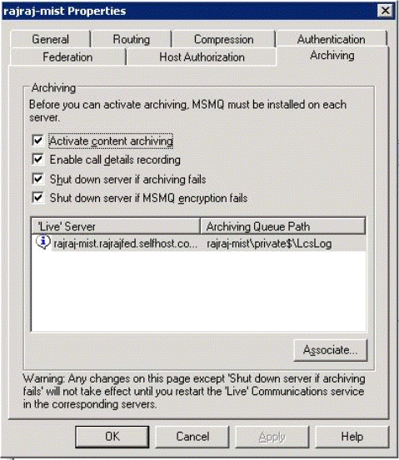
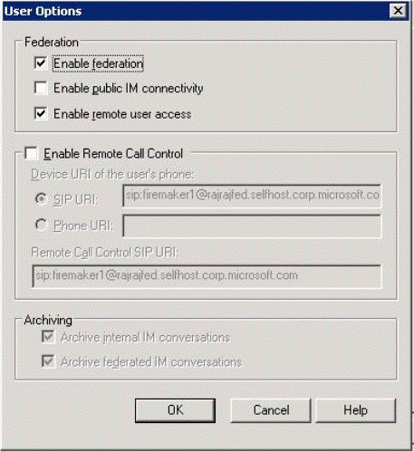
Configuring Archiving

Slide 32
通聯記錄
Communications Server 2007 enables administrators to:
  Capture usage statistics
  Quantify the return on investment (ROI)
  Analyze usage trends of various features and services and plan the infrastructure accordingly

Slide 33
Communicator 2007 使用量
IM session count
IM messages count
IM conversation minutes
P2P audio/video sessions
Count of users
Count of IM file transfer sessions
Count of application sharing sessions
Count of remote assistance sessions

Slide 34
Meeting Console 使用量
Count of conferences
Count of conference minutes
Count of unique conference users
Information of conference presenters versus attendees
Count of conference messages

Slide 35
電話使用量
Count of voice calls between particular users
Count of redirected voice calls
Count of missed calls
Duration of calls
Information about gateways used in the call

Slide 36
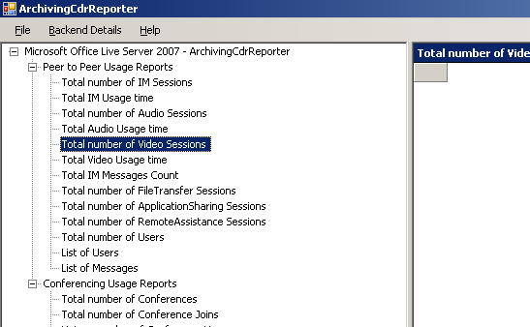
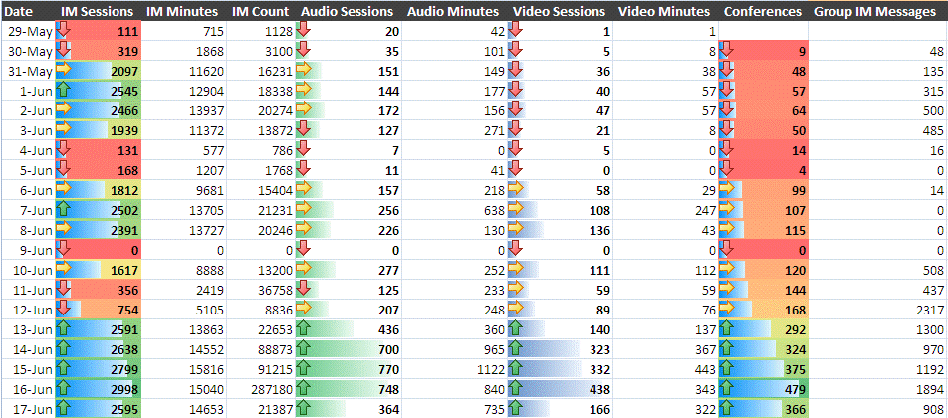
Archiving-CDR Reporter and Usage Info in Excel 2007
Built-in queries for most common reports

Slide 37
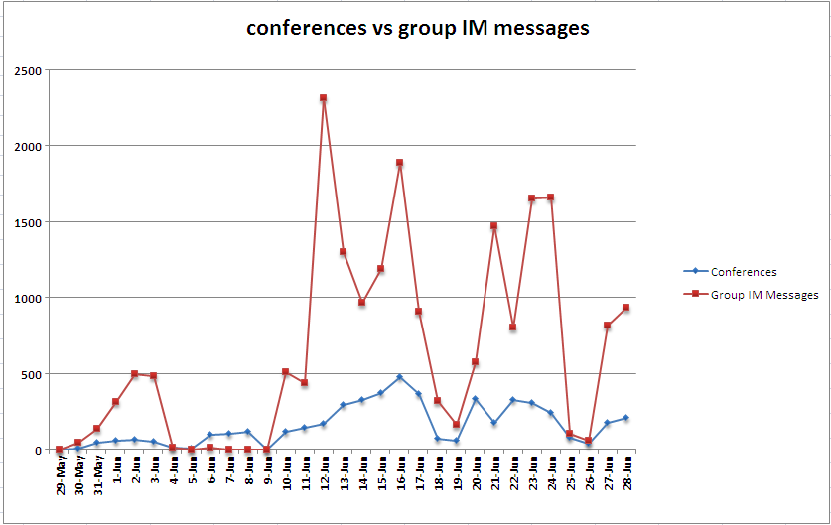
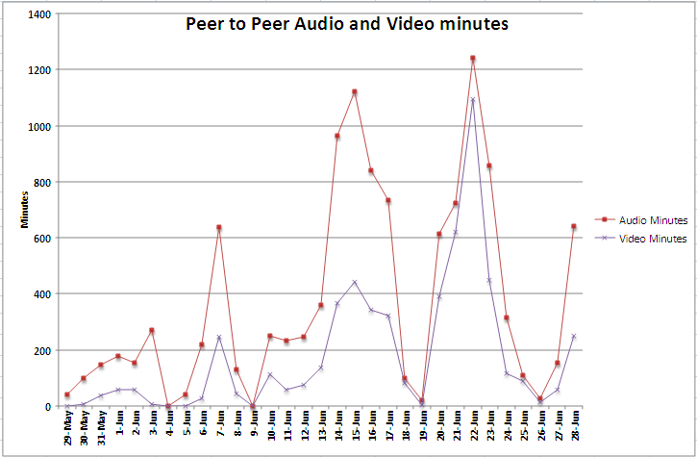
Trend Reports

Slide 38
OCS 2007 衛生保健

Slide 39
什麼是衛生保健 ?
Functionality to enable users to specify and enforce policies, as well as controls to protect their enterprise against security threats

Slide 40
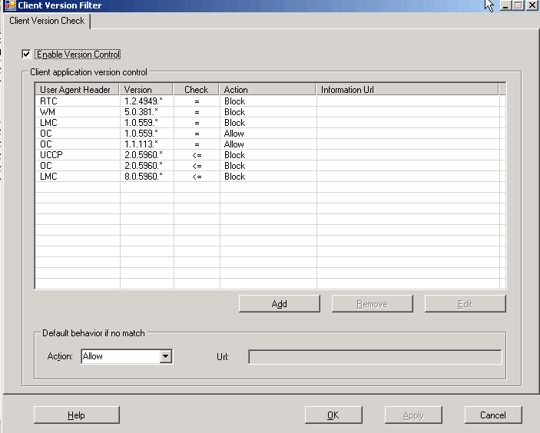
Client Version Check Application
Notes
Feature can be turned on or off
Wild card support
Works for clients that can send SIP invite or subscribe messages
Filters based upon user agent header
Order is significant; processing of the filter records stops once match is found

Slide 41
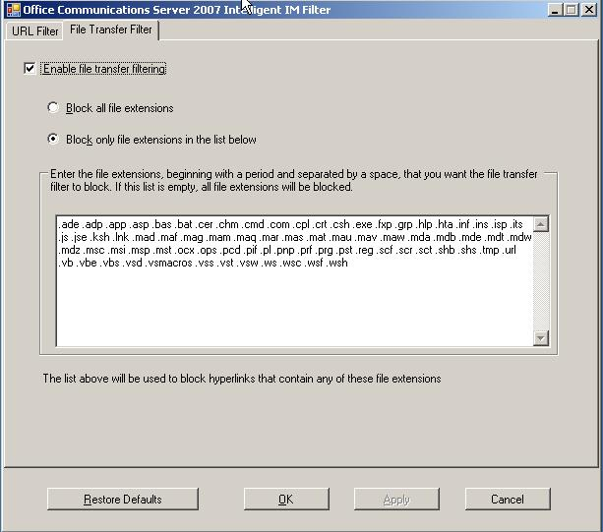
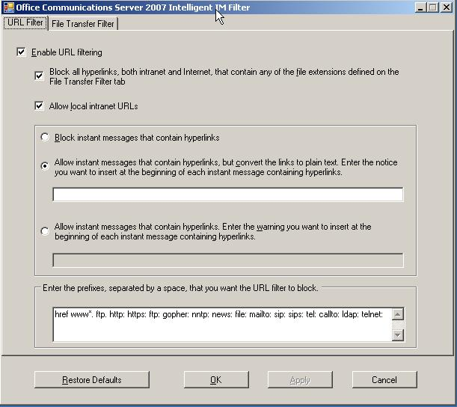
Intelligent IM Filter

Slide 42
Forefront IM 保護機制

Slide 43


即時通訊(IM)的漏洞
Files/URLs
  Executables, hot buttons, phishing
Trojan viruses
  Steal IM info (buddy lists, passwords, log filesl
  Steal info via IM (IP addresses, System Info)
  Remote control
Classic worms
  Send files to designated “buddies”
Blended threats
  Use IM to find vulnerable systems and spread faster
Worm attack forces Reuters IM offline
Published: April 14, 2005, 11:22 AM PDT
CNET News.com
Reuters has shut down its instant messaging
system after suffering an onslaught from a
new Kelvir worm, the company confirmed
Thursday…The new variant attempted to spread by sending fake instant messages to people in contact lists on infected systems, a
technique used by earlier Kelvir strains.
The messages, crafted to look exactly like
legitimate IM correspondence, attempted to
lure people to a Web site where their
computers would be infected with
Kelvir, the representative said.
Notes:
Although a potentially powerful communications tool, IM technology presents a number of security problems--both by accident and design. Most commercial, free IM applications--such as AOL's Instant Messenger (AIM) and ICQ, Microsoft .NET Messenger and Yahoo! Messenger--are susceptible to hacker exploits and malware. They were created to find ways through network perimeters to reach controlling hosts. This form of P2P communication is largely unsecured, transmitting data in the clear. Given the seemingly unstoppable proliferation of instant messaging, IT security managers must find ways to either prohibit or control its use in the workplace.

Slide 44






OCS 2007 IM 保護機制
偵測及刪除在即時通訊(IM)時的病毒
  支援 OCS pooling, PIC, 檔案傳輸及encrypted
  conversations
  封鎖潛在危險的連結
掃描即時通訊及文件中機密和不適當的關鍵字
經由白名單及IM/SMTP的通知，建立即時通訊的政策
Outside IM Clients
Firewall
Live Communications Server
Antigen
Microsoft Office Communicator
Windows Messenger Clients
Notes:
We can support public protocols using Public IM Connectivity (PIC). That’s how we can secure the public IM conversations. You can connect to any public protocol with PIC, so you don’t need to allow Yahoo, etc. in the environment. If you want to allow public IM clients, Antigen does offer integration with IMLogic’s IMManager product, and then we can protect those public IM messages that way.

Slide 45
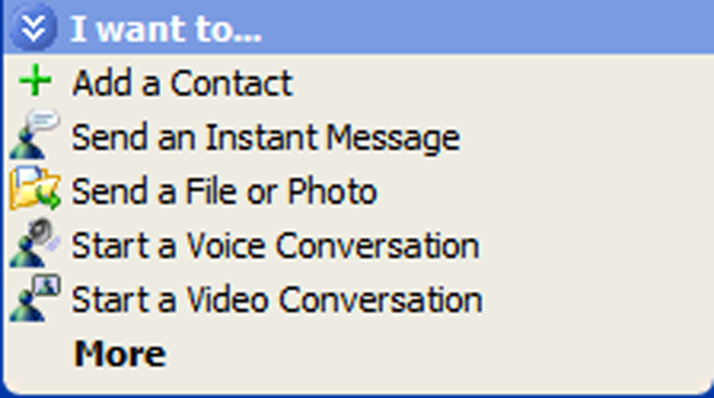
即時通訊(IM)的漏洞
Inappropriate Content
  Privacy Issues
  Profanity
  Legal risks
SPIM
  Unsolicited content
  Phishing attacks
Notes:
Sending confidential or inappropriate content is a particular concern with IM. You have to have the ability to filter out unwanted content – whether that is external SPIM or internal communications that may be outside of corporate communications policies. There is an old but famous case involving ICQ logs and eFront.
ICQ logs spark corporate nightmare
Published: March 15, 2001, 11:05 AM PST
By Paul Festa
Staff Writer, CNET News.com
Thousands of confidential messages between the CEO of an Internet company and top executives have been posted on the Web, stirring up a hornet's nest of corporate intrigue and providing a rare glimpse into a dot-com as it struggled to cope with a brutal shakeout.
More at http://news.com.com/2100-1023-254173.html?legacy=cnet

Slide 46
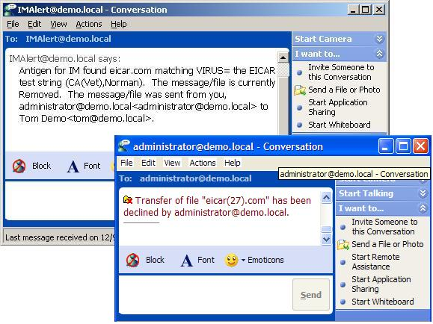
Forefront 病毒防護
當檔案傳輸及訊息交談時，掃描是否有病毒.
整合 SIP (Session Initiation Protocol) 提供即時掃描
支援 OCS
Pooling, PIC, and
encrypted
conversations
使用者可經由Antigen
IM “bot”通知
Notes:
LCS 2005 support: Antigen can now support the new pooling functionality within LCS 2005. IM messages scanned by Antigen on one of the servers in the pool will not be rescanned by another LCS server in the same pool.
Antigen 8.0 for IM now has the ability to be managed by Sybari Enterprise Manager 1.1. The Sybari Enterprise Manager (SEM) is a web-based centralized management console designed to provide administrators central deployment and custom graphical reports for Antigen products in an enterprise. SEM provides administrators a central mechanism for scan engine updates for multiple remote servers via unique push-pull architecture designed to automate and reduce the window of exposure during virus outbreaks. Also included are customizable reports designed to help administrators analyze the current health of their environment.

Slide 47
OCS 內容保護
文件過濾 - 類型、大小及名稱
內容過濾 - 針對交談內容及文件本文，自訂關鍵字
白名單排除被掃描的即時通訊使用者的姓名及位址
SPIM 字典 – 自訂已知的垃圾的字眼(可自訂自己的垃圾字典)
使用內容過濾來封鎖某一些URLs被傳送
Notes:
LCS 2005 support: Antigen can now support the new pooling functionality within LCS 2005. IM messages scanned by Antigen on one of the servers in the pool will not be rescanned by another LCS server in the same pool.
Antigen 8.0 for IM now has the ability to be managed by Sybari Enterprise Manager 1.1. The Sybari Enterprise Manager (SEM) is a web-based centralized management console designed to provide administrators central deployment and custom graphical reports for Antigen products in an enterprise. SEM provides administrators a central mechanism for scan engine updates for multiple remote servers via unique push-pull architecture designed to automate and reduce the window of exposure during virus outbreaks. Also included are customizable reports designed to help administrators analyze the current health of their environment.

Slide 48
合作夥伴
Symantec
FaceTime Communications
Akonix Systems, Inc.

Slide 49
For More Information
Visit TechNet at: www.microsoft.com/technet
For additional information on books, courses, and other community resources that support this session, visit: www.microsoft.com/uc

Slide 50

Questions and Answers
Submit text questions using the “Ask” button.
Don’t forget to fill out the survey.
For upcoming and previously live webcasts: www.microsoft.com/webcasts
Got webcast content ideas? Contact us at: http://go.microsoft.com/fwlink/?LinkId=41781
Today's webcast was presented using Microsoft® Office Live Meeting. Get a free 14-day trial by visiting: www.microsoft.com/presentlive
Notes:
50

Slide 51


