Slide 1


Slide 2
Office Communications Server 2007
新功能介紹
David Feng 馮立偉
精誠資訊 技術服務處 處長

Slide 3
議程大綱
微軟 UC 願景
企業內通訊面臨難題與挑戰
Office Communications Server 2007 各項創新功能預覽
企業部署考量
Q&A

Slide 4
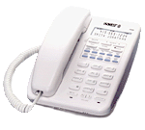






























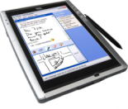







Unified Communications
Innovative Communications with Revolutionary Economics
From proprietary networks and end user experience silos…
to people-centric, software-enhanced communications

Slide 5






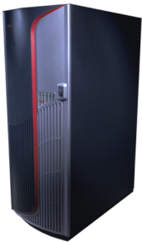


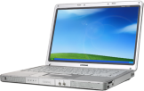




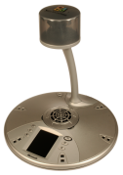






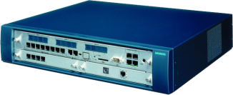

Microsoft 整合通訊
Efficient
Streamlined
Extensible

Slide 6
Microsoft 整合通訊
Efficient Operations
For IT
Streamlined
Communications
For Your
Users
Extensible
Infrastructure
For Your
Organization

Slide 7
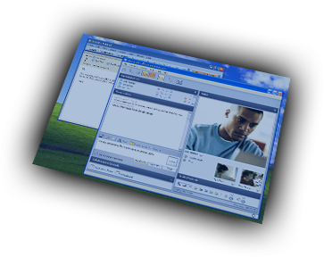
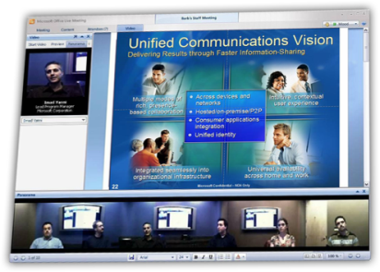
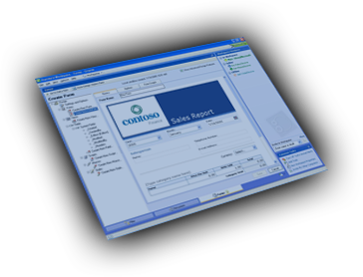
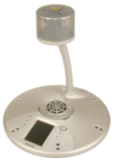
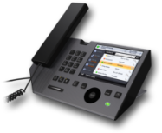

企業內部採用即時通訊的優勢
更多的創新
更好的生產力
基本的即時通訊暨網路電話功能
降低成本
企業內部即時通訊暨網路電話
$
更多的選擇
降低通訊成本

Slide 8
微軟整合通訊的市場地位
Ability to Execute
challengers
leaders
Cisco Systems
Microsoft
IBM
Siemens
Magic Quadrant for
Unified Communications
As of 26 April, 2006
Nortel
Mitel Networks
Alcatel
Avaya
Interactive Intelligence
Oracle
NEC
AVST
TeleWare
Ericsson
niche players
visionaries
Completeness of Vision
Notes:
10/17/2007 5:13 PM
8
©2004 Microsoft Corporation. All rights reserved.
This presentation is for informational purposes only. Microsoft makes no warranties, express or implied, in this summary.

Slide 9




今日的企業環境
員工的心聲
某些電話功能操作不易 (如電話會議, 聽取語音留言等)
通訊工具沒有整合
希望在任何地方都可以工作
員工
在現有的交換機上投資太多
希望在節省通訊成本外能夠多增加企業價值
希望任何技術決策都可以保留彈性
資訊部門主管
任何地方都可以使用企業軟體
跨系統的多重目錄
已存在不同的管理工具
資訊人員
Notes:
10/17/2007 5:13 PM
© 2004 Microsoft Corporation. All rights reserved.
This presentation is for informational purposes only. Microsoft makes no warranties, express or implied, in this summary.
9

Slide 10



今日企業環境
投資策略
在內部使用的應用程式中聯繫他人
整合通訊工具
從任何地方存取
整合通訊平台
整合既有電話系統
軟體式的網路電話系統
多功能的開發平台
網路電話基礎平台
企業級的安全保密及公司治理
集中式使用控管服務
共用的管理工具
作業控制
Notes:
10/17/2007 5:13 PM
© 2004 Microsoft Corporation. All rights reserved.
This presentation is for informational purposes only. Microsoft makes no warranties, express or implied, in this summary.
10

Slide 11









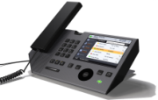
群組即時通訊
增強型使用者狀態呈現
強化延展性, 安全性, 規範性, 及管理性
Enhanced Enterprise IM
Multi-Party On-Premise Conferencing
多人及排程召開線上會議
1:1 或多人 IP 音訊與視訊交談/開會
Enhanced
VoIP
提供豐富及整合性之語音
狀態呈現型式之 IP phone 經驗
控制桌上電話
17 October 2007 | Page 11
Notes:
11

Slide 12
加強型企業 IM

Slide 13
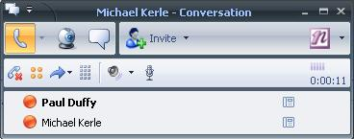
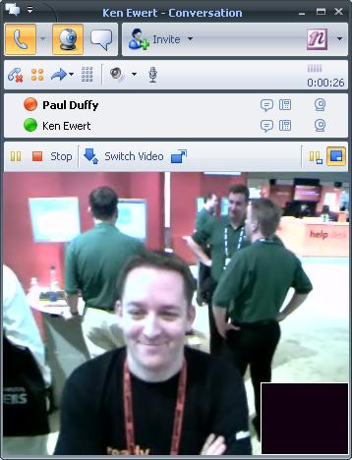


Office Communications Server 2007
Software-powered VoIP with Office Communicator
高品質 VoIP
在 Office 應用程式中只要一個 click 就可啟動 VoIP 能力
VoIP 通訊可以在公司, 家裡或是在路上使用
  - 加密
  - 不需要 VPN
額外提供 IM 及視訊功能
豐富的呼叫管理能力
  容易使用及設定
  依據使用者狀態及 Office Outlook 行事曆智慧型呼叫路由
Notes:
10/17/2007 5:13 PM
© 2004 Microsoft Corporation. All rights reserved.
This presentation is for informational purposes only. Microsoft makes no warranties, express or implied, in this summary.
13
Key Message
With Office Communications Server 2007 you can deliver software-powered VoIP to your users today.
Provides high quality VoIP right from within Microsoft Office applications so users can communicate with a single click from their PC.
Call management capabilities like call forwarding, hold, dynamic routing, and simultaneous ringing on all commonly used phones are easily configured by users.
Enables VoIP communications on any network with optimized quality for connection type – without VPN access to the corporate network.
Enables rich communications with other Communicator 2007 users by enhancing a phone call with IM, video and a subject and other information.
Key Capabilities
Call Authorization
Only allow authorized users to initiate certain calls (e.g. international calls).
Call Context
Voice calls can be given an importance or a subject which would be displayed to another Office Communicator user.
Call Deflect
Users can “deflect” (dynamically forward) incoming voice calls to another device such as a cellular phone or voicemail.
Call Encryptions
Calls can be encrypted to ensure privacy (SRTP).
Call Forwarding
Users can forward calls – all calls, if there’s no answer, based on presence, based on Office Outlook working hours, etc.
Call Hold
Users can put calls on hold and then retrieve them from hold.
Call Logs
Maintain call logs for incoming, outgoing, recent calls, etc.
Call Sensitivity Control
Users can control the sensitivity of calls, preventing others from being added to the call.
Call Transfer
Users can transfer calls either using single-step transfer, or consultative transfer.
Call Waiting
When on a call, users are notified of calls which may be waiting.
Click to Call
Users can initiate calls directly from existing address lists, or other applications where presence information is shown.
Conference Call
Users can initiate multi-party calls or dial-out from an existing call to include other contacts. These calls can be initiated on ad-hoc basis or can be scheduled using a Office Outlook add-in.
DTMF digit generation
Users can use a dial pad to generate DTMF digits whilst on a call (for example to navigate touch tone driven interfaces).
Inbound and outbound calling
Users can make and receive voice calls from their PC to another PC or to and from a regular PSTN telephone number.
Multiple Call
Whilst on one call, a user can initiate a second call and the first is automatically put on hold.
Reverse Number Lookup
When an incoming call is received from the PSTN, the number is compared with those in the corporate address list and the user’s Office Outlook contacts. If a match is found, the contact’s name is displayed.
Simultaneous Ring (aka Call Forking)
A call can simultaneously ring all registered endpoints plus 1 internal, external, or mobile phone number.
Unified Messaging integration
Unified messaging capability from Exchange Server 2007 can be integrated.
USB Device Integration for Voice Calls
Communicator is designed to integrate with USB devices to provide a rich calling experience. This includes interacting with the state of hook-switches, advanced audio configuration options and displaying call information on devices with a display.

Slide 14
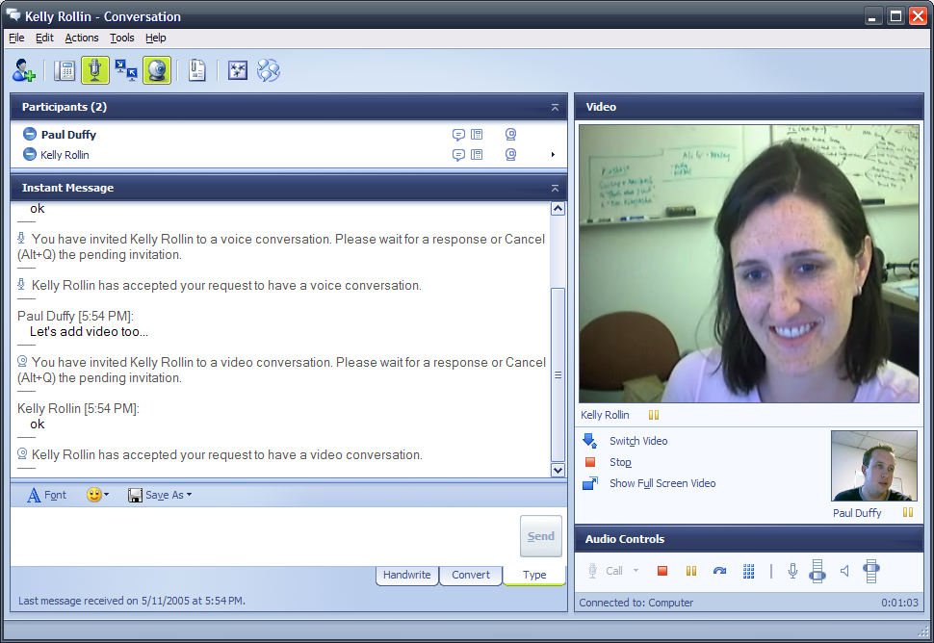
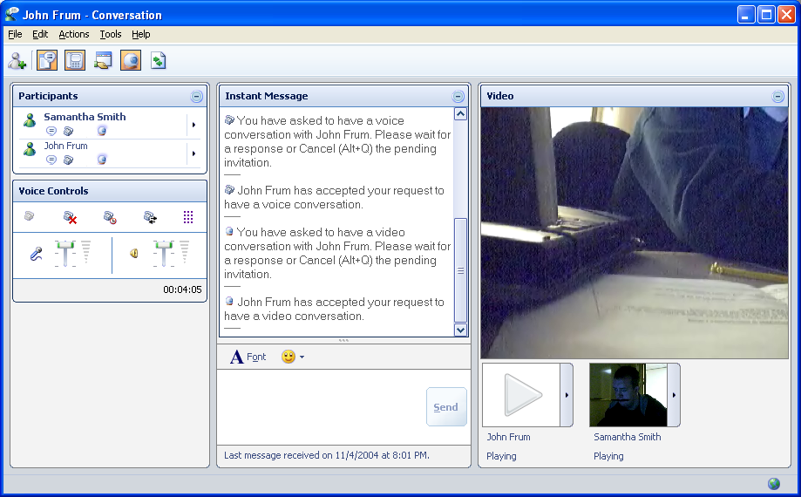
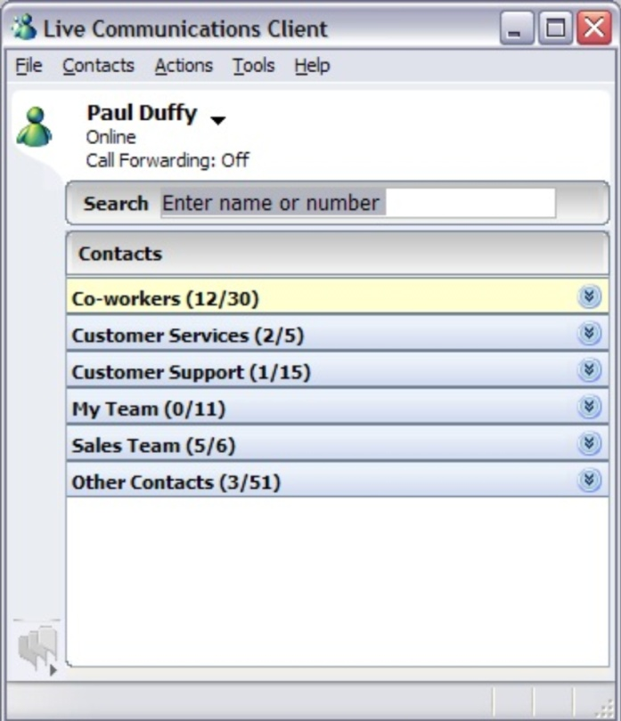
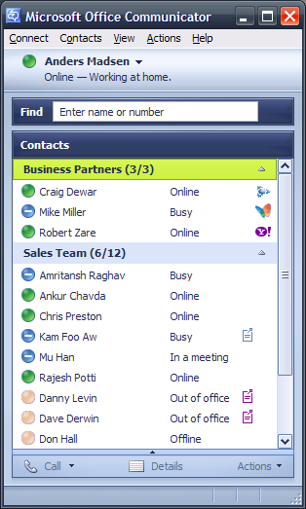
還記得…

Slide 15
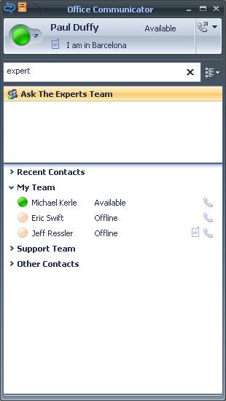
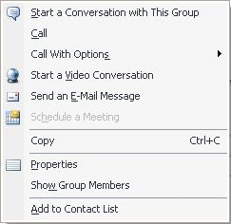
通訊群組整合
整合 Exchange 通訊群組
不再需要手動建立群組
直接使用群組或是加入聯絡人清單

Slide 16
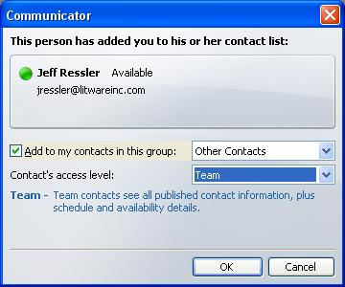
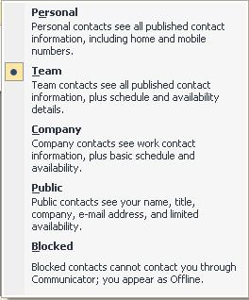
豐富的狀態顯示
使用者狀態顯示不再是顯示或不顯示
聯絡人可以被設定不同 ‘層級'的狀態顯示資訊
可以跨邦聯使用

Slide 17
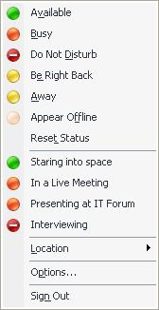
豐富的狀態顯示
使用者現在可以客製設定顯示狀態
可以由使用者或是 IT 管控
設定存於 XML 檔案
可以讓使用者在通訊時做更好的決定
包含位置選項

Slide 18
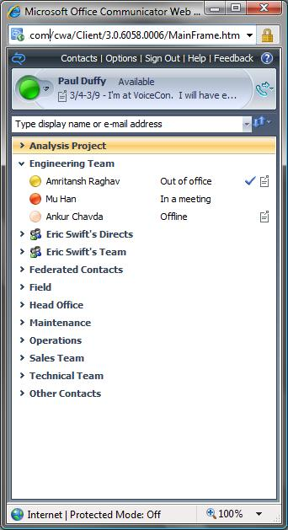
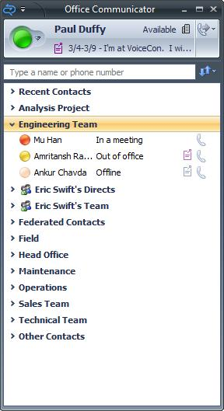
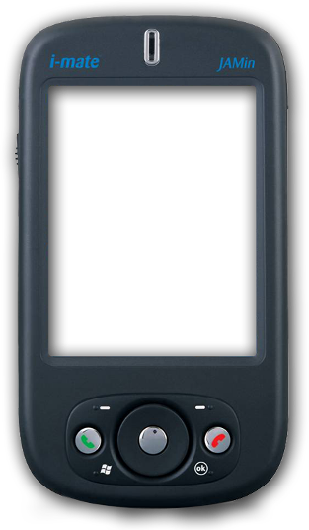
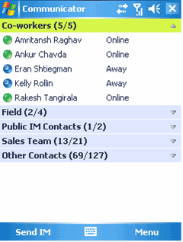
簡化通訊
Anywhere Access
不需要使用 VPN 即可達到安全性通訊存取
針對頻寬不佳之網路提供最佳化 Codecs
從桌上到行動裝置上相同的 Communicator 使用經驗

Slide 19
demonstration
Office Communicator 2007

Slide 20
全新會議功能

Slide 21
On-premise web conferencing
OCS 透過架設於企業內部之機制, 提供類似如現場開會般之網路會議能力
靜態及豐富的內容可以輕鬆的被分享
聲音及影像可以輕易的整合於會議中
  各別 PCs 及 Webcams 裝置
提供與 ACPs 整合

Slide 22
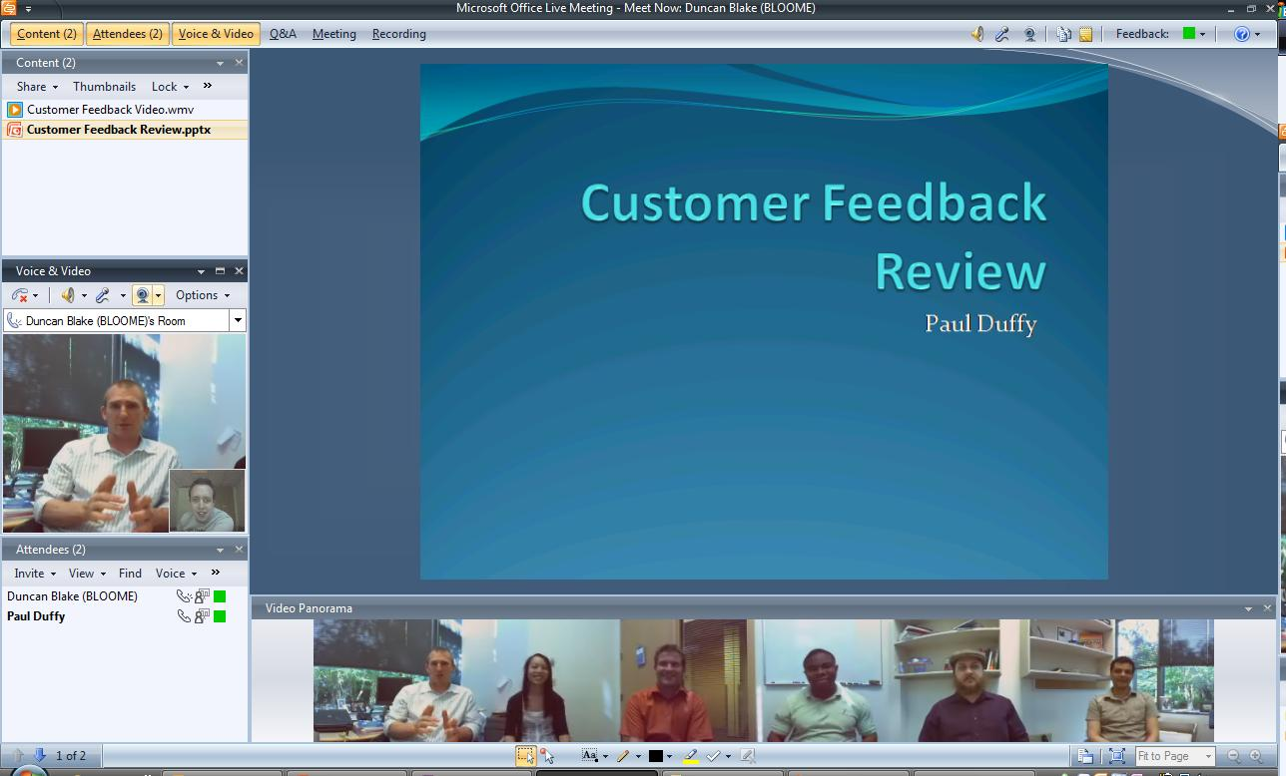
Web Conferencing Experience

Slide 23

協同式會議
召開協同式會議更容易
Connected
Organizations
Key Features
基於 Live Meeting 的使用經驗來簡化使用者操作
無論是 on-premise 或是 hosted 會議, 都是使用單一 meeting client 程式
互動式白板, 全新註解工具及 Shared Notes pane
與會者投票機制以及心情反應圖示

Slide 24

與會人員
藉由整合式的聲音, 影像及媒體產生更生動的會議
Engaged
Attendees
Key Features
豐富的媒體展現 : 影片, Flash 動畫, 及音效檔
支援現場 webcam
整合影像, 聲音及內容打造豐富簡報感覺.

Slide 25
更加互動之會議
藉由雙向多人影像及及聲音讓會議互動性更佳
Engaged
Attendees
Key Features
整合 PSTN 及雙向 VOIP 聲音
動態追蹤目前主要說話者

Slide 26
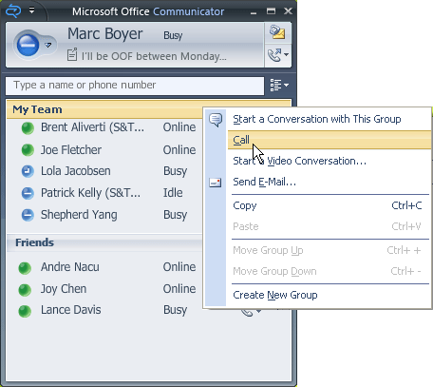

Communicator-based Conferencing
只要‘1-click' 就可以開始會議
輕鬆從雙人語音或視訓轉成 MCU 型式會議
同時可提供文字交談

Slide 27
demonstration
Live Meeting 2007

Slide 28
增強型 VoIP

Slide 29
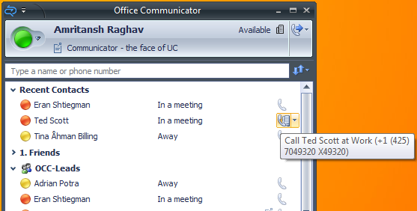
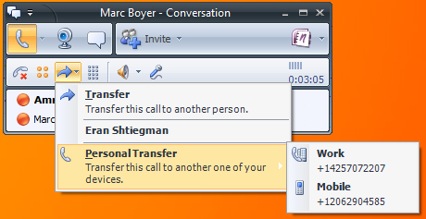

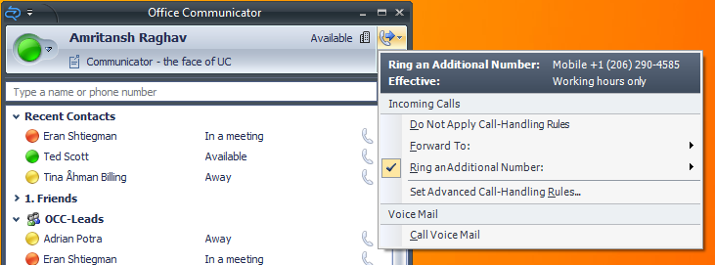
提供傳統電話所能提供之功能
最佳化語音經驗
  容易使用
提供資訊工作者語音需求
  豐富來電控制
  語音郵件訊息通知顯示
  來電轉接設定

Slide 30
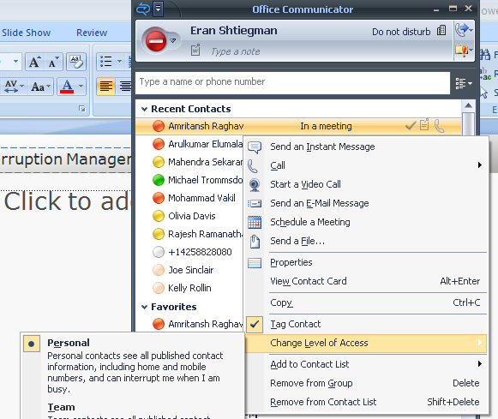

勿打擾管理
在請勿打擾下讓所有通訊都轉到語音郵件
允許特定人員享有特權
在簡報模式下以簡易通知形式展現
根據使用者忙碌程度暫停語音通知

Slide 31


Office Communications Server 2007
創新 Office Communicator Mobile 經驗
Office Communicator for Windows Mobile
豐富狀態顯示
安全的即時通訊
存取企業通訊錄
整合語音能力
當連線到手機網路時使用手機撥號
Notes:
10/17/2007 5:13 PM
© 2004 Microsoft Corporation. All rights reserved.
This presentation is for informational purposes only. Microsoft makes no warranties, express or implied, in this summary.
31
Key Message
Office Communicator Mobile is designed to extend the reach of Office Communications Server 2007 using Windows Mobile powered devices. Office Communicator Mobile has a look and feel similar to the desktop version of Office Communicator 2007 and ensures that access to the capabilities provided by Office Communications Server 2007 can continue when people are away from their desks.
Key Capabilities
Through integration with corporate directories via Office Communications Server 2007, Communicator Mobile can be used to quickly search for and communicate with contacts in an organization.
Future release only: when used in conjunction with a Windows Mobile device that includes a wireless fidelity (Wi-Fi) network adapter, Communicator Mobile can be used to make Voice over Internet Protocol (VoIP) calls over a corporate Wi-Fi network.
Communicator Mobile has a similar look and feel to the desktop version, ensuring that users have a consistent communications experience.
Users' contact lists are maintained across all Communicator clients ensuring that it is straightforward to keep in touch with regular contacts.
Icons used to indicate the presence of other users and other functionality, such as the ability to set custom notes, is maintained with Communicator Mobile, making the transition between the desktop and mobile device seamless.

Slide 32
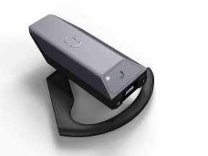
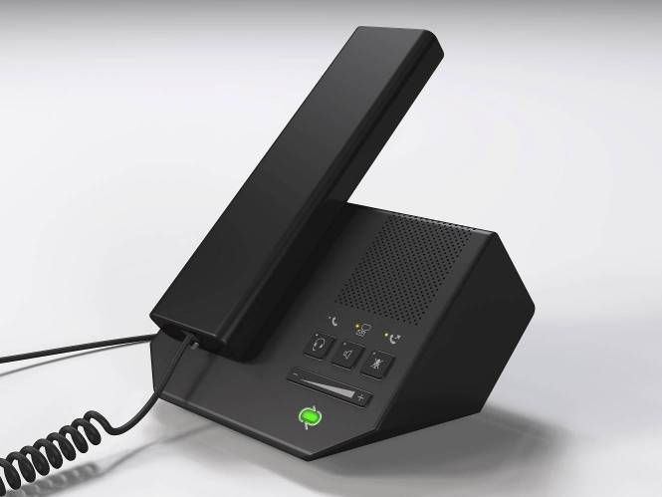
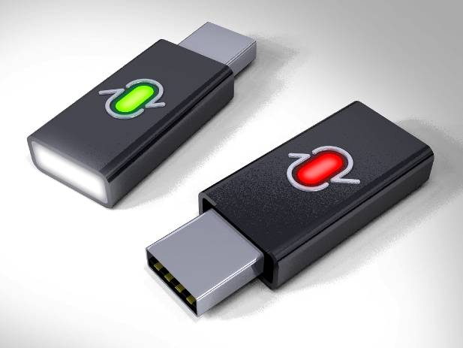
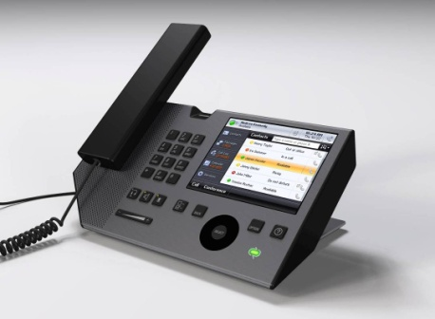
Office Communications Server 2007
創新 Office Communicator 各式裝置經驗
延伸 Communicator 經驗
個人電腦, 網頁及行動裝置
專門的 communications 裝置
創新 IP phones 的軟體
  崁入式軟體設計
  合作夥伴設計量產裝置
Notes:
10/17/2007 5:13 PM
© 2004 Microsoft Corporation. All rights reserved.
This presentation is for informational purposes only. Microsoft makes no warranties, express or implied, in this summary.
32
Key Message
Microsoft Office Communicator IP Phone and Peripheral Devices take advantage of the intuitive interface, rich presence and voice calling features of Communicator 2007 and allow the end user to live an innovative phone experience. Published protocols enable a broad device support through third parties.
Easy-to-use call control
Dial by name
Presence enabled
Easy set up
Office Communications Server 2007 IP Phone
With this people centric phone the user is in control of voice communications through an innovative and integrated soft phone that works with the applications and processes that the information worker uses the most. In addition, the user can experience on the phone most of the features available with Office Communicator 2007.
Intuitive operation
Name-based dialing (of contact lists and corporate directory)
Easily see and set presence, familiar user interface to Office Communicator users
Large touch screen to easily enable UC scenarios
Context based soft keys
Easy and user based setup (not MAC based)
Automatic network discovery and provisioning (NAT traversals)
Easy IT admin provision/move/updates/maintenance
High-quality wideband audio and full duplex speakerphone
Provides added value to Information Worker (access to calendar, rich voicemail functionality)
Does not support IM
Does not support video
USB Handset
The USB Handset plugs in directly to your PC and, when used together with Communicator 2007, allows you to use your PC just like a presence-enabled IP phone.
PC-Based Communication with Familiar Device
Users can get all the benefits of using their PC and Communicator 2007 for their voice communications through a familiar desktop phone. The USB Handset can also be used as a speakerphone for hands-free communication.
High Quality Audio
The USB Handset takes advantage of the wideband audio capabilities of Communicator 2007. Users experience high quality audio through the handset, built in speakerphone or optional headset.
USB ear-bud
The USB ear-bud eliminates the need for a handset or speakers to make or receive calls on a PC.
Great for Mobile Information Workers
The USB ear-bud is ideal for use with users’ mobile devices. Being able to quickly switch between the PC to a mobile device with the same ear-bud provides mobile workers with a single audio device that can move when they do.
Easy Pairing with Bluetooth Devices
The USB ear-bud can be paired with your PC or with your existing Bluetooth devices and it will remember its pairings. Rather than having to pair the ea-bud with each device every time you need to switch, the ear-bud pairing can be changed on the fly with a few presses of the multifunction button on the ear-bud.

Slide 33
完美整合

Slide 34
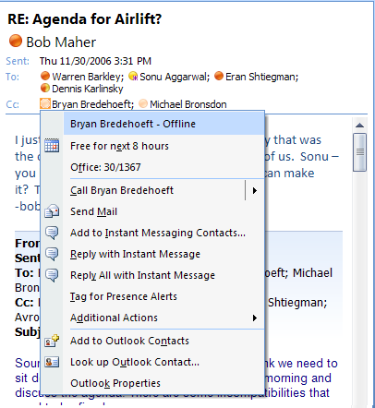
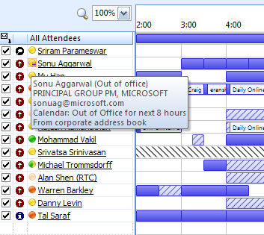
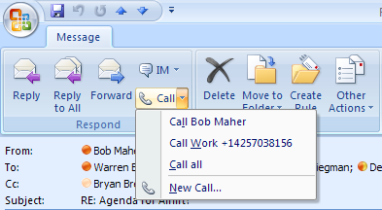
無所不在的狀態顯示
在 Outlook 中狀態顯示分佈在所有地方
整合 Sharepoint
整合 Office 2007

Slide 35
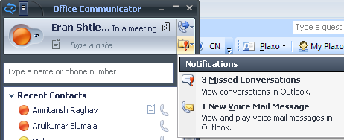
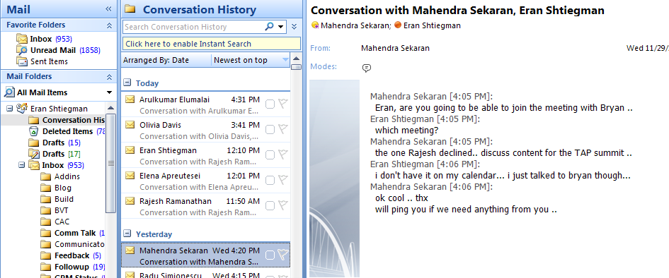
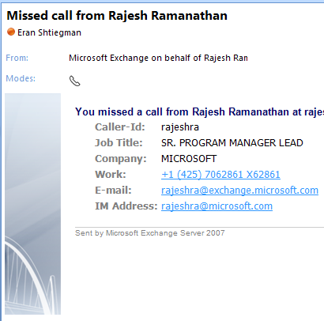
集中式記錄於 Outlook 中
自動歷史紀錄給所有即時訊息及來電
客製化表格及顯示方式於 Outlook 中
漏接來電提供進入 Communicator 之連接點

Slide 36
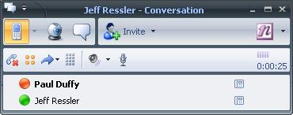
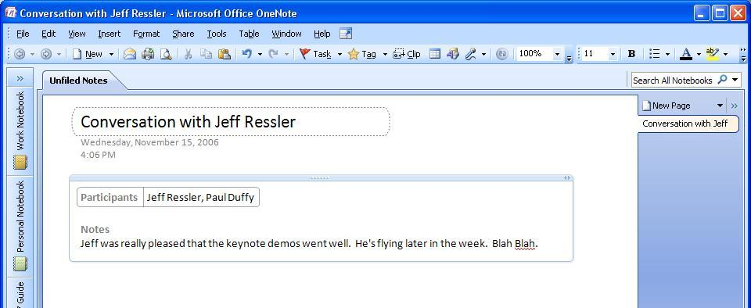
整合 OneNote 2007
來電過程中可用 OneNote 記錄重點 – 直接從交談視窗中啟用即可
儲存之通話紀錄可 Link 到OneNote 紀錄

Slide 37
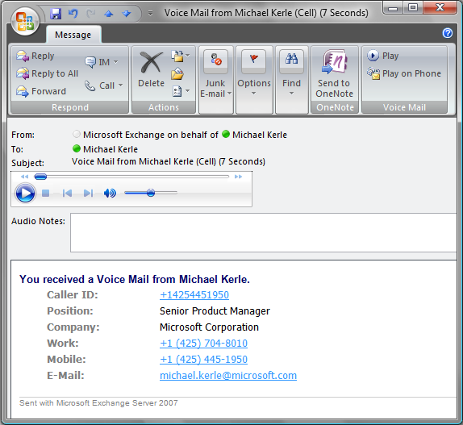

Exchange Server 2007
創新整合通訊經驗
整合 e-mail, fax, 及 電話通訊 到桌上電腦, 行動裝置 及 Web Client
共通收件夾
透過 Office Outlook 存取語音郵件
與現行 PBX 架構整合
使用電話存取語音郵件
使用原生 SIP 或 SIP/PSTN gateway
Notes:
10/17/2007 5:13 PM
© 2004 Microsoft Corporation. All rights reserved.
This presentation is for informational purposes only. Microsoft makes no warranties, express or implied, in this summary.
37
Key Message
Microsoft's introduction of unified messaging support in Exchange Server 2007 marks the start of a new way of unified messaging technology: robust, interoperable, server-based tools that integrate with desktop and mobile clients to give information workers access to voice, fax, and e-mail data from wherever they are and allows users to use the telephone to manage their email, calendar, and personal contacts.
Communications and collaboration are critical elements of business success. Companies that are able to successfully integrate communication and collaboration processes in their business workflows can lower expenses, increase efficiency, and realize the value of information assets they already have. In the new world of work, employees require easier access to these communication types, leading to the integration of telephony, fax, and e-mail capabilities into desktop and mobile clients.
Key Capabilities
Less wasted time
People are able to quickly send, receive, and find the exact information they need, no matter what form it was delivered in and no matter where they are.
One inbox
Exchange Server 2007 seamlessly delivers e-mail, voice mail, calendar data, and fax messages into users' inboxes. Users can sort, manage, and act on multiple message types without having to switch between applications or systems.
Access from the office, at home or on the road
Exchange Unified Messaging delivers access from familiar clients like Office Outlook, Office Outlook Web Access, a variety of mobile devices, and ordinary telephones.
Reduced costs
Integrated unified messaging systems allow site and server consolidation, reducing the total number of servers required to provide voice mail and fax service. Consolidation can dramatically lower maintenance and upkeep costs, particularly for organizations with remote or branch offices.
Foundation for unified communications
The combination of e-mail, voice mail, and fax capability can be augmented with presence, instant messaging (IM), and real-time conferencing capability to expand the ways in which users can share information and communicate.
Basic unified messaging technology
Calls coming from phones and fax machines via the public switched telephone network (PSTN) as well as internal calls are routed via the existing PBX infrastructure. Either this is a traditional PBX or an IP-PBX.
An IP-PBX can talk directly to the unified messaging server using SIP.
A legacy PBX talks via a SIP/PSTN gateway to the unified messaging server. The gateway sits at the same site as the PBX.
The unified messaging server is located in the existing forest and should ideally be very close to the rest of the Exchange infrastructure. The unified messaging server communicates with the other Exchange server roles, storing messages on the mailbox server.

Slide 38
延展性

Slide 39
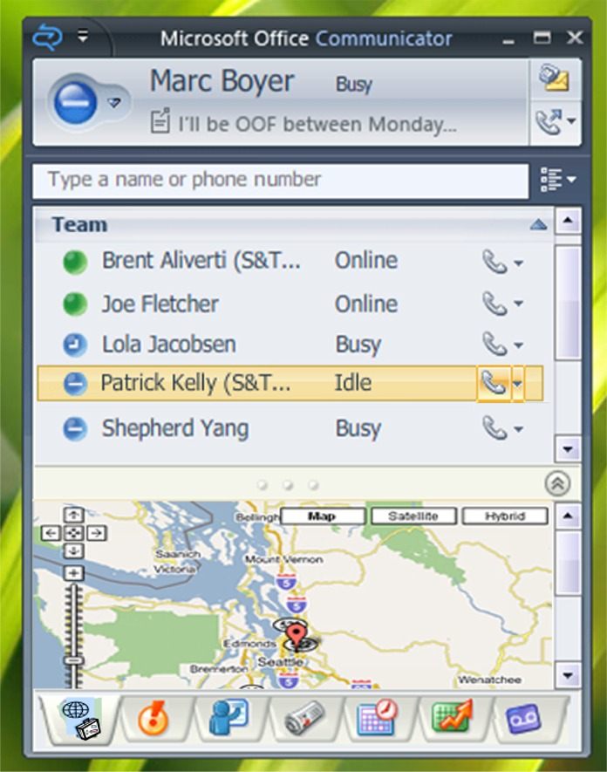
改良之 ‘Tabs’

Slide 40
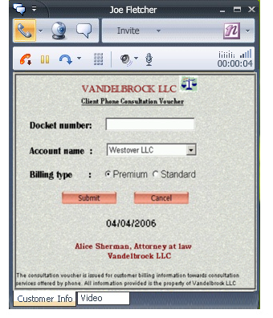
來電與企業AP之結合

Slide 41
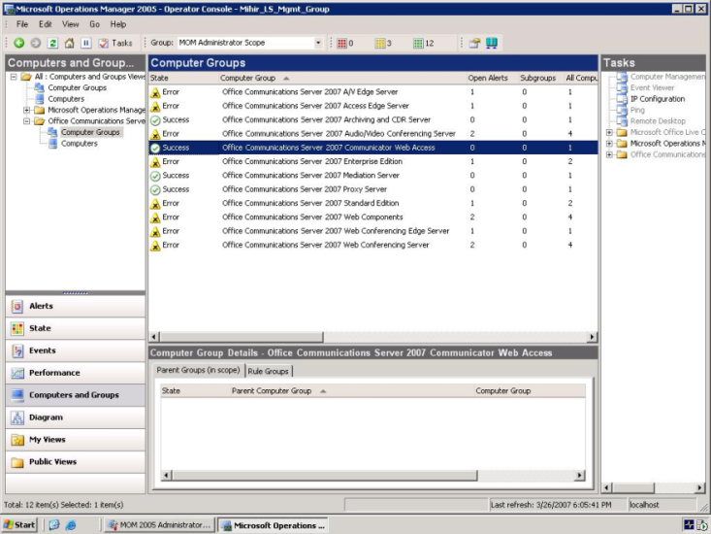
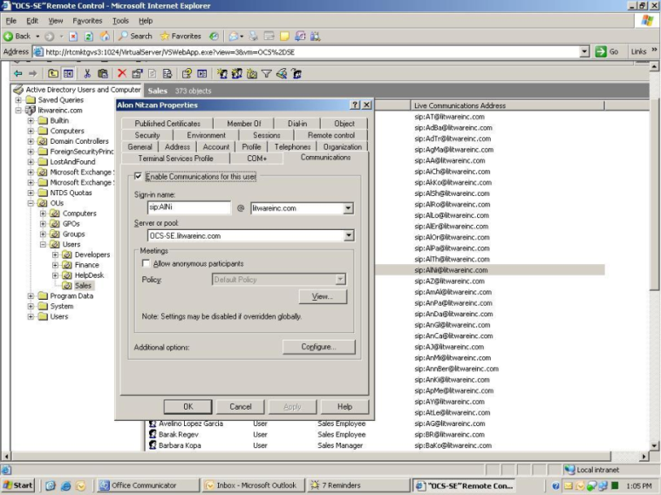
系統功能
共通管理工具
“資訊人員致多花 70% 的時間在於維護既有的系統上.”
—Accenture Study, 2004
跟目錄服務整合的管理工具
智慧型的設定精靈更加容易佈署
與 MOM 整合提供軟體監控服務

Slide 42

集中控管介面

Slide 43
安全性

Slide 44


智慧型 IM 過濾器

Slide 45



設定紀錄與封存

Slide 46





微軟整合通訊服務
建構基礎架構
建構整合通訊的基礎
單一識別, 單一目錄
訊息及行事曆服務
現狀資訊和企業內部即時通訊
各式通訊方式的整合
  軟體式的網路電話系統
  整合訊息
  線上會議及語音/視訊會議
  語音辨別 (英文)
www.microsoft.com/uc
Notes:
10/17/2007 5:13 PM
© 2004 Microsoft Corporation. All rights reserved.
This presentation is for informational purposes only. Microsoft makes no warranties, express or implied, in this summary.
46

Slide 47





































































Microsoft Unified Communications
廣泛合作夥伴解決方案

Slide 48
Q & A / Discussion

Slide 49


