Slide 1

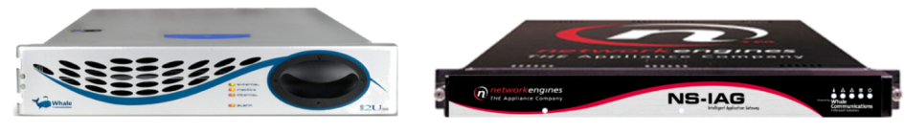


Remote Access to Applications:
A Deep Dive into Intelligent
Application Gateway 2007
Franklin Lo
IT Pro Evangelist
Microsoft Hong Kong Limited

Slide 2
Session Objectives and Takeaways
Session Objectives
  Outline security requirements for comprehensive secure remote access to extranet resources (for employees, partners, vendors, contractors and customers)
  Understand the benefits of IAG 2007
Takeaways
  A variety of security and functionality concerns are at play when implementing extranet remote access
  IAG 2007 provides a turnkey solution for access from virtually any device to almost any enterprise application

Slide 3
Session Objectives And Agenda
What is IAG 2007
Extranet Scenarios
Common Security Concerns
Common Functionality Concerns
User and Admin Experience Demo
Feature Re-Cap

Slide 4



Security & Management
Client Security
Desktop & Device Management
Server Security
End-to-End Service Management
Edge Security
Integrated Management Across Physical & Virtual
Common Management Infrastructure and Platform
Productive
Simplified
Integrated

Slide 5






Lowering Costs: fashion in the workplace
1990s
NOW
1980s

Slide 6



A Little History
The Problem:
With the growing prevalence of internet connectivity, enterprises required platforms to provide remote access for employees, partners and customers in a secure way
The Solution?:
  1st attempt: Dialup remote access → proving too
  costly, limited user experience
  2nd attempt: Limited use of reverse proxies to
  publish web based applications
  3rd attempt: IPSec VPN makes leap for user
  remote access
    IPSec VPN first developed for site to site connectivity

Slide 7
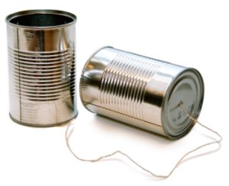
A Little History - IPSec Dominates
Introduces following limitations:
  Potential security exposure by extending network
  Limited functionality from firewall/NAT’ed networks
  Client grows to accommodate more security functionality
  (virus inspection, split tunneling control, etc.)
  Client becomes difficult to roll out:
    Requires administrative installation
    Clashes with other IPSec and security software
    Not very user friendly
Result:
  Enterprises limit usage to “road warriors” and
  managed PCs
  TCO is high and ROI limited

Slide 8

























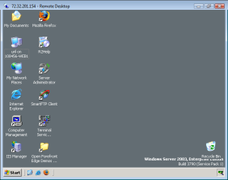


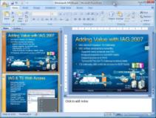







Current Solutions
Internet
Corpnet
IAS RADIUS
IPSec VPN
  Requires Client Installation
  Doesn’t work
  from everywhere
  Connects unmanaged PCs to corporate network
Reverse Proxy
  Doesn’t resolve
  non-web applications
  Doesn’t scale when publishing numerous applications
Terminal Services
  Typically limited deployments given server computing requirements
Remote User
ISA
Quarantine
Active Directory
Web
Server
4
3
2
DNS
Server
5
1
6
Central Location
ISA
Server
Branch Office
Home Office
Mobile Worker
In Airport

Slide 9




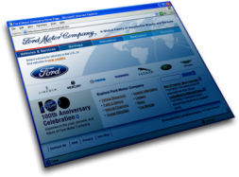
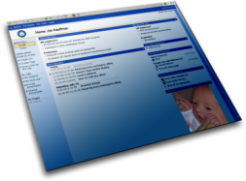
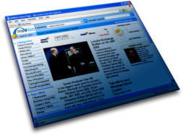
A Little History – SSL VPN Is Born
Promises to offer similar functionality for:
  Any user
  Any location
  Any application
Delivers on lower TCO
Introduces new security considerations as clients are now unmanaged
First wave of development is focused on connectivity
Current wave is focused on Application Intelligence

Slide 10

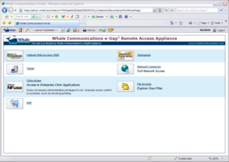
Supports all Applications with SSL VPN
    Web – Client/Server - File Access
      Microsoft – SharePoint, Exchange, Dynamics
      In-house developed
      Third-party, e.g. Citrix, IBM, Lotus, SAP, PeopleSoft…
Designed for Managed and Unmanaged Users & Devices
    Automatic detection of user system, software and configuration
    Access policies according to device “security state”
    Delete temporary files and data traces from unmanaged devices
Drives Productivity with Application Intelligence
    Apply policy at granular application feature levels
    Dynamically control application data for desired functionality
    Single Sign-on with multiple directories, protocols and formats
    Fully customizable portal and user interface

Slide 11















Intelligent Application Gateway
A comprehensive line of business security products that helps you gain greater protection through deep integration
and simplified management
Client and Server OS
Server Applications
Edge

Slide 12


ISA and IAG – Good… Better… Best…
Forefront Edge Security and Access products, Internet Security and Acceleration (ISA) Server 2006 and the Intelligent Application Gateway (IAG) 2007, provide enhanced network edge protection and application-centric, policy-based access to corporate IT infrastructure
Secure Remote Access
Optimized access for employees, partners and customers from virtually any device or location
Branch Office
Security
Enhanced connectivity and security for remote sites and applications
Internet Access Protection
Increased resiliency for IT infrastructure from Internet-based threats

Slide 13









Microsoft IAG 2007
Provides employees, partners and customers with
policy-based access to data and applications
from any managed or unmanaged device
Financial
Partner or Field Agent
Home PC
Legacy Apps
Custom Financials
Limited Intranet
Logistics
Partner
Kiosk
Limited Webmail:
no attachments
Project Manager
Employee
Corporate
Laptop
Full Intranet
Payroll & HR
File Access
Supply Chain
Remote Technician
Employee
Unmanaged Partner PC
Webmail
Tech Support App
Notes:
Office Connections
Updates will be available at http://www.devconnections.com/updates/LasVegas _06/Office_Connections
13

Slide 14

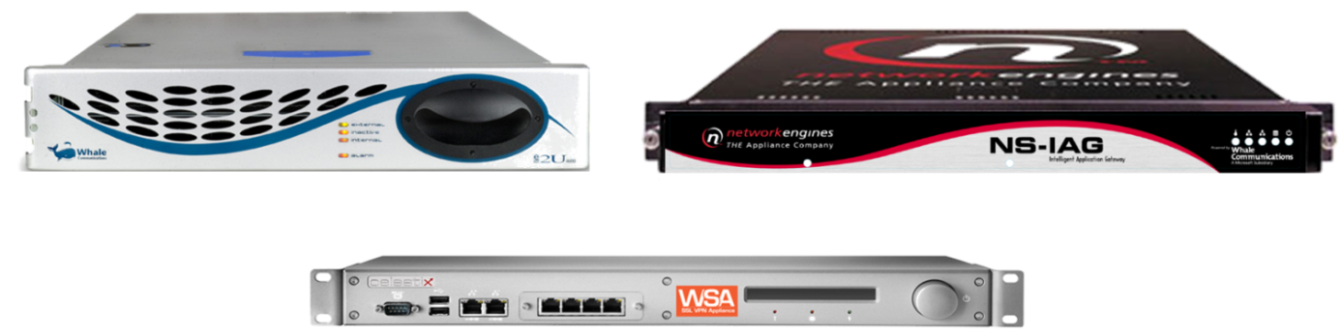
Appliance Options
Intelligent Application Gateway 2007
Notes:
Microsoft Confidential – February 20072007 Microsoft Corporation. All rights reserved.
This presentation is for informational purposes only. Microsoft makes no warranties, express or implied, in this summary.

Slide 15




Customer Scenarios
Insurance Company
Access for agents
  Collaboration
  E-Mail
  Create Quotes
  Manager Customer Accounts
Access for
Customers
Remote Access
for Employees
Movie Studio
Remote Access
for contractors
  Production people accessing:
    Scripts, resources, production reports
    Time management applications
    Budget and
    expense tracking
Remote Access for Employees
  Time Sheet
  Messaging
  Collaboration
  HR Portal
Large Beverage Mfr.
Remote Access
for employees
  Messaging and collaboration
Remote Access
for distributors
and logistics
  Order tracking
  Resource management
  HR

Slide 16
Security Concerns
Authentication – Who are you?
Strong Authentication – Are you really him/her?
Authorization – What can you access?
Transport Security – Can they hear?
Application Security – Should you be doing that?
End Point Security – From there?
Information Safeguard – Should this be left around?
Session Security – How long can you do this for?

Slide 17

Functionality Concerns
Easily publish web and non-web
(client/server) applications
Easy User Experience
  No client or thin client installation
  Single point of access/entry
  Single sign on
  Self-Help (Remediation)
  Password Management

Slide 18
IAG User and Admin Experience
Demo

Slide 19
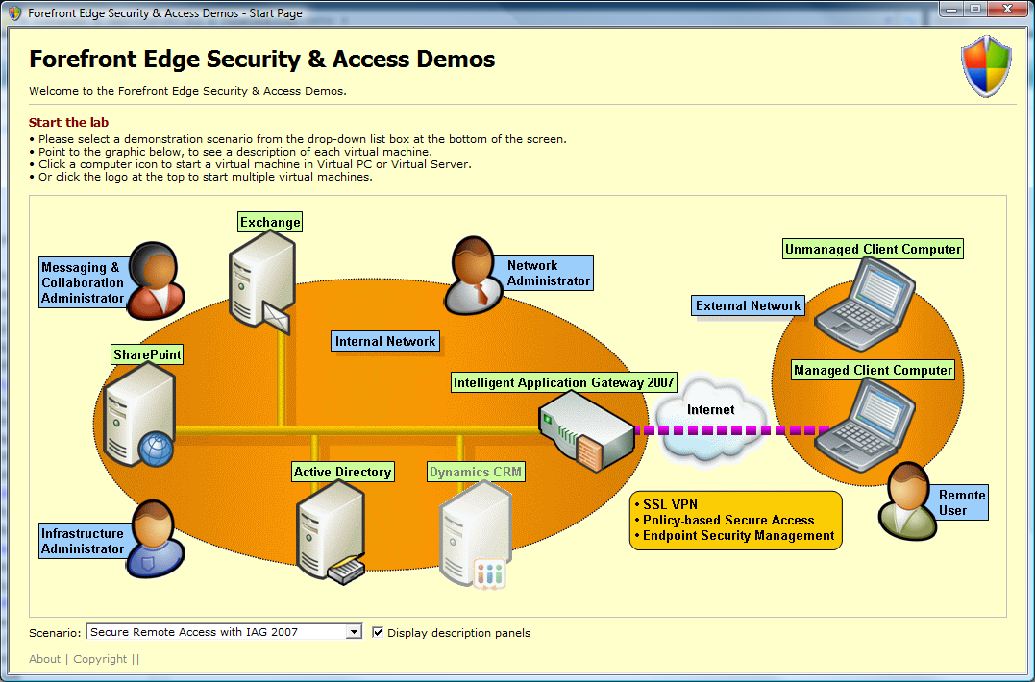
Demo Environment
Download the VPC demo at www.microsoft.com/iag - click on “Trial”

Slide 20
Core Differentiators
Technology | Benefits
Built-in Application Intelligence Deep understanding and analysis of core line of business applications Built-in security policies for over 60 applications with enhanced functionality and security Ongoing commitment to core applications and platforms Robust tools and features to create comprehensive policies for proprietary and home-grown applications | Pick and chose configurations for most common applications. Easily configure proprietary/home-grown applications Wizard driven configuration of complex security policies that enhance productivity and security Simple and straight-forward user experience including single-sign-on and customized dialogues Unparalleled protection of application and data More functionality from more locations limiting the need and use of tunneling agents
Built-in End Point Detection Support for most all common variants of Antivirus, Antispyware, personal firewall and over 50 other variables Easy to use and highly flexible engine to allow support for any OS variable not previously included | No 3rd party software required Includes integrated security policies that cross between end-point and application variables to enhance security and functionality of common applications
Platform Flexibility Easy and functional out-of-the-box user and administrator experiences Unparalleled flexibility and customization options in user experience and functionality Makes use of popular technologies such as ASP /.NET and XML for customization | Allows for easy customization of user experience and/or functionality resulting in better user adoption, minimized helpdesk and increased ROI Easily integrates into most all customer environments Increased value by allowing IAG to be used as a platform for more applications and usage scenarios

Slide 21





What Every SSL VPN Has
Applications
Tunneling
Web
Authentication
Security
Authorization
Portal
SSL VPN Gateway
Simple TCP
Management
Other non-Web
Client
SSL VPN solution comprised of:
  Tunneling – Transferring web and non-web application traffic over SSL;
  Client-Side Security – Security compliance check, cache cleaning, timeouts
  Authentication – User directories (e.g. Active Directory),
  strong authentication support, Single-Sign-On
  Authorization – Allow/Deny access to applications
  Portal – User experience, GUI

Slide 22


Endpoint Detection and Application Intelligence
Applications Knowledge Center
Application Aware Platform
Application Definition Syntax/Language
Application Modules
Generic Applications
OWA …
………...
Citrix
……..
SharePoint
. ………....
Web
Browser Embedded
Tunneling
Authentication
Security
Application
Aware
Modules
Client/Server
Authorization
User Experience
SSL VPN Gateway
Specific Applications
Client
High-Availability, Management, Logging, Reporting, Multiple Portals
Exchange/ Outlook
OWA
Devices Knowledge Center
SharePoint
PDA
…....
Linux
……..
MAC
….....
Windows
. ………...
Citrix

Slide 23

SSL VPN Tunneling
Web Proxy
Port Forwarding
  Application usages:
    MS Terminal; Citrix; Telnet; SSH; SAP Client;
  Simply TCP Relay; HTTP proxy; HTTP redirect
Socket Forwarding
  Application usages:
    Native Outlook ; IP-based applications ;
    clustered terminal services; notes cluster etc
  Technology: “SOCKS-ify”
  complex applications
Network Connector
  Application usages:
    Any IP (TCP/UDP/ICMP) applications;
    In/Out Directions
  Technology: Full Network Access
  (Virtual Client Driver)
Breadth of Locations
“Anywhere” level
Internet kiosk
Customer/Partner PC
Home PC
Corporate laptop
Web Proxy
Port/Socket Forwarder
Network Connection

Slide 24
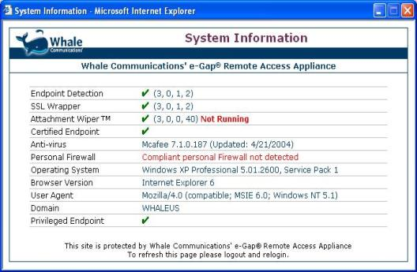
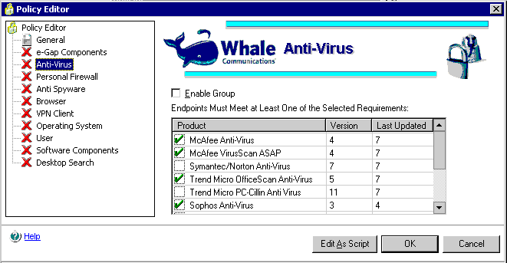
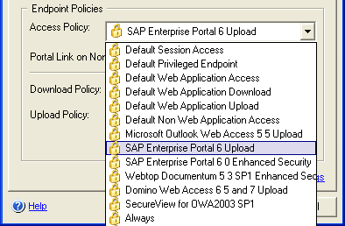

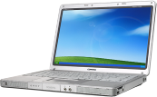
End Point Detection
Out-of-the-box support for over
70 variables of detection including
    Antivirus
    Antimalware
    Personal Firewall
  Desktop Search/Index Utilities
  And much more…
  Easy to configure GUI that allows
  simple management of policies
  Extended GUI for manual editing
  and modification of policies
  Leverage Windows Shell Scripting
  to create any policy and inspect for
  any client side variable

Slide 25
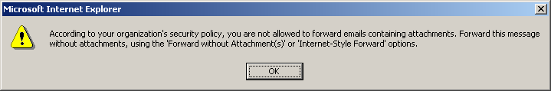

Access Policy and Control
Provide controlled access to application areas,
operations through policy definitions
Can allow or block application functions including
  Document download / upload
  Document check out / check in
  Edit document / properties
  Delete
Works at both the client and server
Example: e-mail attachment
Forwarding Problem
  Users can bypass predefined policy disallowing downloads by forwarding mail with attachments to external mail systems (e.g., Hotmail), then open attachments on non-compliant endpoints
Solution
  Forward: user who tries to use the “Forward” option (with or without attachments) will be blocked and instructed to use either “Forward without Attachment” or “Internet-Style Forward”
  Reply with History: user who tries to use this option (with or without attachments) will be blocked and instructed to use one of: “Reply”, “Internet-Style”, or “Reply without Attachment”

Slide 26
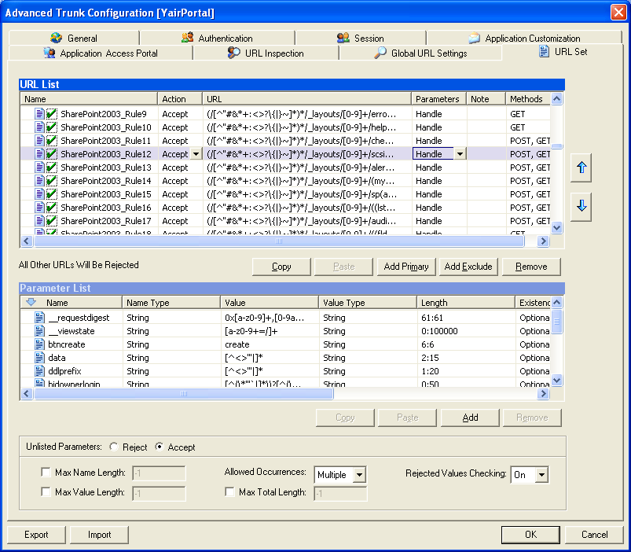
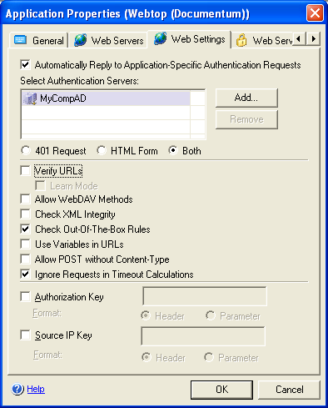
Integrated Application Firewall
Deep application-level filtering assessed through application behavior knowledge prevents exploits that cause unexpected application responses
Blocks potentially malicious traffic using positive-and negative-logic rules that identify errant commands and syntax
Out-of-the-box positive-logic
policy enforcement for
supported applications
Reduces the immediacy of server software patches (protection from zero-day attacks)

Slide 27
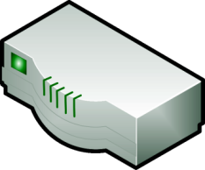





User-Specific Portals
Manages access of employees, partners & customers from anywhere to corporate business applications
  More than one Portal page can be published per appliance
  Each is based on a unique IP and host name
  Each can present a completely unique user
  experience; including look and feel, applications,
  authentication and authorization
Extends the business beyond the
borders of the network
  Implements corporate policies without
  weakening security
  Leveraging existing investments in software
  infrastructure and applications
  Ensures maximum functionality
  based on endpoint profile
Based on SSL VPN access platform
  Leverages the Web browser to allow
  universal access Provides a broad
  range of connectivity options
IT Support Center
Username:
Password:
Token:
Employee Portal
Username:
Password:
Token:
Partner Extranet
Username:
Password:
e-Commerce
Username:
Password:
IT Support
support.xyz.com
Employees
portal.xyz.com
Partners
extranet.xyz.com
Customers
shopping.xyz.com

Slide 28
Application Intelligence – Security and Access Management
Access Policies
  Allow/deny functions within application
    Uploads or downloads disabled.
    Access to management features restricted
Session Cleanup Agent
  Clears application specific cache (e.g. Citrix Cache, SharePoint Offline folder)
Protecting the Network Session
  Ignore background polling command for timeout calculation
  (e.g. check for new email), adds secure logoff button where
  absent, e.g. SharePoint as remote access portal
Protecting the Application
  Predefined positive logic rule sets for the supported
  web applications

Slide 29
Application Intelligence – Policy Management
Out-Of-The-Box Configuration
  Built in support for most popular applications, end point clients and policies
  Easy, default driven configurations
  Initial implementation in less than an hour
  Example: Configure multiple methods of authentication and filtering for Outlook Web Access,
  iNotes or SharePoint though simple GUI
Wizard-Driven Customization
  Tighten white-list and append end point client policies through wizards
  Robust authentication and user-experience options directly from GUI
  Example: Large Investment Banking Company - Allow printing through Citrix/Terminal
  Services only from corporate issued/approved laptops
Fully Customizable Configuration
  Surgical removal/alterations of application features or behavior
  Easily upgradeable and portable
  Use of XML and ASP/.NET
  Example: Large Beverage Company – Disallow any access or mention of
  attachments in iNotes from non-corporate PCs

Slide 30
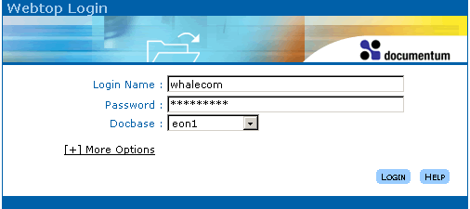
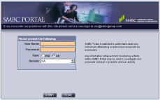
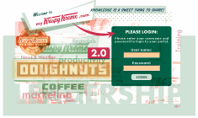
Single Sign-On
No need for directory replication
or repetition
  Alternative approaches require
  local repository
Transparent Web authentication
  HTTP 401 request
  Static Web form
  Dynamic browser-sensitive Web form
Integrates with …
  Password change management
  User repositories

Slide 31
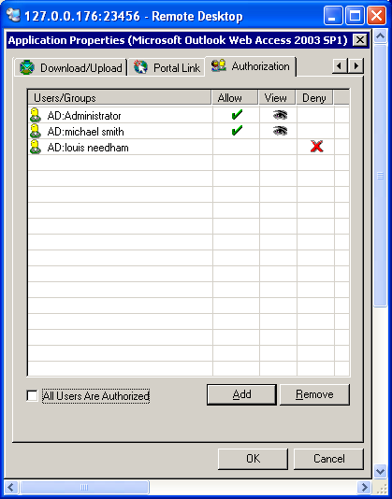
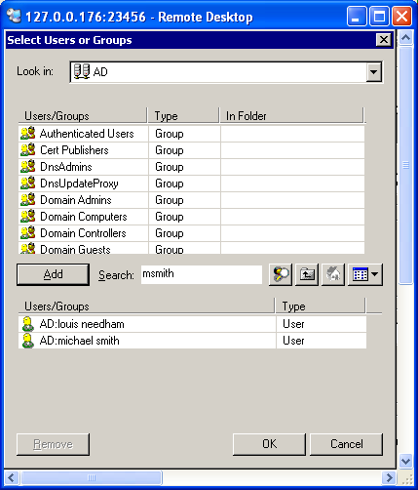
Group Authorization
Group authorization
can be tied to each individual application
Simple to use search feature allows the administrator to
select individual
users or groups from multiple repositories
for authorization
Users and or groups can be authorized for “Allow”,
“View” or “Deny” to any individual application

Slide 32


Attachment Wiper
Clears the browser’s cache upon session termination
  Process does not require user initiation
Optimizers integrate logic to identify and scrub custom caches
  Supports custom scripts for custom file cleaning
Removes
  Downloaded files and pages
  AutoComplete form contents
  AutoComplete URLs
Triggers
  User logoff
  Inactivity timeout
  Scheduled logoff
Security Policy
  Allows for “Can’t Wipe – Can’t Download” policy
  Allows fall back policy to “no-cache” tag mechanism
  Cookies
  History information
  Any user credentials
  Browser crash
  Browser closure
  System shutdown

Slide 33

Summary
Control Access
Protect Assets
Safeguard Information
An integral part of Microsoft Forefront™
Visit http://www.microsoft.com/edge/
  Learn more about how the Intelligent Application Gateway fits in the Forefront & System Center solution
  Download virtual SSL VPN appliance and environment
“Web-based remote access is becoming ubiquitous, for companies big and small. With the need to provide access from diverse endpoints to multiple applications, it is imperative that enterprises have remote access solutions that can meet expanded connection and security needs, Microsoft’s Intelligent Application Gateway
provides the functionality companies require”
– Charles Kolodgy, IDC
“Microsoft’s SSL VPN crown jewel is its intelligent Application Optimizer templates for deploying large applications, which will save hours of complex configuration for IT administrators…”
– Forrester Research INC.
Notes:
33
33

Slide 34

More Info:
Download the Virtual PC Demo today!
http://www.microsoft.com/forefront/edgesecurity/trial.mspx
Contact the IAG Team at:
  IAG2007@MICROSOFT.COM
Partners:
  Get Trained!
    US Partners:
    www.msreadiness.com/forefront
    WW Partners: https://training.partner.microsoft.com/plc/home.aspx
Notes:
10/8/2007 2:42 PM
© 2005 Microsoft Corporation. All rights reserved.
This presentation is for informational purposes only. Microsoft makes no warranties, express or implied, in this summary.
34

Slide 35


