Slide 1
Internet Explorer 8
Štěpán Bechynský
Developer Evangelist
Microsoft s.r.o.

Slide 2
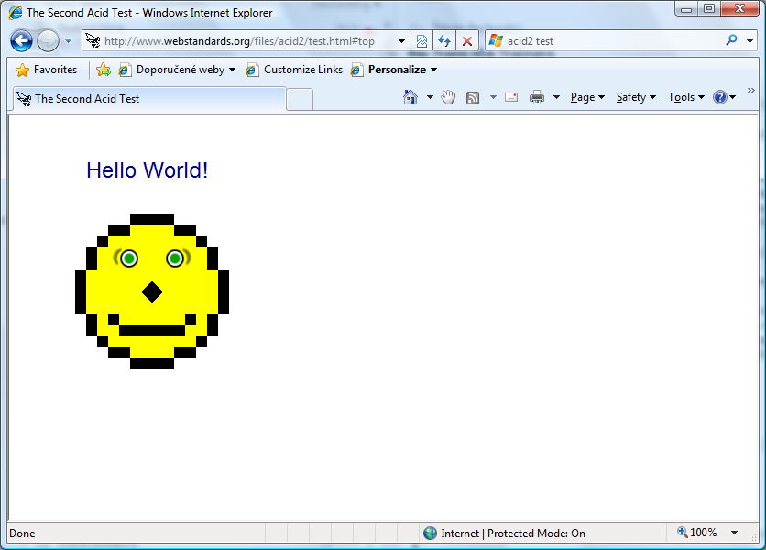

Slide 3
Kompatibilita
DOCTYPE
META Tag
  <meta http-equiv="X-UA-Compatible" content="IE=7" />
Hlavička protokolu HTTP
  X-UA-Compatible: IE=7
<!--[if gte IE 8]>

Slide 4
Vestavěné nástroje pro vývojáře
Zobrazení stromu dokumentu
CSS
Javascript
  Debug
  Call stack

Slide 5
Demo
Nástroje pro vývojáře

Slide 6
AJAX
W3C HTML 5.0
  http://www.w3.org/html/wg/html5/
AJAX Navigation
XMLHTTPRequest Enhancements
DOM Storage
Connectivity events
Cross-domain Request (XDR)
Cross-document Messaging (XDM)
Ochrana před nežádoucím kódem

Slide 7
Demo
Javascript klient pro ADO.NET Data Services

Slide 8
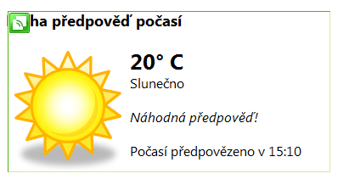
Webslices
Vychází z mikroformátu hAtom
Obdoba RSS Feed – odběr části webové stránky
<div class="hslice" id="1">
<p class="entry-title">…</p>
<div class="entry-content">…</div>
</div>

Slide 9
Demo
Webslice

Slide 10
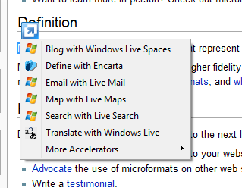
Accelerators
Rozšiřuje možnosti práce s obsahem stránky
Popis pomocí XML
Registrace
  window.external.AddService('…');

Slide 11
Demo
Accelerator

Slide 12
Search Suggestions
Našeptávač
Postaveno na Opensearch
  http://opensearch.org/
Typ URL: application/x-suggestions+xml

Slide 13
Demo
Našeptávač

Slide 14
Odkazy
http://www.microsoft.com/ie8
http://blogs.msdn.com/ie/default.aspx
Rediness Toolkit
  http://www.microsoft.com/windows/internet-explorer/beta/readiness/developers.aspx
CSS Compatibility and Internet Explorer
  http://msdn.microsoft.com/en-us/library/cc351024(VS.85).aspx

Slide 15
Demo
Co se stane, když udělá programátor chybu

Slide 16

© 2007 Microsoft Corporation. All rights reserved. Microsoft, Windows, Windows Vista and other product names are or may be registered trademarks and/or trademarks in the U.S. and/or other countries. The information herein is for informational purposes only and represents the current view of Microsoft Corporation as of the date of this presentation. Because Microsoft must respond to changing market conditions, it should not be interpreted to be a commitment on the part of Microsoft, and Microsoft cannot guarantee the accuracy of any information provided after the date of this presentation. MICROSOFT MAKES NO WARRANTIES, EXPRESS, IMPLIED OR STATUTORY, AS TO THE INFORMATION IN THIS PRESENTATION.

