Slide 1
Windows 7 Training

Slide 2
Windows® 7 Compatibility
Version Checking

Slide 3
Introduction
Most applications will function properly on Windows 7
Windows 7 is designed to run on the same hardware as Windows Vista®
The application compatibility in Windows 7 is very high
Windows 7 is Windows NT 6.1
Why?
Developers test against operating system major version. By not changing the major version number Microsoft hops to avoid new compatabilty issues

Slide 4
The Problem
Application installers might be unable to install the application
Applications might be unable to start
Applications might become unstable or crash
Applications might generate error messages, but continue to function properly
Most of the application features might work, some might fail

Slide 5
Solutions
Applications should not perform operating system version checks
If an application needs a specific feature, it is preferable to try to find the feature
If the application is valuable without the needed feature
Disable the advanced features
Notify the user to upgrade the operating system to get the full application functionality

Slide 6
Solutions
Applications should always accept version numbers greater than or equal to the lowest supported version of the operating system
Exceptions should occur only if there is a specific legal, business, or system-component requirement

Slide 7
Checking Version Incorrectly Native
OSVERSIONINFOEX osVer;
ZeroMemory(&osVer, sizeof(OSVERSIONINFOEX));
osVer.dwOSVersionInfoSize = sizeof(OSVERSIONINFOEX);
if (!GetVersionEx((LPOSVERSIONINFO) &osVer))
{
MessageBox(NULL, _T("Error in GetVersionEx."),… return 1;
}
if (osVer.dwMajorVersion != 5 || osVer.dwMinorVersion != 1)
{
MessageBox(NULL, _T("Windows XP is required."),… return 1;
}

Slide 8
Checking Version Correctly Native
OSVERSIONINFOEX osvi;
DWORDLONG dwlConditionMask = 0; int op=VER_GREATER_EQUAL;
ZeroMemory(&osvi, sizeof(OSVERSIONINFOEX));
osvi.dwOSVersionInfoSize = sizeof(OSVERSIONINFOEX);
osvi.dwMajorVersion = 5;
osvi.dwMinorVersion = 1; // Windows XP
// Initialize the condition mask.
VER_SET_CONDITION( dwlConditionMask, VER_MAJORVERSION, op );
VER_SET_CONDITION( dwlConditionMask, VER_MINORVERSION, op );
if (!VerifyVersionInfo(&osvi, VER_MAJORVERSION | VER_MINORVERSION | VER_SERVICEPACKMAJOR | VER_SERVICEPACKMINOR, dwlConditionMask)
{ // Show error }

Slide 9
Checking Version Incorrectly .NET Framework
if (Environment.OSVersion.Version !=new Version(5, 1))
{
MessageBox.Show("Windows XP required.",
"Incompatible Operating System",
MessageBoxButtons.OK,
MessageBoxIcon.Error);
return;
}

Slide 10
Checking Version Correctly .NET Framework
if (Environment.OSVersion.Version <new Version(5, 1))
{
MessageBox.Show("Windows XP or later required.",
"Incompatible Operating System",
MessageBoxButtons.OK,
MessageBoxIcon.Error);
return;
}

Slide 11
Checking For Feature Native
typedef BOOL (WINAPI *SetWaitableTimerExProc)(
__in HANDLE hTimer,
__in const LARGE_INTEGER *lpDueTime,
__in LONG lPeriod,
__in PTIMERAPCROUTINE
pfnCompletionRoutine,
__in LPVOID
lpArgToCompletionRoutine,
__in PREASON_CONTEXT WakeContext,
__in ULONG TolerableDelay
);

Slide 12
Checking For Feature Native
// Get module handle
HMODULE hKernel32Module = GetModuleHandle(_T("kernel32.dll"));
// Get Address of function
SetWaitableTimerExProcpFn = (SetWaitableTimerExProc) GetProcAddress(hKernel32Module, "SetWaitableTimerEx");
if (pFn != NULL)
pFn(hTimer, &liDueTime,
1000, NULL, NULL,
&reasonContext, 1000);

Slide 13
Checking For Feature .NET Framework
try
{
// Use Windows 7 version if possible
Win32.SetWaitableTimerEx(_hTimer, ref dueTime, period, IntPtr.Zero,
IntPtr.Zero, ref rc, 5000);
}
catch (EntryPointNotFoundException)
{
// Use SetWaitableTimer
}

Slide 14
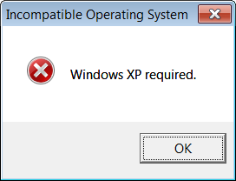
Identifying The Problem
Symptoms
Installer refuses to install the application
“Can’t install – The operating system version is incorrect”
Application refuses to start
“Can’t run – The operating system version is incorrect”
Use tools to verify
Use Compatibility View setting

Slide 15
Old System Compatibility View
Another way to identify and even overcome the problem is to use the Compatibility View
To enable the Compatibility View, right-click the shortcut or the executable file, and then apply the Windows® XP SP2 or Windows Vista Compatibility View from the Compatibility tab
IT Professionals can also apply any of the applicable VersionLie compatibility fixes with Compatibility Administrator, which installs with the Application Compatibility Toolkit (ACT)

Slide 16
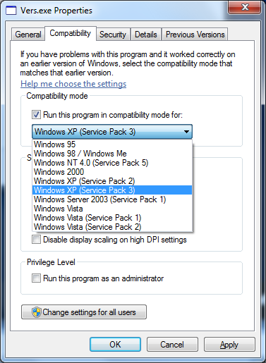
Compatibility View – User Setting

Slide 17
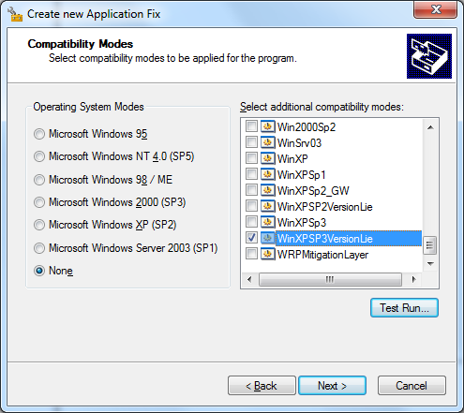
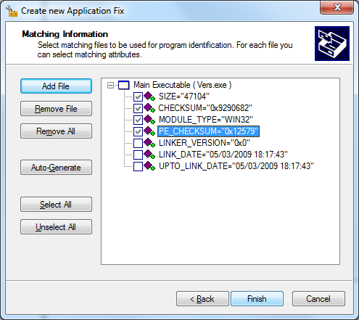
VersionLie Compatibility Fixes

Slide 18
Identifying The Problem
If the application installs and runs when applying the Compatibility View, the problem is incorrect version checking
If you are not the application developer, contact the application developer and ask for a fix
The fix is very simple!

Slide 19
Summary
Most applications will function properly on Windows 7
The application compatibility in Windows 7 is very high
Windows 7 is Windows NT 6.1
Applications should not perform operating system version checks
In any case check with >= instead of ==
Applications should try to find the needed features

Slide 20
Additional Resources
Cookbook: http://msdn.microsoft.com/enus/library/bb963893.aspx
Microsoft Application Compatibility Toolkit 5.5 Download: http://www.microsoft.com/downloads/details.aspx?FamilyId=24DA89E9-B581-47B0-B45E-492DD6DA2971
Known Compatibility Fixes, Compatibility Modes, and AppHelp Messages: http://technet.microsoft.com/en-us/library/cc765984.aspx

Slide 21
© 2009 Microsoft Corporation. All rights reserved. Microsoft, Windows, Windows Vista and other product names are or may be registered trademarks and/or trademarks in the U.S. and/or other countries.
The information herein is for informational purposes only and represents the current view of Microsoft Corporation as of the date of this presentation. Because Microsoft must respond to changing market conditions, it should not be interpreted to be a commitment on the part of Microsoft, and Microsoft cannot guarantee the accuracy of any information provided after the date of this presentation. MICROSOFT MAKES NO WARRANTIES, EXPRESS, IMPLIED OR STATUTORY, AS TO THE INFORMATION IN THIS PRESENTATION.

