Slide 1
Windows 7 Training

Slide 2
Windows® 7 Compatibility
User Account Control Virtualization
Data Redirection

Slide 3
Introduction
In Windows 7 standard users have restricted access to certain files, folders, and registry keys
Read-only access to Windows folder, Program Files, system root (typically, drive C), and boot files
Some exceptions exist, such as \Windows\Temp
Read-only access to HKEY_LOCAL_MACHINE, other registry hives
File restrictions are controlled by NTFS access control lists (ACLs)
Registry restrictions are controlled by registry ACLs

Slide 4
The Problem
Some applications write files (logs, settings, temporary files, saved state) to restricted locations
Examples: \Program Files and \Windows
Sometimes, applications only read files, but open those files with GENERIC_READ|GENERIC_WRITE flags
Same story applies for registry
Examples: HKLM\Software
Registry keys are opened for writing when they are only read
For 32-bit applications that are not marked as UAC aware, Windows redirects (virtualizes) access to a per-user location
Marking an application is done via a UAC section in the manifest
64-bit applications don’t get virtualized

Slide 5
The Problem Virtualized case
File or registry access to restricted locations by non-UAC aware applications will be virtualized
File I/O redirected to a per-user VirtualStore folder (for example, C:\Users\Bob\AppData\Local \VirtualStore)
Registry I/O redirected to a per-user location (for example, HKCU\Classes\VirtualStore)
Files and registry keys become per-user instead of being shared between users
Data saved to unexpected places
Services are exempt from UAC and won’t get redirection
Running the application as administrator will also turn off redirection
Virtualization is a temporary solution and will be removed in future versions of Windows

Slide 6
The Problem Non-virtualized case
File or registry access to restricted locations by UA-aware applications will be blocked (that is, access denied)
Redirection is disabled, so the operation will be subject to NTFS/registry ACLs which apply on the requested location (for example, \Program Files\MyApp)
Default for applications compiled under Visual Studio® 2008 (C++/.NET Framework), due to UAC manifest embedding by default

Slide 7
File Virtualization
Legacy
application
Windows Vista®
application
User mode
\Windows\App.ini
Kernel mode
Luafv.sys
\Users\<user>\AppData\Local\ VirtualStore\Windows\App.ini
\Windows\App.ini
Ntfs.sys
Access Denied

Slide 8
Registry Virtualization
Legacy
application
Windows Vista®
application
User mode
HKLM\Software\App
Kernel mode
Access Denied
Ntoskrnl.exe
HKCU\Software\Classes\VirtualStore\ Machine\Software\App
Registry

Slide 9
Solutions
Recommended
Save global (shared by all users) files to the common (or per-user, as appropriate) known folders
See code examples in the next slides
Or use AppData and LocalAppData environment variables, where APIs are unavailable
Use HKCU\Software instead of HKLM\Software
If necessary, refactor HKLM access to an elevated process

Slide 10
Getting Application Data Folder Paths Win32
#include <shlobj.h>
// link with shell32.lib
PWSTR pSzFolderPath = NULL;
if (SUCCEEDED(SHGetKnownFolderPath( FOLDERID_ProgramData, 0, NULL, &pSzFolderPath))
{
// use pSzFolderPath CoTaskMemFree(pSzFolderPath);
}

Slide 11
Getting Application Data Folder Paths .NET Framework
string folderPath = Environment.GetFolderPath(
Environment.SpecialFolder.CommonApplicationData);

Slide 12
Identifying The Problem
Symptoms
Error messages: Access Denied, ERROR_ACCESS_DENIED, 0x5, 0x80070005, E_ACCESSDENIED, UnauthorizedAccessException
Other symptoms: application crashes, hangs, data not being saved
Use tools to verify
Windows SysInternals Process Monitor
LUA Buglight

Slide 13
Identifying The Problem
Run tests to verify
Go to the VirtualStore folder or VirtualStore registry key (as appropriate) and look for your files or registry keys there
%localappdata%\VirtualStore (file system)
HKCU\Software\Classses\VirtualStore (registry)
Run the application elevated (Run as administrator)
Virtualization is disabled, writing to privileged locations succeed
Caveat: Application won’t find files or registry keys previously redirected to the VirtualStore
Add a UAC manifest to disable virtualization
You’ll get an access denied error, possibly simplifying the process of finding the responsible code\

Slide 14
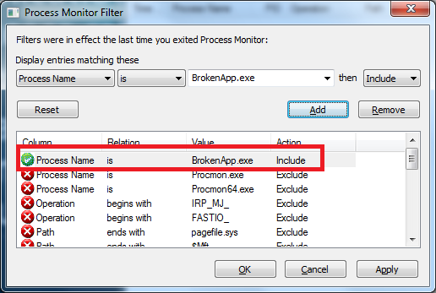
Identifying The Problem Process monitor
Run and set up filter to include your application’s process name

Slide 15
Identifying The Problem Process monitor
Enable capturing file or registry events only
Press Ctrl-E to suspend or resume capturing
Look at the magnifying glass icon for current status: (shown enabled)
Press Ctrl-X to clear the log
Run the scenario in your application which results in a virtualized write while capturing is enabled

Slide 16
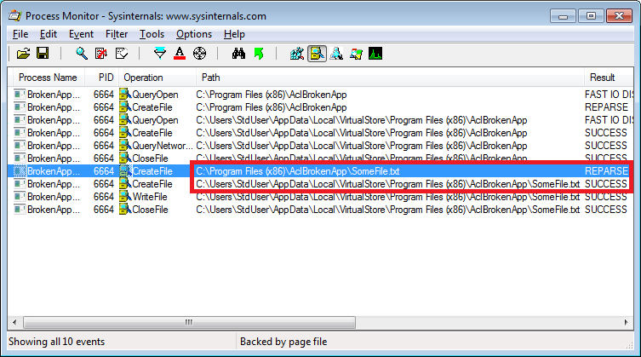
Identifying The Problem Process monitor
Look at the Results column, search for operations with result REPARSE

Slide 17
Identifying The Problem Process monitor
If you see a REPARSE operation, it is a good indication that this operation was subjected to virtualization
The next line (with result SUCCESS) will usually show the new path
Double-click the operation with result REPARSE and click the Stack tab

Slide 18
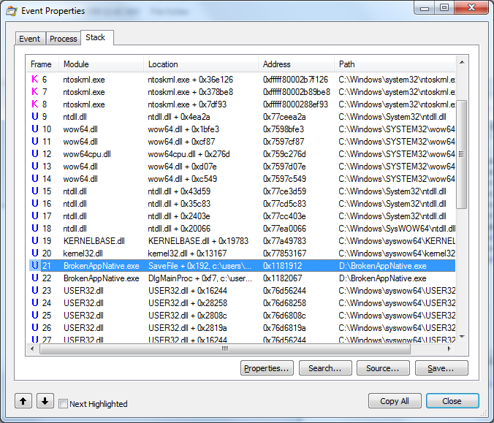
Identifying The Problem Process monitor
The call stack shown is the one at the moment of the operation
Use it to find the function in your code which is responsible for the write

Slide 19
Summary
Why UAC virtualization
When it applies
Problems
How to fix
Native and managed APIs
Environment variables
How to diagnose
List of suggested tests
List of tools
Diagnosing with Process Monitor

Slide 20
Additional Resources
Windows Vista Application Compatibility: UAC: Standard User Changes: http://msdn.microsoft.com/en-us/library/bb963893.aspx
Common file and registry virtualization issues in Windows Vista: http://support.microsoft.com/kb/927387
New UAC Technologies for Windows Vista: http://msdn.microsoft.com/en-us/library/bb756960.aspx
Inside Windows Vista User Account Control: http://technet.microsoft.com/en-us/magazine/2007.06.uac.aspx

Slide 21
© 2009 Microsoft Corporation. All rights reserved. Microsoft, Windows, Windows Vista and other product names are or may be registered trademarks and/or trademarks in the U.S. and/or other countries.
The information herein is for informational purposes only and represents the current view of Microsoft Corporation as of the date of this presentation. Because Microsoft must respond to changing market conditions, it should not be interpreted to be a commitment on the part of Microsoft, and Microsoft cannot guarantee the accuracy of any information provided after the date of this presentation. MICROSOFT MAKES NO WARRANTIES, EXPRESS, IMPLIED OR STATUTORY, AS TO THE INFORMATION IN THIS PRESENTATION.

