Slide 2
Windows Server 2008 R2 Group Policy Changes
Michael Kleef
Program Manager
Microsoft
Session Code: WSV326

Slide 3
Session Objectives
Session Objectives:
  Quick review of new GP features in Windows Server 2008 & Windows Vista SP1.
  In depth understand what Group Policy changes have been made to Windows 7
Takeaway
  GP in Windows 7 / Windows Server 2008 R2 is incremental, not major change

Slide 4
















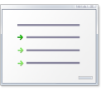






Background
How Group Policy works now...
Group Policy Service
GP now runs in a shared service
Hardened Service, more reliable
Windows Vista/Windows Server 2008
Group Policy Process
Part of Winlogon
Group Policy Templates
ADM Templates now in
ADMX files (ADMX, ADML)
Templates
ADM templates difficult to manage
ADM
ADM
ADM
ADM
ADM
ADMX
ADM
Local GPOs
Limited flexibility with a single local GPO
Multiple Local GPOs
Settings
~1,800 policy settings in XP
Incomplete coverage means missing key scenarios
Group Policy Settings
Over 800 new policy changes
with Windows Vista
Extended GP for new Windows
Vista features
LGPO’s
LGPO’s
LGPO
LGPO
Local Computer Policy
Local Computer Policy
Admin
Admin/Non-Admin Group Policy
User
User Specified Group Policy
Network
Limited awareness of changing network conditions
Network Location
Awareness (NLA)
NLA service provides the latest
network information
Applications can query or register with
NLA for network change indications
Templates and Replication
Journal Wrap anyone? Bloated SYSVOL?
Group Policy Central Store
Centralized repository for ADMX
Created in the Sysvol on DC
in each domain
New Replicator with DFS-R
ADMX
ADML
Troubleshooting
Userenv log
GP Result
SysVol
Group Policy Logging
Administrative log
Applications and Services log
XML based event logs
New Tools - GPOLogView
DC
DC
SysVol
+
Policies
+
GUID
+
ADM
+
Policy Definitions
FRS/DFS-R
ADMX, ADML Files

Slide 5
Overview
What is new?
GP PowerShell features
  Adding to GP scripts extensions
  PowerShell cmdlets to perform GP operations
Starter GPOs in-box in Windows 7
  Best practices that map to the security guide
ADMX enhancements
GP Preferences enhancements
  GP Preferences, new in Windows Server 2008
  New items added to support new OS functionality

Slide 6
Powershell In and Out
PowerShell Scripting inside GP
  Extend current reach of GP Script Extension to include PowerShell for logon/logoff, startup/shutdown scripts
Powershell Cmdlets for GPMC operations
  Full lifecycle: create, link, rename, backup, copy, remove
  Enables interesting new scenarios for customers
Powershell Cmdlets that write and read registry settings to GPO(s)
  Values can be written to either Policy or Preferences
  Settings can accept more value types

Slide 7
GP Powershell Cmdlets
Import-module GroupPolicy
get-help *-gp*
New
New-GPLink
Get
Get-GPInheritance
Set
Set-GPInheritance
New-GPO
New-GPStarterGPO
Get-GPO
Get-GPOReport
Get-GPPermissions
Get-GPPrefRegistryValue
Get-GPRegistryValue
Get-GPResultantSetofPolicy
Get-GPStarterGPO
Set-GPLink
Set-GPPermissions
Set-GPPrefRegistryValue
Set-GPRegistryValue
Remove
Remove-GPLink
Remove-GPO
Remove-GPPrefRegistryValue
Remove-GPRegistryValue
Misc
Backup-GPO
Copy-GPO
Import-GPO
Rename-GPO
Restore-GPO

Slide 8
PowerShell Examples
Backup all GPOs in current domain to directory
Backup-GPO –all –path ‘C:\BackupFiles\’
Get RSOP for local computer and logged on user in html form
Compare values across GPO’s
Get-GPResultantSetofPolicy -ReportType -html -Path D:\ConfigDocuments\Reports\
$A =get-GPRegistryValue –Name GPO1 –key $reg_keypath –ValueName ScreenSaveTimeOut
$B =get-GPRegistryValue –Name GPO2 –key $reg_keypath –ValueName ScreenSaveTimeOut
$reg_keypath = “HKCU\Software\Policies\Microsoft\Windows\Control Panel\Desktop”
$A[0].equals($B[0])
Grant permission to ‘Apply’ to a GPO for all users belonging to a group
Get-ADGroupMember DlgtdAdmins | where {$_.objectclass -eq "user"} | %{Set-GPPermissions -Name 'Test GPO' -PermissionLevel Apply -TargetName $_.SamAccountName -TargetType User}

Slide 9
Powershell
demo

Slide 10
Starter GPOs
Easy experience out-of-the-box
  Embody best practices that map to Microsoft security guide
8 System Starter GPOs:
  User and Computer case
  Available for Vista and XP SP2
  Enterprise Client (EC) and Specialized Security Limited Functionality (SSLF)
System vs Custom
  Static / Editable
  ADMX / Security Settings

Slide 11
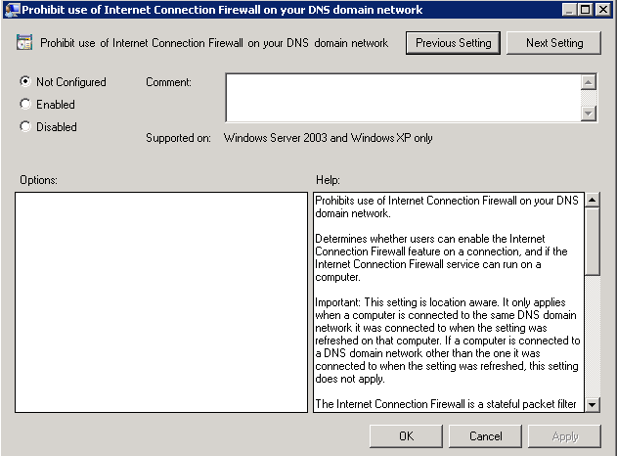
ADMX Improvements
New UI: More intuitive, integrated help content, no more tabs
Support for:
REG_MultiSZ
REG_QWORD

Slide 12
Starter GPOs & ADMX UI
demo

Slide 13
GP Preferences
Preference Settings
  Not true “Policy”
More control of desktop – more settings!
  Not limited to policy-aware applications
Ease of administration through rich UI
Better targeting
New in Windows 7
  Support for new Power Plan settings
  Support for new Schedule task triggers, actions, etc.

Slide 14
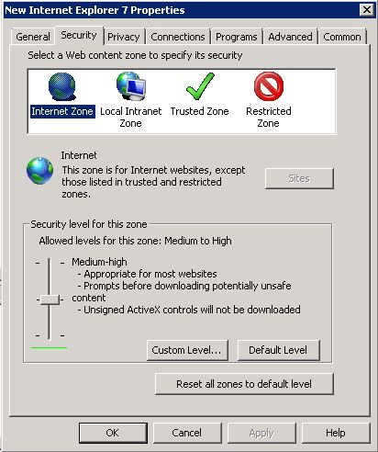
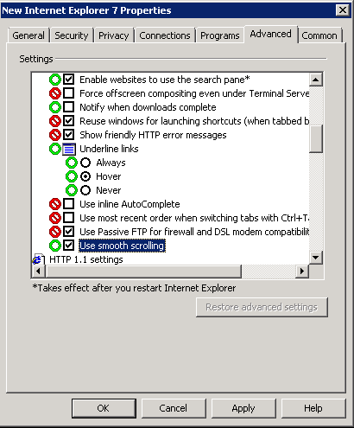
Richer UI
Familiar Experience
  Clearer to understand
  and find
  Easy to manage
  Better control of individual
  settings – Red/Green
Powerful browsers
  Avoids typing errors
  Configure settings quicker

Slide 15
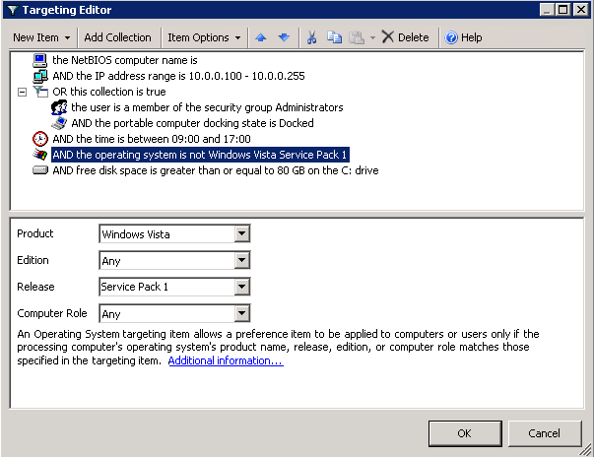
Better Targeting
Robust targeting
29 types
Boolean logic (And, Or, Not)
Collections
Item level targeting, not GPO level
Intuitive UI
No need to learn query languages

Slide 16
ADMX and Preferences
demo

Slide 17
What is new in ADMX
3000 Total ADMX settings
300 new ADMX settings
  IE more than 90 new
  Bitlocker
  Taskbar
  Power
  Terminal Services rebranded
  “Remote Desktop Services”
Settings Spreadsheet

Slide 18
What about Security Settings?
12 settings added under Security Options
  Restrict NTLM (multiple)
  Kerberos encryption types
  Local System null session fallback
Only supported on Windows 7 & Windows Server 2008 R2
Settings Spreadsheet

Slide 19
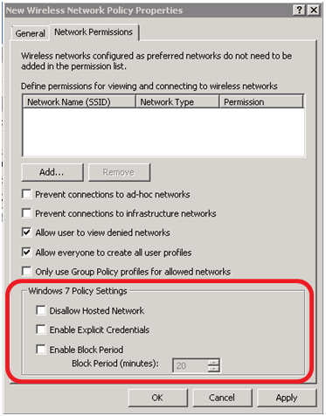
Anything else?
Wireless Network (IEEE 802.11) Policies
Public Key Policies
  Certificate Services Client - Certificate Enrollment Policy
  BitLocker Drive Encryption
Network Access Protection
  Enforcement Clients: Removed RAQ EC and TS Gateway
  Enforcement Clients: Added RD Gateway QEC
Application Control Policies – AppLocker
  More info
Advanced Audit Policy Configuration
  More info
Name Resolution Policy

Slide 20
FAQ’s
What about any server dependencies?
Are there any schema changes required?
What about the Vista Central Store?
Will ADMX create an impact on my policies?

Slide 21
FAQ’s
Does policy itself replicate any differently?
Is it actually stored any differently?
Do you still use the same tools to diagnose replication issues like Ultrasound (FRS)?
With the move from Winlogon to a service does this mean users can deny policy applying?
Any impact for co-existence between Windows Server 2003 GP and Windows Server 2008 and onwards?

Slide 22
FAQ’s
Will I have to recreate all the policies again for Windows 7?
Can I drop ADM files into the Central Store?
Do we have plans to provide an updated GPMC/GPOE to support Windows XP administrative PC’s with ADMX and the Central Store?
Is it a good idea to separate Vista GPO from the Windows XP GPO's through new OUs or filtering with WMI?
Is there any way to restrict editing GPOs from certain OS versions ? i.e.: restrict editing from anything below W2K3 ?

Slide 23
Deployment
Guidance
Firewall Policy
  Will apply the most permissive rule
  Best Practice: Separate Policy for Windows Vista/7 machines
IPSEC Policy
  Old UI for pre-Vista
  New UI for Vista
  Best Practice: Separate Policy for Windows Vista machines
Three methods for policy separation
  Grouping (Read/Apply control)
  Separate OU with GPO link
  WMI Filter
    Select * FROM <WMI_CLASS> WHERE <WMI Property>=<value>
    Select * FROM Win32_OperatingSystem WHERE Caption="Microsoft Windows XP Professional" AND CSDVersion="Service Pack 2"

Slide 24
Deployment
Guidance
Auditing Policy
  Totally different in XP to Vista and Windows 7/2008 R2
  Fine Grained (Vista/W7) as opposed to clumsy and awful (XP)
  Separate it

Slide 25
blogs.technet.com/mkleef
question & answer

Slide 26




Resources
www.microsoft.com/teched
  Sessions On-Demand & Community
www.microsoft.com/learning
Microsoft Certification & Training Resources
http://microsoft.com/technet
  Resources for IT Professionals
http://microsoft.com/msdn
  Resources for Developers
www.microsoft.com/learning
Microsoft Certification and Training Resources

Slide 27
Resources
Link to Group Policy TechNet page
http://www.microsoft.com/technet/grouppolicy
Group Policy Team Blog
http://blogs.technet.com/grouppolicy
Deploying Group Policy Using Windows Vista
http://go.microsoft.com/fwlink/?LinkId=77080
Group Policy Settings Reference Windows Vista
http://go.microsoft.com/fwlink/?LinkId=54020
Step-by-Step Guide to Managing Multiple Local Group Policy Objects
http://go.microsoft.com/fwlink/?LinkId=73434
How to troubleshoot Group Policy using Event logs
http://go.microsoft.com/fwlink/?LinkId=74139

Slide 28
Related Content
WCL308: MDOP: Managing GPOs with Advanced Group Policy Management (AGPM) 3.0
WCL18-HOL Managing Windows Internet Explorer 8 Security Settings in the Enterprise
WCL11-HOL Microsoft Desktop Optimization Pack: Advanced Group Policy Management
WCL20-HOL Deploy and Manage Windows Internet Explorer 8

Slide 29

Windows Server Resources
Required Slide
Track PMs will supply the content for this slide,
which will be inserted during
the final scrub.
Make sure you pick up your copy of Windows Server 2008 R2 RC from the Materials Distribution Counter
Learn More about Windows Server 2008 R2:
www.microsoft.com/WindowsServer2008R2
Technical Learning Center (Orange Section):
Highlighting Windows Server 2008 and R2 technologies
Over 15 booths and experts from Microsoft and our partners

Slide 30
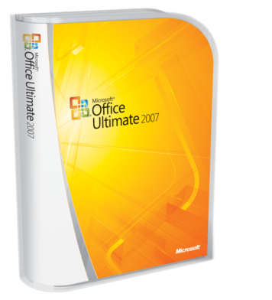




Complete an evaluation on CommNet and enter to win!

Slide 31

© 2009 Microsoft Corporation. All rights reserved. Microsoft, Windows, Windows Vista and other product names are or may be registered trademarks and/or trademarks in the U.S. and/or other countries.
The information herein is for informational purposes only and represents the current view of Microsoft Corporation as of the date of this presentation. Because Microsoft must respond to changing market conditions, it should not be interpreted to be a commitment on the part of Microsoft, and Microsoft cannot guarantee the accuracy of any information provided after the date of this presentation. MICROSOFT MAKES NO WARRANTIES, EXPRESS, IMPLIED OR STATUTORY, AS TO THE INFORMATION IN THIS PRESENTATION.

