Slide 2
Windows Server 2008 R2:
Hyper-V
Corey Hynes
Technical Lead
HynesITe
Jeff Woolsey
Principal Group Program Manager
Windows Server, Hyper-V
WSV328

Slide 3
Agenda
Microsoft Virtualization Strategy/Portfolio
Overview of Windows Server 2008 R2 Hyper-V
Features, features, features!
System Center Virtual Machine Manager R2
Microsoft Hyper-V Server 2008 R2
Q & A

Slide 4


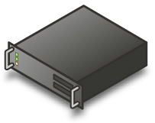
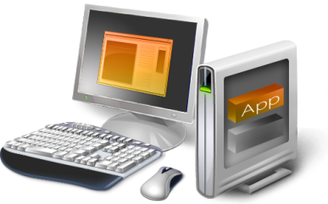
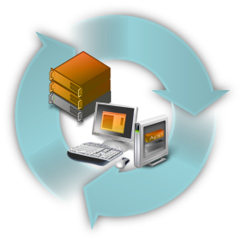
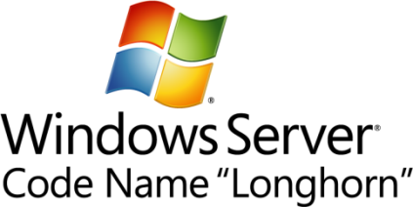




Microsoft Virtualization Strategy
It’s the Platform you know
Data center to desktop
End-to-End Management
Best TCO/ROI
Key feature
of platform
Full range of products & solutions
Physical and Virtual & Cross-hypervisor
1/3 the price
up front
Tools
you know
Large partner
eco-system
Interoperability
Lower ongoing costs

Slide 5

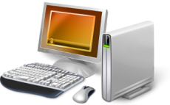
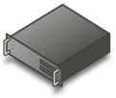
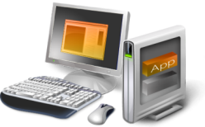


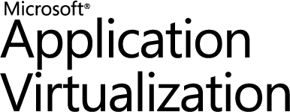




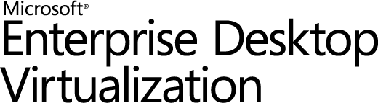
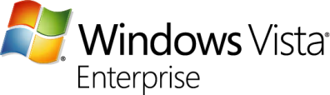
Microsoft Virtualization Products
From the datacenter to the desktop
Server
Virtualization
Application
Virtualization
Presentation
Virtualization
“Having one vendor for the hypervisor, operating system, and much of our application software was very appealing to us from a support and cost perspective.”
Bert Van Pottelberghe,
Sales Director, Hostbasket
Desktop
Virtualization
User State
Virtualization
Document Redirection and Offline Files

Slide 6
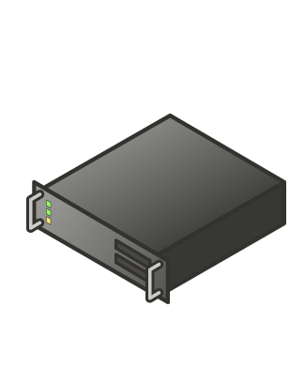
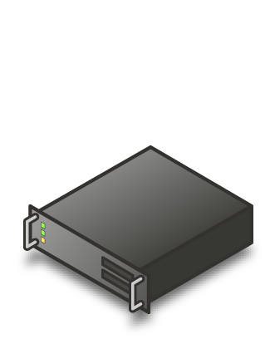
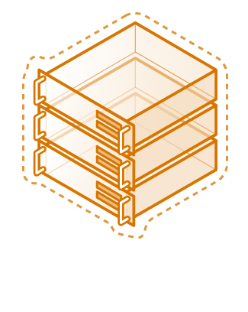
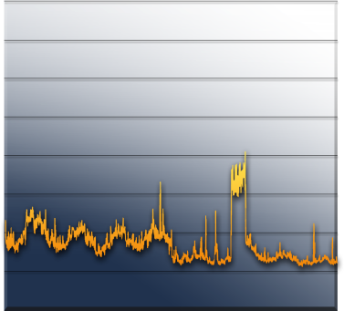
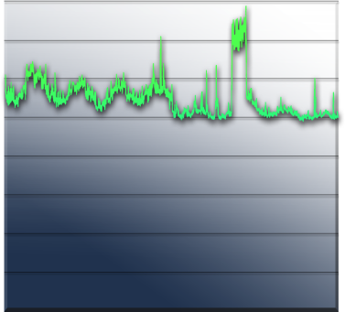
Server Consolidation
The fastest way to reduce costs
Challenges:
Underutilized hardware
Excessive power consumption
Expensive space across datacenter and branch offices
“We expect to consolidate an additional 75 servers using Hyper-V, which will lead to a cost savings of more than $325,000 annually. By the time we hit our fifth virtual machine, we’ve usually paid for the host.
Long term, we will be able to reduce our total data center holdings by 75 percent—from nearly 400 servers to fewer than 100 servers.”
Robert McShinsky Senior Systems Administrator, Dartmouth-Hitchcock Medical Center
Server Utilization

Slide 7
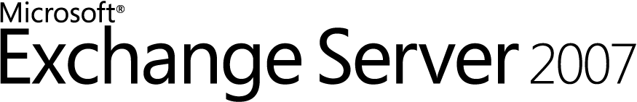

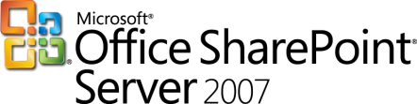

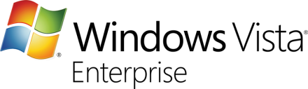

Virtualized Workloads
Microsoft fully supports our key server applications in a virtualized environment
Microsoft has updated server workload licensing to enable virtualization mobility
Management of the workloads is key, not just the virtual machine
“Maxol runs Exchange Server 2007, SQL Server 2005, Terminal Services, and file and print servers as key workloads in its virtual environment. Going forward, nearly every business application at Maxol will be a candidate for virtualization.”
Maxol Case Study
“We’ve seen first-hand that we can virtualize everything from file, print, and web servers to database servers running SQL Server and Oracle, and actually have the virtual machine run *faster* than what it ran on our original physical box.”
Janssen Jones, Indiana University

Slide 8
Windows Server 2008 R2
Hyper-V

Slide 9




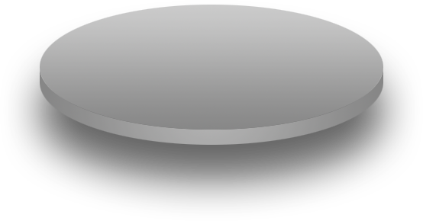




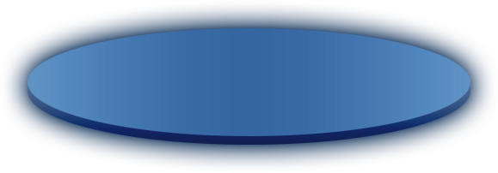
Windows Server 2008 R2 Hyper-V
Building on the rock-solid architecture of Windows Server 2008 Hyper-V
Integration with new technologies
Enabling new dynamic scenarios:
  Increased Server Consolidation
  Dynamic Data Center
  Virtualized Centralized Desktop
Customer Driven

Slide 10
Live Migration

Slide 11
Live Migration
#1 Customer Request
Moving a virtual machine from one server to another without loss of service
Enables new dynamic scenarios
  Load balancing VMs via policy

Slide 12
Live Migration
Live Migration via Cluster Manager
  In box UI
Live Migration via Virtual Machine Manager
  Orchestrate migrations via policy
Moving from Quick to Live Migration:
  Guest OS limitations?: No
  Changes to VMs needed?: No
  Changes to Storage infrastructure: No
  Changes to Network Infrastructure: No
  Update to Windows Server 2008 R2
  Hyper-V: Yes

Slide 13
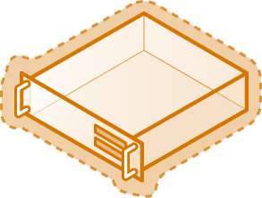

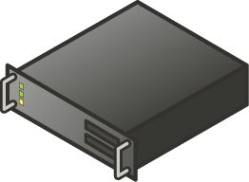

Live Migration
Create VM on target server
Copy memory pages from the source to the target via Ethernet
Final state transfer
  Pause virtual machine
  Move storage connectivity from source host to target host via Ethernet
Run new VM on source; Delete VM on target
Host 1
Host 2
Blue = Storage
Yellow = Networking
Shared Storage

Slide 14
Live Migration Memory Internals
Worker process on source host creates “dirty bitmap” of memory pages
  Iterates over pages, sending them to
  target worker process
  Registers for modify-notifications on pages to
  detect subsequent changes
    Source VM still active and can be modifying memory
  Repeats over newly modified pages
Stops iterating when one of the following:
  All pages sent
  Makes 10 passes

Slide 15
Live Migration Operation
Memory
Memory
Configuration
Configuration
State
State
Server 1
Server 2

Slide 16
Migration & Storage
Windows Server 2008 R2 Hyper-V
  NEW Cluster Shared Volume (CSV)
  CSV provides a single consistent file name space;
  All Windows Server 2008 R2 servers see
  the same storage
    Easy setup; Uses NTFS
    No reformatting SANs
    Create one big data store
    No more drive letter problems
    Existing tools just work

Slide 17
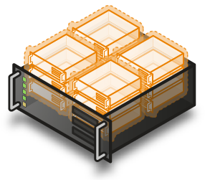
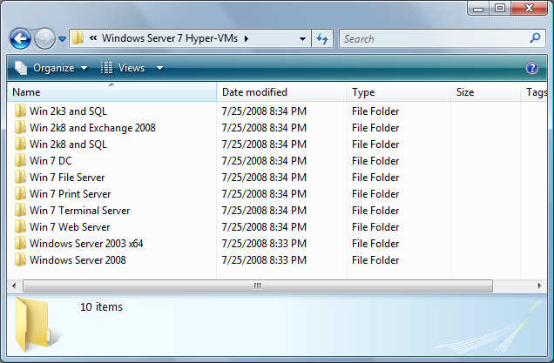

Cluster Shared Volumes
All servers “see” the same storage

Slide 18





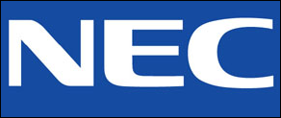

Failover Cluster Configuration Program (FCCP)
New for Windows Server 2008 Failover Clustering
Customers have the flexibility to design failover cluster configurations
  If the server hardware and components are logo’d and…
  it passes the cluster validation tool, it’s supported!
Or customers can identify cluster-ready servers via the FCCP
  OEMs have pre-tested these configurations and list them on the web
  Microsoft recommends customers purchase FCCP-validated servers
Look for solutions with this tagline:
  “Validated by Microsoft Failover Cluster Configuration Program”

Slide 19
New Processor
Feature Support

Slide 20
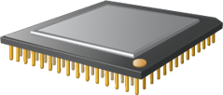
64 Logical Processor Support
Overview
  Provides Hyper-V the ability to utilizes up to 64 of the logical processor pool presented to Windows Server 2008 R2
Benefits
  Significantly increase host
  server density
  Easily provide multiple processors per virtual machine

Slide 21
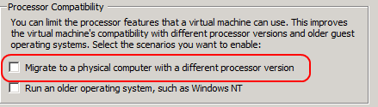

Processor Compatibility Mode
Overview
  Allows live migration across different CPU versions within the same processor family (i.e. Intel-to-Intel and AMD-to-AMD)
    Does NOT enable cross platform from Intel to AMD or vice versa
  Configure compatibility on a per-VM basis
  Abstracts the VM down to the lowest common denominator in terms of instruction sets available to the VM.
Benefits
  Greater flexibility within clusters
  Enables migration across a broader ranger of Hyper-V host hardware

Slide 22
VM Memory Management
Today, processors provide one level of
address translation, but hypervisor
needs to manage two
Guest Virtual Address
Guest Virtual Address
Guest OS defines GVA-to-GPA mappings
Shadow page tables combine these mappings because the processor knows how to perform only one level of translation
Guest Physical Address
Hypervisor defines GPA-to-SPA mappings
System Physical Address
System Physical Address

Slide 23
Shadow Page Tables
Hypervisor maintains a Shadow Page Table
  Combines two layers of translation into a
  single page table
  Demand-filled when Child OS touches a page
  Flushed any time the Child OS modifies
  its page tables
Shadow Page Table overhead
  Fills and flushes invoke the hypervisor
  Can account for up to 10% of total CPU time
  Consumes roughly 1MB of memory per VM

Slide 24
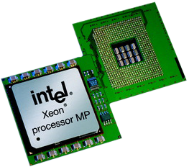

Second Level Address Translation
(SLAT)
Goes by several names
  Intel calls it Extended Page Tables (EPT)
  AMD calls it Nested Page Tables (NPT) or
  Rapid Virtualization Indexing (RVI)
Processor provides two levels of translation
  Walks the guest OS page tables directly
  No need to maintain Shadow Page Table
  No hypervisor code for demand-fill or flush operations
Resource savings
  Hypervisor CPU time drops to 2%
  Roughly 1MB of memory saved per VM

Slide 25

Windows Server 2008 R2
Core parking
Overview
  Scheduling virtual machines on a single server for density as opposed to dispersion
  This allows “park/sleep” cores by putting them in deep C states
Benefits
  Enhances Green IT by reducing
  CPU power consumption

Slide 26
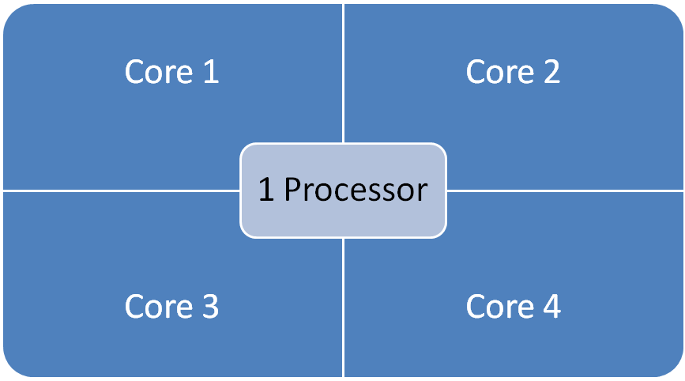
Windows Server 2008
16 LP Server

Slide 27
Windows Server 2008 R2 Core Parking
16 LP Server
Processor is “parked”
Processor is “parked”

Slide 28
Hyper-V Virtual Storage

Slide 29
Hot Add/Remove Storage
Overview
  Add and remove VHD and pass-through disks to a running VM without requiring a reboot.
    Hot-add/remove disk applies to VHDs and pass-through disks attached to the virtual SCSI controller
Benefits
  Enables storage growth in VMs without downtime
  Enables additional datacenter backup scenarios
  Enables new SQL/Exchange scenarios

Slide 30
Hyper-V Networking

Slide 31
Networking
TCP Offload support
Overview
  TCP/IP traffic in a VM can be offloaded to a physical NIC on the host computer
Benefits
  Reduce CPU burden
  Networking offload to improve performance
  Live Migration is supported with Full TCP Offload

Slide 32
Networking
Virtual Machine Queue (VMQ) Support
Overview
  NIC can DMA packets directly into VM memory
    VM Device buffer gets assigned to one of the queues
    Avoids packet copies in the VSP
    Avoids route lookup in the virtual switch (VMQ Queue ID)
  Allows the NIC to essentially appear as multiple NICs on the physical host (queues)
Benefits
  Host no longer has device DMA data in its own buffer resulting in a shorter path length for I/O (performance gain)

Slide 33
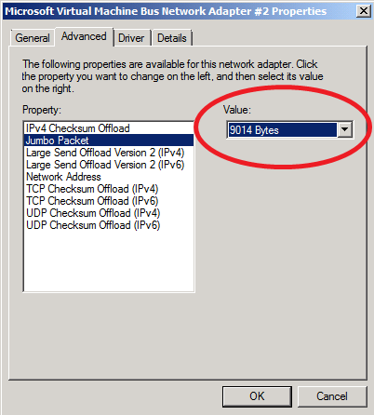
Networking
Jumbo Frame Support
  Ethernet frames >
  1,500 bytes
  Ad hoc standard is ~9k
Overview
  Enables 6x larger
  payload per packet
Benefits
  Improves throughput
  Reduce CPU utilization
  of large file transfers

Slide 34
Hosted Desktops aka Virtual Desktop Infrastructure(VDI)
Corey Hynes
HynesITe

Slide 35

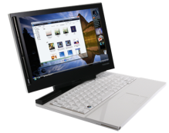
Desktop Virtualization – a key enabler
Focus: Reducing Costs
Roaming Profiles
Folder Redirection
Data, User settings
Microsoft Application Virtualization
Applications
Local Desktop Virtualization
OS
Microsoft Remote Desktop Services
Microsoft Virtual Desktop Infrastructure
Microsoft Enterprise Desktop Virtualization
Remote Desktop Virtualization
Hardware
Traditional Client Computing
Focus: Increasing Flexibility

Slide 36






Using Desktop Virtualization Effectively
Managed Desktops
Managing Unmanaged Desktops
Task
Office
Mobile
Work from home
Contractor / Offshore
Lay the foundation for desktop optimization
User State Virtualization
Microsoft Application Virtualization
Shared Remote Desktops
(RDS)
Personalized Remote Desktops
(VDI)

Slide 37


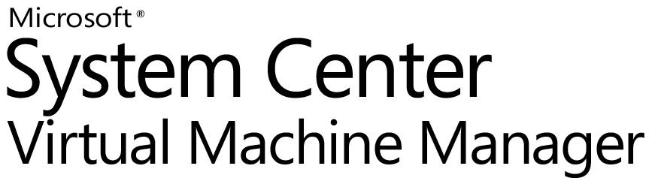
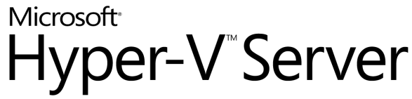
What is VDI
    What is it?
User PC or Thin Client
Server
    Running users’ desktops in server-based virtual machines and making them available remotely over a network
Presentation
Virtual Desktop
User State
Applications
  Key Benefits
Desktop experience is centralized and gets delivered to user’s PC or thin client
OS
  Access to data and applications from any device in the organization
  Improve data security and compliance
  Simplify management and deployment of applications
Hyper-V
Server OS
Virtual Machine Manager is a comprehensive management solution for the virtualized datacenter.
Windows Server Hyper-V, is the next-generation server virtualization technology.

Slide 38
Two VDI Solutions
Pooled Desktops
  Set of shared desktops
  User state is temporary (discarded at session end)
  Preservation of data is done via “roaming” technologies | Folder Redirection, Profiles, etc.
Personalized Desktops
  Closest to physical
  One VM per user
  Different options for user state | In VM,
  roaming, etc.

Slide 39
Citrix?
R2 provides VDI in box
XenDesktop is more scaleable, for
enterprise implementations
Differences
  R2 relies on SCVMM to provision individual desktop VHD’s, even in pooled scenarios.
  XenDestkop uses shared vDisks over multiple VM’s, quicker, lighter provisioning
  XenDestkop has more features for
  VDI management

Slide 40
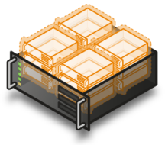
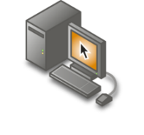

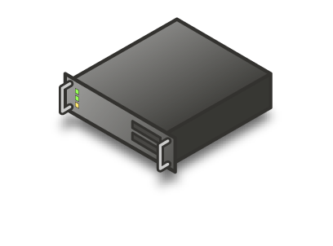
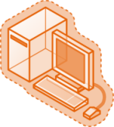
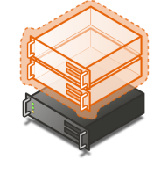


Connection Broker Infrastructure
TS Gateway
TS Session Broker
TS Users
Remote
TS Farm
Storage
Hosted Desktop
Users (Remote)
Hyper-V Farm
Hosted Desktop Users
TS Users

Slide 41
VDI in R2
Components
  RD WebAccess presents unified view
  Active Directory holds user desktop assignments
  RD Connection Broker collects and publishes all things a user can do
  RDS as Redirector proxies RDP connection to desktop
  RD Virtualization starts requested desktop on behalf of RD Connection Broker
  Client connects directly to VM via RDP
  Entire flow is RD Gateway friendly
Show me

Slide 42
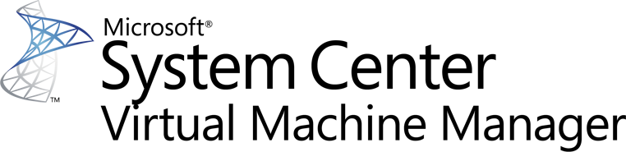

Slide 43
VMM 2008 R2 Objectives
Support New Features From Windows Server 2008 R2 and Microsoft Hyper-V R2
Address Major Customer Asks
Further Improve Customer Experience With Bug Fixes and Feature Enhancements

Slide 44
System Center Virtual Machine Manager 2008 R2
VMM 2008 Features
Hypervisor Management - Hyper-V, VMware | Cluster Integration
Host Configuration | Intelligent Placement
Library Management | Deployment and Storage
Virtual Machine Creation/Provisioning | Monitoring and Reporting
Conversions: P2V and V2V | Automation with PowerShell
Delegation and Self Service | Performance and Resource Optimization
New in VMM R2
Management of Windows Server 2008 R2 and Microsoft Hyper-V R2 | Multiple Virtual Machines Per LUN
Live Migration | Cluster Shared Volumes
Storage Migration | Maintenance Mode
SAN Related Enhancements | Network Optimizations
Hot Add of Storage | Rapid Provisioning

Slide 45
Storage Migration
Ability To Migrate VM Storage to New Location
VMM R2 Adds Support For Storage Migration
  Adds Quick Storage Migration for Hyper-V
  Enables storage vMotion for VMWare
Example Usage: Consolidation of VM Storage
  Prior to VMM R2, One VM Per LUN
  With CSV, VMs can Be Consolidated Into a Single CSV LUN
  Using QSM, VM Storage Can Be Migrated With Minimal Downtime

Slide 46
Comparing QSM with Storage vMotion
Quick Storage Migration
Storage vMotion
Migrate Virtual Machine Along With Storage
Yes
No
Zero downtime
No
Yes
Migrate Virtual Machines with Snapshots
Yes
No
Provided Without Additional Licensing
Included in Workgroup & EE Editions starting at $500 per server
Only Available in EE/EE+ starting at $2875 per proc

Slide 47
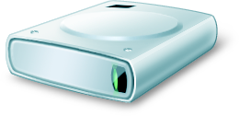
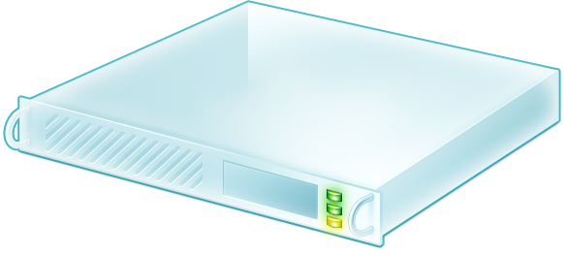
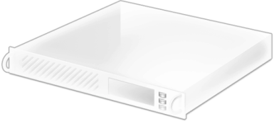
Quick Storage Migration
Source Disk
Destination Disk
Quick Storage Migration Enables VM Migration from one storage infrastructure to another!

Slide 48
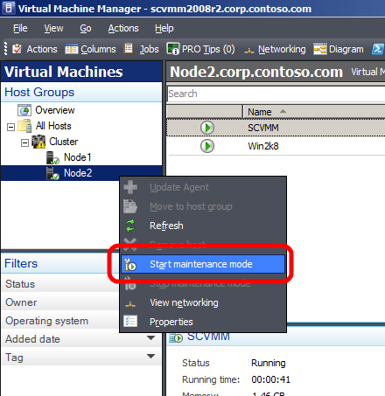
Maintenance Mode
VMM R2 allows host servers
to be put into a
maintenance mode
  Useful for servicing hardware,
  software or power energy
  management
  If host is clustered VMs running
  on the host are automatically
  live migrated to other hosts
  If host is standalone admin
  can choose to save state or
  shutdown VMs
Placement
  Host in maintenance mode gets zero
  star ratings
Supported for Hyper-V, Virtual
Server and VMWare Hosts

Slide 49
VMM 2008 R2 Timeline
Beta - Released in March ’09
RC - May ’09
RTM - 60 Days After Windows Server 2008 R2 RTM

Slide 50
Microsoft Hyper-V
Server V2

Slide 51
Microsoft Hyper-V Server 2008
Simplified, optimized and free
  Provides basic virtualization capabilities
  Great stand-alone hypervisor-based virtualization product
Streamlined
  Micro-kernelized hypervisor
Easily integrates into existing infrastructure
  Active Directory integration
  Leverage existing management tools (e.g,: System Center Virtual Machine Manager 2008)
  Leverage existing support tools & processes
  Leverage existing IT Pro skill-set and knowledge

Slide 52
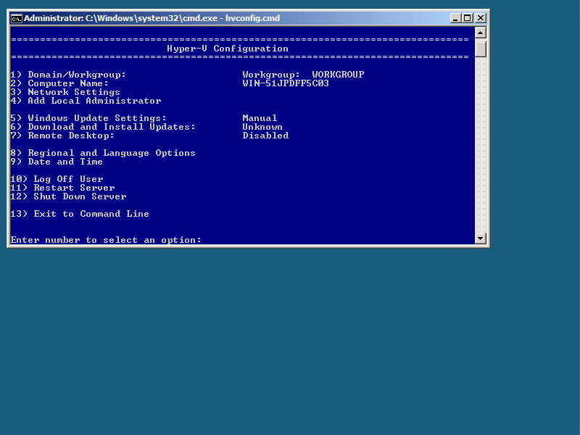
HVconfig
Automatic startup at login
Easy setup utility for server configuration
Localized in 11 languages

Slide 53


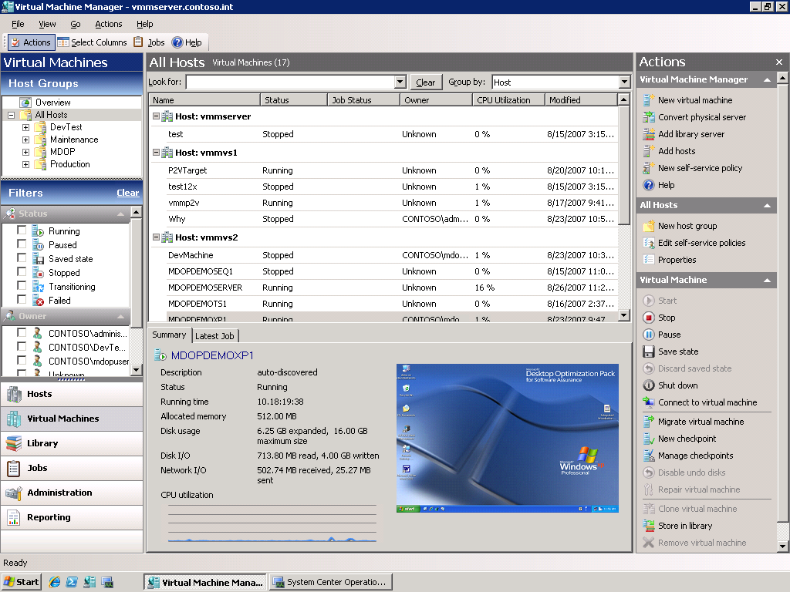
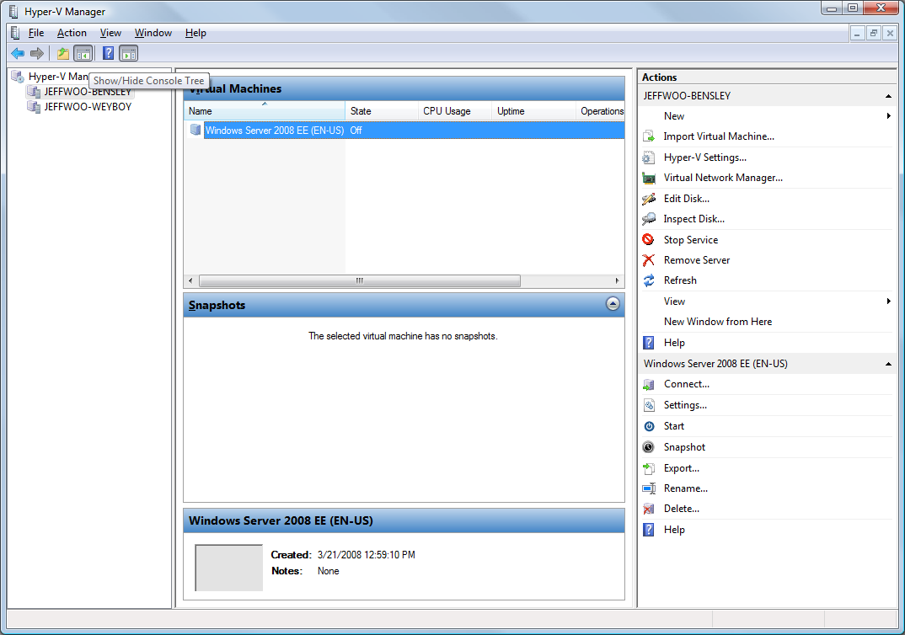
Manage Remotely…

Slide 54
Microsoft Hyper-V Server V2
New features
Live Migration
High Availability
New Processor Support
  Second Level Address
  Translation
  Core Parking
Networking Enhancements
  TCP/IP Offload Support
  VMQ & Jumbo Frame Support
Hot Add/Remove virtual storage
Enhancements to HVCONFIG
Enhanced scalability

Slide 55
Hyper-V Server V1 vs. V2
 | Microsoft Hyper-V Server 2008 | Microsoft Hyper-V Server V2
Processor Support | Up to 4 processors | Up to 8 processors
Physical Memory Support | Up to 32 GB | Up to 1 TB
Virtual Machine Memory Support | Up to 32 GB total (e.g. 31 1 GB VMs or 5 6 GB VMs) | 64 GB of memory per VM
Live Migration | No | Yes
High Availability | No | Yes
Management Options | Free Hyper-V Manager MMC SCVMM | Free Hyper-V Manager MMC SCVMM

Slide 56
Live Migration $$ Comparison
 | Hyper-V Server R2 | VMware vSphere
3 Node Cluster 2 Socket Servers | Free | $13,470
3 Node Cluster 4 Socket Servers | Free | $26,940
5 Node Cluster 2 Socket Servers | Free | $22,450
5 Node Cluster 4 Socket Servers | Free | $44,900

Slide 57








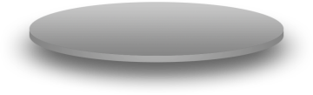









A centralized management application solution for the virtual data center
Heterogeneous Management
Manage Hyper-V, Virtual Server and VMware from a single console
Maximize Resources
Centralized virtual machine deployment and management
Intelligent placement of virtual machines
Fast and reliable Physical to Virtual (P2V) and Virtual to Virtual (V2V) conversion
Comprehensive service-level enterprise monitoring with Microsoft® Operations Manager
Increase Agility
Rapid provisioning of new and virtual machines with templates and profiles
Centralized library of infrastructure components
Take advantage and extend existing storage infrastructure
Allow for delegated management of virtual machines
Take Advantage of Skills
Familiar interface, common foundation
Monitor physical and virtual machines from one console
Fully scriptable using Windows PowerShell™
VM
VM
VM
VM
VM
VM
VM
VM
VM
VM
VM
VM
VM
VM
VM
VM
VM
VM
VM
VM
VM
VM
VM
VM

Slide 58
Summary
Microsoft Hyper-V Server 2008
  R1: Production ready & available now
  R2: Release Candidate Available Now
Windows Server 2008
  R1: Production ready & available now
  R2: Release Candidate available now
System Center Virtual Machine Manager 2008
  R1: Available now
  R2: RTM within 60 days of Windows Server 2008 R2

Slide 59
question & answer

Slide 60
Online Resources
Microsoft Virtualization Home:
  http://www.microsoft.com/virtualization
Windows Server Virtualization Blog Site:
  http://blogs.technet.com/virtualization/default.aspx
Windows Server Virtualization TechNet Site:
  http://technet2.microsoft.com/windowsserver2008/en/servermanager/virtualization.mspx
MSDN & TechNet Powered by Hyper-V
  http://blogs.technet.com/virtualization/archive/2008/05/20/msdn-and-technet-powered-by-hyper-v.aspx
Virtualization Solution Accelerators
  http://technet.microsoft.com/en-us/solutionaccelerators/cc197910.aspx
How to install the Hyper-V role
  http://www.microsoft.com/windowsserver2008/en/us/hyperv-install.aspx
Windows Server 2008 Hyper-V Performance Tuning Guide
  http://www.microsoft.com/whdc/system/sysperf/Perf_tun_srv.mspx
Using Hyper-V & BitLocker White Paper
  http://www.microsoft.com/downloads/details.aspx?FamilyID=2c3c0615-baf4-4a9c-b613-3fda14e84545&DisplayLang=en

Slide 61




Resources
www.microsoft.com/teched
  Sessions On-Demand & Community
www.microsoft.com/learning
Microsoft Certification & Training Resources
http://microsoft.com/technet
  Resources for IT Professionals
http://microsoft.com/msdn
  Resources for Developers
www.microsoft.com/learning
Microsoft Certification and Training Resources

Slide 62
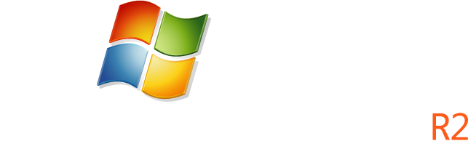
Windows Server Resources
Make sure you pick up your copy of Windows Server 2008 R2 RC from the Materials Distribution Counter
Learn More about Windows Server 2008 R2:
www.microsoft.com/WindowsServer2008R2
Technical Learning Center (Orange Section):
Highlighting Windows Server 2008 and R2 technologies
Over 15 booths and experts from Microsoft and our partners

Slide 63
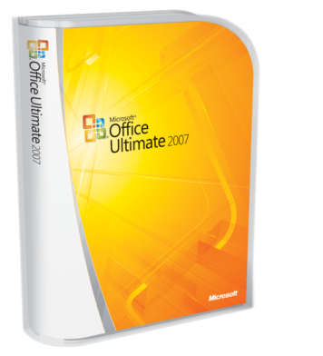
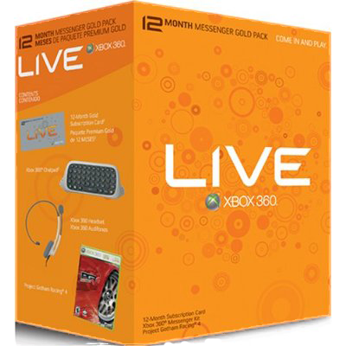



Complete an evaluation on CommNet and enter to win!

Slide 64

© 2009 Microsoft Corporation. All rights reserved. Microsoft, Windows, Windows Vista and other product names are or may be registered trademarks and/or trademarks in the U.S. and/or other countries.
The information herein is for informational purposes only and represents the current view of Microsoft Corporation as of the date of this presentation. Because Microsoft must respond to changing market conditions, it should not be interpreted to be a commitment on the part of Microsoft, and Microsoft cannot guarantee the accuracy of any information provided after the date of this presentation. MICROSOFT MAKES NO WARRANTIES, EXPRESS, IMPLIED OR STATUTORY, AS TO THE INFORMATION IN THIS PRESENTATION.

Slide 65
VMware’s Video Lies…

Slide 66
The Facts
In the first 7 months of Hyper-V RTM availability, we've had over 750,000 downloads of Hyper-V gold bits.
Hyper-V is the fastest growing x86/x64 hypervisor in history. We are laser focused on our customers and providing high performance, high quality virtualization for everyone from small business to Fortune 500 customers.
We have hundreds of Hyper-V case studies from customers worldwide and we're winning new customers daily.
Hyper-V continues to power MSDN, TechNet and Microsoft.com as well as numerous other MS properties. Microsoft.com continues to receive over a BILLION hits per month and there has been no downtime to any of these internet properties running atop Hyper-V. Period.
Of those 750,000+ downloads, the number of support calls we have received on Hyper-V is less than .02%. (Yes, a minimal fraction of a percent.)

Slide 67
The Reaction
Customers Love It
  More features, more value
  SMB gets Live Migration for the first time
VMware
  Still selling Live Migration for $2300 per processor
  Customer questioning value

Slide 68
The Result
You Tube Video
  100% FUD Inaccuracies throughout
  No Test Methodology
  Improper Configuration
  No Facts, can’t answer basic questions:
    What version of Hyper-V was used: Beta? RTM?
    Install Integration Components? What version?
Posted By:
  Scott Drummonds, VMware Product Marketing
  Desperate?

