Slide 2
What’s New in Server Core for Windows Server 2008 R2
Andrew Mason
Principal Program Manager
Microsoft
WSV323

Slide 3
Agenda
Overview of the R2 Additions
.NET in Server Core
IIS Additions to Server Core
PowerShell in Server Core
Further Minimizing Server Core
Other Additions

Slide 4
Server Core Patch Reduction
If Server Core had existed
Windows 2000 is ~60% reduction
Windows Server 2003 is ~40% reduction
Windows Server 2008 to date is:
~35% reduction if accepting all patches
~59% reduction if applying only necessary patches
~59% elimination of reboots

Slide 5
Server Core Additions in Windows Server 2008 R2
.NET Framework in Server Core
Subset of .NET 2.0
Subset of .NET 3.0
Windows Communication Framework (WCF)
Windows Workflow Framework (WF)
Subset of .NET 3.5
WF additions from 3.5
LINQ
Subset of ASP.NET support for IIS
PowerShell
Server Manager cmdlets
Best Practice Analyzer (BPA) cmdlets

Slide 6
Server Core Additions (cont.)
File Server Resource Manager (FSRM)
Certificate Server
WoW64 as an optional feature
If running all 64-bit, no need to have WoW64 installed
Installed by default
If removed from the image, reduces disk footprint by ~150MB
New command line add/remove tool (dism.exe)

Slide 7
Windows Server 2008 R2 Server Core Architecture
Server, Server Roles (for example only)
TS
ADFS
WDS
Etc…
Server Core Server Roles and Optional Features
Server
With .NetFx, Shell, Tools, etc.
.NET 2.0
.NET 3/3.5
PS
ASP.NET
Cert Server
DNS
DHCP
AD
File
AD LDS
Print
Media Server
IIS
Hyper-V
Server Core
Security, TCP/IP, File Systems, RPC, plus other Core Server Sub-Systems
WoW64
GUI, Shell, IE, Media, Mail, Etc.

Slide 8
Server Roles
Optional Features

Slide 9
Deployment Image Servicing and Management (dism.exe)
New Command Line Tool to Add/Remove Roles and Features
Shows install status
Better error reporting than Ocsetup
Allows multiple features to be installed from a single command line
Dism /online /enable-feature /featurename:MicrosoftWindowsPowerShell /featurename:ServerManager-PSH-Cmdlets
Included in client and server
Works online and with images

Slide 10
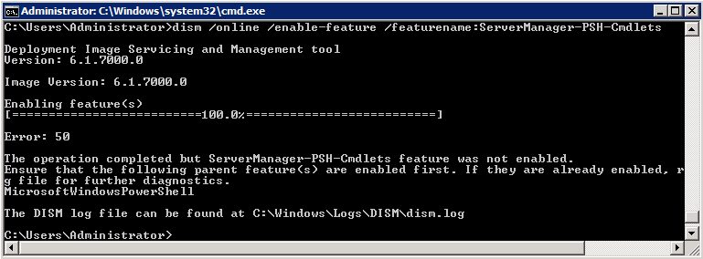
Finding Dependencies
Dism.exe will list dependent features that are not installed

Slide 11
Finding Installed Roles and Features
Dism /online /get-features
Equivalent of Oclist
No dependency hierarchy
Shows if a package is
Enabled
Disabled
Reboot pending

Slide 12
DISM.EXE Demo

Slide 13
Installing FSRM and Certificate Server
File Server Resource Manager (FSRM)
Part of the file server role
Dism /online /enable-feature /featurename: FSRM-Infrastructure-Core
Certificate Server
Dism /online /enable-feature /featurename: CertificateServices

Slide 14
.NET Framework Architecture
WCF
WF
WPF
ASP.NET
LINQ
CLR 2.0
CLR 3.0
Additions
CLR 3.5
Additions

Slide 15
.NET Framework in Server Core
WCF
WF
WPF
ASP.NET
LINQ
WPF
CLR 2.0
CLR 3.0
Additions
CLR 3.5
Additions

Slide 16
.NET Framework 2.0 in Server Core
Subset of .NET 2 on Server Core
.NET functionality aligns with functionality in Server Core
Not installed by default
To install
Dism /online /enable-feature /featurename:NetFx2-ServerCore
If 32-bit support is needed:
Dism /online /enable-feature /featurename:NetFx2-ServerCore-WOW64

Slide 17
.NET Framework 3 in Server Core
.NET 3 functionality
No WPF in Server Core
.NET 3.5 functionality
LINQ
.NET 3 and 3.5 functionality is installed with a single package
Dism /online /enable-feature / featurename:NetFx3-ServerCore
If 32-bit support is needed:
Dism /online /enable-feature / featurename:NetFx3-ServerCore-WOW64

Slide 18
.NET Namespaces Not in Server Core
Microsoft.Aspnet.Snapin
Microsoft.Ink
Microsoft.ManagementConsole.*
Microsoft.StylusInput.*
Microsoft.VisualBasic.Compatibility.VB6
Microsoft.Windows.Themes
Microsoft.WindowsCE.Forms
Microsoft.WindowsMobile.DirectX.*
System.ComponentModel.Design.*
System.Data.Design
System.Deployment.Application
System.Diagnostics.Design
System.Media
System.Messaging.*
System.Speech.*
System.Web.UI.Design.*
Design time support is unavailable, runtime support for expression builders is supported
System.Windows.*
UIAutomationClientsideProviders

Slide 19
IIS Additions to Server Core in R2
IIS-ASPNET
Enables hosting of ASP.NET applications
IIS-NetFxExtensibility
Enables hosting of .NET framework managed module extensions
IIS-ManagementService
Allows remote management via the Web server Management Console
IIS-PowerShellProvider
IIS PowerShell cmdlets
IIS-FTPExtensibility
Supports FTP feature extensions, such as custom providers
IIS-WebDAV
WebDAV extension module
WCF-HTTP-Activation
Process activation via HTTP support

Slide 20
ASP.NET
Included with IIS
Same package as full Server: IIS-ASPNET
Limitations
System.Web.Mail classes will fail because CDOSYS
Use System.Net.Mail instead
Web Application Tool (WAT) not available

Slide 21
Remotely Managing IIS on Server Core
Install the IIS Management Service
Dism /online /enable-feature /featurename:IIS-ManagementService
Enable Remote Management
Set EnableRemoteManagement to 1 under HKLM\Software\Microsoft\WebManagement\ Server
Start the Management Service
Net start wmsvc

Slide 22
ASP.NET Demo

Slide 23
PowerShell in Server Core
Full Command Line PowerShell
Scripts and cmdlets are limited like any other code or script
Installing PowerShell
Dism /online /enable-feature /featurename:MicrosoftWindowsPowerShell
If 32-bit support is needed:
Dism /online /enable-feature /featurename: NetFx2-ServerCore-WOW64
Dism /online /enable-feature /featurename:MicrosoftWindowsPowerShell-WOW64

Slide 24
PowerShell Cmdlets in Server Core
Require PowerShell to be installed first
Server Manager cmdlets
Dism /online /enable-feature /featurename:ServerManager- PSH-Cmdlets
Import-module ServerManager
The cmdlets are add-windowsfeature, get-windowsfeature, and remove-windowsfeature
Best Practice Analyzer cmdlets
Dism /online /enable-feature /featurename:BestPractices- PSH-Cmdlets
import-module BestPractices
The cmdlets are get-bparesult, invoke-bpamodel and set-bparesult

Slide 25
WoW64 in Server Core R2
Installed by default
Dism /online /disable-feature /featurename:ServerCore-WOW64
Required for and must be installed for
Active Directory
Active Directory Lightweight Directory Services

Slide 26
Other WoW64 Packages
The following all have WoW64 support that can be installed
FailoverCluster-Core-WOW64
NetFx2-ServerCore-WOW64
MicrosoftWindowsPowerShell-WOW64
NetFx3-ServerCore-WOW64
Printing-ServerCore-Role-WOW64
ServerCore-EA-IME-WOW64
SUACore-WOW64
Must first install Corresponding 64-bit feature, e.g., FailoverCluster-Core

Slide 27
Potential Issues with WoW64
Installers Requiring WoW64
When an MSI requires WoW64, it will return:
Error 1719. The Windows Installer Service could not be accessed. This can occur if the Windows Installer is not correctly installed. Contact your support personnel for assistance.
Applications Requiring WoW64
When trying to run a 32-bit application, you will receive the following error:
The subsystem needed to support the image type is not present.

Slide 28
PowerShell and WOW64 Demo

Slide 29
Reducing the Footprint
Can remove roles and features from the Server Core image
One-way process; once removed, it is gone unless you reinstall
Largest footprint savings
.Net Support ~500MB
IME Support ~200MB
WoW64 Support ~150MB

Slide 30
Removing Packages
Change to \windows\servicing\packages
Dir *coreedition*.mum /w
Copy file name up to extension
For example: Microsoft-Windows-ServerEnterpriseCoreEdition~31bf3856ad364e35~ amd64~~6.1.7100.0
Dism /online /get-features /packagename: <core edition package>
Dism /online /disable-feature /packagename: <core edition package> /featurename: <name_from_previous_step_to _remove>

Slide 31
Reducing the Footprint Demo

Slide 32
Installing a Product Key
Setup no longer prompts for Product Key
No OOBE on Server Core
Can use SLMGR.VBS
Slmgr.vbs -ipk <product key>
Slmgr.vbs -ato

Slide 33
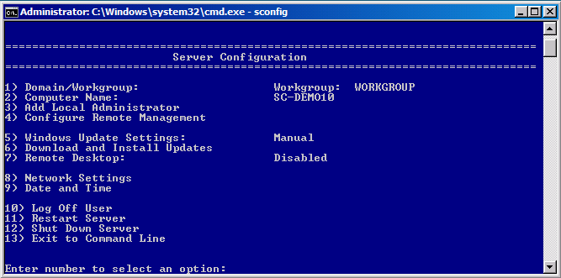
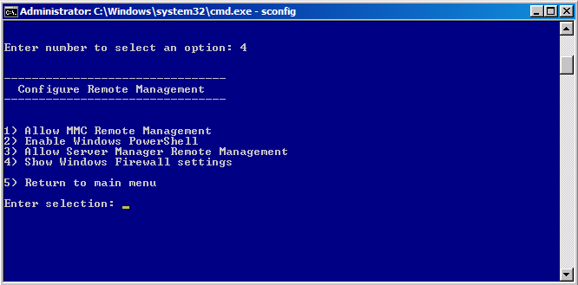
Sconfig
New script to ease initial configuration

Slide 34
question & answer

Slide 35
Server Core Resources
Server Core Blog
http://blogs.technet.com/server_core/default.aspx
Newsgroups
http://forums.technet.microsoft.com/en-US/winservercore/threads/
http://forums.msdn.microsoft.com/en-US/servercorefordevelopers/threads/
Step-by-Step Guide
Online at
http://technet2.microsoft.com/windowsserver/longhorn/en/library/bab0f1a1-54aa-4cef-9164-139e8bcc44751033.mspx?mfr=true
Download in Word Document in the Download Center
http://download.microsoft.com/
E-mail
srvcfdbk@microsoft.com

Slide 36
Windows Server Resources
Required Slide
Track PMs will supply the content for this slide, which will be inserted during the final scrub.
Make sure you pick up your copy of Windows Server 2008 R2 RC from the Materials Distribution Counter
Learn More about Windows Server 2008 R2:
www.microsoft.com/WindowsServer2008R2
Technical Learning Center (Orange Section):
Highlighting Windows Server 2008 and R2 technologies
Over 15 booths and experts from Microsoft and our partners

Slide 37
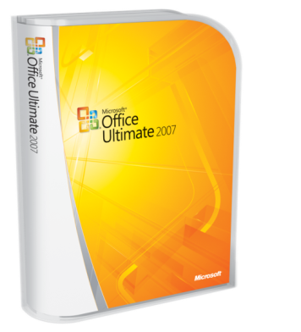
Required Slide
Complete an evaluation on CommNet and enter to win!

Slide 38
Required Slide
© 2009 Microsoft Corporation. All rights reserved. Microsoft, Windows, Windows Vista and other product names are or may be registered trademarks and/or trademarks in the U.S. and/or other countries.
The information herein is for informational purposes only and represents the current view of Microsoft Corporation as of the date of this presentation. Because Microsoft must respond to changing market conditions, it should not be interpreted to be a commitment on the part of Microsoft, and Microsoft cannot guarantee the accuracy of any information provided after the date of this presentation. MICROSOFT MAKES NO WARRANTIES, EXPRESS, IMPLIED OR STATUTORY, AS TO THE INFORMATION IN THIS PRESENTATION.

