Slide 2
Best Practices & Implementing Hyper-V on Clusters (HA)
Jeff Woolsey
Principal Group Program Manager
Windows Server, Hyper-V
WSV315

Slide 3
Agenda
Virtualization Requirements
Hyper-V Security
Server Core
Enabling Hyper-V with Server Core
Designing a Windows Server 2008 Hyper V & System Center Infrastructure
Deployment Considerations
Best Practices & Tips and Tricks

Slide 4
Virtualization Requirements
Scheduler
Memory Management
VM State Machine
Virtualized Devices
Storage Stack
Network Stack
Binary Translators (optional)
Drivers
Management API

Slide 5













New: Hyper-V Architecture
Parent Partition
Child Partition
Provided by:
Virtualization Stack
Rest of
Windows
VM Worker
Processes
Guest Applications
Hyper-V
WMI Provider
VM
Service
ISV
Ring 3: User Mode
Virtualization
Service
Clients
(VSCs)
OS
Kernel
Server Core
Virtualization
Service
Providers
(VSPs)
Windows
Kernel
Device
Drivers
VMBus
Enlightenments
Ring 0: Kernel Mode
Windows hypervisor
Server Hardware

Slide 6
Virtualization Attacks
Parent Partition
Child Partition
Provided by:
Virtualization Stack
Rest of
Windows
VM Worker
Processes
Guest Applications
Hyper-V
WMI Provider
VM
Service
ISV
Ring 3: User Mode
Hackers
Virtualization
Service
Clients
(VSCs)
Virtualization
Service
Clients
(VSCs)
OS
Kernel
Server Core
Virtualization
Service
Providers
(VSPs)
Windows
Kernel
Device
Drivers
Enlightenments
VMBus
Enlightenments
VMBus
Ring 0: Kernel Mode
Windows hypervisor
Server Hardware

Slide 7
Why not get rid of the parent?
No defense in depth
Entire hypervisor running in the most privileged mode of the system
Virtual
Machine
Virtual
Machine
Virtual
Machine
User
Mode
User
Mode
User
Mode
Ring 3
Kernel
Mode
Kernel
Mode
Kernel
Mode
Ring 0
Scheduler
Memory Management
Storage Stack
Network Stack
VM State Machine
Virtualized Devices
Binary Translators
Drivers
Management API
Ring -1
Hardware

Slide 8
Micro-kernelized Hypervisor
Defense in depth
Using hardware to protect
Hyper-V doesn’t use binary translation
  Further reduces the attack surface
Parent Partition
Virtual
Machine
Virtual
Machine
VM State Machine
Virtualized Devices
Management API
User
Mode
User
Mode
Ring 3
Storage Stack
Network Stack
Drivers
Kernel
Mode
Kernel
Mode
Ring 0
Scheduler
Memory Management
Ring -1
Hardware

Slide 9
Hyper-V Security

Slide 10
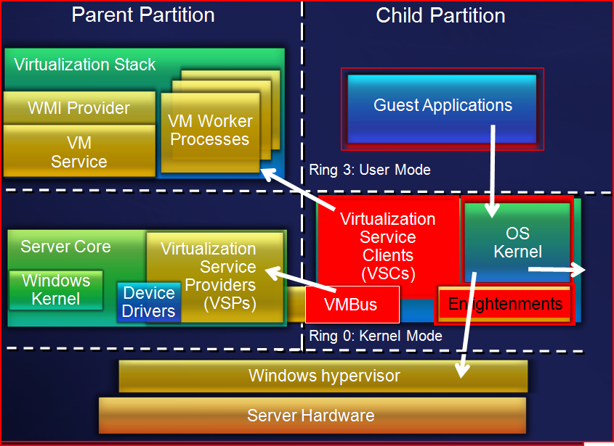
Security Assumptions
Guests are untrusted
Trust relationships
  Parent must be trusted by hypervisor
  Parent must be trusted by children
Code in guests can run in all available processor modes, rings, and segments
Hypercall interface will be well documented and widely available to attackers
All hypercalls can be attempted by guests
Can detect you are running on a hypervisor
  We’ll even give you the version
The internal design of the hypervisor will be well understood

Slide 11
Security Goals
Strong isolation between partitions
Protect confidentiality and integrity of guest data
Separation
    Unique hypervisor resource pools per guest
    Separate worker processes per guest
    Guest-to-parent communications over unique channels
Non-interference
    Guests cannot affect the contents of other guests, parent, hypervisor
    Guest computations protected from other guests
    Guest-to-guest communications not allowed through VM interfaces

Slide 12
Isolation
We’re serious folks
  No sharing of virtualized devices
  Separate VMBus per vm to the parent
  No sharing of memory
    Each has its own address space
  VMs cannot communicate with each other, except through traditional networking
  Guests can’t perform DMA attacks because they’re never mapped to physical devices
  Guests cannot write to the hypervisor
  Parent partition cannot write to the hypervisor

Slide 13
Hyper-V Security Hardening
Hypervisor has separate address space
  Guest addresses != Hypervisor addresses
No 3rd party code in the Hypervisor
Limited number of channels from guests to hypervisor
  No “IOCTL”-like things
Guest to guest communication through hypervisor is prohibited
No shared memory mapped between guests
Guests never touch real hardware I/O

Slide 14
Server Core

Slide 15
Windows Server Core
Windows Server frequently deployed for a single role
  Must deploy and service the entire OS in earlier Windows Server releases
Server Core: minimal installation option
  Provides essential server functionality
  Command Line Interface only, no GUI Shell
Benefits
  Less code results in fewer patches and reduced servicing burden
  Low surface area server for targeted roles
Windows Server 2008 Feedback
  Love it, but…steep learning curve
Windows Server 2008 R2 Introducing “SCONFIG”

Slide 16
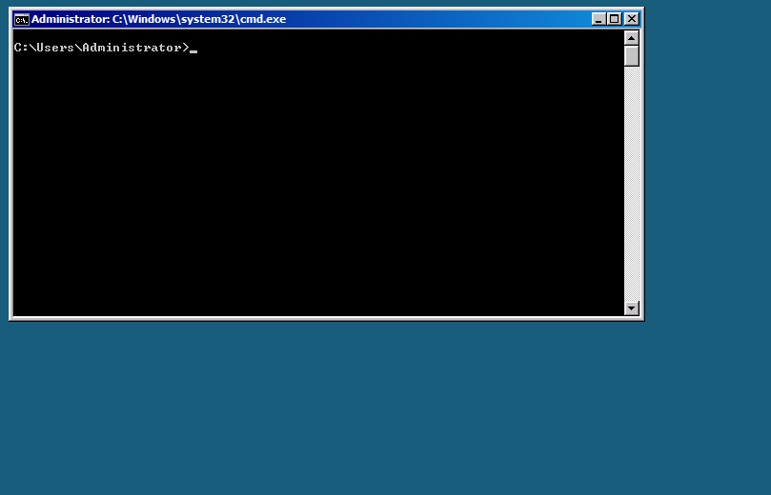
Windows Server Core
Server Core: CLI

Slide 17
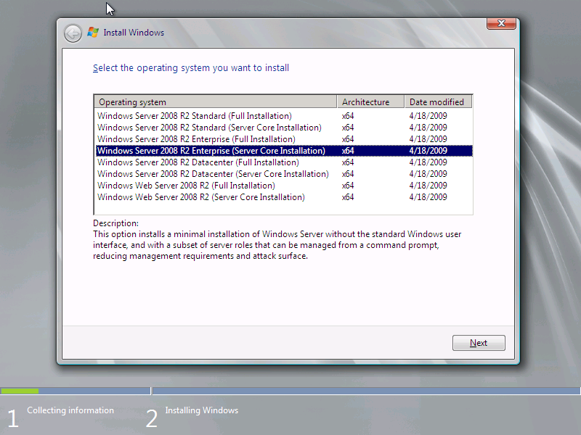

Installing Hyper-V Role on Core
    Install Windows Server and select Server Core installation

Slide 18
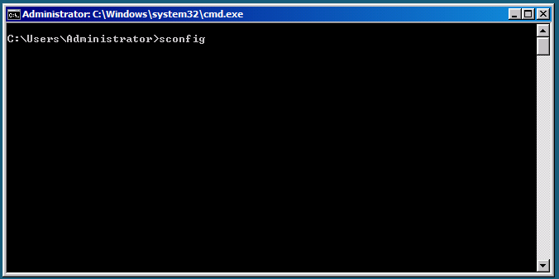
Enable SCONFIG
Log on and type sconfig

Slide 19
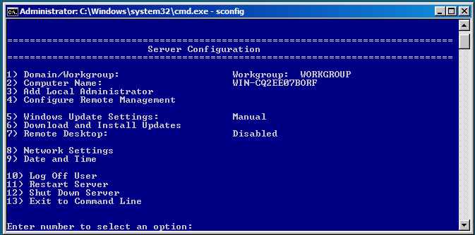
Easy Server Configuration

Slide 20
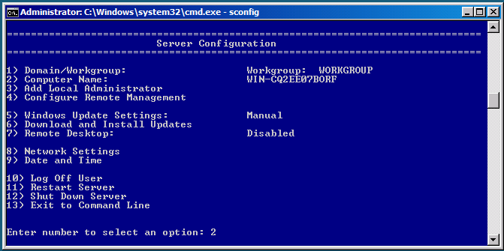
Rename Computer
Type 2 & enter computer name and password when prompted

Slide 21
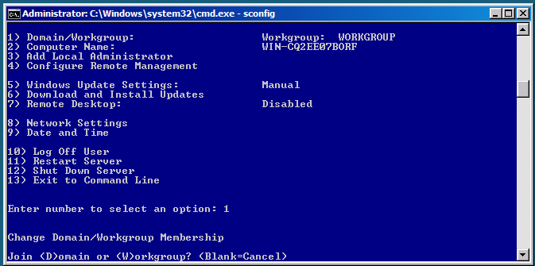
Join Domain
Type 1 & D or W and provide name & password

Slide 22

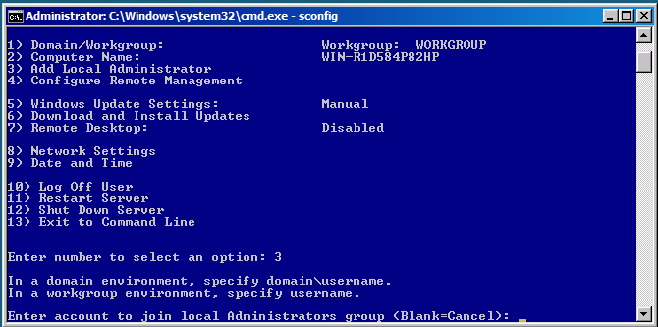
Add domain account
Type 3 & <username> and <password> when prompted

Slide 23
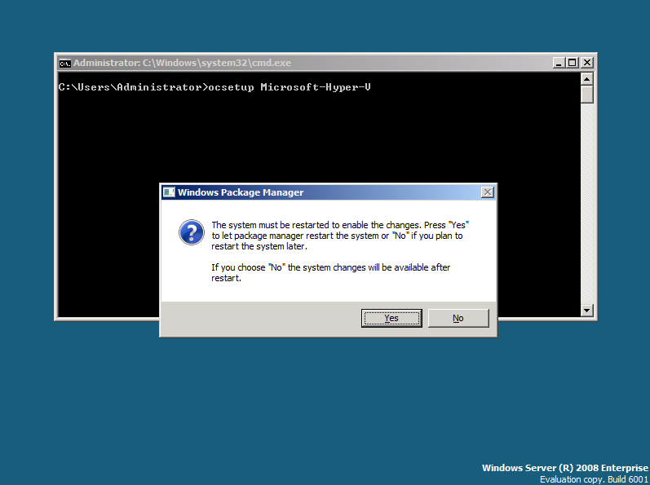
Add Hyper-V Role
ocsetup Microsoft-Hyper-V
Restart when prompted

Slide 24
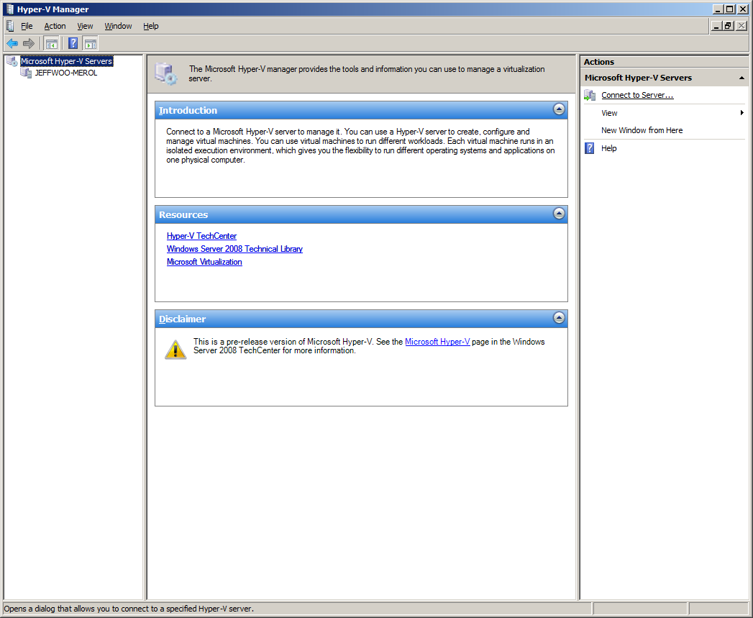
Connect remotely via MMC

Slide 25
Hyper-V Networking

Slide 26
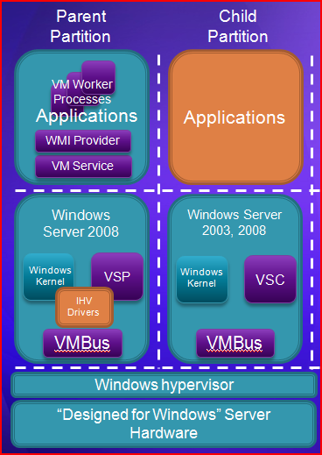
Hyper-V Networking
Two physical network adapters at minimum
  One for management
  One (or more) for VM networking
  Dedicated NIC(s) for iSCSI
  Connect parent to back-end management network
    Only expose guests to internet traffic

Slide 27
Hyper-V Network Configurations
Example 1:
  Physical Server has 4 network adapters
  NIC 1: Assigned to parent partition for management
  NICs 2/3/4: Assigned to virtual switches for virtual machine networking
  Storage is non-iSCSI such as:
    Direct attach
    SAS or Fibre Channel

Slide 28
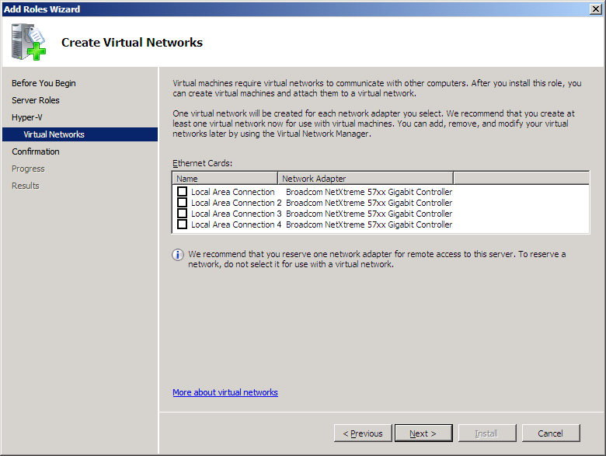
Hyper-V Setup & Networking 1

Slide 29
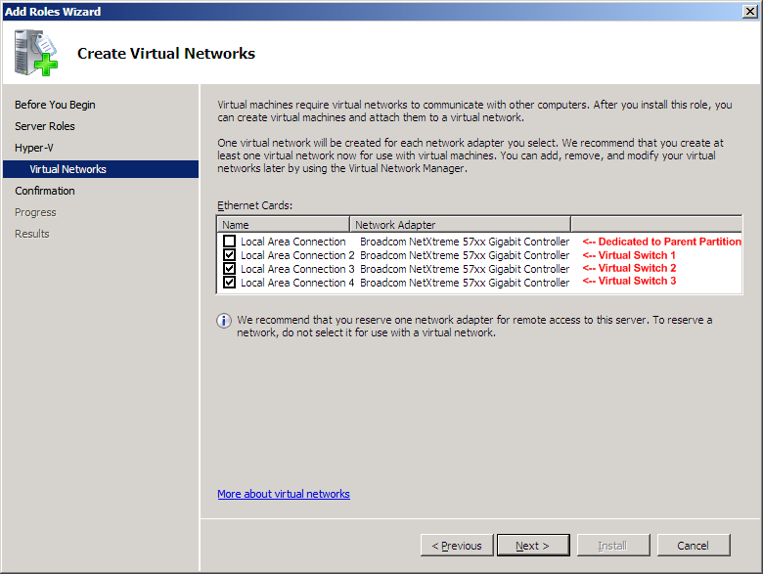
Hyper-V Setup & Networking 2

Slide 30
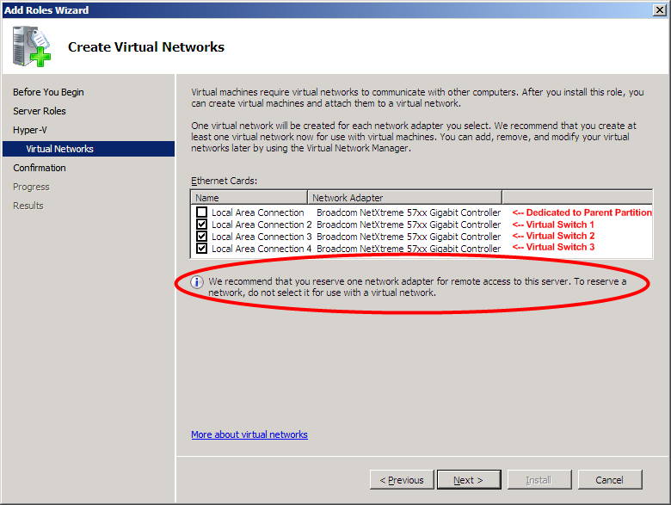
Hyper-V Setup & Networking 3

Slide 31
Each VM on its own Switch…
Parent Partition
Child Partitions
Applications
Applications
Applications
VM Worker Processes
User Mode
WMI Provider
VM Service
Windows Server 2008
VM 1
VM 2
VM 3
VSP
Windows Kernel
VSC
Windows Kernel
VSC
Linux Kernel
VSC
VSP
VSP
Kernel
Mode
VMBus
VMBus
VMBus
VMBus
Windows hypervisor
Ring -1
“Designed for Windows” Server Hardware
Mgmt
NIC 1
VSwitch 1
NIC 2
VSwitch 2
NIC 3
VSwitch 3
NIC 4

Slide 32
Hyper-V Network Configurations
Example 2:
  Server has 4 physical network adapters
  NIC 1: Assigned to parent partition for management
  NIC 2: Assigned to parent partition for iSCSI
  NICs 3/4: Assigned to virtual switches for virtual machine networking

Slide 33
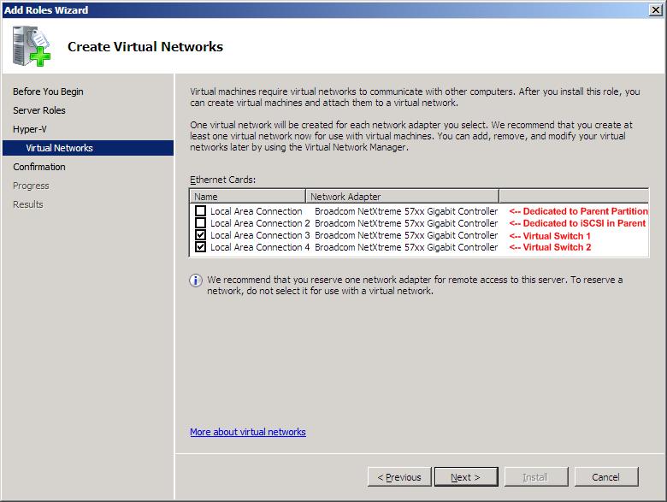
Hyper-V Setup, Networking & iSCSI

Slide 34
Now with iSCSI…
Parent Partition
Child Partitions
Applications
Applications
Applications
VM Worker Processes
User Mode
WMI Provider
VM Service
Windows Server 2008
VM 1
VM 2
VM 3
Windows Kernel
VSC
Windows Kernel
VSC
Linux Kernel
VSC
VSP
VSP
Kernel
Mode
VMBus
VMBus
VMBus
VMBus
Windows hypervisor
Ring -1
“Designed for Windows” Server Hardware
Mgmt
NIC 1
iSCSI NIC 2
VSwitch 2
NIC 3
VSwitch 3
NIC 4

Slide 35
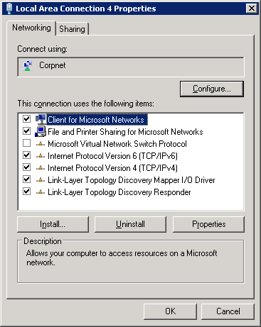
Networking: Parent Partition

Slide 36
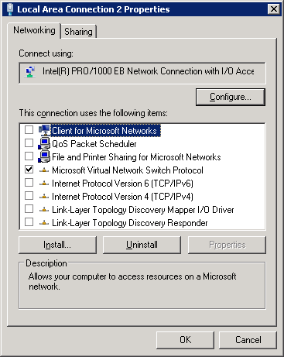
Networking: Virtual Switches

Slide 37
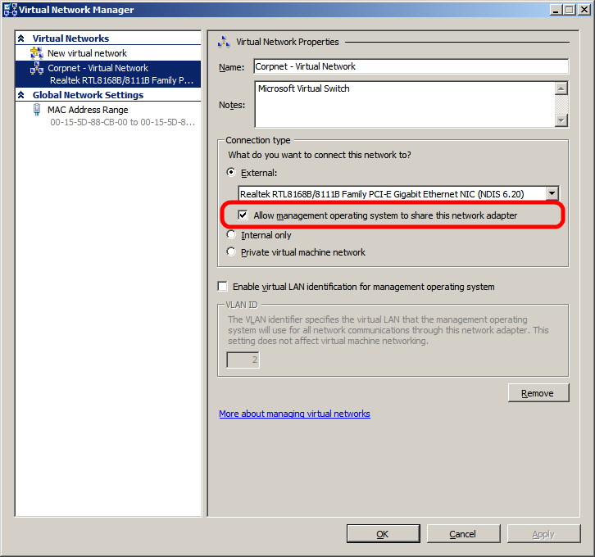
NIC Configuration

Slide 38
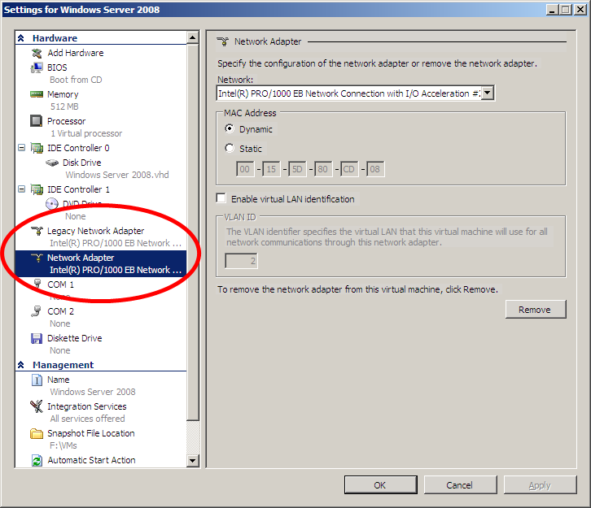
VM with Legacy & Synthetic NIC

Slide 39
Designing a Windows Server 2008 Hyper-V & Microsoft System Center Infrastructure

Slide 40
Building a Virtualization Farm
If you could build a virtualization infrastructure and money was no object how would you do it?
What hardware would you use?
How would you manage it?
  Bare metal deployment
  Virtualization deployment
  Overall Systems Management
    Workload health monitoring
    Servicing
    Backup
    High Availability
    Data replication

Slide 41
Step 0: Choosing the building blocks
Build a balanced system
Windows Server 2008 R2 DTC
  Server Core Installation
Quad processor/Quad Core (16 cores)
  AMD-V or Intel VT
Memory
  4 GB per core minimum (64 GB)
  8 GB per core recommended (128 GB)
Storage
  8 Gb Fiber Channel x 2 (MPIO)
Networking
  1 Gb/E NIC (onboard) for VM management/cluster heartbeat/migration
  1 quad-port Gb/E PCI-E for VMs

Slide 42
Step 1: Ensure you have Active Directory
Domain
Controller
Ethernet

Slide 43
Step 2: Building a Virtualization Farm
Domain
Controller
Virtualization Farm 1
(14 + 2 Servers)
Ethernet

Slide 44
Step 3: Adding Storage
Domain
Controller
Virtualization Farm 1
(14 + 2 Servers)
SAN
32 connections
Ethernet
32-Port
Fibre Channel
Switch

Slide 45
Step 4: Bare Metal Provisioning with System Center Configuration Manager
Domain
Controller
System Center
Configuration Manager
Virtualization Farm 1
(14 + 2 Servers)
SAN
32 connections
Ethernet
32-Port
Fibre Channel
Switch

Slide 46
Step 5: Virtual Machine Provisioning with System Center Virtual Machine Manager
Domain
Controller
System Center
Configuration Manager
Virtualization Farm 1
(14 + 2 Servers)
SAN
System Center
Virtual Machine Manager
32 connections
Ethernet
32-Port
Fibre Channel
Switch

Slide 47
Step 6: Health Monitoring with System Center Operations Manager
Domain
Controller
System Center
Configuration Manager
Virtualization Farm 1
(14 + 2 Servers)
SAN
System Center
Virtual Machine Manager
32 connections
Ethernet
32-Port
Fibre Channel
Switch
System Center
Operations Manager

Slide 48
Step 7: Virtual Machine Snapshots with Data Protection Manager
Domain
Controller
System Center
Configuration Manager
Virtualization Farm 1
(14 + 2 Servers)
SAN
System Center
Virtual Machine Manager
32 connections
Ethernet
32-Port
Fibre Channel
Switch
System Center
Operations Manager
System Center
Data Protection Manager

Slide 49
Step 8: Virtual Machine Snapshots with Data Protection Manager
Domain
Controller
System Center
Configuration Manager
Virtualization Farm 1
(14 + 2 Servers)
Replication
SAN
System Center
Virtual Machine Manager
WAN
32 connections
Ethernet
32-Port
Fibre Channel
Switch
System Center
Operations Manager
System Center
Data Protection Manager

Slide 50
Best Practices & Tips and Tricks

Slide 51
Deployment Considerations
Minimize risk to the Parent Partition
  Use Server Core
  Don’t run arbitrary apps, no web surfing
    Run your apps and services in guests
Moving VMs from Virtual Server to Hyper-V
  FIRST: Uninstall the VM Additions
Two physical network adapters at minimum
  One for management (use a VLAN too)
  One (or more) for vm networking
  Dedicated iSCSI
  Connect to back-end management network
    Only expose guests to internet traffic

Slide 52
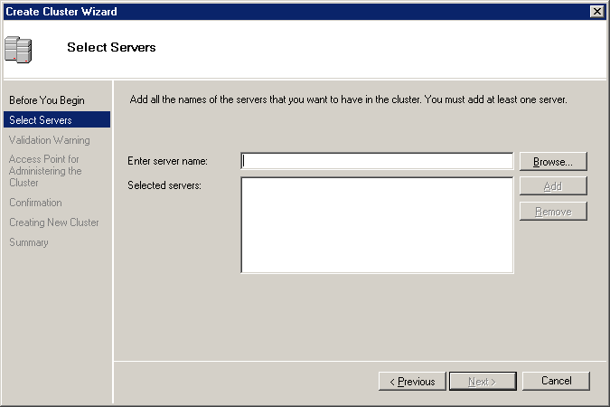
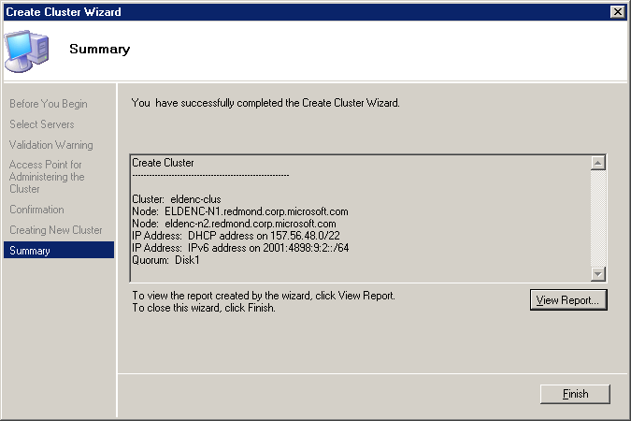
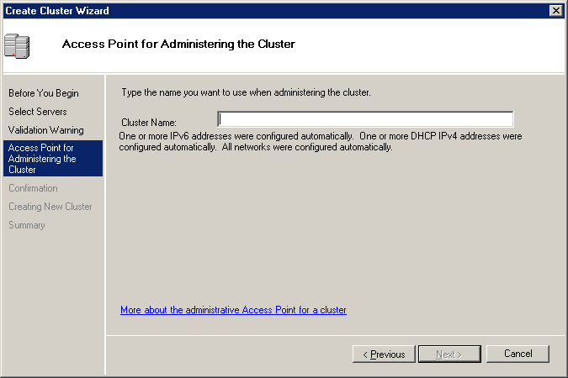

Cluster Hyper-V Servers

Slide 53
Live Migration Best Practices
Best Practices:
  Cluster Nodes:
    Hardware with Windows Logo + Failover Cluster Configuration Program (FCCP)
  Storage:
    Storage with Windows Logo + FCCP
  Networking:
    Multiple Gigabit Interfaces
    CSV uses separate network

Slide 54
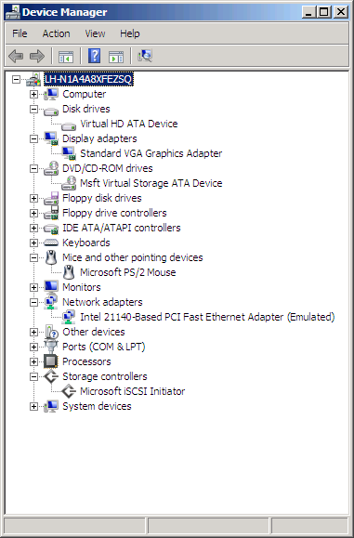
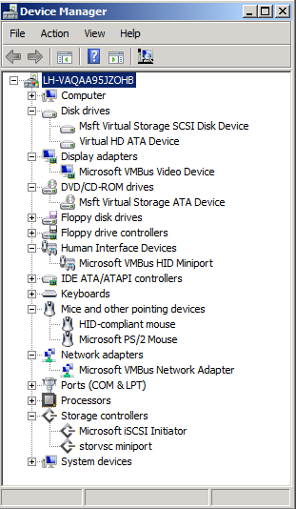
Don't forget the ICs!
Emulated vs. VSC

Slide 55
Anti-Virus & BitLocker…
Parent partition
  Run AV software and exclude .vhd
Child partitions
  Run AV software within each VM
BitLocker
  Great for branch office
  Still testing with Hyper-V; More to come…

Slide 56
More…
Mitigate Bottlenecks
  Processors
  Memory
  Storage
    Don't run everything off a single spindle…
  Networking
VHD Compaction/Expansion
  Run it on a non-production system
Use .isos
  Great performance
  Can be mounted and unmounted remotely
  Having them in SCVMM Library fast & convenient

Slide 57
Creating Virtual Machines
Use SCVMM Library
Steps:
  Create virtual machine
  Install guest operating system
  Install integration components
  Install anti-virus
  Install management agents
  SYSPREP
  Add it to the VMM Library
Windows Server 2003
  Creat vms using 2-way to ensure an MP HAL

Slide 58




Resources
Required Slide
Speakers,
TechEd 2009 is not producing
a DVD. Please announce that
attendees can access session
recordings at TechEd Online.
www.microsoft.com/teched
  Sessions On-Demand & Community
www.microsoft.com/learning
Microsoft Certification & Training Resources
http://microsoft.com/technet
  Resources for IT Professionals
http://microsoft.com/msdn
  Resources for Developers
www.microsoft.com/learning
Microsoft Certification and Training Resources

Slide 59
Related Content
Required Slide
Speakers,
please list the Breakout Sessions,
TLC Interactive Theaters and Labs
that are related to your session.
Breakout Sessions (session codes and titles)
Interactive Theater Sessions (session codes and titles)
Hands-on Labs (session codes and titles)
Hands-on Labs (session codes and titles)

Slide 60
Track Resources
Required Slide
Track PMs will supply the content for this slide,
which will be inserted during
the final scrub.
Resource 1
Resource 2
Resource 3
Resource 4

Slide 61
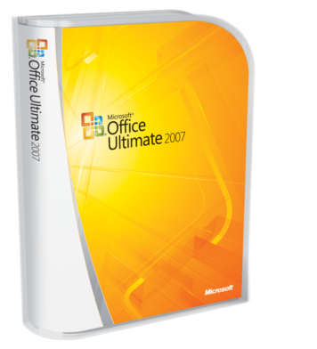



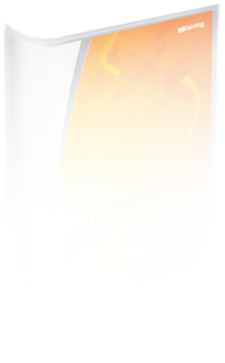
Required Slide
Complete an evaluation on CommNet and enter to win!

Slide 62

Required Slide
© 2009 Microsoft Corporation. All rights reserved. Microsoft, Windows, Windows Vista and other product names are or may be registered trademarks and/or trademarks in the U.S. and/or other countries.
The information herein is for informational purposes only and represents the current view of Microsoft Corporation as of the date of this presentation. Because Microsoft must respond to changing market conditions, it should not be interpreted to be a commitment on the part of Microsoft, and Microsoft cannot guarantee the accuracy of any information provided after the date of this presentation. MICROSOFT MAKES NO WARRANTIES, EXPRESS, IMPLIED OR STATUTORY, AS TO THE INFORMATION IN THIS PRESENTATION.

Slide 63
Hidden Speaker Notes
Some speakers at Microsoft like to use this slide for hidden “notes slides”.
Delete it if you don’t want to use it.
NEXT: <next slide title>

Slide 64
Deadlines & Resources
Thank you for committing to speak at TechEd North America 2009, Microsoft’s premier event for IT Professionals and Developers. Below is important information regarding your participation:
Important Content Deadlines – submit at the Speaker Portal: https://www.msteched.com/ws
April 1 at Noon | Upload draft of PPT presentation at the Speaker Portal (you must be registered as a speaker to access it) → Your Session Schedule → Manage Slides, follow instructions for Deck Management.
April 1-30 | Content Review Process (dry run, speaker training, LCA review, etc.)
May 6 at Noon | Submit final PPT at the Speaker Portal. Additional changes must be brought onsite and editing charges may apply. YOUR PROMPT FINAL PPT SUBMISSION IS APPRECIATED.
Slide Design Resources – located at the Speaker Portal
Graphics and Images Library (pictures of arrows, devices, people)
Books, Webinars, Websites, and much more to help you build a great deck
Licensing information and permission for any third-party photography or art must be credited in the PPT or it will be deleted.
Points of Contact
Direct presentation questions to tespkr@microsoft.com
Direct content questions to your Track PM. (contact info is at the speaker portal)
This template is designed for use with Office PowerPoint 2007.
PRINTING: This template is set to print in color or grayscale, not black and white.

Slide 65
Presentation Outline (hidden slide):
Speakers: complete this slide using the session information found at the speaker portal.
Title:
Technical Level:
Intended Audience:
Objectives (what do you want the audience to take away from this session):
  1.
  2.
  3.
Presentation Outline (including demos):

Slide 66
Scrub Checklist
Your final PPT will be scrubbed and posted to CommNet 48-hours prior to the session. Upload your final deck on or before May 6, 2009 at Noon PST.
Apply template –
backgrounds, colors,
positioning, font
Verify that required
slides are included
Remove any non-template
logos and graphics from
the walk-in slide
Correct session title and
session code to match
session guide
Set titles to Title Case
and correct widows
(widows = single word
spilling over to a new line)
Replace transition slides
with template
transition slides
Set subtitles to subtitle
color, size, and
sentence case
Correct all type for
consistent shadowing
Set bullets to template
Set software code samples
to template code format
Correct template
application issues
as time allows
Correct Microsoft product names to follow corporate branding rules
Correct misspelled words
Remove all comments, hidden slides and speaker notes from slides
Set file properties box
Set printability in grayscale
If time allows, correct slides for readability
and consistency
If time allows, correct grammar and correct copy
to Microsoft style
Notify Presentation Manager of any images identified
as unlicensed
for escalation

Slide 67
Video Title
video

Slide 68
Customer Title
customer
Name
Title
Company

Slide 69
Demo Title
demo
Name
Title
Company
Notes:
If you would like to host your demo on the Virtual Server, please use the myVPC demo slide, not this slide.

Slide 70
Partner Title
partner
Name
Title
Company

Slide 71
Announcement Title
announcing

Slide 72
question & answer

Slide 73
Notes on Required Slides
In addition to the Walk-in and Title slides,
the following slides are required
Please add your content
and include these in your final presentation

Slide 74
Bar Chart Example

Slide 75
Pie Chart Example

Slide 76
question & answer

Slide 77
Notes on Required Slides
In addition to the Walk-in and Title slides,
the following slides are required
Please add your content
and include these in your final presentation

Slide 78

Resources
Required Slide
Speakers,
TechEd 2009 is not producing
a DVD. Please announce that
attendees can access session
recordings at TechEd Online.
www.microsoft.com/teched
  Sessions On-Demand & Community
www.microsoft.com/learning
Microsoft Certification & Training Resources
http://microsoft.com/technet
  Resources for IT Professionals
http://microsoft.com/msdn
  Resources for Developers
www.microsoft.com/learning
Microsoft Certification and Training Resources

Slide 79
Related Content
Required Slide
Speakers,
please list the Breakout Sessions,
TLC Interactive Theaters and Labs
that are related to your session.
Breakout Sessions (session codes and titles)
Interactive Theater Sessions (session codes and titles)
Hands-on Labs (session codes and titles)
Hands-on Labs (session codes and titles)

Slide 80

Windows Server Resources
Required Slide
Track PMs will supply the content for this slide,
which will be inserted during
the final scrub.
Make sure you pick up your copy of Windows Server 2008 R2 RC from the Materials Distribution Counter
Learn More about Windows Server 2008 R2:
www.microsoft.com/WindowsServer2008R2
Technical Learning Center (Orange Section):
Highlighting Windows Server 2008 and R2 technologies
Over 15 booths and experts from Microsoft and our partners

Slide 81
Track Resources
Required Slide
Track PMs will supply the content for this slide,
which will be inserted during
the final scrub.
Resource 1
Resource 2
Resource 3
Resource 4

Slide 82
Required Slide
Complete an evaluation on CommNet and enter to win!

Slide 83
Required Slide
© 2009 Microsoft Corporation. All rights reserved. Microsoft, Windows, Windows Vista and other product names are or may be registered trademarks and/or trademarks in the U.S. and/or other countries.
The information herein is for informational purposes only and represents the current view of Microsoft Corporation as of the date of this presentation. Because Microsoft must respond to changing market conditions, it should not be interpreted to be a commitment on the part of Microsoft, and Microsoft cannot guarantee the accuracy of any information provided after the date of this presentation. MICROSOFT MAKES NO WARRANTIES, EXPRESS, IMPLIED OR STATUTORY, AS TO THE INFORMATION IN THIS PRESENTATION.

