Slide 2
Deploying NAP: Best Practices and Lessons Learned
Lambert Green
Development Lead
Microsoft Corporation
Venkatesh Gopalakrishnan
Group Program Manager
Microsoft Corporation
WSV305

Slide 3
Agenda
Background: Network Access Protection
Updates in Windows® 7 & Windows® Server 2008 R2
NAP Deployment Basics
Best Practices & Common Mistakes
Conclusions & Takeaways

Slide 4









Today’s Network Challenges
Today’s networks are highly connected
  Multiple access methods
  Users with different access rights
  Numerous devices used for access
New Challenges
  Increased workforce mobility
  Increased exposure to malware
  Need to control guest, vendor access
Key Strategies
  Validate user identity and
  system health
  Aggressively update
  out-of-compliance systems
  Continuously monitor compliance state
  of the network
The Solution
  NAP: comprehensive, policy-based authentication
  and compliance platform
Internet
Boundary Zone
Customers
Employees , Partners, Vendors
Intranet
Partners
Remote Employees

Slide 5




Network Access Protection
Network Access Control solution that
Validates whether computers meet health policies
Monitors compliance state of computers
on the network
Can Limit access for noncompliant computers
Automatically remediates
noncompliant computers
Internet
Boundary Zone
Customers
Employees , Partners, Vendors
Intranet
Partners
Solution Highlights
Available on multiple platforms
Works with most devices
Supports multiple antivirus solutions
Highly extensible
Remote Employees

Slide 6

Network Access Protection
Several Enforcement Options to choose from!
Multiple Enforcement Modes
  Reporting mode
    Used for monitoring level of compliance
  Deferred enforcement mode
    Full access up to a specified date/time
  Full enforcement mode
Available on multiple platforms
  Windows® 7, Vista & XP SP3
  Windows® Server 2008 & 2008 R2
  Other OS’s via partner ecosystem
IPsec
802.1x
VPN
DHCP
Terminal Services Gateway
Direct Access

Slide 7
Terminology
NPS (Network Policy Server)
  AAA server role in Windows® Server 2008 used to validate user identity
  and system health
HRA (Health Registration Authority)
  Server role that provides compliant clients with an X.509 certificate to
  make health claims
SHA (System Health Agent)
  Plug-in component that monitors health status on the client to generate
  a health claim
SHV (System Health Validator)
  Plug-in server component interprets health claim from the corresponding SHA
SoH (Statement of Health)
  Protocol used to communicate health claims between SHAs and SHVs
QEC/EC (Quarantine Enforcement Client)
  Component that manages quarantine behavior on the client
NAS (Network Access Server)
  Any server or device used to gain access to a network – e.g. 802.1x switch, VPN, TSG, DHCP server, HRA

Slide 8
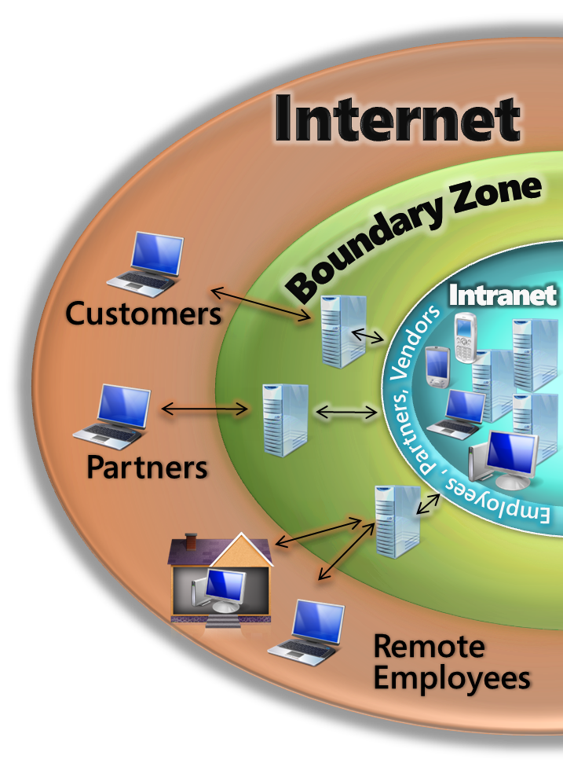



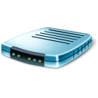


NAP - How It Works
Directory and Health Servers
e.g.., Active Directory, Patch, AV
1
1
Access requested
Authentication data and health state sent to NPS (RADIUS)
NPS validates against access and health policy
If compliant, access granted
If not compliant, restricted network access
and remediation
2
Microsoft NPS
3
Not policy compliant
5
3
2
Remediation
Servers
e.g., Patch
Restricted
Network
4
Policy compliant
NAS
DHCP, VPN, HRA, TSG, 802.1x switch
5
Corporate Network
4

Slide 9





NAP Architecture
Remediation Servers
System Health Servers
Health Policy
Updates
NAP Client
Network Policy Server (NPS)
SoH Packets
System Health Validators (SHV)
System Health Agents (SHA)
SHV-WSC
SHV-AV
SHV-Patch
SHA-WSC
SHA-AV
SHA-Patch
NAP Server
NAP Agent
Network Access Messages
Network Access Devices and
Enforcement Servers (ES)
Enforcement Clients (EC)
802.1x
IPsec
EC-x
VPN
DHCP
HRA
VPN Srv
DHCP srv
…
ES-x
Health
Data
802.1x Switch

Slide 10
New in Windows® 7 & Server 2008 R2
Enhancements & New Features:
  NPS Server configuration templates
  Multi-SHV configuration
  Migration from Windows Server 2003 IAS
  NAP client user interface enhancements
  Accounting Wizard
New NAP Scenarios
  NAP for Direct Access
  Terminal Services Gateway Remediation
  Off-network health assessment & remediation
  Forefront Client Security SHA/SHV

Slide 11
Off-network Health Assessment
Recording compliance for roaming clients
NAP can be used to assess compliance of
your off-network clients
Clients connect to an internet facing
health validation server which records
health assessment
Out of compliance clients can be
remediated before they return
to the intranet
Advantages
  Record compliance for all your assets
  Remediate clients anywhere
  Scalable solution
  Easy to deploy
Policy Servers
NPS
Corporate Resources
HRA
Remediation
Servers
e.g., Patch
Not policy compliant

Slide 12
NAP Deployment Basics

Slide 13
Planning Basics
Identify your NAP deployment goals
Inventory the various methods computers access your network
Determine which enforcement options are right for you
Understand what “system health” means for your network
Determine your monitoring or compliance reporting needs
Determine if exemptions will be required
Create a testing and rollout strategy
Create an availability and scale out strategy

Slide 14
Potential NAP Deployment Goals
Manage risk within a network
Track compliance with security policies
Keep computers updated
Protect roaming laptop computers
Protect corporate assets from unmanaged computers
Protection for corporate HQ network
Protection for branch offices
Protection for remote access

Slide 15
Enforcement Options
Enforcement Option | Healthy Client | Unhealthy Client
No Enforcement | Compliance state recorded | State recorded Auto remediation possible
IPSec | Can communicate with any trusted peer | Connection requests rejected by healthy peers
802.1x | Full access | Restricted VLAN
Terminal Services Gateway | Full application access | Access restricted to limited set of resources for remediation
VPN | Full access | IP filters to remediation servers enforced by VPN server
DHCP | Routable IP configuration | Restricted route to remediation servers only
Direct Access | Direct tunnel to intranet hosts | Connection rejected, new health certificate required

Slide 16
Enforcement Options
No Enforcement or Reporting Mode
  Enables monitoring of the compliance state of your network
  Useful for organizations that don’t want to take the productivity
  hit of full enforcement
  Allows for “commercially reasonable compliance”
  Can turn on deferred or full enforcement based on current risk
IPSec Enforcement
  Health Certificate (X.509) is provided to clients that comply with policy (HC is required for all IPSec connections)
  Works with existing network infrastructure
  Protects roaming computers
  Requires PKI infrastructure

Slide 17
Enforcement Options
802.1x Enforcement
  Provides strong network restrictions for devices accessing the network
  Applies to both wireless and wired connections
  Clients are restricted using IP filters or VLAN identifier
  Works with any 802.1x compliant switch or wireless access point
Terminal Services Gateway
  Ensures health policy is met before allowing terminal services
  gateway connections to corporate applications & servers
  Does not require specific network devices
VPN Enforcement
  Protects the network from unhealthy computers remotely connecting
  to the network
  NPS instructs VPN server to apply IP filters to restrict unhealthy clients
  Simple to deploy – no specific network gear required

Slide 18
Enforcement Options
DHCP
  Validates client health when IP address is requested
  Unhealthy clients can only route to the default gateway
  Requires configuration of static route to remediation server
  Very easy to deploy – great for pilot NAP deployment
Direct Access
  Enables remote computers to connect directly to hosts
  in the intranet without using a VPN
  Connections use IPSec tunnels
  Client health is validated before IPSec connection
  is established
  Same requirements as IPSec Enforcement

Slide 19
Health Policy Options
Windows Security Center
  Firewall on/off
  Anti-virus installed & up to date
  Anti-spyware installed & up to date
  Automatic updates enabled
System Center Configuration Manager
  Required software patches are installed
  Automatic patch installation to remediate
Forefront Client Security
  Malware signature definition files up to date
  State of system services
Third party SHA/SHVs
  Major anti-virus vendors
  Extensible health validation rules (registry, WMI, etc.)

Slide 20
NAP Deployment Example
demo
Lambert Green
Development Lead
Microsoft Corporation

Slide 21

Testing & Rollout
Lab Testing
  Use step by step guides to create a proof of concept deployment
  Recommend trying DHCP enforcement in the lab
Pilot Deployments
  Roll out to a controlled set of users (e.g. Admins) before each deployment phase
Phased Production Rollout
  Reporting Mode – measure compliance
  Deferred Enforcement – give users a chance
  Full Enforcement – forced quarantine and automatic remediation

Slide 22
Best Practices
Reporting Mode
  Sufficient for many organizations
  Most users will bring their systems into compliance after
  some encouragement
Availability & Failover
  Recommend a minimum of two servers for each role
  Use NPS internal load balancing capability
  Load balance HRA servers behind a VIP
Scale-out
  Consider performance, server roles, access profile and location
  Recommend at least one NPS server in each branch location
Remediating clients on the Internet
  Use Internet facing HRA to monitor and remediate domain joined clients that are currently off-network

Slide 23
Common Mistakes
HRA not configured to accept SSL requests
Network connectivity between servers
Insufficient network policies defined
No health policy is defined
Incorrect certificate lifetime
Accounting port ACLs not open
NAP client is not enabled via Group Policy

Slide 24
Takeaways
10 things you should know about NAP
NAP server roles are built into Windows® Server 2008 & 2008 R2
The NAP client is built into Windows® XP Service Pack 3,
Windows® Vista and Windows® 7
The NAP “agent” isn’t really an agent; it is a service that can be
managed via Group Policy
Microsoft has over 100 partners that integrate or interoperate with
the NAP platform
NAP clients for Linux and Macintosh are available from our partners
There are no additional licenses required to deploy NAP
NAP is deployed on nearly 300,000 desktops at Microsoft
Several enforcement methods can be used with NAP – 802.1x, IPSec, DHCP, TS Gateway, VPN, Direct-Access
No Enforcement or Reporting Mode is sufficient for many organizations
NAP can be used to assess and remediate clients even when they are not connected to your network!

Slide 25










Conclusions
Why deploy NAP?
Software solution – no new gear to purchase
Scalable – Microsoft uses it on hundreds
of thousands of desktops
Widely available
Extensible platform
Large partner ecosystem – several
3rd party extensions
Policy Servers
e.g.., Patch, AV
Microsoft NPS
Not policy compliant
Remediation
Servers
e.g., Patch
Restricted
Network
Benefits
Policy compliant
DCHP, VPN
Switch/Router
Enhanced security
Simplified health management
Lower risk
Greater interoperability
Investment protection and increased ROI
Corporate Network

Slide 26
NAP Resources
NAP Website: http://www.microsoft.com/nap
NAP Blog: http://blogs.technet.com/nap
TechNet: http://technet.microsoft.com/en-us/network/bb545879.aspx

Slide 27
question & answer

Slide 28




Resources
www.microsoft.com/teched
  Sessions On-Demand & Community
www.microsoft.com/learning
Microsoft Certification & Training Resources
http://microsoft.com/technet
  Resources for IT Professionals
http://microsoft.com/msdn
  Resources for Developers
www.microsoft.com/learning
Microsoft Certification and Training Resources

Slide 29
Related Content
DPR305 Practical Regulatory Compliance and Risk Management
SIA02-INT Advanced Deployment of Microsoft Forefront Code Name "Stirling"
SIA205 The Risks and Rewards of Security, Identity, and Access Integration
PRC06 Microsoft System Center Configuration Manager 2007:
Setup, Deployment, and Administration

Slide 30

Windows Server Resources
Make sure you pick up your copy of Windows Server 2008 R2 RC from the Materials Distribution Counter
Learn More about Windows Server 2008 R2:
www.microsoft.com/WindowsServer2008R2
Technical Learning Center (Orange Section):
Highlighting Windows Server 2008 and R2 technologies
Over 15 booths and experts from Microsoft and our partners

Slide 31





Complete an evaluation on CommNet and enter to win!

Slide 32

© 2009 Microsoft Corporation. All rights reserved. Microsoft, Windows, Windows Vista and other product names are or may be registered trademarks and/or trademarks in the U.S. and/or other countries.
The information herein is for informational purposes only and represents the current view of Microsoft Corporation as of the date of this presentation. Because Microsoft must respond to changing market conditions, it should not be interpreted to be a commitment on the part of Microsoft, and Microsoft cannot guarantee the accuracy of any information provided after the date of this presentation. MICROSOFT MAKES NO WARRANTIES, EXPRESS, IMPLIED OR STATUTORY, AS TO THE INFORMATION IN THIS PRESENTATION.

