Slide 1
Multiply Your Power

Slide 2
La solución correcta para el cliente correcto
Windows Home
Server
Small Business
Server
< 75 PCs
Essential Business Server
< 300 PCs
Windows Server, Exchange Server, SQL Server
Hogar
Pequeños Negocios
Mediana Empresa
Grandes Organizaciones
Corporativo
Multi-PC, Broadband Connected Homes
<25 PCs 1-49 employees
25-500 PCs 50-1,000 employees
500-1,000 PCs
1,000 -5,000 employees
>1,000 PCs
>5,000 employees
67% de Servidores
33% of Servidores

Slide 3
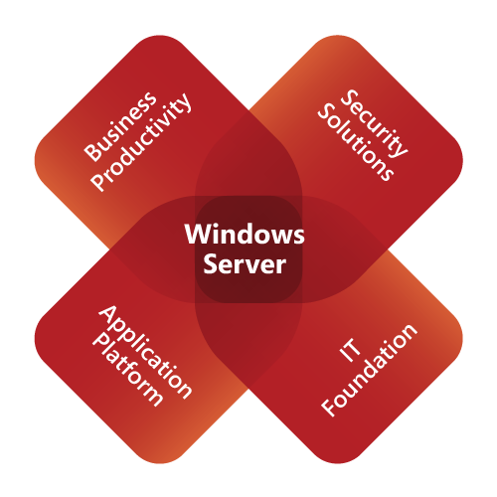
Familia de soluciones Windows Essential Server
{ Soluciones empresariales. Diseñadas y con precios para Medianas Empresas }
Diseñado para Pequeñas y medianas empresas | Versiones completas, integradas y con mejores practicas de implementación Precios y licenciamiento simples y más bajos Estandarizado y extensible a aplicaciones de linea de negocios
Menos complejidad y más control | Administración centralizada en una consola Implementación, control, monitoreo y administración consistentes Mantenimiento del ambiente Microsoft con las mismas herramientas
Crecer capacidad de negocios | Libertad de trabajar desde cualquier lugar con dispositivos moviles Mayor capacidad de crecimiento Menor costo que productos independientes
MultiplyYourPower.com
SBS 2008 Standard
Small Business Server 2008 Premium
Essential Business Server 2008 Standard
Essential Business Server 2008 Premium

Slide 4
Windows Essential Server Solutions
25
75
100
300
Número de PCs
Ideal para negocios con hasta 75 PCs
“Primer servidor” o “servidor correcto”
Standard edition = 1 Servidor
Premium edition = 2 Dos Servidores
Ideal para negocios con menos de 300 computadores
Creado para negocios con personas de tecnología (internos o externos)
Integrada y configurada para la infraestructura de IT de Medina empresa con mejores practicas del mercado
Standard edition = 3 servidores
Premium edition = 4 servidores
Administración de servicios centralizada
Notes:
Next slide will focus on SBS. Here, point out smaller brother SBS as the version below EBS or the version to grow from to EBS.
SBS will support up to 75 users/devices but it is recommended that the server support up to 50 PCs before considering a move to EBS. EBS supports up to300 users/devices.

Slide 5
Windows Small Business Server 2008
Standard
Premium
Windows Server® 2008 Standard
Microsoft® Exchange Server 2007 Standard Edition
Windows® SharePoint® Services 3.0
Windows Server Update Services 3.0
Microsoft Forefront™ Security for Exchange Server^{1, 2}
Windows Live™ OneCare for Server^{1, 2}
Integración con Office Live Small Business²
Lo mismo del standard adicionalmente un segundo servidor con:
Windows Server 2008 Standard
Microsoft SQL Server® 2008 Standard Edition for Small Business³
Administración y configuración centralizados
Protección a información de negocio
Crecer capacidad de negocio
Soporte hasta 75 usuarios o dispositivos
¹ 120 day trial included in product.
² Windows Live OneCare for Server and Office Live Small Business are not available in all markets and languages; Microsoft Forefront Security for Exchange Server is not available in all languages. Please see www.microsoft.com/sbs08 for details. ³ For the first year of availability, customers using applications that are not yet certified for use on SQL Server 2008, a copy of SQL Server 2005 Standard will also be included in SBS 2008 Premium. SQL Server 2008 (or 2005) Standard can be installed on either server; if you install SQL Server 2008 Standard on the first server then you must install the management tools on another machine.
Notes:
Instructor: Both SBS editions have a user/device limit of 75 CALs.
Also probably a good time to “bust a myth” and mention that additional servers (a 3rd, 4th, 5th, etc.) can be added as desired to the SBS environment!
Script: When building the Windows Server Small Business Server, security was a center point of the design from setup through to end of life of the product. Many security enhancements come as defaults in this new server SKU. Some of these items include:
Strong password policies
Creating a new Administrator account so that the Administrator account is not well known
A local host firewall solution using the latest versions of Windows Firewall and enabling core functionality
SSL-based Web security using either a free (self-issued certificate solution) or paid trusted certificate solution to secure Web traffic
Anti-spam features provided by Exchange Server 2007
Built-in WSUS 3.0 with auto-approval policies for critical, security and definition, updates for the entire network
A single point of reference on the server to monitor and manage security services
Instructor Note: Briefly touch on the two editions of SBS, that one is a single server solution, the other a second server solution. The second server, despite being sold with SQL 2008 can be used as any type of server. For instance, TS or other applications.
Next slides are going to dive into included technologies.
Windows Small Business Server 2008 comes in two editions: Standard and Premium.
A Client Access License (CAL) for all included products simplifies license management.
Windows Small Business Server 2008 Premium Edition becomes a second server solution.
Standard Edition will run on one hardware server and Premium Edition will run on two hardware servers, with the second server running Windows Server 2008 Standard and SQL Server 2008 Standard edition for Small Business³ for Line of Business applications.
Windows Small Business Server 2008 will include individual Client Access Licenses (CALs) for Standard and Premium Editions vs. a common CAL for both.
Windows Small Business Server 2008 will include the option to purchase a single CAL (in addition to 5/10/20 CAL Packs) in all channels.
All processor and memory limits will now match Windows Server 2008 Standard Edition.
¹ 120 day trial included in product.
² May not be available in all markets and/or languages. Refer to the Editions Overview page at www.microsoft.com/sbs for details on market and language availability.
³ For the first year of availability, customers using applications that are not yet certified for use on SQL Server 2008, a copy of SQL Server 2005 Standard will also be included in SBS 2008 Premium. SQL Server 2008 (or 2005) Standard can be installed on either server; if you install SQL Server 2008 Standard on the first server then you must install the management tools on another machine.

Slide 6
Minimum System Requirements
Windows Small Business Server 2008
Processor* | 2 GHz, 64-bit (4 physical sockets supported, no limit on cores)
Memory* | 4 GB RAM Minimum – 32 GB RAM Max
OS Drive Partition | 60 GB Minimum
DVD-ROM | Bootable from system BIOS
Network Adapter | 1 x 100 Mb Ethernet adapter
Monitor and Video adapter | Super VGA (SVGA) monitor and video adapter with 800 x 600 or higher resolution
Network Devices | Router that supports IPv4 NAT
*NOTE: Windows SBS 2008 has the same processor and memory limits as Windows Server 2008 Standard. http://www.microsoft.com/windowsserver2008/en/us/compare-specs.aspx
Notes:
http://www.microsoft.com/sbs/en/us/system-requirements.aspx
These are minimum recommended requirements – with hardware it simply is the most that money can buy – faster processors, more RAM, more drive space.
SBS 2008 will work best with only a single NIC installed! The install may fail if there are two NICs detected.
Point out the recommended requirements below here as these are also posted at the SBS2008 site
Small Business Server 2008
Processor: Recommended: 2 GHz or faster Memory: Recommended: 4 GB RAM – maximum is 32GB (the more the better) Maximum: 32 GB Available Disk Space: Minimum: 60 GB
Second Server:
Processor: Recommended: 2 GHz (x86 and x64 processors) and 1 GHz (IA64) or faster Memory: Recommended: 2 GB RAM Available Disk Space: 12.2 GB of available hard-disk space
Both Servers:
Network Card: Ethernet network interface card from the Windows server catalog Internet: Some Internet functionality may require Internet access (fees may apply) and a Windows Live ID Account Fax Modem: Fax Services require fax modem Supported Client Operating Systems: Microsoft Windows XP Professional Edition SP2 or later; Windows Vista Business, Enterprise, and Ultimate; Windows Mobile 5.0 or later
-DVD-ROM drive -Super-VGA (800 × 600) or higher-resolution monitor -Keyboard and Microsoft® Mouse or compatible pointing device -Internet access (fees may apply)

Slide 7
Windows SBS 2008: Razones para comprarlo
Oficina virtual
Acceso en cualquier lugar, y dispositivo
Consola única
Consola integrada de administraicón
Asistente para conexión a Internet
Conexión fácil a Internet
Asistente para respaldo de información
Proteje la información de negocio
Reportes de Red
Reportes de la salud de servidor y estaciones

Slide 8
Cuales son los productos que encontraran los clientes en la Suite de SBS 2008?

Slide 9
Windows Server 2008 Standard
Alta disponibilidad
Soporte a red
Windows PowerShell
Monitores de desempeño
Virtualización
Hyper-V
Multiples sistemas operativos
Web
Internet Information Service 7.0
Integración con ASP.NET
Seguridad
Politicas para control de usuarios
Read Only Domain Controller (RODC)
Notes:
Instructor: Point out that RODC (security) is good to use in a branch-office scenario.
Improved Network Performance and Control—New TCP/IP Stack
The efficient use of bandwidth has a direct impact on the productivity of users working in remote locations that rely on WAN connections to the organization’s central servers. The redesigned “next generation” TCP/IP included in Windows Server 2008 provides vastly improved performance in a remote location scenario, offering faster throughput and more efficient routing of network traffic. Using the combination of Windows Server 2008 and Windows Vista in a branch-office scenario can provide as much as a threefold improvement in throughput over the WAN connection.
Windows PowerShell is a new optional command-line shell and scripting language, which enables administrators to automate routine system administration tasks across multiple servers.
Windows Reliability and Performance Monitor provides powerful diagnostic tools to give you ongoing visibility into your server environment, both physical and virtual, to pinpoint and resolve issues quickly.
Read Only Domain Controller (RODC) allows a more secure method for local authentication of users in remote and branch-office locations using a read-only replica of your primary AD database.
Server Consolidation and Resource Optimization—Hyper-V
Most servers operate at far below their capacities, with as much as 80 to 90 percent of their processing power unused, on average. With Hyper-V, the Windows Server 2008 virtualization solution, a single physical server can host the workloads of multiple Line of Business servers. Hyper-V helps organizations to achieve optimal use of their hardware resources and provides the agility needed to adapt to changing IT needs. New management tools simplify the deployment process and allow IT departments to manage virtual servers with the same familiar tools that they use to manage the physical servers in the network.
Delivering Rich Web Content and Applications—IIS 7.0
As Web content gets richer and the Web becomes a viable platform for delivering business applications, the Web server is moving to the center of many networks. IIS 7.0 delivers solutions for today's demanding content, including streaming media and Web applications in Active Server Pages and PHP. With an updated interface that makes administration easier, the new modular design of IIS 7.0 enables administrators to minimize the attack surface of the Web server by installing only the needed components.

Slide 10
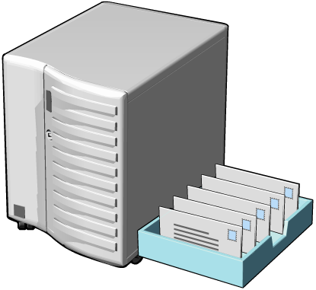
Microsoft Exchange Server 2007
Acceso desde cualquier lugar
Mensajería Web
Mensajería en Celular
Servicios de colaboración
Protección
Anti-spam y Anti-virus
Continuidad de negocio
Mensajería confidencial
Outlook Mobile
Outlook Web Access
Outlook on the desktop
Notes:
Instructor Note: These slides are to be touched on briefly to highlight included technologies in SBS. Later modules will visit these technologies in depth as needed to manage the SBS.
Exchange Server 2007 Features at a Glance
Built-in Protection Anti-spam and Antivirus
Built-in defenses against spam and phishing e-mail as well as additional integrated filtering and multi-engine scanning capabilities provide advanced protection.*
Compliance
Controls for messages in transport or requiring retention, and flexible journaling help meet organizational, legal and regulatory compliance requirements.
Business ContinuityNew data replication capabilities (local and clustered) keep the system highly available while limiting the need and frequency for tape backup.
Confidential MessagingNew encryption features for both internal and Internet-based messages help protect the confidentiality of messages in transit.
Anywhere Access
Web-based Messaging
A rich Office Outlook-like experience from any Internet connected computer with a supported browser provides encrypted access to the inbox, powerful search, and the ability to view different types of attachments.
Mobile Messaging
Exchange ActiveSync technology delivers an improved e-mail and calendaring experience on mobile devices, while offering enhanced device and security policy control.
Collaboration and Productivity
Enhanced calendaring, out-of-office, resource booking, and meeting scheduling capabilities simplify collaboration and increase productivity.
Operational Efficiency
Performance and Scalability
Improved storage efficiency can be achieved through the extended memory and larger cache of x64-based architecture even as mailbox sizes increase; more efficient routing ensures the best use of bandwidth.
Administration
New graphical and command-line interfaces offer improved manageability and increased automation while integrated tools simplify maintenance.
Deployment
Modular setup and server provisioning based on server roles, as well as capabilities to automatically discover Outlook and mobile clients simplify deployment.
Extensibility
New Web services-based application programming interface (API) and .NET integration via Exchange Management Shell tasks enable rapid development for custom and third-party applications.

Slide 11
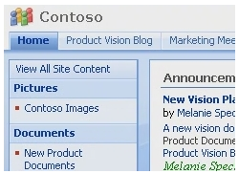
Windows SharePoint Services 3.0
Windows SharePoint Services 3.0
Mejora productividad y trabajo en equipo
Manejo de documentos e integridad de información
Reduce complejidad para seguridad de información
Soporte a Blogs y Wikis
Capacidades de almacenamiento
Alta escabilidad
Permite compartir información a otro nivel
Notes:
Instructor Note: These slides are to be touched on briefly to highlight included technologies in SBS. Later modules will visit these technologies in depth as needed to manage the SBS
The training module for SharePoint is included in the 5-day course, not in the 3-day or shorter courses.
Introduction
Microsoft Windows SharePoint Services 3.0 is a versatile technology that organizations and business units of all sizes can use to increase the efficiency of business processes and improve team productivity. With tools for collaboration that help people stay connected across organizational and geographic boundaries, Windows SharePoint Services gives people access to information they need.
Built on Microsoft Windows Server 2003, Windows SharePoint Services also provides a foundation platform for building Web-based business applications that can flex and scale easily to meet the changing and growing needs of your business. Robust administrative controls for managing storage and Web infrastructure give IT departments a cost-effective way to implement and manage a high-performance collaboration environment. With a familiar, Web-based interface and close integration with everyday tools including the Microsoft Office system, Windows SharePoint Services is easy to use and can be deployed rapidly.
Collaborate Easily and Effectively
Windows SharePoint Services helps teams stay connected and productive by providing easy access to the people, documents, and information they need to make more informed decisions and get the job done. Enhancements in Windows SharePoint Services 3.0 make it easier than ever to share documents, track tasks, use e-mail efficiently and effectively, and share ideas and information.
Provide a single workspace for teams to coordinate schedules, organize documents, and participate in discussions—within the organization and over the extranet.
Easily author and manage documents, and help to ensure their integrity with enhanced features including the option to require document checkout before editing, the ability to view past revisions and restore to previous versions, and the ability to set document-specific security.
Help people and teams stay on task with a variety of communication features that let users know when actions are required or important changes are made to existing information or documentation, including announcements, sophisticated alerts, surveys, and discussion boards.
Provide creative forums for brainstorming ideas, building knowledge bases, or simply gathering information in an easy-to-edit format with new templates for implementing blogs (also known as Weblogs) and Wikis (Web sites that can be quickly edited by team members—no special technical knowledge required).
Stay productive while mobile with enhanced support for offline synchronization through Microsoft Office Outlook 2007 that users can use to manage document libraries, lists, calendars, contacts, tasks, and discussion boards even offline, and to synchronize changes when reconnected to the network.
Top 10 Benefits of Windows SharePoint Services 3.0
Improve team productivity with easy-to-use collaborative tools Connect people with the information and resources they need. Users can create team workspaces, coordinate calendars, organize documents, and receive important notifications and updates through communication features including announcements and alerts, as well as the new templates for creating blogs and Wikis. While mobile, users can take advantage of convenient offline synchronization capabilities.
Easily manage documents and help ensure integrity of content With enhanced document management capabilities including the option to activate required document checkout before editing, the ability to view revisions to documents and restore to previous versions, and the control to set document- and item-level security, Windows SharePoint Services can help ensure the integrity of documents stored on team sites.
Get users up to speed quickly User interface improvements in Windows SharePoint Services 3.0 include enhanced views and menus that simplify navigation within and among SharePoint sites. Integration with familiar productivity tools, including programs in the Microsoft Office system, makes it easy for users to get up to speed quickly. For example, users can create workspaces, post and edit documents, and view and update calendars on SharePoint sites, all while working within Microsoft Office system files and programs.
Deploy solutions tailored to your business processes While standard workspaces in Windows SharePoint Services are easy to implement, organizations seeking a more customized deployment can get started quickly with application templates for addressing specific business processes or sets of tasks.
Build a collaboration environment quickly and easily Easy to manage and easy to scale, Windows SharePoint Services enables IT departments to deploy a collaborative environment with minimal administrative time and effort, from simple, single-server configurations to more robust enterprise configurations. Because deployment settings can be flexibly changed, less pre-planning time is required and companies can get started even faster.
Reduce the complexity of securing business information Windows SharePoint Services provides IT with advanced administrative controls for increasing the security of information resources, while decreasing cost and complexity associated with site provisioning, site management, and support. Take advantage of better controls for site life-cycle management, site memberships and permissions, and storage limits.
Provide sophisticated controls for securing company resources IT departments can now set permissions as deep down as the document or item level, and site managers, teams, and other work groups can initiate self-service collaborative workspaces and tasks within these preset parameters. New features enable IT to set top-down policies for better content recovery and users, groups, and team workspace site administration.
Take file sharing to a new level with robust storage capabilities Windows SharePoint Services supplies workspaces with document storage and retrieval features, including check-in/check-out functionality, version history, custom metadata, and customizable views. New features in Windows SharePoint Services include enhanced recycle bin functionality for easier recovery of content and improved backup and restoration.
Easily scale your collaboration solution to meet business needs Quickly and easily manage and configure Windows SharePoint Services using a Web browser or command-line utilities. Manage server farms, servers, and sites using the Microsoft .NET Framework, which enables a variety of custom and third-party administration solution offerings.
Provide a cost-effective foundation for building Web-based applications Windows SharePoint Services exposes a common framework for document management and collaboration from which flexible and scalable Web applications and Internet sites, specific to the needs of the organization, can be built. Integration with Microsoft Office SharePoint Server 2007 expands these capabilities further to offer enterprise-wide functionality for records management, search, workflows, portals, personalized sites, and more.

Slide 12
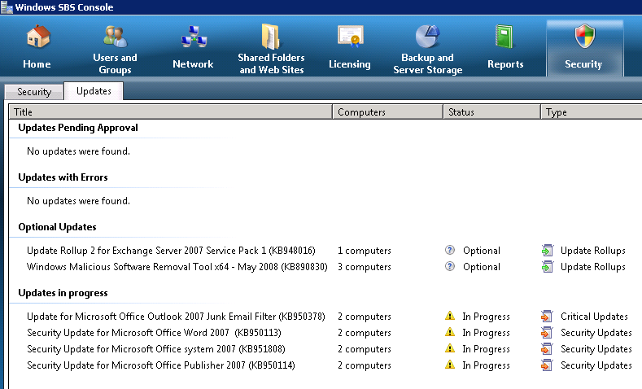
Windows Server Update Services 3.0
Windows Server Update Services 3.0
Implementa las ultimas actualizaciones de Microsoft
Mantiene computadores y servidores al día
Mantiene la red saludable y al día
Integrado con consola de SBS
Semaforos de chequeo
Integrado en reportes de red
Notes:
Support for Windows Server 2008
Support for SQL Server 2008
Enhanced bulk approval capability, preserving existing approvals
Support for separate proxy servers and ports for SSL and non-SSL traffic
Office Excel report export
Microsoft Update
The Microsoft Web site that distributes updates of Microsoft products.
Windows Server Update Services server
The WSUS server allows administrators to manage and distribute updates through the WSUS 3.0 Administration console, which can be installed on any Windows computer in the domain. In addition, a WSUS server can be the update source for other WSUS servers within the organization. At least one WSUS server in the network must connect to Microsoft Update to get available update information. The administrator can determine, based on network security and configuration, whether or not other servers should connect directly to Microsoft Update.
Automatic Updates
This component is built into the Windows Server 2008, Windows Vista, Windows Server 2003, Windows XP, and Windows 2000 SP4 operating systems. Automatic Updates enables both server and client computers to receive updates from Microsoft Update or from a WSUS server.

Slide 13
Forefront Security for Exchange Server
Microsoft Forefront Security for Exchange Server ^{1,2}
Valido por 120 días
Múltiples motores de escaneo para virus (8)
Integrado directamente con Aplicaciones Microsoft
Microsoft Exchange Server 2007 Standard Edition
Pre-configurado para SBS
Revisión de Virus
Filtro de Archivos
Filtro de contenidos
Notificaciones al administrador
¹ 120 day trial included in product.
² May not be available in all markets and/or languages. Refer to the Editions Overview page at www.microsoft.com/sbs for details on market and language availability.
Notes:
3 min (new in SBS2008)
Instructor Notes: See bold below – please cover different scan options available.
Currently no integration Forefront/WSS on SBS2008 – planned to be available in subsequent releases
Microsoft Forefront Security for Exchange Server SBE (small business edition)
120 free trial
Multiple antivirus scan engines (eight) - (can only select 5 at a time)
File filtering by file name, extension, or size
Integrates directly with server applications
Exchange Server 2007 Scanning/Background scanning
and WSS Scanning (when available)
Comprehensive notifications to administrator
Scan job options
Real-time
In Forefront Security for Exchange Server, the Realtime Scan Job continuously scans inbound and outbound e-mail messages. This method of scanning e-mail messages in real time is the most effective way to stop the spread of infectious file attachments. You can configure the Realtime Scan Job to scan message bodies as well as attachments. This feature is disabled by default.
In Forefront Security for SharePoint, the Realtime Scan Job continuously scans the files that users upload to or download from a SharePoint server. This method of scanning file transfers in real time is the most effective method to stop the spread of infectious files. Forefront Security for SharePoint can support up to ten real-time processes. By default, it supports three real-time processes.
Manual
In Forefront Security for Exchange Server, the Realtime Scan Job continuously scans inbound and outbound e-mail messages. This method of scanning e-mail messages in real time is the most effective way to stop the spread of infectious file attachments. You can configure the Realtime Scan Job to scan message bodies as well as attachments. This feature is disabled by default.
In Forefront Security for SharePoint, the Realtime Scan Job continuously scans the files that users upload to or download from a SharePoint server. This method of scanning file transfers in real time is the most effective method to stop the spread of infectious files. Forefront Security for SharePoint can support up to ten real-time processes. By default, it supports three real-time processes.
Transport
In Forefront Security for Exchange Server, the Realtime Scan Job continuously scans inbound and outbound e-mail messages. This method of scanning e-mail messages in real time is the most effective way to stop the spread of infectious file attachments. You can configure the Realtime Scan Job to scan message bodies as well as attachments. This feature is disabled by default.
In Forefront Security for SharePoint, the Realtime Scan Job continuously scans the files that users upload to or download from a SharePoint server. This method of scanning file transfers in real time is the most effective method to stop the spread of infectious files. Forefront Security for SharePoint can support up to 10 real-time processes. By default, it supports three real-time processes.
Quick Scan – Immediately
Scheduled background scanning
In Forefront Security for Exchange Server, a scheduled background scan helps you periodically scan a selected set of messages by using the latest engine updates and scanning configurations. The scope of the background scan is determined by the options that you select in the Background Scanning section of the General Options work pane. The Background Scanning option is not offered by Forefront Security for SharePoint.
On-access scanning
On-access scanning is a new feature that is provided by Exchange Server 2007. This feature ensures that all the files that are accessed by the Exchange Server 2007 server are scanned at least once by Forefront Security for Exchange Server. On-access scanning is not offered by Forefront Security for SharePoint.

Slide 14
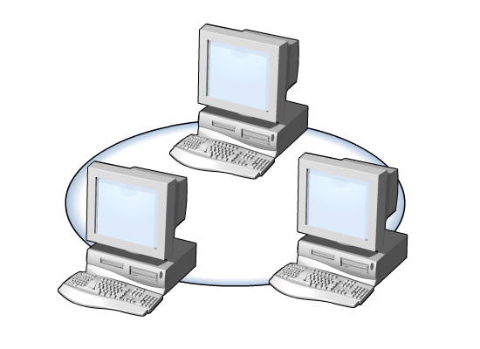
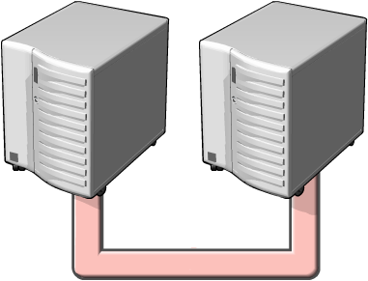
Windows Live OneCare
Windows Live OneCare for Server ^{1,2}
Prueba por 120 días
Administración de múltiples PCs
Protección antivirus
Respaldo y recuperación (Backup)
¹ 120 day trial included in product.
² May not be available in all markets and/or languages. Refer to the Editions Overview page at www.microsoft.com/sbs for details on market and language availability.
Notes:
Instructor: Windows Live OneCare for server also offers a backup feature. It is always recommended to use the SBS backup. By default, the Backup and Restore in OneCare is turned off.
(Point out that we are in RC0, so for RTM it may be different.)
AV:
AV and antispyware
Microsoft update integration
File and photo backup:
Backs up to CD, DVD, external hdd, network share, USB drives
Up to 3 PCs in circle:
Connects/shares printers
Automatic updates:
Automatic AV updates
Automatic version updates

Slide 15
Servicios Office Live
Integración con Microsoft Office Live Services for Small Business^{1,2}
Creación de un sitio Web para su negocio
Compartir documentos con clientes de forma segura
Públicar su negocio en el AdCenter
Capacidades de E-commerce
Administración de Office Live desde la consola de Windows SBS
Redirecciona trafico a sitio de Office Live
¹ Requires Windows Live ID ² May not be available in all markets and/or languages. Refer to the Editions Overview page at www.microsoft.com/sbs for details on market and language availability.
Notes:
Instructor Note: These slides are to be touched on briefly to highlight included technologies in SBS. Later modules will visit these technologies in depth as needed to manage the SBS.
Note: Point out that DNS will be managed through SBS server using the Internet Address Management wizard, as well as the redirect of the public facing web site of the business.

Slide 16
Windows SBS 2008 Premium
Windows Server 2008 Standard
Microsoft® SQL Server® 2008 Standard for Small Business ¹
Todas las tecnologías de Windows SBS 2008 Standard … más:
Hasta 75 usuarios
¹ For the first year of availability, customers using applications that are not yet certified for use on SQL Server 2008, a copy of SQL Server 2005 Standard will also be included in SBS 2008 Premium. SQL Server 2008 (or 2005) Standard can be installed on either server; if you install SQL Server 2008 Standard on the first server then you must install the management tools on another machine.
Notes:
Instructor Note: All the technologies from the Standard Edition plus Windows Server 2008 Standard x64 and SQL 2008 Standard for Small Business
Highlight that “Windows Server 2008 Standard technologies” is exactly the same as regular Windows Server 2008 Standard except for two things:
75 user/device licensing limit
Must be joined to an SBS 2008 domain
SBS2008 Premium Edition technologies:
Windows Server 2008 Standard (can be 64x or 86x)
Microsoft Exchange Server 2007 Standard Edition
Windows SharePoint Services 3.0
Windows Server Update Services 3.0
Microsoft Forefront Security for Exchange Server ^{1,2}
Windows Live OneCare for Server ^{1,2}
Integration with Microsoft Office Live Small Business ²
Plus:
A Windows Server 2008 Standard
SQL Server 2008 ³
Will not wait for SQL 2008 if not ready and ship w/2005
¹ 120 day trial included in product.
² May not be available in all markets and/or languages. Refer to the Editions Overview page at www.microsoft.com/sbs for details on market and language availability.
³ For the first year of availability, customers using applications that are not yet certified for use on SQL Server 2008, a copy of SQL Server 2005 Standard will also be included in SBS 2008 Premium. SQL Server 2008 (or 2005) Standard can be installed on either server; if you install SQL Server 2008 Standard on the first server then you must install the management tools on another machine.

Slide 17
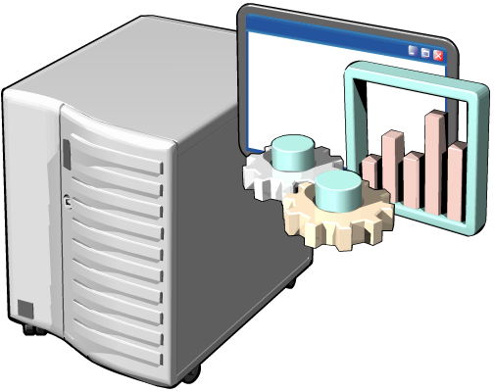
Segundo Servidor
Windows Server 2008 Standard
Servidor de aplicaciones (LOB)
Servidor de Virtualización (Hyper-V)
Servidor de Terminal Services (TS)
Notes:
Instructor Note: Emphasize that the second server can be used for addl applications such SQL 2008 (next slide) and running TS or Hyper-V.
Virtualization Built-in
Windows Server Hyper-V, the next-generation hypervisor-based server virtualization technology, allows you to make the best use of your server hardware investments by consolidating multiple server roles as separate virtual machines running on a single physical machine. You can also efficiently run multiple operating systems - Windows, Linux, and others – in parallel on a single server. With Hyper-V and simple licensing policies, it's now easier than ever to take advantage of the cost savings of virtualization.
Applications can also be efficiently virtualized using Windows Server 2008 centralized application access technologies. Terminal Services Gateway and Terminal Services RemoteApp allow easy remote access to standard Windows-based programs from anywhere by running them on a terminal server instead of directly on a client computer - without the need for a complicated virtual private network (VPN).
.

Slide 18
Microsoft SQL Server 2008 Standard for Small Business ¹
Manejo de datos desde cualquier lugar
Almacena información desde:
Documentos estructurados, semi-estructurados, no estructurados
Servicios integrados permiten:
Análisis y búsqueda de datos
Integración con aplicaciones personalizadas
Integración con Microsoft Office system
Microsoft® Office Word, Microsoft® Office Excel®
¹ For the first year of availability, customers using applications that are not yet certified for use on SQL Server 2008, a copy of SQL Server 2005 Standard will also be included in SBS 2008 Premium. SQL Server 2008 (or 2005) Standard can be installed on either server; if you install SQL Server 2008 Standard on the first server then you must install the management tools on another machine.
Notes:
1 min
Instructor Note: most students will have little or no SQL experience/knowledge. Use or refer to case studies http://www.microsoft.com/sqlserver/2008/en/us/case-studies.aspx to sprout ideas what SQL could be used for at customer sites.
(most micro-SBS customers have third-party apps that come with own SQL engine)
Your Data, Any Place, Any Time
SQL Server 2008 delivers on Microsoft’s Data Platform vision by helping your organization manage any data, any place, any time. It enables you to store data from structured, semi-structured, and unstructured documents, such as images and music, directly within the database. SQL Server 2008 delivers a rich set of integrated services that enable you to do more with your data such as query, search, synchronize, report, and analyze. Your data can be stored and accessed in your largest servers within the data center all the way down to desktops and mobile devices, enabling you to have control over your data no matter where it is stored.
SQL Server 2008 enables you to consume your data within custom applications developed using Microsoft .NET and Visual Studio and within your service-oriented architecture (SOA) and business process through Microsoft BizTalk Server while information workers can access data directly in the tools they use every day, such as the 2007 Microsoft Office system. SQL Server 2008 delivers a trusted, productive, and intelligent data platform for all your data needs.
Microsoft Office Integration
SQL Server 2008 provides new Word rendering that enables users to consume reports directly from within Microsoft Office Word. In addition, the existing Excel renderer has been greatly enhanced to accommodate the support of features, like nested data regions, sub-reports, as well as merged cell improvements. This lets users maintain layout fidelity and improves the overall consumption of reports from Microsoft Office applications.

Slide 19
Administración simple
Conexión a Internet
Manejo de dirección en Internet
Correo en Internet
Red virtual privada
Asistente para “mi primera red”
Instalación de certificados
Asistente para conectar computadores
Asistente para respaldo de información
Asistentes para:
Notes:
30 sec
Instructor Note: The next slides are to be touched on briefly to highlight the main wizards and features included in SBS that simplify administrative tasks. Later modules will visit these in depth as needed to manage the SBS
By its very nature, an operating system running multiple technologies tends toward complex management. However, managing a complex environment does not have to expose that complexity for all tasks. Windows Small Business Server 2008 reduces operating system complexities by using an intuitive management console, one that presents an administrator with relevant system information and a matching set of tasks.
These tasks are the ones most commonly needed by administrators and have been streamlined. Tasks that may take hours to complete with standalone product technologies become very simple, efficient, and effective processes that a non-technical person can perform.
For example, adding a new user to the Windows Small Business Server 2008 network requires a small set of user-specific information and three clicks in a wizard. Windows Small Business Server 2008 handles the rest, automating user account creation—creating the user e-mail alias, providing permissions to server resources, and building the user’s root directory.

Slide 20
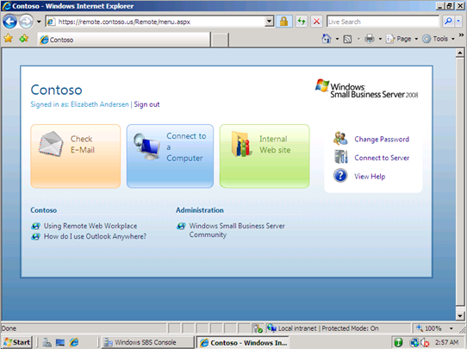
Oficina Virtual
Dos interfaces
Usuarios tienen acceso a:
Correo electronico
Calendarios
Portal Interno de la compañía
Escritorios de usuario
Una sola clave para todo
Servicios de recuperación de contraseñas
Administradores
El mismo acceso de usuarios
Acceso a consola de admnistración
Conexión a Servidores
Notes:
1 min
Remote Web Workplace is a dynamically-updated Web site that provides a single, simple, consolidated, and secure entry point into a small business network. Authorized users can connect to Remote Web Workplace using any computer connected to the Internet with Internet Explorer installed. It brings flexibility to small businesses by offering anytime, anywhere access for employees.
Remote Web Workplace provides two interfaces: one for employees and one for administrators.
For employees, Remote Web Workplace:
Offers full access to e-mail and calendars through Outlook Web Access; to an intranet portal via SharePoint Services; or to computer desktops using Remote Desktop Protocol (RDP).
Provides a single sign-on experience—an employee’s initial authentication will pass through to all subsequent actions within Remote Web Workplace for which they have permissions.
Offers self-service password resets.
For administrators, Remote Web Workplace:
Offers the same access as employees, plus access to the Windows SBS Console through an RDP connection.
Provides links to administrative tools.

Slide 21
Asistente para conectar a Internet
Notes:
1 min
Instructor Note: The Connect to the Internet Wizard configures the basic network settings for the new server, whether connecting to an existing network or setting up a network for the first time. It automates many of the traditional network configuration processes and helps eliminate errors that may arise from configuration mistakes.
If the server is connected to the network and the router is configured properly, the Internet connection is set up during Windows Server SBS installation.

Slide 22
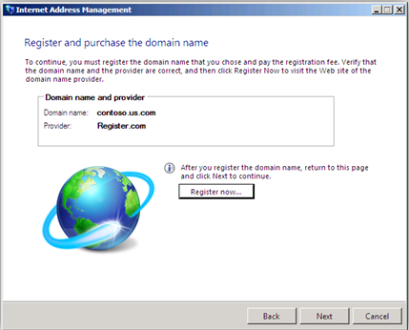
Administración de dirección en Internet
Registrar un nuevo dominio
Administración de un dominio existente
Integración con un dominio
Notes:
1 min
The Internet Address Management Wizard helps the administrator configure the server’s domain name and register that name with an Internet registrar. For businesses that already have a domain name, the Wizard allows the administrator to manually configure the appropriate settings.
The Internet Address Management Wizard (IAMW) configures domain name settings for the network. It helps an administrator obtain a new domain name or work with an existing one. The IAMW automatically configures e-mail services (Exchange Server) and remote access services (Remote Web Workplace) based on the domain name information provided.
Options
There are three specific options available within the Internet Address Management Wizard:
Register for a new domain name from within Windows Small Business Server 2008 through one or more Domain Name Registrar partners.
Transfer the management of an existing domain name from within Windows Small Business Server 2008 through one or more Domain Name Registrar partners.
Integrate an existing domain into the Windows Small Business Server 2008 environment and manage it manually.

Slide 23
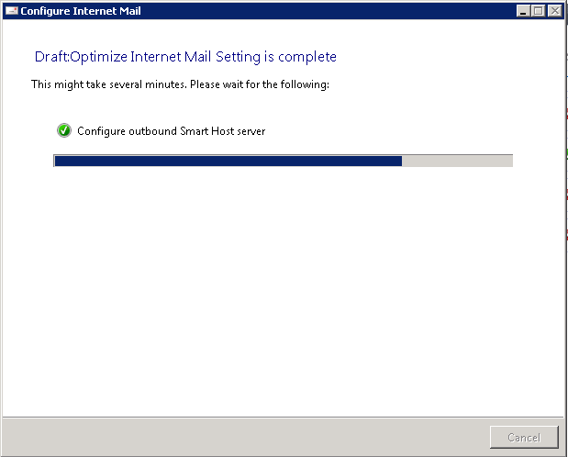
Correo Internet
Configurar correo electronico
Microsoft Exchange Server 2007
Alta velocidad de acceso
Seguridad en correos
Alta disponibilidad de servicios
Notes:
1 min
SBS includes features to help you configure and enhance the security and reliability of the e-mail messages that users send and receive over the Internet.
During installation, SBS automatically configures Exchange Server 2007 to route e-mail messages to and from users on the network. However, you can also configure your server to route your mail through a hosted mail server (smart host) that is managed by your Internet service provider (ISP).
The Configure Internet Mail Wizard also helps improve server performance by offloading some mail processing tasks to your ISP (such as services that monitor e-mail messages for spam or viruses).
Specifically, the Configure Internet Mail Wizard configures the following features:
Enhanced message security Sets up a mail relay that allows you to forward e-mail messages only to trusted servers. Advanced users can also implement authentication, which adds an additional level of security.
Improved e-mail reliability Configures your server to take advantage of the services that are offered by your ISP. As a result, outgoing mail is processed more efficiently and there is less chance of your messages being refused by another server.
Improved server performance Configures your server to enable your ISP to assume responsibility for queuing your e-mail messages and routing them through the appropriate DNS servers. Your ISP can also screen inbound messages for spam and viruses. Your Exchange Server scans these messages, which adds to the depth of protection.

Slide 24
© 2008 Microsoft Corporation. All rights reserved. Microsoft, Windows, Windows Vista and other product names are or may be registered trademarks and/or trademarks in the U.S. and/or other countries.
The information herein is for informational purposes only and represents the current view of Microsoft Corporation as of the date of this presentation. Because Microsoft must respond to changing market conditions, it should not be interpreted to be a commitment on the part of Microsoft, and Microsoft cannot guarantee the accuracy of any information provided after the date of this presentation. MICROSOFT MAKES NO WARRANTIES, EXPRESS, IMPLIED OR STATUTORY, AS TO THE INFORMATION IN THIS PRESENTATION.

Slide 25
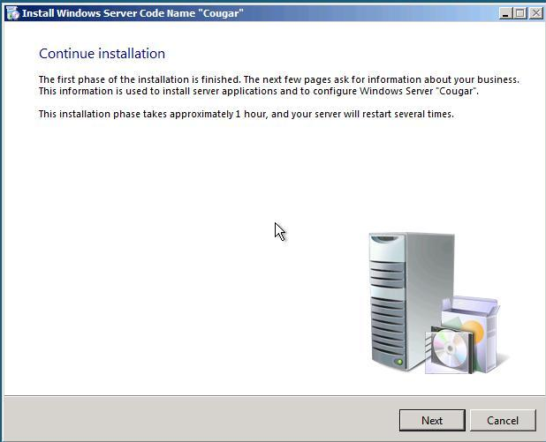
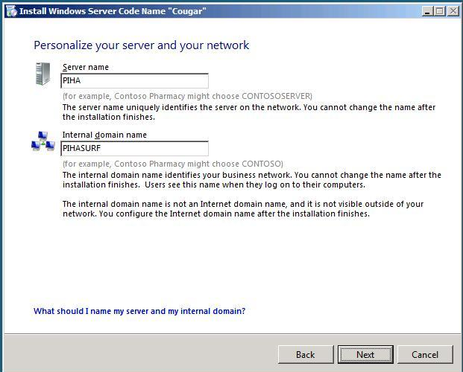
Simplified Setup and Admin
Setup only answering Business related questions
Simple language to explain each step
Designed to meet the needs of Small Business
More customization via answer file or post-setup configuration

Slide 26
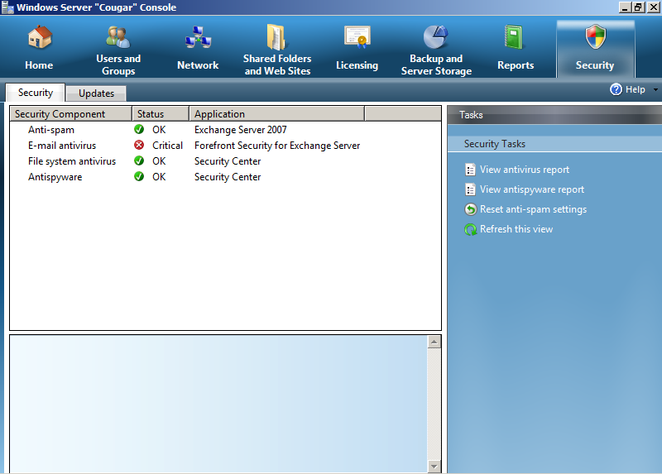
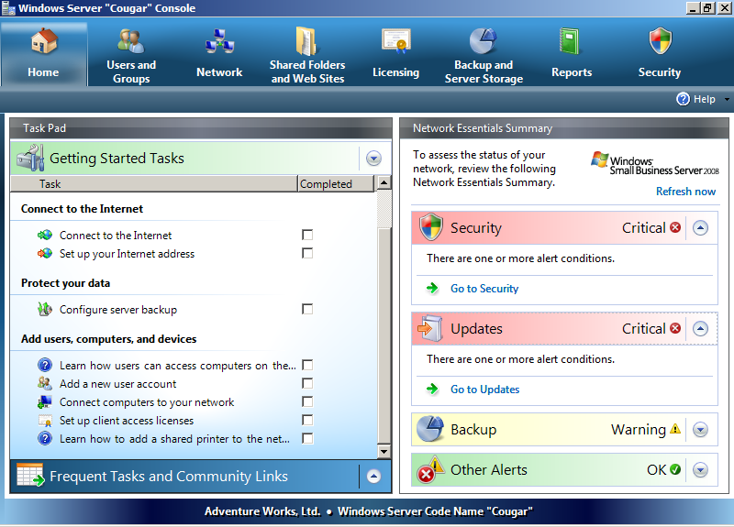
Enhanced Network Wide Protection
Task driven security management
Deployed with secure best practices
Business Data secured and protected from loss
Rich views into the behavior of your entire network
Server Protection with OneCare for Server (1-year trial)
Network Firewall required

Slide 27
Security continued….
A firewall is required as part of Small Business Server 2008 setup – HW, ISA etc customers choice
SBS Server must hold FSMO roles
No child domains or cross-forest trusts

Slide 28
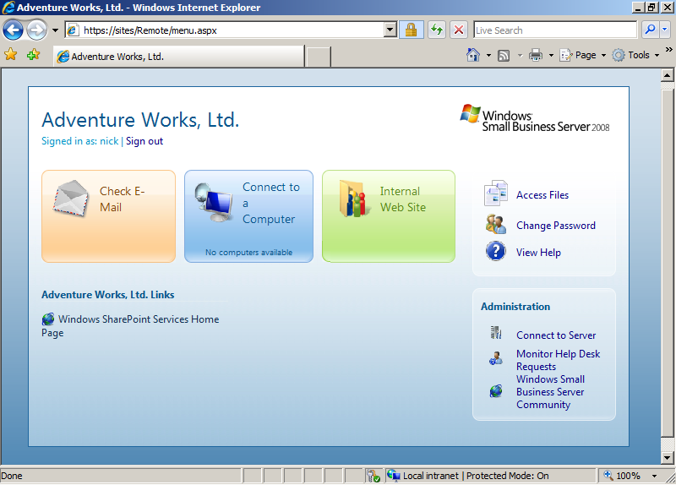
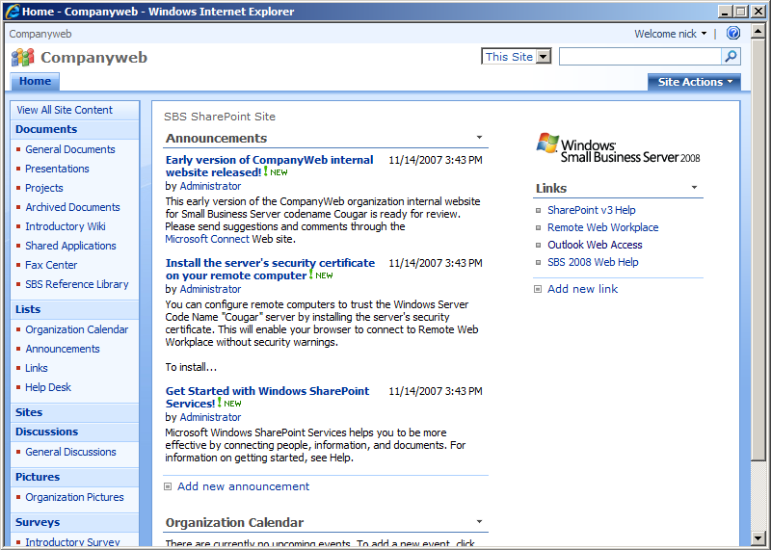
Business Productivity
Remote Web Workplace
Email
Files
Intranet
Remote PC access
WSS v3 installed by default
Document Collaboration
Many new features: Wikis, Blogs, per item security

Slide 29
SBS Premium Designed for LOB
Premium includes a license for Windows Server 2008
Premium also includes SQL Server 2008 for Small Business
Second Server ideal for
LOB applications
TS Application Sharing
Secondary Domain Controller
Other standalone uses

Slide 30
The Solution Family
Complete Infrastructure Platform Designed and Priced for SMB
Right Investment Ready for Growth
Remote Web Workplace
Business Application Ready
Enterprise Class Technologies
Guided Migration
Tailored Admin Experience
Leverage Existing Investments
Windows Small Business Server 2008 Standard
Windows Small Business Server 2008 Premium
Windows Essential Business Server 2008 Standard
Windows Essential Business Server 2008 Premium
25
50
100
250
Number of PCs
Notes:
Window Essential Server Solutions
Complete Infrastructure Platform designed and Priced for SMB
Right Investment Ready for Growth
Business Application Ready
Guided Migration
Leverage existing Investments
Tailored admin experience
Enterprise Class Components
Remote Web Workplace

Slide 31
Which to Choose
Windows Essential Business Server 2008
Windows Small Business Server 2008
Number of PCs
25
50
100
250
Point at which, on average,
businesses hire Full-time IT person
Small Business Server
2008
Essential Business Server 2008
Built for Businesses without internal IT Professional
Built for Businesses with IT Professional
Simplified administration of
core server infrastructure
Unified administration of
multiple-server IT environment
Designed for 75 users or less
Designed for 300 users or less
Engage your local Microsoft Partner to help you choose and implement
the right solution for your business, and complement your in-house IT skills.
Notes:
11/13/2008 11:13 AM
31
Which to Choose
Small Business Server
Simplified Administration
First Server Right Server
75 users or less
Essential Business Server
Unified Administration Console
Broad Integrated Infrastructure
300 users or less

