Slide 2
SharePoint 2010 Upgrade Overview
Name
Title
Company

Slide 3
Upgrade Cycle: Overview
Learn
Requirements/ prerequisites
Upgrade methods
Downtime mitigation
Common issues
Validate
Prepare
Upgrade event failures
UI/UX issues
Data issues
Document environment
Manage customizations
Plan upgrade strategy
Make items upgradable
Implement
Test
Build/upgrade farms
Deploy customizations
Minimize downtime
Monitor progress
Build test farms
Use real data
Evaluate techniques
Find issues early

Slide 4
Objectives
Prerequisites and upgrade paths
Upgradable databases
Methods for upgrading
Choose the correct upgrade method
Improvements in upgrade

Slide 5
Agenda
Requirements/supported upgrade paths
Databases/SSP changes
Upgrade methods
Downtime mitigation
Visual upgrade
Upgrade improvements

Slide 6
Requirements
Upgrade: Learn

Slide 7
Minimum Hardware Requirements
CPU
x64
Quad processor, 2.5 Ghz
Memory
4 GB for developer or evaluation use
8 GB for production use
Storage
80 GB for installation
Additional drive space required for day to day use

Slide 8
Minimum Software Requirements SQL Server/OS
SQL Server 2005
x64 edition
Service Pack 3 + KB967909
SQL Server 2008
x64 edition
Standard
Service Pack 1 + KB970315
Operating System
x64 Windows Server 2008 SP2 Standard
X64 Windows Server 2008 R2 Standard

Slide 9
Helpful Tips
Required to format and reinstall server prior to install if SharePoint 2010 beta was previously installed.
SQL Server 2008 R2 will be supported when it is officially released.

Slide 10
Software Prerequisites
WCF Hotfix - KB976394 (2008) or KB976462 (R2)
SQL 2008 Native Client
Windows Identity Foundation
Sync Framework Runtime v1.0 (x64)
Chart Controls for .NET Framework 3.5
Filter Pack 2.0
SQL Server 2008 Analysis Services ADOMD.NET
Speech Platform Runtime
Speech Recognition Language
Windows PowerShell 2.0
Web Server Role
Application Server Role
Microsoft .NET Framework 3.5 SP1

Slide 11
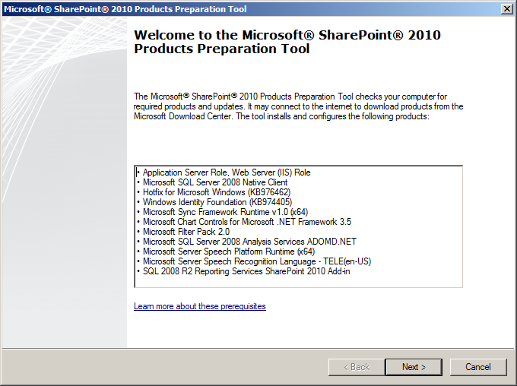
Prereq Installer

Slide 12
Wizards
Microsoft SharePoint Products and Technologies 14 Preparation Tool
Installs the prerequisites
Setup Wizard
Installs binaries
Configures security permissions
Sets registry settings
SharePoint Product and Technologies Configuration Wizard
Installs and configures the configuration database
Installs the SharePoint Central Administration web site
OR Joins server to existing farm
Server Farm Configuration Wizard
Configures the farm
Creates the first site collection
Selects the services and accounts

Slide 13
Minimum Software Requirements Client
Microsoft Silverlight™ 3
Level 1 browsers
IE7 & IE8 (32bit), Firefox 3.5 on Windows
Level 2 browsers
Safari 4.x and Firefox 3.5 on OS X Snow Leopard
IE7 & IE8 (64bit)
Firefox 3.5 on Unix/Linux 8.1
IE 6 is not supported
Details on browser support
http://technet.microsoft.com/en-us/library/cc263526(office.14).aspx

Slide 14
Upgrade methods
Upgrade: Learn

Slide 15
2010 Upgrade Philosophy
Detect issues early
Provide O12 tools to admins
Report critical issues at start of upgrade
Keep the administrator informed
No data loss
Keep content and settings
Minimize downtime
Downtime mitigation processes
Continue when possible
Be reentrant
Upgrade should not be catch 22

Slide 16
2010 Upgrade Overview
New
Upgrade Preparation Tools
Windows PowerShell Upgrade Cmdlets
Feature Upgrade
Visual Upgrade
Patch Management
Downtime Mitigation Processes:
Parallel Upgrade Pipelines
Content DB Upgrade with AAM Redirection
Changed
Upgrade Methods
Improved
Upgrade Status Reporting
Upgrade Logging
Read-only DB Support
Removed
Gradual Upgrade
Side By Side Installation

Slide 17
2010 Upgrade Scenarios and Methods
Supported Scenarios
Unsupported Scenarios
In-Place Upgrade
Database Attach Upgrade:
Content Database
Profile Service Database
Project Service Database
Single Click Install - SQL Migration
Windows Internal Database (WID) -> SQL Express 2008 + File Stream RBS
Upgrade from earlier than WSS v3 SP2/MOSS 2007 SP2
Direct upgrade from WSS v2/SPS 2003 or earlier
Side by side installation
Gradual upgrade

Slide 18
In-Place
Next, next, finished ☺
Advancements
Restartable!
Common blocking time outs removed

Slide 19
In-Place Upgrade
All sites are unavailable during upgrade
Site visitors continue to use the same URLs after upgrade
Does require v3 to be 64 bit
Whitepaper on moving from 32 bit to 64 bit SharePoint
http://technet.microsoft.com/en-us/library/dd622865.aspx
Previous version must be manually removed

Slide 20
In-Place Upgrade Process
WFE
Web App
Web App
WSS v3
WSS v4
v3 Farm
v4 Farm
SQL Instance
Config
Content
Content
Content
Content

Slide 21
In-Place Pros/Cons
Pros
Cons
Farm wide settings are preserved and upgraded
Customizations are available in the environment after the upgrade if they are v4 compatible
Servers and farms are offline while the upgrade is in progress
The upgrade proceeds continuously
Existing v3 farm must support (64 bit and performance

Slide 22
Database Attach
Databases that can be attached
Content database
Profile service database
Project service database
V3 databases that cannot be attached
Configuration
Search

Slide 23
Database Attach Steps
Backup 2007 Content DB
Restore to SharePoint 2010 SQL Server, using SQL Tools
Test-SPContentDatabase –name wss_content_2007 –webapplication http://2010webapp
Mount-SPContentDatabase –name wss_content_2007 –webapplication http://2010webapp

Slide 24
DB Attach Pros/Cons
Pros
Cons
Upgrade multiple content databases at the same time
Combine multiple farms into one farm
Customizations must be transferred manually
The server and farm settings are not upgraded
Customizations must be transferred manually
Missing customizations

Slide 25
Database Attach
Demo

Slide 26
Hybrid Approach
Detach DBs
Upgrade to 2010 in-place
DB Attach content DBs

Slide 27
Hybrid Pros/Cons
Pros
Cons
Farm wide settings preserved
Customizations already in place
Multiple content databases at the same time
Non-upgraded sites (in read-only mode) while you upgrade the content
Labor intensive
Direct access to the database servers
x86 is a lot of work
Existing hardware may need replacing

Slide 28
Supported Paths
Upgrade: Learn

Slide 29
Supported Paths In-Place x86
x86
MOSS 2007
SP2
x64
MOSS 2007
SP2
MSS 2010
x86
x86
MOSS 2007
SP2
x64
MOSS 2007
SP2
MSS 2010
WSS v3.0
SP2
V3 must not be a Trial installation.
x86
x64
2010
WSS v3.0
SP2
WSS v3.0
SP2

Slide 30
WID Migrate to SQL Express + RBS Content DB migration process model
Standalone install
V4 Farm
WSS V4 Web App
WID SQL Instance
SQL Express Instance
Config
Content
Content
Content
Content
Config
Backup/Restore
Move
Search
Copy BLOBs
RBS
RBS

Slide 31
Project Server
Now requires SharePoint Server 2010
Upgrade prior
Has its own Ignite Course

Slide 32
Upgrading FBA Web Apps
Convert Web applications to claims-based authentication
Update web.config with necessary connection information for your provider
Use PowerShell to migrate users and permissions

Slide 33
Databases
Upgrade: Learn

Slide 34
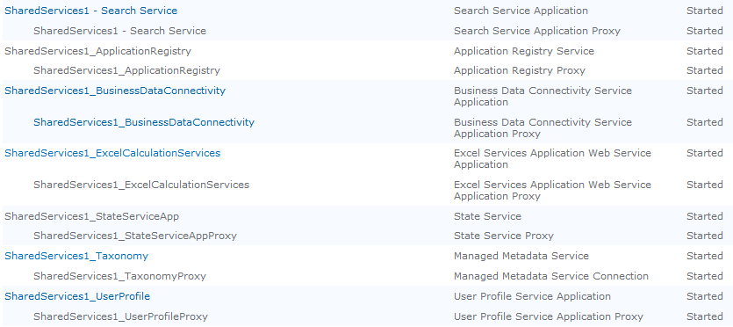
SSP exploded to service applications – Inplace

Slide 35
SSP Service Applications
O12 SSPs and service settings = Flexible shared services model
Service Applications = part of Foundation
Notification of new services after in-place upgrade
Backup/restore of individual services + Provisioning offbox

Slide 36
SSP Service Applications
SSP admin site not upgraded (in-place)
No longer necessary
Health rule to remind you to delete it
SSP database repurposed to User Profile Service Application database
SSP Admins become Central Admin delegated administrators

Slide 37
SSP Service Applications
Multiple SSPs automatically wire up (In-Place)
Web applications to proxy groups
Inter-farm SSP environments are required to upgrade the parent farm SSP first
DB Attach of SSP DB for profiles

Slide 38
Upgrading Parent->Child Farms Phased hybrid upgrade approach
2007 Parent Farm
2010 Parent Farm
2007 Parent Farm Copy
2007
Services
Backup/Restore
2007
Services
2010
Services
Synchronize Data
2010 Child Farm 1
V3 Child Farm 1
V3 Child Farm 2
2010 Child Farm 2
2010
Web App
2010
Web App
2007
Web App
2007
Web App

Slide 39
Downtime mitigation
Upgrade: Learn

Slide 40
Downtime Mitigation Processes
Read-only databases (v3 SP2, v4)
Parallel content database upgrades
Parallel upgrade farms (v4)
Single farm, multiple upgrade sessions (v4)
Content database attach with AAM redirection (v4)
http://technet.microsoft.com/en-us/library/ee720448(office.14).aspx

Slide 41
Read Only Content Databases
From SQL Server set content database to read only
SharePoint sees the change and updates the UI on all Site Collections in the database to read only for everyone
Allows for scenarios where data is available read only while upgrade happens on a different farm

Slide 42
Parallel upgrades
Detach all content databases from v3 farm then perform inplace upgrade
While inplace upgrade is running attach content databases to temporary farms to perform upgrade
Reattach upgraded content databases to original farm once inplace upgrade is complete

Slide 43
Another Parallel Upgrade
Multiple content database attach allowed in the farm at the same time
Just open multiple Windows PowerShell sessions
Parallelism has benefits and limits
Roughly 10% overhead at 4 DBs each with one separate spindle
Upgrades can take longer if using same spindle
SQL IOPS & memory are first order item

Slide 44
Database Attach with AAM Redirect User interaction model
SQL
SQL
?
302

http://WSS
http://WSSold
http://WSS
WFE
WFE
v3 Farm
v4 Farm
WSS v3
Web App
WSS v4
Web App
SQL Instance
v3
Config
v3
Content
v4
Content
v4
Config
Move DB

Slide 45
What is “Visual Upgrade”
A feature that separates data upgrade from UI upgrade
Data and code upgrade happens all at once
Site UI has two modes: this version and previous version
Pages and components make the decision at runtime, and it’s safe by default

Slide 46
Why “Visual Upgrade”?
IT
Focus on the data
Schedule flexibility
Developers
Clear expectations
More control over legacy code and controls
Users
Puts the user impact into users’ hands
Accommodates big shifts (ribbon)

Slide 47
Visual Upgrade
Default upgrade UI is v3
Option to use v4 UI in PSConfig
Single-click installations have no option
Granularity
Web
Site
Setup, PSConfig, and STSAdm
Reporting
Admins can report per Site Collection

Slide 48
Visual Upgrade
PWA (did not support customization in O12)
My sites –Public view (will not preserve customizations on upgrade)
Search Center (preserves web parts but resets User Interface)

Slide 49
Visual Upgrade
Use PowerShell to manipulate visuals
$Site = Get-SPSite $SiteURL
# The line below will display/hide the options to change the UI for all sites
$Site.UIVersionConfigurationEnabled = $true
$Web = $Site.RootWeb
# The line below will display/hide the options to change the UI for the root web
$Web.UIVersionConfigurationEnabled = $true
# The lines below actually sets the site to V3 UI
$Web.UIVersion = 3
# The lines below actually sets the site to V4 UI
$Web.UIVersion = 4
#Don't forget this
$Web.Update()

Slide 50
Visual Upgrade
Demo

Slide 51
Upgrade improvEments
Upgrade: Learn

Slide 52
Core Upgrade Overview Improvement Areas
Upgrade improvement areas
Predictability/reliability
Diagnostic ability/logging
End-user experience
Admin experience

Slide 53
Core Upgrade Improvements
Logging
Upgrade logs per session (saved in same place)
Error log per session ( -error.log)
Separate log for just errors
Shows callstacks
Upgrade logs always have same columns of data making reporting easier to automate.

Slide 54
Core Upgrade Improvements
Reliability
Resume capabilities
Upgrade process durability/survivability
Removed, or made adjustable, SQL timeouts
Upgrade will not be allowed to proceed if all of the farm machines do not have the same binaries installed

Slide 55
Core Upgrade Improvements
Admin experience
Visual feedback
Better warning
Quota handling and locked site collections
Upgrade status page

Slide 56
Core Upgrade Improvements Feature upgrade
Features will now have an enforced version
The version will be tracked in the database and per scope
A web, site, web application, or farm will be determined as “needing upgrade”
Running psconfig – upgrade will execute per-feature upgrade code
Feature version upgraded in DB
Note: we must iisreset after deploying a new version of feature definition and before running upgrade

Slide 57
Summary
Requirements/supported upgrade paths
Databases/SSP changes
Upgrade methods
Downtime mitigation
Visual upgrade
Upgrade improvements

Slide 59
© 2010 Microsoft Corporation. All rights reserved. Microsoft, Windows, Windows Vista and other product names are or may be registered trademarks and/or trademarks in the U.S. and/or other countries.
The information herein is for informational purposes only and represents the current view of Microsoft Corporation as of the date of this presentation. Because Microsoft must respond to changing market conditions, it should not be interpreted to be a commitment on the part of Microsoft, and Microsoft cannot guarantee the accuracy of any information provided after the date of this presentation. MICROSOFT MAKES NO WARRANTIES, EXPRESS, IMPLIED OR STATUTORY, AS TO THE INFORMATION IN THIS PRESENTATION.

