Slide 2
Testing Upgraded SharePoint 2010 Solutions
Name
Title
Company

Slide 3


Upgrade Cycle
Overview
Learn
  Requirements/prerequisites
  Upgrade methods
  Downtime mitigation
  Common issues
Validate
  Upgrade event failures
  UI/UX issues
  Data issues
Prepare
  Document environment
  Manage customizations
  Plan upgrade strategy
  Make items upgradable
Implement
  Build/upgrade farms
  Deploy customizations
  Minimize downtime
  Monitor progress
Test
  Build test farms
  Use real data
  Evaluate techniques
  Find issues early

Slide 4
Objectives
Understand the setup process
Learn how to deploy customizations
Learn how to upgrade SSP and MySites

Slide 5
Agenda
Build SharePoint 2010 farm
Configure the farm
Database preparation
Install/migrate customizations
Database attach content
SSP upgrade

Slide 6
Build 2010 Farm for database attach upgrade
Ignite upgrade: implement

Slide 7
Accounts Needed for Setup
Setup user account
  Domain user account
  Member of the Administrators group on each server on which Setup is run
  SQL Server login on the computer that runs SQL Server
  Member of the following SQL Server security roles
  Securityadmin fixed server role
  Dbcreator fixed server role
Server farm account
  Domain user account
  Will be granted
    Dbcreator fixed server role
    Securityadmin fixed server role
    Db_owner fixed database role for all databases in the server farm

Slide 8

Wizards
Microsoft SharePoint Products and Technologies 14 Preparation Tool
Setup Wizard
SharePoint Product and Technologies Configuration Wizard
Server Farm Configuration Wizard

Slide 9
Microsoft SharePoint Products and Technologies 14 Preparation Tool
A.K.A. – prerequisite installer
Confirms/installs
  Hotfix - KB976394 (2008) or KB976462 (R2)
  SQL 2008 Native Client
  Windows Identity Foundation
  Sync Framework Runtime v1.0 (x64)
  Chart Controls for .NET Framework 3.5
  Filter Pack 2.0
  SQL Server 2008 Analysis Services ADOMD.NET
  Speech Platform Runtime
  Speech Recognition Language
  Windows PowerShell 2.0
  Web Server Role
  Application Server Role
  Microsoft .NET Framework 3.5 SP1

Slide 10
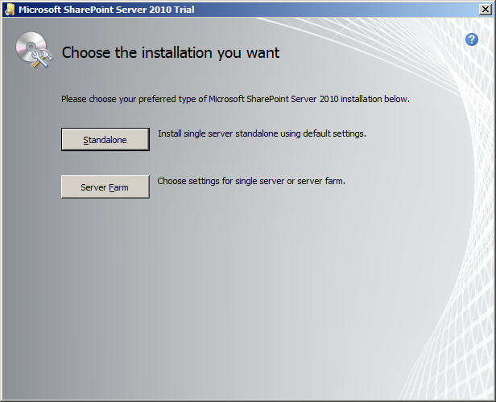
Setup Wizard
Prerequisite checks
Server type
  Complete
  Standalone
Binary installation (SharePoint Root)
Registry changes
Much like the WSS 3.0
and MOSS 2007 setup

Slide 11
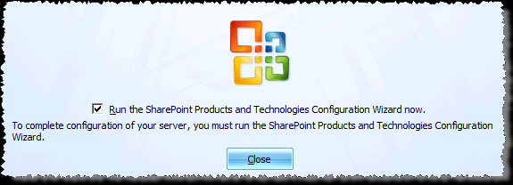
SharePoint Product and Technologies Configuration Wizard
Post-setup configuration wizard
  New farm
  Database server and database name
  Database access account and password
  Port for Central Administration
  Authentication provider (Kerberos or NTLM)
Much like the WSS 3.0 & MOSS 2007 experience

Slide 12
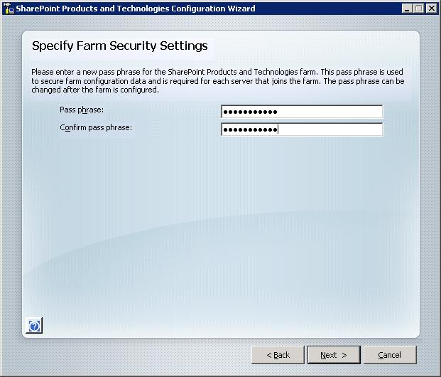
Specify Farm Security Settings

Slide 13

Farm Configuration Wizard
Used to automatically provision services and service applications in farm using default settings
Requires you to specify what managed account to use.

Slide 14
Looking to automate your install?
SPModule available at:
  http://sharepoint.microsoft.com/blogs/zach/lists/posts/post.aspx?ID=55
Allows for remote install of 2010 farm using Windows PowerShell
Scripted installs make for consistent environments and great for DR documentation

Slide 15
Inplace Upgrade Install

Slide 16
Inplace install steps
Same prerequisite steps
Run setup
  Enter key, accept license
  Previous version is identified click install to begin
  Install completes, Config wizard starts
Configuration Wizard
  Input Passphrase
  Make Visual Upgrade choice (next slide)
  Get all other servers in farm to the point and click OK

Slide 17
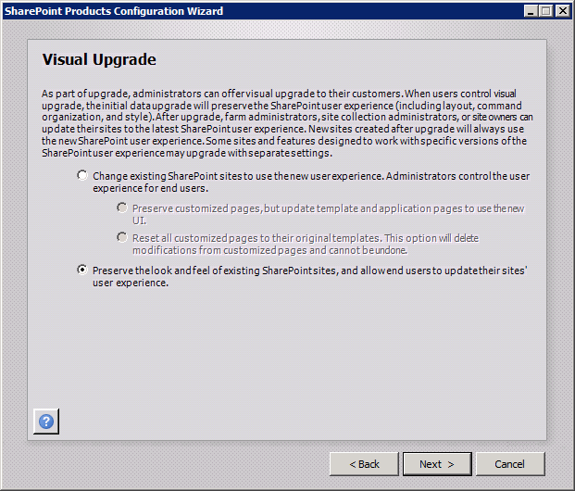
Inplace Visual Upgrade Choice

Slide 18
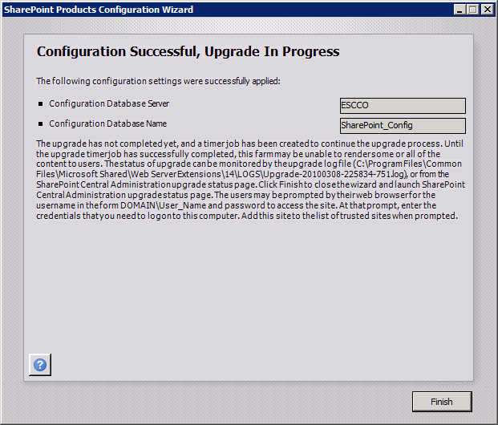
Inplace done but not really

Slide 19
Database Preparation
Ignite upgrade: implement

Slide 20
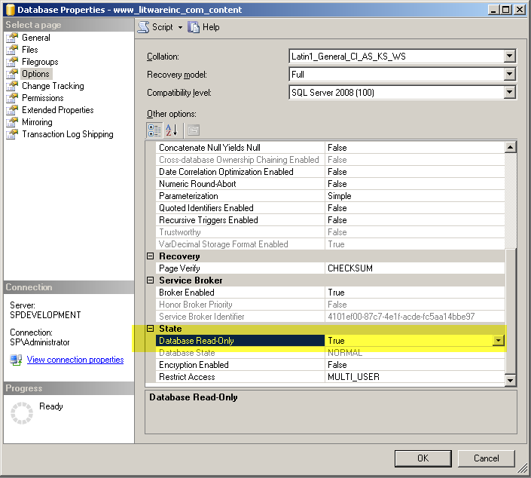
Backup/Restore Databases
Set content databases as read-only
Backup databases
  Content databases
  SSP database
Restore backups to new SQL Server or as new database names to same SQL Server

Slide 21
Verify Databases
Use “test-spcontentdatabase” cmdlet
  Missing customization
Before navigating to the site, check permissions

Slide 22
Migrate Customizations
Ignite upgrade: implement

Slide 23
Customizations
Copy new site definitions into site templates
  Install upgrade definition file
Copy CSS and images
Web parts
Web services
Install features
Install solutions (hopefully you have these)
Web.config changes (eg: security)

Slide 24
Database attach content
Ignite upgrade: implement

Slide 25
Add the Content Databases to the Web Applications
Create Web application(s)
  Remove content database
Begin attaching content databases
  Root site for Web application must be included in the first content database
  Mount-SPContentDatabase –name <db name> –webapplication <2010 URL>
  Repeat for each content database
  Multiple databases at once with multiple instances
    Pay close attention to SQL performance
    Covered in learn section

Slide 26
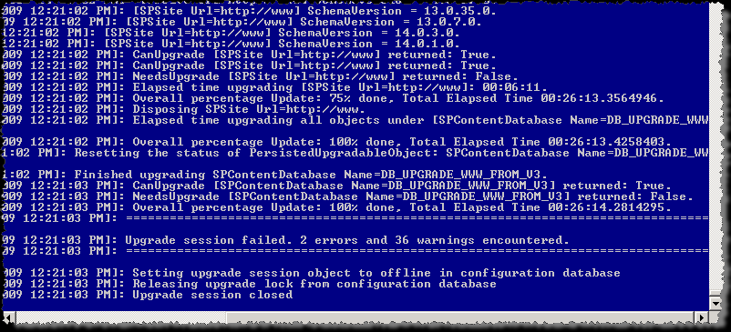
Database Attach Process
Two log files created per database attached
  -error.log file only created if errors are present
Header in *.log file provides content database name
Progress is reported
Use tail.exe or similar tool to watch progress

Slide 27
More Configuration
Web.config settings – application settings
AAMs
Trusted paths
Managed paths
Farm level permissions
BDC setup

Slide 28
Ssp upgrade
Ignite upgrade: implement

Slide 29
SSP Upgrade
Pre-work (used to be SSP)
Create a new, blank Web application
Start People service and the Managed Metadata service
Create a new Metadata service application
Create a new application pool
New People service application

Slide 30
My Sites
Database attach into empty Web application
People service you want to associate with the My Sites
  Setup My Sites
  My Site host is in your content database
  Check or set inclusions

Slide 31
SSP/My Sites
The SSP contains all of your user data
Each My Site is an individual site collection that contains your personal page only
My Site ownership is property in User Profile application
  When you don’t upgrade the SSP, you don’t have this property
If there is no My Site there, a new one will be created for you

Slide 32
Ignite Upgrade and Deployment
Validate

Slide 33
Upgrade Cycle
Overview
Learn
  Requirements/prerequisites
  Upgrade methods
  Downtime mitigation
  Common issues
Validate
  Upgrade event failures
  UI/UX issues
  Data issues
Prepare
  Document environment
  Manage customizations
  Plan upgrade strategy
  Make items upgradable
Implement
  Build/upgrade farms
  Deploy customizations
  Minimize downtime
  Monitor progress
Test
  Build test farms
  Use real data
  Evaluate techniques
  Find issues early

Slide 34
Validate Discussion
Verify High Impact/High Profile sites
Create a new Site Collection/Libraries and verify basic functionality
Application event log and upgrade log failures
UI/UX Issues (XHTML/XSLT/MasterPages)
External Data Sources
Security requires special attention post-upgrade:
  Eg: migration to claims

Slide 35
Summary
Build SharePoint 2010 farm
Configure the farm
Database preparation
Install/migrate customizations
Database attach content
SSP upgrade

Slide 36


Slide 37

© 2010 Microsoft Corporation. All rights reserved. Microsoft, Windows, Windows Vista and other product names are or may be registered trademarks and/or trademarks in the U.S. and/or other countries.
The information herein is for informational purposes only and represents the current view of Microsoft Corporation as of the date of this presentation. Because Microsoft must respond to changing market conditions, it should not be interpreted to be a commitment on the part of Microsoft, and Microsoft cannot guarantee the accuracy of any information provided after the date of this presentation.
MICROSOFT MAKES NO WARRANTIES, EXPRESS, IMPLIED OR STATUTORY, AS TO THE INFORMATION IN THIS PRESENTATION.

