Slide 2
Understanding SharePoint 2010 Topology
Name
Title
Company

Slide 3
Objectives
Understand the big changes in requirements and capabilities at the topology level
Learn the impact of these changes at each tier of the SharePoint farm
Discover the options for providing hosted SharePoint services – either within your own organization or out

Slide 4
Agenda
New Software Requirements
Information Architecture Changes
Logical Architecture Changes
Physical Topology Changes
Multi Tenancy

Slide 5
Minimum Software Requirements
Lets start with the basics – what are you going to need?
  SharePoint Server 2010 is 64-bit only
  Requires 64-bit Windows Server 2008 SP2 or 64-bit Windows Server 2008 R2
  Requires 64-bit SQL Server 2008 or 64-bit SQL Server 2005
    SQL 2005 x64 SP3 CU3*
    SQL 2008 x64 SP1 CU2*
* Subject to change by RTM

Slide 6
Information Architecture Changes
Information Architecture – What Are we Talking About?
  The plan for information access and delivery for your SharePoint solution
New Metadata Service*
Extensive Social Features*
Multi-User Office Support
Search Improvements*
Large Repository Support*
Digital Asset Support
* All covered in great detail in subsequent sessions

Slide 7
Office Web Apps and Multi User
Office Web Applications is a new feature for web-based viewing and editing of Office documents
Very similar to rich Office client apps
Lightweight editing experience
Some Office apps support multi user editing in different scenarios
  Excel in Office Web Apps, but not client
  Word and PowerPoint on the client only, after opening from a doc lib
  OneNote in the client or Office Web Apps
Edit updates occur in near real time

Slide 8
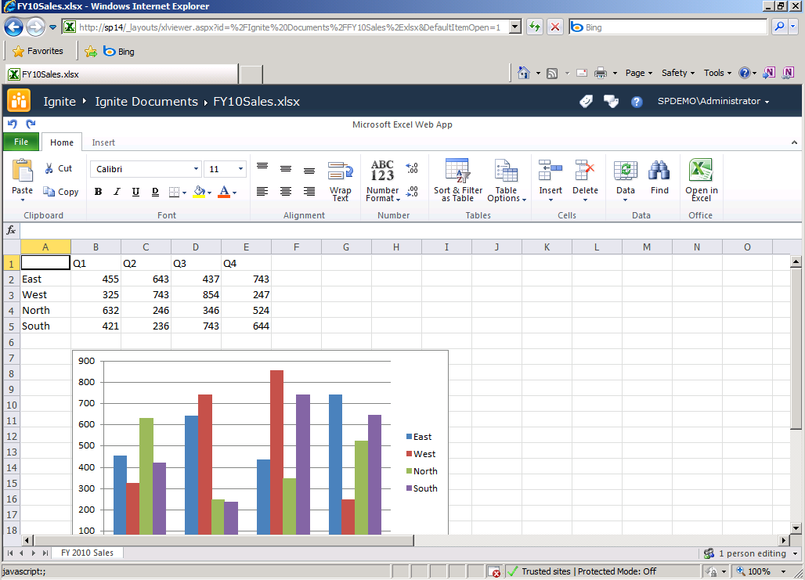
Office Web App Example

Slide 9
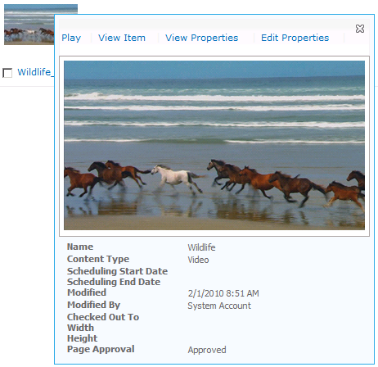
Digital Asset Support
For video:
  A Silverlight media player
  A "Video" content type
  A "Media Web Part" that you can add to web part pages
  A “Media” field control that you can use in publishing pages
  Support for selecting videos in the asset picker
For audio:
  An "Audio" content type that supports storage and playback of audio files
  Support for selecting audio files in the asset picker
For images:
  An "Image" content type for use with asset libraries that supports storing and viewing image files

Slide 10
Digital Asset Scenarios
Digital scenarios we want to support:
  Audio and video on a portal or Internet publishing site
  Community-generated audio and video sites
  Learning and training sites
*Required / Recommended to support:
  *IIS 7.0 Bit Rate Throttling module
  BLOB cache
  Silverlight 2.0 or higher

Slide 11
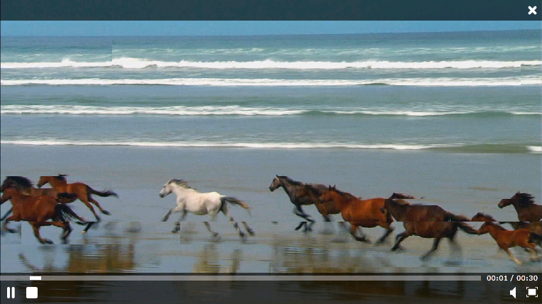
Digital Asset Features
Seek – play from a point forward or backward without having to download entire file
Progressive download – NOT live streaming
Cache reads and serves in chunks – don’t have to cache 100% before downloading
Silverlight Media Player
CBQ feed of videos from Asset Library

Slide 12
Logical Architecture Changes
Services “a la carte” enables far more flexibility in planning farms and services
Improved application integration and support
Large list improvements, allowing libraries and lists to be much larger

Slide 13
Services “a la carte”
Services can be individually consumed from any
Web App
Allows for a very rich (and complex) farm structure
Search
User Profiles
Excel Calc
3rd party Service
BDC
Visio
OWA
http://hrweb/
http://itweb/
Corp Farm

Slide 14
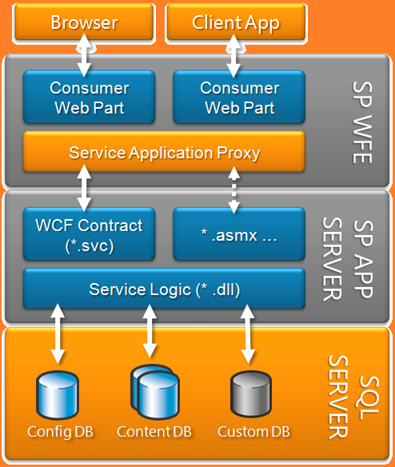
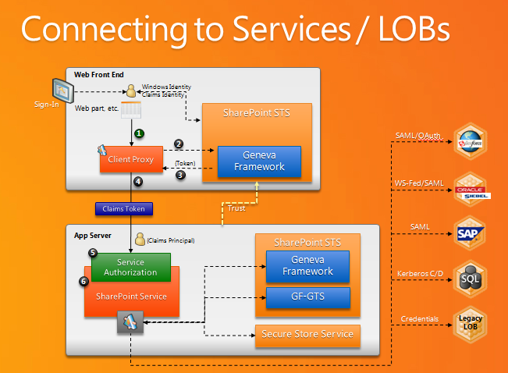
Application Platform Support
Custom Services in Services architecture
Partially Trusted Code Hosting
Better LOB Integration
Claims-based authentication

Slide 15
Physical Topology Changes
Architectural Components
WFE Changes
App Server Changes
SQL Server Changes

Slide 16
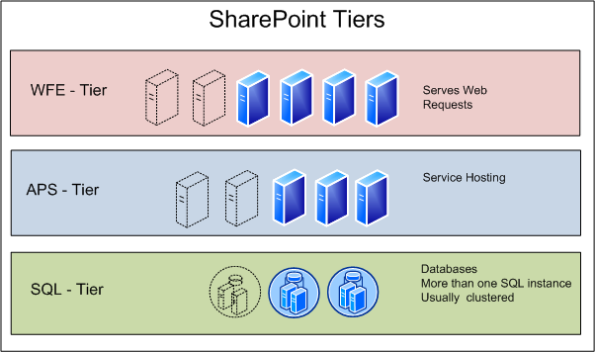
Architectural Components
WFE – Some changes, mostly optimization
App Server – Many changes
SQL – Some changes, heavy optimization
Sum total is:
Architecture is familiar, but there are many more design choices now
2010 is far more flexible than 2007

Slide 17
WFE Changes
New client protocol (transports only deltas)
Throttling feature to better manage peak loads
Client synchronization changes
New Usage Logging and Health data

Slide 18
App Server Changes
Many more services can run on an App Server
User Code Service is a separate isolated service that can run on one to many servers in the farm to isolate “sandbox” code
You can configure on a content db basis which server should be used to run timer jobs for that content db. You can also specify on which servers workflow timer jobs should run

Slide 19
SQL Changes
Many more databases to manage
  Most service applications will have their own database
  People service has 3, Search can have multiple crawl and property store databases
Snapshot management
  You can force snapshots during backup
  Content Deployment will support working off snapshots
Unattached content database restore
  Browse through a content database that isn’t joined to a farm to find content to restore
Remote Blob Storage API
  Replaces External Blob Storage (EBS) from SharePoint 2007
  Supports file stream providers for external storage

Slide 20
Multi Tenancy
The Problem Space
Definitions
Multi-tenancy challenges in SharePoint 2007
Multi-tenancy solutions in SharePoint 2010
Tenant administration

Slide 21
Definition of Multi-Tenancy
Isolation of data, operational services, and management
  Data
  Usage
  Administration
  Customizations
  Operations

Slide 22
Data Isolation
Partitioning data
Physical location (backups, etc.)

Slide 23
Usage Isolation
What data is exposed to the users
What services are exposed to the users
What data from the services is exposed to the users

Slide 24
Administrative Isolation
Administration of sites/data
Administration of shared services
Administration of customizations

Slide 25
Customizations
Customization isolation
  Example:
  Tenant A commissions a customization.
  How can we ensure that it is not shown to Tenant B?

Slide 26
Multi-tenancy challenges in MOSS 2007

Slide 27
Multi-Tenancy Challenges in MOSS 2007
Where to host a tenant
  Own Web application
    Pros: sites within the same namespace
    Cons: each Web application carries significant overhead
  Own site collection
    Pros: lightweight
    Cons: no way to connect and/or isolate related data
Service administration not fine-grained
  SSP is the administrative boundary
A Web application associated to SSPs can consume all services from the SSP
  Creating a Web application and SSP per tenant → too much overhead

Slide 28
Multi-Tenancy Customization Challenges SharePoint 2007
Customization challenges
  Shared 12 hive on the WFEs
Customizing site definitions affects all tenants
Feature stapling affects all tenants

Slide 29
What’s New in SharePoint Server 2010

Slide 30
Our Goal
Goal: To build a set of features to make SharePoint easier to manage as a live running service for one or more divisions, organizations, or companies
How?
  Less total servers to run SharePoint for everybody
  More centralized control over hardware and data storage
  Simplified management and scriptability
  Ability to offer ‘chargeback’
  Block setup of ‘rogue’ SharePoint deployments
  Mechanisms to audit SharePoint usage

Slide 31
What’s New in SharePoint Server 2010
New functionality targeted at hosting SharePoint sites
  “Site subscriptions” group site collections based on tenants
  Multi-tenancy of services makes it possible to share service resources across customers while partitioning data based on site subscriptions
Administrators can centrally deploy and manage features and services while giving tenants full control over the usage and experience
Administration is based on common hosting roles

Slide 32
Hosting multiple tenants in 2010
The ability to uniquely separate each customer on a shared environment
1
2
WA
SA
Tenant 1
Tenant 2
SC
SC
SC
SC
SC
SC
SC
SC
SC
SC

Slide 33
Where to host the Tenant
Each tenant gets their own Web application
  Pros: their own web.config, delegated admin, process isolation
  Cons: overhead
Each tenant gets one or more site collection in the same Web application
  Site collections are grouped together via a subscription ID
  Pros: scalability
  Cons: shared web.config

Slide 34
Site Subscription
Each site collection belonging to a tenant is grouped together with a site subscription ID
The subscription ID is used to map features and services to tenants, and also to partition service data according to tenant
Sites in the same subscription ID can span Web applications, but it’s usually cleaner to keep them together
Once a site is added to a subscription, it cannot be changed

Slide 35
Host Header Site Collections
Allows for “vanity domains”
Host header site collections can have managed paths if site requires
  Examples: foo.com; bar.com; foo.com/sites/foo
Load balancer SSL Termination support

Slide 36
Demo

Slide 37
Customization in SharePoint 2010
Fully trusted code
Same challenges as in SharePoint 2007
Partially trusted code
Site collection administrators can deploy code to site collections
Runs in isolation
Server will not go down from defective Web Parts

Slide 38
Tenant Administration

Slide 39
Tenant Administration
Delegate certain Central Administration tasks to “customers”
  Only affects that “tenant”
  Allows for custom site collection management
  Service administration
  (e.g., user profile management)
Extensible “tenant administration” platform

Slide 40
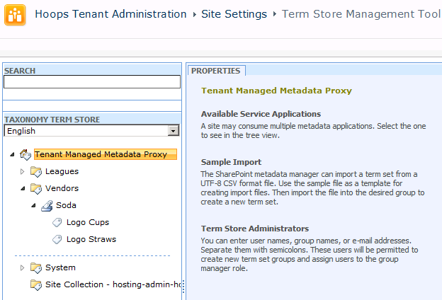
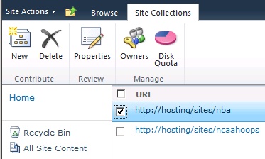
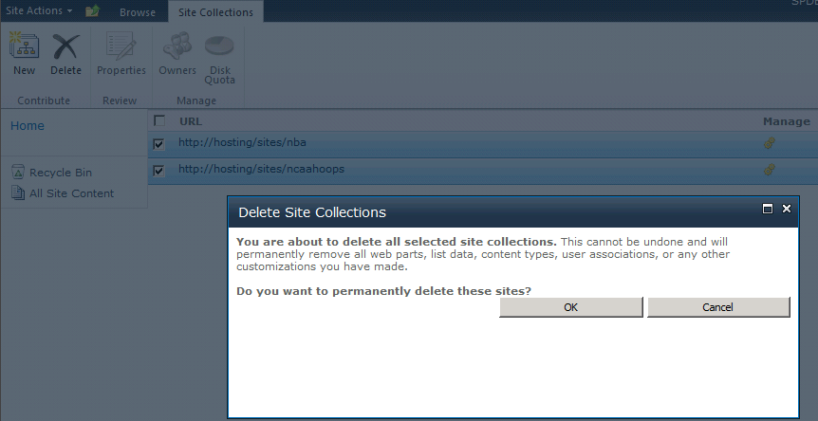
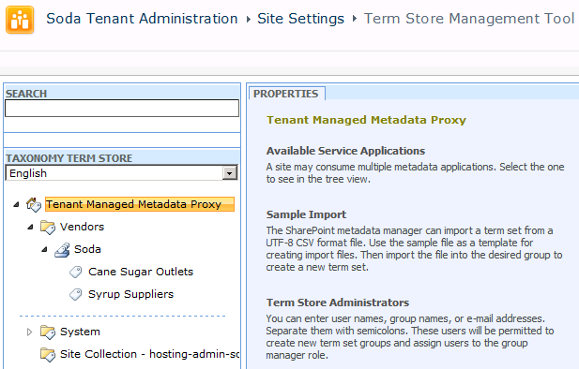

Slide 41
Multi-Tenant Best Practices
Use host header site collections
  Support a variety of namespaces
Use claims authentication
  Support local authentication to cloud resources
Don’t have subscribers cross web apps
  Easiest to maintain and operate

Slide 42
Summary
We’ve made changes at every tier of a SharePoint implementation
  New HW and SW requirements – only x64
  Changes at the WFE, App and SQL tier
We are offering many new features that will impact your topology
  New services
  Different service architecture
  How you organize them across servers
We’ve added additional capabilities to make hosting a first class citizen in SharePoint

Slide 43


Slide 44

© 2010 Microsoft Corporation. All rights reserved. Microsoft, Windows, Windows Vista and other product names are or may be registered trademarks and/or trademarks in the U.S. and/or other countries.
The information herein is for informational purposes only and represents the current view of Microsoft Corporation as of the date of this presentation. Because Microsoft must respond to changing market conditions, it should not be interpreted to be a commitment on the part of Microsoft, and Microsoft cannot guarantee the accuracy of any information provided after the date of this presentation.
MICROSOFT MAKES NO WARRANTIES, EXPRESS, IMPLIED OR STATUTORY, AS TO THE INFORMATION IN THIS PRESENTATION.

