Slide 2
Planning and Using SharePoint 2010 Service Applications
Name
Title
Company

Slide 3
Session Objectives
Become familiar with the new Service Application Model
Understand how sites use Service App features
Know the underlying components in IIS and SQL used to support Service Apps
View some Example Topologies

Slide 4
Service Application Model
The Shared Services Provider Model of SharePoint 2007 goes away
The infrastructure for hosting shared services moves to SharePoint Foundation and is called the Services Application (SA) model
SA’s can also choose to operate in a multi-tenant aware manner
SA’s support process isolation

Slide 5
Service Applications vs SSP
No longer a separate SSP web site
SA’s managed via central admin
Pick and choose your service apps (SA)
If you don’t need a service app, don’t add it
Web apps can consume SAs on an individual basis
Each web app can use any combination of all available SA’s
Deploy multiple instances of the same SA
Just give each one a unique name
Reuse SA instances across multiple web apps in farm

Slide 6
Scaling Service Applications
Service Apps can achieve high scale
Select which servers in the farm the SA runs on
Controlled in Services on Server page
Search Service Application is unique in how its topology is managed
To achieve more scale:
Add more servers
Configure SA’s to run on them

Slide 7
New Service App Model
SSP
Search
User Profiles
Excel Calc
Search
User Profiles
BCS
BDC
Excel Calc
Visio
WAC
3rd party Service
http://hrweb/
http://itweb/
http://hrweb/
http://itweb/
Corp Farm
Corp Farm
MOSS 2007 Model
SP2010 Model

Slide 8
Parent Farm vs. Cross Farm SAs
Parent Farm is all or nothing
Configure 1 SSP to provide services to other farms
Configure 1 SSP to consume ALL services from parent
Child farm needs access to parent farm DBs
Cross Farm SAs
Remote farms don’t need perms to parent farm DBs
Any farm can publish SAs
One web app can use both local and remote SAs
Provides for centralized “enterprise” SAs
Not all SAs can be shared between farms
YES: People, Managed Metadata, BDC, Search, Secure Store, Web Analytics
NO: Usage and Health, State Service, Project, Excel Services, Access, Visio, Word, Word Viewing, PPT, PerformancePoint

Slide 9
Included Service Apps
Access Services
Allows viewing, editing, and interacting with Access databases in a browser.
Application Registry Service
Backwards compatible Business Data Connectivity API
Business Data Connectivity Service
Enabling this service provides the SharePoint farm with the ability to upload BDC models that describe the interfaces of your enterprises’ line of business systems and thereby access the data within these systems.
Excel Services
Allows viewing and interactivity with Excel files in a browser.
Lotus Notes Connector
Search connector to crawl the data in the Lotus Notes server.
Managed Metadata Service
Provides access to managed taxonomy hierarchies, keywords and social tagging infrastructure as well as Content Type publishing across site collections.
PerformancePoint Service Application
Supports the monitoring and analytic capabilities of PerformancePoint Services such as the storage and publication of dashboards and related content.
PowerPoint Service Application
Enables the viewing, editing and broadcast of PowerPoint presentations in a web browser.

Slide 10
Included Service Apps (cont.)
Search Service Application
Index content and serve search queries.
Secure Store Service
Provides capability to store data (e.g. credential set) securely and associate it to a specific identity or group of identities.
State Service
Provides temporary storage of user session data for Office SharePoint Server components.
Usage and Health data collection
This service collects farm wide usage and health data and provides the ability to view various usage and health reports.
User Profile Service Application
Adds support for My Sites, Profile pages, Social Tagging and other social computing features. Some of the features offered by this service require Search Service Application and Managed Metadata Services to be provisioned.
Visio Graphics Service
Enables viewing and refreshing of Visio web diagrams.
Web Analytics Service Application
Enable rich insights into web usage patterns by processing and analyzing web analytics data .
Word Automation Services
Provides a framework for performing automated document conversions
Word Viewing Service
Service used to prepare Word documents for viewing in a web browser.

Slide 11
SA Proxies
A proxy is automatically created for an SA when the SA is created via central admin
It’s a virtual link used to connect web apps to SAs
Proxies in the local farm are not created by admins, but they appear along with the SAs in central admin
Some proxies might include settings that can be modified
For example, for the Managed Metadata SA, you must indicate which proxy is the default taxonomy store

Slide 12
SA Proxy Groups
A proxy group is a group of SA proxies that are selected for a web app
By default, all SA proxies are included in the default proxy group.
You can remove them of course
A single proxy can be in multiple Proxy Groups
When you create a web app you can:
select the default proxy group
create a custom proxy group by selecting which SA proxies should be included
The custom proxy group for one web app cannot be reused with a different web app

Slide 13
Changing the Default Proxy Group
Admin UI:
Application Management <click>
Configure service application associations <click>
“default” (under “Proxy Group”) <click>
PowerShell
Get-SPServiceApplicationProxy lists the SA proxy IDs
Add- and Remove-SPServiceApplicationProxyGroupMember takes the ID as a parameter
NOTE: Do NOT enter a name for the “Identity” parameter in these calls; just press Enter and when prompted and it will use the Default proxy group automatically

Slide 14
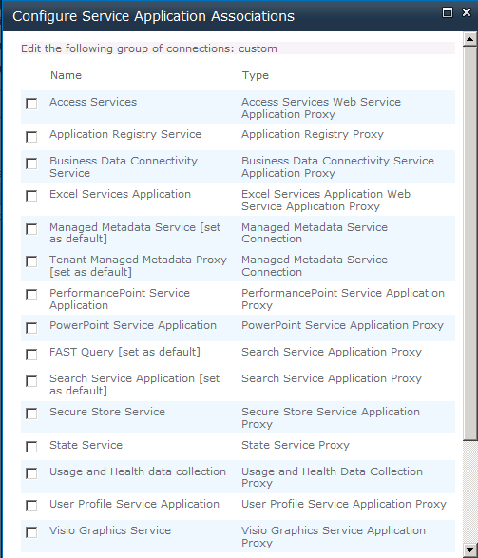
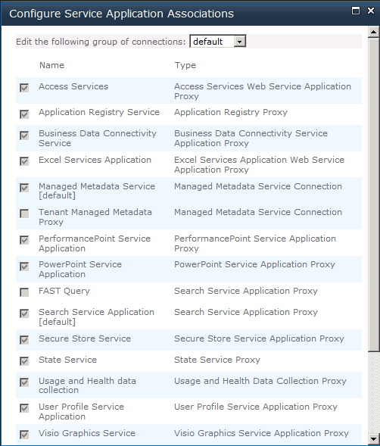
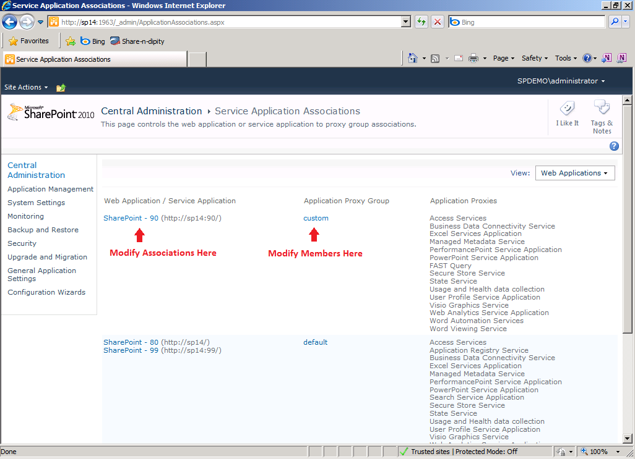
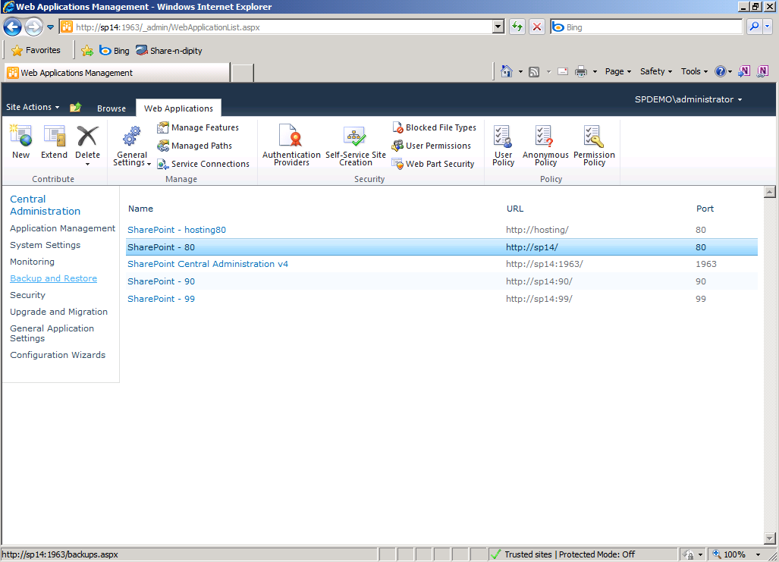
Associating Web Apps to Proxy Groups

Slide 15
Deploying and Managing SAs
Creating:
Select services while running the farm Config Wizard
Add services one by one on the Manage Service Applications page in Central Admin
Use PowerShell
Managing:
Central Admin, Manage Service Applications
Click on any SA and then the Manage button on the ribbon
Use PowerShell
Some PowerShell examples:
http://sharepoint.microsoft.com/blogs/zach/Lists/Posts/Post.aspx?ID=50

Slide 16
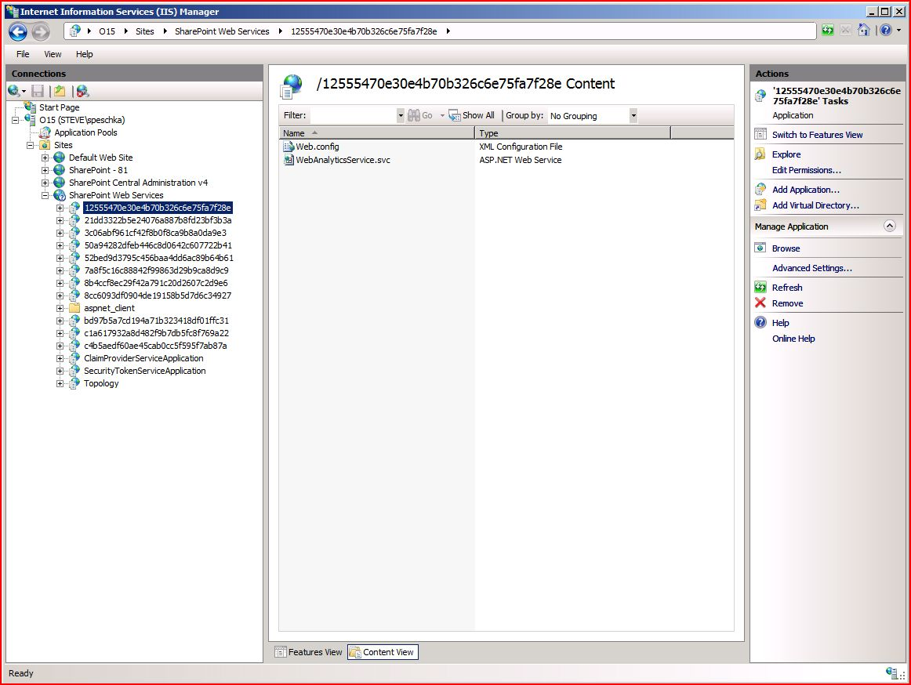
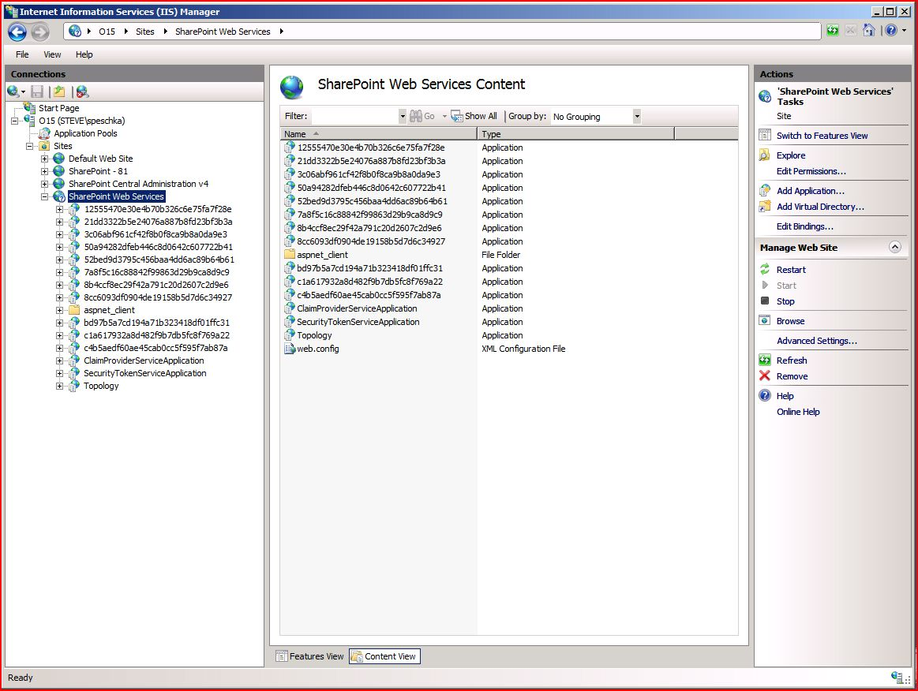
Isolated SAs

Slide 17
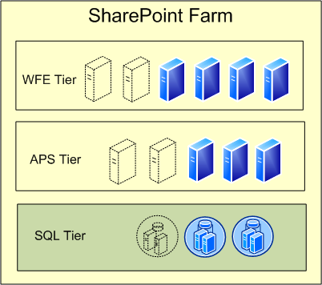
Service Databases
Service Applications with their own DB:
Search
User Profile
Managed Metadata
Secure Store
State Service
Business Data Connectivity
Web Analytics
Performance Point
Usage and Health data collection
Word Automation

Slide 18
Developing Custom SAs
Creating custom SAs is possible
The object model and interfaces have been defined so they act, look and feel like an out of the box service
There is a whitepaper available that outlines the basic concepts and relevant APIs

Slide 19
Common SA Infrastructure
Here are some built in features that custom SAs can take advantage of:
A configuration store for application settings
Support for storing data in custom databases that are managed by SharePoint
A location to host middle tier web services
A mechanism for provisioning Web Services and managing their security
A Service-scoped timer job infrastructure that allows you to perform scheduled operations on your service or on Web applications that consume it

Slide 20
SA Integration Points
Custom SAs can integrate into the infrastructure by hooking into interfaces for:
Starting and stopping service instances
Updating credentials and passwords for service instances
Creating and deleting service applications
Managing settings for services, service instances, and service applications
Associating web applications and site groups with service applications
Connecting to service applications on remote server farms
Backup and restoring service applications

Slide 21
Creating Custom Service Apps
When To:
Provide specialized computations & analytics
Share data across sites & site collections
Execute long running operations that have state tied to a particular request – e.g. Excel Services rendering workbooks
Require a robust scale out strategy
When Not To:
Data and / or features are specific to a particular SharePoint site / site collection
Data and / or features specific to site template

Slide 22
Service Applications and Multi-Tenancy
Each service application is independent (no more SSP)
Can be tied to a single farm, or shared across farms
Web applications are associated to service application proxy groups
Administrate services out of Central Administration
Administration of services can be delegated

Slide 23
Partitioned and Non-partitioned Services
Services can be configured to “share” data across Tenants or to “partition” data for each tenant (data isolation)
Allows multiple organizations to be ‘hosted’ on the same SharePoint configuration, but keeps their data isolated
Configurable ‘per-service’ to allow for “Mixed-Mode Partitioning”
Data
Partition A
Partition B

Slide 24
Examples
Managed metadata
Create a tenant-specific term group
Only visible to the tenant

Slide 25
Service App Architectural Samples
Single Farm – Single Service App Association
Single Farm – Multiple Service App Association
Service App Farm
Content-only Farm consuming from Service App Farm
Multiple Farms – Mixed Service App Association

Slide 26
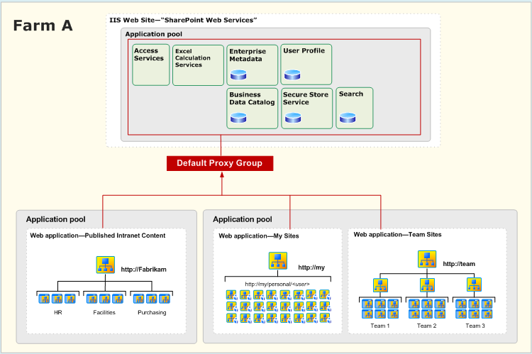
Simple Service App Association

Slide 27
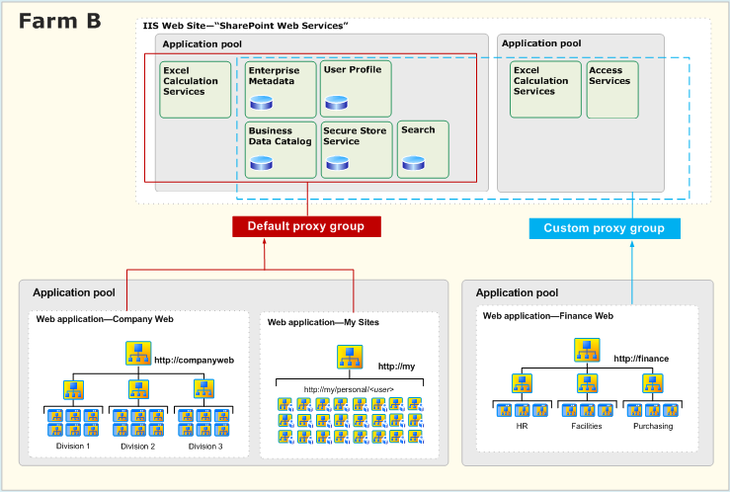
Multiple Service App Association

Slide 28
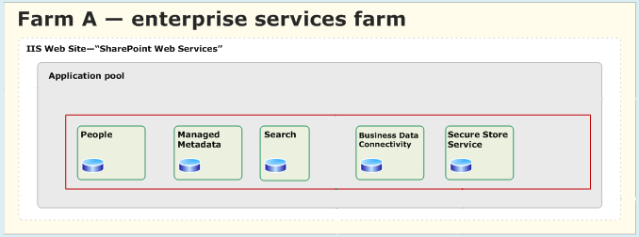
Service App Farm

Slide 29
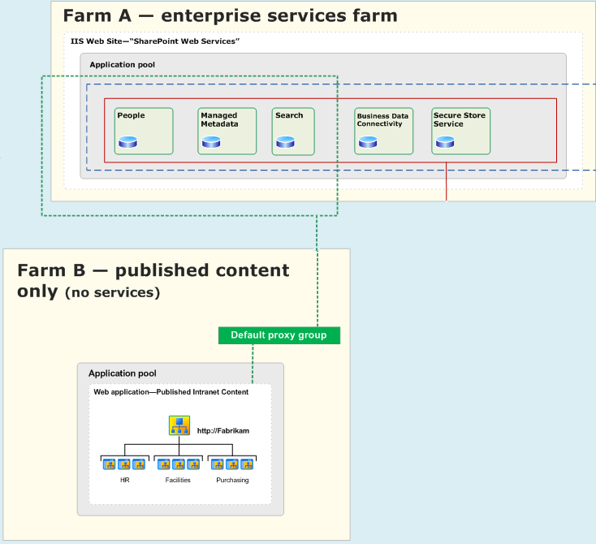
Content-only Farm

Slide 30
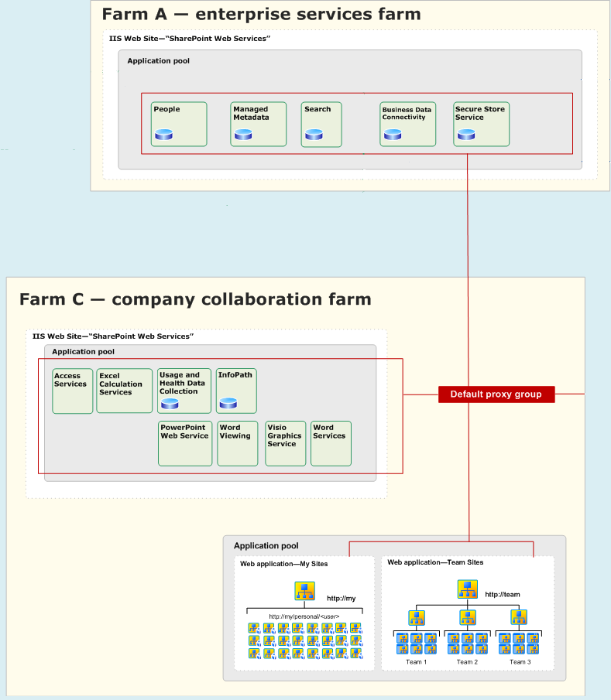
Multiple Farms – Mixed Service App Association

Slide 31
Service Applications
Demo

Slide 32
Service Application Summary
A powerful, scalable and flexible architecture
Web apps can consume Application Services a la carte
There are many design choices that can be made based on usage, available HW, security, etc.
Service Apps are at the center of all SharePoint deployments.

Slide 34
© 2009 Microsoft Corporation. All rights reserved. Microsoft, Windows, Windows Vista and other product names are or may be registered trademarks and/or trademarks in the U.S. and/or other countries.
The information herein is for informational purposes only and represents the current view of Microsoft Corporation as of the date of this presentation. Because Microsoft must respond to changing market conditions, it should not be interpreted to be a commitment on the part of Microsoft, and Microsoft cannot guarantee the accuracy of any information provided after the date of this presentation. MICROSOFT MAKES NO WARRANTIES, EXPRESS, IMPLIED OR STATUTORY, AS TO THE INFORMATION IN THIS PRESENTATION.

