Slide 2
Business Continuity Management Features in SharePoint 2010
Name
Title
Company

Slide 3
Agenda
New features
Site deletions
Backup/restore
Availability within a farm
Disaster recovery across farms
Minimal downtime during patching

Slide 4
Business Continuity Management what’s new in SharePoint Server 2010…
Improved Backup and Restore
Improvements in scale, performance, and resiliency
New configuration only backup
New SQL Server Snapshot support
New Granular Backup options
Unattached Content Database Data Recovery
New high availability scenarios
New support for SQL Server Database Mirroring
New flexible Service Application architecture
New disaster recovery scenarios
Improved read-only database support

Slide 5
Site Delete

Slide 6
Site Delete
Improved site deletion logic
Minimizes blocking
Site is deleted from SiteMap
A GUID referencing that site is instantiated in a new table
Timer Job performs background, chunk-based deletion

Slide 7
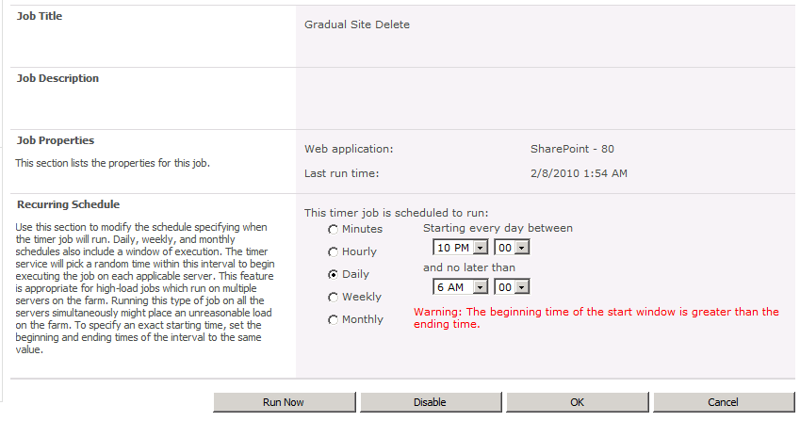
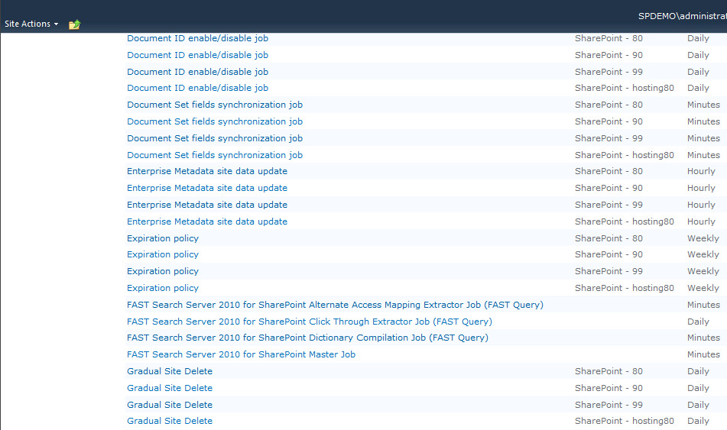
Site Delete

Slide 8
Backup and Restore Using Central Admin

Slide 9
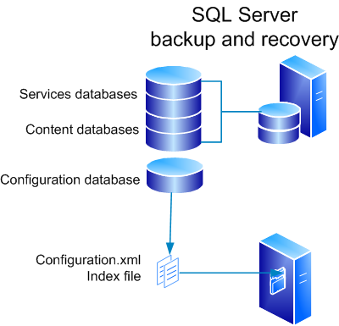
Backup – Farm
Initiates a SQL backup of each service and content database
Config settings are written to an xml file
Search does some additional things
Will be covered in the slides on backing up Search

Slide 10
Farm Backup Solutions
Method/ technology | Recoverable | Backup size supported | Backup type(s) supported
Systems Center Data Protection Manager 2007 | Y | 5 TB (80TB in DPM 2010) | Full, differential, incremental
Microsoft SharePoint Server 2010 | Y | Databases up to 600 GB | Full, differential
SQL Server | N
VSS Writer | Y | Limitation specific to solution implemented | Full, differential

Slide 11
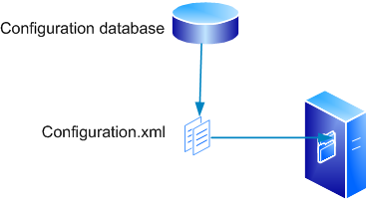
Backup – Config Settings
The configuration settings are written to an xml file, and backed up with file server backup.

Slide 12
Restore – Farm or Config
Instantiate a new farm with the same topology as the original farm
Execute stsadm (restore) or PowerShell (restore-spfarm)
For config-only restore use the –ConfigurationOnly flag
To complete a full farm restore:
Deploy customizations as required
Once you have started your farm activate any features

Slide 13
Config Backup Solutions
Method / technology | Recoverable
Systems Center Data Protection Manager 2007 | N
Microsoft SharePoint Server 2010 | Y
SQL Server | Y*
VSS Writer | Y
*You can restore a configuration database to SQL, and then use the Backup-SPConfigurationDatabase cmdlet and give it the name of the restored database

Slide 14
Backup – Content DB
When you backup a web application or single content database, SharePoint starts a SQL Server backup of each content database

Slide 15
Restore – Content DB
Restore with a new name
- OR –
Restore database and overwrite

Slide 16
Content DB Backup Solutions
Method / technology | Recoverable
Systems Center Data Protection Manager 2007 | Y
Microsoft SharePoint Server 2010 | Y
SQL Server | Y
VSS Writer | Y

Slide 17
Backup - Search
Backup takes place in two sequential phases.
Phase 1
Index merges are prevented from happening, crawling can still continue at this point.
Indexes are copied from one query server per index partition
All search databases are backed up
Phase 2
Crawls are paused
Any changes to the indexes since phase 1 are copied
Any changes to the search databases since phase 1 are backed up
Crawls and merges are resumed

Slide 18
Restore - Search
If restoring to existing Search Service App (overwrite)
All search components are unprovisioned (crawl/query stops working)
Indexes are restored
Databases are restored
Crawls and merges are resumed
If this is a restore from an earlier build, upgrade is run (i.e. backup from RTM, restoring to SP1)
If restoring to a new Search Service App
Existing Search Service Application continues to work
Indexes are restored
Databases are restored
Crawls and merges are resumed
If this is a restore from an earlier build, upgrade is run

Slide 19
Search Backup Solutions
Method / technology | Recoverable
Systems Center Data Protection Manager 2007 | N
Microsoft SharePoint Server 2010 | Y
SQL Server | N
VSS Writer | Y

Slide 20
Backup – Service Apps
If the service applications has an associated database(s)
SharePoint starts a SQL Server backup of the database(s)
SharePoint starts a backup of the service config

Slide 21
Restore – Service Apps
If restoring to existing service application (overwrite)
Existing service app is unprovisioned
Otherwise, existing service app continues to work
Databases, if any, are restored
Config is restored
Service is started

Slide 22
Service App Backup Solutions
Method / technology | Recoverable
Systems Center Data Protection Manager 2007 | N
Microsoft SharePoint Server 2010 | Y
SQL Server | N
VSS Writer | Y

Slide 23
What’s Included in Service Application Backups…
Service configuration information
The databases if the service app has one or more
Secure Store Service
Managed Metadata Service
Search (multiple databases – admin DB, crawl DB’s and property store DB’s)
Usage and Health Data Collection
User Profile Service (profile, sync and social tags)
Business Data Catalog Service
Multi Tenant Service Settings
Performance Point
Search Indexes
NEVER the session state or proxy groups

Slide 24
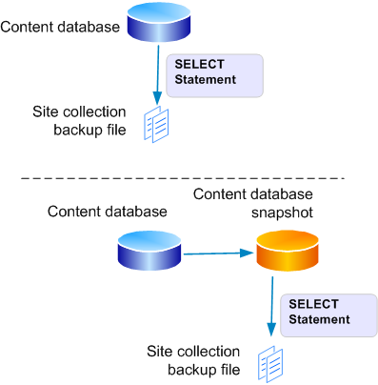
Backup – Site Collection
SharePoint does backup by extracting data out of SQL using multiple SELECT statements, then writing data to file
Optional - Use PowerShell with the UseSqlSnapshot parameter. It creates a snapshot and exports the site collection from the snapshot. It then deletes the snapshot when it’s done
NOTE: Requires a version of SQL Server that supports snap shots (Enterprise)

Slide 25
Restore – Site Collection
Restore from an unattached content database
Do a site collection backup from the unattached content db
Use PowerShell or stsadm to restore the site collection from a backup
PowerShell: restore-spsite

Slide 26
Backup – Site or List
Now possible from within central admin
SharePoint exports the identified site or list by extracting data out of SQL using multiple SELECT statements, then writing data to a package
Optional: Use PowerShell (export-SPWeb) with the UseSqlSnapshot parameter

Slide 27
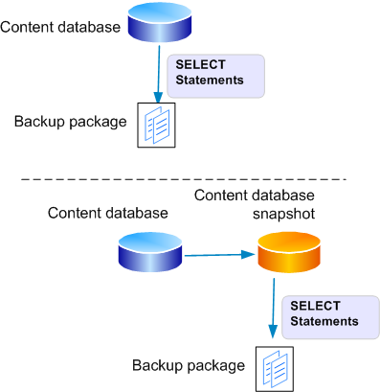
Restore – Site or List
Restore from an unattached content database
Export a site or list
Use PowerShell to restore the site or list (import-SPWeb)

Slide 28
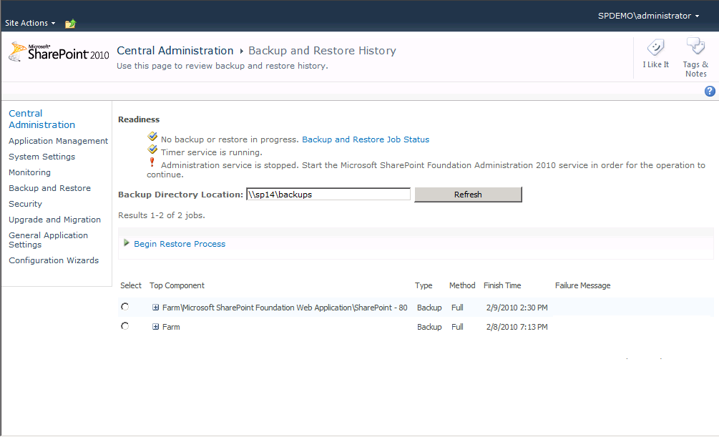
Backup History
Provides execution time, warning and error counts

Slide 29
Unattached Content Database Restore
Granular restore and content browsing of “offline” database
Browse content
Explore site collection content
Backup site collection
Backs up to File System as .bak
Export site or list
Exports to File System as .cmp artifact
Can include Security and Versions
Mitigates requirements to support expensive dedicated restore environments

Slide 30
Restore from Unattached Content Database
Using PowerShell…
Use Restore-SPSite for site collection
Restore–SPSite –identity http://<server>/sites/site -path \\<share>\site.bak –force
Use Import-SPWeb for site or List
Import–SPWeb –identity http://<server>/sites/site/web -path \\<share>\list1.cmp -includeusersecurity

Slide 31
Recovery Scenarios
Backups can be performed to support many recovery scenarios. Common scenarios include
Recreate a farm on new hardware, or in a different location, assuming that no parts of the original farm are available. (Disaster recovery)
Create a new farm based on an existing farm’s configuration and backups
Create backups to support highly-available farms
Archive versions of a site
Use unattached databases to recover site collections, sites or lists

Slide 32
High Availability

Slide 33
Database Mirroring Support
Provides support for database mirroring
Adds failover partner to ADO.NET connection string
Does not implement the mirroring session
UI entry points
Any place you add a new database you can put the failover server name
PowerShell
All databases, including configuration database
Configurable through API
SPDatabase
AddFailoverServiceInstance (method, string)
FailoverServiceInstance (property, SPServer)

Slide 34
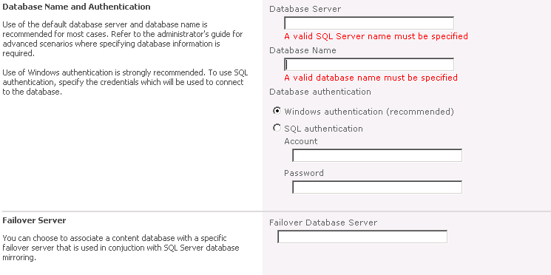
User Interface Support
Failover Database Server

Slide 35
Object Model Support (C#)
string failoverServer = "mySqlServer/myServerInstance";
SPDatabase db = MyGetContentDatabaseMethod();
db.AddFailoverServiceInstance(failoverServer);
db.Update();
or
SPDatabase db = MyGetContentDatabaseMethod();
db.FailoverServiceInstance = MyGetFailoverDatabaseServiceInstance();
db.Update();

Slide 36
Powershell Support
For ConfigDB:
$db = Get-SPDatabase | where {$_.Name -eq "Configuration Database"}
$db.AddFailoverServiceInstance("CP-SQ02L")
$db.Update()
For Other Databases (Content or Service App):
$db = get-spdatabase | where {$_.Name -eq "WSS_Logging"} $db.AddFailoverServiceInstance("phantas-mir") $db.Update()

Slide 37
Disaster Recovery

Slide 38
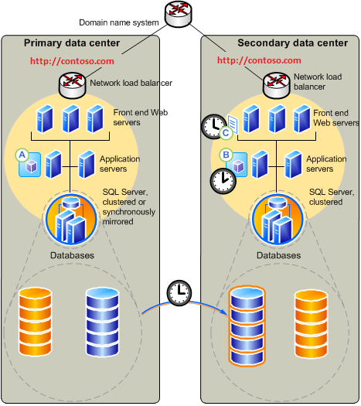
Disaster Recovery Farm Using log shipping
D/R
Search
Primary Search
Config, Services databases DB 1
Config, Services databases DB 2
Content Log Shipping

Slide 39
Disaster Recovery Farm Utilizing logs shipping

Slide 40
Uninterrupted Log Shipping Refreshing the site map
! Use PowerShell
$db = get-spdatabase | where {$_.Name -eq "WSS_ContentDB1"}
$db.RefreshSitesInConfigurationDatabase()

Slide 41
Read-Only Mode

Slide 42
Read-Only Mode
Read-only mode introduced in SharePoint 2007 SP2
Hides parts of UI that aren’t applicable in read only mode
Read-only support provided for
Content databases
Some Service Applications
Some service apps don’t function when their databases are set to read-only, including those associated with Search and Project
Make it read only in SQL
Content databases can set the IsReadOnly SPDatabase property programmatically
Link fix-up and list schema changes don’t occur in read-only mode

Slide 43
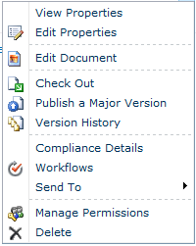
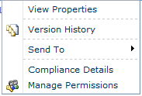
Read-Only Mode

Slide 44
Summary
Several new and extended features in SharePoint 2010 to support BCM
Reduced blocking for site deletion
Configuration-only backup and restore
Export sites and lists from central admin
Used unattached content databases for restore
Use SQL snapshots during backup
UI trimmed for read-only environments

Slide 46
© 2010 Microsoft Corporation. All rights reserved. Microsoft, Windows, Windows Vista and other product names are or may be registered trademarks and/or trademarks in the U.S. and/or other countries.
The information herein is for informational purposes only and represents the current view of Microsoft Corporation as of the date of this presentation. Because Microsoft must respond to changing market conditions, it should not be interpreted to be a commitment on the part of Microsoft, and Microsoft cannot guarantee the accuracy of any information provided after the date of this presentation. MICROSOFT MAKES NO WARRANTIES, EXPRESS, IMPLIED OR STATUTORY, AS TO THE INFORMATION IN THIS PRESENTATION.

