Slide 1
Opportunities for Innovation
Supporting Our Country’s Education Investment

Slide 2
Realities of Our Environment
SEAs and LEAs facing ~30% cross agency budget reductions
Stimulus funding opportunity is “non-recurring” investment driving short term enhancements rather than recurring costs will be emphasized
Limited human infrastructure available to ensure strategic and effective implementation at SEA and LEA level
New opportunity to align our Policy Agenda and our Customer Engagement Strategies to create greater industry impact

Slide 3
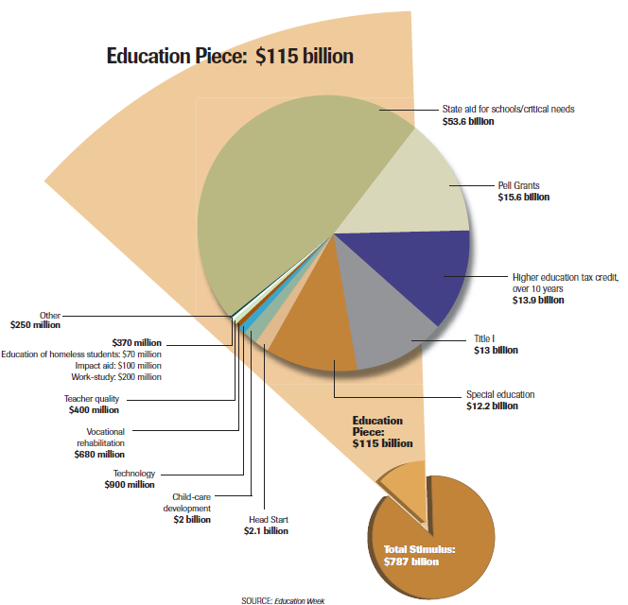
Understanding the Pie

Slide 4
Understanding the Process
Feb. 17
Bill signed into law
Feb. 19
Federal agencies will begin reporting their formula block grant awards
March 3
Federal agencies to begin reporting use of funds
May 3
Federal agencies to begin to make performance plans available to public
May 3
Federal agencies begin reporting on their allocations for entitlement programs
May 20
Federal agencies to begin reporting their competitive grants and contracts
May 15
Detailed agency financial reports are expected to become available
July 15
Recipients of federal funding to begin reporting their use of funds

Slide 5
Understanding the Funding Opportunities
State Fiscal Stabilization Fund
$53.6 Billion
Special Education Part B State Grants
$12.2 Billion
Education Technology Funds
$650 Million
Title I Education
$13 Billion
Fund to local school districts and public colleges and universities in addition to incentive grants as a reward for meeting key education performance measures and additional funding for other high-priority needs such as public safety and other critical services, which may include education
State Grants to help improve educational outcomes for individuals with disabilities, raising the federal contribution to nearly 40 percent, the level established when the law was authorized more than 30 years ago
Funds to purchase up-to-date computers and software and provide professional development to ensure the technology is used effectively in the classroom
Funds for the disadvantaged to help close the achievement gap and enable disadvantaged students to reach their potential

Slide 6
Nuance to the Opportunity
61% based on Pop. Ages 5 – 24 / 39% based on total St. Pop.
Set asides included for state incentive grants
~$ 40B allocated to state k12 and HiED to RESTORE state aid. Allocated to LEAs based on states’ primary and secondary funding formula
Formula
Head Start – Early Intervention Programs Targeted in Part C
Majority of funds to Part B (School Age Children Programs)
Formula and Competitive Grants
50% of funds allocated July 2009 – 50% July 2010
$250M allocated to expand statewide data systems
Additional $5B to be distributed July 1 – 2nd Allocation ($6-7B ) Oct. 1
Formula Grants
State Title 1 Directors encouraging LEA’s NOT to expand services OR purchase items with large recurring costs as additional funds will go away after 2 years
Could see strong focus on Middle School Spending. 30% have failed to meet AYP for 6 or more years (Math)
Expected focus on online and computer assisted assessment
50% allocated through Title 1 Formulas / 50% Competitive Grants
Distributed over 2 years
Funds can be used for modernization projects
$8.2B allocated to governors for public safety and government services
Governors must agree to fund at 2006 levels to receive funds and establish longitudinal data systems
Allows Sect. of Ed in FY10 to allocate $5B in state incentive grants to those delivering data systems and enhanced assessments. Also provides $650M to Sect. for Innovation Fund

Slide 7
Aligning Policy and Opportunity with Innovative Solutions
Infrastructure and Access
21st Century Educator and Student Development
Content
Data Driven Accountability and Transparency
Tools and Services
Holistic Innovation

Slide 8
Identity Management
Unified Communications
Data Interoperability
Virtualization
Title 1 Funds
Education Technology Funds (E2T2)
State Stabilization Funding
Infrastructure and Access
21st Century Educator and Student Development
Content
Data Driven Accountability and Transparency
Tools and Services
Learning Portal
1:1 Access and Green Computing
Integrated Productivity Applications
Integrated Social Networking Tools / Live@EDU
Education Analytics
Business Intelligence
Infrastruture and Access
Tools and Services
Data Driven Accountability and Transparency
Content
21st Century Educator and Student Development
Learning Portal
SCORM Compliant Resources
Semblio
MS Learning
IT Academy / MSDNAA
Career Forward
Education Competency Wheel
MS Institute

Slide 9
Best Practices and Resources
Holistic Reform
Family Portal and Learning Management Solutions Tracy Unified School District
21st Century Skills and Workforce Readiness
IT Academy Click Here
Access For All
Via 21st Century Infrastructure and Resources
Live@EDU St. Johns University
MSDNAA Click Here
Education Analytics Miami-Dade County Public Schools
Dropout Early Warning System Summer 2009
Green Computing Microsoft Green Computing
Unified Communication Lemon Grove School District
Anytime Anywhere Learning Fresno Unified School District
Virtualization Kentucky Department of Education
Identity Management Florida DOE
Supplemental Resources
MS Institutes
Competency Wheel
SOF Resources
The Journal Article
Supplemental Resources
Career Forward
Digital Literacy Curriculum
Digital Constitution
Elevate America Website
Supplemental Resources
K12 – HIED Technology Blue Prints
Argentina Voucher Model
Unlimited Potential Resources

Slide 10
Additional Education Opportunities
HiED Tax Credit and FASA form improvement (See Next Slide)
$15.6 billion to increase the maximum Pell Grant by $500.
  This aid will help 7 million students pursue postsecondary education
$3.95 billion for job training
  Including State formula grants for adult, dislocated worker, and youth programs (including $1.2 billion to create up to 1 million summer jobs for youth).

Slide 11
Stimulus Speaking Points Aligned to MS Areas of Focus and Funding
Holistic Reform
Investment in a culture enabling rich, relevant instructional and leadership development which support new ICT enabled pedagogies and curriculum
21st Century Skills and Workforce Readiness
Discipline and competency specific content that encourages development in subjects as well as 21st Century skills
Adaptive, rich and relevant content available to all students regardless of time and place
Access For All Via 21st Century Infrastructure and Resources
Access to a device for every learner and educator is a right and supported via government subsidy/incentive
Wireless connectivity within schools and community areas of congregation
Tools and solutions that allow for the manipulation of information, not just its consumption
Mobile and flexible learning systems that support and deliver instruction in a variety of locations and times
Broadband connectivity to all schools and colleges and areas of congregation
Investment in 21st Century skills requirements, assessments and best practice for instructional staff and school leaders
Investment in 21st Century skills requirements, assessments and best practice for instructional staff and school leaders
Varied mediums which require and support multiple assessment models
Integrated school/state/county educator and learner performance data driving continuous improvement via Educator/learner/guardian dashboards that inform instruction and provide continuous self-improvement and guidance
Connected learning communities that provide immediate access to content, information, progress and outcomes for all learners, educators, leaders and guardians regardless of time and place

Slide 12
Current Strategies for Impact
PR
Proactive Outreach
ED Tech Trades
Partners
Live Meeting Series
Internal
Accounts
Economic / Education / Workforce Dev Pitch
Monthly All-hands Updates
Team Meeting Sessions for Understanding
Overview Documents and Sharing
CIO Summit Overview and Partner Session
Education Stimulus Opportunities for Impact Brochure
Go To Market via telesales and managed accounts

Slide 13
Appendix slides

Slide 14
State Stimulus Reports
Click Below to Access a State Stimulus Report.
Each report outlines the state allocation they receive as a result of the stimulus package
Alabama
Alaska
Arizona
Arkansas
California
Colorado
Connecticut
Delaware
D.C.
Florida
Georgia
Hawaii
Idaho
Illinois
Indiana
Iowa
Kansas
Kentucky
Louisiana
Maine
Maryland
Massachusetts
Michigan
Minnesota
Mississippi
Missouri
Montana
Nebraska
Nevada
New Hampshire
New Jersey
New Mexico
New York
North Carolina
North Dakota
Ohio
Oklahoma
Oregon
Pennsylvania
Rhode Island
South Carolina
South Dakota
Tennessee
Texas
Utah
Vermont
Virginia
Washington
West Virginia
Wisconsin
Wyoming

Slide 15
State Stimulus Impact Examples
CA
$4.6B
$1.2B
NY
$2.5B
TX
$3.2B
$945.6M
FL
GA
PA
OH
MI
NC
IL
$74.2M
$1.6B
$759.2M
$52.9M
$1.2B
$57.7M
$2.2B
$1.2B
$30.1M
$627.2M
$651.7M
$1.2B
$313.8M
$20M
$1.6B
$420.2M
$426.6M
$25.4M
$523.8M
$1.5B
$437.7M
$23M
$472.4M
$1.3B
$400.6M
$23.8M
$499.5M
$1.1B
$314.4M
$16.4M
$338.3M
$1.7B
$506.5M
$24.7M
$525.9M
State Fiscal Stabilization Fund
Special Education Part B State Grants
Education technology funds
Title I Education
Learning Resource: http://www.thejournal.com/articles/23982

Slide 16
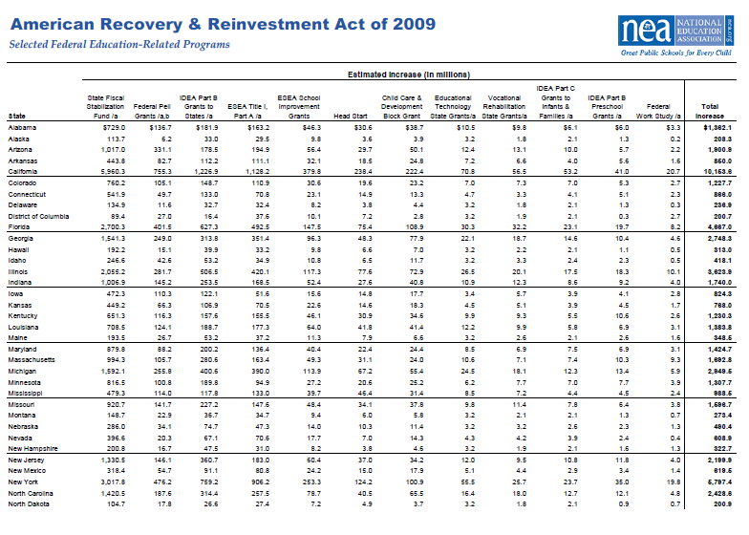

Slide 17
