Slide 1
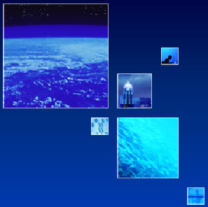
介紹如何在微軟新一代服務平台
建立雲端運用程式
李智樺
K2 SourceCode 諮詢顧問
MSDN 講師

Slide 2
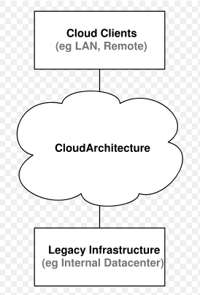
雲端運算 Cloud Computing
Cloud名稱由來為繪製
網路配置示意圖時，
習慣將網際網路畫成
一片雲。
雲端運算不是技術，它是概念。
為什麼？因為 cloud computing 本身就不代表任何一項資訊科技的技術，它是一種電腦運算的概念，而一種概念就會有許多不同的方式去實踐，這個時候才會有不同的技術衍伸出來。
最簡單的雲端運算技術在網路服務中已經隨處可見。
例如: 搜尋引擎、網路信箱等，使用者只要輸入簡單指令即能得到大量資訊。未來如手機、GPS等行動裝置都可以透過雲端運算技術，發展出更多的應用服務。

Slide 3
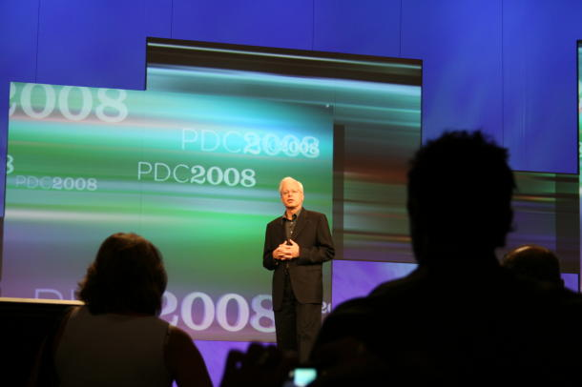
Ray Ozzie 微軟軟體架構長:「這是
我們軟體的轉換，以及策略的轉
化，Windows Azure 仍在非常
初期的階段，目前是以預覽形式
提供給開發人員，還有部分功能
會在正式版之前加進來。 」
這個雲端版稱為 Windows Azure（視窗藍天），與其說是要取代既有桌面PC，還不如說這是給開發人員使用的替代選擇，它主要是要讓軟體工程師所撰寫的程式直接在微軟資料中心理上線，而不用靠公司裡的伺服器。
目前的 Azure 服務將在單一的微軟資料中心執行（位於華盛頓州 Quincy市）
微軟也預期，企業顧客將需要一些時間，把主要的應用軟體移往 Azure。眼前的目標是讓開發者開始瞭解 Azure，並試用其軟體開發工具組。

Slide 4










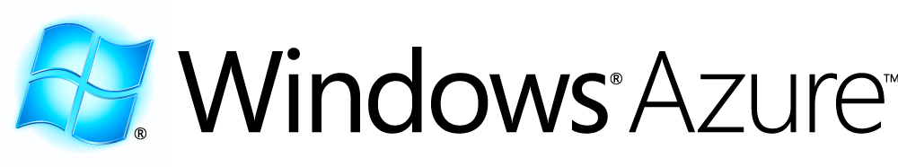
Azure™ Services Platform

Slide 5
What Is The Cloud?
A set of connected servers
On which developers can:
  Install and run services
  Store and retrieve data

Slide 6
What Is Windows Azure?
It is an operating system for the cloud
It is designed for utility computing
It has four primary features:
  Service management
  Compute
  Storage
  Developer experience

Slide 7
Imagine Building A Desktop Application In This Way:
Select your hardware, wire it all together
Find some device drivers
Write a file system
Write a job scheduler
Write an application installer
…
This would be a complete waste of time!

Slide 8
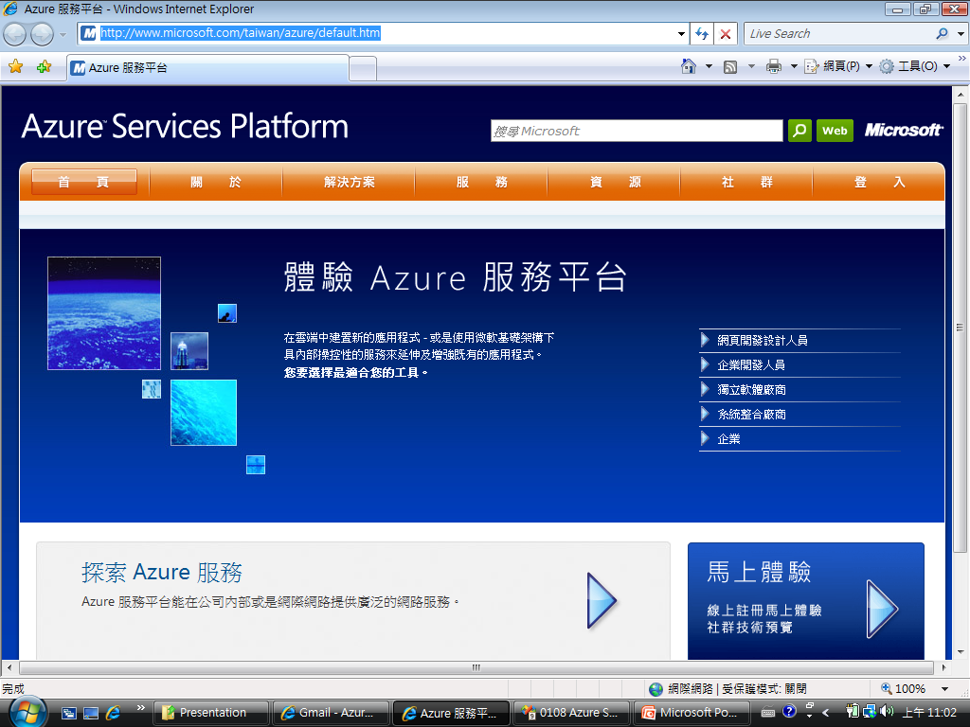
But This Is What Every Cloud
Service Developer Has To Do Today!
Business logic
…
Expand to new locale
Perform live upgrade for new feature
Apply OS patches
Service “glue”
and operations
Diagnose service failures
Add storage capacity
Handle increase in traffic
Respond to hardware failures
Datacenter

Slide 9
What's Missing In The Cloud?
An operating system for the cloud:
….
……
Service 1
Service 2
Service 3
Service N

Slide 10
What Should The Cloud OS Provide?
The same facilities that a desktop OS provides, but on a set of connected servers:
  Abstract execution environment
  Shared file system
  Resource allocation
  Programming environments
And more: Utility computing
  24/7 operation
  Pay for what you use
  Simpler, transparent administration

Slide 11
How Is The Cloud OS Manifested?
Automated service management
  You define the rules and provide your code
  The platform follows the rules: deploys, monitors, and manages your service
A powerful service hosting environment
  All of the hardware: servers; load balancers; …
  Virtualized and direct execution
Scalable, available cloud storage
  Blobs, tables, queues, …
A rich, familiar developer experience

Slide 12
DEMO
The Cloud on Your Desktop

Slide 13
Automated Service Management
What’s in the model?
  Service topology and size
  Health constraints
  Configuration settings
Develop and Model
Deploy and Run
Maintain Service Health

Slide 14
Automated Service Management
Maintaining service health
Abstraction is the key
  All resources are logical, and must be declared in the service model
  Service code calls platform APIs to map logical resources to physical entities
  Service code then uses standard APIs
The OS can replace resources transparently
  In the face of failures
  When performing upgrades

Slide 15
Automated Service Management
The bottom line
A balance between power and ease of use
  Write well behaved services, reduce your TCO
  Designed for a full range of scenarios, from
  the hobbyist to the enterprise developer
But there is an escape hatch …
  In “Raw” mode, you can build your own
  VM and manage the service yourself
More information? Attend ES 02, ES 19

Slide 16
Scalable, Available Cloud Storage
Simple, essential storage abstractions:
  Large items of user data: Blobs, file streams, …
  Service state: Simple tables, caches, …
  Service communication: Queues, locks, …
With an emphasis on:
  Massive scale, availability and durability
  Geo-distribution and geo-replication
This is not a database service in the cloud
More information? Attend ES 04, ES 07

Slide 17
Rich, Familiar Developer Experience
A cloud environment on the desktop
Support for a variety
of programming languages
  ASP.NET, .NET languages, native code, PHP
An ecosystem of tools and support
  Integration with Visual Studio, Eclipse
  Logging, alerts, tracing, …
  Samples, documentation, MSDN, forums, …
More information? Attend ES 01, ES 17

Slide 18
DEMO
How to develop
Windows Live
Service
Application

Slide 19
Putting It All Together
Simple architectures for scalability
Example:
n
m
Web Role
Worker Role
LB
Cloud Storage (blob, table, queue)

Slide 20
Takeaways: Windows Azure Is
Designed to encourage best practices
  Stateless compute + durable storage
  Co-location of computation and data
  Queues for asynchronous processing
An open platform
  Connect outbound to any server
  Open protocols and APIs on all components
  More information? Attend ES03

Slide 21
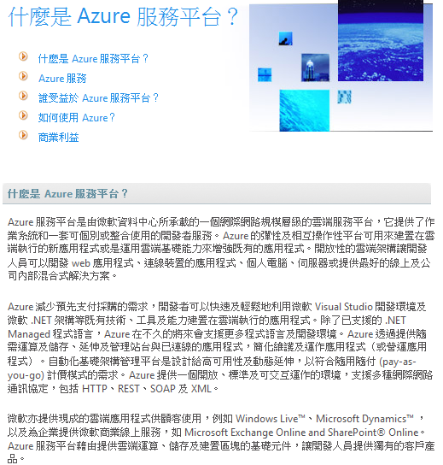
What Is Windows Azure?
It is an operating system for the cloud
It is designed for utility computing
It has four primary features:
  Automated service management
  A powerful service hosting environment
  Scalable, available cloud storage
  A rich, familiar developer experience

Slide 22
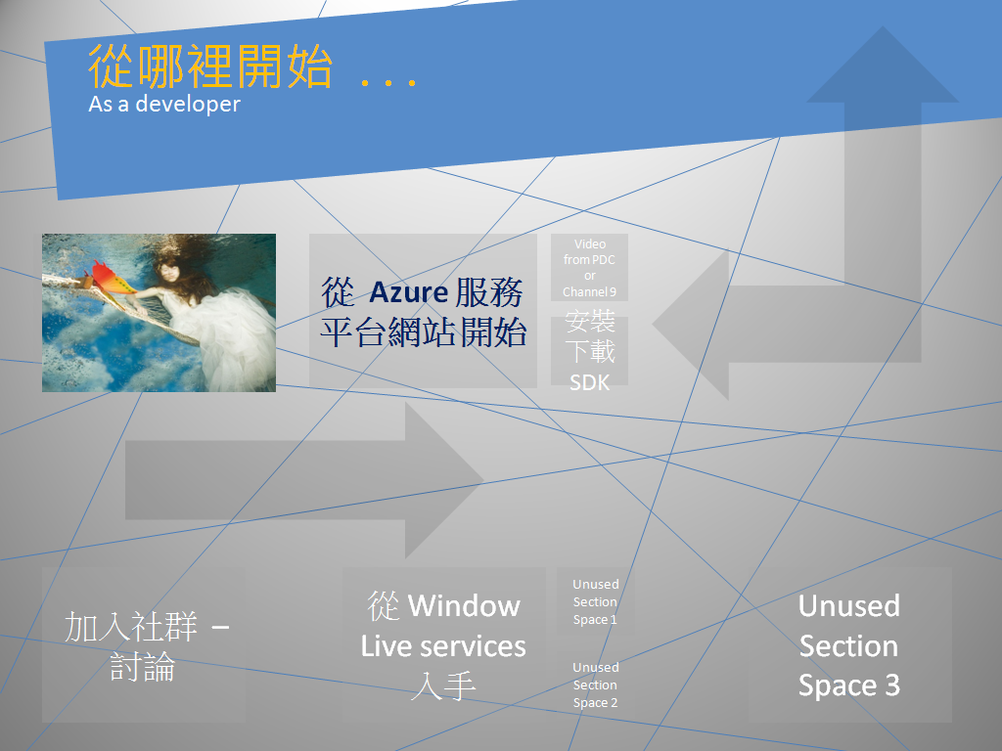

Slide 23
那裏可以下載到課程資料: (My skydrive) http://cid-68b24674607c69d9.skydrive.live.com/home.aspx
Q & A

Slide 24


