Slide 1

Welcome
Notes:
<SLIDETITLE INCLUDE=0>Entry Slide</SLIDETITLE>
<KEYWORDS></KEYWORDS>
<KEYMESSAGE></KEYMESSAGE>
<SLIDEBUILDS>0</SLIDEBUILDS>
<SLIDESCRIPT></SLIDESCRIPT>
<SLIDETRANSITION>
</SLIDETRANSITION>
<COMMENT></COMMENT>
<ADDITIONALINFORMATION>
<ITEM></ITEM>
</ADDITIONALINFORMATION>

Slide 2

Microsoft SQL Server 2008
資料倉儲及商業智慧大躍進
錢曉明
資策會資深講師
Notes:
<SLIDETITLE INCLUDE=7>Title Slide</SLIDETITLE>
<KEYWORDS></KEYWORDS>
<KEYMESSAGE></KEYMESSAGE>
<SLIDEBUILDS>0</SLIDEBUILDS>
<SLIDESCRIPT>
Hello and Welcome to this Microsoft TechNet session on {insert session title}. My name is {insert name}
</SLIDESCRIPT>
<SLIDETRANSITION>
<TRANSITION LENGTH=7>Let us start this session by going into more detail on exactly what we will be covering.</TRANSITION>
</SLIDETRANSITION>
<COMMENT></COMMENT>
<ADDITIONALINFORMATION>
<ITEM></ITEM>
</ADDITIONALINFORMATION>

Slide 3
議程
Integration Service 新增功能
  Change Data Capture (變更資料擷取)
  Cache Transform (資料轉換快取)
  Lookup Transform (資料轉換比對)
Reporting Service 新增功能
  新增資料區域結構: Tablix
Analysis Service 新增功能
  Best Practice Design Alerts (最佳化設計警示)
  資料倉儲全方面效能提升

Slide 4













SQL Server 2008
您的資料任何地點，任何時間
企業資料平台
Services
Reporting
Integration
Analysis
Synch
Entity Data Model
不僅是關聯式資料
FILE
Query
RDBMS
OLAP
Search
XML
動態開發
Mobile and
Desktop
Cloud
Server
深入資料內涵

Slide 5




微軟商業智慧平台
DELIVERY
COLLABORATION
CONTENT MANAGEMENT
SEARCH
SharePoint Server
Reports
Dashboards
Excel
Workbooks
Analytic
Views
Scorecards
Plans
END USER TOOLS & PERFORMANCE MANAGEMENT APPS
Excel
PerformancePoint Server
BI PLATFORM
SQL Server
Reporting Services
SQL Server
Analysis Services
SQL Server RDBMS
SQL Server Integration Services

Slide 6






SQL Server 2008
商業智慧今日所面臨的挑戰
企業資料分散在不同部門
企業績效資訊掌握不易
決策所需資訊取得不易

Slide 7






SQL Server 2008
智慧型資料平台
整合資料
彙整及清理異質資料來源
傳送報表
強大的報表製作功能，符合各類報表需求
深入執行決策
建制企業級的分析解決方案
自動傳送各類格式的報表
管理及延展報表工作負載
擴充預測能力
簡化資料倉儲管理
因應快速成長的資料量，確保資料回應效能
讓每一位使用者均能深入瞭解執行決策
整合服務
報表服務
分析服務
Notes:
These are the overall messaging pillars for SQL Server 2008.
The rest of the PPT will focus on net new features and benefits delivered with the BI technologies of SQL Server 2008 but will still reference the overall value prop

Slide 8

SQL Server 2008
SQL Server 2008 商業智慧技術設計主軸
設計
資料 處理
使用者經驗
提高開發者產能
效能提昇
豐富使用者經驗
Notes:
Outline the core investments areas for the release of 2008

Slide 9
議程
Integration Service 新增功能
  Change Data Capture (變更資料擷取)
  Cache Transform (資料轉換快取)
  Lookup Transform (資料轉換比對)
Reporting Service 新增功能
  新增資料區域結構: Tablix
Analysis Service 新增功能
  Best Practice Design Alerts (最佳化設計警示)
  資料倉儲全方面效能提升

Slide 10
資料整合技術
Data Warehousing and Integration Services 2008
資料延展性及大量使用者及資料管理
  提昇大型資料表查詢效能
  資料倉儲查詢效能最佳化
  有效率的資料儲存,降低儲存成本,提昇存取效能
  管理同一時間資料存取,報表服務及資料分析工作負載
整合快速成長的資料
  比對會整資料正確性
  變更資料擷取
  簡化資料新增修改流程
  檢測並辨示不正確的資料
Enhanced Partitioning
DW Query Optimizations
Data Compression
Resource Governor
Persistent Lookups
Change Data Capture
MERGE SQL Statement
Data Profiling

Slide 11
Demo
Change Data Capture (變更資料擷取)

Slide 12
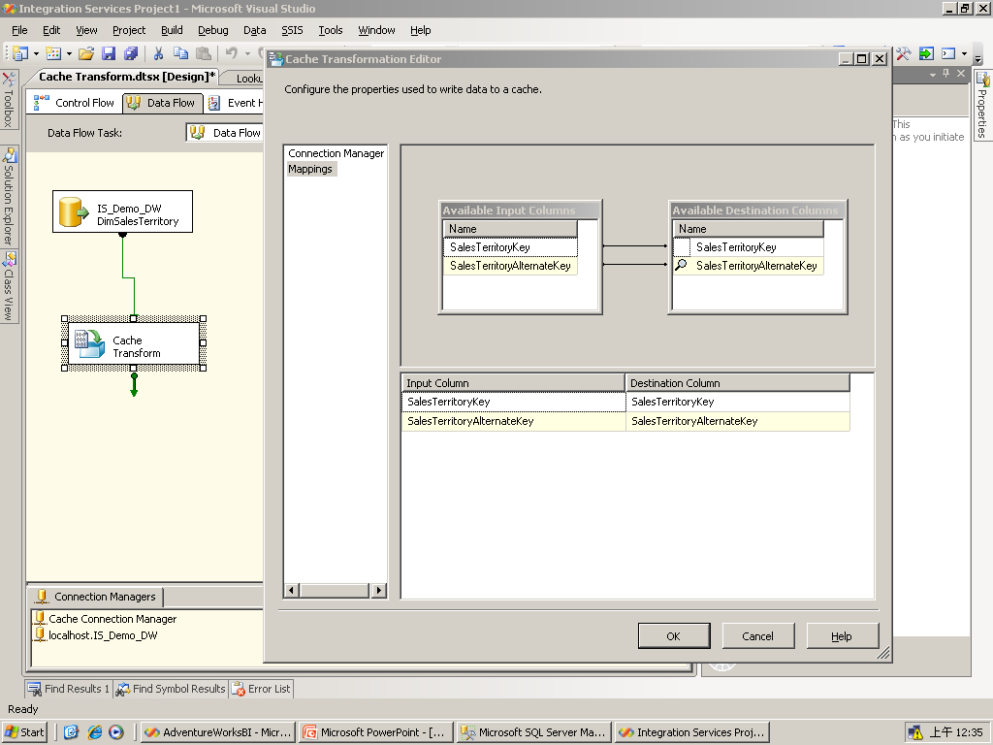
Cache Transform –
搜尋Foreign Key
Data Warehousing and Integration Services 2008

Slide 13
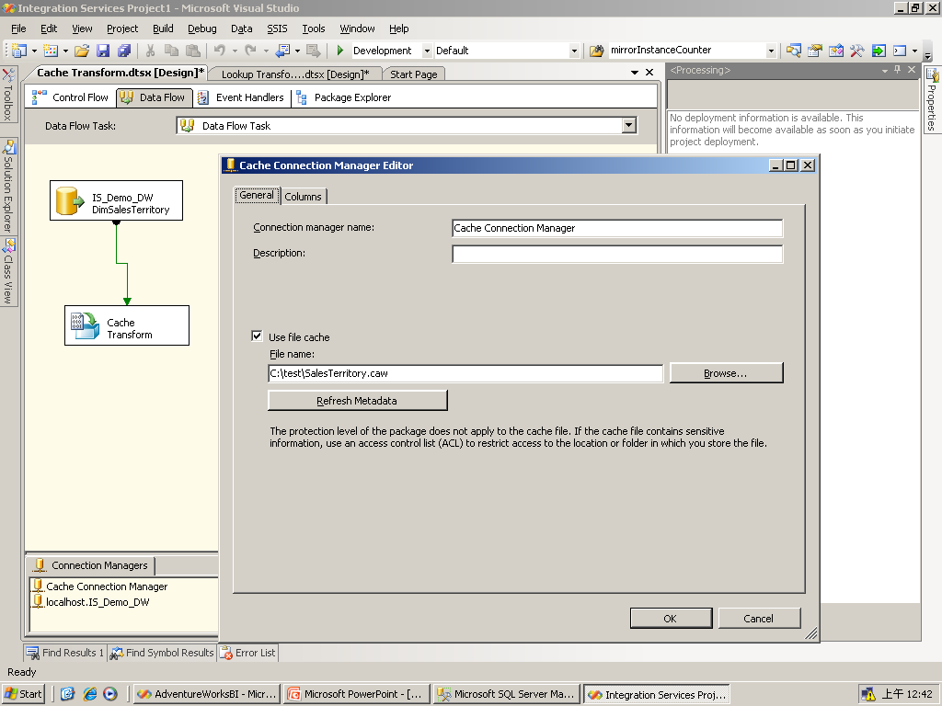
Cache Connection Manager –
將資料儲存在 file cache (.caw)
Data Warehousing and Integration Services 2008

Slide 14
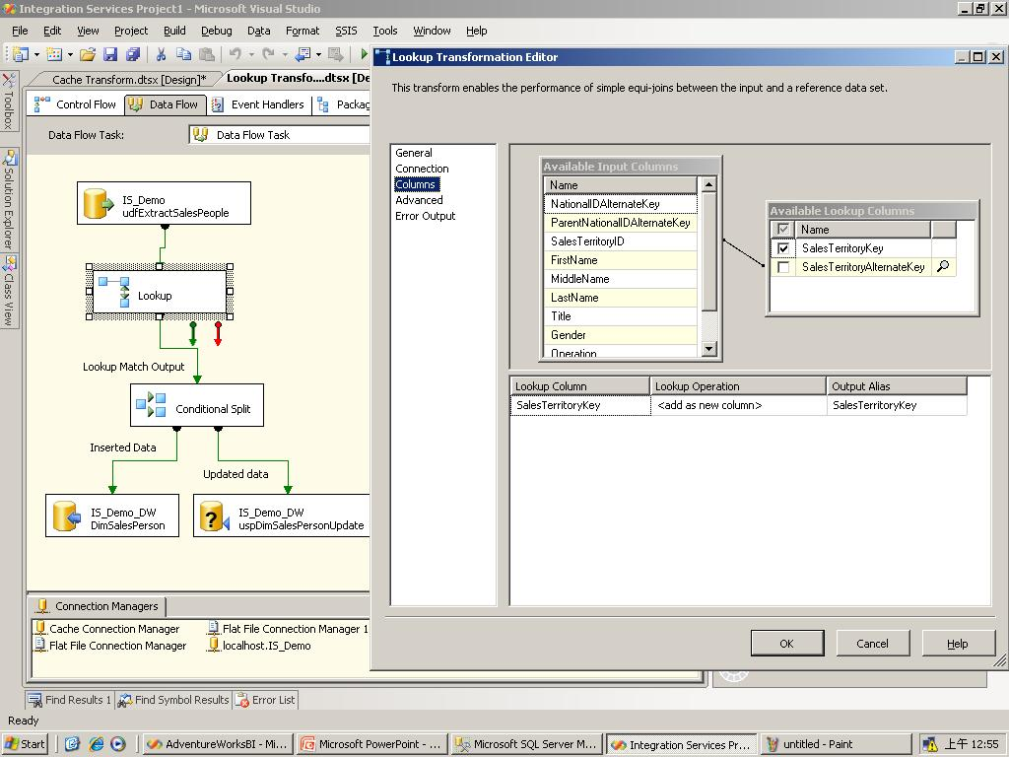
Lookup transformation
搜尋file cache 資料, 比對Foreign Key
Data Warehousing and Integration Services 2008

Slide 15
  Demo
  SQL Server 2008 整合服務
  Lookup Transform (資料轉換比對)

Slide 16
議程
Integration Service 新增功能
  Change Data Capture (變更資料擷取)
  Cache Transform (資料轉換快取)
  Lookup Transform (資料轉換比對)
Reporting Service 新增功能
  新增資料區域結構: Tablix
Analysis Service 新增功能
  Best Practice Design Alerts (最佳化設計警示)
  資料倉儲全方面效能提升

Slide 17
報表製作功能大幅提昇
Reporting Services 2008
豐富的視覺化及彈性的設計可符合各類報表需求
新增資料區域結構: Tablix
  集Table 及 Matrix 之優點於一處
強大的視覺化設計
  Charts
  Gauges
全新的設計介面-- Report Designer
  全新的 Data Pane
  更友善的對話視窗
  對齊功能
  Grouping panes
Deliver Relevant Reports
Author
Manage & Scales
Experience

Slide 18
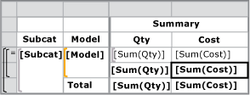
Table
以Grid方式一筆一筆的顯示資料
欄位數固定,筆數不固定

Slide 19
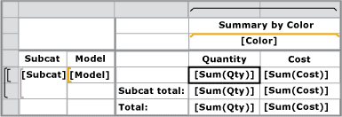
Matrix
顯示Rows及Columns彙總資料
欄位數及筆數均不固定
例如在列的地方顯示產品資料，在欄的地方顯示年度資料

Slide 20
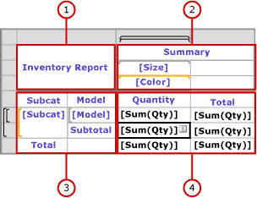
Tablix
Tablix 的資料區分為四個部分:
選擇性角落, 選擇性列群集區域, 選擇性欄群集區域, 及報表本體

Slide 21
彈性的報表製作
Reporting Services 2008
什麼是Tablix?
  是集合了Table 及 Matrix 的優點
  可以有固定的或動態的欄與列
  在縱軸或橫軸均可成巢狀
  欄與列可成多層平行式架構
  欄或列的標題可與內容不同
Deliver Relevant Reports
Author
Manage & Scale
Experience

Slide 22
Flexible Report Layout
Reporting Services 2008
Tabl
e + Matr
ix
Customer
Retail
Odin
Bikes, Inc.
Wholesale
ABC Corp.
Thor, Ltd.
Grand Total
Growth
19%
322%
19%
322%
56%
Retail | Odin
 | Bikes, Inc.
Wholesale | ABC Corp.
 | Thor, Ltd.
Grand Total
2001 | 2002 | Total
1,115 | 1,331 | 2,446
152 | 642 | 794
11,156 | 13,312 | 24,468
1,523 | 6,421 | 7,944
13,946 | 21,706 | 35,653
1,267 | 1,973 | 3,230 | 56%
12,679 | 19,733 | 32,412 | 57%

Slide 23
Parallel Dynamic Groups
Reporting Services 2008
Extensive Report Authoring
 |  | 2005 | 2006
WA | Seattle | 50 | 60
 | Spokane | 30 | 40
OR | Portland | 40 | 50
 | Eugene | 20 | 30
 |  | Table | Chair
WA | Seattle | 20 | 30
 | Spokane | 10 | 20
OR | Portland | 10 | 10
 | Eugene | 25 | 5
Current
 |  | Year |  | Product
 |  | 2005 | 2006 | Table | Chair
WA | Seattle | 50 | 60 | 20 | 30
 | Spokane | 30 | 40 | 10 | 20
OR | Portland | 40 | 50 | 10 | 10
 | Eugene | 20 | 30 | 25 | 5
Desired
Deliver Relevant Reports
Author
Process
Experience

Slide 24
Demo
SQL Server 2008 報表服務
Tablix

Slide 25
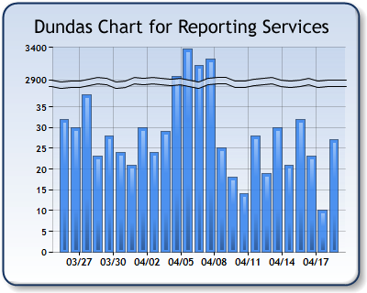
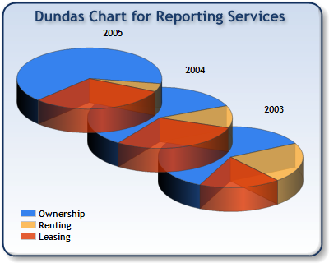
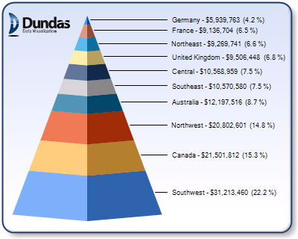
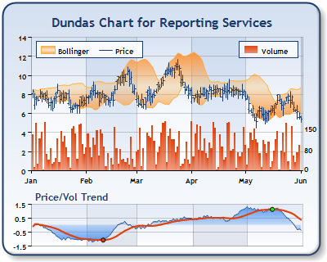
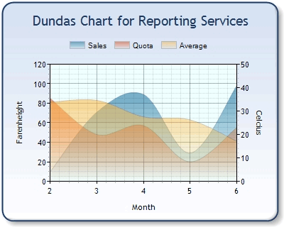
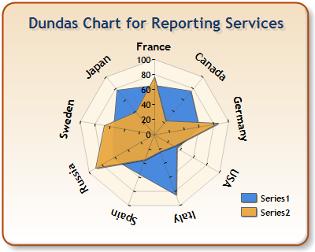
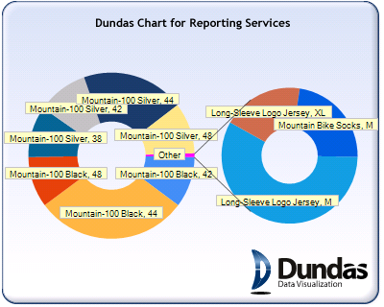
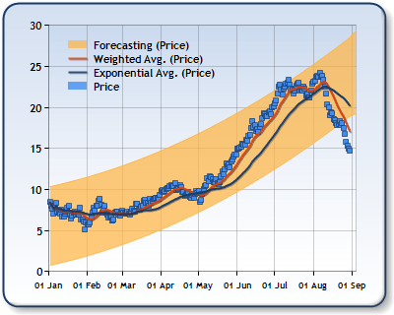
豐富的視覺化設計 – Chart (圖表)
Reporting Services 2008
報表製作功能大幅提昇
Richer end user experience with new visualization engine
Chart Examples
Deliver Relevant Reports
Author
Process
Experience

Slide 26

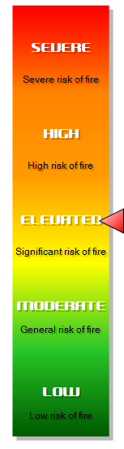
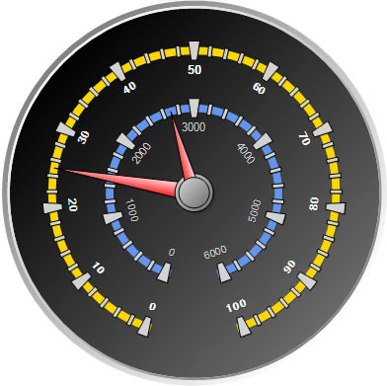
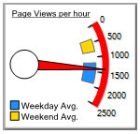
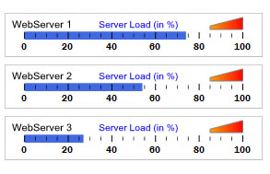
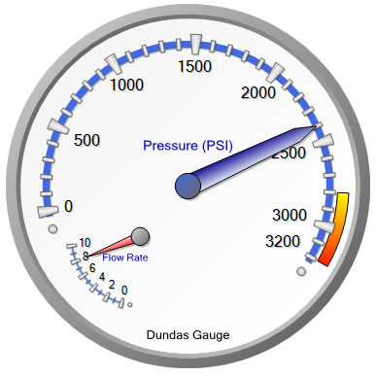
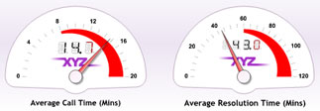

豐富的視覺化設計 – Gauge (計量圖表)
Reporting Services 2008
Extensive Report Authoring
Deliver Relevant Reports
Author
Process
Experience

Slide 27
議程
Integration Service 新增功能
  Change Data Capture (變更資料擷取)
  Cache Transform (資料轉換快取)
  Lookup Transform (資料轉換比對)
Reporting Service 新增功能
  新增資料區域結構: Tablix
Analysis Service 新增功能
  Best Practice Design Alerts (最佳化設計警示)
  資料倉儲全方面效能提升

Slide 28
深入執行決策
Analysis Services 2008
多樣化Cube設計介面
彙總設計增強功能
維度設計增強功能
最佳化設計警示
“設計及執行”
設計
執行
監控
新增次空間計算
備份設計增強功能
MOLAP 回寫功能
新增資源監控
執行計畫
Notes:
value prop pillars on the right can be deleted as preferred

Slide 29
建制企業級的分析解決方案
Analysis Services 2008
設計經驗最佳化
減少建立解決方案的時間與成本
修改設計介面以自然達到最佳化設計的目的
內建 best practices 及 performance tuning 提示和使用者介面
Best Practice Design Alerts (最佳化設計警示)
將超過 40 個 best practices 提示，整合到 real-time 的設計檢查
將real time “squiggly alert lines” 當成建制時的警訊
  沒有 pop-ups 視窗
可依需要解除警示
Drive Actionable Insights
Design
Scale & Monitor
Run & Experience

Slide 30
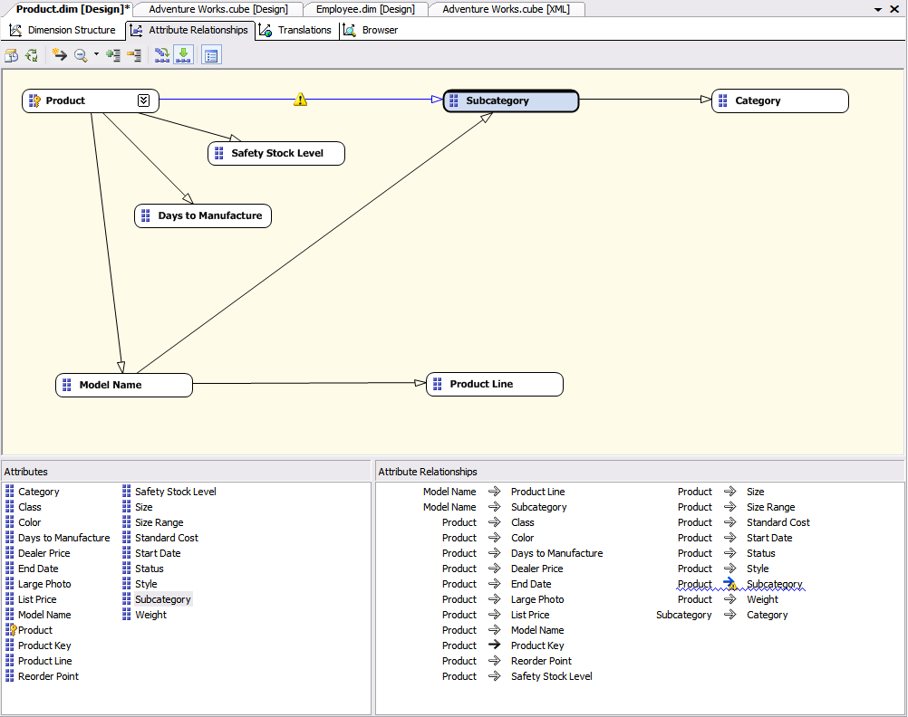
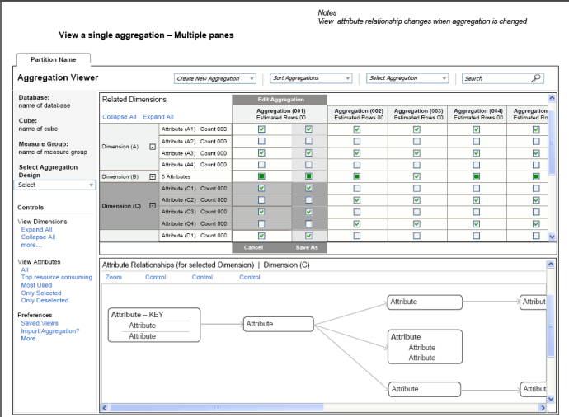
Analysis Services 2008
建制企業級的分析解決方案
Design Tools
維度設計
屬性關係設計
  方便設計及修改屬性的關係
  多重內建驗證機制，支援建立理想維度設計
Dimension Wizard
Dimension Editor
彙總設計
One Wizard
Improved Algorithm
Dedicated Designer
  Aggregation and aggregation design views
  Support for Manual edit/create/delete
  Built-in validations for optimal designs assistance
Drive Actionable Insights
Design
Scale & Monitor
Run & Experience

Slide 31
  Demo
  Best Practice Design Alerts
  (最佳化設計警示)

Slide 32
議程
Integration Service 新增功能
  Change Data Capture (變更資料擷取)
  Cache Transform (資料轉換快取)
  Lookup Transform (資料轉換比對)
Reporting Service 新增功能
  新增資料區域結構: Tablix
Analysis Service 新增功能
  Best Practice Design Alerts(最佳化設計警示)
  資料倉儲全方面效能提升

Slide 33
資料倉儲查詢最佳化
Block Computation – SQL Server 不儲存Null值,大量減少資料庫儲存空間,並提升效能. 完全專注在non-null資料上，可提昇查詢效能。
Attribute-based hierarchies -- 可避免共通的屬性重複存放
Proactive caching -- 可同時兼顧資料的即時性及效能
Writeback (回寫功能)-- 過去Writeback資料是以ROLAP形式儲存,現在是以MOLAP形式儲存

Slide 34

Analysis Services 2005 Write Back(回寫功能)
Retrieve committed write back
Data Entry
Cube Partitions
Commit write back to data Store
Write-Back Table
Write Back Cache
Write-Back Partition
ROLAP Enabled Write Back
Notes:
You are in your (write back supporting) Business app
You update forecasted sales quantity cell from the quantity of 10 to the quantity of 14
CLICK
SSAS stores the delta of 4 in the write back partition of the Cube and stores in the cache
CLICK
When the write back is committed SSAS sends the delta back to the write back table (that SSAS created) in the original source system (OLTP). This since the 2005 Write back is ROLAP MODE - The cache is deleted
Now when the app is ready to retrieve the committed write back result SSAS – [due to the fact that the WB is ROLAP ]- sends request back to the WB table in the original data store which then passed on results to the app…

Slide 35
Analysis Services 2008 Write Back(回寫功能)
Retrieve committed write back from MOLAP
Data Entry
Cube Partitions
Copy to data source
Write-Back Table
Write Back Cache
Write-Back Partition
Commit write back to the MOLAP store
MOLAP Store
MOLAP Enabled Write Back
Notes:
Same scenario:
You are in your (write back supporting) Business app
You update forecasted sales quantity cell from the quantity of 10 to the quantity of 14
CLICK
SSAS stores the delta of 4 in the write back partition of the Cube that is now leverages a MOLAP STORE and stores the delta in the cache too
CLICK
When the write back is committed , SSAS sends A COPY – for backup reasons - to the write back table in the original source system (OLTP).
Now when the app is ready to retrieve the committed write back transactions the result is sent directly from the MOLAP store in SSAS… No additional trip back to the original data store ……huge perf gains – both for write back process and – in particular for retrieval process

Slide 36
資料倉儲查詢最佳化– Bitmap Filter
Bitmap Filter 是由第一個資料表中選出一組值用來過濾第二個資料表中的資料。 在第二個資料表中,只有符合第一個資料表條件的資料才會被處理。
最佳化的bitmap filtering 可大量提昇資料倉儲查詢效能, 因為在 star schemas 的架構下,在查詢的初期即將不符合條件的資料自 fact table 排除.

Slide 37
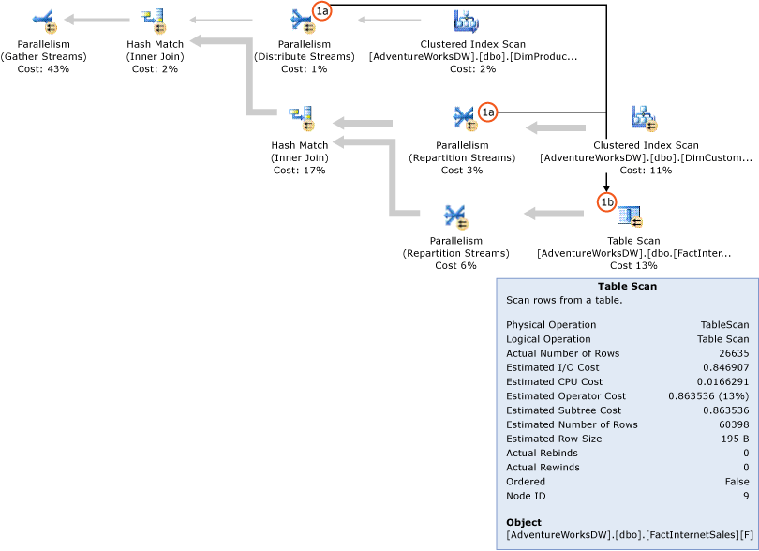
Bitmap Filter

Slide 38
Demo
Star Join Query (星狀結構查詢)

Slide 39
SQL Server 2008 資料採礦
Analysis Services 2008
引擎及演算法之改進
  預測功能提升
  加強對時間序列的支援
  加強採礦結構
    將訓練資料及測試資料分開
    針對結構化資料查詢
    建構模型時即過濾資料
    不相容的模型可放在同一結構中
    交叉驗證
Office 2007 資料採礦增益集
  提升使用者經驗
  讓資料採礦可提供更多人使用
Drive Actionable Insights
Design
Scale & Monitor
Run & Experience

Slide 40
總結
SQL Server 2008 商業智慧
設計
處理
使用者經驗
整合各類資訊
提送相關 訊息
深入執行 決策
Notes:
SQL Server 2008 Development efforts translated into overall 2008 value prop as to how SQL Server 2008 allows you to integrate any data , deliver relevant reports and drive actionable insights

Slide 41
Incredible Market Momentum
Microsoft is positioned in Leaders Quadrant for Magic Quadrant for Data Warehouse Database Management Systems, 2007
SQL Server 是成長最快的 DBMS and BI vendor
SQL Server is the #1 OLAP Server on the market
SQL Server 交貨數量大於 Oracle and IBM 兩者加起來
http://www.olapreport.com
Notes:
http://mediaproducts.gartner.com/reprints/microsoft/article19/article19.html (Gartner)
http://download.microsoft.com/download/A/B/9/AB93175B-BA6A-4332-AFBF-FE4C3749BBEC/IDC%202006%20DB%20Marketshare%20206061.pdf (IDC)
http://www.olapreport.com/market.htm (The OLAP Report)
http://download.microsoft.com/download/6/C/D/6CDC123B-A159-438C-BBAD-7750EE5D0D67/IDC-Server%20Workloads%20Forecast.pdf (IDC)

Slide 42
Call To Action
Learn more about SQL Server 2008
  Visit the SQL Server 2008 web site for more details http://www.microsoft.com/sql/prodinfo/futureversion/default.mspx
  Get hands on experience through the latest CTP https://connect.microsoft.com/SQLServer/content/content.aspx?ContentID=5395
  Get up to speed on new Data Warehouse improvements http://msevents.microsoft.com/CUI/WebCastEventDetails.aspx?culture=en-US&EventID=1032344498&CountryCode=US
  Attend more of the upcoming SQL Server 2008 Webcasts http://www.microsoft.com/sql/prodinfo/futureversion/webcasts.mspx

Slide 43
在何處取得 TechNet 相關資訊？
訂閱 TechNet 資訊技術人快訊 http://www.microsoft.com/taiwan/technet/flash/
訂閱 TechNet Plus
http://www.microsoft.com/taiwan/technet/
參加 TechNet 的活動
http://www.microsoft.com/taiwan/technet/
下載 TechNet 研討會簡報與錄影檔
http://www.microsoft.com/taiwan/technet/webcast/

Slide 44

Notes:
<SLIDETITLE INCLUDE=0>Tag line</SLIDETITLE>
<KEYWORDS></KEYWORDS>
<KEYMESSAGE></KEYMESSAGE>
<SLIDEBUILDS>0</SLIDEBUILDS>
<SLIDESCRIPT></SLIDESCRIPT>
<SLIDETRANSITION>
</SLIDETRANSITION>
<COMMENT></COMMENT>
<ADDITIONALINFORMATION>
<ITEM></ITEM>
</ADDITIONALINFORMATION>

