Slide 2
VoIP Topologies and Interoperability
Name
Title
Microsoft Corporation

Slide 3
Session Objectives
Understand the voice deployment scenarios for OCS 2007
Learn how OCS 2007 integrates with SIP/PSTN gateways and PBXs
See how to get started with a simple gateway-only configuration
Understand OCS Integration with any PBX (TDM or IP-based)
Understand Native OCS Integration with an IP-PBX

Slide 4




Today’s Business Environment
What customers are telling us
Employees
Communications tools don’t work together
New infrastructure should support existing work style
IT Decision Makers
Big investments in existing PBX systems
Make decisions that ensure flexibility
IT Professionals
Difficulty managing disparate PBX systems
Moves, adds, and changes should transcend infrastructure
Notes:
“From research that includes talking to a lot of IT Pros, we see the following 3 challenges consistently surface.
First, new communications methods enable increases in flexibility and productivity, but we still must make sure these channels are secure and that content is protected regardless of how employees choose to communicate amongst each other, with partners, or with customers.
Second, communications are very relevant to organizational governance objectives. Communications applications must be flexible to allow IT Pros to enforce even the most complex organizational governance requirements.
Finally, external threats continue to be top of mind for all companies, as spammers, phishers, and other dangerous entities have strong financial motivations to penetrate your companies resources.
Microsoft Unified Communications offers applications and services to help address these challenges. We’ll explore these solutions by stepping through “A Day in the Life of an IT Administrator.” Throughout the day, will see how the administrator relies on UC applications and services to efficiently handle situations in each of the business environment categories listed above.

Slide 5


Software-Powered VoIP Architecture
Today
Future
Legacy PBX interoperability
Pilot today to prepare
for the future
Focus on the user experience
OCS & OC replace legacy telephony infrastructure
Integrated user experience across all communication channels
Build Foundation
Single identity with Microsoft Active Directory
Instant Messaging and Presence with OCS 2007
Unified Messaging with Exchange Server 2007
Notes:
9/6/2007 8:27 AM
© 2004 Microsoft Corporation. All rights reserved.
This presentation is for informational purposes only. Microsoft makes no warranties, express or implied, in this summary.
5
Build Foundation
Companies who choose not to migrate to software-powered VoIP (for any number of reasons, though most commonly because of existing investments in the PBX infrastructure) should start building the foundation for software-powered VoIP.:
Provide single identity and single directory for everybody (Active Directory)
Add or migrate to OCS 2007 to provide IM and presence
Consider web conferencing, either on premise, hosted via Live Meeting, or both, depending on the user or scenario. The Server/Services continuum makes the choice of which to use depend entirely on the individual requirements, as the client and deployment can support either or both.
Note: Remote Call Control (RCC) can be included with this scenario. RCC was a key LCS 2005 scenario but with the introduction of OCS 2007 either “Simultaneous Ringing” or “Office Communicator only” are favorites.
Enable OCS 2007 Co-Existence
In addition to an existing IP-PBX phone, provide software-powered VoIP for specific users, groups, sites or the entire enterprise. At this point, users have a given phone number provisioned simultaneously on Office Communicator AND on an IP-PBX phone). Incoming calls ring on Office Communicator and on the existing IP-PBX phone at the same time, and can be answered at either endpoint (simultaneous ringing or dual call forking). Outbound calls can be made from either the OC or PBX endpoint, and recipients will see the call as originating from the same phone number, whichever endpoint is used to initiate the call.
Enable OCS 2007 Stand-Alone
The legacy PBX phone is removed and the full Unified Communications experience enabled by software-powered VoIP is configured for specific users. UC enabled users have ONLY Office Communicator and/or stand alone Office Communicator Telephony devices for a given phone number). Start migrating a department or a team to software-powered VoIP behind an existing PBX. Rely on OCS 2007 rather than on PBX infrastructure for these users. Fully supported by standard PBX migration procedures. Migrate to Exchange Server 2007 and add Unified Messaging at the same time.

Slide 6
Software-Powered VoIP Architecture
Deployment scenarios for today
Scenario | When to Deploy | Infrastructure Required
OCS Co-existence | All the features of the existing PBX, plus all features of OC and OCS | Modern PBX that can natively interoperate with OCS
OCS Standalone | Pilot the future with specific groups: Highly collaborative employees Mobile employees | PSTN Gateway or existing TDM or Hybrid-IP PBX.
Notes:
9/6/2007 8:27 AM
© 2004 Microsoft Corporation. All rights reserved.
This presentation is for informational purposes only. Microsoft makes no warranties, express or implied, in this summary.
6
Build Foundation
Companies who choose not to migrate to software-powered VoIP (for any number of reasons, though most commonly because of existing investments in the PBX infrastructure) should start building the foundation for software-powered VoIP.:
Provide single identity and single directory for everybody (Active Directory)
Add or migrate to OCS 2007 to provide IM and presence
Consider web conferencing, either on premise, hosted via Live Meeting, or both, depending on the user or scenario. The Server/Services continuum makes the choice of which to use depend entirely on the individual requirements, as the client and deployment can support either or both.
Note: Remote Call Control (RCC) can be included with this scenario. RCC was a key LCS 2005 scenario but with the introduction of OCS 2007 either “Simultaneous Ringing” or “Office Communicator only” are favorites.
Enable OCS 2007 Co-Existence
In addition to an existing IP-PBX phone, provide software-powered VoIP for specific users, groups, sites or the entire enterprise. At this point, users have a given phone number provisioned simultaneously on Office Communicator AND on an IP-PBX phone). Incoming calls ring on Office Communicator and on the existing IP-PBX phone at the same time, and can be answered at either endpoint (simultaneous ringing or dual call forking). Outbound calls can be made from either the OC or PBX endpoint, and recipients will see the call as originating from the same phone number, whichever endpoint is used to initiate the call.
Enable OCS 2007 Stand-Alone
The legacy PBX phone is removed and the full Unified Communications experience enabled by software-powered VoIP is configured for specific users. UC enabled users have ONLY Office Communicator and/or stand alone Office Communicator Telephony devices for a given phone number). Start migrating a department or a team to software-powered VoIP behind an existing PBX. Rely on OCS 2007 rather than on PBX infrastructure for these users. Fully supported by standard PBX migration procedures. Migrate to Exchange Server 2007 and add Unified Messaging at the same time.

Slide 7



Software-Powered VoIP Architecture
Deployment scenario: OCS 2007 Co-existence
OCS 2007 Co-existence
Simultaneous ringing
  Interoperability with PBX systems
  Users have both OC and legacy phone
Utilize existing PBX capabilities
  Receptionist and boss-admin needs
  Emergency call requirements
  Analog lines (e.g., fax machines)
  Voicemail
Existing
PBX
Mediation
Server
SIP/PSTN
Gateway
SIP
OCS 2007
Inbound Routing
Outbound Routing
Voicemail Routing
IM, Presence,
Audio, Video, Conferencing, IVR
Notes:
9/6/2007 8:27 AM
© 2004 Microsoft Corporation. All rights reserved.
This presentation is for informational purposes only. Microsoft makes no warranties, express or implied, in this summary.
7
Key Message
Additionally to the existing legacy phone provide software-powered VoIP for specific users or everybody (so they are on Office Communicator and on a legacy phone at the same time). Signal incoming calls on Office Communicator and on existing legacy phone at the same time (simultaneous ringing or call forking).
Simultaneous ringing on Office Communicator and legacy phone
Provide single identity and single directory for everybody (Microsoft Active Directory)
Migrate to OCS 2007 (IM and presence)
Provide software-powered VoIP for specific users or everybody at the same time
Allow a single user to have both Office Communicator and legacy phone
Provide interoperability with PBX systems (simultaneous ringing, Office Communicator and legacy phone, both ring at the same time)
Limit the changes needed to the existing telephony world (it’s an addition not a replacement)
Make use of PBX legacy capabilities
Interoperability with defined and supported PBX infrastructure only
Use native SIP interfaces to interconnect with IP-PBX infrastructure
Use standard industry SIP/PSTN gateways supporting majority of common PBX network interfaces and ISDN protocols
Completely adopt the existing PBX network numbering plan (signal complete E.164 number or extension only, add or cut prefix, etc.)
Transparent number signaling from and to PBX network
Rely on PBX infrastructure for legacy capabilities (features like boss-admin, teams, receptionist, switchboard, etc.)
Rely on PBX voicemail or add Exchange Server 2007 (unified messaging) BUT be aware that unified messaging has to be deployed separately and interoperates directly with PBX in this scenario, NOT via OCS 2007.
Rely on PBX infrastructure for legacy requirements (e.g. emergency phones, analog fax machines or analog modem lines)

Slide 8
Software-Powered VoIP Architecture
Deployment scenario: OCS 2007 Standalone
OCS 2007 Stand-Alone
Migrate groups to Software-powered VoIP
  Typically information or mobile workers
  All users have IM and presence
Standard PBX migration procedures
  Common PBX network interfaces
  PBX numbering plans
  No PBX upgrade required
Existing
PBX
Mediation
Server
SIP/PSTN
Gateway
SIP
OCS 2007
Inbound Routing
Outbound Routing
Voice Mail Routing
IM, Presence,
Audio, Video, Conferencing, IVR
Notes:
9/6/2007 8:27 AM
© 2004 Microsoft Corporation. All rights reserved.
This presentation is for informational purposes only. Microsoft makes no warranties, express or implied, in this summary.
8
Key Message
Replace legacy phone and provide software-powered VoIP for specific users (so they are either on Office Communicator or on a legacy phone). Start migrating a department or a team to Software-based VoIP behind an existing PBX. Fully supported by standard PBX migration procedures.
Migrate teams or departments to software-powered VoIP
Provide single identity and single directory for everybody (Microsoft Active Directory)
Migrate to OCS 2007 (IM and presence)
Migrate to Exchange Server 2007 (unified messaging)
Start providing software-powered VoIP user-by-user at the same time, typically for information workers and mobile workers (people who use their personal computer all the time and wherever they are)
Supports standard PBX migration procedures
Setup of a PBX network interface is a standard procedure in the PBX world
Rely on standard industry SIP/PSTN gateways supporting majority of common PBX network interfaces and ISDN protocols
Does not require software upgrade of the existing PBX network (just add another network interface card)
Use native SIP interfaces to interconnect with IP-PBX network (defined and supported IP-PBX infrastructure only)
Completely adopt the existing PBX network numbering plan (signal complete E.164 number or extension only, add or cut prefix, etc.)
Transparent number signaling from and to PBX network
Rely on legacy PBX infrastructure for legacy requirements (e.g. emergency phones, analog fax machines or analog modem lines)

Slide 9
Session Objectives
Understand the voice deployment scenarios for OCS 2007
Learn how OCS 2007 integrates with SIP/PSTN gateways and PBXs
See how to get started with a simple gateway-only configuration
Understand OCS Integration with any PBX (TDM or IP-based)
Understand Native OCS Integration with an IP-PBX

Slide 10












OCS 2007 Voice Components
UC endpoints
Public IM Clouds
QOE Monitoring Archiving
CDR
MSN
DMZ
AOL
Yahoo
Data
Audio/Video
Inbound
Routing
SIP
Outbound
Routing
Remote
Users
Voice Mail
Routing
Access
Server
Front-End Server(s)
(IM, Presence)
Conferencing
Server(s)
Backend
SQL server
Active Directory
Mediation Server
Exchange
2007 Server UM
Federated
Businesses
(SIP-PSTN GW)
Voicemail
PSTN
PRI
PBX
Notes:
Briefly describe basic architecture of OCS and where edge servers are located.

Slide 11
Mediation Server
Connects OCS and SIP/PSTN Gateway or IP-PBX
Front-end of the Microsoft OCS voice world
  Intermediate signaling and call flow
  Manage innovative elements of the SIP transaction
  Transcode RTP flows from G.711 to RTAudio and SIREN
  Act as an ICE Client for PSTN-originated calls
Enables OCS to…
  Provide IP telephony
  Interconnect with the legacy PSTN
Notes:
Dual-homed server connecting between OCS Front-end(s) and SIP/PSTN Gateway or IP-PBX
Front-end of the Microsoft OCS voice world:
Intermediate signaling and call flow as a Back-to-back user agent (B2BUA)
Manages elements of SIP transaction not supported by other telephony elements (TLS for security, video, IM, etc.)
Transcode RTP flows from G.711 to RTAudio & SIREN
Act as an ICE Client (NAT firewall traversal for PSTN-originated calls)
Allows OCS to both innovate in IP telephony and interconnect with the legacy PSTN.

Slide 12
SIP/PSTN Gateways
Basic Media Gateway
  Standalone appliance
  Supports TDM features
  SIP over TCP
  RFC 3261 compliant SIP
  G.711
  Works with Mediation Server
Hybrid Media Gateway
  Media Gateway appliance
  Collocated with Mediation Server
Vendor | Model | Type | Availability
Aculab | Hybrid for OCS | Hybrid | Fall 2007
Audiocodes | Mediant 2000 | Basic | Today
Audiocodes | Hybrid | Hybrid | Winter 2007
Dialogic | 1000 | Basic | Oct 16th
Dialogic | 2000 | Basic | Oct 16th
Dialogic | 4000 | Hybrid | Oct 16th
Quintum | Tenor DX | Basic | Oct 16th
Quintum | Hybrid | Hybrid | Winter 2007

Slide 13
PBXs: Current Partners and Categories
Many vendors committed to working natively with OCS
TDM-based PBXs
  No UC interoperability
  Use SIP gateway
PBX Vendor | Availability
Alcatel-Lucent | TBD
Avaya | TBD
Cisco | TBD
Ericsson | TBD
Mitel | TBD
NEC | TBD
Nortel | December 2007
Siemens | TBD
This slide will
Be updated with
More dates –
Check UCWEB

Slide 14
Session Objectives
Understand the voice deployment scenarios for OCS 2007
Learn how OCS 2007 integrates with SIP/PSTN gateways and PBXs
See how to get started with a simple gateway-only configuration
Understand OCS Integration with any PBX (TDM or IP-based)
Understand Native OCS Integration with an IP-PBX

Slide 15
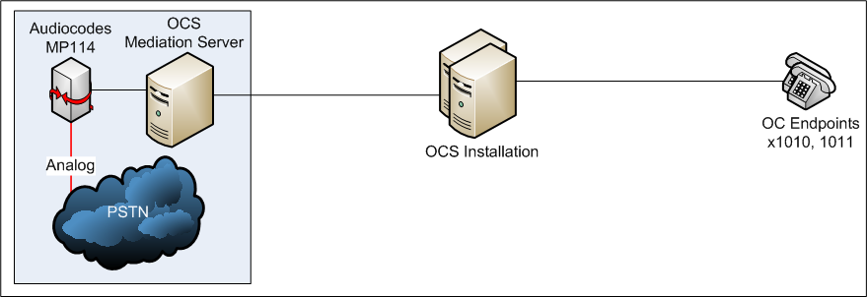
Gateway-Only Configuration

Slide 16
Gateway-Only Configuration Steps
Define location profile for lab environment
Configure
  Media gateway
  Mediation server
Define
  Phone usages
  Voice policies
  Outbound call routes
Call restrictions: Blocking numbers
Use Communicator to dial a PSTN number
Notes:
Demonstrate everything needed for full range of calling options (including OC to OC, OC to PSTN, and PSTN to OC calls).

Slide 17
Gateway-Only Configuration
demo

Slide 18

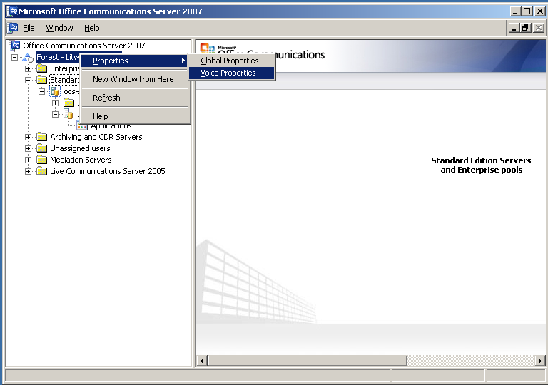
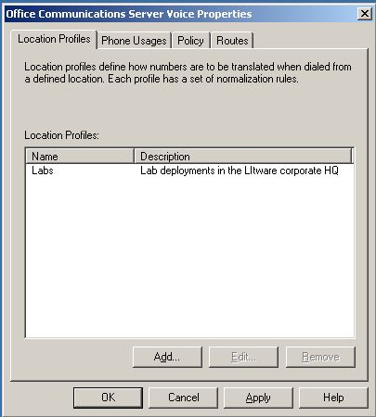
Configure Location Profile
Notes:
If no gateway available, or for reference with Demonstration script.

Slide 19
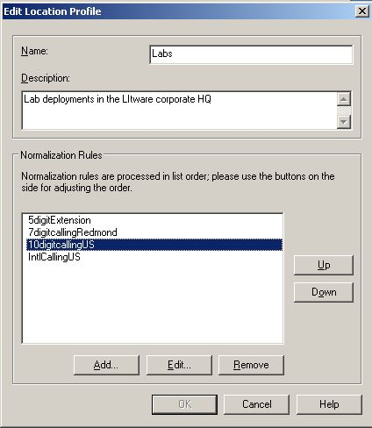
Local Dialing Conditions
Notes:
If no gateway available, or for reference with Demonstration script.

Slide 20
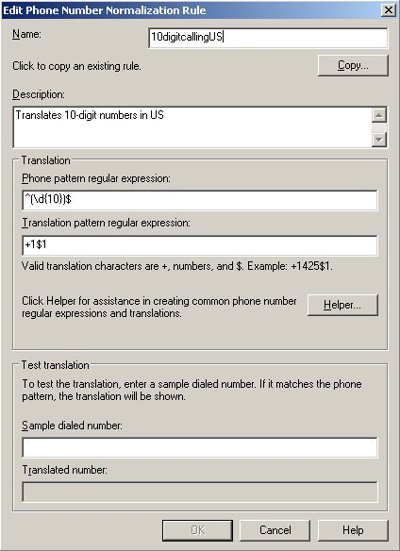
Normalization Rule For Dialing
Notes:
If no gateway available, or for reference with Demonstration script.

Slide 21
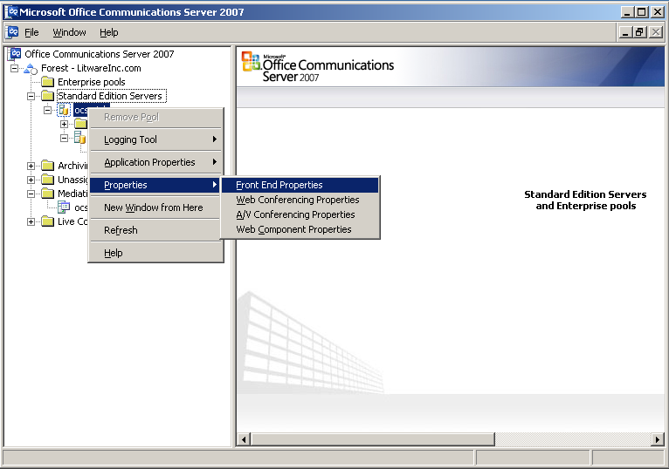
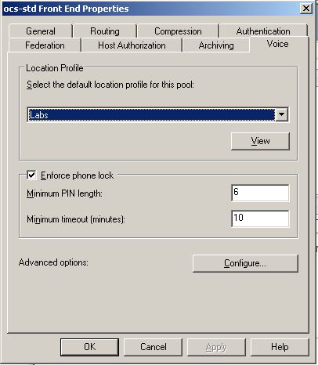
Configuring The Default Location Profile
Notes:
If no gateway available, or for reference with Demonstration script.

Slide 22
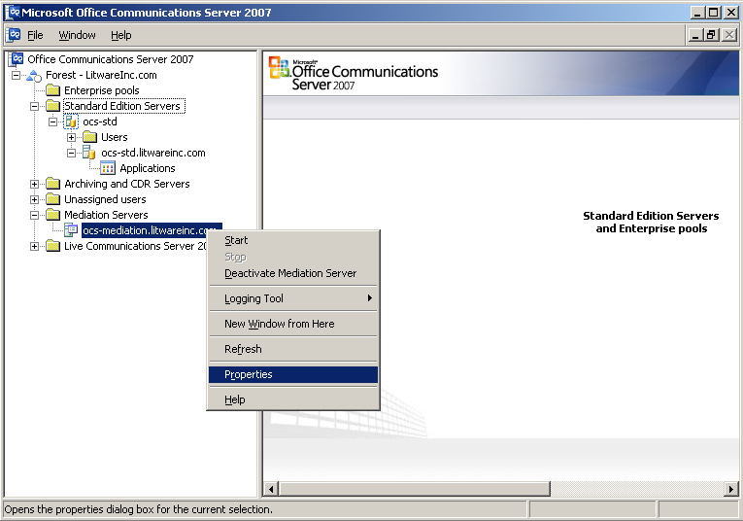
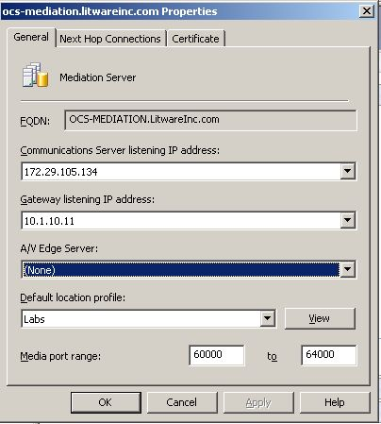
Location Profile For Mediation Server
Notes:
If no gateway available, or for reference with Demonstration script.

Slide 23
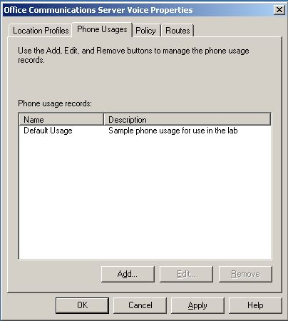
Configure Default Phone Usage
Notes:
If no gateway available, or for reference with Demonstration script.

Slide 24
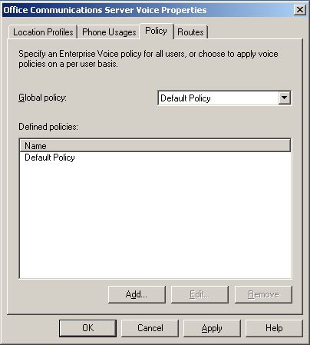
Configure Default Policy
Notes:
If no gateway available, or for reference with Demonstration script.

Slide 25
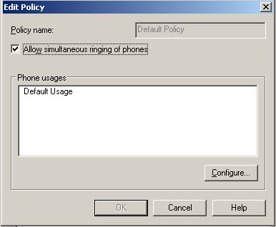
Policy Associated To Phone Usage
Notes:
If no gateway available, or for reference with Demonstration script.

Slide 26
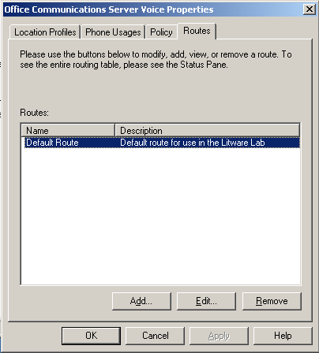
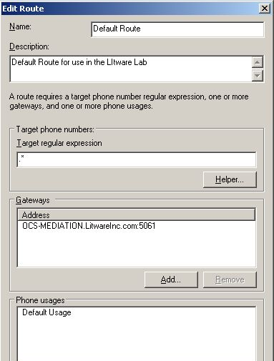
Default Route For Lab – Unrestricted
Notes:
If no gateway available, or for reference with Demonstration script.

Slide 27
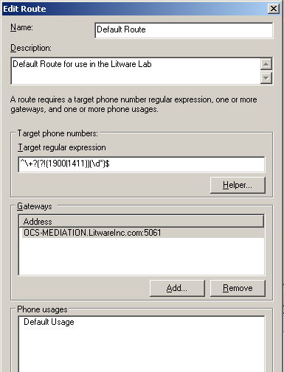
Default Route For Lab – Restricted
Notes:
If no gateway available, or for reference with Demonstration script.

Slide 28
Gateway-Only Configuration

Slide 29
Session Objectives
Understand the voice deployment scenarios for OCS 2007
Learn how OCS 2007 integrates with SIP/PSTN gateways and PBXs
See how to get started with a simple gateway-only configuration
Understand OCS Integration with any PBX (TDM or IP-based)
Understand Native OCS Integration with an IP-PBX

Slide 30
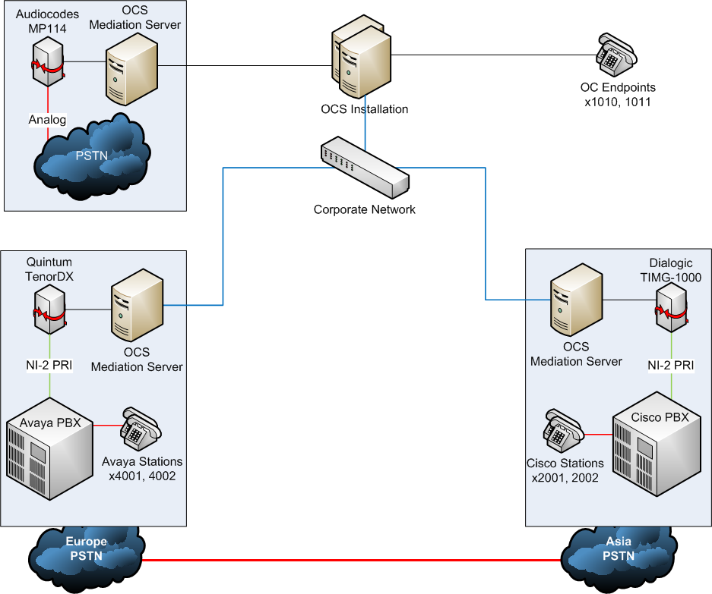
PBX Interoperability (TDM or IP)

Slide 31
PBX Interoperability (TDM or IP)
Define location profile for additional sites
  (examples for London and Hong Kong)
Configuring four-digit dialing across all PBXs
Expand call routes
PSTN toll bypass
Notes:
If demoing live, add:
From Communicator, call Hong Kong user (on Cisco PBX) at x3001 and conference in London user (on Avaya PBX).

Slide 32
PBX Interoperability
(TDM or IP)
demo

Slide 33
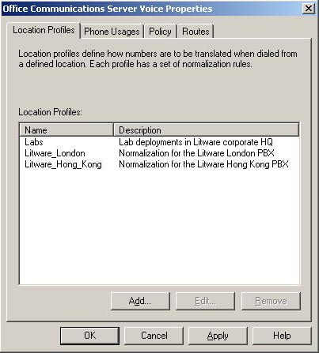
Expanding Location Profiles

Slide 34
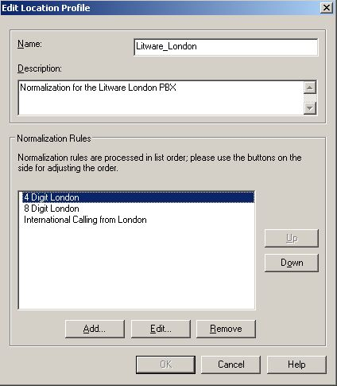
Location Profile For London

Slide 35
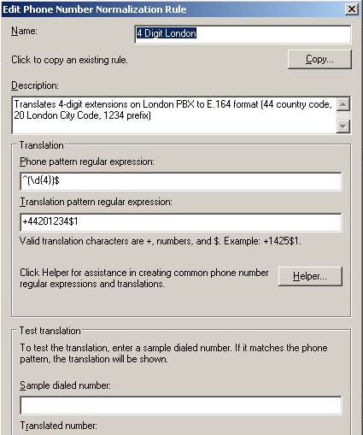
Four-Digit Dialing In The London PBX

Slide 36
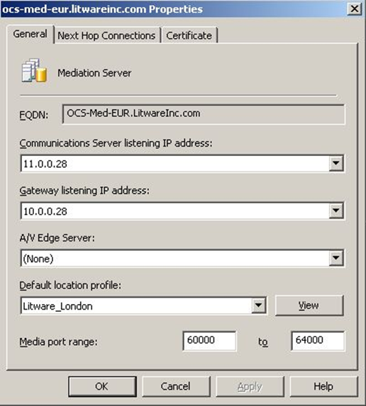
Europe’s Mediation Server

Slide 37

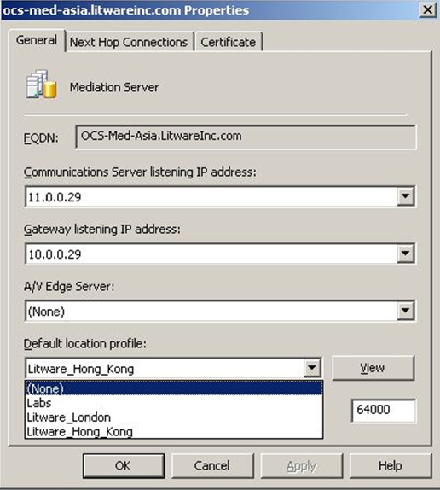
Asia’s Mediation Servers

Slide 38
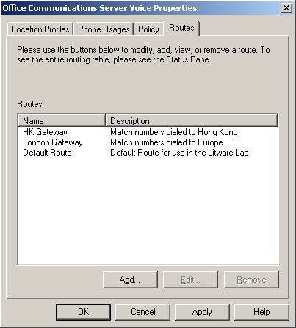
Additional Routes For Mediation Servers

Slide 39
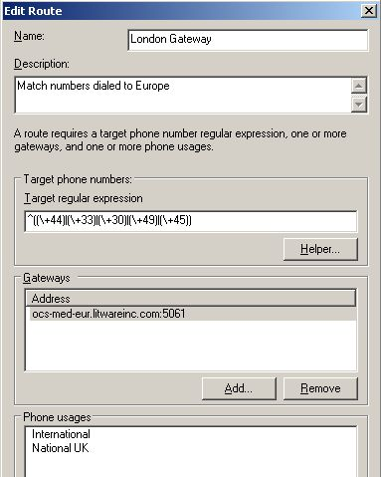
Routes Flexibly Support Site Or Regions
Notes:
+44 = UK
+33 = France
+30 = Greece
+49 = Germany
+45 = Denmark

Slide 40
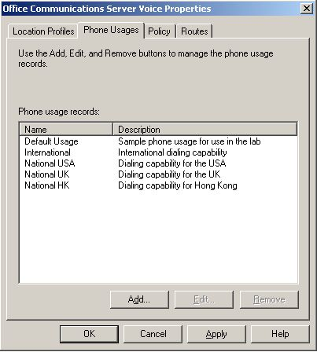
Usage Records For National Dialing

Slide 41
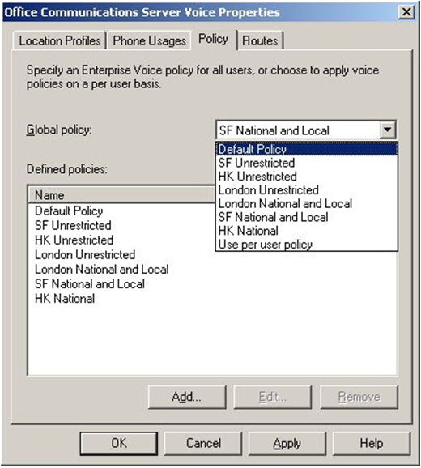
Policies To Restrict User Dialing

Slide 42
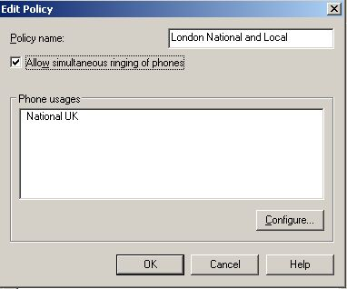
Matching Policy To Phone Usage

Slide 43
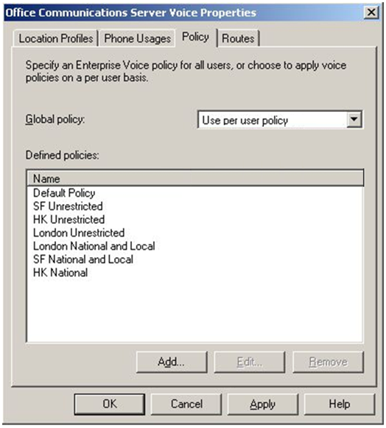
Global Policy Configured Per User

Slide 44
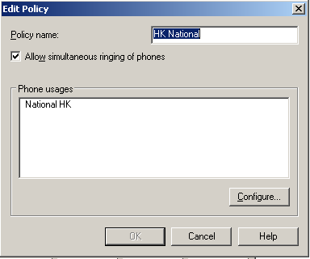
User Policy For Hong Kong

Slide 45
Matching Route To Dialing And Usages
Notes:
+44 = UK
+33 = France
+30 = Greece
+49 = Germany
+45 = Denmark

Slide 46
PBX Interoperability (TDM or IP)

Slide 47
Session Objectives
Understand the voice deployment scenarios for OCS 2007
Learn how OCS 2007 integrates with SIP/PSTN gateways and PBX
See how to get started with a simple gateway-only configuration
Understand OCS Integration with any PBX (TDM or IP-based)
Understand Native OCS Integration with an IP-PBX

Slide 48
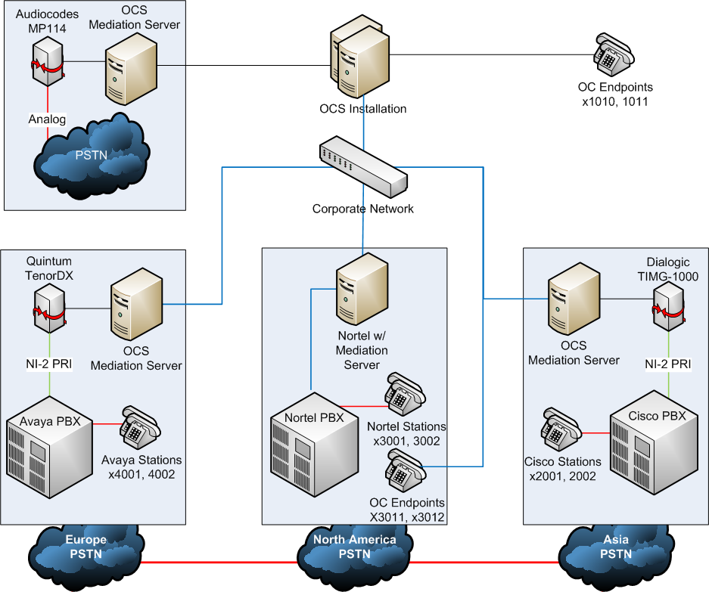
Native IP-PBX Interoperability

Slide 49
Native IP-PBX Interoperability
Define Location Profile for North America PBX
Define Routes and Policies
OCS Co-existence Scenario
Notes:
If demoing live, add:
Dial UC user & have PBX phone ring
Conference with users across the system

Slide 50
Native IP-PBX Interoperability
demo

Slide 51
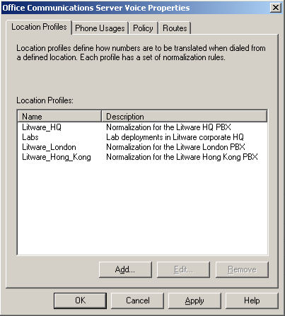
Adding HQ Location Profile

Slide 52
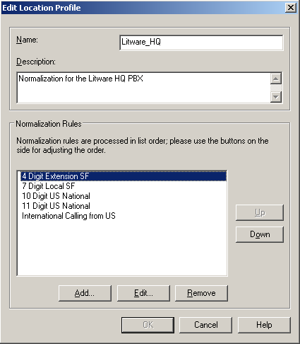
Normalization Rules For HQ

Slide 53
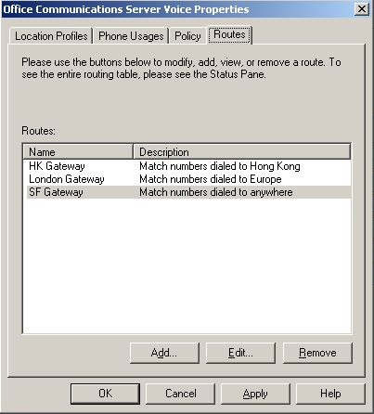
Additional Route For SF Gateway

Slide 54
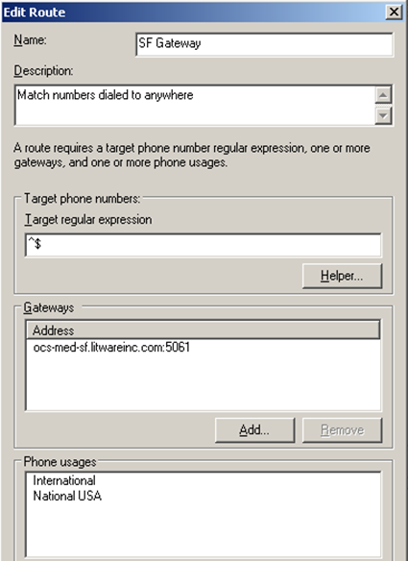
SF Gateway Route Detail

Slide 55
Native IP-PBX Interoperability

Slide 56
Key Takeaways
Understand the voice deployment scenarios for OCS 2007
Learn how OCS 2007 integrates with SIP/PSTN gateways and PBX
See how to get started with a simple gateway-only configuration
Understand OCS Integration with any PBX (TDM or IP-based)
Understand Native OCS Integration with an IP-PBX

Slide 57
Q&A

Slide 58
Resources
Integrating Telephony with OCS 2007
http://www.microsoft.com/uc/products/default.mspx
  Visit the OCS 2007 Tech Center
  http://technet.microsoft.com
  Gateways qualified with Office Communications Server
  http://go.microsoft.com/fwlink/?LinkID=87482
Notes:
9/6/2007 8:27 AM
© 2005 Microsoft Corporation. All rights reserved.
This presentation is for informational purposes only. Microsoft makes no warranties, express or implied, in this summary.
58

Slide 60

© 2007 Microsoft Corporation. All rights reserved. Microsoft, Windows, Windows Vista and other product names are or may be registered trademarks and/or trademarks in the U.S. and/or other countries.
The information herein is for informational purposes only and represents the current view of Microsoft Corporation as of the date of this presentation. Because Microsoft must respond to changing market conditions, it should not be interpreted to be a commitment on the part of Microsoft, and Microsoft cannot guarantee the accuracy of any information provided after the date of this presentation.
This document may contain information related to pre-release software, which may be substantially modified before its first commercial release.
Accordingly, the information may not accurately describe or reflect the software product when first commercially released
MICROSOFT MAKES NO WARRANTIES, EXPRESS, IMPLIED OR STATUTORY, AS TO THE INFORMATION IN THIS PRESENTATION.

