Slide 2
Security and Organizational Governance
Name
Title
Microsoft Corporation

Slide 3
Session Objectives
After this session, you will understand how to
Provide built-in protection for more secure communications
Support organizational governance requirements
Add protection against external threats
Notes:
“This session focuses on many of the security and organizational governance features of Microsoft’s next wave of UC products and services. As this slide shows, there are 3 key elements of security and organizational governance we want to share with you. [read each of the 3 bullets on slide].
We don’t have enough time to detail every aspect security and organizational governance in this release, but we will highlight some of the key security and organizational governance features. Let’s begin by first discussing the business environment as it relates to communications.“

Slide 4




Today’s Business Environment
What customers are telling us
Secure communications in an Anywhere Access World
Ensure privacy for all communications
Deploy in a secure and cost-effective way
Organizational governance
Archive, find, and retrieve information quickly
Avoid penalties for e-mail misuse
Protection against external threats
Ensure reliability of mission-critical systems
Stay ahead of increasingly complex threats
Notes:
“From research that includes talking to a lot of IT Pros, we see the following 3 challenges consistently surface.
First, new communications methods enable increases in flexibility and productivity, but we still must make sure these channels are secure and that content is protected regardless of how employees choose to communicate amongst each other, with partners, or with customers.
Second, communications are very relevant to organizational governance objectives. Communications applications must be flexible to allow IT Pros to enforce even the most complex organizational governance requirements.
Finally, external threats continue to be top of mind for all companies, as spammers, phishers, and other dangerous entities have strong financial motivations to penetrate your companies resources.
Microsoft Unified Communications offers applications and services to help address these challenges. We’ll explore these solutions by stepping through “A Day in the Life of an IT Administrator.” Throughout the day, will see how the administrator relies on UC applications and services to efficiently handle situations in each of the business environment categories listed above.

Slide 5




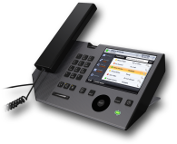

















Litware Inc. Network Architecture
Internet
Perimeter Network
Corporate Network
Clients and Devices
Edge Access
Conferencing
Audio/Video
Edge Transport
Remote Users
Office Communications Server 2007
Services
Active
Directory
Instant Messaging
Voice
Conferencing
PSTN connectivity
Web Access
Federated Businesses
Exchange Server 2007
PSTN
Mailboxes
Unified Messaging
Hub Transport
Client Access
Public
Internet
Clouds
Notes:
Before we begin to drill into the security and compliance aspects of the Unified communications solution – let us first look at the network architecture of the organization – Litware Inc – that we will use for today’s discussion.
Litware Inc uses Active Directory to manage users, groups and devices in the organization – shown in the far right hand side of the diagram. The company also has a link to the PSTN cloud to make external calls.
With the Exchange Server 2007 deployment for messaging and Office Communications Server 2007 deployment for communications – employees at LitwareInc are enabled to use a variety of Clients and Devices in the corporate network. These include Microsoft Outlook for messaging, Internet Explorer for Outlook or Communicator web access, Office Communicator, as well as a variety of phone devices that integrate seamlessly with Office Communications Server 2007. With this setup, corporate users can access rich presence information and features such as click-to-call, multi-party voice and video calls,
By enabling remote access for users using the Perimeter Network setup, LitwareInc has enabled the same rich experience for its corporate users that are outside of the corporate network as well as federated users from other businesses and the public internet cloud users (AOL, Yahoo! and Windows Live messenger). In addition the company also utilizes Microsoft Exchange Hosted Services via the internet.
-----------
“We want to set the context of the discussion with the CSO by showing
him the applications, services, and devices available from Microsoft Unified Communications. For this example, we will focus on an IM conversation using Office Communications Server and Office Communicator 2007 that escalates to a VoIP conversation.”

Slide 6
A Day In The Life of an IT Pro
CSO wants to
learn more
about security in Anywhere Access communications
A peer informs you of a large spam and virus outbreak
Corporate counsel has an unexpected legal discovery request
9:00 am
Notes:
“Let’s begin the day in the life of our IT Pro. It’s 9am and the CSO enters your office and has some questions on the security of some of the newly deployed communication options, such as IM and VoIP.”

Slide 7
Litware Inc. Network Architecture
Internet
Perimeter Network
Corporate Network
Clients and Devices
Edge Access
Conferencing
Audio/Video
Edge Transport
Remote Users
Office Communications Server 2007
Services
Active
Directory
Instant Messaging
Voice
Conferencing
PSTN connectivity
Web Access
Federated Businesses
Exchange Server 2007
PSTN
Mailboxes
Unified Messaging
Hub Transport
Client Access
Public
Internet
Clouds
Notes:
“We want to set the context of the discussion with the CSO by showing him the applications, services, and devices available from Microsoft Unified Communications. For this example, we will focus on an IM conversation using Office Communications Server and Office Communicator 2007 that escalates to a VoIP conversation.”

Slide 8
Enable Secure Communications with a Remote User
demo

Slide 9
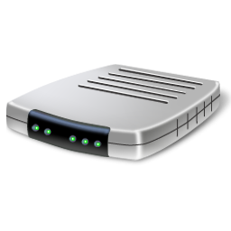
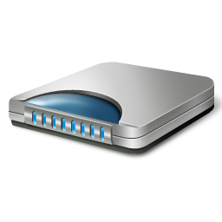

Security For Anywhere Access
Corporate Network
DMZ
Remote User
ISP
Internet
NAT
Notes:
Remote user – from a public internet connection (like a coffee shop)
On the Network Address Translator (NAT) – usually the wireless router in the coffee shop.
ISP – provides gateway to internet for the coffee shop
The external firewall of the corporation is routable via the internet.

Slide 10
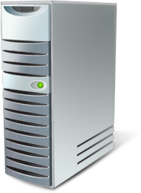
Sign In
Corporate Network
DMZ
Remote User
ISP
Internet
Access Edge Server
Front End Server
NAT
Notes:
Let’s see how authentication works in this scenario:
Office Communicator on Remote User’s laptop initiates a connection (using SIP – session initiation protocol).
SIP message travels via the NAT (wireless router) and through the Gateway provided by the ISP onto the external edge of the corporate firewall.
Office Communications Server 2007 Access Edge Server – sits on the DMZ and accepts the incoming request for Sign-In.
It then forwards request to the Office Communications Server 2007 Front-End Server.
Front-End server authenticates this user for sign-in similar to the process it uses for corporate users. It uses the services from Microsoft Active Directory for authentication and authorization. Active Directory is THE single place for the IT Administrator to manage identities for all users, devices, messaging and communications in the organization.
We did not require a VPN connection from the remote user in this case.

Slide 11

Connection Setup
Corporate Network
DMZ
Remote User
ISP
Internet
Access Edge Server
Front End Server
NAT
Corporate User
Notes:
Once the remote user is signed-on:
User can see his buddy list, search the organization’s directory and view rich presence information about other users – just as though he or she was signed-in from within the corporate network.
Similarly, other users within the corporate network will be able to see the remote user’s presence state. In this example, a corporate user requests a new IM session with the remote user. The SIP messages required for this connection travel a similar path as in the Sign-In above.
Once both users have accepted, an IM session is established.

Slide 12
Media Connection
Corporate Network
DMZ
Remote User
ISP
Internet
Access Edge Server
Front End Server
NAT
A/V Edge Server
Corporate User
Notes:
The media connection flows in a similar path up to the corporate firewall. At this point, the Office Communicator 2007 Audio/Video Edge Server assumes responsibility for taking the media data (audio/video) and switching this into the corporate network.
The Edge server establishes a direct connection with the corporate user and so media flows ‘peer-to-peer’.
The media stack uses the RT Audio codec. A similar media stack is also used for the consumer product (Windows Messenger) where more than 1.5 billion minutes of audio/video are transcoded each month on this media stack.
The codecs dynamically adapt to network conditions and enable a rich media experience (audio/video) even on public internet connections.

Slide 13
Media Connection
Corporate Network
DMZ
Remote User
ISP
Internet
Access Edge Server
Front End Server
NAT
A/V Edge Server
Corporate User
Notes:
Control information –such as SIP Messages for Call setup, Call teardown etc – flow through the Access Edge Server role and the Front-End server role enabling features such as archiving, policy enforcement.
But once a media connection is established, media data flows ‘peer-to-peer’ enabling better performance and scalability.

Slide 14
External Access
Internet
Corporate Network
DMZ
Signaling
SIP/TLS/443
SIP/MTLS/5061
Signaling
SIP/TLS/443
SIP/MTLS/5061
Access Edge Server
Audio/Video
STUN/TCP/443
SRTP/TCP/(Range)
STUN/UDP/3478
SRTP/UDP/(Range)
Audio/Video
STUN/TCP/443
SRTP/TCP/(Range)
STUN/UDP/3478
SRTP/UDP/(Range)
A/V Edge Server
Notes:
Let us examine what happens in the firewall to enable communications for remote users.
On the DMZ we have 2 server roles – the Access Edge Server which is responsible for authentication, and control information such as call setup, call teardown. The Audio/Video edge server enables media packets to flow across the firewall in both directions.
A similar server role (Conferencing Edge Server) can be deployed for supporting remote users to join Conferences.
All signaling (SIP messages) and media is encrypted with AES 128 bit encryption.
Signaling requires authenticated servers (using TLS – Transport layer security). The signaling between servers is mutually authenticated (MTLS).
Audio/Video media data flows uses the Secure Real-Time Protocol (SRTP).
In summary, we have seen that:
Remote users are enabled to access the rich presence information, click-to-IM, click-to-call and other features such as – multi-party audio and video, conferencing – while outside the corporate network.
This does not require a VPN connection and is secured with encryption, authentication and authorization. All the streams including control information and media are encoded and the Edge Server roles in Office Communications Server 2007 help enable secure communications through the firewall boundary.

Slide 15
Communications Security Wrap Up
 | User Authentication | Remote Access | Encryption
E-mail
IM
Voice
Conferencing
Notes:
To wrap up the first section of the presentation on secure communications, I’d like to state that Microsoft UC helps IT Pros to ensure privacy across email, IM, voice, and conferencing by employing User Authentication, supporting remote access, and communication encryption.

Slide 16
A Day In The Life of an IT Pro
CSO wants to
learn more
about security in Anywhere Access communications
A peer informs you of a large spam and virus outbreak
1:00 pm
Corporate counsel has an unexpected legal discovery request
Notes:
The next event for the day is a 3-part legal discovery request. Your company’s attorney pops into your office and frantically states that (1) you need to produce all executive email in the last month that contains the word “sales,” (2) archive all executive email going forward, and (3) append a confidentiality disclaimer to all outbound executive emails. Let’s take a look at how this request can be easily satisfied with Microsoft’s Unified Communications products and services.

Slide 17
Litware Inc. Network Architecture
Internet
Perimeter Network
Corporate Network
Clients and Devices
Edge Access
Conferencing
Audio/Video
Edge Transport
Remote Users
Office Communications Server 2007
Services
Active
Directory
Instant Messaging
Voice
Conferencing
PSTN connectivity
Web Access
Federated Businesses
Exchange Server 2007
PSTN
Mailboxes
Unified Messaging
Hub Transport
Client Access
Public
Internet
Clouds

Slide 18












Microsoft Exchange Hosted Archive
Message archiving for organizational governance and legal discovery
Internet
EHS Global Data Center Network
Corporate Network
SPAM
Filtered Inbound E-mail
← COPY
Filtered Outbound E-mail
COPY →
← Copy via journaling
Access for End Users & Admin
Access for Auditors, Outside Counsel
Full text indexing of e-mail and attachments, IM and Bloomberg mail
Governance tools for supervising, escalating, and tracking messages
Access message archive via the Web for real time e-mail functionality
Archive repository benefits from upstream spam and virus protection features
Notes:
9/6/2007 8:20 AM
18
© 2005 Microsoft Corporation. All rights reserved.
This presentation is for informational purposes only. Microsoft makes no warranties, express or implied, in this summary.

Slide 19
Legal Discovery Made Simple
demo

Slide 20

Organizational Governance Wrap Up
 | Archive | Search and Retrieval for Discovery | Custom Policies
E-mail
IM
Voice
Conferencing
Notes:
We saw one organizational governance scenario satisfied with Exchange Server 2007 and EHA, but organizational governance capabilities exist across all of the communication possibilities available through Microsoft UC.

Slide 21
A Day In The Life of an IT Pro
CSO wants to
learn more
about security in Anywhere Access communications
A peer informs you of a large spam and virus outbreak
Corporate counsel has an unexpected legal discovery request
4:30 pm

Slide 22
Litware Inc. Network Architecture
Internet
Perimeter Network
Corporate Network
Clients and Devices
Edge Access
Conferencing
Audio/Video
Edge Transport
Remote Users
Office Communications Server 2007
Services
Active
Directory
Instant Messaging
Voice
Conferencing
PSTN connectivity
Web Access
Federated Businesses
Exchange Server 2007
PSTN
Mailboxes
Unified Messaging
Hub Transport
Client Access
Public
Internet
Clouds

Slide 23



















Comprehensive Antivirus, Anti-Spam Protection
Choice of protection: “Software + Services” or On-Premise
Hosted Service
On-Premise Software
Firewall
Internet
SMTP
Hub Transport Server
Mailbox Server
Client Access Server
Antivirus and anti-spam protection for Exchange Server 2007 Server Roles
DMZ
On-Premise Software
Firewall
Internet
SMTP
Edge Transport Server
Hub Transport
Server
Mailbox Server
Client Access
Server
Antivirus and Anti-spam protection for Exchange
Server 2007 Roles
Notes:
Network Edge Protection
Services and on-premise software protect against spam and viruses before they penetrate the network
Firewall Protection
Protocol and application-layer inspection enable secure, remote access to Exchange server
Internal Anti-virus Protection
Protects against malicious threats, while enforcing e-mail content policies

Slide 24



















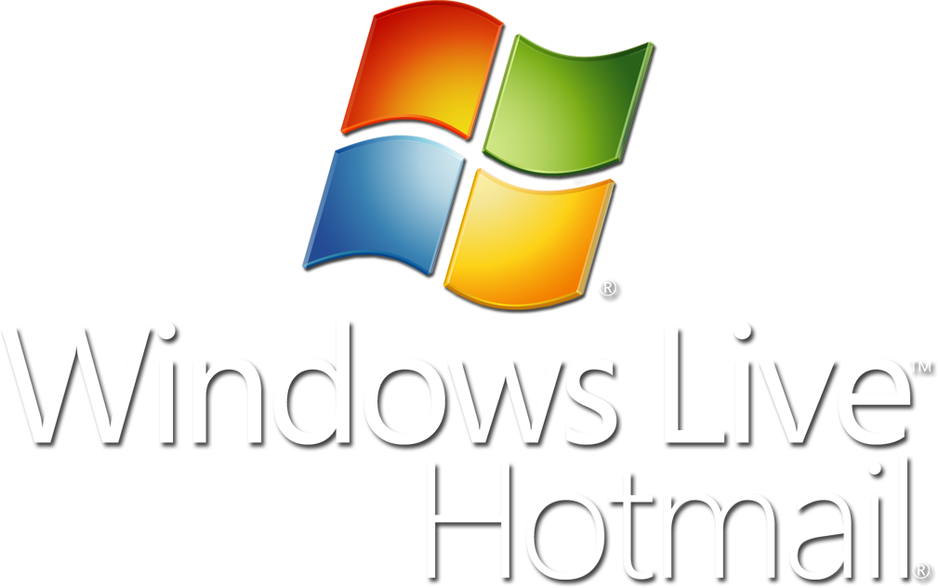
Microsoft Exchange Hosted Filtering
Multilayer spam and virus protection and policy enforcement
Anti-spam
Junk E-mail
Corporate
Network
Antivirus
Inbound
Filtered
E-mail
Policy
Disaster Recovery
Legitimate
E-mail
Messaging
Admin
Outbound
Filtered
E-mail
Admin
Console
Employees
Junk E-mail Quarantine
About 85% of
E-mail is junk
Incorporated Microsoft Technologies
Notes:
9/6/2007 8:20 AM
24
© 2005 Microsoft Corporation. All rights reserved.
This presentation is for informational purposes only. Microsoft makes no warranties, express or implied, in this summary.

Slide 25
Enhanced Protection From External Threats
demo

Slide 26
Protection From External Threats Wrap Up
 | Antivirus | Anti-spam | Automatic Updates
E-mail
IM
Voice* |  | N/A
Conferencing* |  | N/A
* Microsoft Forefront Security for Office Communications Server 2007 coming in 2008
Notes:
To wrap up, external threats are a concern for all communication methods, and Microsoft offers active protection against external threats for each of the communication mediums for which threats exist.

Slide 27
Key Takeaways
In this session you learned how to
Provide built-in protection for more secure communications
Support organizational governance requirements
Add protection from external threats

Slide 28
Q&A

Slide 29
Resources
Technical Communities, Webcasts, Blogs, Chats and User Groups
http://www.microsoft.com/communities/default.mspx
  Visit the OCS 2007, and Exchange Server 2007 Tech Centers
  http://technet.microsoft.com
Trial Software and Virtual Labs
http://www.microsoft.com/technet/downloads/trials/default.mspx

Slide 30
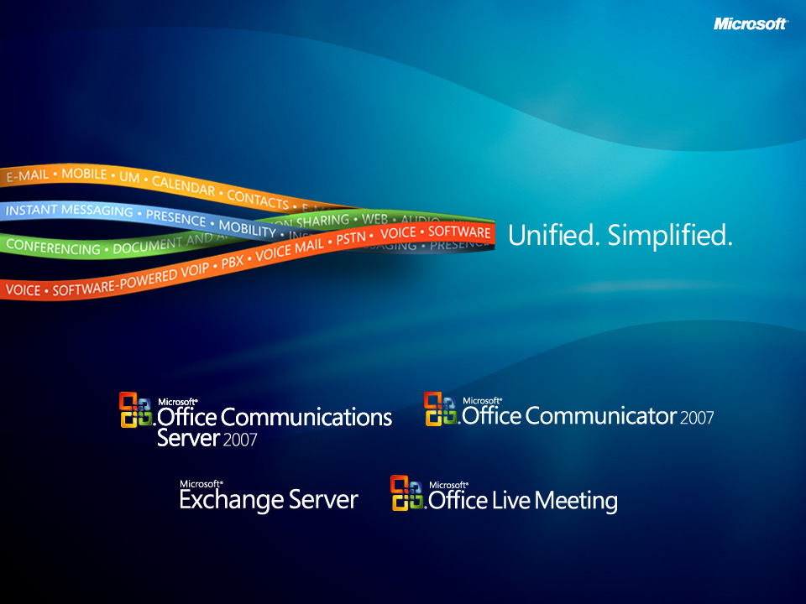

Slide 31

© 2007 Microsoft Corporation. All rights reserved. Microsoft, Windows, Windows Vista and other product names are or may be registered trademarks and/or trademarks in the U.S. and/or other countries.
The information herein is for informational purposes only and represents the current view of Microsoft Corporation as of the date of this presentation. Because Microsoft must respond to changing market conditions, it should not be interpreted to be a commitment on the part of Microsoft, and Microsoft cannot guarantee the accuracy of any information provided after the date of this presentation.
This document may contain information related to pre-release software, which may be substantially modified before its first commercial release.
Accordingly, the information may not accurately describe or reflect the software product when first commercially released
MICROSOFT MAKES NO WARRANTIES, EXPRESS, IMPLIED OR STATUTORY, AS TO THE INFORMATION IN THIS PRESENTATION.

