Slide 2
Mobility And Anywhere Access
Name
Title
Microsoft Corporation

Slide 3
Session Objectives
In this session, you will…
Learn about remote, external and mobile access
See an Anywhere Access demo
Review security features to enable remote and external access
Understand server topology and architecture

Slide 4

Today’s Business Environment
What Customers Are Telling Us
Mobile Workers
Information Workers want access from any location
Full feature access regardless of location
Flexibility in choice of devices and modes depending on need
Manage External Access
Secure communications
Secure external user access
Flexibility in setting policies per organization’s needs
Increasing complexity
Scalable, flexible architecture
Deployment and administrative ease
Reduced cost and complexity
Notes:
Mobile access has become a key customer requirement. Users want full feature access regardless of location. They want choices of modes and devices depending on their need and convenience. Both flexibility and access are important. IT administrators on the other hand worry, that every time they open up their networks to remote access, they make themselves vulnerable. Companies want security in communication and external access as well as control over the functionality depending on the needs of the organization. Does this add to a lot of complexity? We don’t think it should. One of the key demands of IT administrators has been the need for simplicity. So we hear you when you ask for simple, cost effective and scalable environments.

Slide 5
Microsoft's Investment Themes
Mobility and Anywhere Access
  Similar experience on desktop, web browser and mobile phone
  Efficient collaboration with conferencing and document sharing
  VPN-less corporate network access
Anywhere Access
Built-in Protection
Encrypted communication and content
Help secure connections with external users
New policies to meet organizational requirements
Flexible Architecture
Flexible deployment and topologies
Modular server architecture
Software + Services continuum
Notes:
9/6/2007 8:21 AM
© 2004 Microsoft Corporation. All rights reserved.
This presentation is for informational purposes only. Microsoft makes no warranties, express or implied, in this summary.
5
Let’s start by taking a brief look at the core investments we’ve made in each of these pillars. These investments center around making the user more productive and the IT environment more secure and easy to manage and deploy.
You now have choice of communication modes and devices that offer a similarity of experience from the desktop to the mobile phone. These options provide not only communication choices, but also fulfill the need to collaborate and continue to work without interruption. You can now securely access your email and instant messaging functionality without the need for a VPN connection into the corporate network.
Careful attention has been paid to the security aspects of enabling this functionality. This includes a comprehensive approach looking at each aspect of security, from the transport layer to authentication and encryption of content. Organizations have control over enabling external access and new policies particularly around mobile communications provide greater latitude for organizations to set policies per their requirements.
Architecturally, Exchange and OCS offer simple, easy to deploy solutions that scale well. Sever based roles allow for greater flexibility and make for easier deployment. Microsoft offers a server-service based continuum so that you have a choice to sign up for always on services, without the need and hassle for maintaining a lot of infrastructure if that is your preference.

Slide 6
Anywhere Access

Slide 7

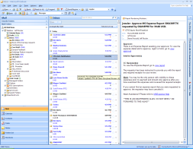
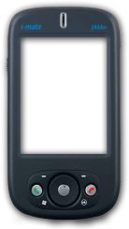
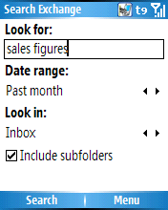

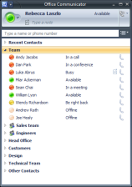

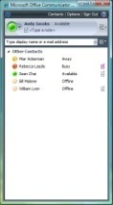
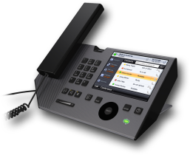

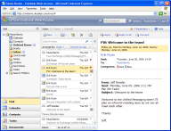
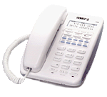

Anywhere Access
Similar experience from desktop to mobile devices
Microsoft® Office Outlook® 2007
Microsoft® Office Communicator 2007
Microsoft® Office Outlook® Mobile
Microsoft® Office Communicator Mobile
Exchange Server 2007
Office Communications Server 2007
Microsoft® Office Outlook® Voice Access
Microsoft® Office Communicator Phone Edition
Microsoft® Office Outlook® Web Access
Microsoft® Office Communicator Web Access
Notes:
This slide presents the menu of options that are available to you to access Outlook and Communicator. You have the same richness and consistency in experience. Both Office and Communicator have desktop clients that allow for access from within and without the LAN/Wan environment. In addition, there is Outlook Mobile and Communicator mobile that can be used on a mobile device and Outlook and Communicator web access that provide functionality with just a web browser. With Outlook Voice Access you can have your e-mails read out to you, interact with your calendar such as notifying participants that you will be late and listen to voice mail, all interacting with voice commands. Likewise, Communicator provides software for IP phones so that you can access your contact lists and presence information from within the phone itself.

Slide 8
Anywhere Access
Efficient Communication and Collaboration
VPN-less remote access
Corporate file share and SharePoint site access
GAL Access for scheduling meetings
Presence and contact information
Long distance charge savings
Optimized codecs for variable network conditions
Notes:
Remote access is available for both Outlook and Communicator clients without the need for a VPN connection to the corporate network. In addition to communication options, users have access to corporate file shares and SharePoint sites and can access corporate address book information to schedule and set up meetings remotely.
Communicator offers presence enabled real time communications, so you know before hand if a person is available or not and the best way to reach them.
One of the benefits of this is the ability to make phone calls with just an internet connection. If you travel frequently, you’ve felt the pain of having to pay expensive communication charges. You can now make calls from your hotel’s internet connection using Communicator without having to pay costly long distance charges hotels typically levy. One of the questions we get from people is the about the quality of voice conversations over public networks. Office Communications Server has invested heavily in developing intelligent codecs that provide a good experience even with variable network speeds, so you can leverage this functionality without sacrificing on quality.

Slide 9
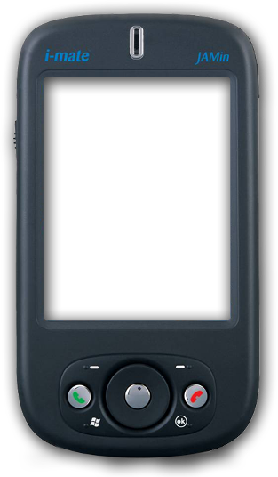
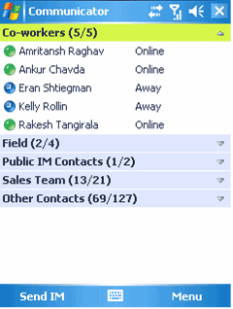



Anywhere Access
Mobile Messaging
Optimized for small form factor
Efficient search
Presence enabled communication
Corporate address book
Office application access
Notes:
Outlook mobile and Communicator mobile are clients that work on the Windows mobile platform and provide access to email and instant messaging functionality. The look and feel is similar to the desktop clients and they have features optimized for the small form factor. Outlook provides efficient search functionality, so it’s now very easy to search your inbox from your mobile device. If you download only a few days data, you can now search the rest of your inbox on the server from the device as well. This is a very convenient way to retrieve older messages, without having the need to store and occupy precious space.
Communicator offers presence enabled real time communication and access to the corporate address book. What this means is that you have the ability to easily search for anyone in the organization, see their “presence” and then communicate with them in a variety of ways. Integration with the underlying phone capabilities means that Communicator Mobile can be used to initiate calls over the cellular voice network without requiring you to manually enter numbers.
Windows mobile also offers support for office applications like word and excel, so in essence you can carry your complete office on just your mobile phone.

Slide 10
Anywhere Access
demo

Slide 11
Built-in Protection

Slide 12
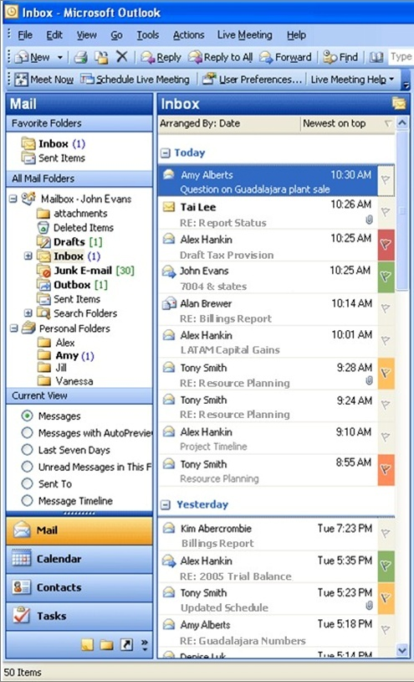
Built-in Protection
Powerful Security Features
Help protect against viruses, spam, and other malware
  Built-in security technologies to help protect against latest threats
  Frequent and automatic updates to ensure up-to-date protections
Comprehensive approach
  Enhanced security of communication and content
  Controlled external user access through federation and PIC
Edge server roles
  Edge servers in the perimeter zone provide routing security
  Different edge server roles for different media types in OCS 2007
Notes:
Exchange offers extensive safeguard to protect users’ and the organization’s valuable data from internal and external threats such as spam, viruses, and e-mail tampering, as well as frequent updates to security protocols to keep the protection up to date.
Office Communications Server takes a comprehensive approach to security, looking at each point in the process. There are protocols built in to provide security at the communications layer, through TLS and MTLS, user authentication and content encryption. External access is controlled through federation and public IM connectivity, both of which are optional.
Exchange and OCS also define edge server roles that sit in the perimeter area of the network and filter unauthorized traffic, acting as sentinels to the network. Appropriate security protocols are implemented through the specialized edge server roles for the different media types, providing for a more robust approach.

Slide 13
Built-in Protection
Access based on user type
Remote User | Federated | Public IM | Anonymous
Enterprise users either on a public network or 3rd party network | Users belonging to enterprises federated with each other | AOL, MSN, Yahoo! users | Users invited to meetings without a SIP identity from the enterprise or federated enterprise
Full Functionality | Full functionality except Corporate Address Book Search | IM and Presence | Web Conferencing
Notes:
We’ve talked a little about external access. Let’s look at it in more detail and see what it means in the context of real time communications and the roles defined by Office Communications Server. OCS defines 4 types of users, providing them with different levels of functionality, thus enabling organizations to control who gets access to what. The first is Remote users, which are users belonging to your organization but on a public or 3rd party network. Remote users get full functionality, which means they can use all features offered by OCS, remotely. This is anywhere access working in action, which is the ability to get a consistent experience whether you are inside or outside the office.
The second is Federated Users, who are users from an organization also using OCS, that you have a federated relationship with. These can be vendors or partners with whom you have frequent communication needs. Federated users also have full functionality access, for example, you can make or receive VoIP calls with them, except access to your corporate address book.
The 3rd type of users are users on Public IM networks like Yahoo and AOL. These users have IM and presence capability, so you can see their presence and hold an instant messaging conversation with them.
The last are Anonymous users, i.e. users who do not have a SIP identity with you or an organization you federate with, but can still be invited to live meeting web conferences hosted by your company.
OCS will check for user type during authentication and accordingly allow appropriate access and functionality.

Slide 14
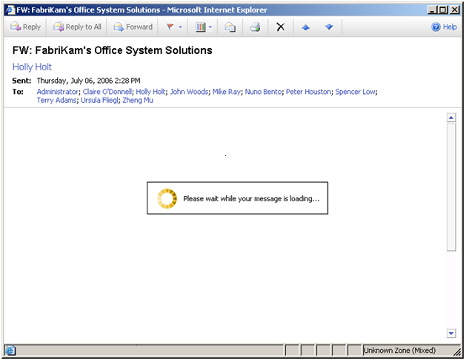
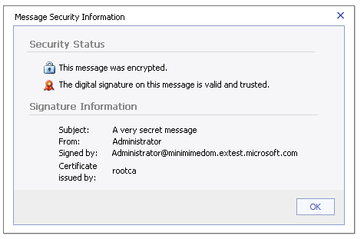
Built-In Protection
New: S/MIME Support in OWA
Notes:
Exchange now offers S/MIME support in OWA, allowing for greater and more ubiquitous remote access to all your messages.

Slide 15
Built-In Protection
New Exchange ActiveSync Policies
30 new policies in SP1
  New: Device Control, Application Control, Network Control
  Enhanced: Authentication, Synchronizations, Encryption
33% reduction in bandwidth usage
Device Wipe
  User confirmation for device wipe completion (OWA & Outlook)
  Users/Admins can now cancel a device wipe request
Notes:
Exchange ActiveSync policies have been considerably enhanced in the new release, with the addition of 30 new policies in the areas of device and network control. There are also enhanced policies, which we’ll see in just a minute, covering authentication, encryption and synchronization that can be enforced on users devices. For example, you are now able to encrypt the entire device, disable components such as the camera or Wi-Fi, or even block the ability to use SMS or consumer e-mail so that your intellectual property is not compromised.
The architecture is also improved, utilizing 33% less bandwidth than previously. In terms of delegating greater power to users and reducing the workload on the IT department, users can now self wipe their device using Outlook Web Access if they lose or misplace it while traveling. This not only reduces the burden on IT, but also adds to the overall security of the system.

Slide 16
Built-in Protection
demo

Slide 17
Flexible Architecture

Slide 18














Exchange Server 2007 Architecture Overview
Enterprise Network
Other
SMTP
Servers
Hub
Transport
Edge
Transport
PBX
or VoIP
Routing Hygiene
Routing Policy
I
N
T
E
R
N
E
T
Unified
Messaging
Applications
OWA
Voice Messaging
Protocols
ActiveSync, POP, IMAP, RPC / HTTP
Mailbox
Fax
Programmability
Web services,
Web parts
Mailbox
Client Access
Public Folders
5 server roles – Edge, Hub Transport, UM, Mail and Client Access
Notes:
This diagram shows the quintessential Exchange topology. There are 5 server roles defined – edge transport, client access, hub transport, mailbox and Unified messaging.
Inside the corporate network, with Active Directory access are:
Mailbox server, which hosts mailboxes, public folders, and core services including calendaring
Client Access server, which provides Outlook Web Access, mobility, and Web services
Hub Transport that provides internal routing and a policy engine for enforcing compliance rules
And Unified Messaging which integrates with the PBX system for voicemail, fax receiving, and voice access services
The Edge server does not need Active Directory access and acts as the SMTP gateway; providing Anti-virus, anti-spam and messaging security services. This is an optional server role and if implemented, it should be deployed in the perimeter network.

Slide 19
Exchange Server Roles
Edge Transport and Client Access
Edge Transport role resides in the perimeter network
  Not required to be part of Active Directory
  Provides routing hygiene and security
Client Access Server enables
  OWA, mobility, and web services
Flexible deployment options – co-locate or separate
Automated provisioning with Windows Powershell scripting
Notes:
In the context of the discussion topic of today, the server roles that we are most concerned with are the Client Access and Edge Transport servers. To recap briefly, edge server does not require access to the Active Directory and provides routing hygiene and security. And, Client Access server is responsible for providing access to outlook web access and outlook mobile.
The server roles we discussed can be consolidated on one server or separated. The modular architecture provides for flexibility and ease of deployment. Exchange provides for simple installation and configuration and provisioning can be automated through Windows Powershell scripting.

Slide 20













OCS 2007 Architecture Overview
UC endpoints
Public IM Clouds
QOE Monitoring Archiving
CDR
MSN
DMZ
AOL
Yahoo
Data
Audio/Video
Inbound
Routing
SIP
Outbound
Routing
Remote
Users
Voice Mail
Routing
Access
Server
Front-End Server(s)
(IM, Presence)
Conferencing
Server(s)
Backend
SQL server
Active Directory
Mediation Server
Exchange
2007 Server UM
Federated
Businesses
(SIP-PSTN GW)
Voicemail
PSTN
PRI
PBX
Notes:
Let’s now take a look at the Office Communications Server architecture. It utilizes the similar concept of modular server roles with edge servers in the perimeter zone. One key difference is the role of edge servers. In Exchange, the edge server role was optional and the client access server enabled outlook web access and outlook mobile. In case of OCS, it is the edge servers that enable external and internal users to communicate with each other.

Slide 21
OCS 2007 Edge Server Basics
3 different Edge Server roles:
  Access Edge
  Web Conferencing Edge
  Audio/Video (A/V) Conferencing Edge
Co-locate on single server or separate
Recommend separate server for A/V
Load-balance for improved availability
Web Conferencing & A/V Edge
Servers can be deployed in multiple locations
Notes:
OCS defines 3 different edge server roles – access edge, audio/video edge and conferencing edge. All of these sit in the perimeter zone and can be located on a single server or separated on different boxes. We recommend that a separate box be used for Audio/Video edge server because of the higher bandwidth traffic. If you’re using multiple servers, then a hardware load balancer can be used to distribute traffic. Another point to note is that if you are utilizing a multiple site topology, then the access edge has to be deployed at the main site, but audio/video and web conferencing edge can be deployed at regional sites and users will connect for example to the server hosting the conference.
In the diagram, you can see the different traffic types that flow through each of these servers. In the next slide, we’ll look at the specific roles of each of these.

Slide 22
OCS 2007 Edge Server Roles
Access Edge Server
  Enables remote and external user access
  Validation of SIP message headers and routing information
  Mandates traffic encryption
Web Conferencing Edge Server
  Enables external user access to Web conferencing
  All connections are TLS and meeting content is encrypted
  Access restricted by conference
  Enables external user access for A/V calls and conferences
  Provides NAT and firewall traversal
  All users sending and receiving media authenticated
Audio/Video Edge Server
  Reverse proxy (not an OCS role), allows Communicator Web Access,
  Address Book download, DG expansion and meeting content access
Notes:
The first is the Access Edge Server. All SIP traffic flows through the Access Edge, which validates the message header and routing information. It is also responsible for mandating traffic encryption, TLS between client and server and MTLS between servers. Access edge allows remote and external parties to connect to users in the environment.
The second is Web conferencing edge, which allows external user access to web conferences. It mandates all content to be encrypted and allows for different conference types. Conferences can be restricted to only the invited participants from the organization, or allow for more broader participation including external parties to join in.
And lastly, the A/V conferencing edge enables external and remote access to A/V calls and conferences. It provides NAT and firewall traversal and therefore shields users from network complexities. To make A/V calls from outside the firewall, all participants, including those receiving the calls have to be authenticated.
Reverse proxy, which is not an OCS role also sits in the perimeter zone and provides access to Communicator Web access, address book download, Distribution group expansion and meeting content in web conferences.

Slide 23
Key Takeaways
In this session, you learned about
Remote, External and Mobile Access
Security features to enable Remote and External Access
OCS 2007 and Exchange Server 2007 Architecture

Slide 24
Q&A

Slide 25
Resources
  Visit the OCS 2007 and Exchange Server 2007 Tech Centers
  http://technet.microsoft.com
  Try a Hosted End-user Trial of Exchange Server 2007
  https://signmeup.exchange2007demo.com/exchange2007demo/?wt.svl=highlights
Notes:
9/6/2007 8:21 AM
© 2005 Microsoft Corporation. All rights reserved.
This presentation is for informational purposes only. Microsoft makes no warranties, express or implied, in this summary.
25

Slide 26
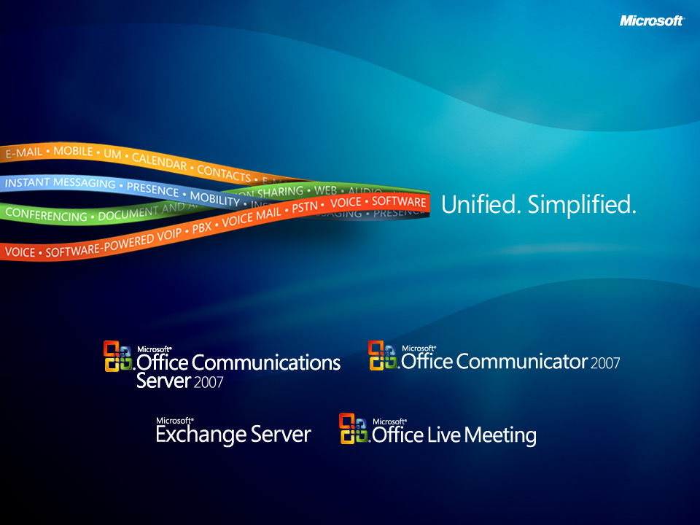

Slide 27

© 2007 Microsoft Corporation. All rights reserved. Microsoft, Windows, Windows Vista and other product names are or may be registered trademarks and/or trademarks in the U.S. and/or other countries.
The information herein is for informational purposes only and represents the current view of Microsoft Corporation as of the date of this presentation. Because Microsoft must respond to changing market conditions, it should not be interpreted to be a commitment on the part of Microsoft, and Microsoft cannot guarantee the accuracy of any information provided after the date of this presentation.
This document may contain information related to pre-release software, which may be substantially modified before its first commercial release.
Accordingly, the information may not accurately describe or reflect the software product when first commercially released
MICROSOFT MAKES NO WARRANTIES, EXPRESS, IMPLIED OR STATUTORY, AS TO THE INFORMATION IN THIS PRESENTATION.

