Slide 1
Virtualization and Security
Ravi Sankar
Technology Evangelist | Microsoft Corporation
Ravisankar.spaces.live.com/blog

Slide 2

Agenda
  Securing the virtual environment: Similarities and differences
  Microsoft’s integrated approach to virtualization security
  Achieving benefits through Core Infrastructure Optimization

Slide 3
The Malware Landscape
77,000+
More Advanced
Attacks
Variations of One Trojan
170%
Increased
Volume
Increase In Potentially Unwanted Software
150%
Profit
Motivated
Increase In Fraud & Phishing scam emails
Source: Microsoft Malware Protection Center, H1 2007

Slide 4
Securing The Virtual Environment
What’s the same
  Deploying and properly configuring security technologies
  Protecting against complex attacks – securing virtual and physical machines
  Enabling secure access to virtual and physical assets based on policy
  Managing identities and their rights to manage physical and virtual machines
  Ensuring software running in virtual and physical machines remains up-to-date
  Getting critical visibility into security state into endpoints and virtual machines
  Responding to and remediating security issues

Slide 5
Securing The Virtual Environment
What’s different
Securing the virtualization layer
  “Hyperjacking”: Compromising hypervisor
  “Blue pill”: Concept of installing rogue hypervisor
  Ensuring trusted platform on which virtual machines run
Increased attack surface and vulnerability potential
  Denial of service possible by compromising hypervisor
  Virtual “appliances” offer benefits but also potential vulns
  Ensuring offline virtual machines stay in compliance
Increased asset concentration on devices
  If physical machine lost or stolen, so are the VMs on it
Isolating virtual machines from each other
Monitoring VM to VM traffic
  Only enabling communication where policies can be enforced
  A well-planned, integrated approach to securing physical and virtual assets is key
Microsoft Confidential – Provided under NDA

Slide 6
Problems With Point Products
  Operating in Silos
Lack of Visibility
  Is the organization secure, well-managed, and compliant?
  How and where to audit?
Identity Management
Virtualization
Lack of Integration
  Multiple vendors with multiple offerings
  Difficult to coordinate & manage
Systems Mgmt
Patching
Information Protection
Edge Protection
High Cost of Ownership
Client Protection
Server Protection
  High integration & maintenance costs
  Manual coordination

Slide 7
Value Of Infrastructure Integration
Microsoft’s Integrated, Simplified Solutions
Customer Benefits
Security
Save time
Lower cost of ownership
Identity
Gain greater visibility
Protect IT
Access
Management
  From the desktop to the datacenter…
  Across physical and virtual environments…
  And covering all virtual elements: application, presentation, and hardware
  Common Platform & Infrastructure
Physical
Virtual
Client OS
Server OS
3rd Party

Slide 8
Microsoft’s Approach To Virtualization Security
  Secure Computing Solution
  Hyper-V in Windows Server 2008 designed for security through its architecture and features
  Integrated Protection
  Defense-in-depth combining Windows Server 2008 security features with Forefront security solutions
  Simplified Management
  Simplify administrative tasks and get clear visibility with Window Server 2008, System Center, and Identity Lifecycle Manager
Microsoft Confidential – Provided under NDA

Slide 9
Monolithic Vs. Microkernelized
Virtualization: Hypervisor + Drivers + Virt software stack + Mgmt interface
Microkernelized Hypervisor
  Only partitioning memory & CPU
  Increase reliability and minimize trusted computing base
  No third-party code
  Drivers run within guests
Monolithic Hypervisor
  Includes all virtualization components, including drivers
  Runs all code in most privileged part of the processor
  Patching may be more likely given code included
VM 1
(“Root”)
VM 2
(“Guest”)
VM 3
(“Guest”)
VM 1
(Admin)
VM 2
VM 3
Virtualization
Stack
Hypervisor
Drivers
Drivers
Drivers
Drivers
Drivers
Drivers
Drivers
Drivers
Drivers
Drivers
Drivers
Hypervisor
Drivers
Hardware
Hardware

Slide 10


Microsoft’s Hypervisor
Very Thin Layer of Software
  Microkernel
  Highly reliable
Optimized for hardware virtualization features from Intel & AMD
  Only runs in most privileged part of processor, where execution context is enforced by the processor
Minimized Attack Surface
  No drivers, extensible code, or 3rd party code included in Hyper-V
  Minimal size (only ~600 kilobytes)
  Drivers run in the root partition
Simplifies Management
& Maintenance
  Because of microkernel architecture, the Microsoft hypervisor can be fully updated where needed via Windows Update
  Easily replacing the existing installation with a new one without the need for patching.
  The hypervisor update can also be rolled back through the control panel
Windows Hypervisor
Server Hardware

Slide 11






Root Partition
Root Partition
Guest Partitions
What is a Root Partition?
  Portion of hypervisor that has been pushed up and out
  Virtualization stack runs within the root partition
  Manages guest partitions
Lock it down and minimize its size by using WS 2008 server core
Separation of components by privilege and process
  Code signing helps ensure that the hypervisor has not been modified
  Before Windows Server 2008 engages Hyper-V through the root partition, it checks to ensure Hyper-V has the proper signature
Virtualization Stack
  VM 1
  VM 2
. . .
WMI Provider
VM Worker
Processes
VM Mgmt
Service
User Mode (“Ring 3”)
Server Core
Virtualization
Service
Providers
(VSPs)
Windows
Kernel
Device
Drivers
Kernel Mode (“Ring 0”)
Windows Hypervisor
Server Hardware
Provided by:
Windows
Hyper-V
3rd Party ISVs

Slide 12




The Complete Architecture
Root Partition
Guest Partitions
Guest-to-guest isolation mitigates risks
  VMs can be configured to only communicate through networks where policies can be enforced
  If compromised, limits damage because of architecture and hardware
  Enables use all of management tools for Windows environment
  No need to learn additional tools to manage or secure
  Use all device drivers for Windows environment
Virtualization Stack
User Mode (“Ring 3”)
Guest Applications
WMI Provider
VM Worker
Processes
VM Mgmt
Service
Kernel Mode (“Ring 0”)
Virtualization
Service
Clients
(VSCs)
OS
Kernel
Server Core
Virtualization
Service
Providers
(VSPs)
Windows
Kernel
Device
Drivers
VMBus
Enlightenments
  Created using Microsoft’s Security Development Lifecycle
  Readily enables security ecosystem via published
  VHD standard
Windows Hypervisor
Server Hardware
Provided by:
Windows
Hyper-V
3rd Party ISVs

Slide 13
Virtualization Attacks
Root Partition
Guest Partitions
Virtualization Stack
User Mode (“Ring 3”)
Windows
Hyper-V
WMI Provider
VM Worker
Processes
Guest Applications
VM Mgmt
Service
3rd Party ISVs
Hackers
Attack Vectors
Kernel Mode (“Ring 0”)
Virtualization
Service
Clients
(VSCs)
OS
Kernel
Server Core
Virtualization
Service
Providers
(VSPs)
Windows
Kernel
Device
Drivers
VMBus
Enlightenments
Windows Hypervisor
Server Hardware

Slide 14
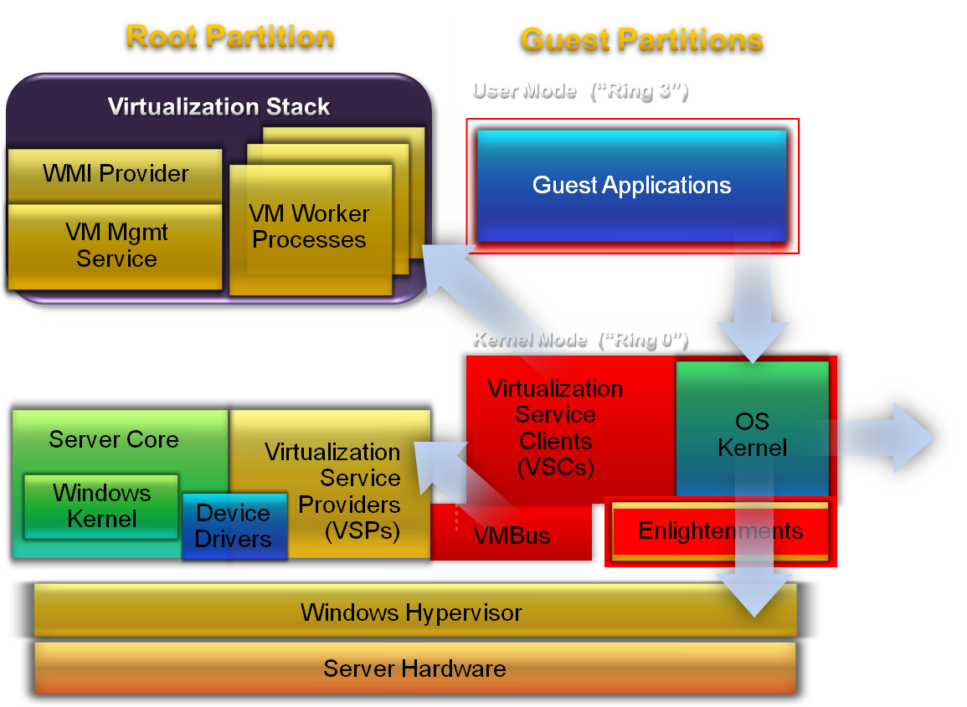

Attack Mitigation
Non-interference
  Guest computations protected from other guests
  Guest-to-guest communications not allowed through VM interfaces
Separation
  Separate worker processes per guest
  Guest-to-parent communications over unique channels
SDL
  Threat modeling, penetration testing, and secure code review of all components

Slide 15
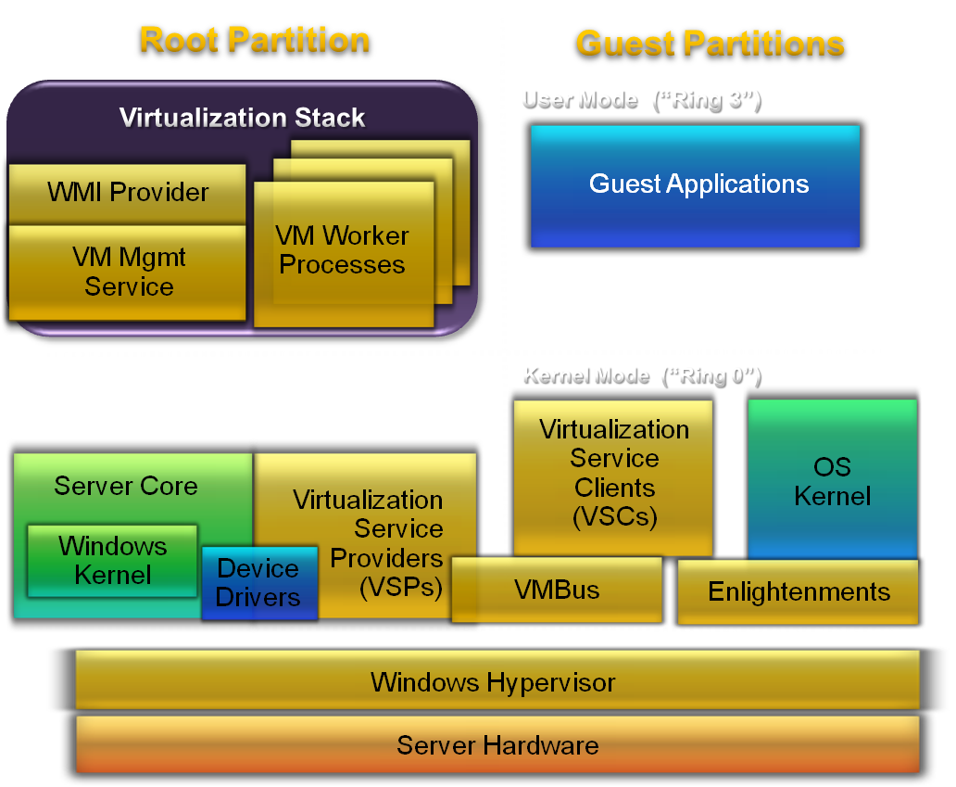
Integrated Protection
Windows Server 2008 and Windows Vista
  Hyper-V
  Security Features
  Server & Domain Isolation
  Network Access Protection with IPSec
Enables trusted relationships between devices
  Dynamically segment the network based on policy
  When used with Hyper-V, each virtual machine can be set to only communicate with trusted virtual machines on a network
  Enforced by IPSec and Active Directory
Control access and enforce compliance for physical and virtual clients based on consistent policy
  Individual health certificates are associated with each virtual client
  Compliance can be enforced on a per virtual session basis
  Hyper-V also enables creation of virtual LANs for network segmentation within the virtual environment

Slide 16
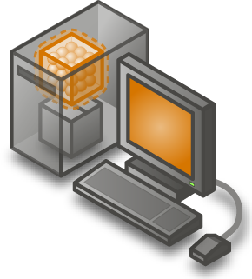
Complete Virtualization Solution
Server Virtualization
Desktop Virtualization
Presentation Virtualization
Application Virtualization
Microsoft’s Hyper-V
(Win Server 2008)
  Terminal Services
  (Win Server 2008)
  Microsoft’s
  Softgrid
Definition
  Enables app to run on one computer but be accessed through another
Enables app to run on a machine without installing it on the OS
Security Benefit
  Helps limit exposure from unmanaged devices by keeping app execution off client device
  Eliminates the need for applications requiring administrative privilege to install locally

Slide 17

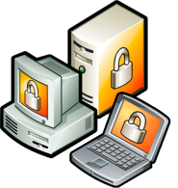



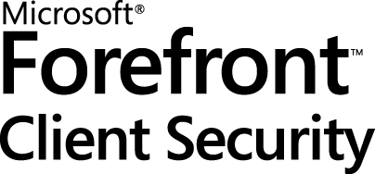
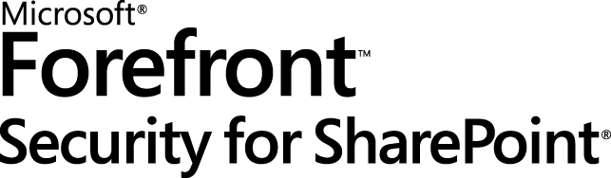

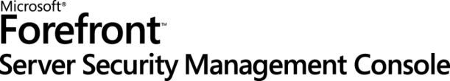
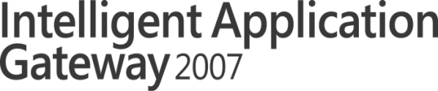
Complementary Security Solutions
Comprehensive line of business security products that helps you gain greater protection and secure access through deep integration and simplified management
  Client & Server OS
  Server Applications
  Network Edge

Slide 18
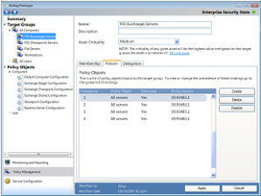
Microsoft Forefront Code Name “Stirling”
An integrated security system
Now in
Public
Beta
  Management
  & Visibility
  Dynamic Response
Action
Shared Information
Action
  Endpoint
  Security
  Messaging and Collaboration Application Security
  Network Edge Security
Common Management Infrastructure and Platform

Slide 19
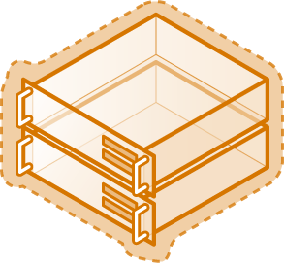
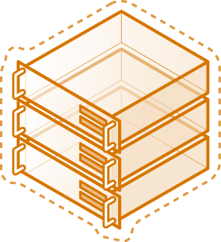
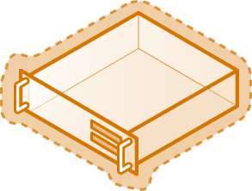

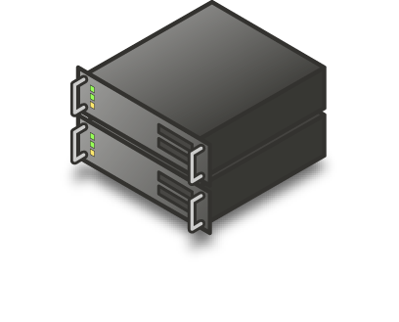
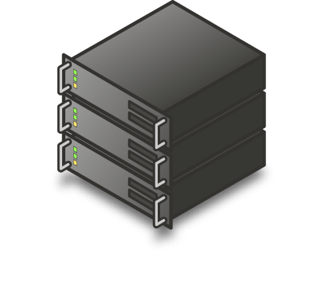
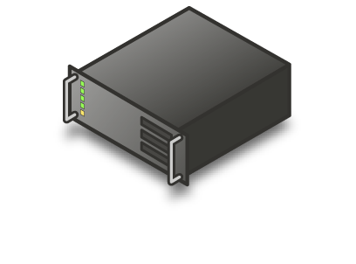
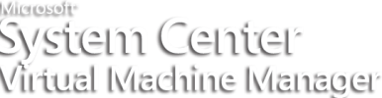
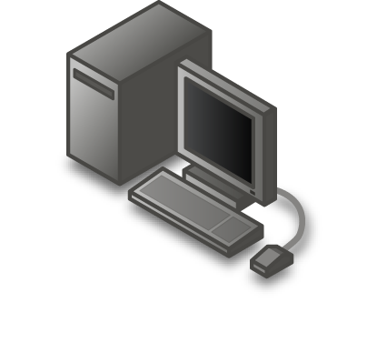
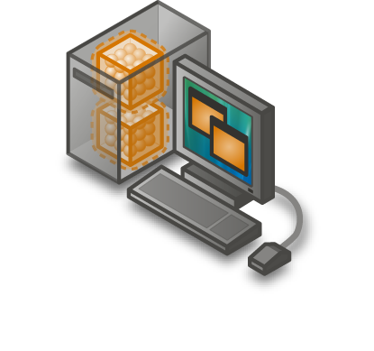
Simplified Management . . .
Virtual Environment
  WS08 and Hyper-V
  Authorization Manager (AzMan) for Role-Based Access Control
  Microsoft Identity Lifecycle Manager
  Provides a single view of a user’s identity and its privileges across the heterogeneous enterprise
  Enable end-uses to request access to physical and virtual assets through a defined
  workflow
  Enables management of Hyper-V virtual machines while supporting heterogeneous environments
  Integrates with Active Directory and other System Center solutions for coordinated management across physical and virtual environments.
Physical Environment

Slide 20
…With Complementary Tools
Offline VM Servicing Toolkit
V1 Solution Accelerator Just Released
  Automates VM OS patching of XP, Vista, WS2k3 clients on Virtual Server
Integration with System Center and WSUS
  System Center Virtual Machine Manager (VMM 2007)
  System Center Configuration Manager 2007 (ConfigMgr 2007)
  Windows server update service (WSUS3.0)
V2 Fall 2008 Features
  Hyper V, WS2008 clients, CfgMgr 2007 SP1, WSUS 3.0 SP1, NAP

Slide 21
... And Enabled By Active Directory
System Center Virtual Machine Manager
Microsoft Identity Lifecycle Manager
Active Directory
  Active Directory enables a single identity store for virtualization
  Virtual machines based on Hyper-V are treated as a file on the file system.
  Across physical / virtual environments, file access can then be granted through user groups
  Across different forms of virtualization
Forefront security solutions
Virtualization
Hardware
Presentation
Application
  Hyper-V
  Terminal Services
  Softgrid
Network Access Protection
Server & Domain Isolation

Slide 22

Core Infrastructure Optimization
Basic
Standardized
Rationalized
Dynamic
Uncoordinated, manual infrastructure
Managed IT infrastructure with limited automation
Managed, consolidated, and automated IT infrastructure
Fully automated
management, dynamic resource usage
Windows Server 2008: Hyper-V, Active Directory
Terminal Services
Server & Domain Isolation
SoftGrid Application Virtualization
Forefront Security products
System Center Virtual Machine Mgr
Microsoft Identity Lifecycle Manager
Microsoft’s virtualization and other infrastructure solutions
are key enablers toward achieving dynamic IT

Slide 23
Summary
Many things are similar in securing the virtual environment, but there are key differences
We’re delivering an integrated, simplified approach to IT security across physical and virtual environments
  Secure computing platform: Hyper-V’s architecture
  Integrated protection: WS08 + complementary Microsoft solutions (Terminal Services, Softgrid, Forefront)
  Simplified management: Hyper-V + System Center + Identity Lifecycle Manager + tools / guidance
Customers at every stage of IT maturity can use this approach through Core IO guidance

Slide 24
For More Information
Virtualization: www.microsoft.com/virtualization
Windows Server: www.microsoft.com/windowsserver
Forefront: www.microsoft.com/forefront
Identity & Access: www.microsoft.com/ida
System Center: www.microsoft.com/systemcenter

Slide 25
Feedback / QnA
Your Feedback is Important!
  Please take a few moments to fill out our online feedback form at:
  << Feedback URL – Ask your organizer for this in advance>>
  For detailed feedback, use the form at http://www.connectwithlife.co.in/vtd/helpdesk.aspx
  Or email us at vtd@microsoft.com
Use the Question Manager on LiveMeeting to ask your questions now!

