Slide 2
Business Value of Virtualization
Kalyan Kumar
Global Practice Head,ITSA
HCL Technologies – Infrastructure Services Division

Slide 3
Agenda
Industry Pain Points
Demystifying Virtualization
Virtualization Trends
Virtualization – The Road Ahead
  Evolving Delivery Models
  Operational and Management Impact
Application Virtualization
Vendor Landscape
Calculating ROI
Summary

Slide 4

Industry Pain Points
Virtualization is Hot !!!!!!!!!!
Market demands
Workloads
Service levels
Changing Workforce
Virtualization changes and touches everything in the IT portfolio !!!
Change
Management
Administration
Power
Hardware
Licenses
Complexity
Cost
Heterogeneous resources
Organizational silos
Composite applications
Regulations
Security
Audit capabilities
Compliance

Slide 5
Virtualization lets a single physical resource (such as a server, an operating system, an application, or storage device) appear as multiple logical resources; or making multiple physical resources (such as storage devices or servers) appear as a single logical resource.
Definition: Virtualization is a technique for hiding the physical characteristics of computing resources to simplify the way in which other systems, applications, or end users interact with those resources

Slide 6
Types of Virtualization
Hypervisor | Software Streaming
Hardware Virtualization | Server-Based (or Remote) Desktop Virtualization
Server Virtualization | Client-Based (or Local) Desktop Virtualization
Paravirtualization | Storage Virtualization
Operating System Virtualization | Network Virtualization
Application virtualization | Data Virtualization
Application Isolation | Clustering
Presentation Virtualization | Grid Computing
 | Software-As-A-Service (SaaS)

Slide 7
Virtualization Myths
Myth 1 # Virtualization will save money by reducing personnel requirements
  You will still have the same number of logical servers and staffers are still needed to manage every virtual machine instance.
  Large organizations may see some staff reductions.
  It is possible to save money on power and space costs.
Myth 2 # Server consolidation saves money on software licensing
  Today most vendors have developed advanced software to take advantage of virtualization, and it usually costs more money.
  Most Licenses being on OSEs you need to pay the same if not less
Myth 3 # Server virtualization boosts reliability
  This depends on configuration, how machines are accessed, etc. In some cases, business continuity is an issue if you have a single point of failure

Slide 8

Virtualization will be the most impactful trend in infrastructure and operations through 2010, changing:
How you plan
How, what and when you buy
How and how quickly you deploy
How you manage
How you charge
Technology, process, culture
The primary reasons for using virtualization technology as a core underpinning in server consolidation projects are based on three drivers:
Greater flexibility in use of systems architecture resources
Improved application isolation and availability
The ability to meet the changing requirements for systems resources and capacities

Slide 9
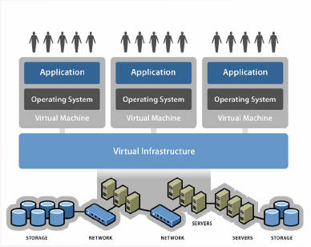
Virtualization : Stepping stone to Business & IT Alignment
Infrastructure is what connects resources to your business
Virtual Infrastructure is a dynamic mapping of your resources to your business
Result: decreased costs and increased efficiencies and responsiveness
Virtualization transforms farms of individual servers, storage, and networking into a pool of computing resources

Slide 10
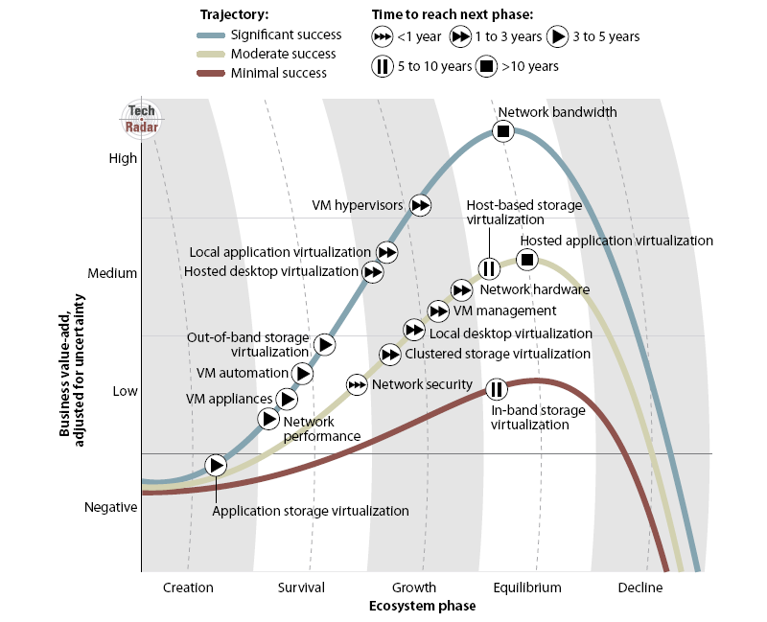
Virtualization Technologies Roadmap
Source : Forrester TechRadar Infrastructure Virtualization Q2 2008

Slide 11
Virtualization Benefits
Traditional Perceived Benefits
Server Consolidation
Reduced hardware and infrastructure costs
  Reduced power consumption and DC space
Reduces administrative efforts
  Lowers operational costs
    Fewer servers to manage
Improves resource utilization
Increases availability
However the Value Proposition of Virtualization is changing..!!

Slide 12
Changing Paradigm
The shift is on:
  From virtualization for consolidation, to virtualization management and agility through virtualization
The value proposition of virtualization has shifted towards new capabilities like:
  Disaster Recovery
  Reduction in planned downtime
  Rapid deployment of servers
  Ease of Virtualization management
Notes:
The majority of organizations start their virtualization projects by focusing on consolidation. However, after virtualization technology has been deployed, the value proposition of virtualization shifts toward new capabilities (such as disaster recovery), reducing planned downtime (through live or quick migration) and rapid deployment (roughly 30 times faster to deploy a virtual server than a physical server).
There's a tremendous opportunity here for agility and efficiency, but without good management tools (and associated process changes), there's also the possibility of failure.
As the value proposition shifts away from saving money and consolidating toward easier management and new capabilities, the price that organizations will be willing to pay for these management tools will be tested.
The VM container is more than a method to consolidate servers — it's also a platform to enable the packaging, delivery and runtime for applications. This can be as simple as pre installing and pre configuring an application on an OS, and shipping (or downloading) that VM as a ready-to-run package; or it can be more extreme — a software appliance in which the OS is hidden beneath the application and is inaccessible to the user. The value of a software appliance is that it simplifies deployment and management, and it also frees a vendor from dependence on specific OS installations. As a platform, the VM creates a balance-of-power shift from OS vendors to independent software vendors and hardware vendors. Hardware appliance vendors are starting to shift to the software appliance concept (especially security vendors).

Slide 13
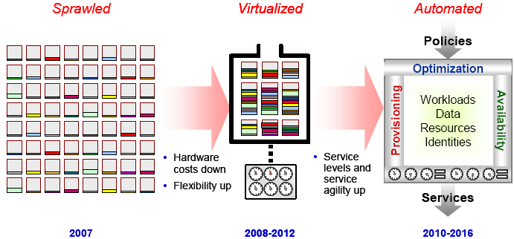
Virtualization : The Road to Real-Time Infrastructure
Source : Gartner (March 2008)
Notes:
Virtualization is the highest-impact issue changing infrastructure and operations through 2012. It will change how you manage, how and what you buy, how you deploy, how you plan and how you charge. It will also shake up licensing, pricing and component management. Infrastructure is on an inevitable shift from components that are physically integrated by vendors (for example, monolithic servers) or manually integrated by users to logically composed “fabrics” of computing,
I/O and storage components
As virtualization matures, the “next big thing” will be automating the composition and management of the virtualized resources. Storage has already been virtualized, but primarily within the scope of individual vendor architectures. Networking is also virtualized. The leading
edge of this change is server virtualization. Roughly 90% of the server market is composed of x86 architecture servers. Based on a traditional model of one application per server, roughly 80% to 90% of the x86 computing capacity is unused at any one time. This unused capacity needs to be managed. It takes up data center space and requires power and cooling. Virtualization promises to unlock much of this underutilized capacity. IT organizations are approaching server virtualization as a cost-saving measure, and it is saving money. However, organizations that have a mature server virtualization deployment in place are leveraging virtualization for much more:
faster deployments, reduced downtime, disaster recovery, variable usage accounting and usage
chargeback, holistic capacity planning and more.

Slide 14
Virtualization Trends in 2008
The hypervisor architecture is becoming thin and embedded, and will "disappear" as it's absorbed into the hardware.
Prices are dropping fast, changing the return on investment (ROI) equation and putting pressure on vendors to adjust.
The value proposition is shifting to management tools, and the market for virtualization management tools is becoming crowded.
The virtual machine (VM) is becoming an application platform and creating an entirely new method of software packaging, delivery and management — leading to software as a service (SaaS).
VMware suddenly has serious competition, including "megavendors" Microsoft, Oracle and Sun Microsystems.
Notes:
There are several emerging alternatives to VMware. The strategic decision should be centered on the vendor you choose to become a primary distributed infrastructure management partner.
Virtualized servers are ripe for vulnerability attacks, and stability is becoming more critical as the density of virtual servers to physical servers is rising. Consider the size of the hypervisor as a major factor, and remain focused on the overall distributed virtual server architecture (including management and administration) to reduce your vulnerability.
Prices will be dropping fast, so avoid long-term contracts and price locking. Tactical deals and rapid ROI remain the safest business case approaches.

Slide 15
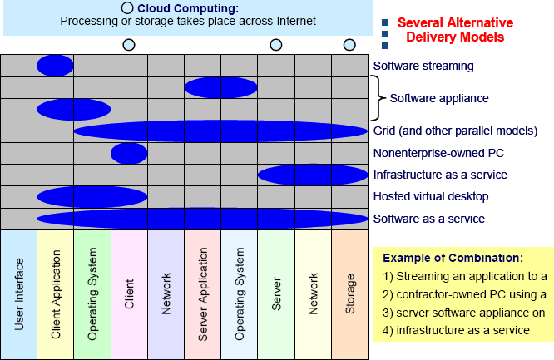
Evolving Delivery Models
Source : Gartner (March 2008)
Notes:
IT virtualization is the abstraction of IT resources in a way that masks the physical nature and
boundaries of those resources from resource users.
Virtualization can take place at various points in the IT architecture, and each point of virtualization creates an opportunity for alternative
delivery models — new ways of delivering capability at that layer.
Virtualization technologies will make it easy to consolidate to larger resources. However, virtualization technologies will also
make distributed resources easier to manage, reprovision and use efficiently.
Processor capability has outpaced the performance requirements of many applications.
Performance is relatively inexpensive and, therefore, the overhead of a virtualization layer is not
an issue. Although processing power is inexpensive (and getting less expensive), space, power,
installation, integration and administration are not, and they cost the same whether a resource is
10% or 90% used. Additionally, Web access has changed workload levels from relatively
predictable to spiky, forcing enterprises to overprovision. Virtualization is not just about
consolidation. By enabling alternative delivery models, new modes of providing functionality at
each layer will evolve. As illustrated in Figure 2, by creating layers of abstraction, each layer can
be managed relatively independently, and even owned by someone else (from streamed
applications to software appliances to employee-owned PCs).

Slide 16
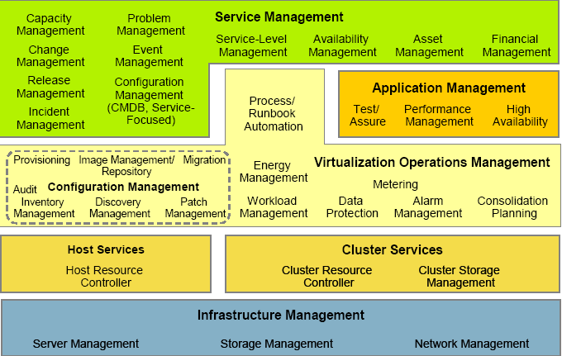
Virtualization Management Hierarchy
Source : Gartner ( Feb 2008)
Notes:
Key Findings
• Virtualization (virtual server) management is not a monolithic market, but instead
represents a stack of functions correlating to IT operations professionals' wants and
needs.
• Virtual infrastructure providers are well-positioned to expand their market share at the
expense of traditional management providers.
• There are nearly 100 providers of products adapted for the server virtualization
management marketplace — a market which, to date, has limited revenue. There have
already been some initial acquisitions, and this, as well as other partnering activity, will
likely continue as technology providers jockey for position and expand their portfolios.
Recommendations
• Plan virtual server infrastructure management in conjunction with more-broad-based
enterprise serviceability needs, which rely on physical and virtual assets.
• The growing number of management providers represents an opportunity for end-user
pricing leverage, but many of these also will require early adopters to factor risk
management into their purchase equations.
• No vendor offers a complete set of server virtualization management functionality. Thus,
IT organizations will have to undertake (or outsource) their management system
integration efforts.

Slide 17
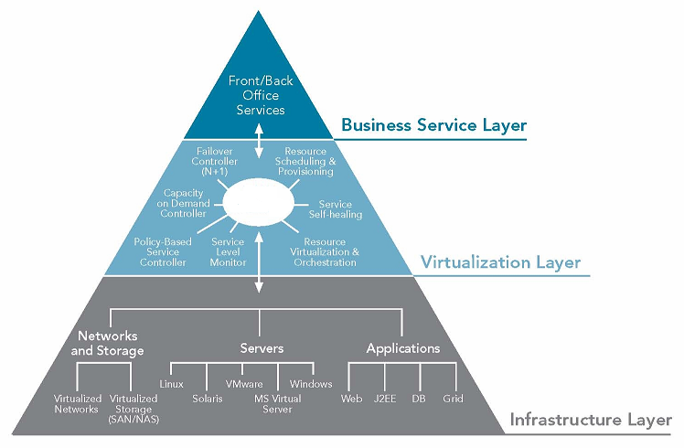
Managing Virtual Environment Creates Complexity
Virtual
Mgmt
Notes:
Key Findings
• Virtualization (virtual server) management is not a monolithic market, but instead
represents a stack of functions correlating to IT operations professionals' wants and
needs.
• Virtual infrastructure providers are well-positioned to expand their market share at the
expense of traditional management providers.
• There are nearly 100 providers of products adapted for the server virtualization
management marketplace — a market which, to date, has limited revenue. There have
already been some initial acquisitions, and this, as well as other partnering activity, will
likely continue as technology providers jockey for position and expand their portfolios.
Recommendations
• Plan virtual server infrastructure management in conjunction with more-broad-based
enterprise serviceability needs, which rely on physical and virtual assets.
• The growing number of management providers represents an opportunity for end-user
pricing leverage, but many of these also will require early adopters to factor risk
management into their purchase equations.
• No vendor offers a complete set of server virtualization management functionality. Thus,
IT organizations will have to undertake (or outsource) their management system
integration efforts.

Slide 18
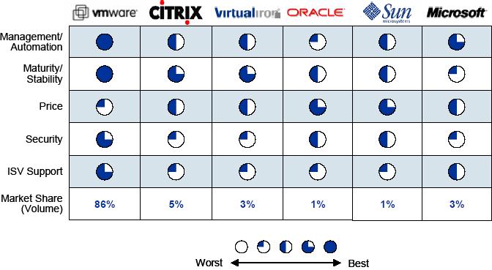
Virtualization Vendor Landscape
Source : Gartner (March 2008)
Notes:
According to Gartner , roughly 6 % of the market has been addressed during the past 7 years and there is still a lot of opportunity in this space.
VMware is the most-mature solution with the richest management portfolio.
• Citrix (acquired XenSource in October 2007) and Virtual Iron have matured, but
competition with emerging Xen-based alternatives from Oracle and Sun, as well as
Microsoft's Hyper-V, will limit their market potential.
• Oracle will be most successful with established, large Oracle customers, specifically with
Oracle business applications. Similarly, Sun will be challenged to expand outside the
Sun hardware and Solaris base.
• Microsoft is late, especially for enterprise use of virtualization, but the midmarket is still a
wide-open opportunity. Gartner is concerned that the Hyper-V architecture may cause
reliability, vulnerability and maintenance issues because of its dependency on a single
copy of Windows Server 2008.

Slide 19
Application Virtualization
“ An application that is abstracted from the user’s OS and runs in isolation from other applications “ – Forrester Definition
By 2010, 50% of large organizations and by 2013,50% of mid size organizations will use application virtualization as part of their PC life cycle management practices. - Gartner March 08
Key Benefits
Eliminates Application conflicts
Decrease management and support costs
Cab be used in conjunction with other types of client virtualization technologies

Slide 20
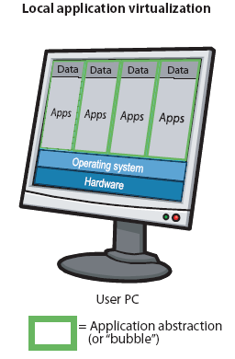
Types of Application Virtualization
Local Application Virtualization
Next generation of application packaging
Applications are packaged as self-contained executables that run independent of any other application on the machine
Run in an isolated bubble on the user’s OS, unable to interact with other applications
Solutions Available
  Altiris Software Virtualization Solutions
  Citrix XenApp
  Microsoft Application Virtualization
  VMware Application Virtualization

Slide 21
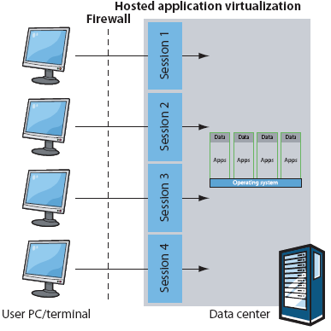
Types of Application Virtualization
Hosted Application Virtualization
Applications are run in bubbles hosted on data center servers
Users access these applications over the network
It provides secure remote access and data security
Solutions Available
  Citrix XenApp (Presentation Server)
  Microsoft Terminal Services
  Sun Secure Global Desktop

Slide 22



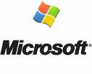
Vendors
Products
Features
XenApp is an agent-based solution
It provides the option of packaging applications for Publication or streaming with virtualization.
Xenapp
Application
Jukebox
It provides seamless integration and streaming.
It offers isolation, with an integrated virtualization akin to an abstraction layer between the applications (installed and virtualized) and the OS, enabling applications to interact, and configurable virtualization.
InstallFree
Bridge
It provides packaging capabilities to build InstallFree Virtual (IFV) applications.
IFV packages integrate seamlessly, avoiding runtime dependencies, and enable the ability to package an application once and deploy it.
It is an agent-based solution and has a larger installed base than similar products from other Application virtualization vendors.
It includes streaming and has its own management console.
Softgrid
( App V)

Slide 23


Vendors
Products
Features
It comes in two versions: Standard (without streaming) and Professional (with streaming).
SVS requires an agent for each device. It has its own management console but can be integrated into
Symantec (Altiris) Client Management Suite. Applications are installed in a "layer,“ usually together, and this is how they achieve isolation.
SVS v.2.1
ThinApp is an agentless solution that provides seamless integration between virtualized applications and locally installed applications
ThinApp provides a built-in mechanism to stream applications into memory through a shortcut, including streaming capabilities.
ThinApp
It is an agentless solution that doesn't require specific drivers or administrator permissions.
It does not include streaming.
Virtual Application Studio does not have any specific integration with PCLM vendors, but this is expected in 2009.
Virtual
Application
Studio

Slide 24
Calculating ROI on Virtualization Investments
Establish a baseline of current costs, including the cost of “doing nothing”
What will your organization need to change to move towards virtualization?
  Hardware costs
  Software costs
  Network improvements
  IT services or staffing changes
What are the maintenance fees?
Licensing costs for the operating systems and applications that will be run within guest instance
What is the impact of adding CPUs?
Do multi core chips have higher per-CPU licensing costs for your software?
ROI should also include improved services, response times and security

Slide 25
Summary
Virtualization can a play a key role in Business to IT alignment by bringing in agility and automation
Manageability and security aspects will drive the business case for Virtualization
Virtualization will lead to evolution of alternate delivery models and will have a deep impact on current outsourcing, pricing and licensing models
“ Virtualization changes virtually everything”
Notes:
Examples of alternative delivery and acquisition models: User-owned devices, software streaming
and software-based appliances, Web platforms, community sources, remote
management services, communication as a service, capacity and storage on demand, grid and
utility computing, IUs, SaaS and business process utilities.

Slide 26

© 2008 Microsoft Corporation. All rights reserved. Microsoft, Hyper-V, RemoteApp, Windows logo, Windows Start button, Windows Server Windows, Windows Vista and other product names are or may be registered trademarks and/or trademarks in the U.S. and/or other countries. All other trademarks are property of their respective owners. The information herein is for informational purposes only and represents the current view of Microsoft Corporation as of the date of this presentation. Because Microsoft must respond to changing market conditions, it should not be interpreted to be a commitment on the part of Microsoft, and Microsoft cannot guarantee the accuracy of any information provided after the date of this presentation. MICROSOFT MAKES NO WARRANTIES, EXPRESS, IMPLIED OR STATUTORY, AS TO THE INFORMATION IN THIS PRESENTATION.

