Slide 1
Software Configuration Management with TFS
Tejasvi Kumar
Developer Technology Specialist | Microsoft India
tejkumar@microsoft.com

Slide 2











Visual Studio Team System
Visual Studio Team Suite
Software
Architects
Software
Developers
Software
Testers
Database
Professionals
Visual
Studio
Team
Explorer
Visual
Studio
Industry
Partners
Application Modeling
Code Analysis
Performance Testing
Database
Deployment
Infrastructure and Deployment Modeling
Performance Tuning
Manual Testing
Database
Change Mgmt.
Security Analysis
Test Case Management
Database
Testing
Unit Testing
Code Coverage
MSF Process and Guidance
Class Modeling
Visio and UML Modeling
Visual Studio Professional Edition
Load Test Agent
Visual Studio Team Foundation Server
Change Management
Reporting
Integration Services
Work Item Tracking
Project Site
Project Management

Slide 3





Team Foundation Server
Integrated Platform for Collaborating on Software Development Projects
Work Item Tracking
Project Management
Reporting
Version Control
Build Automation

Slide 4
Work Item Tracking

Slide 5








Example Workflow
Bugs
Non Functional
Requirements
Test
Use Case
Tasks
Business
Analyst
Dev Team
Change
Requests
Project
Manager
Production
Errors
“Work Items are the units of
communications within the
development team”
Operations

Slide 6

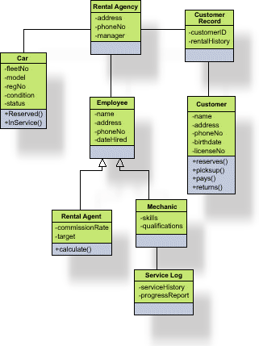

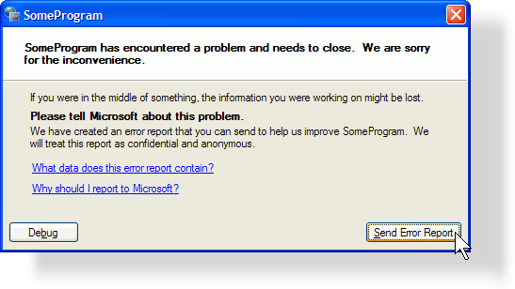
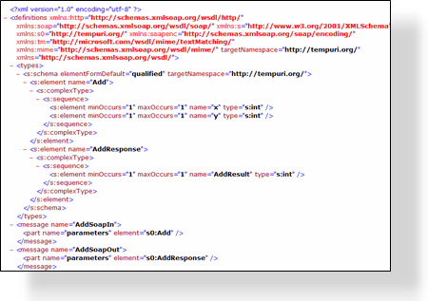




What is in a Work Item?
Proposed
Title
Description
Current State
Active
Active
Attachments
Use Case
Tasks
Bugs
Resolved
Who it is assigned to
Resolved
Links to other Work Items
Full Audited history
Closed
Closed
Anything else you want …

Slide 7
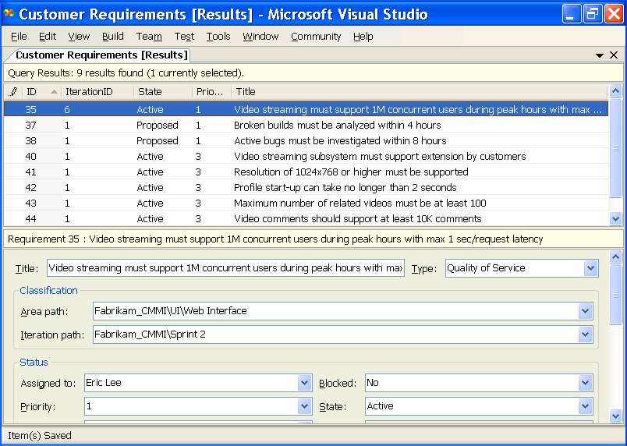
Work Item Interface in Team Explorer
Business requirements captured and managed to enable end-to-end traceability

Slide 8
Project Management

Slide 9
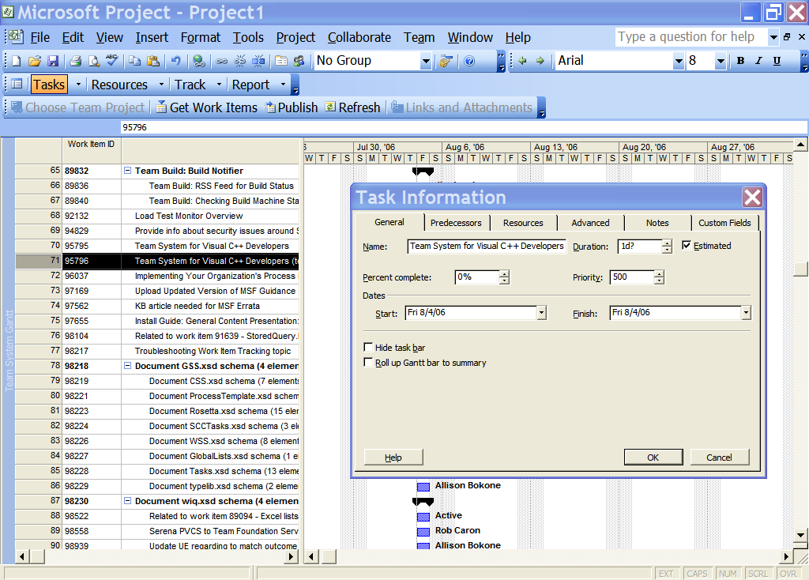

Project Planning
Full integration into Microsoft Project for
a real-time view
of work items

Slide 10
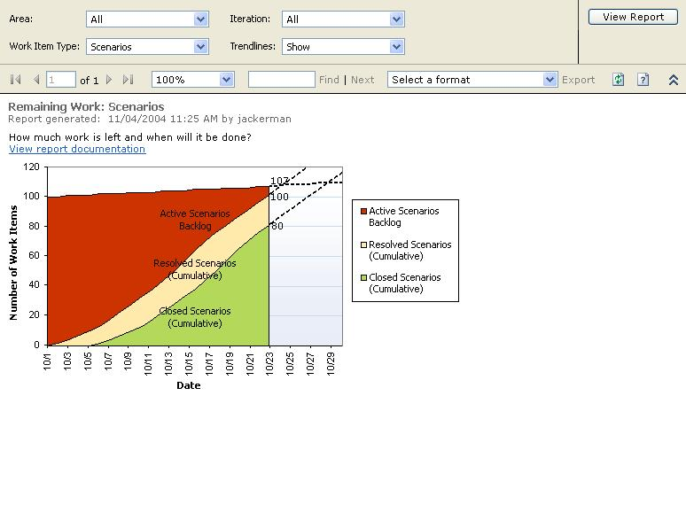
How much work is left?
Planned
Work
Completed
Work

Slide 11
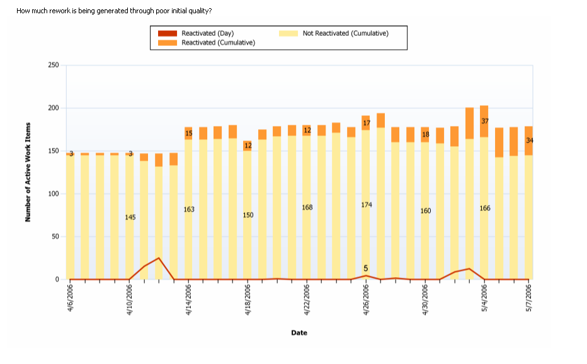
Recognizing Sloppy Development Practices
Growing “Fault Feedback Ratio” – bugs requiring multiple handling

Slide 12
Source Code Control

Slide 13
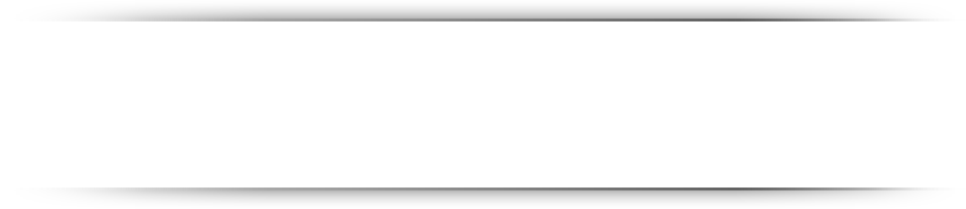

Team Foundation Source Control
Totally New Version Control System
Built new from the ground up
3-tier ASP.NET web service
SQL Server 2005 data store
Integrated check-in
Shelving
Source Control Explorer
More…
Lots of New Features
Support for distributed teams
Secure, Reliable, Scalable
Internally used at Microsoft
Built for the Enterprise

Slide 14


Source Control Feature Support
Yes No
Atomic Check-in
Work Item Integration
Check-in Policies
Shelving
Delta File Storage
Delta Binary File Storage
Large File Support (>4GB)
Distributed Team Support

Slide 15
Source Control Feature Support
Yes No
E-mail Checkin Notification
Non-Windows Support
Diff Tool Extensibility
Shared Checkout
VS 2003 Integration
Keyword Expansion
Pinning & Sharing
Shadow Folders

Slide 16
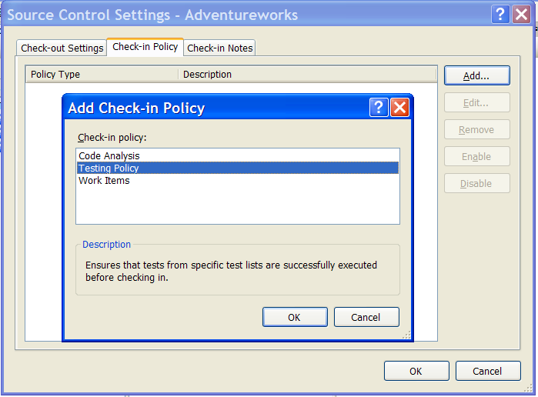

Check-in Policies
Policies enforced by tooling
reinforce good development practices

Slide 17

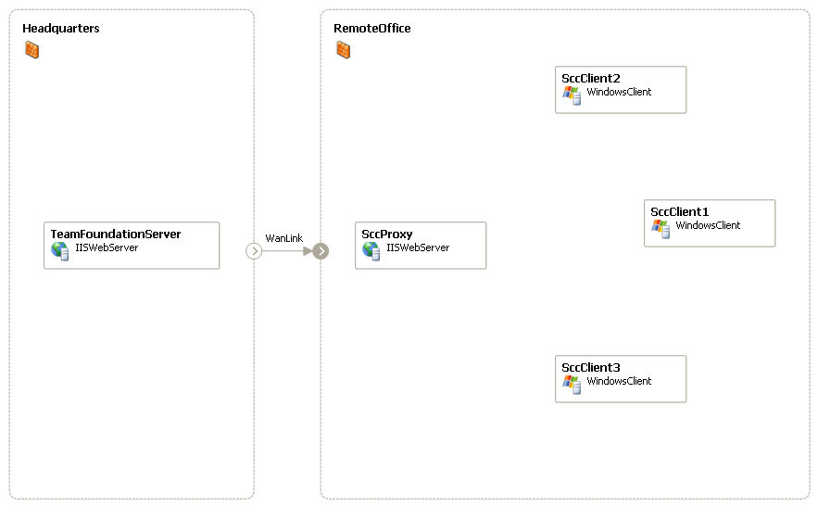



Distributed Development
TFS Proxy
SOAP Messages
File Uploads
SOAP Messages
Downloads
File Uploads
SOAP Messages
File Uploads

Slide 18
Collaboration

Slide 19
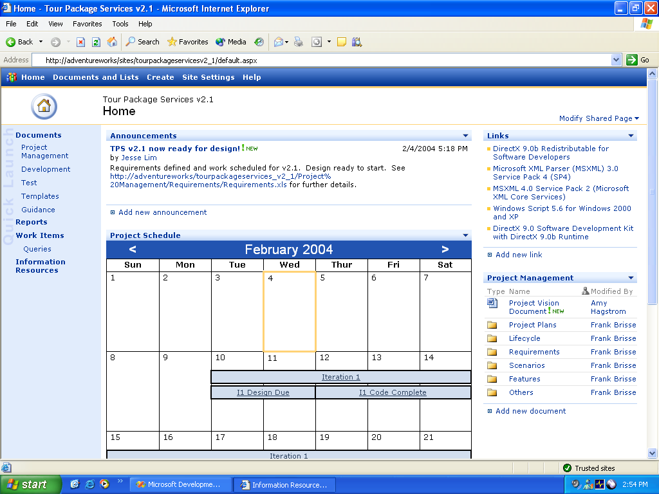
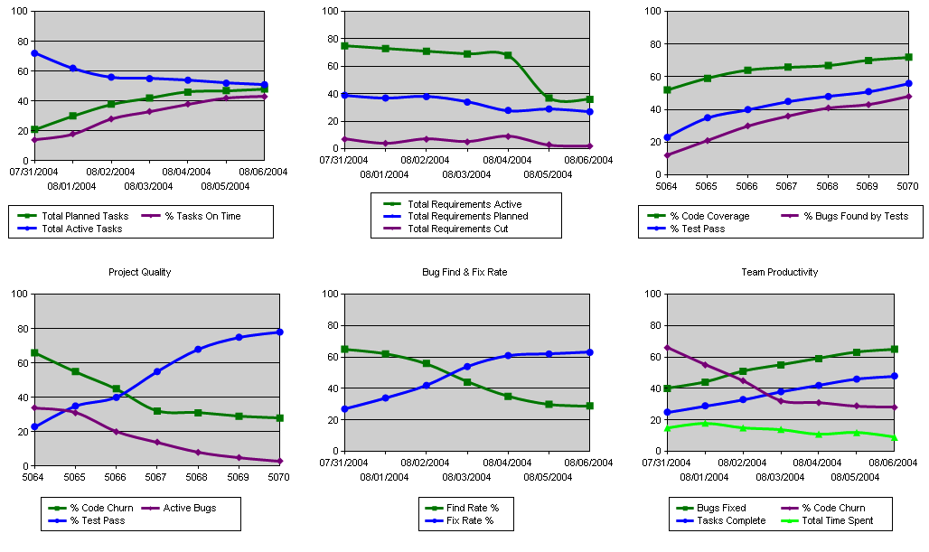
Project Portal
SharePoint-based
Project Portal

Slide 20
Process Guidance

Slide 21
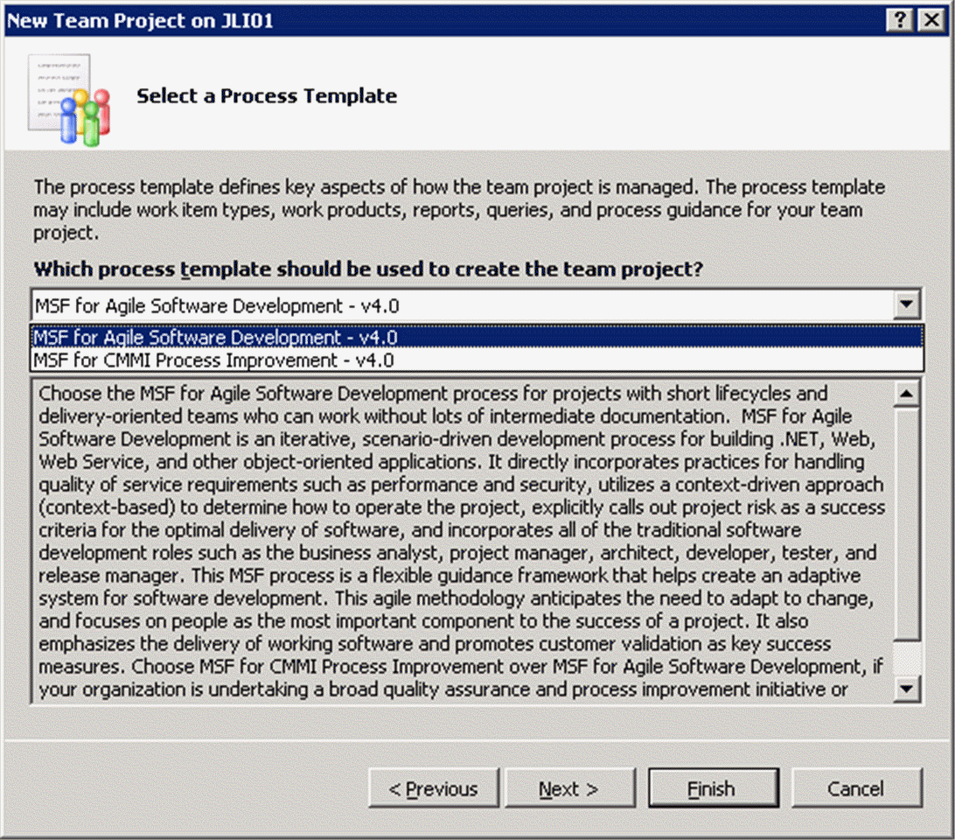
Process Enacted By Tooling

Slide 22
Build Automation

Slide 23
Build Process
Extensible Build Process
  Compile Code
  Execute Unit Tests
  Static Code Analysis
  Deploy Database
  Generate Test Data
  System or Load test Entire application

Slide 24
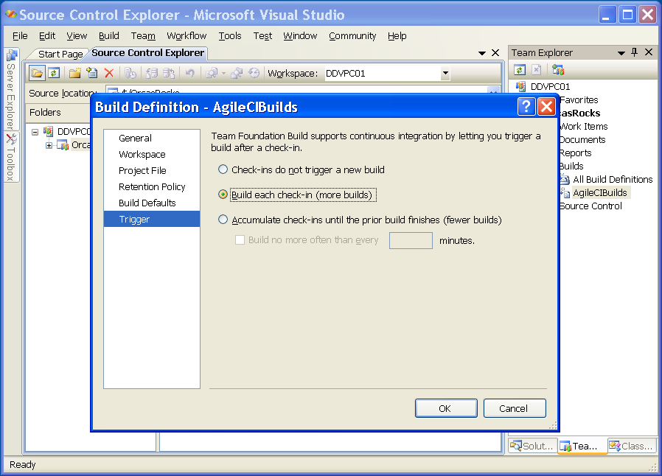

Continuous Integration
Automatically kick off a team-wide build on every check-in.
Notes:
Continuous build can take many forms, but the general idea is to automatically kick off a team-wide build when a developer makes a check-in. Some development teams like to gather up a few check-ins before kicking off the build. The idea is to try and catch changes that break the build as soon as possible.
The exciting news is that with the Orcas release of Team Foundation Server, there is a feature in the build called Triggers. These triggers enable you to determine when a build should be kicked off. One such trigger will start a build with each checkin; so we finally have Continuous Build!

Slide 25
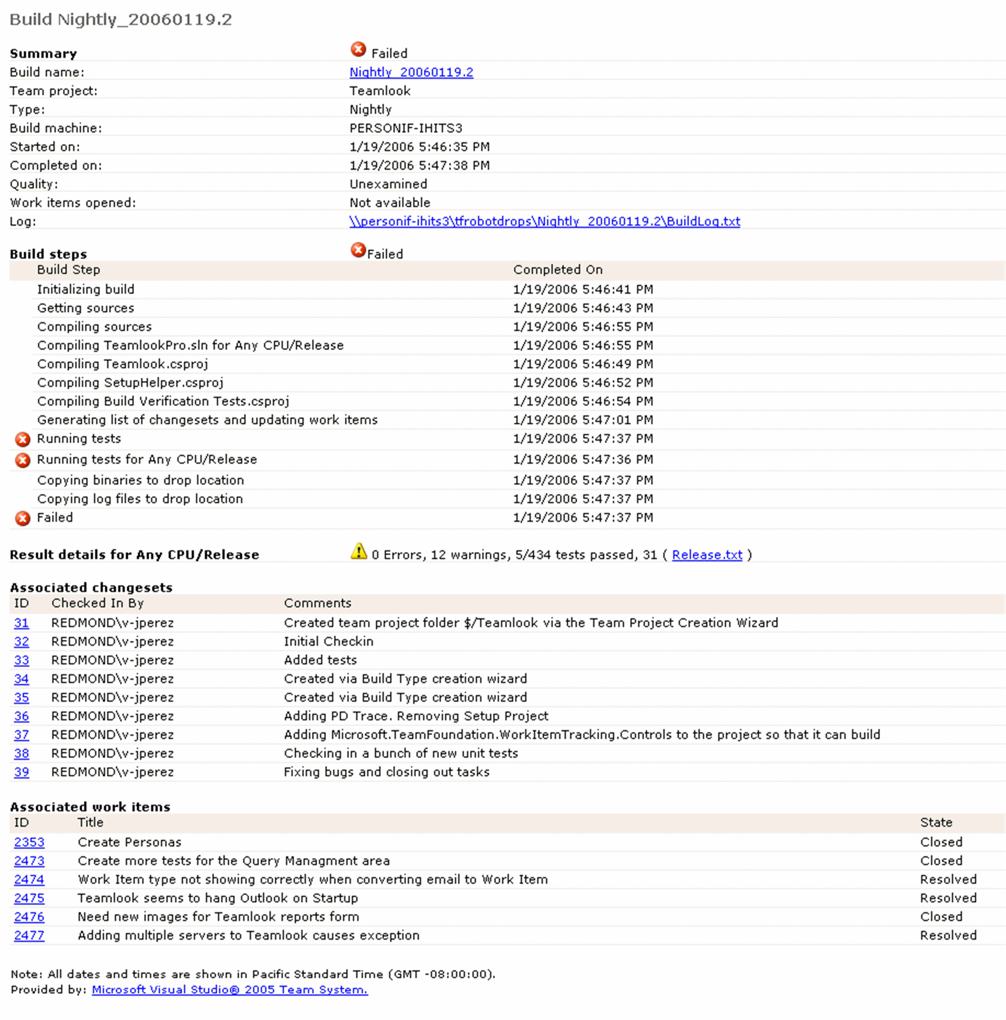
Build and Deployment
Build Verification Test results as part of the build process
Who checked
in what?
Automated release note: Why the work was delivered

Slide 26
Team Foundation Server
DEMO

Slide 27
References
Visual Studio Team System:
  http://msdn.microsoft.com/teamsystem
Microsoft Application Platform:
  http://msdn.microsoft.com/applicationplatform

Slide 28
Feedback / QnA
Your Feedback is Important!
  Please take a few moments to fill out our online feedback form at:
  << Feedback URL – Ask your organizer for this in advance>>
  For detailed feedback, use the form at http://www.connectwithlife.co.in/vtd/helpdesk.aspx
  Or email us at vtd@microsoft.com
Use the Question Manager on LiveMeeting to ask your questions now!

Slide 29

tejkumar@microsoft.com

