Slide 1


Slide 2

Virtualization
Vitalis Konopelec
Technology Solution Professional
vitalis.konopelec@microsoft.com
Microsoft Slovakia s.r.o.

Slide 3


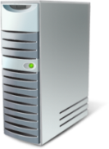



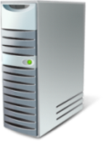




  Windows Server 2008
Server Virtualization
Presentation Virtualization
Windows Server Virtualization
Management
Desktop Virtualization
Application Virtualization

Slide 4




















  Windows Server 2008
A Multi-level Approach
Licensing
Infrastructure
Management
Interoperability
Applications
Terminal Services
Deliver
cost-effective, flexible and simplified licensing
Royalty Free VHD format
Create agility
Better utilize
server resources
Partner with AMD and Intel
Ease consolidation
onto virtual infrastructure
Better utilize
management
resources
Support
heterogeneity
across the
datacenter
OSP (Open Specification Promise) VHD
Accelerate
deployment
Reduce the cost of supporting
applications

Slide 5
  Presentation Virtualization
  Terminal Services

Slide 6







  Terminal Services
Central office
Centralized Application Access
  Application Deployment
  Branch Office
  Secure Anywhere Access
  Compliance and Security
Enabling Technologies
  TS Gateway
  TS Remote Programs
  SSO for Managed Clients
Designed for
low complexity scenarios
Branch office
Home office
Roaming user

Slide 7
  New and Improved Features
RDC 6.0 (Vista,WinXP SP2)
Network Level authentication
Server authentication / TLS
Display improvements
Display data prioritization
PnP Device redirection
Terminal Services RemoteApp
Terminal Services Gateway (HTTPS)

Slide 8





  Terminal Services Gateway
Internet
Perimeter Network
Corp LAN
Tunnels RDP over RPC/HTTPS
Strips off RPC/HTTPS
Passes RDP/SSL traffic to TS
Terminal
Server
External Firewall
Internal Firewall
Home
Terminal
Server
Internet
Hotel
Other RDP
Hosts
Terminal Services Gateway Server
Network Policy Server
Business Partner/
Client Site
Active Directory DC

Slide 9

  Remote Applications
Runs on Terminal Server
Admins – TS Remote Programs
Users – TS Web Access
What Are Remote Programs?
Access to Local Devices
System Tray Integration
Drag and Drop Local Resources
Local Integration
Local Applications
Runs Side by Side

Slide 10
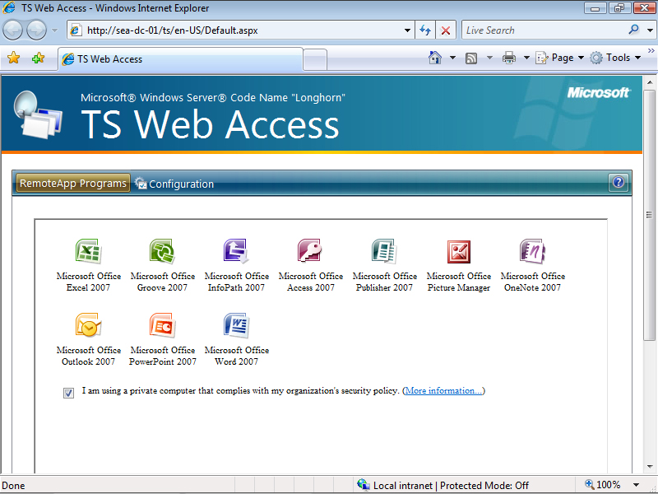
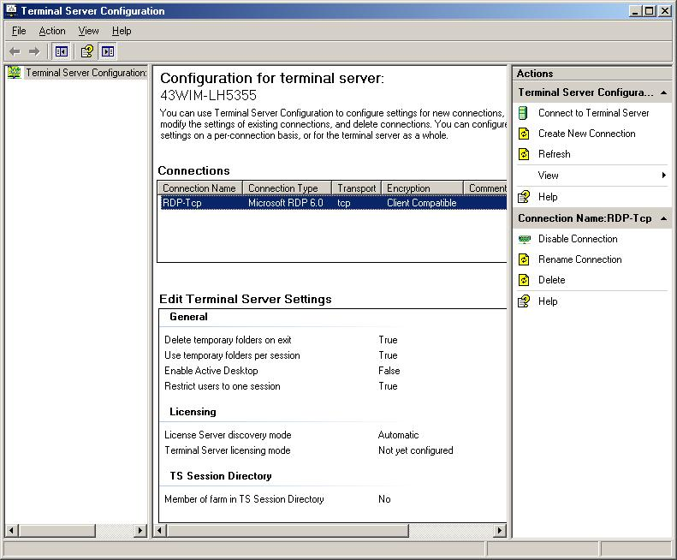
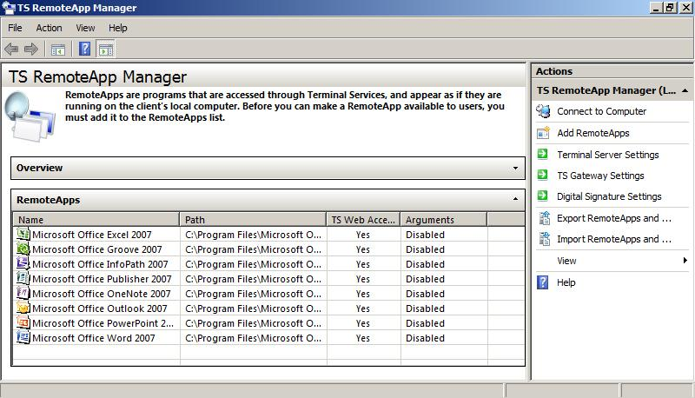
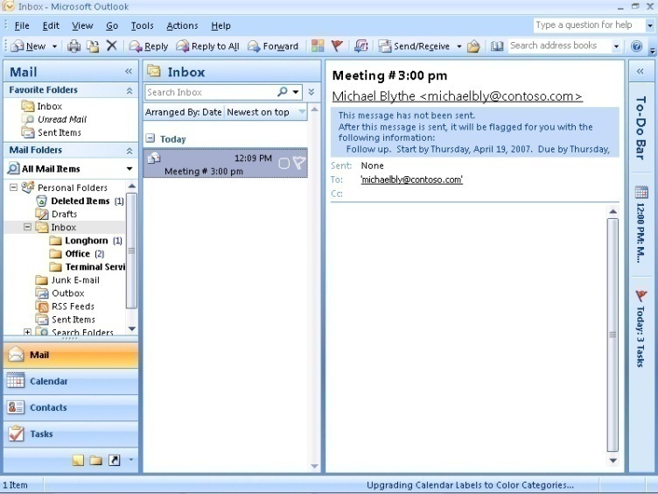



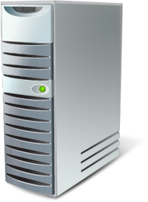
  TS Remote Applications
RemoteApp console used to make application available
Also used to make programs available via TS Web Access
Programs look like they are running locally
Only supported by Remote Desktop client 6.0, or newer
Remote programs integrated with local computer
Centrally configure a terminal server with the Terminal Server Configuration console
Remote Desktop client required
Terminal Services
Gateway Server

Slide 11

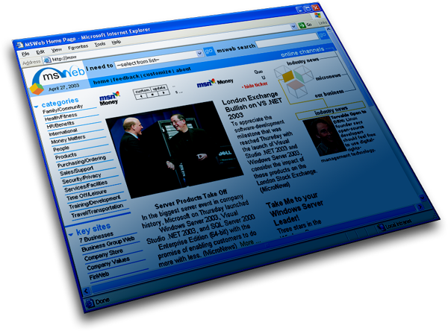


  TS Remote Applications
Terminal Services Remote Programs available from a Web browser
Default Web page or SharePoint Services
Active Directory Domain Services

Slide 12
  Terminal Services Demo
Terminal Services Role configuration
Terminal Services management console
Configuring basic properties
Configuring TS RemoteApps
Configuring TS Gateway
TS Live: TSWeb Access
TS Live: Using Remote Applications
TS Live: Accessing TS via TS Gateway

Slide 13
  Windows Server Virtualisation

Slide 14
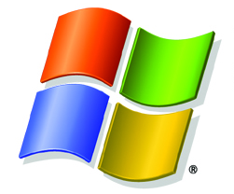
  Windows Server 2008
What is Windows Virtualization?
What are the Requirements?
Hypervisor based virtualization platform
Windows Server 2008 x64 Edition technology
Standards based
Windows Server 2008
x64 Editions
Hardware assisted virtualization
  AMD-V or Intel VT
Hardware enabled Data Execution Prevention (DEP)
  AMD (NX no execute bit)
  Intel (XD execute disable)

Slide 15
  Hypervisor Architecture
Parent Partition
Child Partitions
Virtualization Stack
Applications
Applications
Applications
User Mode
WMI Provider
VM Worker
Process
VM Service
Windows Server 2008
Windows Server 2003, 2008
Non-Hypervisor Aware OS
Xen-enabled Linux Kernel
Linux VSCs
Windows Kernel
VSP
Windows Kernel
VSC
OS Kernel
Hypercall Adapter
Kernel Mode
VMBus
VMBus
Emulation
VMBus
Windows Hypervisor
AMD-V,
Intel VT Chipset
“Designed for Windows” Server Hardware
OS
Windows Server Virtualization
MS / XenSource Novell
ISV/IHV/OEM

Slide 16
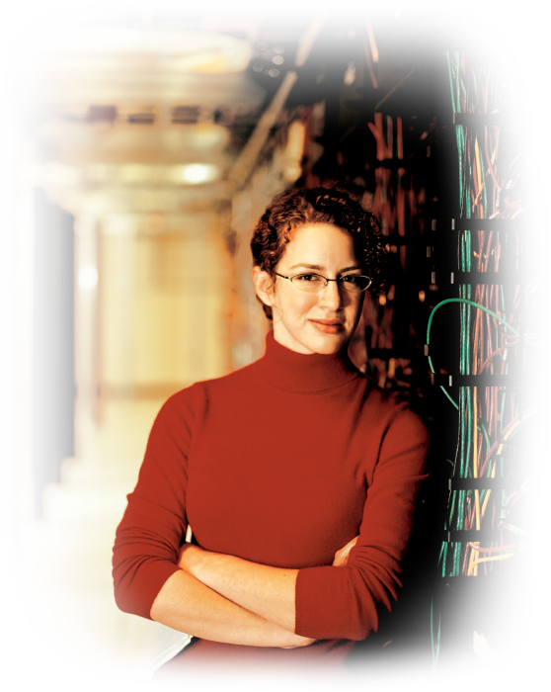



  Hypervisor Design Goals
Hypervisor
Strong Isolation
Security
Performance
Virtualization support
Simplicity
  Restrict activities to monitoring
  and enforcing
  Where possible, push policy up

Slide 17
  Virtualisation Demo
Hyper-V management console
Virtual networks with Hyper-V
Creating and managing virtual machines
VM Disk management
VM Snapshots

Slide 18




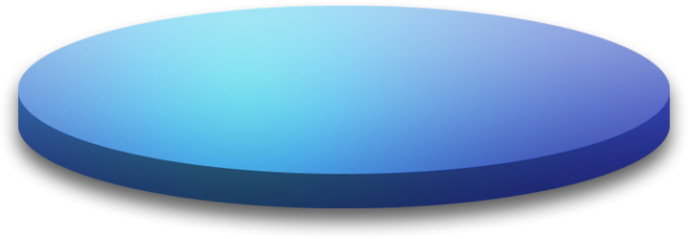





  Server Virtualization Scenarios
Data Center
Branch Office
Test & Dev

Slide 19



  Server Virtualization Scenarios
Branch Office
Data Center
Consolidated Workloads
Improved & maximized hardware utilization
Reduced Server Management
Reduced Electrical Costs
Branch Office

Slide 20





  Server Virtualization Scenarios
Test and Development
Data Center
Improved & maximized hardware utilization
Consolidated Workloads
Reduced Server Management
Reduced Electrical Costs
Test & Dev

Slide 21
  Server Virtualization Scenarios
Server Consolidation
Data Center
Server Consolidation
Consolidated Workloads
Improved & maximized hardware utilization
Reduced Server Management
Reduced Electrical Costs
Fundamental driving force behind the virtualization of servers.

Slide 22







  Server Virtualization Scenarios
Disaster Recovery – Host Clustering
Passive
Active
Data Center
Business Continuity Management
Ensure continuity or uninterrupted provision of operations and services
Provide scalable, high availability solutions
Improve disaster and business recovery
Provide robust enterprise management
Controlling and minimizing scheduled and unscheduled downtime

Slide 23

  Server Virtualization Scenarios
Disaster Recovery – VM Clustering
Data Center
Dynamic Datacenter
Decouple workloads from hardware
Rapidly provision workloads
Provide dynamic scale up solutions
Ease scale out solutions
Simplify/automate design, deployment, and operation of complex systems
Taking advantage of the benefits of virtualization to create a more agile infrastructure

Slide 24
  Server Virtualization Scenarios

Slide 25
© 2005 Microsoft Corporation. All rights reserved.
This presentation is for informational purposes only. Microsoft makes no warranties, express or implied, in this summary.

