Slide 1
Driving Business Value and Operational Efficiency with the Microsoft Platform
Ruth Morton
IT Pro Advisor, Microsoft Canada

Slide 2



“We’re All Facing an Economic ‘Reset’ …Businesses are responding by emphasizing efficiency as companies look to trim anything that isn’t strategic or doesn’t contribute to the bottom line.”
Steve Ballmer, CEO Microsoft Corp

Slide 3




Security and
Compliance
Mobile & Distributed Workforce
“Consumerization” of IT

Slide 4


versus

Slide 5

…Do More
Productivity & Innovation
Costs
With Less…

Slide 6
With Less…
Reduce IT complexity
Improve control and reduce helpdesk costs
Increase automation
Consolidate server resources

Slide 7
...Do More
Enable new services
Connect people with information
Optimize business processes
Work securely from anywhere

Slide 8






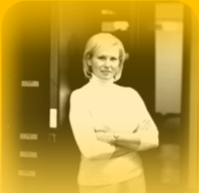


Infrastructure Optimization Model
www.microsoft.com/infrastructure
Reduce Risk, Improve
Productivity
Reduce Costs
Manage Complexity,
Achieve Agility
People Process Technology
Basic
Standardized
Rationalized
Dynamic
IT is a
cost center
IT is an efficient
cost center
IT is a
business center
IT is a
strategic asset

Slide 9


Session 2
Desktop Optimization
Reduce complexity
Increase control
Work securely anywhere
Connect people with information

Slide 10
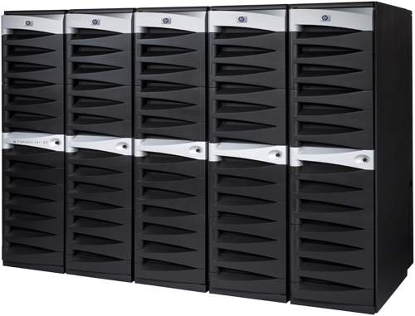


Session 3
Server Optimization
Consolidate resources
Increase automation
Enable new services

Slide 11


Session 4
Services Optimization
Extend new services
Work anywhere
Create agility

