Slide 1
IIS 7 for Hosters
Deven Kampenhout
Web Platform Architect
Developer & Platform Evangelism

Slide 2
IIS 7 Built For Hosting
Windows Server Web Edition 2008
New IIS Manager: manage thousands of sites
Opt-in modular architecture
World-class hosting for ASP.NET and PHP
New, flexible configuration system
Security based on IIS 6’s solid legacy, simplified and enhanced
Rich suite of automation tools
Modern, secure FTP server

Slide 3
Windows Server 2008 Web Edition
Reduced costs, increased capacity
4 processors
4GB Ram (x32), 32GB (x64)
Microsoft® SQL Server™ allowed for local Web applications
Includes Windows SharePoint
Server Core optional install

Slide 4
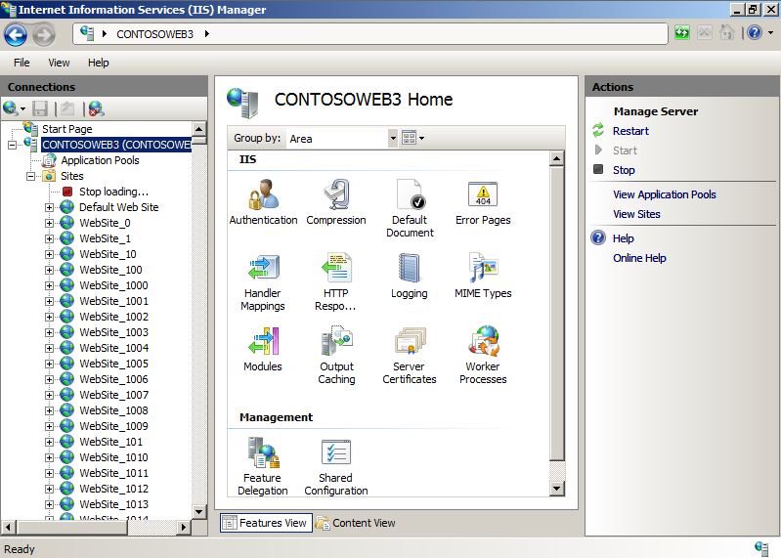
The New IIS 7 Manager
Completely redesigned IIS Manager
Allows IIS and ASP.NET configuration
Icons instead of tabs
Fully extensible
Add new management and IIS features
Integrate custom applications config
View health and diagnostics info
Built-in remote administration over HTTPS
Manage 1 or 1000s of sites

Slide 5
Demo: Managing 4000 Sites

Slide 6
IIS6 Architecture - Request Processing
Authentication
Monolithic implementation - install all or nothing…
NTLM
Basic
Anon
…
Determine
Handler
CGI
Static File
ASP.NET
ISAPI
…
PHP
Send Response
Extend server functionality only through ISAPI…
Log
Compress

Slide 7
IIS 7 Architecture - Request Processing
Server functionality is split into ~ 40 modules...
Authentication
Authentication
NTLM
Basic
Anon
Authorization
…
Modules plug into a generic request pipeline…
ResolveCache
Determine
Handler
CGI
…
Static File
ExecuteHandler
Modules extend server functionality through a public module API
…
ISAPI
…
UpdateCache
Send Response
Log
Compress
SendResponse

Slide 8
IIS 6 ASP.NET Integration
ISAPI-based implementation
Only sees ASP.NET requests
Feature duplication
Authentication
NTLM
Basic
Anon
…
Determine
Handler
CGI
aspnet_isapi.dll
Static File
Authentication
Forms
Windows
ISAPI
…
…
ASPX
Map Handler
Send Response
Trace
Log
Compress
…
…

Slide 9
IIS 7 ASP.NET Integration
Basic
Two App Pool modes
Classic (IIS 6)
Integrated Mode
.NET modules/handlers plug directly into pipeline
Process all requests
Full runtime fidelity
Anon
Authentication
Authorization
ResolveCache
aspnet_isapi.dll
Static File
ExecuteHandler
Authentication
Forms
Windows
ISAPI
…
ASPX
UpdateCache
Map Handler
Trace
SendResponse
Compress
…
…
Log

Slide 10
PHP/FastCGI
Reach new markets with reliable better performing PHP hosting
Develop and deploy on the same platform
PHP apps benefit from IIS 7 capabilities
Pipeline service available to PHP
Leverage .NET Forms Authentication
Use URLFiltering, URLAuth, Caching
Tracing and diagnostics
Delegated administration
Apps benefit from integration with Microsoft suite of servers and management services

Slide 11
Flexible Configuration
XML-based configuration
Xcopy server or site configuration
Easy to manage with new APIs and tools
Fully extensible schema for custom applications
Delegate administration
Permit site owners to control specific settings
Shared configuration
Multiple servers share single config file

Slide 12
Demo: IIS7 Configuration

Slide 13
Security Enhacments
Built on IIS 6’s proven security design
Improved application pool sandbox
Anonymous user “built in”, not a local account
Customer configurable rules
URLFiltering: Filtering of suspicious URLs
Replaces URLScan
URLAuthorization: control access to content
Does not rely on ACLs
Rules are stored locally and relocate with content

Slide 14
Excellent Application Compatibility
Static, ASP and ISAPI: fully compatible
ASP.NET
Very high compatibility in integrated mode
Classic mode insures IIS 6 equivalent functionality
PHP, works without modification
IIS 6 ADSI: Install IIS 6 Metabase compatibility role service

Slide 15
Tracing and Diagnostics
View detailed errors in the browser
New errors provide prescriptive guidance
Runtime state info in real time
New APIs expose runtime diagnostic information
E.g. See all currently executing requests
Rapidly troubleshoot faulty applications
Define ‘failures’ triggers by error code or time taken
Configurable per application or URL
Failed request log chronicles events for trigger
Quickly identify bottlenecks
Extensible “eventing” system

Slide 16
Automating IIS 7 Management
APPCMD
General purpose command line tool
Managed code API
Microsoft.Web.Administration
WMI
Improved namespace for IIS 7
ADSI compatibility
Powershell
Use with Managed API and WMI

Slide 17
FTP 7
Integrated publishing
Secure file transfer with FTPS
Improved user isolation
Authenticate to non-Windows accounts
Integrated with the IIS manager

Slide 18
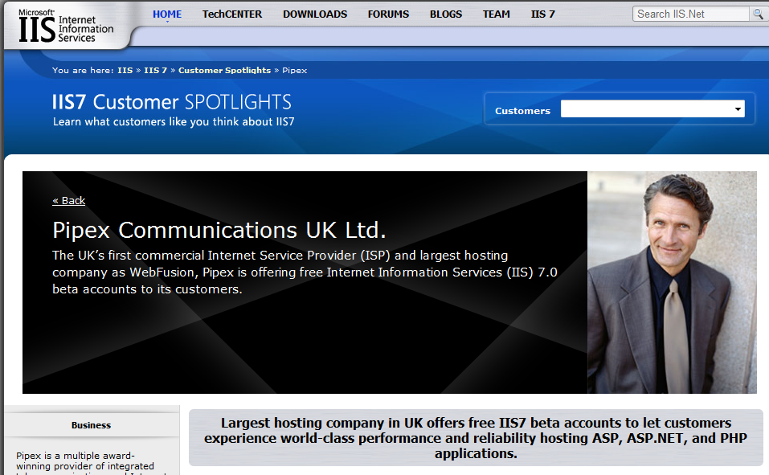
IIS.net: Home for IIS Community
In-depth technical articles and samples
Connect with other IIS experts on blogs & forums
Free advice and assistance in forums
Download center with IIS solutions

Slide 19
Opportunity for Hosters
Manage with Ease:
More efficient administration tools including delegated administration and shared configuration
Powerful Hosting of Applications and Services:
Expanded application hosting for .NET, ASP, PHP Web applications and XML services
Lower Infrastructure Costs:
Improved scalability, reliability and enhanced security features

Slide 20
Questions?
Tell me about your experience with Windows Server 2008 and IIS7!
Deven Kampenhout – http://blogs.msdn.com/devenkamp
Additional Resources Available:
http://www.iis.net/ - Central information store for IIS specific content
http://microsoft.com/hosting - Hosting specific content

