Slide 1
SharePoint and Office with Microsoft Visual Studio 2010

Slide 2
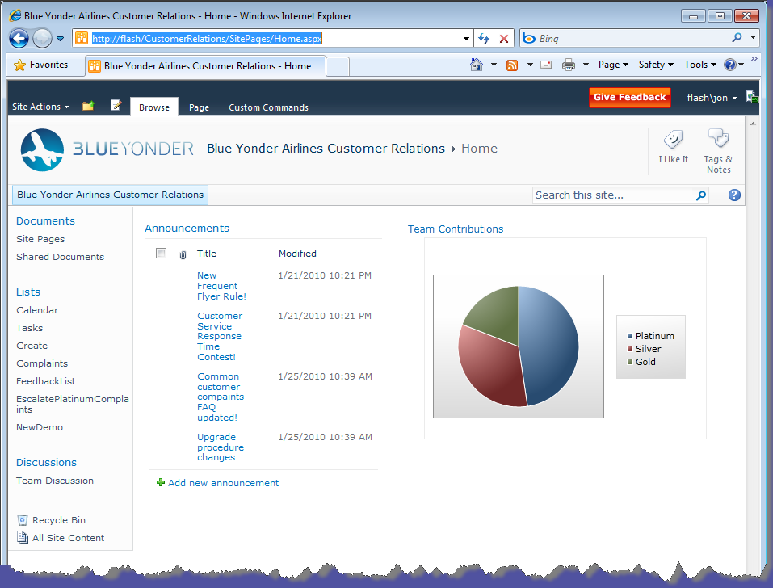
Huge developer community
650,000 SharePoint Developers
100M+ licenses
Users love SharePoint
Great opportunity for you to leverage your ASP.NET skills
Build on a successful platform

Slide 3
SharePoint platform and product
Microsoft Product
Your Product
{your opportunities here}
Built on / Built with
Web Portal UI Document Library User Self Service BCS Data Integration | SharePoint Designer Contextual Ribbon Sites and Lists Claims Authentication Human Workflow | Wiki Pages Web Parts Authorization UI Comprehensive SDK
Base Platform
.NET Framework 3.5 | ASP.NET | Windows Workflow Foundation

Slide 4
Leverage .NET and ASP.NET skills
You are using the same tools
Same designers, controls, etc.
Event handling model
Save “F5” deploy/debug experience
Familiar programming model
Styling is the same
Use JavaScript and Silverlight

Slide 5
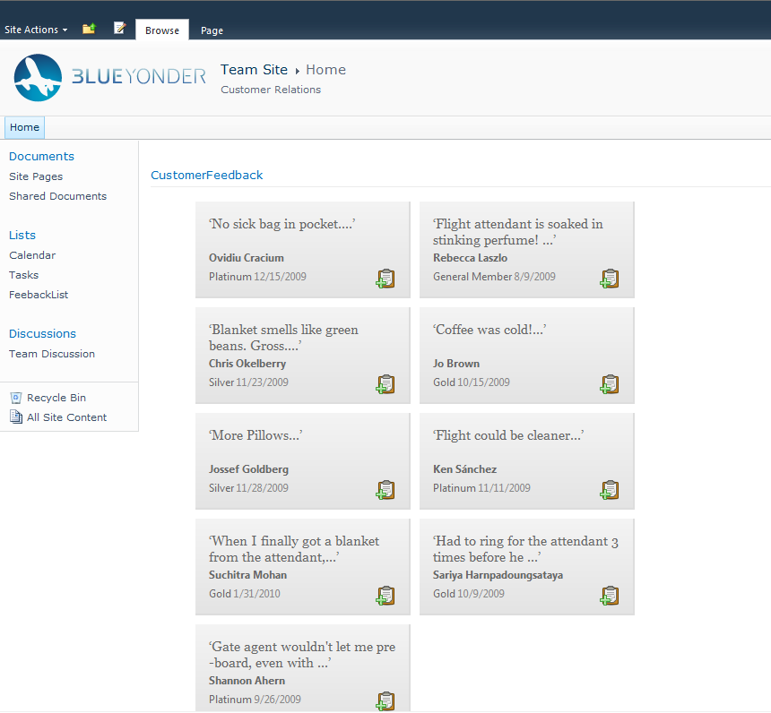
Demo: Visual Web Part

Slide 6
Visual Web Part
New for SharePoint 2010
Uses ASP.NET User Controls (ASCX)
Can combine ASP.NET and SharePoint controls
Integrated designer support in Visual Studio
Develop, deploy, debug using new SharePoint project system

Slide 7
F5
17

Slide 8
Visual Studio 2010 Developer Tools for SharePoint
Server Explorer
Package and Feature Designers
BDC Designer
Workflow Designer
Visual Web Part Designer
Design
Develop
Deploy
Debug

Slide 9
Features, Features, Features

Slide 10
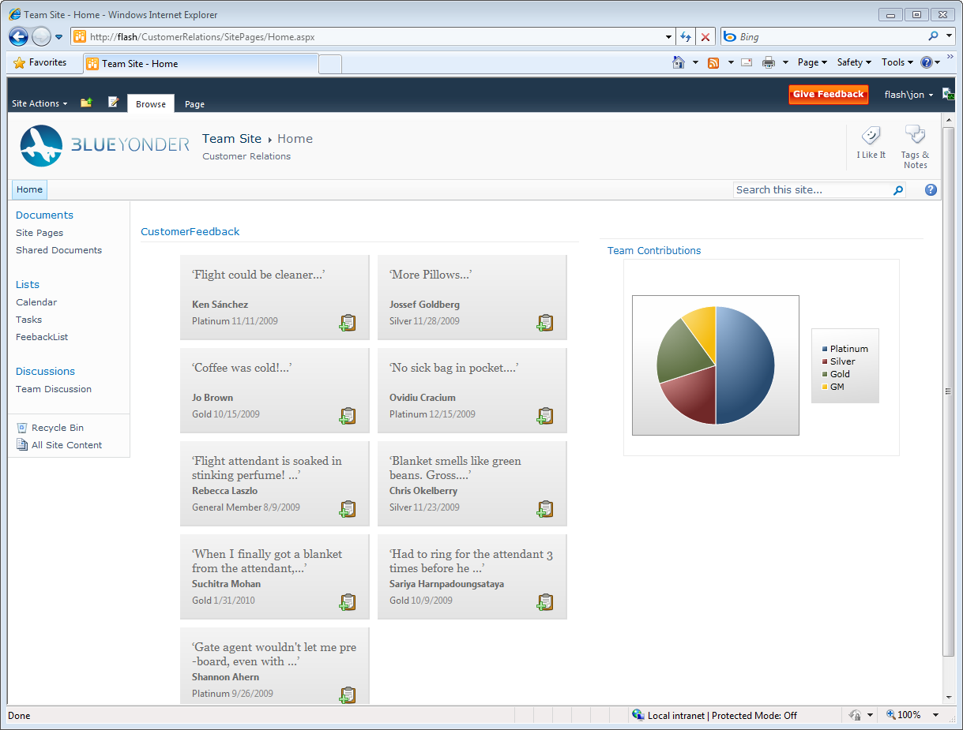
Demo: Connecting data and people with SharePoint

Slide 11
Connecting People
Business Data Connector brings enterprise data to your users
Rich client object model allows you to integrate with SharePoint via JavaScript
SharePoint Feature provides consolidated package for ease of deployment

Slide 12
Demo: SharePoint and Silverlight

Slide 13
SharePoint
New client API build especially for Silverlight
New Silverlight Web Part to ease deployment and use of Silverlight Applications

Slide 14
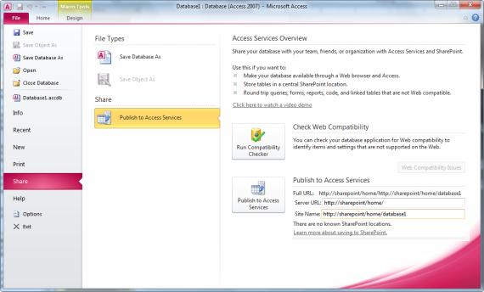
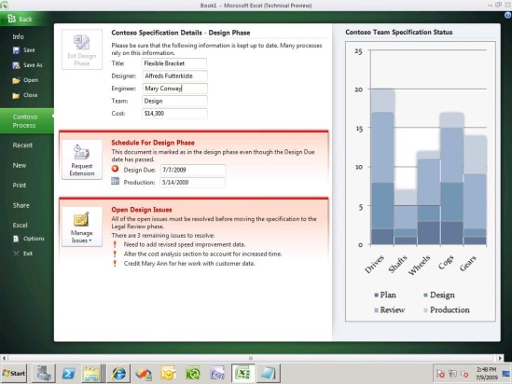
Large install base
Build instantly familiar applications
Evolved developer platform with new services and extensibility
Connected cloud and on-premises services to a common Office PC, phone and browser user experience

Slide 15
Visual Studio 2010 + Office
Removes dependency on Office PIAs
Language enhancements
C#—Optional Parameters, Named Arguments, Dynamic types
VB—Implicit line continuation, Dynamic types, Auto-properties
Deployment enhancements
Multi-Solution deployment
Post deployment activities
Integrate with SharePoint

Slide 16
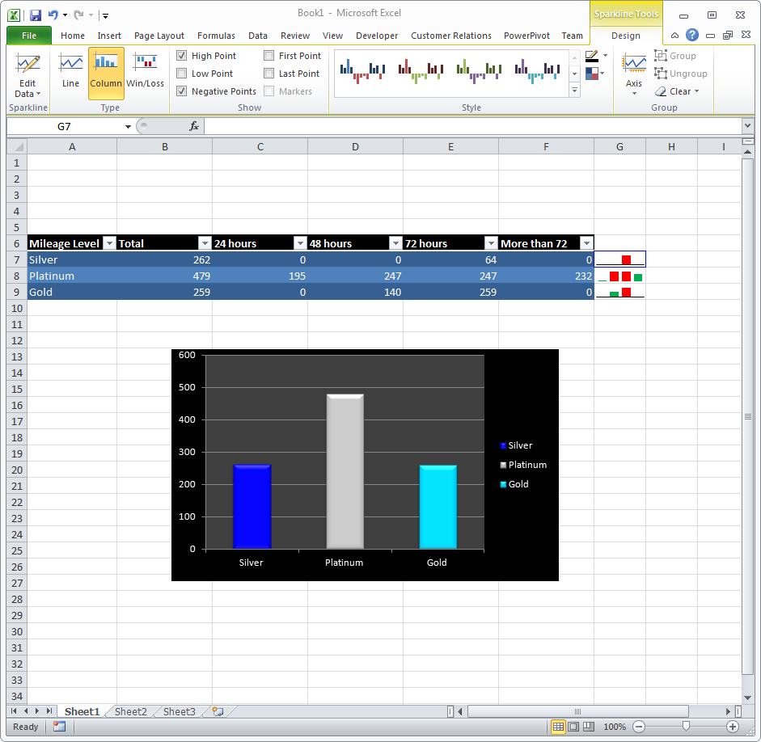
Demo: Excel Add In

Slide 17
Summary
SharePoint is great platform to build on
Leverage your skills—if you build with ASP.NET, you can build with SharePoint
Visual Studio 2010 provides a first class development experience for SharePoint
Visual Studio 2010 continues to make it easy to build Microsoft Office-based solutions

